Slide 1


Chemical Bonding

Slide 2
Chemical Bonding
The periodic table can be viewed as containing the ingredients of life.
The atoms, depending on their properties, can form chemical bonds with other atoms to form compounds.
For example:
2 atoms of Hydrogen and 1 atom of Oxygen can bond together to form Water, H₂O.
1 atom of Carbon and 4 atoms of Hydrogen can bond together to form Methane, CH₄.
1 atom of Sodium and 1 atom of Chlorine can bond together to form Sodium Chloride, NaCl, which is table salt.

Slide 3
Chemical Bonding
With chemical bonding there are 6 things you need to know:
1. Unlike charges attract.
2. Like charges repel.
3. Electrons tend to pair. (For the sake of simplicity)
4. Valence electrons occupy the outer shells of atoms.
5. Atoms with filled outer shells or with 8 electrons in the outer shell are called noble gases and are said to have achieved an octet.
6. The noble gases are stable and tend not to form chemical bonds.

Slide 4
Chemical Bonding
Chemical bonds are stable linkages:
1. between combining atoms
2. and can be formed between atoms of identical or different elements.
Examples include:
Oxygen---Oxygen = O₂
Carbon---Hydrogen = CH₄
Sodium---Chlorine = NaCl

Slide 5
Chemical Bonding
Atoms use their outer shell electrons more commonly refered to as _______________ electrons.
When they do this each atom in the bond acquires a stable electron configuration often similar to that of the noble gases.

Slide 6
Chemical Bonding
A stable structure, compound, can be achieved in one of the following ways:
a. Metals with 1, 2 or 3 electrons in their valence/outer shells may LOSE these electrons to become positively charged ions (cations).
b. Non-metals with 5, 6 or 7 electrons in their valence/outer shells may GAIN electrons, acquiring the electronic structure of the next noble gas, and become negatively charged ions (anions).
c. Two or more non-metallic elements with 4-7 valence electrons may also SHARE electrons with each other to attain an electronic structure similar to that of the noble gases.

Slide 7
Chemical Bonding
The major types of chemical bonds, along with some common materials in which they occur are:
a. The ionic or electrovalent bond.
Lattices such as sodium chloride, copper(II) sulphate and calcium oxide contain these types bonds.
b. The covalent bond.
Molecular structures such as water, glucose, propane and PVC contain these types of bonds.
c. The metallic bond.
Metals such as iron, aluminum and zinc contain these types of bonds.

Slide 8
Types of Chemical Bonding
Ionic Bonding
IONIC BONDS are formed when electrons are transferred from a METAL atom to a NON-METAL atom.
The metal atom upon LOSING an electron(s) becomes a positive ion often referred to as a CATION.
The non-metal atom upon GAINING an electron(s) becomes a negative ion often referred to as an ANION.

Slide 9
Types of Chemical Bonding
Ionic Bonding
Sodium chloride, NaCl, magnesium chloride, MgCl₂ and lithium oxide Li₂O are examples of compounds with ionic bonds.
Note well that Na, Mg and Li are all METALS while Cl and O are all NON-METALS.
Attractions between the oppositely charged ions provide the binding FORCES which hold ionic compounds together.

Slide 10
Types of Chemical Bonding
Ionic Bonding
Using Lewis dot structures let us draw the electron arrangement of the valence electrons in the sodium and chlorine atoms.
Sodium has 11 electrons while chlorine has 17. Determine how many valence electrons each atom has.

Slide 11
Types of Chemical Bonding
Ionic Bonding
The sodium atom would therefore lose 1 valence electron making it a(n)_____________ while the chlorine atom would gain an electron making it a(n)_____________.
Both the sodium and chloride ions would have achieved a noble configuration or a stable octet.

Slide 12
Types of Chemical Bonding
Ionic Bonding
Using Lewis dot structures let us show how sodium and chlorine would look after they react with each other.
Please note that upon the gain of an electron chlorine goes from being a halogen to a halide and is refered to as a chloride ion. We will learn of this in later chapters.

Slide 13
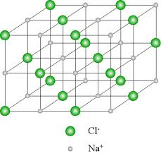
Types of Chemical Bonding
Ionic Bonding
Sodium chloride is a crystal lattice
which has a giant structure.
It is an orderly arrangement of ions in
which attractions between oppositely
charged ions outweigh repulsions
between ions of the same charge.
The lattice only includes Na⁺ and Cl⁻ ions.
The sodium chloride structure is a regular, repeating arrangement of ions. Each sodium ion is surrounded by six chloride ions as nearest neighbours. Each chloride ion in turn has six sodium ions as its nearest neighbours. This arrangement of ions results in a closely packed 3-dimensional structure. Ionic compounds are said to consist of a ‘giant structure of ions’.

Slide 14
Types of Chemical Bonding
Ionic Bonding
It must be noted that when ionic bonds are formed:
a. Each atom involved in the combining process ends up with a stable electronic configuration like that of the noble gases. What does this mean?
b. The ionic compound has different properties from the elements from which it is derived from. How so?
c. The charge on each ion depends on the number of protons and electrons in it. For example, the sodium ion, Na⁺ would now have 10 electrons as opposed to the 11 electrons it had before. While the chloride ion, Cl⁻, would now have 18 electrons as opposed to the 17 electrons it had before.

Slide 15
Types of Chemical Bonding
Ionic Bonding
Try reacting potassium with fluorine.
First ask yourself these questions:
a. How many valence electrons does potassium, K, have?
b. What is potassium’s electronic configuration?
c. How many valence electrons does fluorine, F, have?
d. What is fluorine’s electronic configuration?
e. How many electrons does K have to lose or gain in order for it to achieve a stable octet?
f. How many electrons does F have to lose or gain in order for it to achieve a stable octet?
Using the information above show how the bond(s) between potassium and fluorine will form.

Slide 16

Types of Chemical Bonding
Ionic Bonding
Try reacting Magnesium, Mg, with oxygen, O.
Again, ask yourself these questions:
a. How many valence electrons does magnesium, Mg, have?
b. What is magnesium’s electronic configuration?
c. How many valence electrons does oxygen, O, have?
d. What is oxygen’s electronic configuration?
e. How many electrons does Mg have to lose or gain to achieve a stable octet?
f. How many electrons does O have to lose or gain to achieve a stable octet?
Using the information above show how the bond(s) between magnesium and oxygen will form.

Slide 17
Types of Chemical Bonding
Ionic Bonding
Try the following questions. Use Lewis dot structures to show the bonding between each species.
1. LiCl
2. MgS
3. NaF
4. CaI₂
5. BaCl₂
6. Al₂O₃

Slide 18
Types of Chemical Bonding
Ionic Bonding
The following are properties of ionic compounds.
Ionic compounds:
a. Are, brittle crystalline solids;
b. Have high melting points and heats of fusion
c. Conduct electricity well, when molten or when dissolved in water
d. Do not conduct electricity in the solid state. Can salt conduct electricity?
e. Most of them dissolve readily in water
f. React readily with each other in solution

Slide 19
Types of Chemical Bonding
Ionic Bonding
Below are reasons tabulated to demonstrate why ionic properties are the way they are
Properties of ionic compounds | Reasons for ionic compounds having these properties
Crystalline solid | This is due to regular arrangement of ions, resulting from strong attractions between opposite charges
Conduct electricity when molten | On melting, ions are set free. These ions move to an oppositely charged electrode when a voltage is applied
High melting point, High boiling points, High heats of fusion, High heats of vaporization | These high values indicate that the ions are strongly held, therefore lots of energy is needed to separate the ions

Slide 20
Types of Chemical Bonding
Ionic Bonding
Right about now you must be wondering how do you write the formula for ionic compounds.
A formula, in chemistry, is a chemical expression showing what type and how many of each atom are bonded together.
For example H₂O is a formula which tells us that there are 2 atoms of hydrogen and 1 atom of oxygen.
Oxidation states are specific to the group in which atoms are located.
When atoms react they become ions and are said to be oxidised.

Slide 21
Types of Chemical Bonding
Ionic Bonding
Oxidation states of ions correspond to the groups they are in.
Here is an easy way for remembering the oxidation numbers of elements found in particular groups:
Let’s consider the compound, CaCl₂.
The positive charge on the calcium ion = +2
The negative charge on the chloride ion = -1
Why is this so?
Group | 1 | 2 | 3 | 4 | 5 | 6 | 7 | 8
Oxidation States | +1 | +2 | +3 | +4 | -3 | -2 | -1 | 0

Slide 22
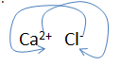
Types of Chemical Bonding
Ionic Bonding
The formula of calcium chloride is written such that the total positive charge equals the total negative charge.
Each Ca²⁺ ion needs two (2) Cl- ions to balance the charges.
The formula is thus CaCl₂.

Slide 23
Types of Chemical Bonding
Ionic Bonding
Please note that a lone + or – charges denote a physical notation of 1 and is left out of the equation. Therefore this is incorrect, Ca₁Cl₂, since the 1 is understood.
Charges naturally fall as a subscript for the opposite ion that it is reacting with.
Elements placed within groups also tell you how many valence electrons are present in that atom. Barium is a metal that can be found in group two. What is its oxidation state and how many valence electrons does it have?
Try writing the formulae of the ionic compounds below:
Metal | Non – metal | Ionic Formulae
Al³⁺ | O²⁻
Na⁺ | S²⁻
Ba²⁺ | Cl⁻

Slide 24
Types of Chemical Bonding
Covalent Bonding
Covalent bonds are formed between non-metals atoms.
They share electrons to achieve a stable electron arrangement similar to that of a noble gas.
They share one or more pairs of electrons.
In simple covalent bonding each of the combining atoms contributes one or more electrons to the bond. The bond therefore consists of electrons shared between the two atoms.
Attraction between the nuclei of the atoms and the shared pair(s) of electrons provides the binding force which holds the atoms together.

Slide 25
Types of Chemical Bonding
Covalent Bonding
Simple covalent bonds are formed between non-metal atoms of:
a. The same element, for example fluorine, F₂, oxygen, O₂ and nitrogen, N₂.
b. Different elements, for example hydrogen and chlorine atoms, combine to form hydrogen chloride (HCl). On the other hand nitrogen and hydrogen atoms combine to form ammonia, NH₃.

Slide 26
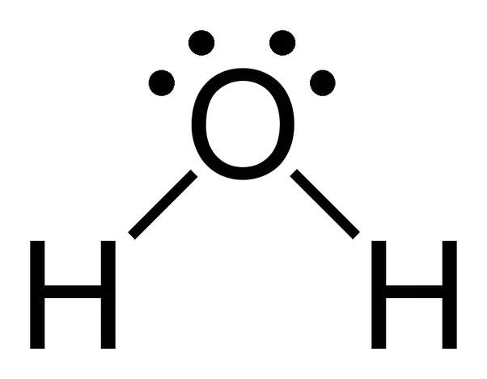
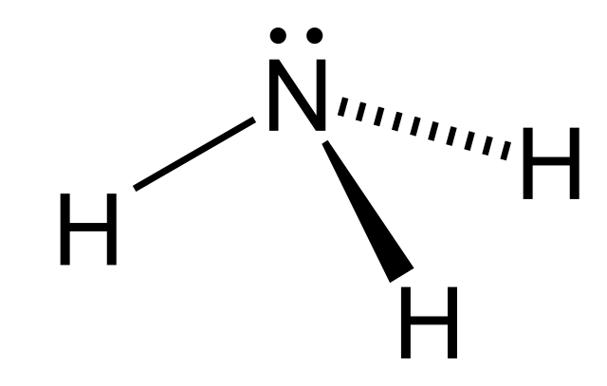
Types of Chemical Bonding
Covalent Bonding
Covalent bonds are also formed when one atom of a molecule, such as ammonia and water, donates both electrons for the bond.
The nitrogen atom in ammonia and the oxygen atom in water both have valence electrons which are not involved in bonding.

Slide 27
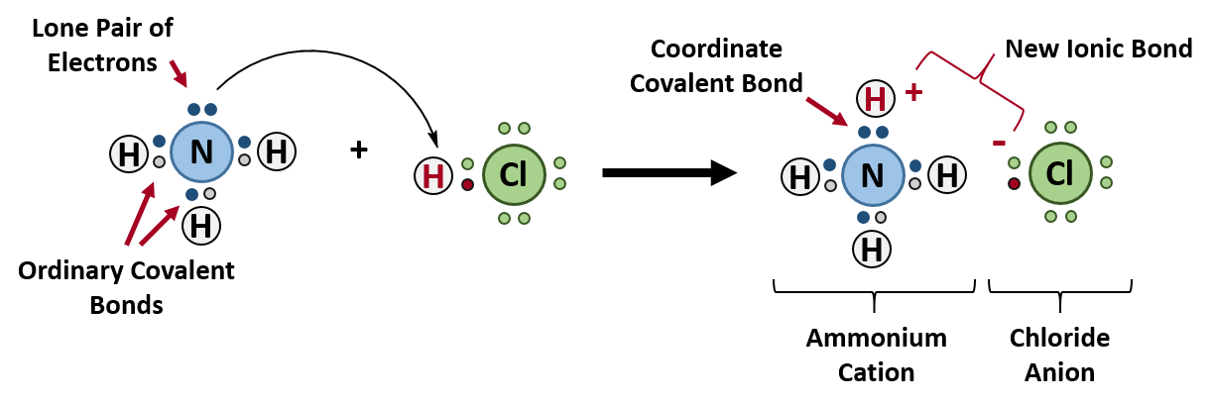
Types of Chemical Bonding
Covalent Bonding
These molecules are able to use these ‘non-bonding’ electron pairs to form covalent bonds with another element.
In ammonium chloride, NH₄Cl, the nitrogen atom in the ammonia molecule donates both electrons for the bond between ammonia and hydrogen chloride. This is called a dative or co-ordinate covalent bond.

Slide 28
Types of Chemical Bonding
Covalent Bonding
While ionic bonding involves the giving and taking away of electrons covalent bonding involves the sharing of electrons.
Take for example the bonding in ammonia, NH₃. The bonding is usually shown using only the valence shell of electrons overlapping each other.
Since the atom nitrogen is found in group 5 it has _____________ valence electron(s) while hydrogen which is found in group 1 has _______ valence electron(s).

Slide 29
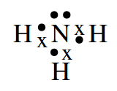
Types of Chemical Bonding
Covalent Bonding
Usually x’s are used to represent electrons however if another atom is present dots are used for differentiating purposes.
Take a look at the bonding experienced in ammonia.

Slide 30
Types of Chemical Bonding
Covalent Bonding
Let us try to draw out the covalent bonding in methane, CH₄.
If carbon is in group 4 and hydrogen is in group 1 how many valence electrons are there in each?
How many of each atom is needed for this molecule based on the chemical formula?

Slide 31
Types of Chemical Bonding
Covalent Bonding
When illustrating the formation of covalent bonds:
a. Only the valence electrons are shown when combining atoms.
b. The electrons are all the same. Dots (.) and crosses (x) merely indicate the source of the electrons.
c. A line or dash between the symbols for the atoms (as in F-F) represents a bonding pair of electrons; a double line as in O=O represents two bonding pairs of electrons and so on.
d. One bond represents an electron pair which means there are 2 electrons which make a bond. Two bonds are equal to 2 electron pairs which means there are 4 electrons. How many electrons are there in a triple bond?

Slide 32
Types of Chemical Bonding
Covalent Bonding
From the information on the previous page let us try to draw the covalent bonds existing between:
a(i) the oxygen molecule, O₂, which has two bonds between it?
a.(ii) Which group is oxygen found in?
b.(i) The nitrogen molecule, N₂, which has three bonds between it?
b.(ii) Which group is nitrogen found in?
Did you notice that there are some electrons in both molecules that are not being used? These electrons are referred to as lone pairs.
Look back at the figures you drew. Count how many lone pairs there are in the molecule O₂ and N₂?

Slide 33
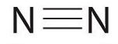
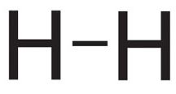
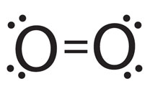
Types of Chemical Bonding
Covalent Bonding
Covalent bonds may also be represented as:
a. In N₂ b. In H₂
c. In O₂

Slide 34
Types of Chemical Bonding
Covalent Bonding
Molecules, because they bond covalently, their shapes are altered by the lone pairs present. Of course there are exceptions to the table depicted. At this level this is all you need to become acquainted with.
Number of bonds | Number of lone pairs | Shape of molecule
4 | 0 | Tetrahedral
3 | 1 | Pyramidal
2 | 2 | Bent
1 | 0 | Linear

Slide 35
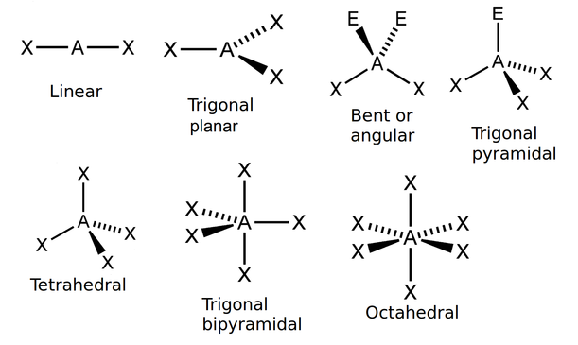
Types of Chemical Bonding
Covalent Bonding

Slide 36
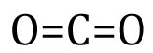

Types of Chemical Bonding
Covalent Bonding
Please note that the table can be followed for single bonding however, with triple and double bonding molecules are usually linear because of the immobility that such bonds cause. This is so because the more bonds between two atoms the shorter they are.
Single bonds are longer than double or triple bonds and allows for rotation of atoms about the bonds.
Such examples include the:
a. carbon dioxide molecule, CO₂ b. Nitrogen molecule, N₂

Slide 37
Types of Chemical Bonding
Covalent Bonding
Given the previous information try to draw the covalent bonding and shapes of the following molecules:
a. Water, H₂O
b. Ammonia, NH₃
c. Methane, CH₄

Slide 38
Types of Chemical Bonding
Covalent Bonding
The following are some general properties of molecular substances
Properties of molecular substances | Comment
Some are liquids or gases at room temperature | They consist of small molecules with weak attractive forces between them (known as Van der Waal forces)
Low melting and boiling temperatures, low heats of fusion and vapourization | Due to weak intermolecular forces (attractive forces between the molecules)
Some are soluble in water, while some are also soluble in non-polar organic solvents such as methylbenzene | The non-polar molecular substances dissolve in non-polar solvents
Do not conduct electricity when molten | Due to the absence of ions (Note: A few react with water to produce ions. The resulting ‘solution’ conducts electricity)
Do not usually react as quickly as ionic compounds | Energy is required to break down the bonds in these substances, while there are ions present in ionic compounds

Slide 39
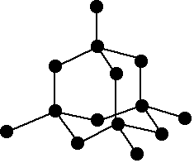
Types of Chemical Bonding
Covalent Bonding
Some covalent substances have high melting and boiling points as well as high heats of fusion and vaporization. In these compounds, covalent bonds link atoms together in a three-dimensional network called a giant structure of atoms or a giant molecule. Silica, silicon dioxide, SiO₂, graphite and diamond are examples of substances with giant structures of atoms.
In diamond, each carbon atom is bonded
to four others. There are strong bonds in
all directions. Diamond is one of the hardest
substances known and is widely used in cutting
and drilling. Due to the absence of free electrons,
combined electrons, diamond does not conduct electricity.

Slide 40
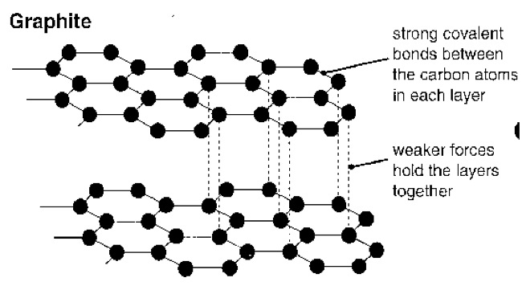
Types of Chemical Bonding
Covalent Bonding
In graphite, the atoms are arranged in flat six-membered rings. The bonds are strong in two directions but weak in the third (shown by the broken lines).
Why do you think graphite is
able to conduct electricity?
The lubricating properties of graphite
can be explained in terms of the
ability of the planes to slide past
each other.

Slide 41
Types of Chemical Bonding
Covalent Bonding
Carbon exists in two allotropic forms, these are diamond and graphite.
Allotrophy is the presence of more than one form of an element in the same physical state. These different forms have the same chemical properties but different physical properties.
The physical properties of diamond and graphite are different in that diamond is hard and a non-conductor of electricity whereas graphite is ___________________ and a _____________________ of electricity.
On the other hand, when the same amount of diamond and graphite are heated in excess oxygen they produce equal amounts of carbon dioxide gas which proves they are chemically the same.

Slide 42
Types of Chemical Bonding
Covalent Bonding
Sulphur and iodine have simple molecular crystals.
They are held together by weak Van der Waals forces between the molecules. Since their molecules are not held together strongly their melting and boiling points are low. Iodine sublimes. What is sublimation again?
In covalent bonds between identical atoms, example H₂, O₂ and Cl₂, the shared pair of electrons lies midway between the two nuclei.
The shared pair is equally attracted by both nuclei. This type of covalent bond is referred to as non-polar since neither atom develops a permanent electrical charge.
Non-polar covalent bonds exist only between atoms of the same element.

Slide 43

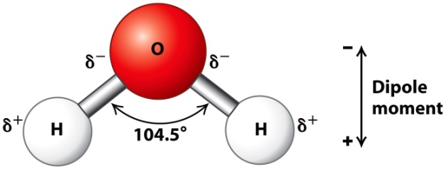
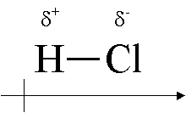
Types of Chemical Bonding
Covalent Bonding
By contrast, for covalent bonds between different elements the shared electron pair(s) tend to be closer to one of the combining atoms.
This uneven sharing of the electron pair(s) causes the bond to be slightly negative at one end and slightly positive at the other end. This type of bond is described as polar.
The more unequally the paired electrons are shared the more distorted the bond.
Molecules with polar bonds include water, hydrogen chloride and ammonia.
The polarity of the bond affects both the physical and chemical properties of the molecules.

Slide 44
Types of Chemical Bonding
Metal Bonding
Metals contain free electrons.
They normally have a few electrons in their outer/valence shell and can be located in groups 1, 2 and 3.
They do not achieve the stable octet or electronic configuration of the nearest noble gas by forming either covalent or ionic bonds with other metal atoms .

Slide 45
Types of Chemical Bonding
Metal Bonding
Metal atoms can achieve a stable structure when they bond only if electrons can be shared communally among them.
To be communally shared, electrons have to be mobile or free.
Since free or mobile electrons exist, it follows that the atoms from which they came must exist as positive ions within the metal structure.

Slide 46
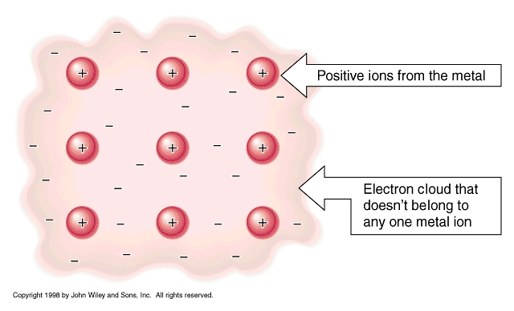
Types of Chemical Bonding
Metal Bonding
1. The mobile electrons
spread or drift through
the entire metal structure.
2. Free electrons and
positive ions mutually
attract each other, and
it is this attraction
that is responsible
for the rather unusual
bonding in metals.
Metals are viewed as an orderly arrangement of positive ions held together by a sea of freely moving electrons.
The mobile electrons are mainly
responsible for the properties of metals.

Slide 47
Types of Chemical Bonding
Metal Bonding
The main features of metallic conduction are as follows:
a. The charge carriers in metals are electrons
b. The passage of an electric current through a metallic conductor does not alter it chemically
c. Alloys, being solid solutions of metals (mainly), are electrically conducting
d. Electrical conductivity decreases with increasing temperature

Slide 48
Types of Chemical Bonding
Metal Bonding
Electricity has been used to divide elements into metals and non-metals.
The electron sea model of metals explains other physical properties of metals such as their thermal conductivity, malleability and metallic lustre.

Slide 49
Types of Chemical Bonding
Metal Bonding
Thermal conduction:
Metals are good conductors of heat in both the solid and liquid state.
The more quickly this happens the better the thermal conducting properties of the metal.
How is this thermal energy passed on throughout the metal?
The following are metals with high thermal conductivity:
silver, copper, gold, aluminum, tungsten, zinc and iron.
Can you identify one use each for copper, aluminum and tungsten which are all related to their thermal conducting properties?

Slide 50
Types of Chemical Bonding
Metal Bonding
Malleability:
Metals can be bent and molded into shape.
Ductility:
Metals can be drawn into wires.

Slide 51
Types of Chemical Bonding
Metal Bonding
The following table compares the properties of metals and non-metals
Most metals | Most non-metals
Solids of high melting points, giving high boiling point liquids | Gases or low melting point solids, giving low boiling point liquids
Shiny, reflecting light of many wavelengths | Dull, reflecting light poorly or absorbing strongly
High density | Low density
Usually hard | Usually soft
Malleable, ductile, strong | Often brittle, weak
Good conductors of heat and electricity | Insulators

