Slide 1
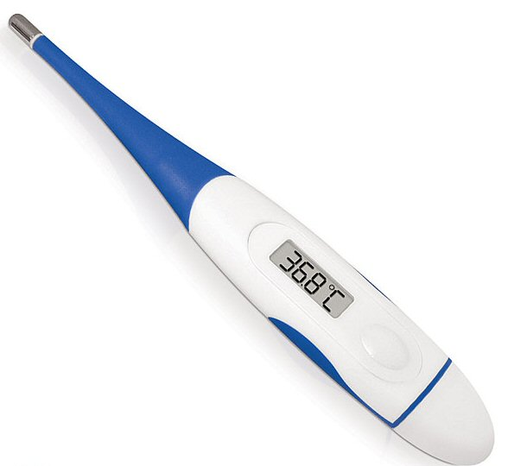
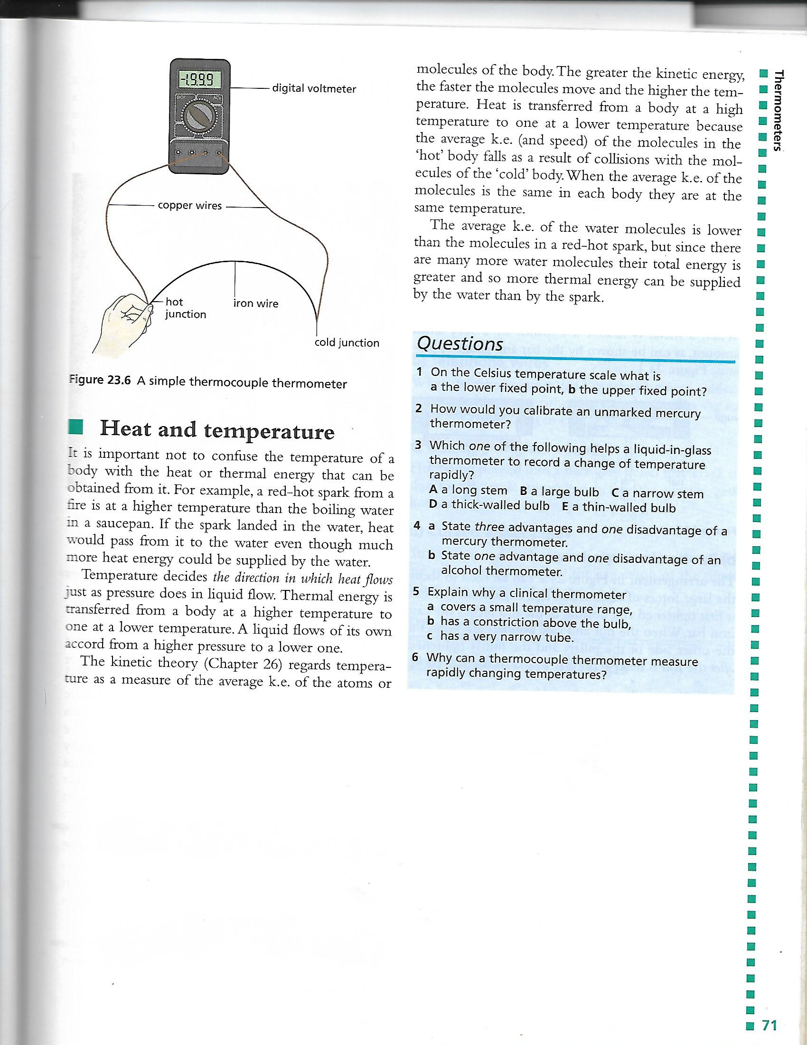
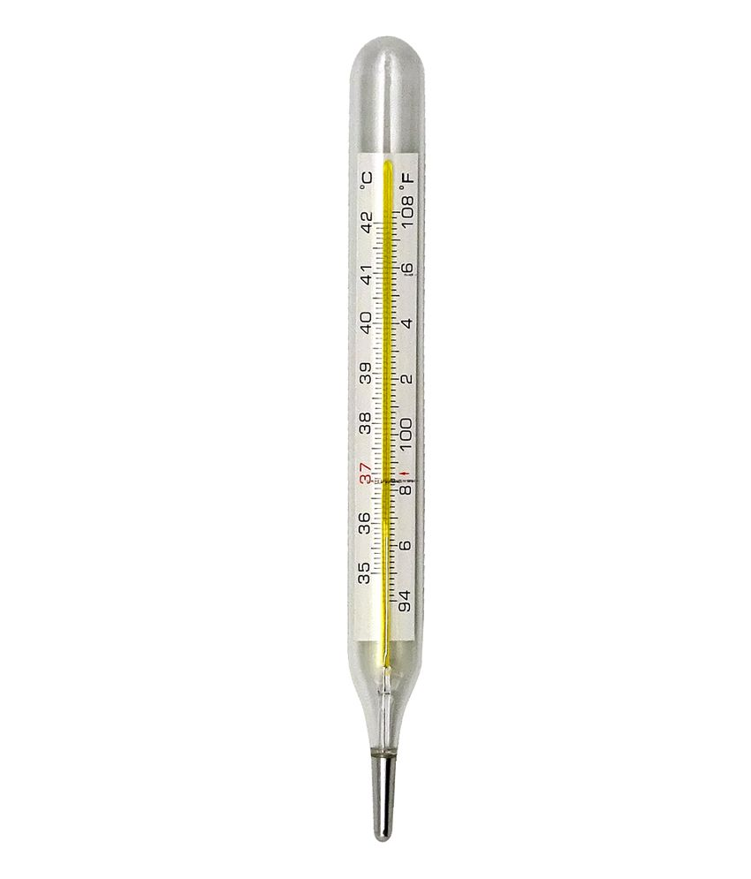
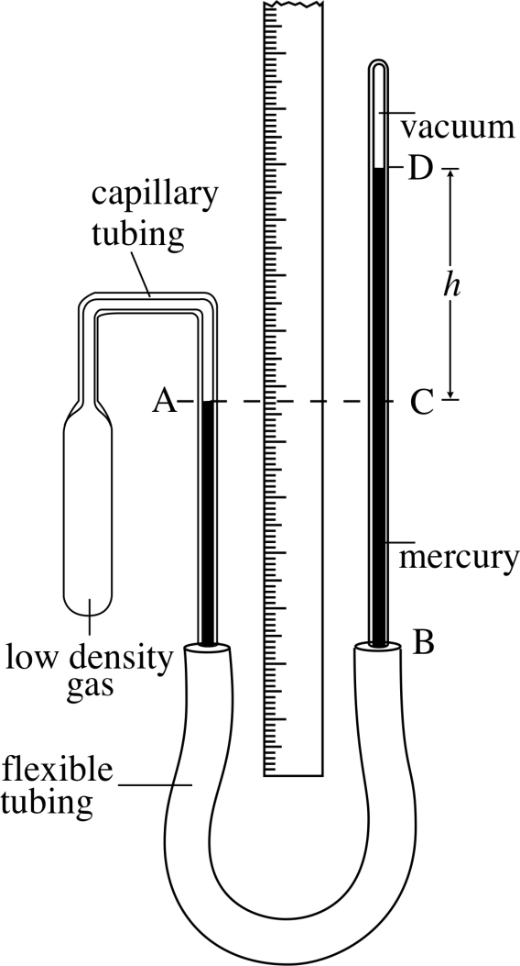
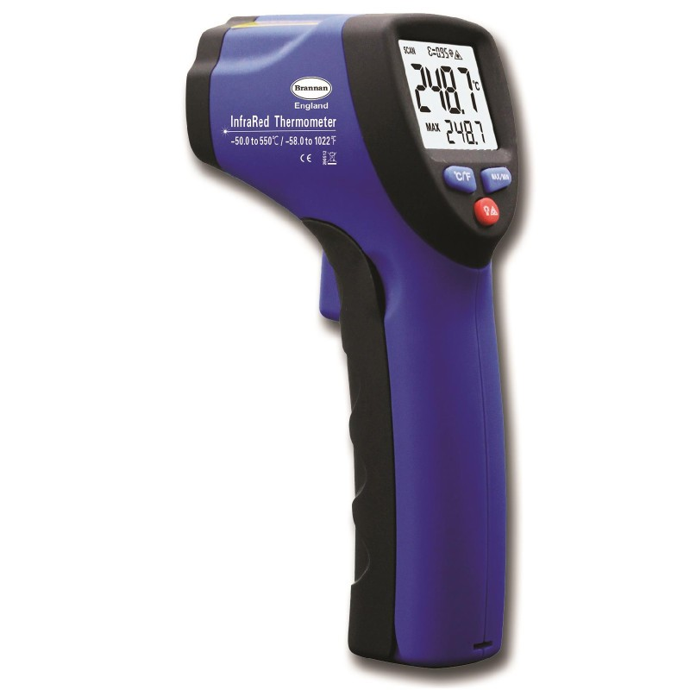
Thermometers

Slide 2
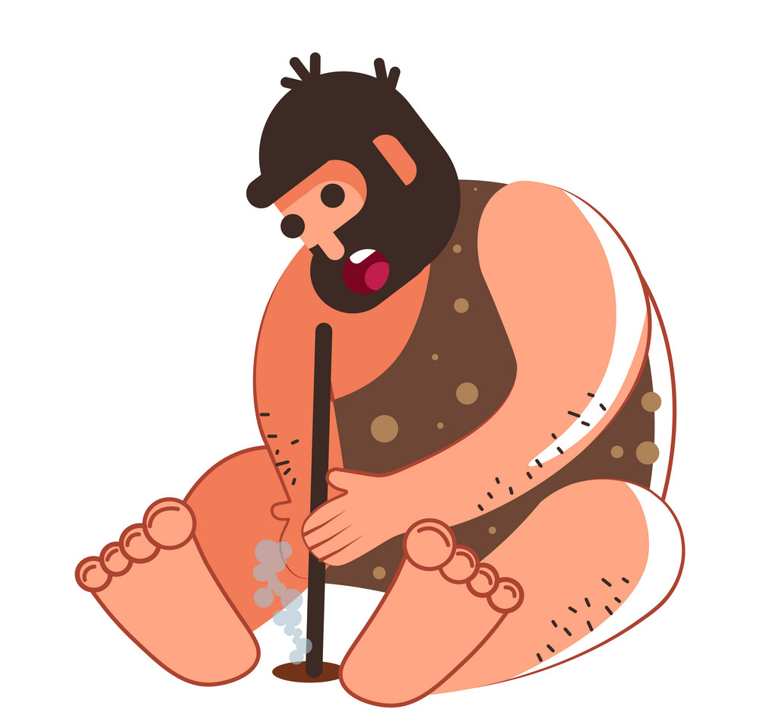
From since the dawn of mankind, FIRE has intrigued humans because of our need for warmth and light in times of darkness.
Fires have also improved cooking and our overall health for much
of our lives while living
here on planet Earth!
How else has fire
improved
our life?

Slide 4
Caloric Theory
The caloric theory of heat is an OBSOLETE theory from the 18th century.
Heat was believed to be an invisible fluid called ‘caloric’, which could combine with matter and raise its temperature.

Slide 5
Reasons WHY the Caloric Theory is OBSOLETE
1. Heated bodies did not increase in caloric during phase changes eg. Solid to liquid OR liquid to solid.
2. Different substances experienced different amounts of temperature increases when given the same amount of heat(caloric) which indicated they received different quantities of ‘caloric’.
3. When a body or object was heated it did not increase in weight. The weight remained the same.
4. Rumford’s canon-boring experiment proved that when work was done on the canon by boring, they both heated up. Therefore when the boring was taken out of the canon either one of them should have been hot while the other stayed cold.
Remember this was the dark ages….

Slide 6
The Dark Ages
In the Dark Ages many things were believed and practiced that we gawk and laugh at today.
Bloodletting: Veins were cut open or leeches were used to get rid of bad blood during times of sickness.
Trepanation: Boring holes into the skull

Slide 7
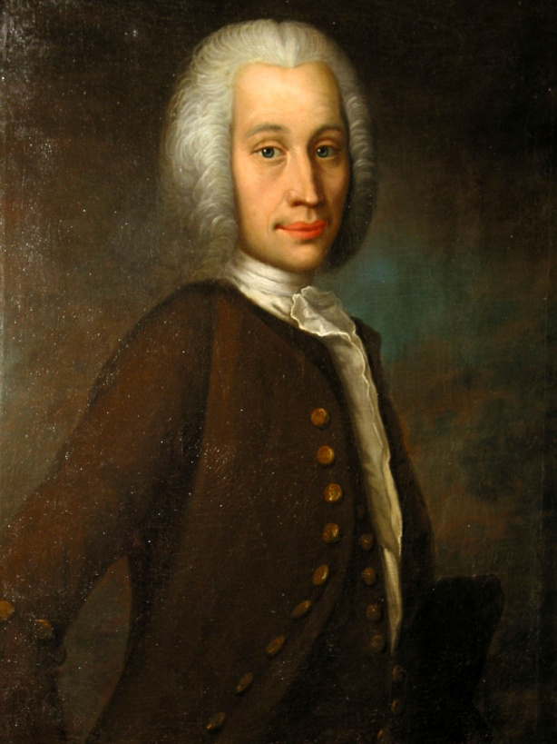
Temperature
The temperature of a body can be
measured in degrees on the Celsius
(ºC) scale named after the Swedish
scientist, Anders Celsius, who
suggested it.

Slide 8
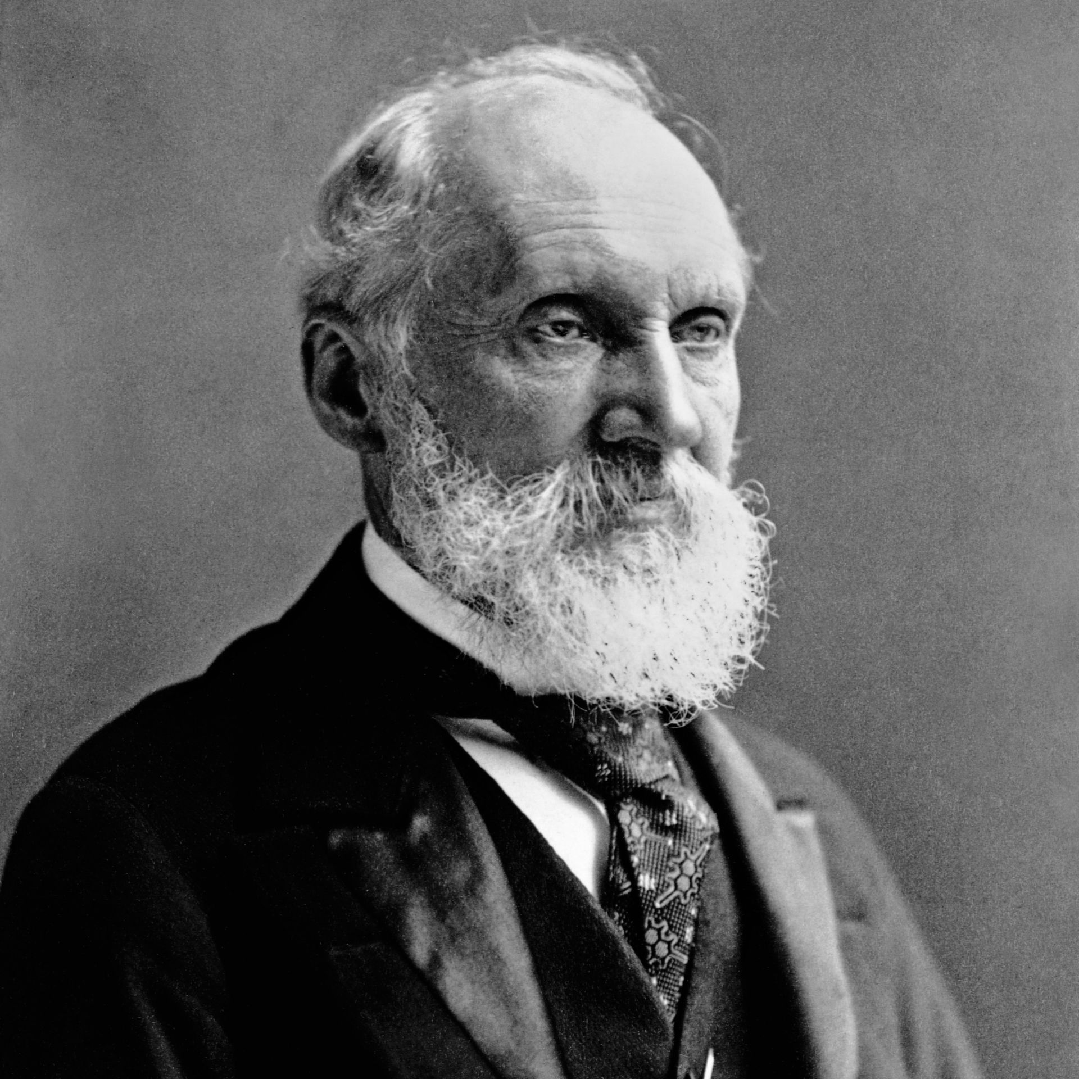
Temperature
Temperature can also
be measured in kelvins (K).
This scale was devised by
Sir William Thomson Kelvin.
The temperature
of a body tells us how
hot it is.

Slide 9
Temperature Scales
A temperature scale is a simple way of expressing the relative hotness and coldness of objects.
Hotter objects have a higher temperature.
There are several temperature scales:
a. Celsius
b. Kelvin
c. Fahrenheit

Slide 10
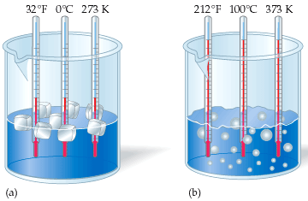
Temperature Scales
Celcius Scale
The Celcius scale is based on the properties of water where the freezing point of pure water is 0ºC and the boiling point of pure water is 100ºC.

Slide 11
Temperature Scales
Kelvin Scale
The Kelvin scale is based on the properties of ideal gases and the energy of particles. The low point of the scale is absolute zero.
At absolute temperature the particles have zero thermal energy and so they cannot become any colder.

Slide 12
How to Convert K to ºC and ºC to K?
To convert K to ºC subtract 273
eg. 298 K = 298 K – 273 = 25 ºC
To convert ºC to K add 273
eg. 30 ºC = 30 ºC + 273 = 303 K

Slide 13
How to Convert K to ºC and ºC to K?
Exercise
 | Temperature in ºC | Temperature in K
Absolute zero |  | 0
Boiling point of liquid nitrogen |  | 77
Freezing point of ethanol | -117
Freezing point of water | 0
Body temperature |  | 310
Boiling point of ethanol | 79
Boiling point of water | 100

Slide 14
How to Convert K to ºC and ºC to K?
Exercise
 | Temperature in ºC | Temperature in K
Absolute zero |  | 0
Boiling point of liquid nitrogen |  | 77
Freezing point of ethanol | -117
Freezing point of water | 0
Body temperature |  | 310
Boiling point of ethanol | 79
Boiling point of water | 100

Slide 15
How to Convert from ºC to ºF and from ºF to ºC
The equation is ºF = (1.8 × ºC) + 32
Hence
To go from ºC → ºF
(ºC × 1.8) + 32
Therefore:
To go from ºF → ºC
(ºF – 32) ÷ 1.8

Slide 16
Have Some Fun and Try the Following
0ºC → …………. ºF
32 ºF → …………. ºC
100 ºC → ………… ºF
- 5 ºF → ………….. ºC

Slide 17
Have Some Fun and Try the Following
0ºC → …………. ºF
32 ºF → …………. ºC
100 ºC → ………… ºF
- 5 ºF → ………….. ºC

Slide 18
Thermal Energy
Heat is referred to as thermal energy and it is measured in joules, J.
Heat is transferred from a hotter body to a colder one because the average kinetic energy/speed of the molecules in the ‘hot’ body falls as a result of collisions with the molecules of the ‘cold’ body.
When the average kinetic energy of molecules is the same in each body they are at the same temperature which is referred to as thermal equilibrium.

Slide 19
Thermometer
A thermometer is a device used to measure the temperature of an object or a substance.
Thermometers rely on properties that vary with temperature.

Slide 20
Types of Thermometers
There are many types of thermometers.
1. Liquid-in-glass
2. Thermocouples
3. Gas
4. Infra-red

Slide 21
Types of Thermometers
Any property of matter, if it varies continuously with temperature and can be measured accurately, may form the basis of a thermometer for measuring temperature.
Thermometer | Thermometric property as temperature increases
Liquid-in-glass | Volume of liquid increases
Constant-pressure gas thermometer (gas thermometer) | Volume of gas increases at constant pressure
Constant-volume gas thermometer (gas thermometer) | Pressure of gas increases at constant volume
Thermoelectric thermometer (thermocouple) | Electromotive force, e.m.f., produced varies non-linearly (an e.m.f. is the difference in potential that tends to give rise to an electric current)
Resistance thermometer (these are slowly replacing thermocouples) | Resistance increases
Thermistor (these are slowly replacing thermocouples as well) | Resistance usually decreases but increases for some types

Slide 22
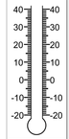
How to Read a Thermometer’s Scale
Colour the Area to Show the Temperature Depicted Below
22 ºC
-5 ºC
40 ºC
-15 ºC
35ºC
5 ºC
18 ºC

Slide 23
How to Read a Thermometer’s Scale
Colour the Area to Show the Temperature Depicted Below
22 ºC
-5 ºC
40 ºC
-15 ºC
35ºC
5 ºC
18 ºC

Slide 24
Types of Thermometers
Liquid In Glass
Liquid-in-glass thermometers are based on
the principle that the liquid will expand as its
temperature increases and that this expansion
is proportional to the increase in temperature.
A reservoir of liquid, mercury or coloured alcohol, is contained at the bottom of the thermometer in a ‘bulb’.
The reservoir is connected to a narrow capillary tube through which the liquid will expand and rise upwards.

Slide 25
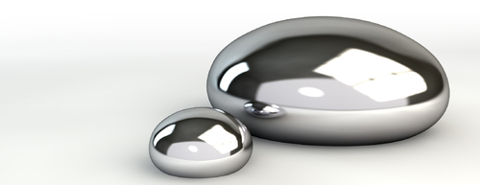
Types of Thermometers
Liquid In Glass
With good thermometers droplets must not stick to the inside of the tube or the reading will be low when the temperature is falling.
Mercury freezes at -39 ºC and boils at 357 ºC and is suitable for high temperatures. Alcohol freezes at -115 ºC and boils at 78 ºC and is therefore more suitable for low temperatures.

Slide 26
Types of Thermometers
Calibration of Liquid In Glass Thermometers
The thermometer can be calibrated by placing the bulb of liquid in melting ice and then marking the level of the liquid in the capillary tube.
This point would represent 0ºC since pure ice melts at this temperature.
The bulb would then be placed in a liquid of pure boiling water and the level the liquid expands to would represent 100ºC since pure water boils at that temperature.

Slide 27
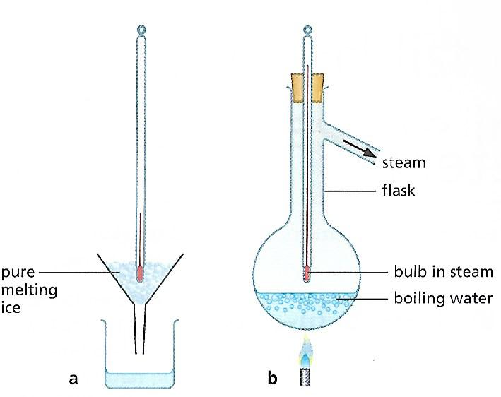
Types of Thermometers
Calibration of Liquid In Glass Thermometers
The mark made at 0ºC is called the lower limit while the 100ºC mark is referred to as the upper limit.
The distance between the
two points would then be
divided into 100 equal
divisions.

Slide 28
Types of Thermometers
Example of Liquid In Glass Thermometers
An example of a liquid in glass thermometer is a clinical thermometer.
The human body temperature is approximately 37ºC and varies between 35ºC and 42ºC. Because of this clinical thermometers are designed to cover that range.
Hence clinical thermometers are very precise with temperature division of 0.1ºC.
The shape of the thermometer is designed to magnify the capillary tube so that it is easier to read the temperature.

Slide 29
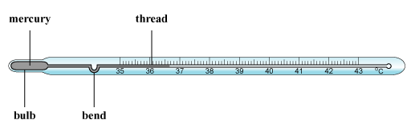
Types of Thermometers
Example of Liquid In Glass Thermometers
Clinical thermometers need to be removed from the patient before they can be read.
To prevent an inaccurate reading as the liquid contracts, a small constriction is built into the thermometer that breaks the liquid thread.
The liquid can be returned to the bulb after reading by flicking the thermometer.

Slide 30
Types of Thermometers
Example of Liquid In Glass Thermometers
Clinical thermometers take a few minutes to reach thermal equilibrium to display an accurate temperature.
Most clinical thermometers are being replaced with electronic thermometers because of this.

Slide 31
Advantages of Mercury Thermometers
Mercury has high conductivity and low specific heat capacity therefore temperature quickly adjusts to the temperature it is measuring.
Mercury has a high boiling point, 357 ºC. If alcohol thermometers were used in the lab it would evaporate and distil on the upper part of the bore.
Mercury is bright silver and can be easily seen.
The thermometer has a linear scale which is easy to read.

Slide 32
Disadvantages of Mercury Thermometers
It cannot be used to measure very cold temperature because mercury freezes at
-39ºC.
It is expensive.
Mercury is poisonous.

Slide 33
Types of Thermometer
Thermocouple
A thermocouple consists of two
wires of different materials, for
example, copper and iron, joined
together.
It is an electrical thermometer which relies on the potential difference produced when two different metals are connected.
The potential difference produced varies with temperature.
Thermocouples can measure very high temperatures and they respond very quickly to changes.

Slide 34
Types of Thermometer
Thermocouple
The potential difference they produce can also be recorded quite simply by data loggers or computers.
The potential difference is then converted and a temperature is shown on a digital display making them very easy to read.
Because of their efficiency they are used quite a lot in industry.

Slide 35
Advantages of a Thermocouple
Responds quickly to temperature changes because metals have high conductivities and low specific heat capacities.
Withstands very low and very high temperatures.
It can be connected to a digital display and computer systems.

Slide 36
Disadvantages of a Thermocouple
The scale is non-linear and is therefore difficult to read.
The measuring instrument used with a thermocouple must be sensitive to small changes in emf and this can be expensive.

Slide 37
Types of Thermometer
Gas
Gas thermometers use the fact that a gas expands when its temperature increases.
This expansion is proportional to
the temperature change.

Slide 38
Types of Thermometer
Infra-red
Infra-red thermometers measure the rate of emission of infra-red radiation from objects.
The intensity of this radiation
depends on the temperature
of the object. Hotter objects
emit more radiation.
Infra-red thermometers can find
the temperature of something without needing to touch it.

Slide 39
The difference between
Temperature & Heat
It is important NOT to confuse the temperature of a body with the heat or thermal energy that can be obtained from it.
Heat is the energy provided to cause particles to vibrate while temperature is the measurement of heat in kelvins, degree Celsius or degree Fahrenheit.

Slide 40
The difference between
Temperature & Heat
Temperature decides the direction in which heat flows just as pressure does in liquid flow.
Thermal energy is transferred from a body at a higher temperature to one at a lower temperature. A liquid flows of its own accord from a higher pressure to a lower one.

Slide 41
The difference between
Temperature & Heat
The kinetic theory regards temperature as a measure of the average kinetic energy of the atoms or molecules of the body.
The greater the kinetic energy the faster the molecules move and the higher the temperature.

Slide 42
The difference between
Temperature & Heat
Heat is transferred from a body at a ____________ temperature to one at a ___________ temperature because the average kinetic energy and speed of the molecules in the ‘hot’ body falls as a result of collisions with the molecules of the ‘cold’ body.
When the average kinetic energy of molecules is the same in each body they are at the same temperature.

Slide 43
Questions
Temperature
On the Celsius temperature scale what is
a. The lower fixed point?
b. The upper fixed point?
How would you calibrate an unmarked mercury thermometer?
Which one of the following helps a liquid-in-glass thermometer to record a change of temperature rapidly?
A. A long stem B. A large bulb
C. A narrow stem D. A thick-walled bulb
E. A thin-walled bulb

Slide 44
Questions
Temperature
State three advantages and one disadvantage of a mercury thermometer.
State one advantage and one disadvantage of an alcohol thermometer.
Explain why a clinical thermometer
a. Covers a small temperature range,
b. Has a constriction above the bulb,
c. Has a very narrow tube.
Why can a thermocouple thermometer measure rapidly changing temperatures?

Slide 45
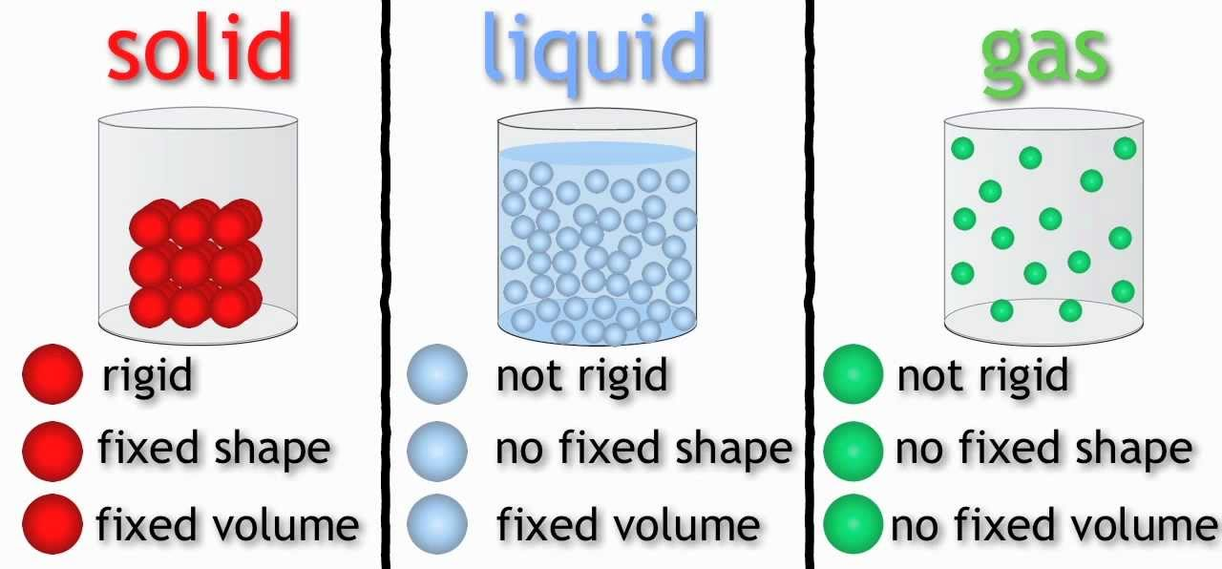
Molecules

Slide 46
What is Matter?
Matter is made up of tiny particles/atoms or molecules which are too small for us to see directly.
Molecules consist of even smaller particles known as atoms.
Atoms can be viewed under an electron microscope.

Slide 47
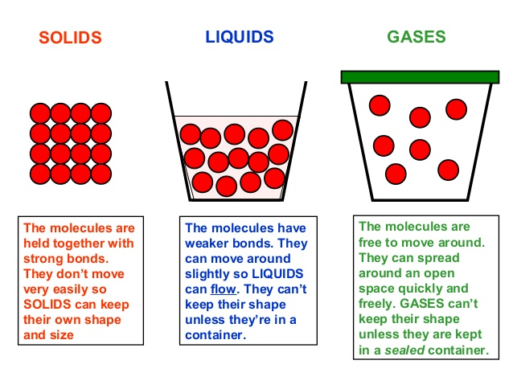
Arrangement of atoms in solids, liquids and gases

Slide 48
Solids, Liquids & Gases
Phases | Arrangement of particles | Intramolecular Forces | Density | Shape | Ability to flow | Compressibility | Main motion of particles
Solids | Very close/rigid particles vibrate | Strong | High | Fixed | Rigid bonds does not allow solids to flow | Not easily compressed because particles are close | Particles vibrate in place
Liquids | Close but particles are able to move past each other | Intermediate | High | Takes the shape of the container if it is in a container. Outside of a container liquids have no shape. | These have weaker forces between the particles so they are able to flow | Not easily compressed because particles are close | Particles vibrate and translate constantly changing neighbours
Gases | Very far apart | Weak | Very low | Takes the shape of the container if it is in a container. Outside of a container gases have no shape. | These have very weak forces between the particles so they are able to flow | Easy to compress because particles are far apart | The particles translate freely, having neighbours only at the time of collision

Slide 49
The Kinetic Theory of Particles
The particles of matter (atoms, molecules) are in constant motion of vibration, translation or rotation.
There is space between the particles. Forces (bonds) pull them together when they are near to each other, and so the particles have potential energy.
When a substance is heated, the heat energy supplied could result in an increase in the kinetic energy of the particles of the substance, and hence in its thermal energy, causing the temperature to rise.
When a substance is heated so that it changes state, the heat energy supplied results in an increase in the spacing of the particle and hence an increase in their potential energy, allowing them to break bonds with their neighbours and to expand against any surrounding pressure.

Slide 50
Questions
Describe solids, liquids and gases in terms of the separation and motion of their particles, and the forces between those particles.
Explain the following properties of a LIQUID in terms of your description in question 1.
a. Density b. Shape
c. Compressibility d. Fluidity

Slide 51
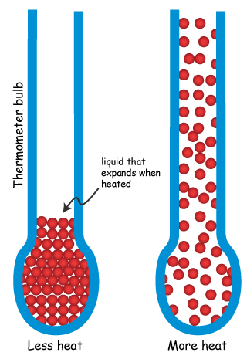
Thermal expansion

Slide 52
Heating Matter
When matter is heated it EXPANDS.
When matter is cooled it CONTRACTS.

Slide 53
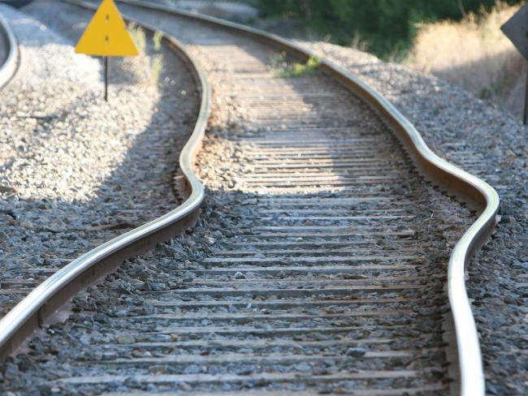
Thermal Expansion of Solids
When a metal is
heated it EXPANDS.
Thermal expansion
is the major cause
for the buckling of
railroads in places that experience extreme heat.

Slide 54
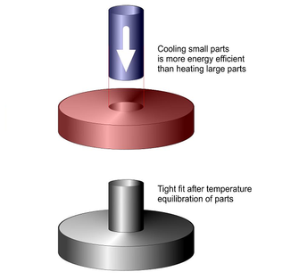
Uses of Thermal Expansion
Shrink fitting
Axles can be shrunk by cooling them in liquid nitrogen at -196 ºC until the gear wheels can be slipped on to them. On regaining normal temperature what do you think happens?

Slide 55
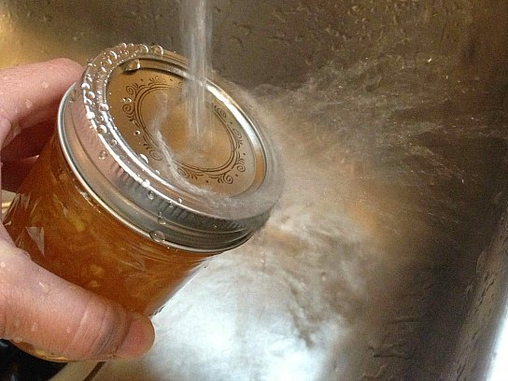
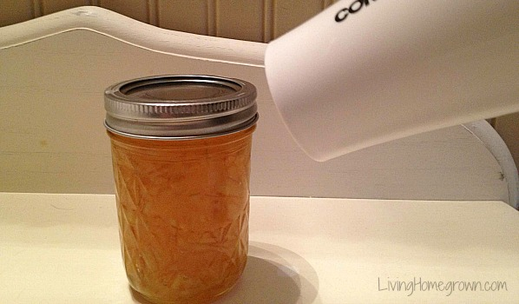
Uses of Thermal Expansion
Opening tight lids
How can a tight lid be removed and why does this method work?

Slide 56
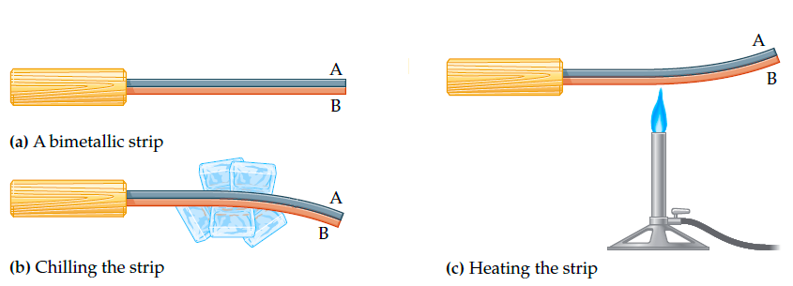
Uses of Thermal Expansion
c. Bimetallic strips – A bimetallic strip consists of two metal strips riveted together. The strips bend on heating such that the metal that expands more is on the outer side of the curve.
Bimetallic strips are used in fire alarms. Heat from the fire causes the strip to bend upward and closes the contacts.

Slide 57
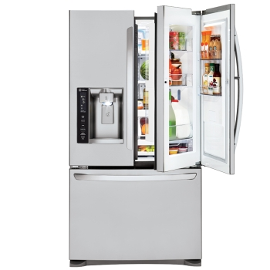
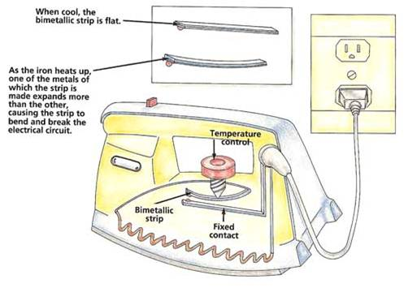
Uses of Thermal Expansion
c. Bimetallic strips – A bimetallic strip is also used in thermostats in refrigerators, ovens, irons and heaters.

Slide 58
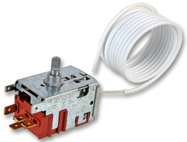
What is a Thermostat?
A thermostat is an electrical device used to control temperature.
It bends when it
gets hot to break the
circuit.

Slide 59
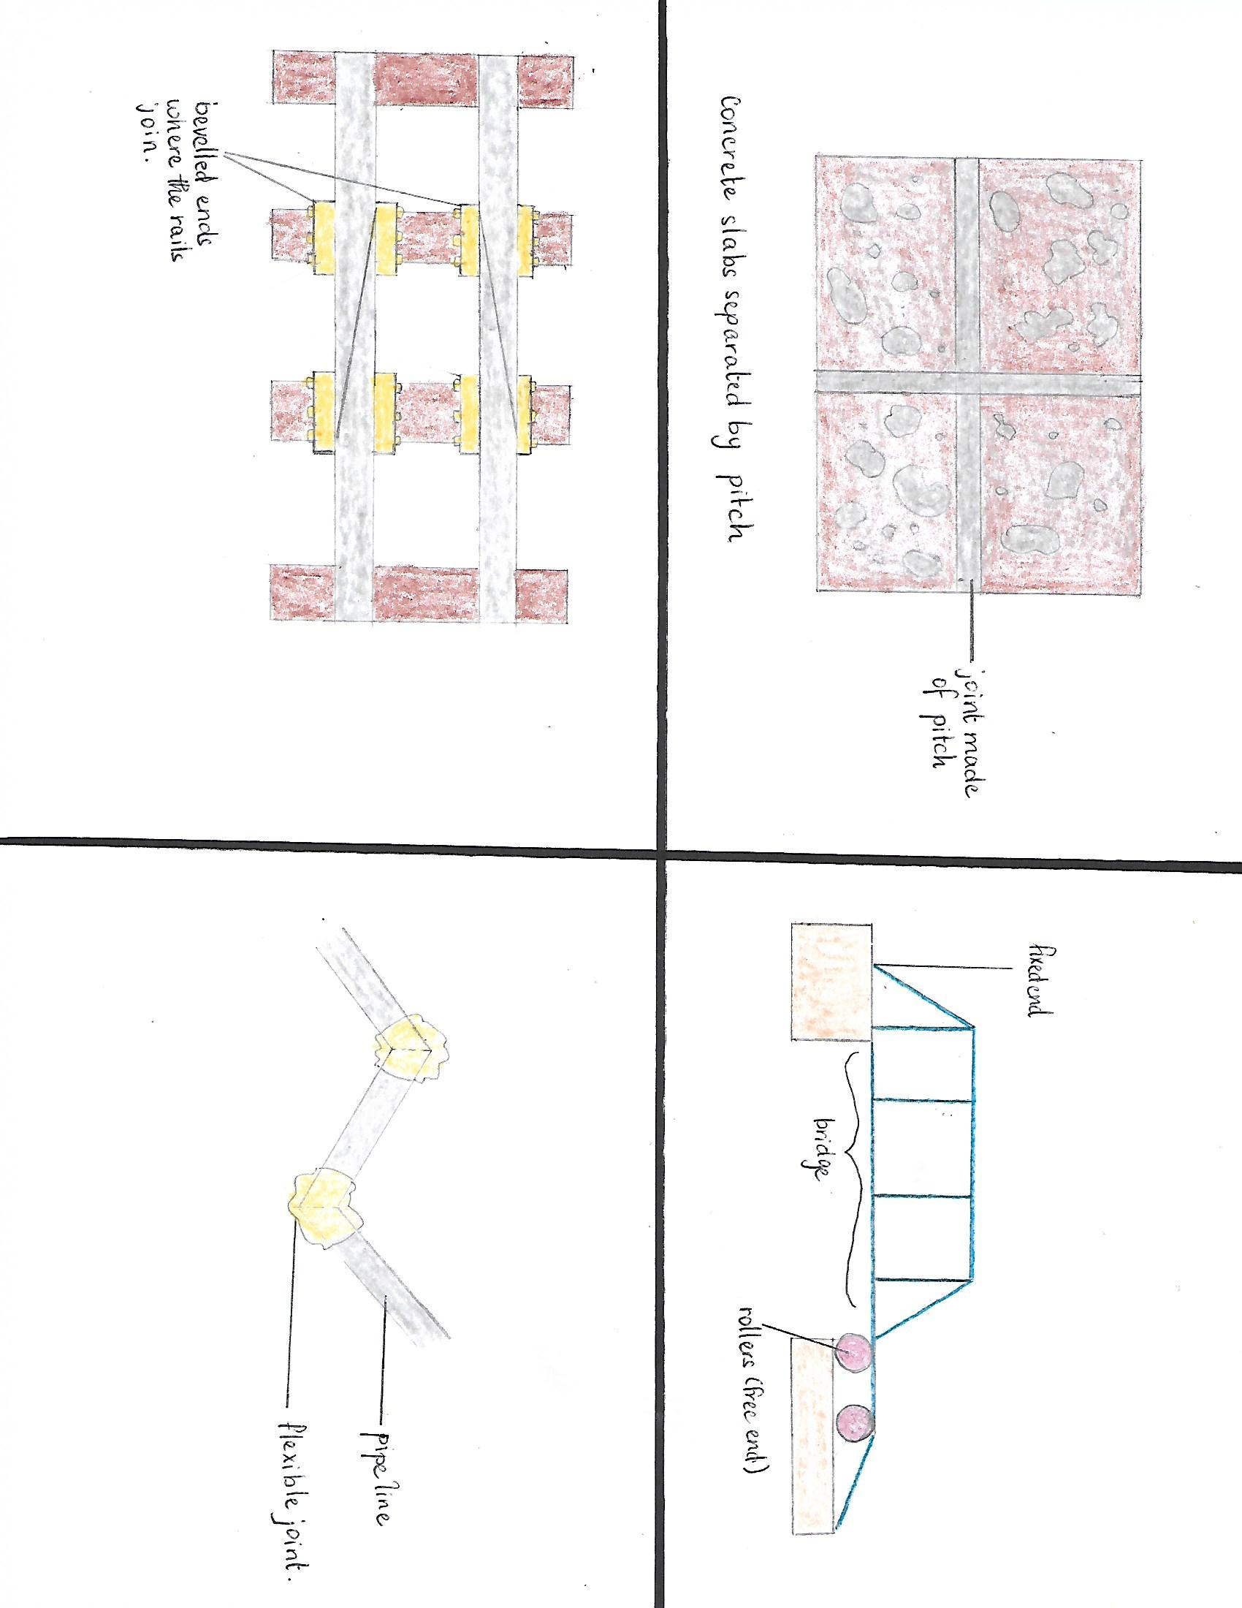
Avoiding problems due to expansion
Concrete surfaces are laid in slabs and the spaces between them are filled with pitch to reduce cracking of the concrete when it starts to expand from too much heat.

Slide 60
Avoiding problems due to expansion
Railway lines are laid in short lengths and they are bevelled to overlap each other so when they expand they just slide past each other.

Slide 61
Avoiding problems due to expansion
Pipelines in deserts or those which carry steam are laid in zig-zag formation with flexible joints to allow the pipe to expand easily when they start to expand.

Slide 62
Avoiding problems due to expansion
Large structures such as bridges can be made with one end on rollers. This allows them to expand and contract with ease.

Slide 63
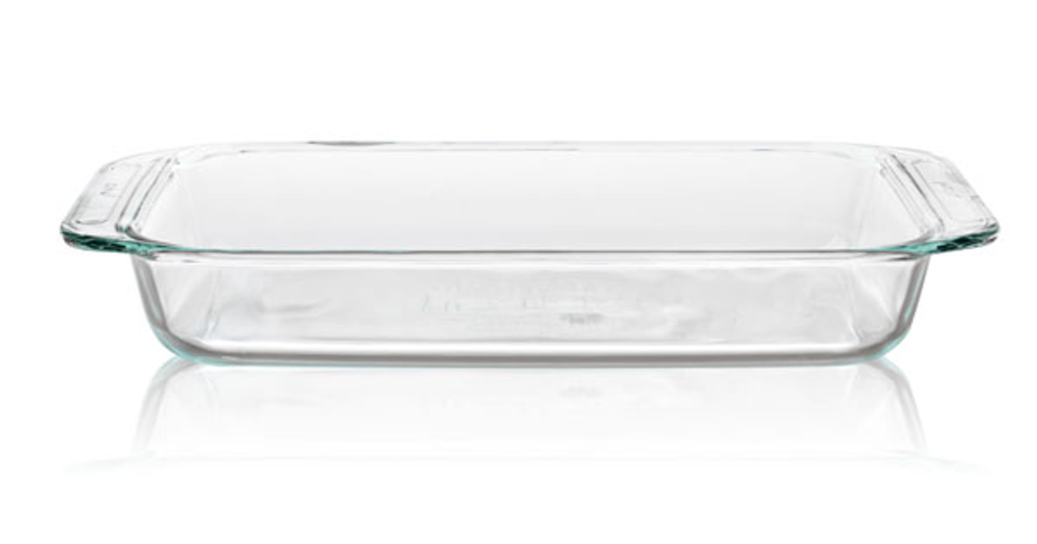
Avoiding problems due to expansion
Baking dishes are made of materials that expand and contract very little with temperature change. This prevents them from cracking when removed from the oven into the much cooler environment.

Slide 64
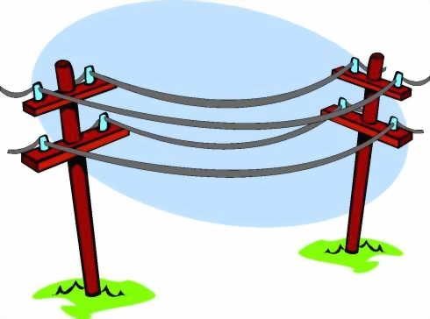
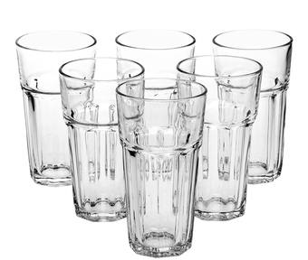
Avoiding problems due to expansion
Wires - Why are telephone wires left to sag?
Cracking of glass vessels - What happens when hot water is poured into a thick glass and why?

Slide 65
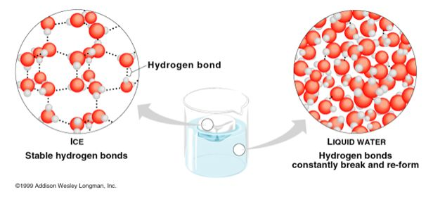
Unusual Expansion of Water
As water is cooled to 4 ºC it contracts, as we would expect. However, between 4 ºC and 0 ºC it expands, surprisingly. Water therefore has a maximum density at 4 ºC.

Slide 66
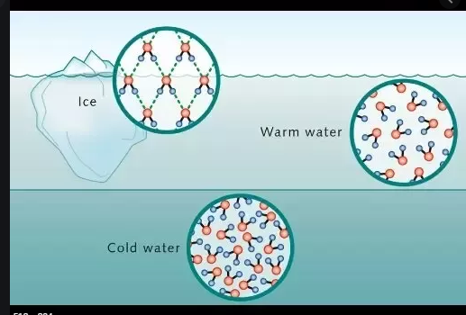
Unusual Expansion of Water
At 0 ºC, when it freezes, a considerable expansion occurs and every 100 cm³ of water becomes 109 cm³ of ice. This accounts for the bursting of water pipes in countries where very cold winters are experienced.

Slide 67
Expansion of Gases
When air is heated it expands and when it is cooled it contracts.
Gases expand much more than liquids and liquids expand more than solids.

Slide 68
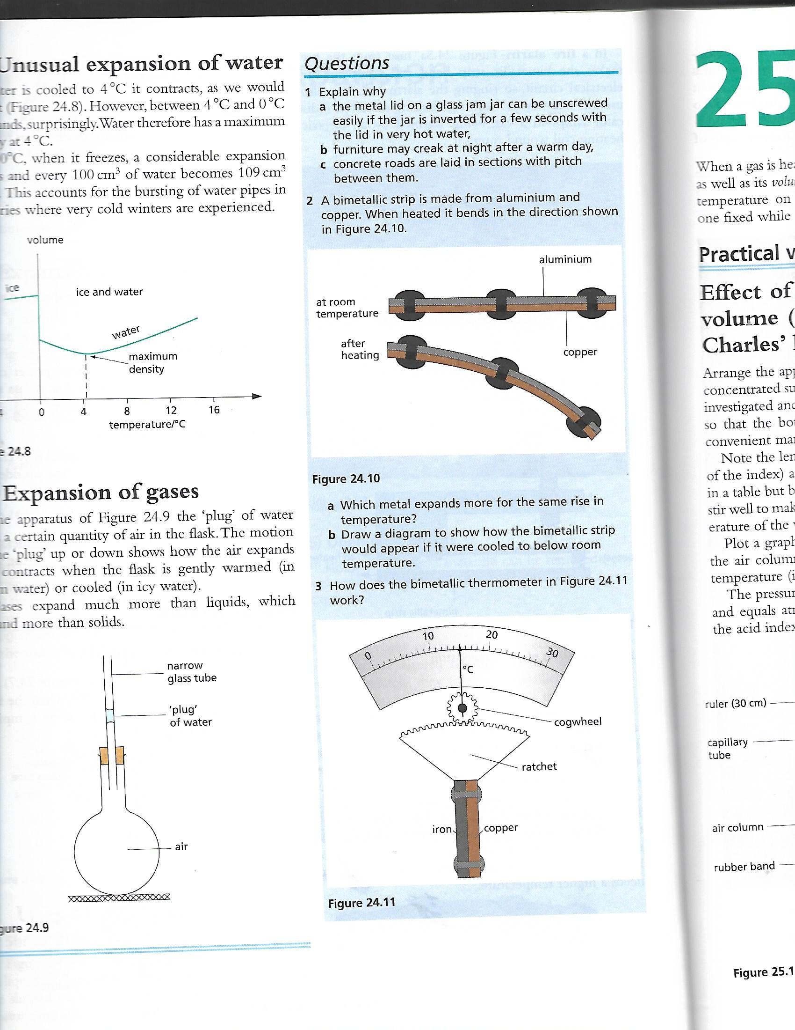
Questions

Slide 69
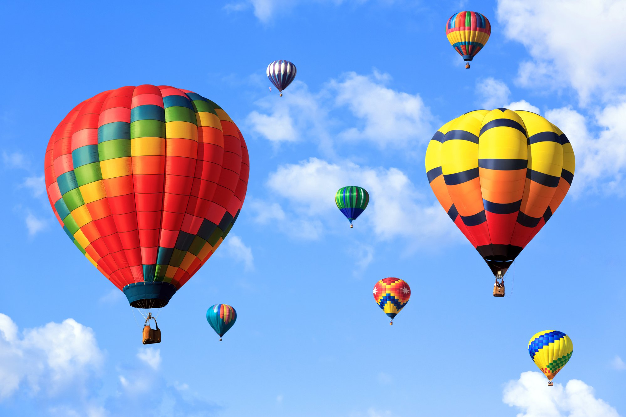
The Gas Laws

Slide 70
What happens when a gas expands?
When a gas is heated pressure as well as its volume may change.
To study the effect of temperature on these two quantities we must keep one fixed while the other is changed.

Slide 71
Two Important Temperature Scales
Two important temperature scales are the Celsius scale and the kelvin scale.
The kelvin scale is known as the thermodynamic temperature scale or absolute scale.
Be reminded that Temperature in kelvins (K) = ºC + 273.

Slide 72
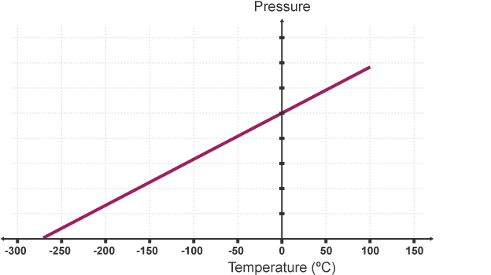
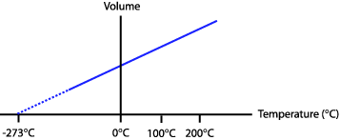
Absolute ZERO
The volume-temperature and pressure-temperature graphs for a gas, which are obtained experimentally, are straight lines. They show that gases expand uniformly with temperature.

Slide 73
Absolute ZERO
It is believed that the lowest temperature possible is – 273 on the Kelvin scale.
It is referred to as the zero or absolute zero.
Any reading taken in kelvins are denoted the unit, K. They are exactly the same size as 1 Celsius degree.

Slide 74
Strange Things happen at
Absolute ZERO
Near to absolute zero, strange things happen.
Liquid helium becomes a ‘superfluid’. It can not be kept in an open vessel because it flows up the inside of the vessel, over the edge and down the outside.
Some metals and compounds become ‘superconductors’ of electricity and a current once started in them flows forever without a battery

Slide 75
The Gas Laws
Boyle’s Law and Charles’ Law
Using absolute temperatures the gas laws can be stated in convenient forms for calculations.
Boyle’s Law:
The volume of a fixed mass of gas is inversely proportional to the pressure, if the temperature is unchanged. Or the pressure of a fixed mass of gas is directly proportional to the inverse of volume.
Equation : P₁V₁ = P₂V₂
Charles’ Law:
The volume of a fixed mass of gas is directly proportional to its absolute temperature if the pressure is kept constant.
Equation : (V₁/T₁) = (V₂/T₂)

Slide 76
The Gas Laws
Pressure Law and General Gas Law
Pressure law:
The pressure of a fixed mass of gas is directly proportional to its absolute temperature if the volume is kept constant.
Equation : P/T = constant
General gas law:
For a fixed mass of an ideal gas changing from state 1 to state 2, the following equation holds
These three equations can be combined to give:
Equation : (P₁V₁/T₁) = (P₂V₂/T₂)

Slide 77
Please note…
P and V may be in any unit of pressure and volume, respectively.
T MUST be measured on the KELVIN scale.
In problems where one of the variables is constant, it may be omitted from the equations.

Slide 78
Constant Temperature
At constant temperature if the vessel is a very good conductor any instantaneous rise or fall in temperature will quickly readjust to that of the environment.
It can therefore be assumed that temperature is constant.

Slide 79
Constant Pressure
At constant pressure if the vessel is freely expandable it can be assumed that the pressure is constant.
Should the pressure instantaneously rise or fall, the vessel will expand or contract so that its contents have the same pressure as the environment (usually atmospheric pressure)

Slide 80
Constant Volume
At constant volume if the container is a strong, solid vessel, it can be assumed that the volume is constant.
An increase in temperature will cause a slight increase in volume of the vessel but this is insignificant when compared to the increase that would have occurred if the gas had freely expanded.

Slide 81
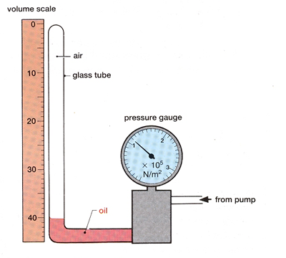
Verifying the Gas Laws
Boyles Law
Boyle’s law can be verified using the following apparatus.
The pressure is increased
by use of the pump and the
new pressure and volume
readings are taken. About
6 readings may be taken
A graph of P against 1/V may be constructed.

Slide 82
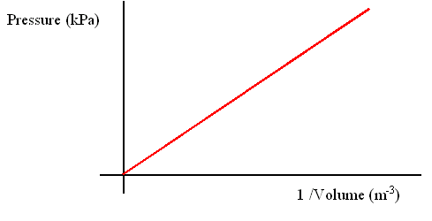
Verifying the Gas Laws
Boyles Law
A straight line graph will be obtained and will verify Boyle’s law.

Slide 83
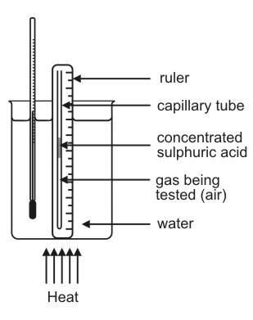
Verifying the Gas Laws
Charles’ Law
Charles’ law can be verified
using the following apparatus.
The air trapped by the bead
of sulphuric acid is measured
and recorded together with
the temperature. The
temperature is increased several
times by about 10 degrees celsius.

Slide 84
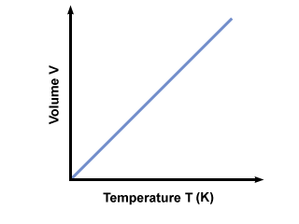
Verifying the Gas Laws
Charles’ Law
A graph of V against T (K) may be constructed.
A straight line graph will be
obtained and will verify
Charles’ law.

Slide 85
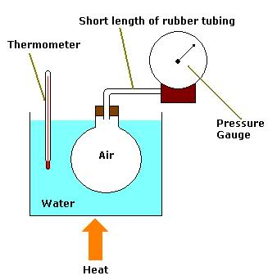
Verifying the Gas Laws
The Pressure Law
The pressure law can be verified using the apparatus shown below.
The pressure, P, and
temperature of the gas
trapped in the spherical flask
is measured and recorded.
The temperature is increased several times by intervals of about 10 ºC each time recording P and T readings.

Slide 86
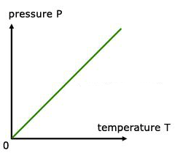
Verifying the Gas Laws
The Pressure Law
A graph of P against T(K) may be constructed and a straight line graph will
be obtained. This will verify
the pressure law.

Slide 87
Gases and the Kinetic Theory
At higher temperatures, molecules translate at higher velocities and therefore the rate of change in momentum (the force) on collision is greater.
Where:
F = m [(v – u) ÷ t] ~ F = ma
The pressure therefore increases: P = F/A

Slide 88
Kinetic Theory and Boyle’s Law
As a gas is compressed at a constant temperature, the speed of its molecules is unchanged and therefore the force exerted by its molecules on the walls remains constant.
Since volume decreases pressure would increase due to collisions of molecules on a smaller surface area.

Slide 89
Kinetic Theory and Charles’ Law
As the temperature of a gas rises, the average kinetic speed of its molecules increases and therefore the force exerted by its molecules on the walls is greater.
If the vessels is freely expandable the volume will increase and therefore the area of the walls will also increase.
The force and area increase by the same factor therefore pressure will remain the same/constant.

Slide 90
Kinetic Theory and the Pressure Law
As the temperature of a gas rises, the average kinetic speed of its molecules increases and therefore the force exerted by its molecules on the walls is greater.
If the volume remains constant the area of the walls is constant.
Since the force increases as the area remains constant the pressure on the walls increases.

Slide 91
QUEST OF THE ONIONS
A bicycle pump contains 50 cm³ of air at 17 ºC and a pressure of 1.0 atmosphere. Find the pressure when the air is compressed to 10 cm³ and its temperature rises to 27 ºC.
A diver releases an air bubble of volume 2 cm³ at a depth of 30 m in water. Find its volume when it reaches the surface, assuming the water temperature is constant and that atmospheric pressure is 10 m of water.

Slide 92
QUEST OF THE ONIONS
A gas is heated in a closed container so that its volume cannot change. Which of the following will NOT happen?
A. The average kinetic energy of the molecules will increase.
B. The molecules will move in all directions
C. The number of molecules will increase
D. The molecules will hit the walls of the container more often.
E. The pressure of the gas will increase.

Slide 93
QUEST OF THE ONIONS
A container holds gas a 0 ºC. To what temperature must it be heated for its pressure to treble, assuming the container does not expand?
A gas occupies a volume of 100 cm³ at a temperature of 27 ºC and a pressure of 1 atmosphere. Find the volume when
a. The pressure is doubled, at constant temperature,
b. The absolute temperature is doubled at constant pressure,
c. The pressure is 3 atmospheres and the Celsius temperature is 127 ºC.

Slide 94



Properties of matter

Slide 95

Diffusion
Diffusion is the movement of particles from an area of high concentration to an area of lower concentration.
Give an example of diffusion.
The speed of diffusion of a gas depends on:
a. the speed of its molecules, and
b. the mass of its molecules (lighter molecules travel faster)

Slide 96
Surface Tension
The surface of a liquid behaves as if it were covered with an elastic skin that is trying to shrink.
This effect is called surface tension.
How can surface tension be reduced?
Surface tension is due to the molecules in a liquid surface being slightly farther apart than normal, like those in a stretched wire.

Slide 97
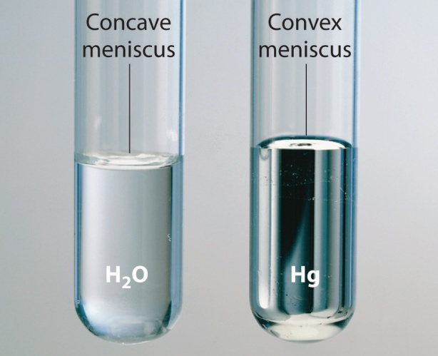
Adhesion & Cohesion
The force of attraction
between molecules of the SAME substance is known as COHESION.
(For example attraction between two water molecules)
The force of attraction between molecules of DIFFERENT substances is known as ADHESION.
(For example attraction between water molecules and glass molecules)

Slide 98
Adhesion & Cohesion
The ADHESION of water to glass is greater than the COHESION of water molecules with itself. This is why water is able to wet and clean glass by spreading a thin film upon it.
In contrast, mercury on glass forms small spherical drops or large flattened ones if applied to glass, why is this so?

Slide 100
Adhesion & Cohesion
The cleaning action of detergents depends on their ability to weaken the cohesion of water molecules amongst themselves.
Instead of forming drops on greasy clothes, detergents make it easier for water to penetrate the fabric to release the dirt.

Slide 101
Capillarity
How does water move along a capillary tube and why?
The action of blotting paper is due to capillary rise in the narrow spaces between the fibres it contains.
Mercury is depressed in a capillary tube. Why?

Slide 103
Mechanical Properties of Materials
When selecting a material for a particular job we need to know how it behaves when forces act on it.
Hence we need to know what a material’s mechanical properties are.

Slide 104
Mechanical Properties of Materials
Mechanical properties include:
1. Strength:
The strength of some materials depends on how the force is applied.
2. Stiffness:
A stiff material resists forces which try to change its shape or size or both.
3. Elasticity:
An elastic material such as rubber recovers its original shape and size after the force deforming it has been removed.
4. Ductility:
Materials which can be rolled into sheets, drawn into wires or worked into other useful shapes without breaking are ductile.
5. Brittleness:
A brittle material is fragile and breaks suddenly.

Slide 105
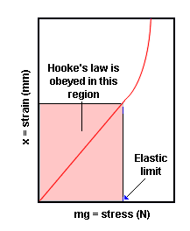
Stretching a Wire
Useful information about mechanical properties is obtained from stretching a long wire of material by gradually loading it with a weight.
The graph obtained by plotting
extension against load is similar
to that for stretching a spring.
At the elastic limit molecules are
pulled slightly farther apart, the
deformation is elastic and the
wire recovers its original length
when the load is removed.
Beyond the elastic limit layers of atoms slip over each other; the deformation is plastic and if unloaded the wire does NOT return to its previous length.

Slide 106
Questions
1. Explain why
a. Diffusion occurs more quickly in a gas than in a liquid,
b. Diffusion is still quite slow even in a gas,
c. An inflated balloon gradually goes down even when tied.
2. Explain the following observations as fully as you can:
a.
(i) a small needle may be floated on the surface of water, but if a drop of detergent is added to the water the needle sinks
(ii) insects can stand on the surface of a pond.
b. State two practical uses of capillary action.

Slide 107
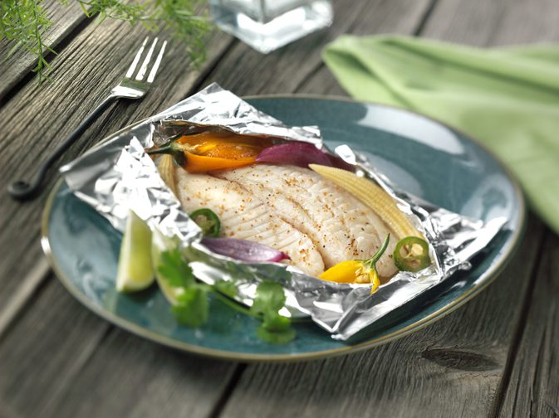
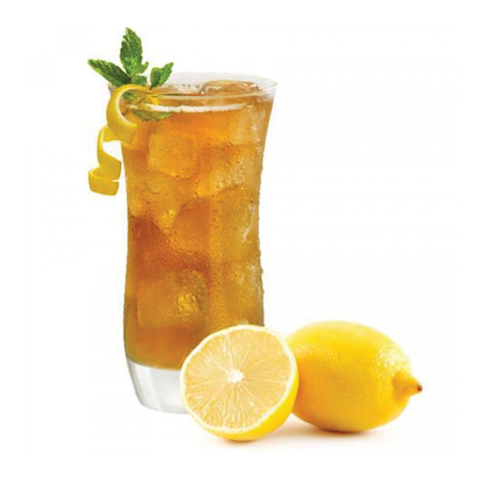
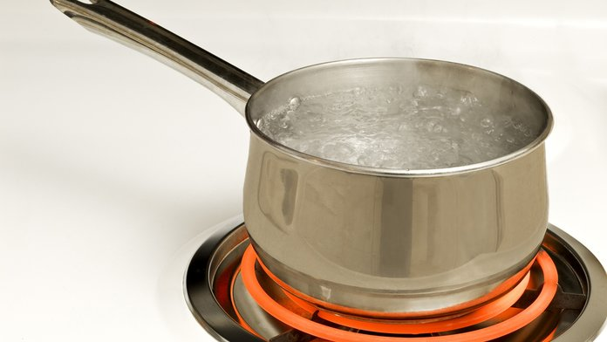
Specific heat capacity
E_{H} = ml_{v}
E_{H} = mcΔT
E_{H} = E_{p}
E_{H} = E_{k}
E_{H} = ml_{f}
E_{H} = Pt

Slide 108
What is Specific Heat Capacity?
Specific heat capacity, c, of a substance is the heat required to produce unit temperature rise in unit mass.

Slide 109
What is Specific Heat Capacity?
Heat, like other forms of energy, is measured in joules, J, and the unit of specific heat capacity is:
a. joule per kilogram degree Celsius,
J/kgºC or J kg^{-1o}C⁻¹
b. joule per kilogram kelvin, J/kgK or J kg⁻¹K⁻¹
In physics the word specific means that unit mass is being considered.

Slide 110
Heat Equation
heat received or given out
= mass (kg) × temperature change (ºC or K) × specific heat capacity (J/kgºC or J/kgK)
E_{H} = m × Δѳ × c
where:
m stands for mass in kg
Δ stands for change in whatever
ѳ stands for temperature and
c stands for specific heat capacity.
Try this:
If the temperature of a 5 kg mass of copper of specific heat capacity 400 J/kgºC rises from 15 ºC to 25 ºC, what is the heat received?

Slide 111
Thermal Capacity
The thermal capacity, C of a body is the quantity of heat needed to raise the temperature of the whole body by 1 ºC.
Thermal capacity = mass (kg) × specific heat capacity (J/kgK)
C = m × c
The thermal capacity is measured in joules per ºC , J/ºC or J ºC⁻¹ and J/K or J K⁻¹
Try this:
For a copper block of mass 0.1 kg and specific heat capacity 390 J/kgºC, what is the thermal capacity?

Slide 112
Questions
Let’s try these together:
Question 1 -
A tank holding 60 kg of water is heated by a 3 kW electric immersion heater.
If the specific heat capacity of water is 4200 J/kgºC, estimate the time for the temperature to rise from 10 ºC to 60 ºC.
1kW = 1000 W = 1000 J and we’ll let t, be the time taken in seconds to raise the temperature of the water by (60 -10) ºC = 50 ºC :. Heat supplied to water in time t = (3000 × t)J

Slide 113
Questions
Let’s try these together:
Question 2 –
A piece of aluminum of mass 0.5 kg is heated to 100 ºC and then placed in 0.4 kg of water at 10 ºC. If the resulting temperature of the mixture is 30 ºC, what is the specific heat capacity of aluminum if that of water is 4200 J/kg ºC.
Here heat given out by the aluminum = heat taken in by water

Slide 114
The Importance of the HIGH Specific Heat Capacity of Water
The specific heat capacity of water is 4200 J/kg ºC and that of soil is about 800 J/kg ºC. As a result the temperature of the sea rises and falls more slowly than that of the land.
A certain mass of water needs five times more heat for its temperature to rise by 1 ºC than does the same mass of soil.
Water also has to give out more heat for its temperature to fall by
1 ºC.
Since islands are surrounded by water they therefore experience much smaller changes of temperature from summer to winter than do large land masses such as Central Asia.

Slide 115
Conversion of Mechanical Energy to Heat
a. Potential energy –
The potential energy of water at the top of a waterfall becomes ________________ energy as the water falls and when it strikes the ground, heat and ______________ are produced. The temperature of the water at the bottom is higher than that a the top. If we assume that all the potential energy becomes heat the temperature rise can be calculated.
E_{H} = Ep ~ mcΔT = mgh
Consider 1 kg of water falling a vertical distance of 105 m.
Take gravity as g = 10 N/kg and the potential energy = mass × gravity × height = ____________ Joules
Use the heat equation and take the specific heat capacity of water to = 4200 J/kg ºC
heat produced = 1 kg × 4200 J/kg ºC × Δѳ
:. 4200 J /ºC × Δѳ = 1050 J
Δѳ = _______________
b. Kinetic energy –
When a car is brought to rest by the brakes, kinetic energy becomes heat and the temperature of the brake linings (or disc pads) rises.

Slide 116
Nature of Heat
Caloric Theory
In the 18th century heat was regarded as an invisible fluid called caloric which could be neither created nor destroyed and which was present in all matter.
Temperature rises or falls in a body were thought to be due to the addition or removal of caloric.
The weakness of the theory was the lack of experimental evidence to show that a hot body weighed more than a cold one as it should if caloric is a material fluid with weight like all other fluids.
Part of the difficulty was weighing a hot body accurately when temperatures were changing.

Slide 117
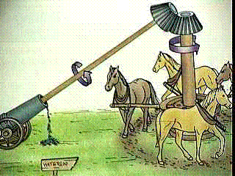
Nature of Heat
Rumford (1753 – 1814)
Evidence against the caloric theory came from observations Rumford made while supervising the boring of brass cannons at the military arsenal in Munich.
He was surprised at how hot both
the cannons and the brass borings
became. Moreover, the effect
continued for as long as the boring
did. It seemed to Rumford that:
i. Heat can be created and so is
not a material substance and
ii. It is created when work is done against friction (as it is in boring a cannon) that is mechanical energy and heat are related.
*Boring is a machining process which is used to enlarge the diameter of hole in a metallic object by using a cutting tool. In this procedure the cutting tool is used to cut the metal off the hole which is rotating at a very high speed

Slide 118
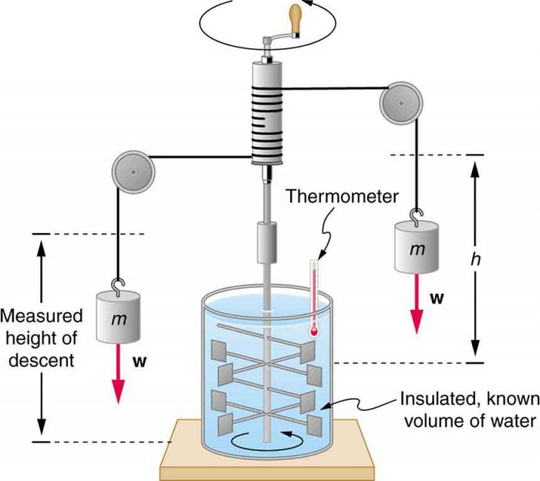
Nature of Heat
Joule (1818 -1889)
The caloric theory was not overturned until the mid 19th century, largely through the work of the English brewer and amateur scientist, Joule.
Basically, Joule discovered
the amount of work that
had to be put into raising
1 kg of water to 1ºC by
using a closed system, a
mass and a paddle wheel
set up.

Slide 119
Nature of Heat
Joule (1818 -1889)
On all occasions Joule found that a certain amount of mechanical energy always produced the same amount of heat. That is the rate of exchange between them was fixed.
Around the same time the view that matter consisted of atoms and molecules was gaining ground and helped to make more plausible the opinion of Joule (and others) that heat was a form of energy connected with molecular motion.
Today we believe that when matter is heated and its temperature rises, then this is due to the speed and so the kinetic energy of the molecules increasing.
Joule’s work also helped to establish the conservation principle for all forms of energy. What are they talking about?

Slide 120
Questions
Heat equations that can be used:
E_{Hgained} = E_{Hlost}
E_{H} = mcΔT
E_{H} = Pt
E_{H} = E_{k}
E_{H} = E_{p}
Take the specific heat capacity of water as 4200 J/kg ºC
1. How much heat is given out when an iron ball of mass 2 kg and specific heat capacity 440 J/kg ºC cools from 300 ºC to 200 ºC?
2. How much heat is needed to raise the temperature by 10 ºC of 5 kg of a substance of specific heat capacity 300 J/kg ºC?
3. 2000 J of energy is needed to heat 1 kg of paraffin through 1 ºC. How much heat is needed to heat 0.5 kg of paraffin through 8 ºC?
4. How many joules of heat energy are supplied by a 2 kW heater in
a. 10 s
b. 1 minute?

Slide 121
How much heat is given out when an iron ball of mass 2 kg and specific heat capacity 440 J/kg ºC cools from 300 ºC to 200 ºC?
How much heat is needed to raise the temperature by 10 ºC of 5 kg of a substance of specific heat capacity 300 J/kg ºC?
3. 2000 J of energy is needed to heat 1 kg of paraffin through 1 ºC. How much heat is needed to heat 0.5 kg of paraffin through 8 ºC?
4. How many joules of heat energy are supplied by a 2 kW heater in
a. 10 s
b. 1 minute?

Slide 122
Questions
Heat equations that can be used:
E_{Hgained} = E_{Hlost}
E_{H} = mcΔT
E_{H} = Pt
E_{H} = E_{k}
E_{H} = E_{p}
Take the specific heat capacity of water as 4200 J/kg ºC
5. When 0.1 kg of a metal at 100 ºC is dropped into 0.15 kg of water at 25 ºC, the final temperature is 30 ºC. What is the specific heat capacity of the metal?
6. An electric water heater raises the temperature of 0.5 kg of water by 30 ºC every minute. Assuming that no heat is lost, what is the power of the heater?
7. What mass of cold water at 20 ºC must be added to 60 kg of hot water at 80 ºC by someone who wants to have a bath at 50 ºC? Neglect heat losses!

Slide 123
Take the specific heat capacity of water as 4200 J/kg ºC
5. When 0.1 kg of a metal at 100 ºC is dropped into 0.15 kg of water at 25 ºC, the final temperature is 30 ºC. What is the specific heat capacity of the metal?
6. An electric water heater raises the temperature of 0.5 kg of water by 30 ºC every minute. Assuming that no heat is lost, what is the power of the heater?
7. What mass of cold water at 20 ºC must be added to 60 kg of hot water at 80 ºC by someone who wants to have a bath at 50 ºC? Neglect heat losses!

Slide 124
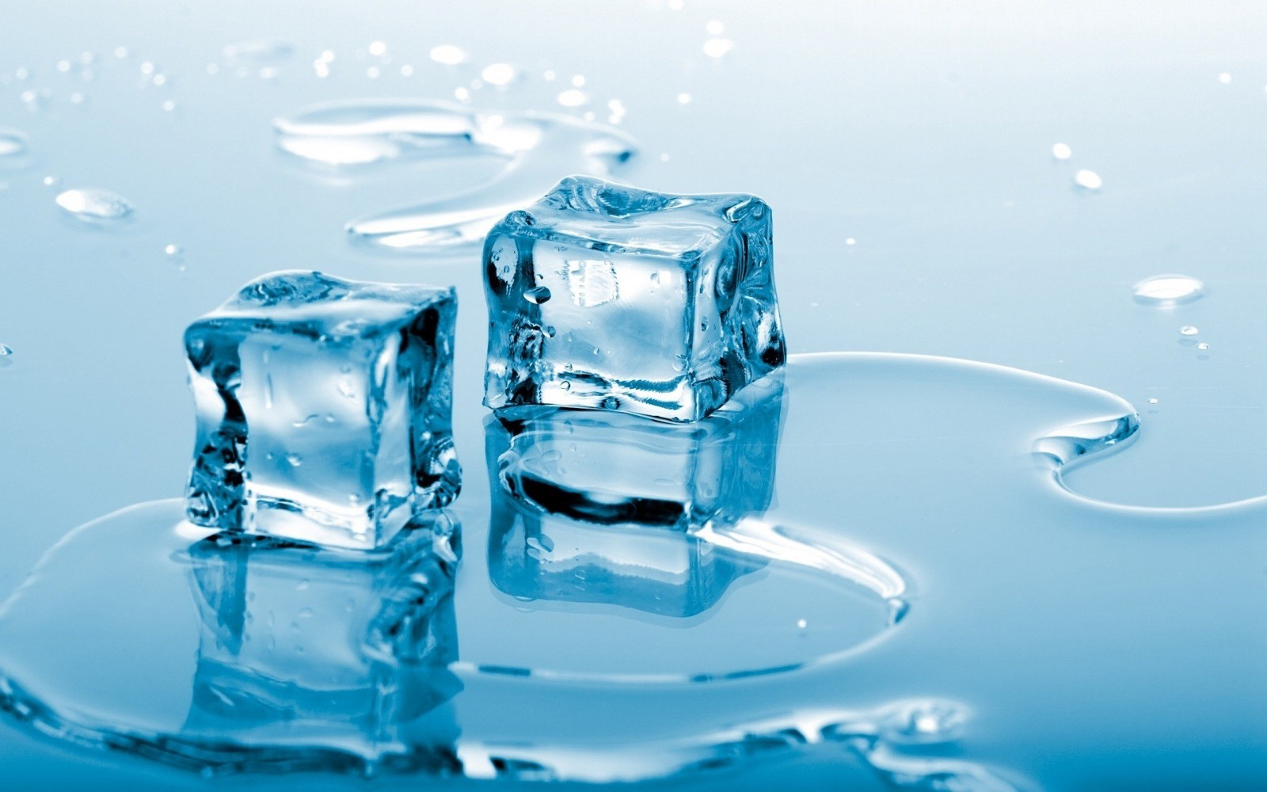
Specific latent heat

Slide 125
Latent Heat
Latent means hidden. Latent heat does not cause a temperature change; it seems to disappear.
A pure substance melts at a definite temperature, called the melting point; it solidifies at the same temperature – the freezing point.
A pure substance also boils at a definite temperature called the boiling point.
Pure substances do this due to latent heat.

Slide 126
Specific Latent Heat of Fusion
During solidification a substance loses heat to its surroundings but its temperature does not fall. Conversely, when a solid is melting, the heat supplied does not cause a temperature to rise. For example, the temperature of a well-stirred ice-water mixture remains at 0 ºC until ALL the ice has melted.
Heat which is absorbed by a solid during melting or given out by a liquid during solidification is called its latent heat of fusion.
Latent means hidden and fusing means melting. Latent heat does not cause a temperature change; it seems to disappear.

Slide 127
Specific Latent Heat of Fusion
The specific latent heat of fusion (l_{f}) of a substance is the quantity of heat needed to change unit mass from solid to liquid and liquid to solid without temperature change.
It is measured in J/kg or J/g.
In general, the quantity of heat E_{H} to change a mass m from solid to liquid is given by: E_{H} = ml_{f}

Slide 128
Specific Latent Heat of Vaporization
Latent heat is also needed to change a liquid into a vapour.
When steam condenses to form water, latent heat is given out. This is why a scald from steam may be more serious than one from boiling water.
The specific latent heat of vaporization (l_{v}) of a substance is the quantity of heat needed to change unit mass from liquid to vapour without change of temperature.
In general, the quantity of heat E_{H} to change a mass m from liquid to vapour is given by: E_{H} = ml_{v}

Slide 129
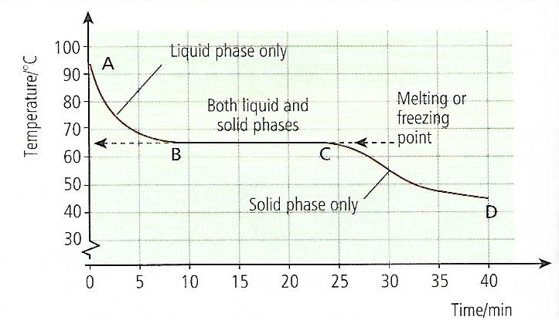
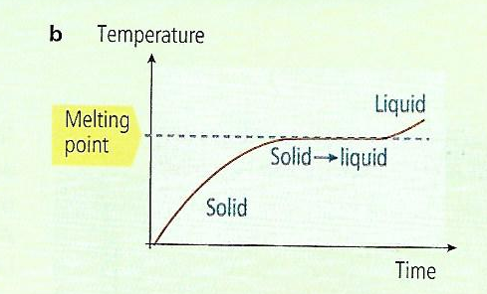
Latent Heat and the Kinetic Theory
The kinetic theory sees the latent heat supplied to a melting solid or an evaporating liquid as enabling the molecules to overcome sufficiently their forces of attraction and allow greater freedom of movement.
It increases their potential energy but not their kinetic energy which increases if the temperature rises.
Cooling Curve
Melting Curve

Slide 130
Evaporation
Evaporation causes a liquid to vapourise and occurs at the surface of a liquid without ever reaching its boiling point.
Evaporation occurs most when there is a lot of wind, plenty of sun and if there is only a little water vapour present in the air.
What are some of the differences between evaporation and boiling?
Boiling and evaporation are both processes that need latent heat of vaporization

Slide 131
Cooling by Evaporation and the Kinetic Theory
The molecules of a liquid have an average speed at a particular temperature but some are moving faster than others.
Evaporation occurs when faster molecules escape from the surface of the liquid.
The average speed, and therefore the average kinetic energy of the molecules left behind decreases, that is the temperature of the liquid falls.

Slide 132
Refrigerators
In a refrigerator heat is taken in at one place and given out at another by the refrigerating substance as it is pumped round a circuit. The coiled pipe round the freezer at the top of the refrigerator contains a volatile liquid. This evaporates and takes latent heat from its
surroundings, so causing cooling.

Slide 133
Refrigerators & Air Conditioners
In air conditioners cooling by evaporation is also used. Warm air is pulled in through a dust filter by a fan and cooled by supplying latent heat to the liquid evaporating in the coiled pipe.

Slide 134
Questions
1. How much heat is needed to change 20 g of ice at 0 ºC to steam at 100 ºC?
 | Water | Ice | Aluminum
Specific heat capacity (J/g ºC) | 4.2 | 2.0 | 0.90
Specific latent heat (J/g) | 2300 | 340

Slide 135
Questions
2. An aluminum can of mass 100 g contains 200 g of water. Both, initially at 15 ºC, are placed in a refrigerator at – 5.0 ºC. Calculate the quantity of heat that has to be removed from the water and the can for their temperatures to fall to -5.0 ºC.
 | Water | Ice | Aluminum
Specific heat capacity (J/g ºC) | 4.2 | 2.0 | 0.90
Specific latent heat (J/g) | 2300 | 340

Slide 136
Questions
3. a. How much heat will change 10 g of ice at 0 ºC to water at 0 ºC?
b. What quantity of heat must be removed from 20 g of water at 0 ºC
to change it to ice at 0 ºC?
 | Water | Ice | Aluminum
Specific heat capacity (J/g ºC) | 4.2 | 2.0 | 0.90
Specific latent heat (J/g) | 2300 | 340

Slide 137
Questions
4. a. How much heat is needed to change 5 g of ice at 0 ºC to water at 50 ºC?
b. If a refrigerator cools 200 g of water from 20 ºC to its freezing point in
10 minutes, how much heat is removed per minute from the water?
 | Water | Ice | Aluminum
Specific heat capacity (J/g ºC) | 4.2 | 2.0 | 0.90
Specific latent heat (J/g) | 2300 | 340

Slide 138
Questions
5. How long will it take a 50 W heater to melt 100 g of ice at 0 ºC?
 | Water | Ice | Aluminum
Specific heat capacity (J/g ºC) | 4.2 | 2.0 | 0.90
Specific latent heat (J/g) | 2300 | 340

Slide 139
Questions
6. Some small aluminum rivets of total mass 170 g and at 100 ºC are emptied
into a hole in a large block of ice at 0 ºC.
a. What will be the final temperature of the rivets?
b. How much ice will melt?
 | Water | Ice | Aluminum
Specific heat capacity (J/g ºC) | 4.2 | 2.0 | 0.90
Specific latent heat (J/g) | 2300 | 340

Slide 140
Questions
7. a. How much heat is needed to change 4 g of water at 100 ºC to steam
at 100 ºC?
b. Find the heat given out when 10 g of steam at 100 ºC condenses
and cools to water at 50 ºC.
 | Water | Ice | Aluminum
Specific heat capacity (J/g ºC) | 4.2 | 2.0 | 0.90
Specific latent heat (J/g) | 2300 | 340

Slide 141
Questions
8. A 3 kW electric kettle is left on for 2 minutes after the water starts to boil.
What mass of water is boiled off in this time?
 | Water | Ice | Aluminum
Specific heat capacity (J/g ºC) | 4.2 | 2.0 | 0.90
Specific latent heat (J/g) | 2300 | 340

Slide 142
Questions
9. If a 500 W immersion heater takes 34 s to melt 0.050 kg of ice, what is the specific latent heat of fusion of ice?
 | Water | Ice | Aluminum
Specific heat capacity (J/g ºC) | 4.2 | 2.0 | 0.90
Specific latent heat (J/g) | 2300 | 340

Slide 143
Questions
10. A 1 kW immersion heater takes 450 s to boil away 0.200 kg of water at 100 ºC. What value does this give for the specific latent heat of vaporization of water?
 | Water | Ice | Aluminum
Specific heat capacity (J/g ºC) | 4.2 | 2.0 | 0.90
Specific latent heat (J/g) | 2300 | 340

Slide 144
Questions
11. Some water is stored in a bag of a porous material eg. canvas, which is hung where it is exposed to a draught of air. Explain why the temperature of the water is lower than that of the air.
 | Water | Ice | Aluminum
Specific heat capacity (J/g ºC) | 4.2 | 2.0 | 0.90
Specific latent heat (J/g) | 2300 | 340

Slide 145
Questions
12. Explain why a bottle of milk keeps better when it stands in water in a porous pot in a draught.
 | Water | Ice | Aluminum
Specific heat capacity (J/g ºC) | 4.2 | 2.0 | 0.90
Specific latent heat (J/g) | 2300 | 340

Slide 146
Questions
1. How much heat is needed to change 20 g of ice at 0 ºC to steam at 100 ºC?
 | Water | Ice | Aluminum
Specific heat capacity (J/g ºC) | 4.2 | 2.0 | 0.90
Specific latent heat (J/g) | 2300 | 340

Slide 147
Questions
2. An aluminum can of mass 100 g contains 200 g of water. Both, initially at 15 ºC, are placed in a refrigerator at – 5.0 ºC. Calculate the quantity of heat that has to be removed from the water and the can for their temperatures to fall to -5.0 ºC.
 | Water | Ice | Aluminum
Specific heat capacity (J/g ºC) | 4.2 | 2.0 | 0.90
Specific latent heat (J/g) | 2300 | 340

Slide 148
Questions
3. a. How much heat will change 10 g of ice at 0 ºC to water at 0 ºC?
b. What quantity of heat must be removed from 20 g of water at 0 ºC
to change it to ice at 0 ºC?
 | Water | Ice | Aluminum
Specific heat capacity (J/g ºC) | 4.2 | 2.0 | 0.90
Specific latent heat (J/g) | 2300 | 340

Slide 149
Questions
4. a. How much heat is needed to change 5 g of ice at 0 ºC to water at 50 ºC?
b. If a refrigerator cools 200 g of water from 20 ºC to its freezing point in
10 minutes, how much heat is removed per minute from the water?
 | Water | Ice | Aluminum
Specific heat capacity (J/g ºC) | 4.2 | 2.0 | 0.90
Specific latent heat (J/g) | 2300 | 340

Slide 150
Questions
5. How long will it take a 50 W heater to melt 100 g of ice at 0 ºC?
 | Water | Ice | Aluminum
Specific heat capacity (J/g ºC) | 4.2 | 2.0 | 0.90
Specific latent heat (J/g) | 2300 | 340

Slide 151
Questions
6. Some small aluminum rivets of total mass 170 g and at 100 ºC are emptied
into a hole in a large block of ice at 0 ºC.
a. What will be the final temperature of the rivets?
b. How much ice will melt?
 | Water | Ice | Aluminum
Specific heat capacity (J/g ºC) | 4.2 | 2.0 | 0.90
Specific latent heat (J/g) | 2300 | 340

Slide 152
Questions
7. a. How much heat is needed to change 4 g of water at 100 ºC to steam
at 100 ºC?
b. Find the heat given out when 10 g of steam at 100 ºC condenses
and cools to water at 50 ºC.
 | Water | Ice | Aluminum
Specific heat capacity (J/g ºC) | 4.2 | 2.0 | 0.90
Specific latent heat (J/g) | 2300 | 340

Slide 153
Questions
8. A 3 kW electric kettle is left on for 2 minutes after the water starts to boil.
What mass of water is boiled off in this time?
 | Water | Ice | Aluminum
Specific heat capacity (J/g ºC) | 4.2 | 2.0 | 0.90
Specific latent heat (J/g) | 2300 | 340

Slide 154
Questions
9. If a 500 W immersion heater takes 34 s to melt 0.050 kg of ice, what is the specific latent heat of fusion of ice?
 | Water | Ice | Aluminum
Specific heat capacity (J/g ºC) | 4.2 | 2.0 | 0.90
Specific latent heat (J/g) | 2300 | 340

Slide 155
Questions
10. A 1 kW immersion heater takes 450 s to boil away 0.200 kg of water at 100 ºC. What value does this give for the specific latent heat of vaporization of water?
 | Water | Ice | Aluminum
Specific heat capacity (J/g ºC) | 4.2 | 2.0 | 0.90
Specific latent heat (J/g) | 2300 | 340

Slide 156
Questions
11. Some water is stored in a bag of a porous material eg. canvas, which is hung where it is exposed to a draught of air. Explain why the temperature of the water is lower than that of the air.
 | Water | Ice | Aluminum
Specific heat capacity (J/g ºC) | 4.2 | 2.0 | 0.90
Specific latent heat (J/g) | 2300 | 340

Slide 157
Questions
12. Explain why a bottle of milk keeps better when it stands in water in a porous pot in a draught.
 | Water | Ice | Aluminum
Specific heat capacity (J/g ºC) | 4.2 | 2.0 | 0.90
Specific latent heat (J/g) | 2300 | 340

Slide 158

Convection, Conduction and Radiation
Heat travels in three main ways:
1. Conduction
2. Convection
3. Radiation

Slide 159
Conduction and convection

Slide 160
Ways In which Heat Travels
Conduction and convection are two of the ways in which heat can travel.

Slide 161


Conduction
Conduction is the flow
of heat through matter
from places of higher
to places of lower
temperature without
movement of the
matter as a whole.
An example of conduction is _______

Slide 162
Conduction
Most metals are good conductors of heat.
Materials such as wood, glass, cork, plastics and fabrics are bad conductors/insulators.
Metal objects below body temperature feel colder than those made of bad conductors because they carry heat away faster from the hand, even though all the objects are at the same temperature.

Slide 163

Conduction
Liquids and gases also conduct heat but only very slowly.
Water is a poor
conductor of heat.

Slide 164
Conduction
Uses of conductors:
a. Good conductors:
These are used when ever heat is required to travel quickly through something. Give an example of an appliance that is a good conductor of heat.
b. Bad conductors/Insulators:
What are bad conductors and give an example of a device of such?
Why are hollow blocks used to build the walls of houses?

Slide 165
Conduction and the Kinetic Theory
Two processes occur in metals when they are heated.
a. In metals the electrons travel faster and cause electrons in cooler parts to vibrate as well.
b. Atoms in hotter parts of the metal cause atoms in cooler parts of the metal to vibrate. This happens in non-metals as well since non-metals do not have free electrons.

Slide 166

Convection
Convection is
the usual
method by
which heat
travels through
fluids, example liquids and gases.
Give an example of such.

Slide 167
Convection in Liquids
Convection is the flow of heat through a fluid from places of higher to places of lower temperature by movement of the fluid itself.
In convection a fluid floats within a fluid, not a solid in a fluid. And remember, hot air always rises.

Slide 168

Convection in Air
Black marks often appear on
the wall or ceiling above a
lamp or a radiator.
What do you think they
are caused by?
Convection currents set up by electric, gas
and oil heaters help to warm homes in cold climates. Many so-called ‘radiators’ are really convector heaters.

Slide 169



Natural Convection Currents
Can you give
two examples
of natural convection currents?

Slide 170

Natural Convection Currents

Slide 171
Questions
1. Explain why
a. Newspaper wrapping keeps hot things hot,
b. Fur coats would keep their owners warmer if they were worn inside out
c. A string vest keeps a person warm even though it is a collection of holes bounded by string.
2. Why is a glass milk bottle likely to crack if boiling water is poured into it?

Slide 172
Questions
3. a. When a vessel of water is heated at the top, why doesn’t the water at the bottom warm up?
b. Convection currents stop us from being suffocated when we are asleep in bed. Why?
c. Why is the freezer compartment at the top of a refrigerator?
4. Convection takes place
A. Only in solids B. Only in liquids
C. Only in gases D. In solids and liquids
E. In liquids and gases

Slide 173


Radiation

Slide 174
How Does Radiation Conduct Heat?
Radiation is a third way in which heat can travel, but whereas conduction and convection both need matter to be present, radiation can be transmitted in a vacuum.

Slide 175
How Does Radiation Conduct Heat?
Evidence for this is provided by the fact that in some electric lamps the radiation emitted as light by the filament travels across a vacuum in the glass bulb to get out.

Slide 176

How Does Radiation Conduct Heat?
Radiation is how heat and light reach us from the Sun, also mostly through a vacuum.

Slide 177
How Does Radiation Conduct Heat?
Radiation travels as electromagnetic waves. What happens to these waves when they fall on an object?
Radiation is the flow of heat from one place to another by means of waves.
Radiation is emitted by all bodies above absolute zero and consists mostly of infrared radiation, but light and ultraviolet radiation are also present if the body is very hot – for example the sun.

Slide 178
Good and Bad Absorbers of Heat
Give some examples of good absorbers of heat and bad absorbers of heat.
Good Absorbers of Heat | Bad Absorbers of Heat
Metals | Cotton

Slide 179

Good and Bad Absorbers of Heat
Dull black surfaces are better absorbers of radiation than white shiny surfaces.
What are shiny surfaces good for?
Why are buildings in hotter countries painted white?

Slide 180
Good and Bad Emitters of Heat
Some surfaces also emit radiation better than others when they are hot.
The cooling fins on the heat exchanger of a refrigerator are painted black so that they lose heat more quickly.

Slide 181

Good and Bad Emitters of Heat
Why are teapots and
kettles able to keep
their heat longer?
In general, surfaces
that are good
absorbers of radiation
are good emitters
when hot.

Slide 182
Factors that affect the amount of Radiation given off
Two other factors that affect the amount of radiation emitted per second by a surface are:
a. its area and
b. its temperature.
Increasing either of these increases the radiation.

Slide 183

Effective Uses of Radiation
Vacuum Flasks

Slide 184

Effective Uses of Radiation
Glass-House Effect
The warmth from the sun
is not cut off by a sheet
of glass but the warmth
from a red-hot fire is. Why is this?

Slide 185
Effective Uses of Radiation
Glass-House Effect
Light and short-wavelength infrared rays from the sun penetrate a glass-house (greenhouse) and are absorbed by the soil, plants, etc., raising their temperature. These in turn emit infrared radiation but, because of their relatively low temperature, this has a long wavelength and is not transmitted by the glass. The greenhouse thus acts as a ‘heat-trap’ and its temperature rises.
What does the presence of carbon dioxide in the atmosphere cause?

Slide 186

Effective Uses of Radiation
Solar Water Heating
Solar water heating:
Can you explain how these work?

Slide 187
Effects of CO₂ in the Atmosphere
What does the presence of carbon dioxide in the atmosphere cause?
1. Global warming
2. ______________

Slide 188

Effects of CO₂ in the Atmosphere

Slide 189
Questions
1. We feel the heat from a coal fire by:
A convection B conduction
C expansion D diffusion
E radiation
2. Three cans are of identical size and shape: one can is painted matt black, one is dull white and one is gloss white. The cans are filled with boiling water. In which can will the water cool most quickly? Give a reason.

Slide 190
Questions
3. Why does radiation pass more readily into a glass-house than out of it?
4. a. The earth has been warmed by the radiation from the sun for millions of years yet we think its average temperature has remained fairly steady. Why?
b. Why is the temperature less likely to fall on a cloudy night than on a clear one.

