Slide 1
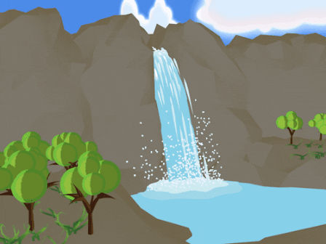
Water and Air

Slide 2
Conserving Water
Water and Air

Slide 3
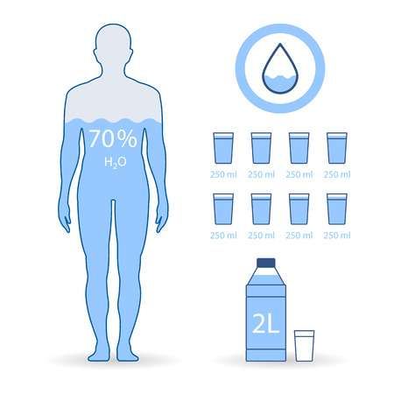
Conserving Water
Importance of Water
Water is necessary for life.
70 % of the human body
is made up of water.
Human beings should
consume at least two
Litres of water per day
to replenish their cells.

Slide 4
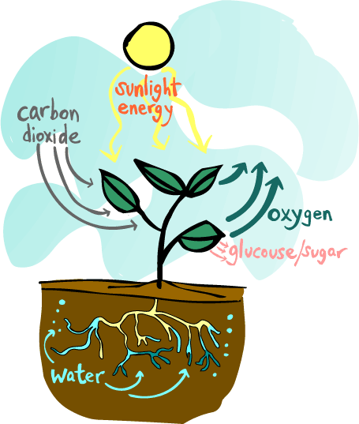
Conserving Water
Importance of Water
In plants, water is necessary for photosynthesis and for the transport of minerals.

Slide 5
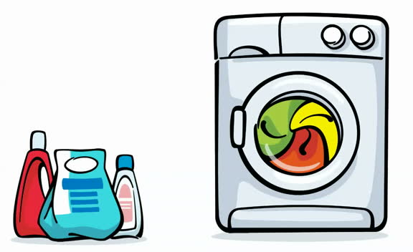
Conserving Water
Uses of Water
Water may be used:
1. in our homes for cooking, cleaning and washing.
2. for transportation for example travel via sea and movement of logs down river.
3. for recreation and sports like jet skiing and swimming.
4. for the generation of electricity in hydro-electric power plants.

Slide 6
Examples of how water may be wasted and conserved
Fill in the empty spaces
Water Wastage | Water Conservation
Taps left running while brushing your teeth or taking a long shower | Turning taps off while not in use
Taps left dripping due to incompletely turning them off or leaks | Taking care to turn taps of fully
 | Reporting leaks and burst pipes
 | Using only water that is needed for use at any particular time

Slide 7
Water and Air
Sources of Water

Slide 8

Conserving Water
Two Natural Sources of Water
Two-thirds (66%) of the Earth’s surface is covered with water.

Slide 9
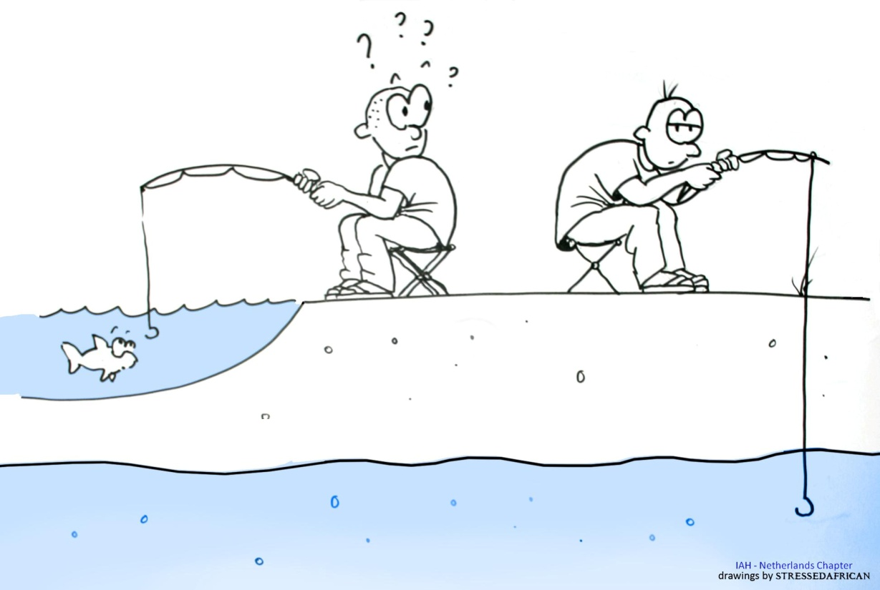
Conserving Water
Two Natural Sources of Water
Two main natural sources of water are:
1. Ground water
and
2. Surface water

Slide 10
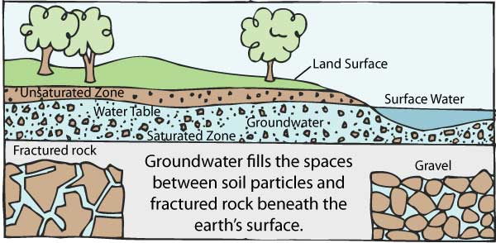
Conserving Water
Ground Water
Ground water comes from rain water that percolates (soaks) through porous rocks and sand and gets trapped in the Earth. This forms the water table.

Slide 11
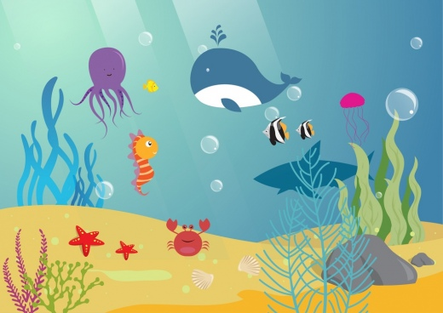
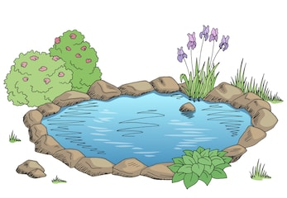
Conserving Water
Surface Water
Surface water comes from rain water that flows into oceans, rivers, lakes, ponds, springs and streams.

Slide 12
Conserving Water
Man-made sources of Water
A man-made source of water is a reservoir.
Reservoirs collect and store water which is diverted from rivers.
Other man-made sources of water are dams, wells, hand-pumps, canals and harbours.

Slide 13
Conserving Water
Causes of Water Pollution
Water from your tap is never pure.
Rain water contains dissolved gases and collects impurities from the ground and containers.
Water can also be polluted with water from factories and sewage.

Slide 14
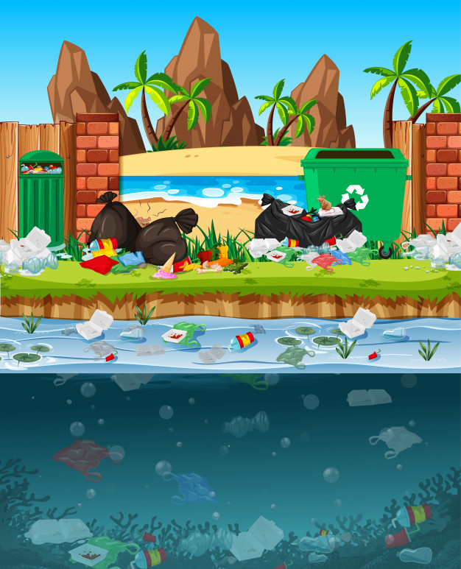
Conserving Water
Dangers of Drinking Contaminated Water
Polluted/contaminated
water is dangerous for
your health and
contributes to the
spread of diseases
like dysentery and cholera.

Slide 15
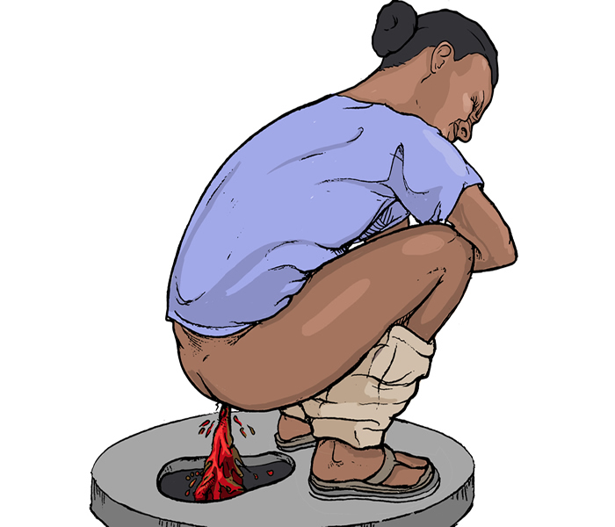
What is Dysentery?
Dysentery is an infection of the intestines which results in severe diarrhea with the presence of blood and mucus in the feces.

Slide 16
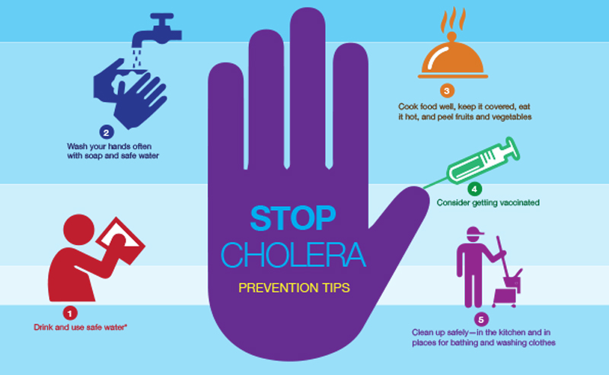
What is Cholera?
Cholera is an infectious and often fatal bacterial disease of the small intestine which is typically contracted from infected water supplies and causes severe vomiting and diarrhea.

Slide 17
Conserving Water
Purification on Water
Polluted water may be purified.
In domestic situations water may be boiled or chlorinated.
On a large scale water may be desalinated if it is being taken from the ocean or treated if it is taken from bodies of water that is not salting examples: rivers, lakes and streams.

Slide 18
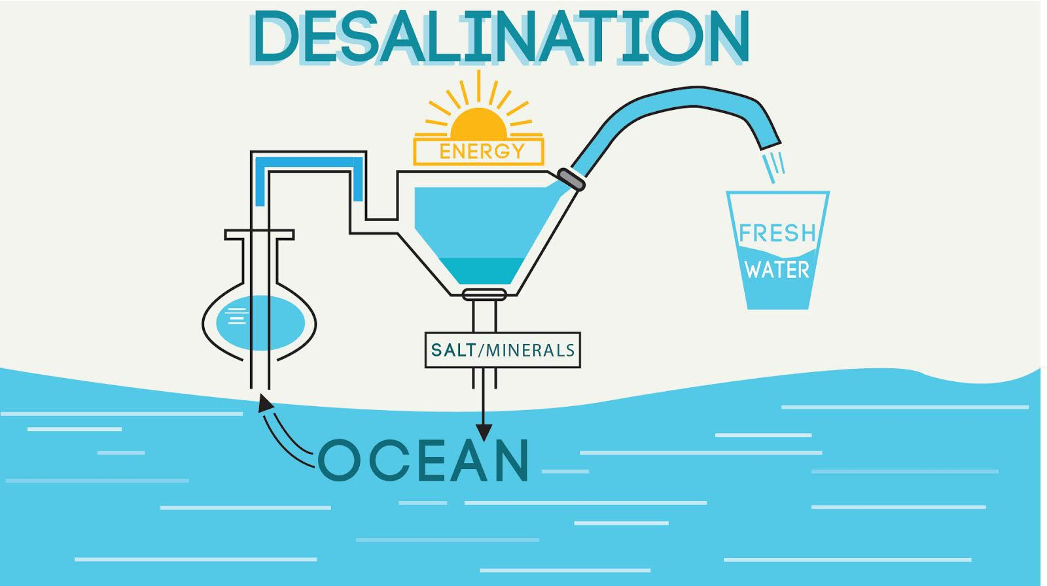
Conserving Water
Methods of Purification of Water
Desalination involves the removal of salt from water.

Slide 19
Conserving Water
Methods of Purification of Water
Water treatment involves the treatment of water collected in reservoirs. It involves four steps:
a. Screening – the removal of large objects
b. Sedimentation – addition of alum to cause suspended particles to settle
c. Filtration – Water is able to pass through beds of sand and gravel which acts as a filter to remove small particles
d. Chlorination – chlorine is added to kill harmful microorganisms

Slide 20
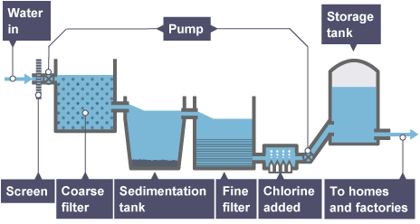
Conserving Water
Methods of Purification of Water

Slide 21
The Water Cycle
Water and Air

Slide 22
The Water Cycle
Three main processes take place during the water cycle: evaporation, condensation and precipitation.
The water cycle is Earth’s way of recycling water.

Slide 23
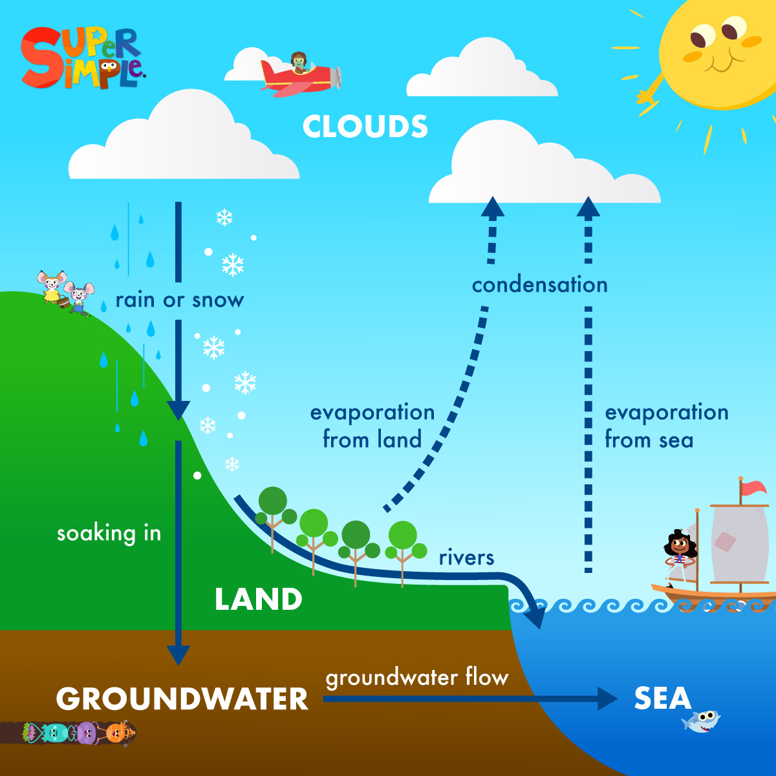
The Water Cycle

Slide 24
Evaporation, Condensation and Precipitation
Evaporation involves the transition from liquid to gas (water vapour). It can occur at any temperature.
Condensation involves the cooling of water vapour to form water droplets which makes clouds.
Precipitation occurs when the droplets become large and heavy and they fall as rain or snow.

Slide 25
Examples of Evaporation and Condensation
Examples of Evaporation | Examples of Condensation
Lowering levels of water in open bodies of water | Dew
Drying of cloth | Mist
Drying of sweat | Fog
Transpiration | Water droplets forming on the outside of a container containing cold substances
 | Water dripping from an air conditioning unit that is in use

Slide 26
Water and Air
Mixing Things With Water

Slide 27
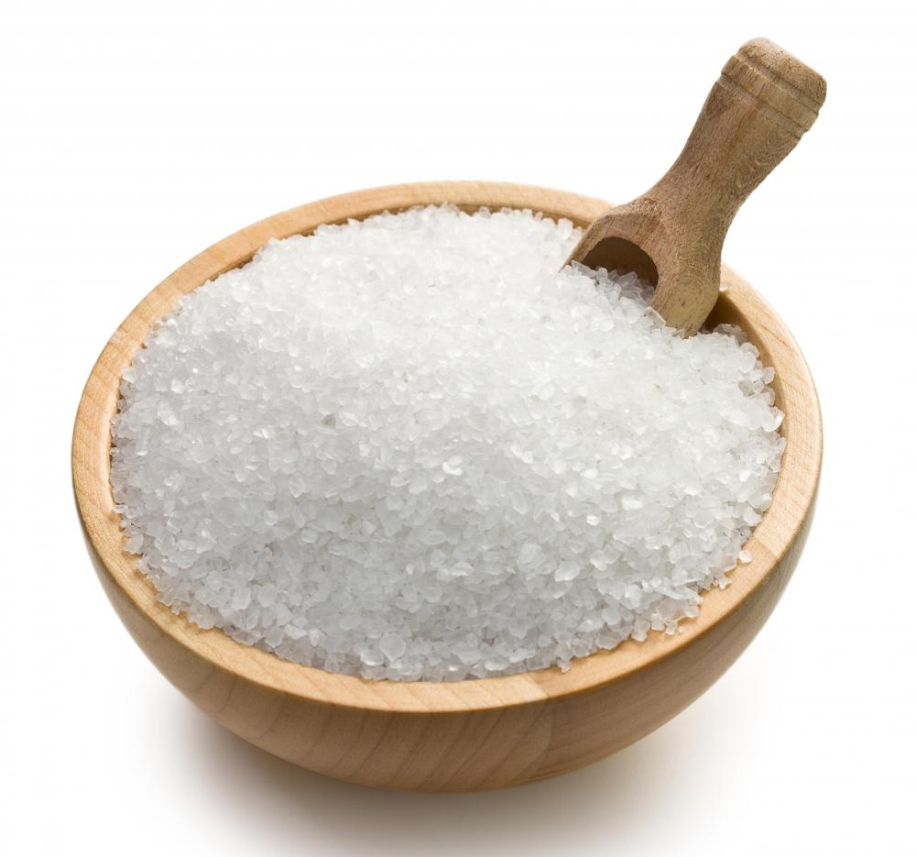
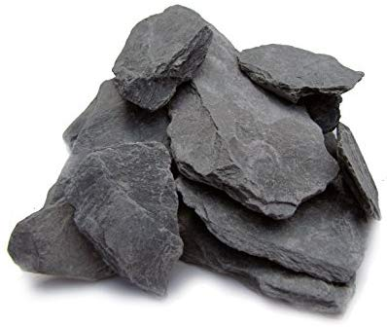
Solutions, Solutes and Solvents
Are all solids soluble or mixable in water?
rocks
salt

Slide 28
Solutions, Solutes and Solvents
A soluble solid dissolves while an insoluble solid does not.
A solution is a mixture of the soluble particles in water.
The solute is the substance which dissolves.
The solvent is the substance which does the dissolving.

Slide 29
Solutions, Solutes and Solvents
Not all solvents are water.
Solution | Solute | Solvent
Soda | Carbon dioxide | Drink
Sugar water | Sugar | Water
Brass (alloy) | Copper | Zinc

Slide 30
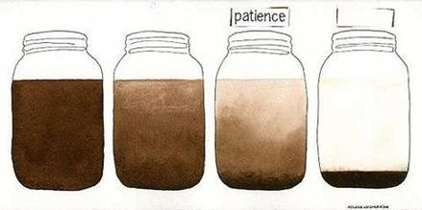
Suspensions
A suspension is the mixture of insoluble particles in water. Instead the particles settle to the bottom of the liquid.
Examples of suspensions are muddy water, chalk in water and sand in water.

Slide 31
Concentration, Dilution and Saturation
The more soluble particles added to a given volume of water the more concentrated it is.
The more water added to a solution makes it dilute.
When no more dissolving is taking place the solution is said to be saturated.

Slide 32
Water and Air
Components of Air

Slide 33
What is Air?
Air is a mixture of different types of gases.
Different types of gases include nitrogen, oxygen, carbon dioxide, water vapour and noble gases.
Examples of noble gases include neon, argon, helium, radon, xenon and krypton.
Nitrogen makes up 78 % of air while oxygen makes up 20 % of air.

Slide 34
Air Pollution
Air can be polluted by a high concentration of poisonous gases entering it.
Examples of poisonous gases include carbon monoxide and gases containing lead and sulphur.

Slide 35
Air Pollution
Air can become polluted from exhaust fumes being given off by vehicles, factories and by burning garbage.
A foul scent in the air may indicate that harmful gases are present.

Slide 36
Physical Properties of Nitrogen
Nitrogen gas is a colourless, scentless gas.
Nitrogen can be used to make fertilizers, dyes, fabrics and explosives.

Slide 37
Physical Properties of Carbon Dioxide
Carbon dioxide is a colourless, scentless gas.
It turns lime water (calcium hydroxide) milky.
It puts a glowing splint out.
It can be used as a refrigerant.
In its solid form it is called dry ice.

Slide 38
Physical Properties of Oxygen
Oxygen is a colourless, scentless gas.
It supports burning.
It relights a glowing splint.
It is used in hospitals, mountain climbing and diving.

Slide 39
Physical Properties of Noble Gases
Noble gases are colourless and scentless.
They may be used in some types of welding, light bulbs and weather balloons.

Slide 40
Water and Air
Maintaining Balance in the Air

Slide 41
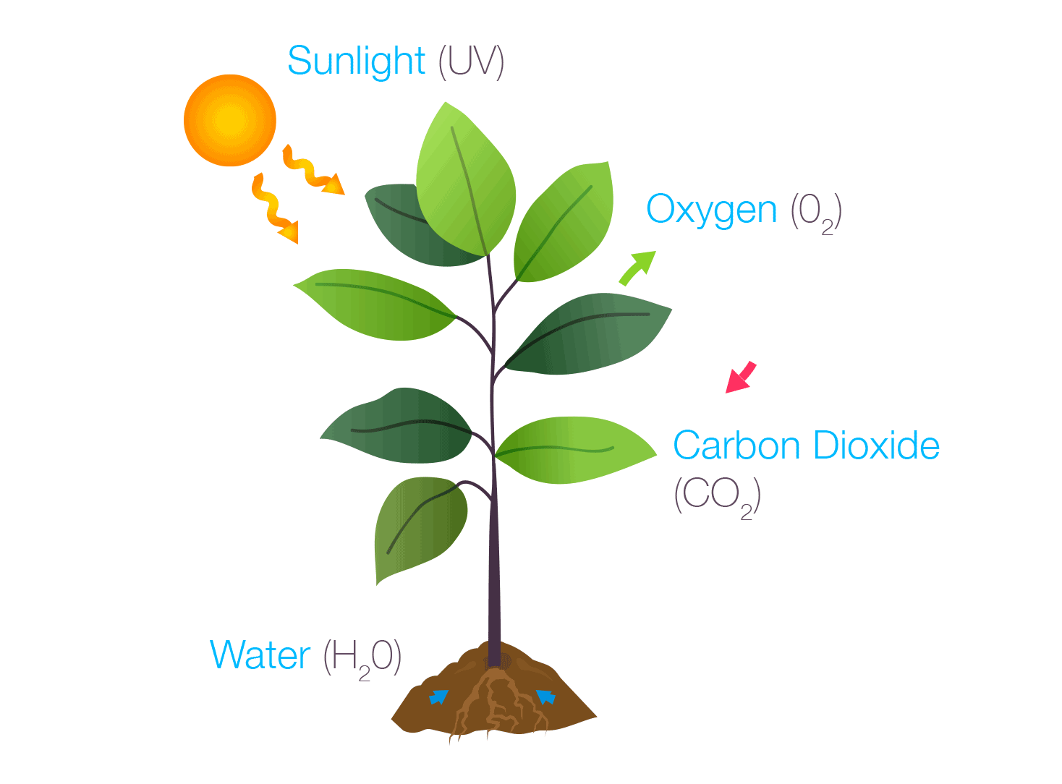
Photosynthesis and Respiration
The combination of photosynthesis and respiration helps to maintain the correct levels of carbon dioxide and oxygen in the air.

Slide 42

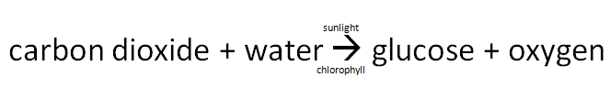
Photosynthesis
Photosynthesis is the process by which green plants make food in the presence of sunlight.
Photosynthesis occurs only during the day time under natural circumstances.

Slide 43

Respiration
Respiration is the release of energy from food in living cells. It is carried out by all living things.
glucose + oxygen → water + carbon dioxide + energy
Respiration occurs during the day and night however, naturally, only respiration would occur during the night time.

