Slide 1
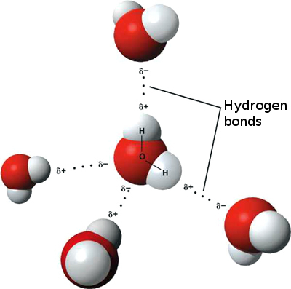

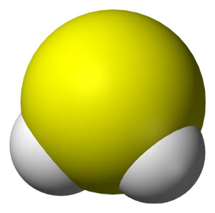

Moles and Molar Masses

Slide 2



The Atom
Atoms are the basic building blocks of matter.

Slide 3
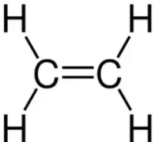
Chemical Formulae
Chemical formulae can be used to represent compounds formed by ionic or covalent bonding.
A chemical formula shows which elements are present in a compound and shows the ratio between the elements.
Chemical formulae can be written in three main ways:
a. Molecular formula C₂H₄
b. Structural formula
c. Empirical formula CH₂

Slide 4
Small Masses
The formula of a compound shows the number of atoms of each type present in one molecule or one formula unit.
For example:
a. H₂O is composed of 2 atoms of H & 1 atom of O
b. CO₂ is composed of 1 atom of carbon and 2 atoms of O
c. Al₂O₃ is composed of ____ atoms of Al and ____ atoms of O.

Slide 5
The mass of atoms
Because an atom of any element is so small, its absolute mass (actual mass) is very difficult to measure.
For example, the absolute mass of a hydrogen atom is 1.67 x 10⁻²⁴g.
Consequently, the masses of atoms are usually compared using relative atomic mass.
The relative atomic mass (A_{r}) is the average mass of on atom of an element compared to 1/12 the mass of an atom of carbon-12.

Slide 6
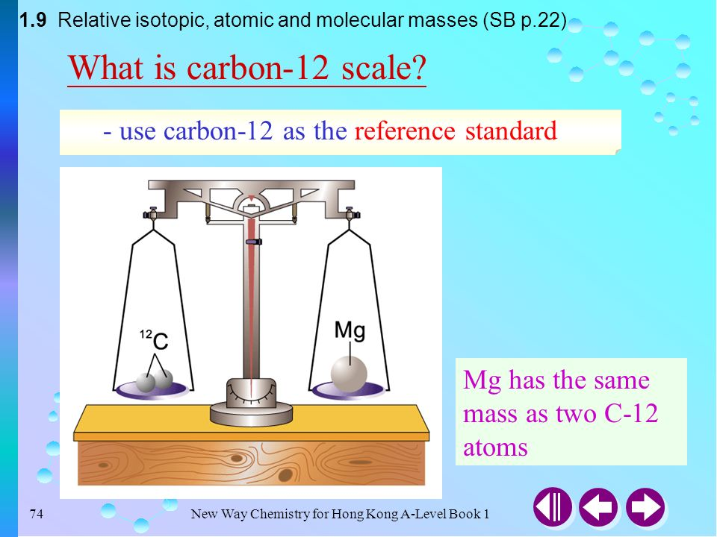
Relative Molecular Mass
Relative molecular mass is the relative mass of one molecule of a compound on a scale where an atom of the carbon – 12 isotope has a mass of exactly 12 units.

Slide 7
Relative Molecular Mass
The mass of an element may be found on the Periodic Table or by simply asking Google.
To find relative molecular masses the relative masses of all of the atoms in the molecule are determined then added.
CO₂ = (1 C × 12 g) + (2 O × 16 g)
= 12 g + 32 g
= 44 g

Slide 8
Relative Molecular Mass
Try the following:
a. CH₄ b. NaCl
c. NH₃ d. CaCO₃

Slide 9
Examples of Atoms, Ions, Formula Units and Molecules
Examples of Atoms: Cl, Ar, Na, Mg, Al
(These species are neutral and exist in their elemental form)
Examples of Ions: Cl⁻, Na⁺, Mg²⁺, Al³⁺
(These species carry charges/oxidation states)
Examples of Formula Units: NaCl, CaF₂, Al₂O₃
(These species contain Ionic bonds)
Examples of Molecules: CO₂, H₂, H₂O, CH₄
(These species contain covalent bonds)

Slide 10
The Mole & The Avogadro Constant
The mole is the basic quantity of chemistry.
Everything and anything compared in chemical equations are done so on a molar basis.

Slide 11
The Mole & The Avogadro Constant
A mole is equal to the relative mass (atomic, molecular or formula) in grams of an element or compound.
Where: 1 mole = molecular mass of element or substance
For example:
1 mole of Na = 23 g/mol OR 23 g mol⁻¹
1 mole of Cl = 35.5 g/mol OR 35.5 g mol⁻¹
1 mole of Cl₂ = ___ g/mol OR ___ g mol⁻¹
1 mole of MgCl₂ = ___ g/mol OR ___ g mol⁻¹

Slide 12
The Mole & The Avogadro Constant
A mole is the amount of substance that contains 6 × 10²³ of specified particles (atoms, molecules or ions) as there are atoms in exactly 12 g of the carbon – 12 isotope.
Where: 1 mole = 6 × 10²³ particles
The number is called Avogadro’s constant.

Slide 13
The Mole & The Avogadro Constant
Therefore the mass of 1 mole is different from element to element and from substance to substance.
For example:
1 mole of Na = 23 g 1 mole of O₂ = 32 g
However the amount of particles, molecules or ions a mole of element or substance may contain is constant: 6 × 10²³
For example:
1 mole of Na = 6 × 10²³ particles
1 mole of O₂ = 6 × 10²³ molecules

Slide 14
The Mole & The Avogadro Constant
The mass of an element depends on the mass of the atoms it is composed of.
A mole of any element contains 6 × 10²³ (atoms, ions, molecules or formula units).
For example:
1 single atom of Cu has a mass of 1.06 × 10⁻²² g
If 1 mole of any substance = Molecular Mass and
1 mol of any substance = contains 6 × 10²³ atoms
Then MM of Cu = 6 × 10²³ atoms
and 1.06 × 10⁻²² g of Cu = 1 atom
We could determine the mass of Cu = ___________ g.

Slide 15
The Mole & The Avogadro Constant
Let’s try these. Find the mass of 1 mole of the following given the mass of an atom particular for the element.
a. Carbon – 12 = 2.00 × 10⁻²³ g
b. Silver = 1.8 × 10⁻²² g
c. Oxygen = 2.66 × 10⁻²³ g

Slide 16
Avogadro’s Law
Avogadro’s law states that under the same conditions of temperature and pressure, equal volumes of all gases contain the same number of molecules.
Avogadro’s Law provides a simple method of determining the molar mass of a gas

Slide 17
Avogadro’s Law
At room temperature and pressure (r.t.p.):
1 mole of any gas would occupy = 24 000 cm³ of space
&
At standard temperature and pressure (s.t.p.)
1 mole of any gas would occupy = 22, 400 cm³ of space

Slide 18
Avogadro’s Law
Therefore:
1 mole of O₂ would occupy = 24, 000 cm³ of space at r.t.p.
1 mole of CO₂ would occupy = 24, 000 cm³ of space at r.t.p.
How many moles of H₂ would occupy 24, 000 cm³ of space at r.t.p.
How many moles of H₂ would occupy 12, 000 cm³ of space at r.t.p.

Slide 19
Standard Temperature and Pressure (S.T.P.)
&
Room Temperature and Pressure (R.T.P.)
We gather that then 1 mol of oxygen, O₂ gas:
a. Contains 6.022 × 10²³ O₂ molecules
b. Has a mass of 2 mol × 16 g mol⁻¹ = 32 g
c. Contains 2 mols of oxygen atoms
d. Occupies 22.4 dm³ of space at s.t.p.
e. Occupies 24.0 dm³ of space at r.t.p

Slide 20
Standard Temperature and Pressure (S.T.P.)
&
Room Temperature and Pressure (R.T.P.)
What volume is occupied by 8 g of hydrogen at s.t.p.?
How many molecules are present in 5.6 dm³ of carbon dioxide, CO₂, at r.t.p.?

Slide 21

Avogadro’s Law
Questions
The balanced equation gives the number of molecules of reactants and products involved in the reaction.
Using Avogadro’s Law, we can easily switch from “number of molecules” to “volumes”, thereby enabling us to predict the volumes, as shown in the following example.
For example in the following equation:
C₃H_{8(g)} + 5O_{2(g)} → 3CO_{2(g)} + 4H₂O_{(g)}
We can deduce that 1 molecule of C₃H₈ reacts with ____ molecules of O₂ to produce _______ molecules of CO₂ and 4 molecules of H₂O.
ALSO by Avogadro’s Law -
We can deduce that 1 volume of C₃H₈ reacts with _____ volumes of O₂ to produce ______ volumes of CO₂ and ______ volumes of H₂O .

Slide 22
Avogadro’s Law
Questions
Using the following equation:
C₃H_{8(g)} + 5O_{2(g)} → 3CO_{2(g)} + 4H₂O_{(g)}
What volume of oxygen is required for the complete combustion of 100 cm³ of propane, C₃H₈ and what volume of carbon dioxide, CO₂, is produced from the equation below?
All volumes are measured at the same temperature and pressure.
100 cm³ of C₃H₈ reacts with _____ cm³ of O₂ to produce ______ cm³ of CO₂ and ______ cm³ of H₂O
Please note:: AVOGADRO’s LAW, when predicting the volume of gaseous reactants and products from balanced equations, ONLY applies to gases!

Slide 23
Avogadro’s Law
Questions
On strong heating, 40 cm³ of ammonia, NH₃, gives 20 cm³ of nitrogen, N₂, and 60 cm³ of hydrogen, H₂.
(All volumes were measured at the same temperature and pressure.)
Deduce the equation for the decomposition of ammonia, NH₃, by heat.

Slide 24
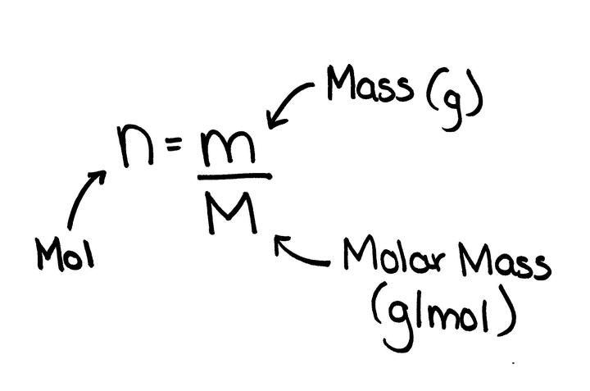
Relating Moles to Mass

Slide 25
Relating Moles to Mass
Using the formula
determine how many:
a. Moles are there in 10 g of Na.
b. Grams are there in 10 mols of Na.

Slide 26
Balancing Equations
The law of conservation of mass states that in a chemical reaction, the mass of the products is equal to the mass of the reactants.

Slide 27
Balancing Equations
In a chemical reaction bonds are broken in the reactants while bonds are reformed to make products.
A chemical reaction is represented as depicted below:
reactants → products

Slide 28
Balancing Equations
In a chemical reaction, the same type and amount of atoms that are on the reactants side will appear on the products side however they will be rearranged.
For example:
2NaBr_{(aq)} + Cl_{2(aq)} → 2NaCl_{(aq)} + Br_{2(aq)}
Na = 2 atoms Na = 2 atoms
Br = 2 atoms Br = 2 atoms
Cl = 2 atoms Cl = 2 atoms
*This equation is balanced since it has the same amount of each type of atom on the reactants side as well as the products side.

Slide 29
Balancing Equations
When you write equations it is important to be able to count up how many of each sort of atom you have.
In particular you must understand the difference between big numbers written in front of formulae such as the 2 in 2HCl and the smaller subscripted number written slightly lower on the line) numbers such as the 4 in CH₄.

Slide 30
Balancing Equations
What for example, is the difference between 2Cl and Cl₂?
The position of the 2 shows whether or not the atoms are joined together where 2Cl means 2 single chlorine atoms and Cl₂ means 2 chlorine atoms joined together.
If you had 2H₂SO₄ you would then have two hydrogen sulphate atoms all together amassing 4 hydrogen atoms, 2 sulphur atoms and 8 oxygen atoms where 2 would simply be used to multiply out all of the subscripts of their respective atoms.

Slide 31
Balancing Equations
In every balanced equation, state symbols are used to indicate the state of the reactants and the products being used.
State symbols:
(s) = solid (g) = gas
(l) = liquid (aq) = aqueous

Slide 32
Balancing Equations
When the equations are given they are balanced by writing a number in front of particular reactants or products.
Let us try to balance the following equations:
Zn_{(s)} + HCl_{(aq)} → ZnCl_{2(aq)} + H_{2(g)}
AgNO_{3(aq)} + CaCl_{2(aq)} → Ca(NO₃)_{2(aq)} + AgCl_{(aq)}
C₂H_{6(g)} + O_{2(g)} → CO_{2(g)} + H₂O_{(g)}

Slide 33
Balance the following equations:
Al_{(s)} + Cr₂O_{3(s)} → Al₂O_{3(s)} + Cr_{(s)}
Mg_{(s)} + O_{2(g)} → MgO_{(s)}
Fe_{(s)} + HCl_{(aq)} → FeCl_{2(aq)} + H_{2(g)}
AgNO_{3(aq)} + MgCl_{2(aq)} → Mg(NO₃)_{2(aq)} + AgCl_{(aq)}
Fe₂O_{3(s)} + C_{(s)} → Fe_{(s)} + CO_{(g)}
Now try these
on your own ☺

Slide 34
Rewrite the following equations as balanced symbol equations:
sodium + water → sodium hydroxide + hydrogen (H₂)
magnesium + copper(II) oxide → magnesium oxide + copper
iron + chlorine (Cl₂) → iron(III) chloride
copper(II) oxide + hydrochloric acid → copper(II) chloride + water
Now try these
on your own ☺

Slide 35
Ionic Equations
When ionic compounds dissolve in water, the ions separate.
An ionic equation is a symbol equation that shows ONLY those ions that take part in a reaction.
The ions that DO NOT take part are called spectator ions.

Slide 36
Charges on some ions
Positive ions |  |  | Negative ions
Charge | Name of ion | Formula | Charge | Name of ion | Formula
1+ | ammonium copper(I) hydrogen lithium potassium silver sodium | NH₄⁺ Cu⁺ H⁺ Li⁺ K⁺ Ag⁺ Na⁺ | 1- | bromide chloride hydroxide fluoride iodide nitrate | Br⁻ Cl⁻ OH⁻ F⁻ I⁻ NO₃⁻
2+ | barium calcium copper(II) iron(II) lead(II) magnesium nickel(II) strontium zinc | Ba²⁺ Ca²⁺ Cu²⁺ Fe²⁺ Pb²⁺ Mg²⁺ Ni²⁺ Sr²⁺ Zn²⁺ | 2- | carbonate oxide sulphate sulphide | CO₃²⁻ O²⁻ SO₄²⁻ S²⁻
3+ | aluminum iron(III) | Al³⁺ Fe³⁺ | 3- | Nitride phosphate | N³⁻ PO₄³⁻
Before attempting to balance ionic equations you need
to learn the types and names of the ions.

Slide 37
Guidelines for Balancing Ionic Equations
1. Complete and balance the equation in the form in which it is given. If it is given in the molecular form, complete it in the molecular form, balance it, and then change it to the ionic form once it is an ionic formula unit example MgO and NaCl.
Ionic formula units are representations of bonds formed between a metal and a non-metal. Additionally, you must remember that you must NOT represent molecular species as ions. For example NaCl is an ionic formula unit written as Na⁺ and Cl⁻ in ionic equations whereas H₂O and H₂S are molecular species and are therefore NOT ionic and can NOT be broken apart into ions.
Within ionic equations molecular compounds REMAIN unchanged / not broken up into ionic components because it is NOT ionic. Such molecular compounds are:
a. non-electrolytes such as glucose
b. weak electrolytes, such as ethanoic acid, ammonia solution, water
c. solids and precipitates formed by mixing aqueous solutions of ionic compounds such as AgCl_{(s)}, CaCO_{3(s)}, which most often exist as ions, but are only sparingly soluble in water so the ions in them can be considered as no longer available
d. gases such as H_{2(g)}, N_{2(g)}, CO_{2(g)}
e. metals

Slide 38
Guidelines for Balancing Ionic Equations
2. Write all strong electrolytes in the ionic form: for example sodium chloride Na⁺ Cl⁻_{(s)} or as Na⁺_{(aq)} + Cl⁻_{(aq)} when in water
3. Ensure that there are the same number of each ion (monoatomic, eg. Na⁺ or Mg²⁺, or polyatomic, eg. CO₃²⁻, OH⁻) and of each atom, on both sides of the equation.
a. The net ionic equation should show only those ions that have undergone a chemical change.
Those ions appearing on both sides of the equation are merely 'spectator ions' and should not be included in the net ionic equation.
b. The net charges must be equal on both sides of the equation.

Slide 39
Ionic Equations
Let’s try to determine the ionic equation of the following equation:
1. AgNO_{3(aq)} + KBr_{(aq)} → AgBr_{(s)} + KNO_{3(aq)}
2. Zn_{(s)} + HCl_{(aq)} → ZnCl_{2(aq)} + H_{2(g)}

Slide 40
Ionic Equations
Let’s try to determine the ionic equation of the following equation:
3. AgNO_{3(aq)} + CaCl_{2(aq)} → Ca(NO₃)_{2(aq)} + AgCl_{(aq)}
4. MgCO_{3(s)} + H₂SO_{4(aq)} → MgSO_{4(aq)} + CO_{2(g)} + H₂O_{(l)}

Slide 41
Naming Compounds
Do not confuse endings like sulphate and sulphide.
A name like copper(II) sulphide means that it contains copper and sulphur ONLY.
Any ‘ate’ ending means that there is something else, usually oxygen. For example, copper sulphate contains copper, sulphur and oxygen.

Slide 42
Naming Compounds
AgNO₃ - silver nitrate Cu(OH)₂ -
PbCl₂ - SO₂ -
CaCO₃ - CuCl₂ -
MgS - Pb(NO₃)₂ -
AlCl₃ -
CaO -
CaSO₄ -
Mg₃N₂ -

Slide 43

Equilibrium Reactions
For equilibrium reactions a pair of arrows are used one on top of the other going in opposite directions of each other as demonstrated below::
The arrow travelling right represents the forward reaction and the other going in the opposite direction represents the backwards reaction.

Slide 44
Equilibrium Reactions
Above these arrows the conditions are usually placed.
The following equation below is an example of an equilibrium reaction where ammonia reacts with pure air to produce nitrogen gas and steam or water vapour in the presence of a platinum catalyst at 600ºC and 10 atm pressure.
4NH_{3(g)} + 5O_{2(g)} 4NO_{(g)} + 6H₂O_{(g)}
Pt; 600ºC; 10atm

Slide 45
Equilibrium Reactions
While the chemical equation tells us that products are formed from a given set of reactants, and it also gives quantitative information about the reaction there are some limitations.

Slide 46
Equilibrium Reactions
Some limitations of a chemical equation are:
a. They can not show how long a reaction may take place; spontaneously, days, weeks, months or even years.
b. Some reactions never go to completion. They are said to be in equilibrium. Equations can not detect when equilibrium has been approached.
c. Some equations can not display whether a reaction will happen or not even if it were balanced. For example
Cu_{(s)} + 2HCl_{(aq)} → CuCl_{2(aq)} + H_{2(g)}
Copper is unable to displace hyrogen because it is below hydrogen in the reactivity series.

Slide 47
Empirical Formula
Empirical formulas are probably going to be the easiest things you’ll be computing in your chemistry career.
An empirical formula is defined as the simplest whole number ratio of atoms or ions in a compound.
Whereas, the actual number of atoms or ions in one molecule or one formula unit of a compound is call the molecular formula of the compound. We did some of that earlier.

Slide 48
Empirical Formula
The usual steps for computing the empirical formula of a molecule or one formula unit of a compound is as follows:
1. Convert the given mass of whatever elements are present with its compound to moles first.
Example:
Mass of Copper = 5.08 g and Mass of Oxygen = 0.62 g in a copper oxide compound.
Convert these masses to moles by dividing them by their molecular weights:
Copper = 5.08 g ÷ ______ g/mol = ________
Oxygen = 0.62 g ÷ _______ g/mol = __________

Slide 49
Empirical Formula
2. Note which ever element within the compound gives the lowest amount of moles.
Which one gave the lowest amount of moles above? Copper or Oxygen? ________________

Slide 50
Empirical Formula
3. Use the lowest value of moles you obtained on the previous page to divide all other answers by.
Example:
Number of moles of copper obtained from above _______ ÷ lowest amount of moles ________
Number of moles of oxygen you obtained from above _______ ÷ lowest amount of moles ________
Empirical formula of the copper oxide compound is:: Cu__O__ = ___________

Slide 51

Empirical Formula
Try the following:
Determine the empirical formula of a chloride of aluminum which contains 54 g of aluminum and 213 g of chlorine. GO!

Slide 52

Percentage Composition by Mass
If you know the molecular formula of a compound, it is a simple exercise to express the percentage by mass of each element in the compound.
This is known as the percentage composition by mass, and is calculated like any other percentage:
% by mass of a particular element in a compound = (totalmass of the particular element ÷ mass of the compound) × 100

Slide 53
Percentage Composition by Mass
The percentage composition by mass of the elements in water, H₂O, can be calculated as follows:
% of hydrogen in water = ( (molar mass of hydrogen, 1 g mol⁻¹ × 2 atoms of hydrogen present in the water molecule H₂O) ÷ 18 g mol⁻¹, the molar mass of water) × 100 = ___________
% of oxygen in water = ______________________________
What is the percentage composition by mass of copper and hydrogen in the hydrated salt copper(II) sulphate-5-water, CuSO₄.5H₂O?
% of copper in the hydrated salt =
% of hydrogen in hydrated salt =

Slide 54
Percentage Composition by Mass
The empirical formula of a compound can be readily found from its percentage composition by mass by following these steps:
1. Convert the percentage composition to an actual mass by simply dropping the percentage sign.
For example:
63.6% of N and 36.4% of O contains, 63.6 g of N and 34.6 g of O in 100 g of the compound.
2. Convert the mass to moles. How would you do that?
3. Find the whole number of ratio of the moles of different atoms by dividing each number by the smallest number.
Empirical formula? __________________

Slide 55
Percentage Composition by Mass
Now try these questions on your own:
Bauxite contains an oxide of aluminium having 52.9% Al and 47.1% O by mass. What is the empirical formula of this oxide?
The hydrocarbon benzene contains 92.3% by mass of carbon, the remainder being hydrogen. The mass of 1 mol of benzene is 78 g. What are the empirical and molecular formulae of this compound?

Slide 56



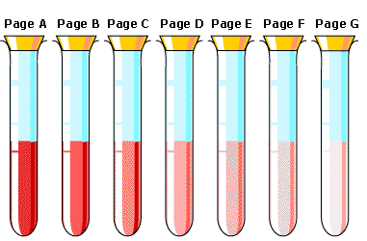
The Importance of Concentration & the Mole
Which one do you think is most concentrated?

Slide 57
Molar Concentration
&
Mass Concentration
The amount of solute dissolved in a given quantity of solution is known as its concentration.
There are two broad categories by which concentration may be expressed:
a. Molar concentration, mol/dm³ OR moldm⁻³
b. Mass concentration, g/dm³ OR g/dm⁻³

Slide 58
Molar Concentration
&
Mass Concentration
Molar concentration =
number of mols of solute (mol) ÷ volume of solvent (dm³)
Mass concentration =
actual mass of solute (g) ÷ volume of solvent (dm³)
Please note – If volume is in cm³ you must divide by 1000 cm³ and multiply by 1 dm³ to get your volume in dm³.

Slide 59
Molar Concentration Questions
Let’s try some examples:
Find the concentration in mol/dm³ of:
a. A solution containing 0.015 mol HCl in 25 cm³ of solution
b. A solution containing 4.0 mol HCl in 5 dm³ of solution
c. A solution containing 0.05 mol HCl in 500 cm³ of solution
Let’s remember that if volume is given in cm³ it must be converted into dm³ since the units for concentration are, mol/dm³ which may be also seen as mol dm⁻³.
1 dm³ = 1000 cm³

Slide 60

Mass Concentration Questions
Find the mass concentration of the following solutions:
a. Sodium carbonate: 25 cm³ of the solution containing 0.05 g Na₂CO₃
b. Potassium hydroxide: 5 dm³ of the solution containing 200 g KOH

Slide 61
Mass Concentration Questions
Find the mass of each solute present in the following volumes of solutions:
a. 45 cm³ of solution of sodium chloride of mass concentration 5.0 g/dm³
b. 2400 cm³ of a solution of hydrochloric acid of mass concentration 450 g/dm³

Slide 62
It’s BRAIN TIME! Let’s try a few examples:
a. What is the concentration in mol/dm³ of a solution of nitric acid containing 2.52 g/dm³ of HNO₃?
b. Find the mass of 1 mol potassium manganate(VII), given that the concentration of its solution is 0.02 mol/dm³, and the mass concentration of this solution is 3.16 g/dm³.
c. 250 cm³ of a solution of sodium chloride contains 11.70 g NaCl. Find the concentration in mol/dm³ of this solution. What do you have to do first judging from the expected units of concentration above?

Slide 63
It’s BRAIN TIME! Let’s try a few examples:
a. What is the concentration in mol/dm³ of a solution of nitric acid containing 2.52 g/dm³ of HNO₃?

Slide 64
It’s BRAIN TIME! Let’s try a few examples:
b. Find the mass of 1 mol potassium manganate(VII), given that the concentration of its solution is 0.02 mol/dm³, and the mass concentration of this solution is 3.16 g/dm³.

Slide 65
It’s BRAIN TIME! Let’s try a few examples:
c. 250 cm³ of a solution of sodium chloride contains 11.70 g NaCl. Find the concentration in mol/dm³ of this solution. What do you have to do first judging from the expected units of concentration above?

Slide 66
It’s BRAIN TIME! Let’s try a few examples:
d. What is the mass concentration in g/dm³ of a solution of 0.2 mol/dm³ potassium nitrate, KNO₃? MW of KNO₃ = 101
e. A solution of FeSO₄.xH₂O has a concentration of 0.22 mol/dm³ and a mass concentration of 61.16 g/dm³. Find the value of x in the formula, FeSO₄.xH₂O.
f. Given a solution of MCl₂ of concentration 0.025 mol/dm³ and mass concentration 2.375 g/dm³, find the relative atomic mass of M.

Slide 67
It’s BRAIN TIME! Let’s try a few examples:
d. What is the mass concentration in g/dm³ of a solution of 0.2 mol/dm³ potassium nitrate, KNO₃? MW of KNO₃ = 101

Slide 68
It’s BRAIN TIME! Let’s try a few examples:
e. A solution of FeSO₄.xH₂O has a concentration of 0.22 mol/dm³ and a mass concentration of 61.16 g/dm³. Find the value of x in the formula, FeSO₄.xH₂O.

Slide 69
It’s BRAIN TIME! Let’s try a few examples:
f. Given a solution of MCl₂ of concentration 0.025 mol/dm³ and mass concentration 2.375 g/dm³, find the relative atomic mass of M.

Slide 70
Dilution Equations
Concentration₁ × Volume₁ = Concentration₂ × Volume₂
OR
C₁V₁ = C₂V₂
Sometimes books would use the word molarity instead of concentration which practically means the same thing. In this case the notation of M instead of C would be used within the dilution equation.
For example :: M₁V₁ = M₂V₂

Slide 71

Dilution Questions
How can you prepare 2.0 dm³ of a 0.1 mol/dm³ solution of NaOH starting with a 5.0 mol/dm³ solution of NaOH?
C₁ = _______ V₁ = ________
C₂ = _______ V₂ = ________
Now fill out the equation:
C₁ × V₁ = C₂ × V₂
_______ _________ = _________ _________
Cross multiply and VOILA!!!! Answer = _______cm³
Please note that in dilution equations you do NOT have to convert volume into dm³ while calculating unless the question asks you to do so.

Slide 72
Dilution Questions
What volume of 11.80 mol/dm³ HCl_{(aq)} is needed to make 1 dm3 of 0.5 mol/dm³ of aqueous HCl_{(aq)}?
a. Circle and list what you have
C₁: ________, C₂: _________, V₁: ________, V₂: ________.
b. What type of question is this? ______________________
c. Calculate in dm³ the volume needed.
___________________________________________________________
d. If 1000 cm³ = 1dm³ what is the volume in cm³?
_______________________________________________ cm³

Slide 73
Before you go, here is a List of Mole Relationships
1 mole of an element, molecule, formula unit or compound =
a. 6.022 × 10²³ atoms, units, particles, molecules, electrons
b. molecular mass
c. number of electrons × 96 500 C
1 mole of any gas occupies =
a. 22.4 dm³ of space at standard temperature and pressure, s.t.p.
b. 24.0 dm³ of space at room temperature and pressure, r.t.p.

Slide 74
A List of Mole Relationships
Number of moles =
a. actual mass (g) ÷ molecular mass (g/mol)
b. concentration (mol/dm³) × volume (dm³)
c. concentration (g/dm³) × volume (dm³)

