Slide 1
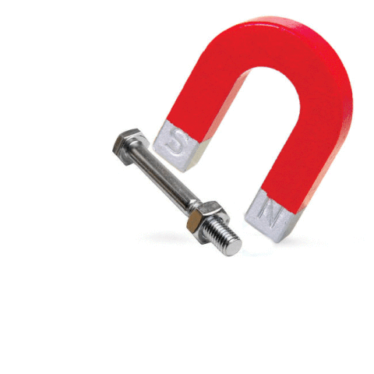
Magnetic Energy

Slide 2
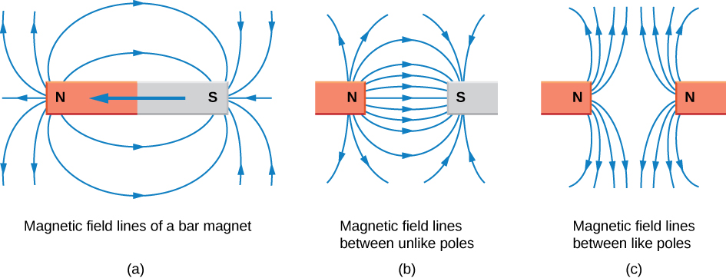
Magnetism
Magnetism is the force that attracts certain materials such as iron, nickel and cobalt.
A magnetic field is the space around a magnet where its magnetic effects can be felt.

Slide 3
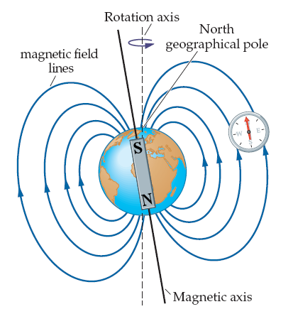
Earth as a Magnet
The Earth is a large but weak magnet.
If a bar magnet is freely suspended it aligns itself in the direction of the Earth’s magnetic field.

Slide 4
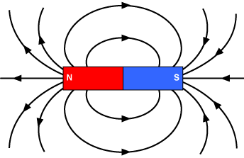
Magnetic Poles
The poles on a magnet are the areas where its magnetic strength is strongest.
A magnet is dipolar which means that it has two poles.

Slide 5
Laws of Magnetism
The laws of magnetism are: 1. Like poles repel 2. Unlike poles attract

Slide 6
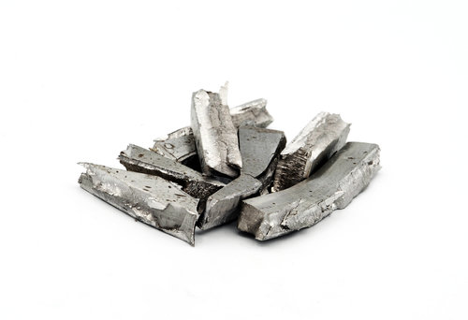
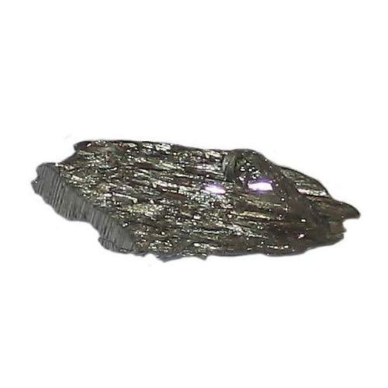
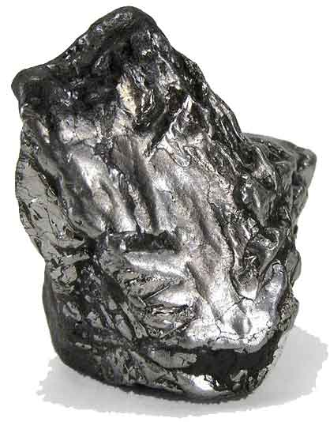
Magnetic Materials
A magnetic material is a material which is attracted to a magnet or which can be magnetized.
Cobalt
Nickel
Iron

Slide 7
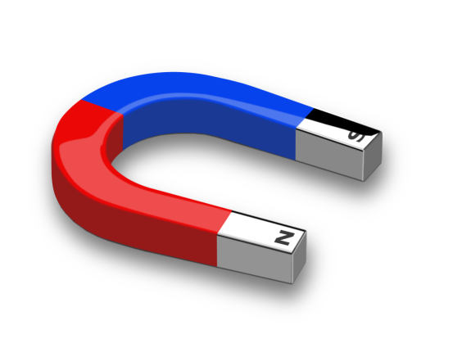
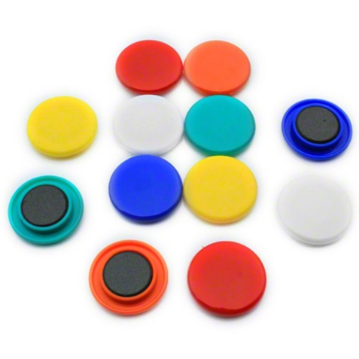
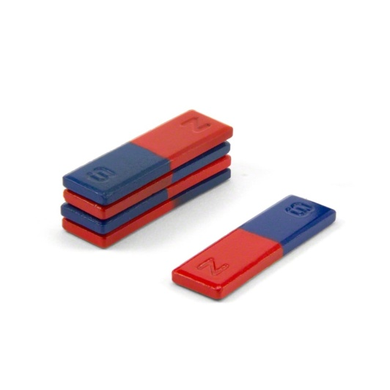
Magnetic Materials
Nickel, Iron and Cobalt are the ONLY naturally occurring magnetic materials.
Other magnetic materials are alloys such as steel which is a mixture of iron and carbon.
Magnets come in a variety of shapes and sizes: bar, horse shoe, U shaped and ringed.

Slide 8
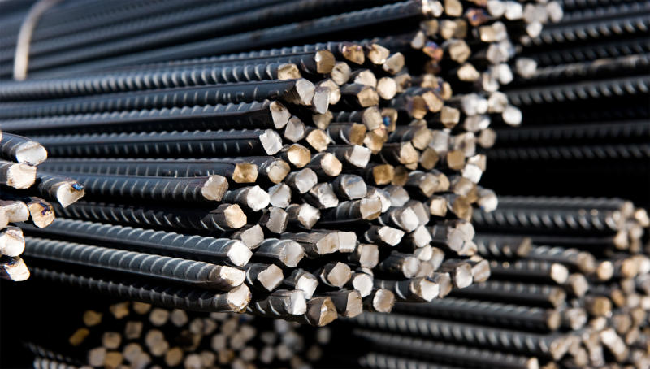
Types of Magnets
There are two types of magnets:
Permanent and Temporary
Steel is a permanent magnet
Iron is a temporary magnet

Slide 9
Comparing Permanent and Temporary Magnets
Permanent Magnets | Temporary Magnets
A permanent magnet will remain magnetized even after the cause of magnetizing is discontinued | A temporary magnet loses its magnetic properties when the cause of magnetizing is discontinued
Its strength is constant | Its strength is varied
Steel is used to make permanent magnets | Iron is used to make temporary magnets
Clasps for jewelry, compasses, credit cards (the black metallic strip at the back), doors of refrigerators and dishwashers, ornamental articles attachable to refrigerators etc. | Cranes, electric guitars, door bells, microphones, generators, in industry to lift iron and steel road and sheets, motors, loud speakers, medicine for MRI (magnetic resonance imaging), telephones, television and computer monitors,

Slide 10
Induction of Magnetism
Magnetism may be induced in some metals by a process called induction.
Magnetic induction is the process by which magnetic properties are transferred from one body to another without physical contact.

Slide 11
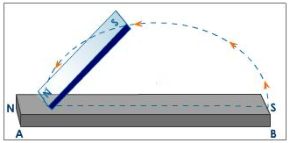
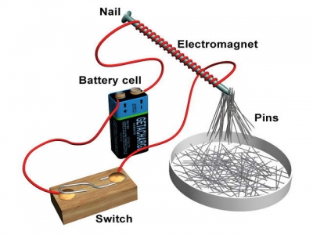
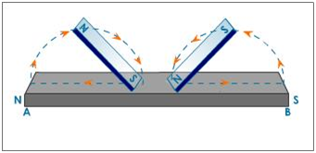
Induction of Magnetism
Induction may involve stroking or the application of a current to a metal.
Single Stroking
Application of Current
Double Stroking

Slide 12
Induction of Magnetism
Magnets contain domains/dipoles.
In magnetized metals the domains/dipoles are aligned.

Slide 13
Induction of Magnetism
In metals that are un-magnetized the tiny magnets referred to as domains/dipoles are NOT aligned.

Slide 14
Induction of Magnetism
Inducing magnetism in un-magnetized metals causes the domains to align making the metal become magnetic.

Slide 15
Electromagnet
An electromagnet is made by passing an electric current through a coil of wire.

Slide 16
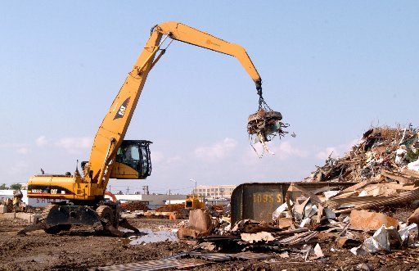
Electromagnets
The strength of an electromagnet is increased by: a. Increasing the amount of current being passed through the coil b. Increasing the number of turns of the coil around it and by c. Using a magnetic core inside of the coil

