Slide 1
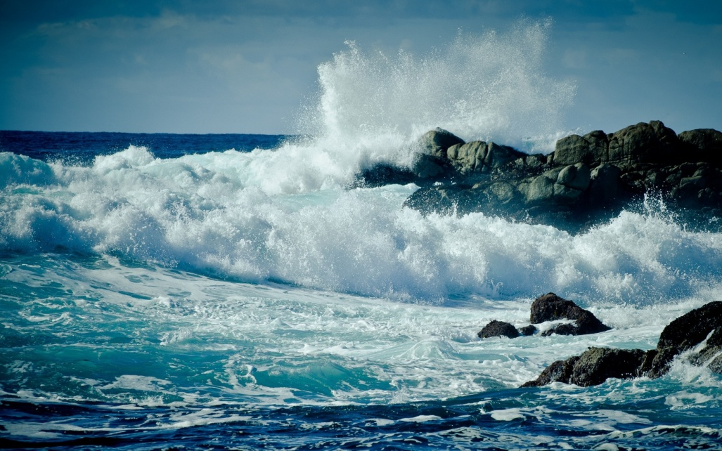
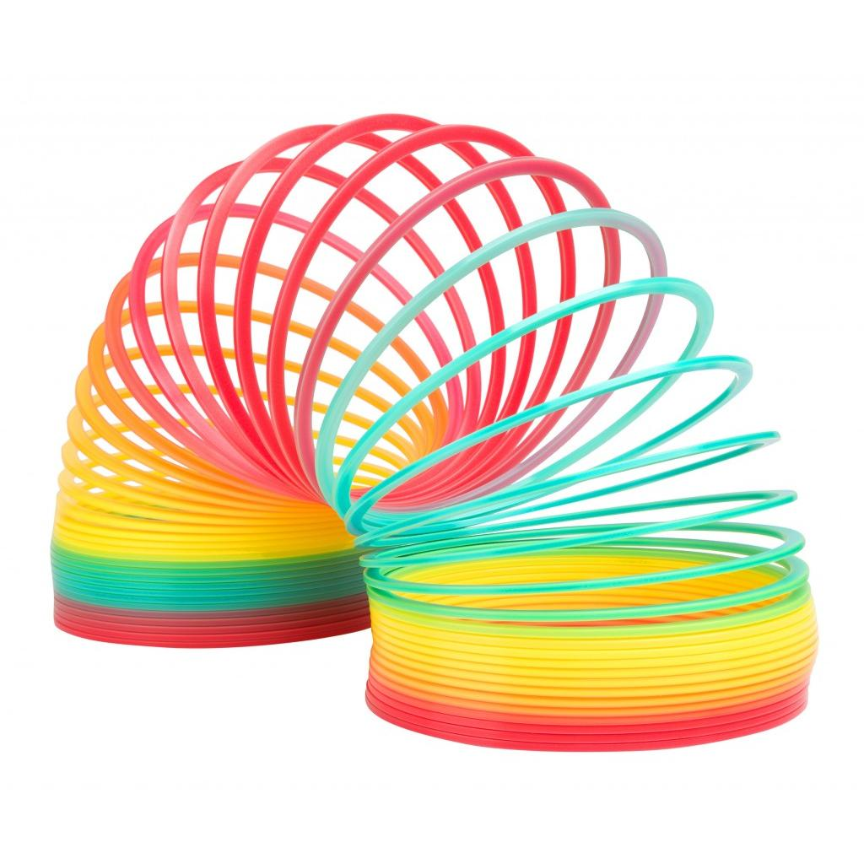
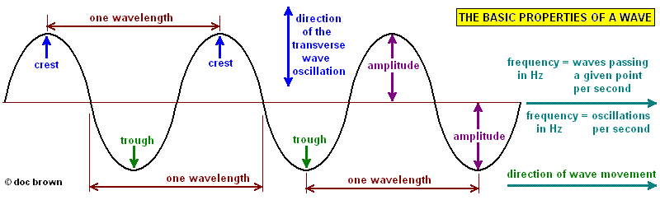
Waves

Slide 2
Types of Waves
A pulse is a single disturbance that propagates from one point to a next.
Waves can be classified as being either transverse or longitudinal.

Slide 3
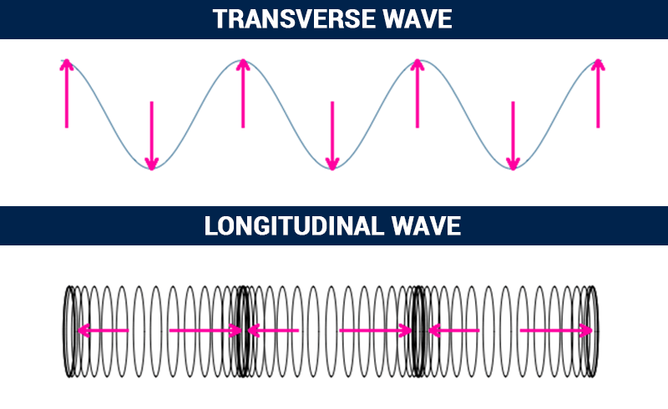
Types of Waves
A transverse wave has vibrations perpendicular to its direction of propagation.
A longitudinal wave is one that has vibrations parallel to its direction of propagation.

Slide 4

Examples of Transverse Waves
A wave produced in a rope or slinky lying on a horizontal surface and vibrated from one end, perpendicularly to its length.

Slide 5
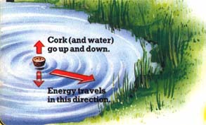
Examples of Transverse Waves
The wave produced in water by an object vibrated perpendicularly into and out of its surface.

Slide 6
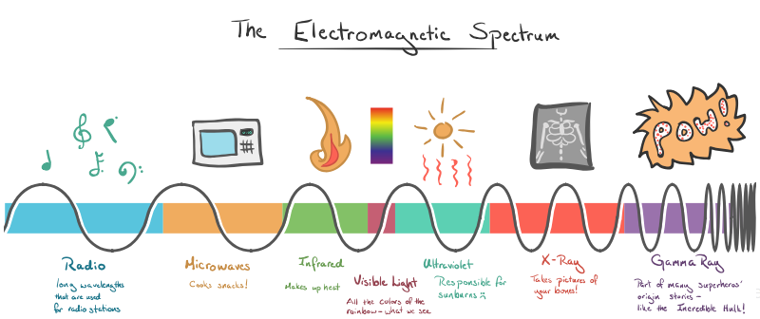
Examples of Transverse Waves
An electromagnetic wave, for example light.

Slide 7
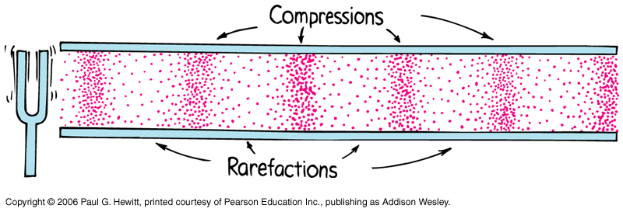
Examples of Longitudinal Waves
Longitudinal waves are characterized by regions of high pressure (compressions) and regions of low pressure (rarefactions).

Slide 8
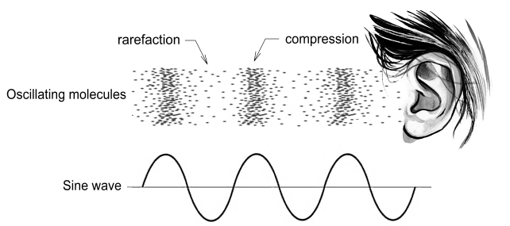
Examples of Longitudinal Waves
A sound wave produced in a solid, liquid or gas.

Slide 9
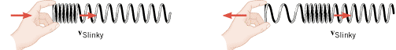
Examples of Longitudinal Waves
The wave produced in a slinky lying straight on a horizontal surface and vibrated parallel to its length from one end.

Slide 10
Progressive and Stationary Waves
Waves may be classified as either being progressive or stationary.
Progressive waves are those that transfer energy from one point to the next.
Stationary waves do not transfer energy.

Slide 11
Wave Parameters or
Things associated with a wave
Amplitude, a
Wavelength, λ
Period, T
Frequency, f
Speed, v
Wavefront
Phase

Slide 12
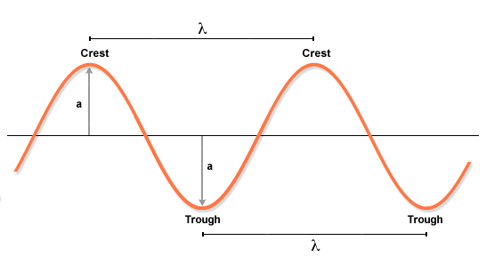
Wave Parameters
Amplitude
The amplitude of a wave is the maximum displacement of the vibration or oscillation from its mean position.

Slide 13
Wave Parameters
Amplitude
If the amplitude of a light increases, the light becomes brighter.
If the amplitude of a sound wave increases, the sound becomes ___________.

Slide 14
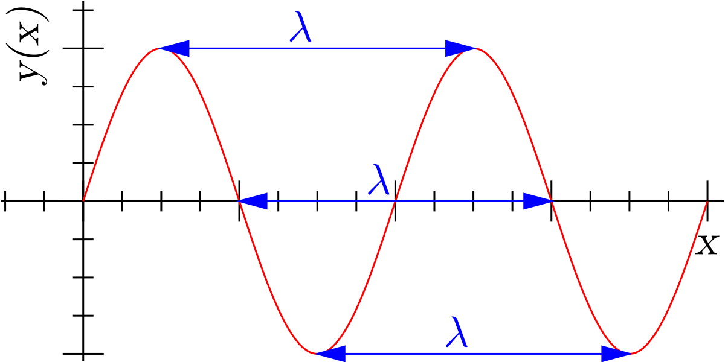
Wave Parameters
Wavelength
Wavelength is represented by the Greek letter, λ, pronounced as lambda.
It is the distance
between successive
points in phase in a
wave. For example
between two
successive crests
or two successive
throughs.

Slide 15
Wave Parameters
Period
The wave period is the time it takes for one complete vibration to occur.
For example the time it takes two successive crests, two successive troughs OR a successive crest and trough to pass.
T = 1/f
Where T must be in seconds, s for f to be in hertz, Hz.

Slide 16
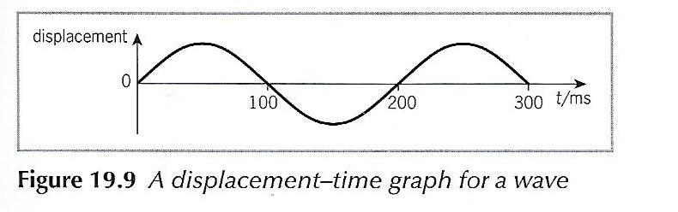
Wave Parameters
Period
In the figure below the period is
200 ms = 0.2 s

Slide 17
Wave Parameters
Frequency
Frequency utilises the symbol, ʄ.
The wave frequency is the number of complete vibrations per second.
The frequency of a wave is also the number of crests passing a chosen point per second.
Frequency, f = 1/T

Slide 18
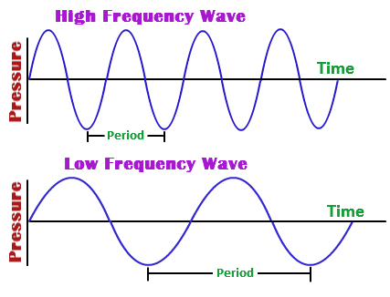
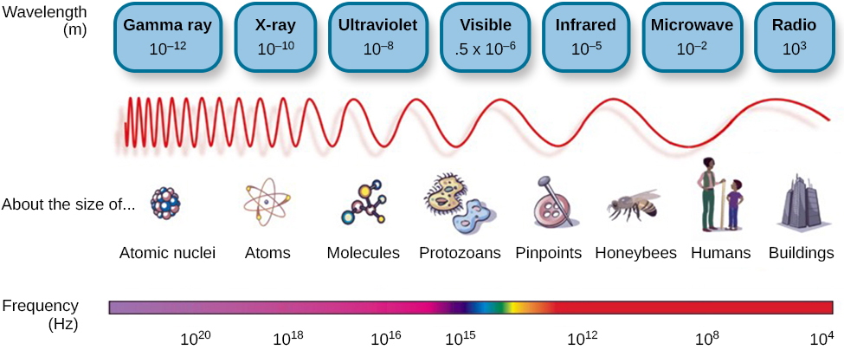
Wave Parameters
Frequency

Slide 19
Wave Parameters
Frequency
Looking at the picture below a successive crest and a successive trough (a complete vibration) passed in a time of 200 ms.
200 ms, which is equivalent to 0.2 s, is the wave’s period, T or the time it took for the wave to pass or vibrate.
To determine the wave’s frequency the following equation: f = 1/T may be used.
Hence f = 1/0.2 s = 5 1/s = 5 s⁻¹ = 5 Hz since 1/s = 1 Hz

Slide 20

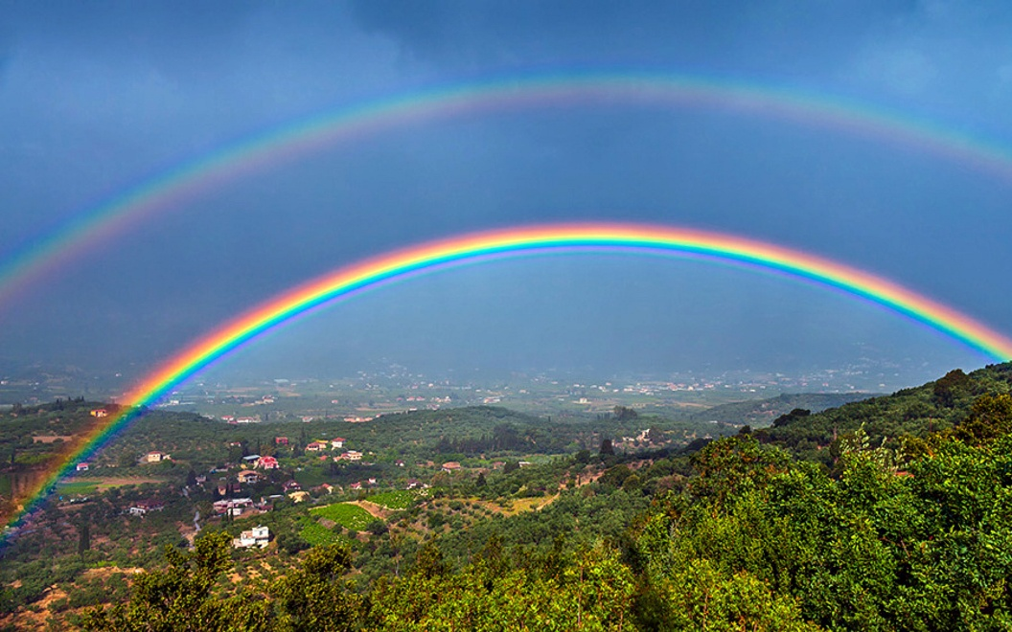
Wave Parameters
Frequency
The frequency of a light wave determines its colour.
Red has the lowest
frequency and violet
has the highest
frequency of the
visible spectrum.

Slide 21
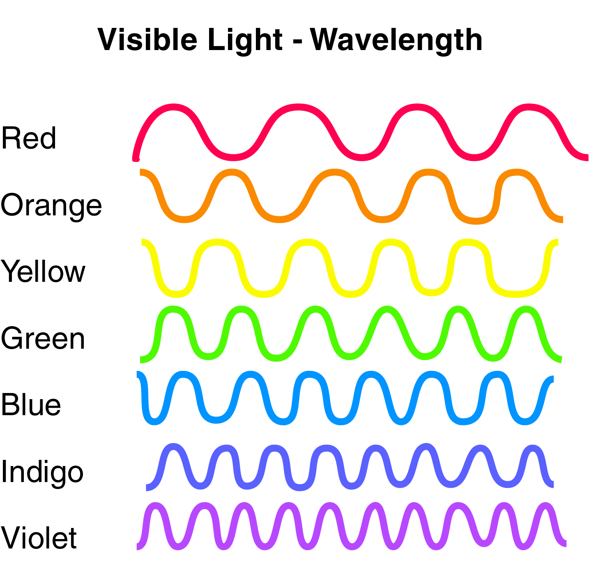
Wave Parameters
Frequency

Slide 22
Wave Parameters
Frequency
The frequency of a sound wave determines its pitch.
A bass note has a low frequency and a treble note has a high frequency.

Slide 23
Wave Parameters
Speed
This is the rate at which wave-fronts of a wave propagate, and it depends on the medium of propagation.
At a boundary between media the speed changes and the wave undergoes refraction.
When a wave refracts it bends.

Slide 24
Wave Parameters
Speed
The speed of sound is greater through gases of lesser density. Molecules of lesser mass respond more readily to vibrations than those of greater mass.
Sound therefore travels faster through air than through carbon dioxide.
Comparing the behaviour of light and sound
Light | Sound
Speed of light in a vacuum is 3 × 10⁸ m/s | Speed of sound in air at 0ºC is 330 m/s
Travels through a vacuum | Does NOT travel through a vacuum
Speed of light travels greater in a media of lesser density for example light travels slower in water or glass | The speed of sound is greatest through solids, less in liquids and least in gases*

Slide 25
Wave Parameters
Speed
Sounds travel faster in solids because of the closer packing of the particles and the rigidity of the bonds in a solid which allows vibrations to transfer more readily.
Sound also travels faster through gases at higher temperatures because the increased kinetic energy allows the vibrations to be passed on more readily.

Slide 26
Wave Parameters
Speed
 | Steel | Water | Air at 0ºC
Speed (m/s) | 5100 | 1500 | 330
1. What are the units of speed? __________________
2. In which medium does sound travel the fastest? ______________________
3. Why does sound travel the fastest as per your answer given above? ____________

Slide 27
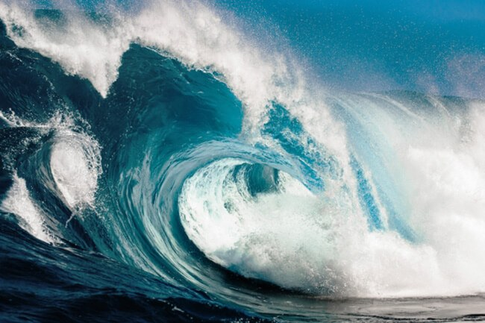
Wave Parameters
Speed
The speed of a water wave is greater across a deeper region.

Slide 28
Wave Parameters
Wave-fronts
A wave-front is a line perpendicular to the propagation to a wave on which all points are in phase.
Wave-fronts are generally taken through crests of transverse waves and through compressions of longitudinal waves.

Slide 29
Wave Parameters
Phase
Points in a progressive wave are in phase if the distance between them along the direction of propagation is equal to a whole number of wavelengths.
When points are in phase in a progressive wave they have the same displacement, direction and speed in their vibrations.

Slide 30
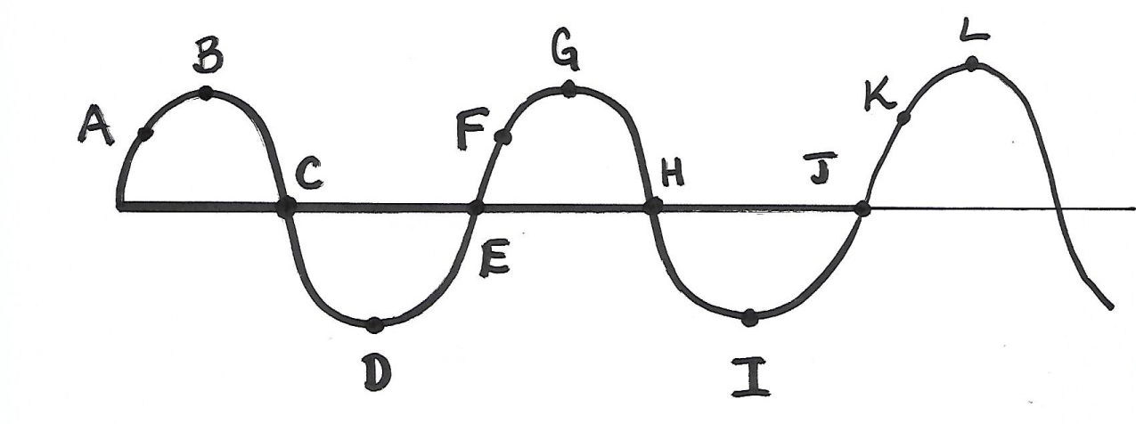
Wave Parameters
Phase
Looking at the graph points A and F are in phase and so are points E and J.
1. What other points are in phase?
2. Which points are out of phase?

Slide 31
General Wave Equations
The speed of a wave may be determined using the following equation:
v = λf
where v means speed of a wave in m/s, λ means wavelength of a wave in m and f means frequency of a wave in 1/s.
Likewise:
λ = v/f & f = v/ λ

Slide 32
General Wave Equations
The speed of a wave may also be determined using the following equation:
v = λ/T
since f = 1/T where T means period of a wave in s.
Likewise:
T = λ/v & λ = v × T

Slide 33
General Wave Equations
v₁/v₂ = λ₁/λ₂ = sinθ₁/sinθ₂ = η₂/η₁
where η represents the refractive index of a medium and θ₁ represents the angle of incidence while θ₂ represents the angle of refraction.

Slide 34
General Notes About Wave Behaviour
When a wave moves into a new medium its speed, wavelength and sin θ also doubles. However the actual θ will NOT double but it will get bigger.
If the speed of the wave doubles, v, then its wavelength will double and so will the sin θ.

Slide 35
General Notes About Wave Behaviour
The period and frequency of the wave does NOT change when a wave passes from one medium to the next.

Slide 36


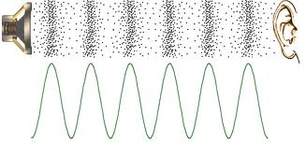
Sound waves

Slide 37

Production and Propagation of Sound Waves
Sound cannot travel/propagate through a vacuum like light can.
Sound waves can only travel through a material medium such as air to travel. Why ?
They are produced by mechanical
vibrations.

Slide 38

Longitudinal Waves
Sound travels as a wave referred to as progressive longitudinal.
Sound gives interference and diffraction effects and is often believed to be a form of energy because of that.
A longitudinal wave can
be sent along a spring.
How can this be done?

Slide 39
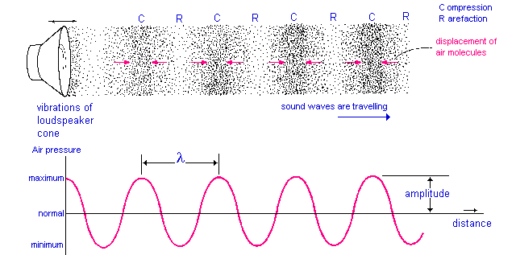
Longitudinal Waves
When a spring is pushed in a back and forth motion compressions, C, where the coils are closer together, and rarefactions, R, where the coils are farther apart, travel along the spring. This is demonstrated below.

Slide 40
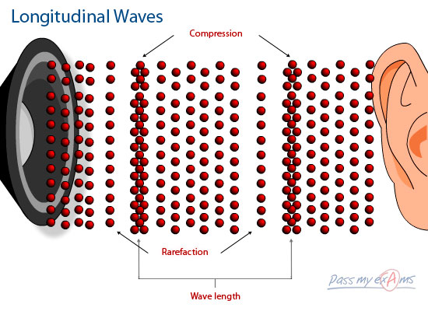
Longitudinal Waves
In a longitudinal wave the particles of the transmitting medium vibrate to and fro along the same line as that in which the wave is travelling, not at right angles to it as in a transverse wave. What is a transverse wave?

Slide 41
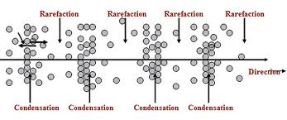
Longitudinal Waves
In a sound wave the region of compression is at a slightly higher pressure due to the air molecules being pushed together whereas the region of rarefaction is at a slightly lower pressure as the air molecules are farther apart.
The wavelength, λ, of a longitudinal wave is the distance between successive compressions or the distance between successive rarefactions. The amplitude is the maximum distance the vibrating particle travels from its undisturbed distance.
λ

Slide 42
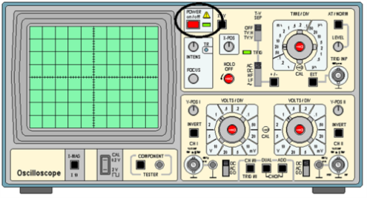
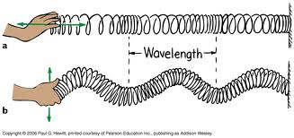
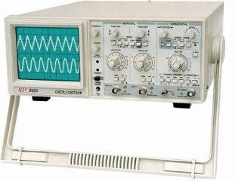
Longitudinal Waves
A longitudinal wave may also be drawn as a transverse wave to show how the displacement of one vibrating particle at a certain distance along the wave varies with time. Such a graph is known as a displacement-distance graph and is generated via a cathode ray oscilloscope.
Label which wave is a transverse and
which one is longitudinal?
Say where the compressions and
rarefactions are on the longitudinal
wave.

Slide 43

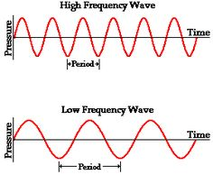
Pitch & LOUDNESS
A greater frequency wave produces a sound of higher pitch.
What type of sound
would a low frequency
produce?

Slide 44
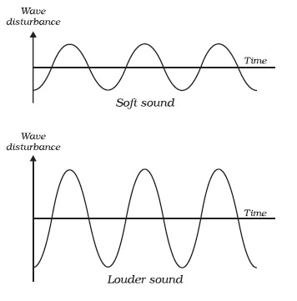
Pitch & LOUDNESS
A greater amplitude wave gives a higher/louder volume

Slide 45
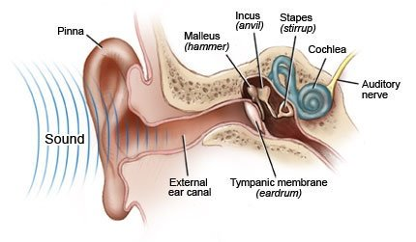
Ultrasound and Infrasound
Frequencies below 20 Hz is referred to as infrasound
The human audible range for hearing is between 20 Hz to 20, 000 Hz.
Frequencies above
20, 000 Hz is
referred to as
ultrasound.
As one gets older the
upper limit gradually
reduces to about 16, 000 Hz.

Slide 46
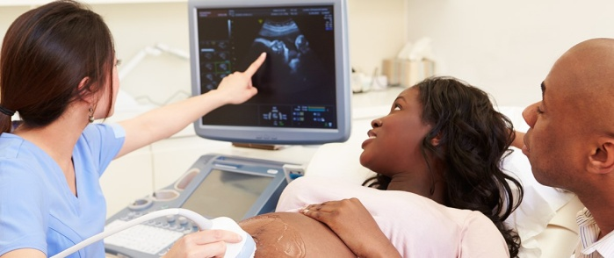
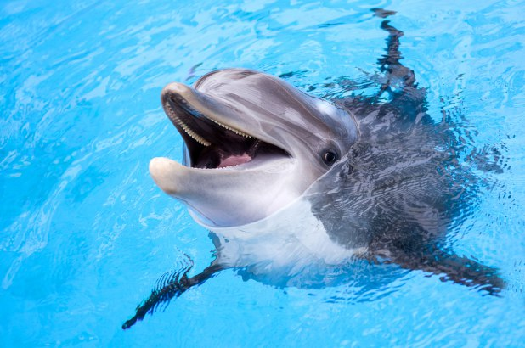
Uses of Ultrasound
1. Medicine
Also known as diagnostic imaging ultrasound is used to view babies inside of the womb. It is also used to examine internal organs.
2. Communication
Animals such as dolphins use
ultrasound to communicate
with each other.

Slide 47
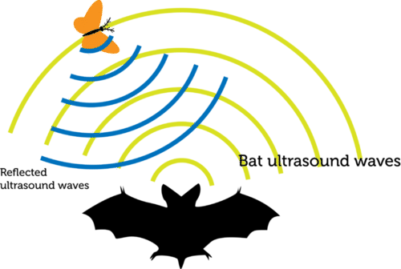
Uses of Ultrasound
3. Measuring distance
a. Bats are nocturnal and blind. To judge how far they have to fly they emit ultrasound which reflects/echoes off of objects to assess their distance from it.

Slide 48
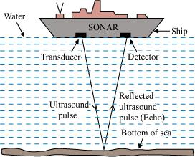
Uses of Ultrasound
3. Measuring distance
b. Depth sounding is the use of
ultrasound by boat operators
to determine the depth of an
ocean floor based on the time
it takes the ultrasound to reflect.
Since the sound wave travels
twice then to find the distance
of the bat from its prey or the
boat from the ocean floor the
following equation may is used:
s = 2d/t
Where:
s means speed of sound in meters per second (m/s)
d means distance in metres (m)
t means time in seconds (s)

Slide 49
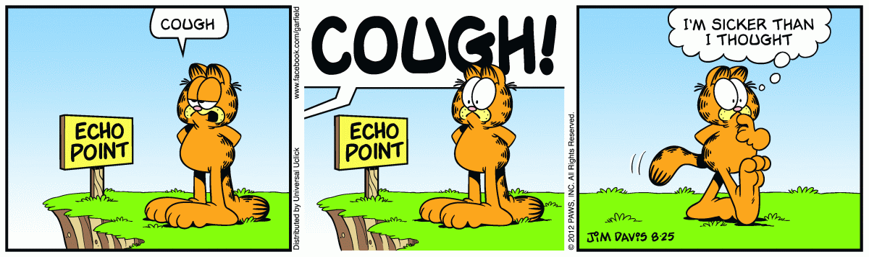
Reflections and Echoes
Sound waves are reflected well from hard, flat surfaces such as walls or cliffs and obey the same laws of reflection as light.
What are the laws of reflection of light?

Slide 50
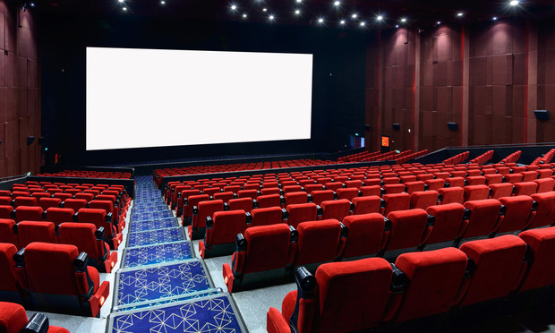
Reflections and Echoes
Reflected sound forms an echo.
If a reflecting surface is nearer than 15 m, the echo joins up with the original sounds which makes the sound seem prolonged. This is called reverberation.
What is often done to
lessen reverberation
in concert halls or
movie theatres?

Slide 51
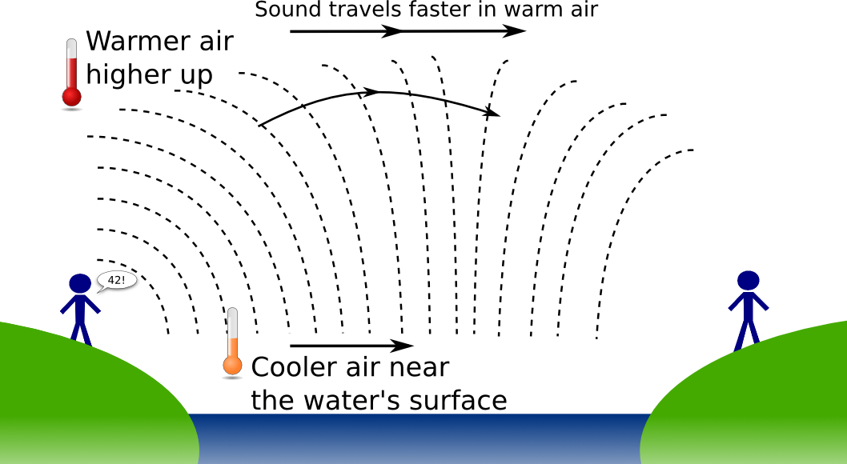
Speed of Sound
In air the speed of sound is about 330 m/s at 0 ºC.
The speed of sound increases at higher temperatures.
In steel the speed of sound is 6000 m/s.

Slide 52
Experiment
EXPERIMENT
1. Stand about 100 m away from a high wall and clap your hands.
2. Listen to the echoes being produced.
3. Clap so that you create a clapping rate where each clap coincides with the echo of the previous one. The sound would have travelled to the wall and back in the time between two claps which is one interval.
4. Time 30 intervals with a stop – watch. Determine the time, t, for one interval.
5. Determine the accurate distance from the high wall.
6. Calculate the speed of sound in air using the equation 2d/t

Slide 53
Refraction, Diffraction and Interference
a) Refraction
When a sound wave enters a medium of different density, its speed changes and it undergoes refraction unless it strikes the boundary at a right angle.
Why do you think distant sounds are often more audible at night than during the day?
b) Diffraction
Longer-wavelength (lower frequency) sounds are diffracted more than shorter-wavelength (higher frequency) sounds.

Slide 54
Refraction, Diffraction and Interference
c) Interference
What would happen if you place two loudspeakers ½ a meter away from each other? What would you hear?
Ultrasonic waves, in industry, are used to reveal flaws in welded joints; also holes of any shape or size are cut in glass and steel by ultrasonic drills.

Slide 55
Classwork
1. A rocket is seen to burst in the sky and the bang is heard 10 seconds later. If the speed of sound is 330 m/s, how far away is the exploding rocket?
2. In a displacement-time graph two cycles of a wave occupy 0.4 s. What is
a. the time period,
b. the frequency of the wave?

Slide 56

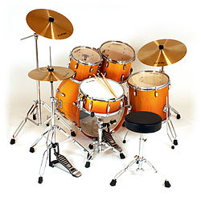
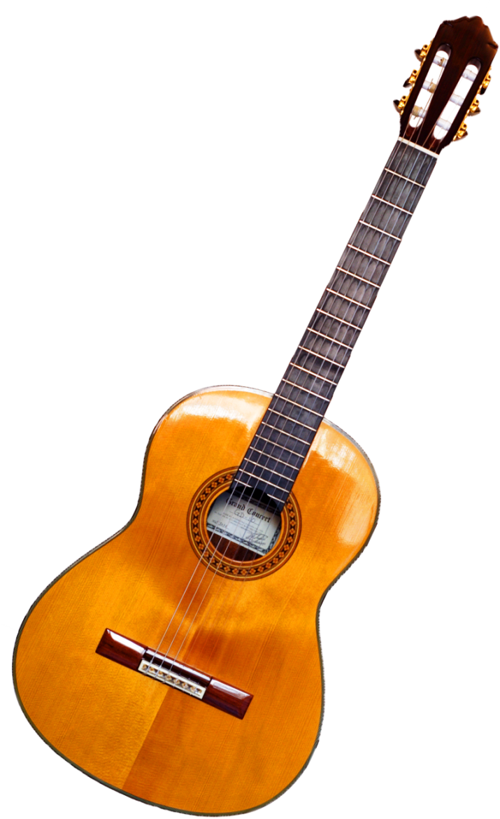
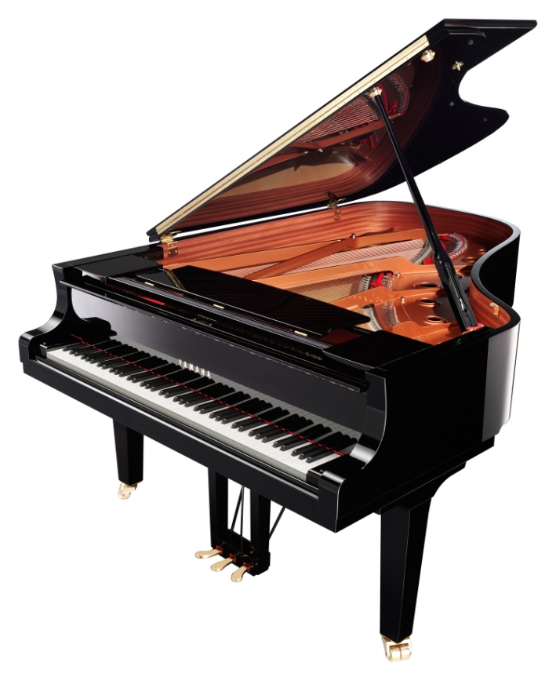
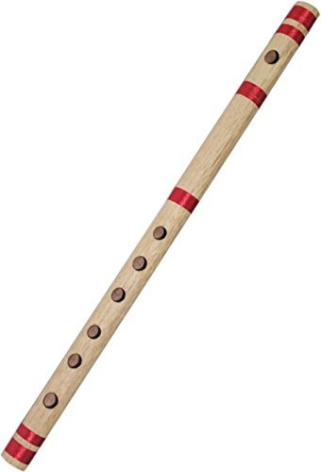
Musical notes

Slide 57
What is noise caused by?
Musical notes are made up of three properties:
1. pitch
2. loudness
3. quality

Slide 58
Pitch
The pitch of a note depends on the frequency of the source of sound.
A high-pitched note has a high frequency and a _________________ wavelength.
The frequency of middle C is 262 vibration per second or 262 Hz and that of upper C is 524 Hz.
Notes are an octave apart if the frequency of one is twice that of the other.

Slide 59
Loudness
A note is louder when more sound energy enters our ears per second than before and is caused by the source vibrating with a larger amplitude.
What does the word source mean here?

Slide 60
Quality
Does the same note on different instruments sound the same or different? Explain your answer.
The difference in sound arises because no instruments, except a tuning fork and a signal generator, emits a pure note, meaning of one frequency.
Notes consist of a main or fundamental frequency mixed with others, called overtones, which are usually weaker and have frequencies that are exact multiples of the fundamental.
Overtones of 262 Hz are 524 Hz, 786 Hz and so on. What would be the next overtone?

Slide 61
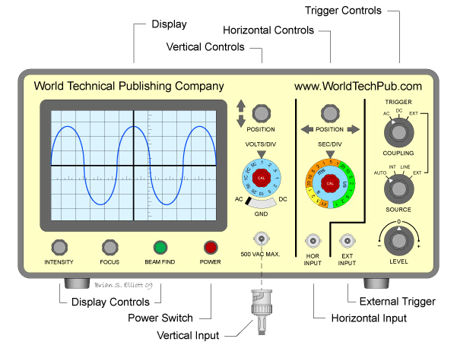
The waveform of a note played near a microphone connected to an oscilloscope can be displayed on the screen. What is an oscilloscope?
Notes produced by different devices can have the same frequency (pitch) but will have different quality (timbre).

Slide 62
CLASSWORK ☺
1. On what does:
a. the loudness
b. the pitch
of a sound depend on?
2.
a. Draw the waveform of
(i) a loud, low-pitched note and
(ii) a soft, high-pitched note
b. If the speed of sound is 340 m/s, what is the wavelength of a note of frequency
(i) 340 Hz
(ii) 170 Hz
For homework look up waveforms for the note produced by at:
1. tuning fork
2. piano
3. violin

Slide 63
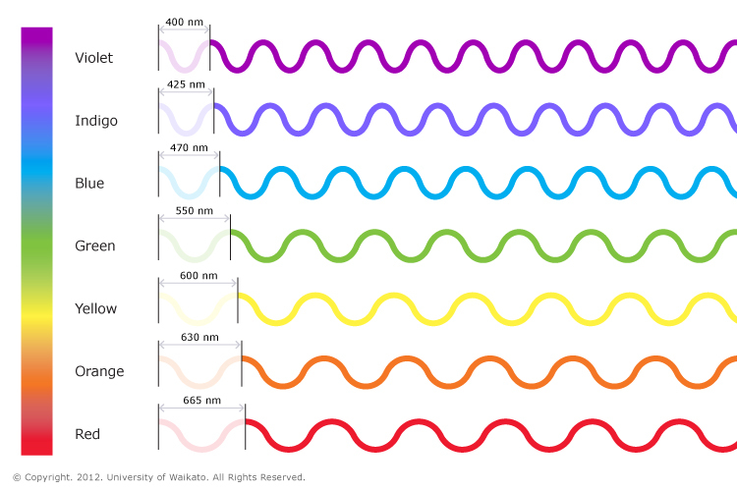
Light waves

Slide 64
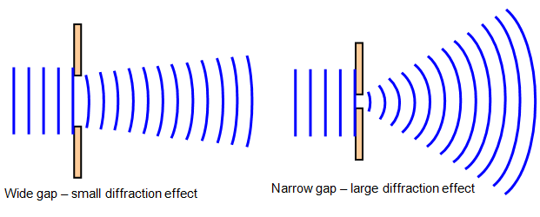
Although we can not see how light travels, it displays the properties of traverse waves.
Diffraction occurs when light passes the edge of an object but it is not easy to detect.
This suggests
that light has
a very small
wavelength

Slide 65
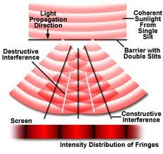
When light falls on two narrow slits very close together a pattern of equally spaced bright and dark bands (called fringes) is obtained on a screen.
One can assume that diffraction occurs at each slit and that interference occurs in the region where the two diffracted beam cross.

Slide 66
At points on the screen where a
‘crest’ from one slit arrives at the
same time as a ‘crest’ from the
other slit, waves are in phase and
there are bright bands.
Dark bands occur where ‘crests’ and
‘troughs’ arrive simultaneously and
the waves cancel.
A similar experiment was performed by Young in 1802.

Slide 67

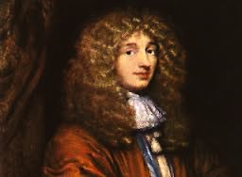
Nature of light
In the 17th century there were two theories of light, the corpuscular theory and the wave theory. Both theories contradicted one another.
The corpuscular theory regarded light as a
stream of tiny particles or corpuscles
travelling at very high speed in straight
lines. Newton supported this view.
The wave theory considered light to
travel in waves. This theory was
proposed by the Dutchman Huygens.
In 1704 Newton proposed that light was ‘shot out’ from a
source a particles. He believed that the mass of the source
diminished as it releases these particles.
In 1960 Huygens suggested that light was a longitudinal
wave capable of propagating through a material called
the aether which he believed filled all space.

Slide 68
Opponents of the wave theory argued that waves need to be carried by something such as water or air, but light did not appear to require one since it could travel in a vacuum.
To meet this objection the idea of a medium called the aether was invented but despite many attempts it defied detection.
Where is the aether?
Where is the aether?
Where is the aether?
Where is the aether?

Slide 69
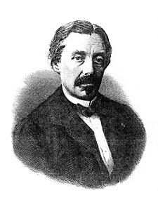
In 1850, the Frenchman Foucault,
showed via experiment, that
light travelled faster in air than
in water, contrary to what
Newton’s corpuscular theory
suggested.
In the meantime, interference and diffraction
effects had been discovered which were more readily explained in terms of waves than in terms of particles.
Foucault

Slide 70
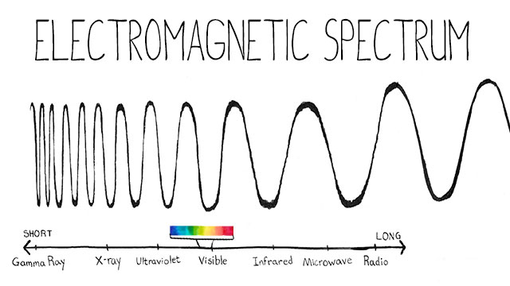
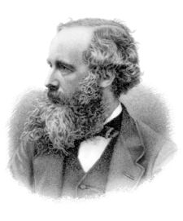
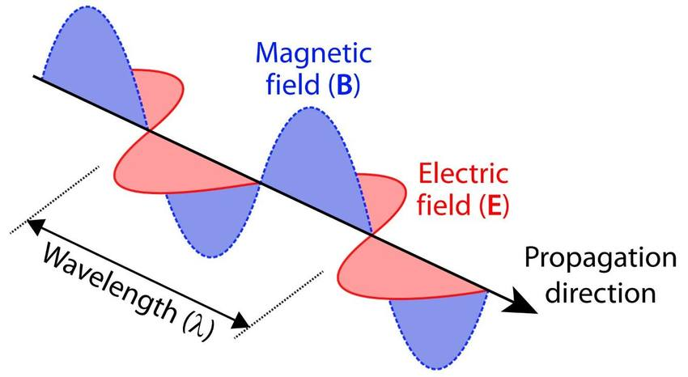
Owing to this, the wave theory was developed further by the Scotsman Maxwell, who suggested that light was a transverse electromagnetic wave consisting of varying electric and magnetic fields travelling through space.
Maxwell

Slide 71
Max Planck in 1900 put forward the Quantum Theory which combined the wave and particle theories.
In 1905 Einstein showed that the phenomenon of photoelectric emission cannot be explained by wave theory, but only by particle theory.
On the other hand, particle theory could not explain phenomena such as diffraction and interference, which are clearly due to waves.
Einstein had also shown that there is an equivalence between matter and energy in accordance with his famous equation,
ΔE = Δmc²

Slide 72
Towards the end of the 19th century discoveries were made concerning the emission and absorption of light by matter which the wave theory could not explain.
One of these was the photoelectric effect, in which light knocks electrons out of certain metals.
Einstein explained this effect by suggesting that light was emitted and absorbed in small packets (quanta) of energy called photons. The quantum theory was then developed.

Slide 73
Today we accept both wave and particle theories to explain the nature of light. They are now regarded as complementary and not contradictory.
Light has both wave-like properties (shown by interference and diffraction) and particle-like properties which justify treating it as rays travelling in straight lines, for example, when considering reflection as will be viewed later.

Slide 74
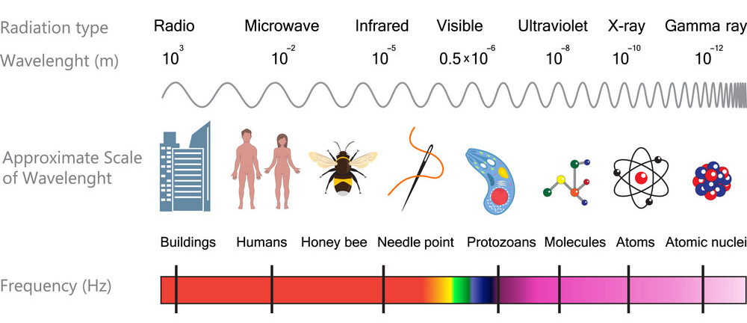
Electromagnetic waves

Slide 75
General Properties of Electromagnetic Waves
Electromagnetic waves:
a. Are all transverse waves
b. Travel at the same speed 3 × 10⁸ m/s through a vacuum or through air.
c. Can propagate through a vacuum.
d. Consist of varying electric and magnetic fields.

Slide 76
General Properties of Electromagnetic Waves
For all waves, electromagnetic waves can:
a. REFLECT
b. REFRACT
c. DIFFRACT
d. EXHIBIT THE PHENOMENON OF INTERFERENCE &
e. TRANSFER ENERGY

Slide 77
General Properties of Electromagnetic Waves
Diffraction is the spreading of a wave as it passes an edge or goes through a gap.

Slide 78
General Properties of Electromagnetic Waves
Interference is the phenomenon which occurs at a point where two or more waves superpose on each other (add) to produce a combined vibration or
amplitude lesser or
greater than any of
the individual waves.

Slide 79
Light is one member of the family of electromagnetic waves, it is found in the visible region of the spectrum.
Give some examples of electromagnetic waves.
All electromagnetic waves exhibit reflection, refraction, interference and diffraction, and travel at 300 million metres per second, 3 × 10⁸ m/s in air.
3 X 10⁸ m/s is the speed of light.
Their different wavelengths and frequencies are related to their speed, v by
v = ʄ × λ

Slide 80
Most of the electromagnetic waves result from electrons suffering some kind of energy change.
An electromagnetic wave has both an electric field and a magnetic field as demonstrated below.

Slide 81
Production of Electromagnetic Waves
Type | Produced by
Radio | Radio transmitters – aerials that emit radio waves when electric current oscillates within them
Infrared | All bodies above temperature 0 K (-273 ºC)
Visible Light (ROYGBIV) | Bodies above 1100 ºC
Ultraviolet | Very hot bodies, such as the Sun (6000 ºC), welding torches, electric sparks, lightning
X-rays and Gamma rays | X rays consist of high speed electrons bombarding metal targets Gamma rays are produced by changes in nuclei of unstable atoms.

Slide 82
Uses of Electromagnetic Waves
Radio Waves & Microwaves
Radio waves and microwaves are used for
a. Radio and television broadcasting
b. Cell phone communication
c. Warming food (Microwave)

Slide 83
Uses of Electromagnetic Waves
Infrared Radiation
Infrared (IR) radiation is detected by our nerves as HEAT.
Anything which is hot but not glowing, i.e. below
500ºC, emits IR radiation alone.
At about 500ºC a body becomes red-hot and emits red light as well as IR.
At about 1000ºC things such as lamp filaments are white-hot and radiate IR and white light, that is ALL the colours of the spectrum.

Slide 84
Uses of Electromagnetic Waves
Infrared Radiation
Infrared radiation is used
a. In Ovens, toasters and heat radiators
b. In remote controls
c. In Fibre Optic cables
d. In Heat – seeking missiles
e. In Treatment of muscular disorders
f. By Some animals that can detect IR from their prey in order to hunt them in the dark.

Slide 85
Uses of Electromagnetic Waves
Ultraviolet Waves
Ultraviolet, UV, waves have shorter wavelength than light waves.
It can cause sun-tans. What type of vitamins do they produce in the skin?
However too much UV waves applied to the skin can be dangerous. Why is this so?
UV radiation causes teeth, finger nails, fluorescent paints and clothes washed in detergents to fluoresce. What does this mean?

Slide 86
Uses of Electromagnetic Waves
Ultraviolet Waves
The shells of fresh eggs fluoresce with a reddish colour; those of ‘bad’ eggs appear violet.
A UV lamp used in science or medicine contains mercury vapour which emits UV radiation when an electric current passes through it.
Bank notes have a marking made of fluorescent substance which becomes visible when UV is incident on them. This helps to discourage the circulation of fraudulent bank notes.

Slide 87
Uses of Electromagnetic Waves
X-rays
X-rays are produced when high-speed electrons are stopped by a metal target in an X-ray tube.
Do X-rays have shorter wavelengths than UV?
X-rays, to some extent, are absorbed by living cells but they can penetrate some solid objects and affect photographic film.
X-rays do not pass through bones, teeth and metals easily and so shadow pictures can be taken.

Slide 88
Uses of Electromagnetic Waves
X-rays
X-rays are used in
a. Medical Imaging of dense materials such as bones or tumors within flesh
b. Security scanning of passengers and luggage
c. X-ray crystallography: a method of investigating the structure of crystals

Slide 89
Uses of Electromagnetic Waves
Gamma Rays
Gamma rays are used to kill cancer cells. What else are they used to kill?
Gamma rays are used in:
a. Cancer therapy
b. Imaging using a gamma camera
c. Tracers
Are gamma rays more penetrating and dangerous than X-rays?

Slide 90
COMPREHENSION
1. Name four properties common to all electromagnetic waves.
2. Which of the following types of radiation has the highest frequency?
a. UV b. radio waves c. Light d. X-rays e. IR
3. Name on type of electromagnetic radiation which
a. causes sun-tan: _____________________
b. passes through a thin sheet of lead: ____________________
c. is used to take photographs in haze: ____________________

Slide 91
COMPREHENSION
4. A VHF radio station transmits on a frequency of 100 MHz (1 MHz = 10⁶ Hz). If the speed of radio waves is
3 × 10⁸ m/s
a. what is the wavelength of the waves,
b. how long does the transmission take to travel 60 km?

Slide 92
Light Rays and Rectilinear Propagation

Slide 93
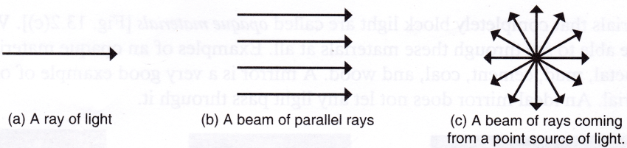
Light
A ray of light is often represented as a single arrow.
Whereas a beam of light is often represented as many rays.

Slide 94
Light
A ray of light is the direction in which light propagates
A beam of light is a stream of light energy.

Slide 95

Shadows
When light from a point source of light hits an object a very dark shadow is produced. It is referred to as an umbra.

Slide 96
Shadows
When light from an extended source of light hits an object a very dark shadow (umbra) as well as a partial shadow (penumbra) are obtained.

Slide 97

Eclipse of the Moon
The moon is a
non-luminous
body. It reflect
light from the
Sun.
An eclipse of the moon occurs when the Earth is between it and the SUN (SEM).
An eclipse
of the moon
is referred to
as a lunar eclipse.

Slide 98


Eclipse of the Sun
The Sun becomes
eclipsed when the
Moon passes
between it and Earth
(SME).

Slide 99

The Pinhole Camera
When an object is placed in front of a pinhole camera a focused, real and inverted image is formed on the
translucent screen.

Slide 100
COMPREHENSION
Define:
a. A ray of light b. A beam of light
State the property of light responsible for the formation of shadows.
Draw ray diagrams to represent the formation of each of the following.
A. The shadow produced by a point source of light
B. An eclipse of the Moon (lunar eclipse)
C. An eclipse of the Sun (solar eclipse)

Slide 101
COMPREHENSION
Draw ray diagrams to show the formation of the image in a pinhole camera for each of the following cases.
A. The camera focusing an image of an object
B. The effect on the image of increasing the size of the hole.
C. The effect on the image of moving the object further from the camera.
D. The effect on the image of making the box deeper.

Slide 102




Reflection and Refraction

Slide 103
Reflection
There are two laws of reflection:
Law 1:
The incident ray, the reflected ray and the normal, at the point of incidence, are on the same plane.
Law 2:
The angle of incidence is equal to the angle of reflection.

Slide 104
Reflection
The image you see in
the mirror is called
a reflection.
When light hits the
surface of a mirror
it bounces away
from the normal at
the same angle
the incident ray did.

Slide 105

Reflection
Images formed in the plane of a mirror are:
1. the same size as the object.
2. the same distance perpendicularly behind the mirror as the object is in front
3. virtual
4. Laterally inverted
Virtually means not real – the image cannot be formed on a screen, and light does not come from where the image appears to be.
Laterally inverted means reversed side to side, so that the image of a word placed to face a mirror is reversed as shown:

Slide 106

Reflection Ray Diagrams Using Point Objects

Slide 107
Refraction
There are two laws of refraction:
Law 1:
The incident ray, the refracted ray and the normal, at the point of incidence, are on the same plane.
Law 2:
The ratio sin θi /sin θr is a constant for a given pair of media, where i is the angle of incidence and r is the angle of refraction. This is Snell’s Law.

Slide 108

Snell’s Law of Refraction

Slide 109
Refractive Index, η
For light travelling from one medium to another, the ratio sin i/sin r is the refractive index of the medium relative to the first η₂/η₁.
Where: sin i/sin r = η₂/η₁
For light travelling from one medium to another, the ratio:
speed in medium of incidence ÷ speed in medium of refraction
Is also equal to the refractive index of the second medium relative to the first:
η₂/η₁ = v_{i}/v_{r}

Slide 110
Refractive indices of common materials
Material | Refractive index, η
Air | 1.0
Water | 1.3
glass | 1.5

Slide 111

Behaviour of Light when passing from one Medium to Another
When light enters a second medium perpendicular to its interface:
1. It does not deviate – the angles of incidence and refraction are both zero.
2. its speed is greater in the less optically dense medium.

Slide 112
Behaviour of Light when passing from one Medium to Another
When light enters a more optically dense medium other than perpendicularly:
1. it refracts towards the normal, that is the angle between the ray and the normal decreases
2. its speed decreases

Slide 113
Behaviour of Light when passing from one Medium to Another
When light enters a less optically dense medium other than perpendicularly:
1. it refracts away from the normal, that is the angle between the ray and the normal increases
2. its speed increases

Slide 114
Refraction Ray Diagrams Using Point Objects

Slide 115
Refraction through a Rectangular Glass Block
The emergent ray is parallel to the incident ray and therefore the angle of emergence is equal to the angle of incidence.

Slide 116
Calculations
The following equation may be used when tackling a refraction problem:
η₂/ η₁ = sinθ_{i}/ sinθ_{r} = v_{i}/v_{r}

Slide 117

Dispersion
The dispersion of white light is the separation of white light into its constituent colours.
The figure below show the set-up of an experiment originally done by Newton.

Slide 118
Dispersion
Newton made a number of changes to the experiment in order to prove that the origin of the coloured light was not within the prism. He:
1. changed the size of the slits of the collimator
2. used prisms of different types
3. isolated a colour and showed that it was not affected by another prism.
4. altered the distance between the light source and the prism
5. added a second prism to show that the colours can be recombined.

Slide 119
Critical Angle and Total Internal Reflection
When light passes from an optically denser medium to one which is optically less dense it will have a large angle of refraction.
At a certain angle of incidence, c, the refracted ray passes just along the surface, for angles greater than this critical angle, there is total internal reflection.

Slide 120
Critical Angle
The critical angle may defined in two ways:
1. The critical angle of a material is the largest angle at which a ray can approach an interface with a medium of smaller refractive index and be refracted into it.
2. The critical angle of a material is the smallest angle at which a ray can approach an interface with a medium of smaller refractive index and be totally reflected by it.

Slide 121

Conditions Necessary for Total Internal Reflection
The ray must approach the second medium from one of greater refractive index, that is from one in which its speed is less.
The angle of approach must be greater than the critical angle.

Slide 122

The Mirage
During the day the temperature of the air directly above the surface of a road increases due to conduction of heat from the asphalt.
A ray of light from low in the sky will refract away from the normal as it enters the hotter, less dense air.
The deviation continues until the ray is totally reflected just above the road. It is then continuously refracted towards the normal as it enters the cooler, denser, air above.
An observer receiving this ray will see a virtual image of the sky and may interpret it as a pool of water.

Slide 123
Relation between critical angle and refractive index
sin c = 1/η
One of the angles is 90º and the other is the critical angle, c. The critical angle is always in the medium in which the wave travels with lesser speed – for light, this is the more optically dense medium.
Note that, if the critical angle or the refractive index of a material is referred to without mention of the second medium, it can be assumed that it is relative to air.

Slide 124

Applications of Total Internal Reflection
Optical Fibres work based on light being totally internally reflected within it.
Optical fibres have the following uses:
a. Telecommunications
b. Endoscopes:
1. Diagnostic imaging
2. Therapy

Slide 125
Reflecting Prisms
A mirror reflects only about 90% of the light incident on it.
Right-angled, isosceles-triangular glass prisms are used in many optical instruments, such as periscopes and binoculars, to reflect light.
When light enters the prism perpendicularly through one of the shorter sides, it meets the opposite wall at 45º. This is more than the critical angle of glass (42º), and therefore there is total internal reflection.

Slide 126

Reflecting Prisms

Slide 127
Lenses

Slide 128

Terms used with Lenses

Slide 129
Some Useful Definitions
A lens is a piece of specially shaped transparent material that can form focused images of objects.
A convex or converging lens is one that is thicker at the centre. It can converge parallel rays of light to produce a real image.

Slide 130
Some Useful Definitions
A concave or diverging lens is one that is thinner at its centre. It can diverge parallel rays of light to produce a virtual image.
The optical centre, O, of a lens is the point at the centre of the lens through which all rays pass without deviation.

Slide 131
Some Useful Definitions
The principal axis of a lens is the line that passes through its optical centre and is perpendicular to the faces of the lens.
The principal focus, F, of a lens is the point on the principal axis through which all rays parallel and close the axis converge, or from which they appear to diverge, after passing through the lens.

Slide 132
Some Useful Definitions
The focal length, f, of a lens is the distance between its optical centre and its principal focus.
The focal plane of a lens is the surface perpendicular to its principal axis and containing its principal focus.

Slide 133
Parallel Ray Focus on the Focal Plane

Slide 134

Magnification
Magnification, m, is the ratio of the size of the image to the size of the object where:
a. magnification = image height/object height
b. magnification = distance of image from lens/distance of object from lens

Slide 135
Real and Virtual Images
Real images are those produced at a point to which light rays converge.
Virtual images are those produced at a point from which light rays appear to diverge.

Slide 136
Examples of Real Images and Virtual Images
Examples of real images | Examples of virtual images
Image produced on the retina | Image produced in a mirror
Image produced in a camera | Image produced by a convex lens acting as a magnifying glass
Image produced on the screen at the cinema | Image produced by a concave lens

Slide 137
Features of real and virtual images of real objects produced by a lens
Real images formed by lenses | Virtual images formed by lenses
Can be formed on a screen | Cannot be formed on a screen
Are produced by the convergence of rays | Are produced due to the divergence of rays
Are located on the side of the lens opposite to the object | Are located on the same side of the lens as the object
Are inverted | Are erect

Slide 138

Constructing Scale Diagrams for Convex Lenses

Slide 139

Characteristics of the Image formed in a Concave Lens
Smaller than the object
Closer to the lens than is the object
Virtual
Erect

Slide 140
The Lens Formula

