Slide 1
Heat and Temperature

Slide 2
Heat and Temperature
Heat is a form of energy.
It has units of joules, J.
Temperature is a measure of the level of heat in a body.
The units of temperature are usually in degree Celsius, ºC or degree Fahrenheit, ºF.

Slide 3
Heat and Temperature
When a substance is heated its temperature may rise.
The rise in temperature of a substance depends on its a. Mass and b. Nature

Slide 4
Heat and Temperature
Condition | Observation
50 g of oil and 50 g of water in two separate beakers. Measure the initial temperature of each. Heat each container for two minutes. Measure the final temperature of each liquid. | The temperature change depends on the nature of the substance. Oil is more viscous and would heat up faster.
Place 50 g of water and 100 g of water in two separate beakers. Measure the initial temperature of the water in each beaker. Heat each container for two minutes. Measure the final temperature of each. | The temperature change depends on the mass of the substance. The greater the mass the smaller the temperature change.

Slide 5
Heat and Temperature
When a substance is heated there may be changes in its: a. Temperature (increase) b. Physical State c. Chemical Composition d. Shape e. Volume (expansion)

Slide 6
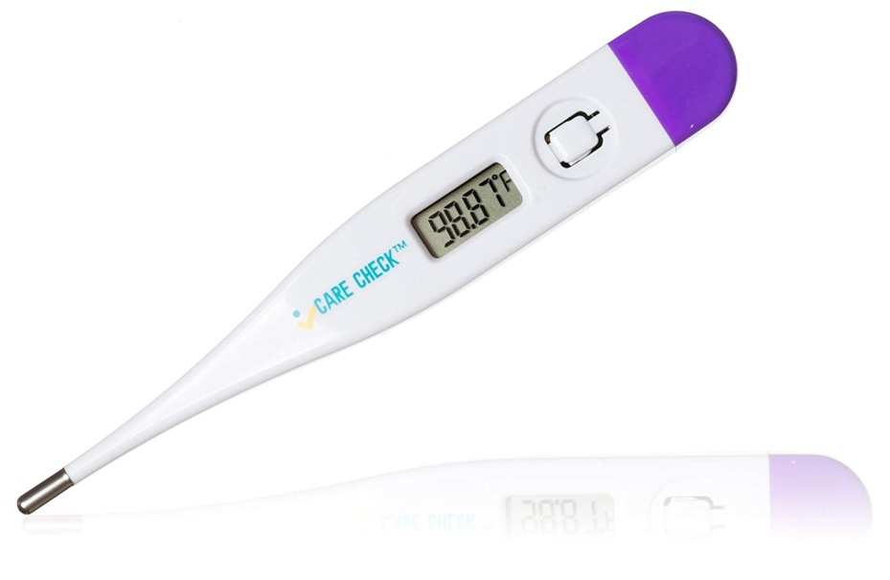
Heat and Temperature
A thermometer is a device used to measure temperature.
There are many different types of thermometers below are two of them: a. Liquid-in-glass and b. Digital

Slide 7
Heat and Temperature
Heat transfer takes place when there is a difference of temperature.
Heat moves from a higher temperature to a lower temperature.

Slide 8
Heat and Temperature
When a substance is heated the particles it is made up of moves/vibrate. Further heating may cause the particles to move further apart because they have gained enough energy to achieve this.

Slide 9
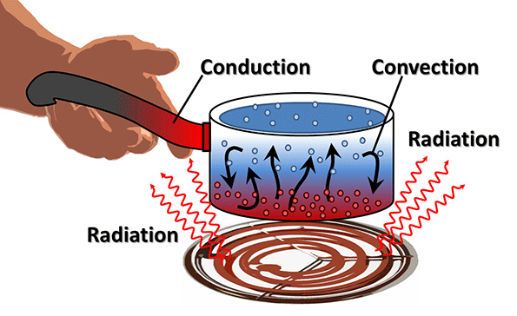
Conduction and convection

Slide 10
Ways In which Heat Travels
Conduction and convection are two of the ways in which heat can travel.

Slide 11
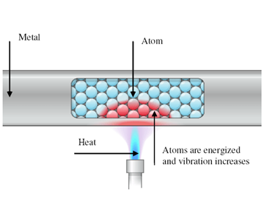
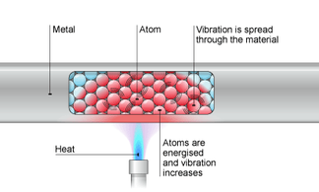
Conduction
Conduction is the flow of heat through matter from places of higher to places of lower temperature without movement of the matter as a whole. An example of conduction is _______

Slide 12
Conduction and the Kinetic Theory
Two processes occur in metals when they are heated. a. In metals the electrons travel faster and cause electrons in cooler parts to vibrate as well. b. Atoms in hotter parts of the metal cause atoms in cooler parts of the metal to vibrate. This happens in non-metals as well since non-metals do not have free electrons.

Slide 13
Conduction
Most metals are good conductors of heat.
Materials such as wood, glass, cork, plastics and fabrics are bad conductors/insulators.
Metal objects below body temperature feel colder than those made of bad conductors because they carry heat away faster from the hand, even though all the objects are at the same temperature.

Slide 14
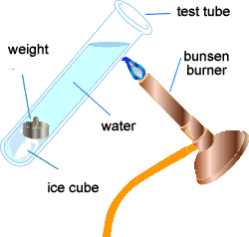
Conduction
Liquids and gases also conduct heat but only very slowly. Water is a poor conductor of heat.

Slide 15
Conduction Uses of Good Conductors
Good conductors are used when ever heat is required to travel quickly through something. Give an example of an appliance that is a good conductor of heat.
Cooking utensils are made from good conductors of heat which are generally copper, brass, steel and aluminium. Such utensils get heated up quickly and food can be cooked in a shorter time.

Slide 16
Conduction Bad Conductors/Insulators
The handles of kettles and utensils are made of bad conductors of heat such as wood, plastic, ebonite etc. They help in holding them comfortably.
Woolen clothes are bad conductors which are not actually warm. They simply do not allow heat to conduct away or to escape out and thus keep out body warm.
Building materials like brick, mud, grass etc. are bad conductors of heat. They do not permit heat and cold to pass through. They keep houses warm in winter and cool in summer.

Slide 17
Conduction Bad Conductors/Insulators
Hair and the fur of animals are bad conductors of heat. They protect them from the cold.
Vehicles carrying flammable materials such as petrol are covered with materials of bad conductors of heat otherwise the petrol can get heated up and catch fire.

Slide 18
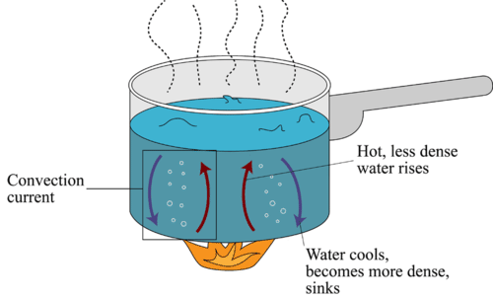
Convection
Convection is the usual method by which heat travels through fluids, example liquids and gases.
Give an example of such.

Slide 19
Convection in Liquids
Convection is the flow of heat through a fluid from places of higher to places of lower temperature by movement of the fluid itself.
Convection currents are streams of warm moving fluids. In convection a fluid floats within a fluid, not a solid in a fluid. And remember, hot air always rises.

Slide 20
Convection in Liquids
Cold fluids are more dense than hot fluids hence hot fluids rise and cold fluids sink.

Slide 21
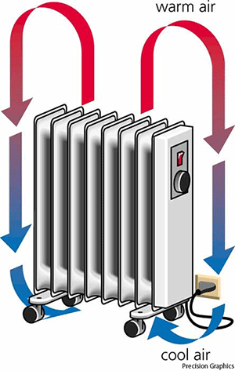
Convection in Air
Black marks often appear on the wall or ceiling above a lamp or a radiator. What do you think they are caused by?
Convection currents set up by electric, gas and oil heaters help to warm homes in cold climates. Many so-called ‘radiators’ are really convector heaters.

Slide 22
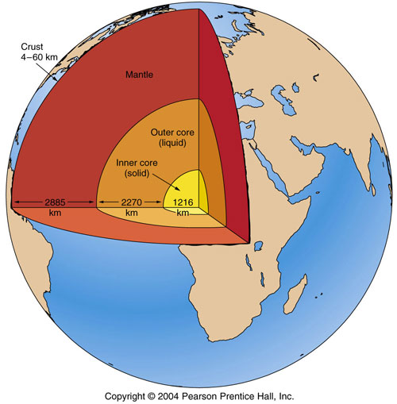
Natural Convection Currents
Can you give two examples of natural convection currents?

Slide 23
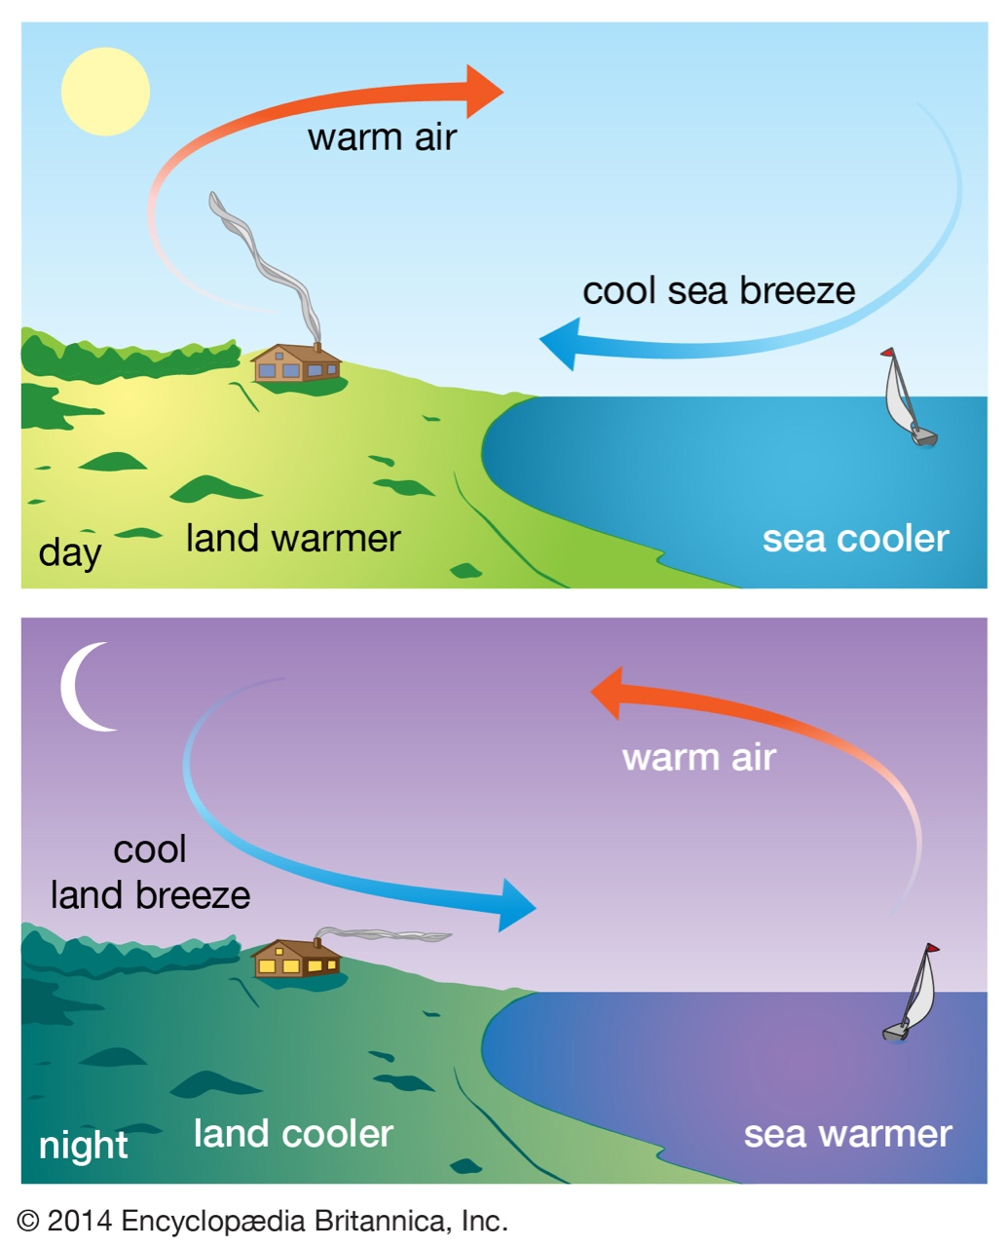
Natural Convection Currents

Slide 24
Questions
1. Explain why a. Newspaper wrapping keeps hot things hot, b. Fur coats would keep their owners warmer if they were worn inside out c. A string vest keeps a person warm even though it is a collection of holes bounded by string.
2. Why is a glass milk bottle likely to crack if boiling water is poured into it?

Slide 25
Questions
3. a. When a vessel of water is heated at the top, why doesn’t the water at the bottom warm up? b. Convection currents stop us from being suffocated when we are asleep in bed. Why? c. Why is the freezer compartment at the top of a refrigerator?
4. Convection takes place A. Only in solids B. Only in liquids C. Only in gases D. In solids and liquids E. In liquids and gases

Slide 26
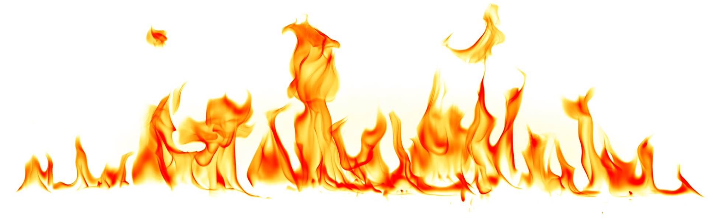
Radiation

Slide 27
How Does Radiation Conduct Heat?
Radiation is a third way in which heat can travel, but whereas conduction and convection both need matter to be present, radiation can be transmitted in a vacuum/empty space.

Slide 28
How Does Radiation Conduct Heat?
Evidence for this is provided by the fact that in some electric lamps the radiation emitted as light by the filament travels across a vacuum in the glass bulb to get out.

Slide 29
How Does Radiation Conduct Heat?
Radiation rays include light, x-rays, gamma rays, radio waves and ultraviolet light.
They all travel at the same speed, 3.0 × 10⁸ m/s.

Slide 30
How Does Radiation Conduct Heat?
Radiation is how heat and light reach us from the Sun, also mostly through a vacuum.

Slide 31
How Does Radiation Conduct Heat?
Radiation travels as electromagnetic waves. What happens to these waves when they fall on an object?
Radiation is the flow of heat from one place to another by means of waves.
Radiation is emitted by all bodies above absolute zero and consists mostly of infrared radiation, but light and ultraviolet radiation are also present if the body is very hot – for example the sun.

Slide 32
Good and Bad Absorbers of Heat
Give some examples of good absorbers of heat and bad absorbers of heat.
Good Absorbers of Heat | Bad Absorbers of Heat
Metals | Cotton

Slide 33
Good and Bad Absorbers of Heat
Dull black surfaces are better absorbers of radiation than white shiny surfaces.
What are shiny surfaces good for?
Why are buildings in hotter countries painted white?

Slide 34
Good and Bad Emitters of Heat
Some surfaces also emit radiation better than others when they are hot.
The cooling fins on the heat exchanger of a refrigerator are painted black so that they lose heat more quickly.

Slide 35
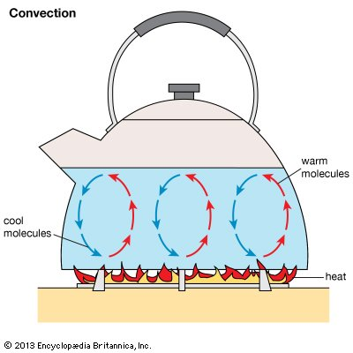
Good and Bad Emitters of Heat
Why are teapots and kettles able to keep their heat longer?
In general, surfaces that are good absorbers of radiation are good emitters when hot.

Slide 36
Factors that affect the amount of Radiation given off
Two other factors that affect the amount of radiation emitted per second by a surface are: a. its area and b. its temperature. Increasing either of these increases the radiation.

Slide 37
Effective Uses of Radiation Vacuum Flasks

Slide 38
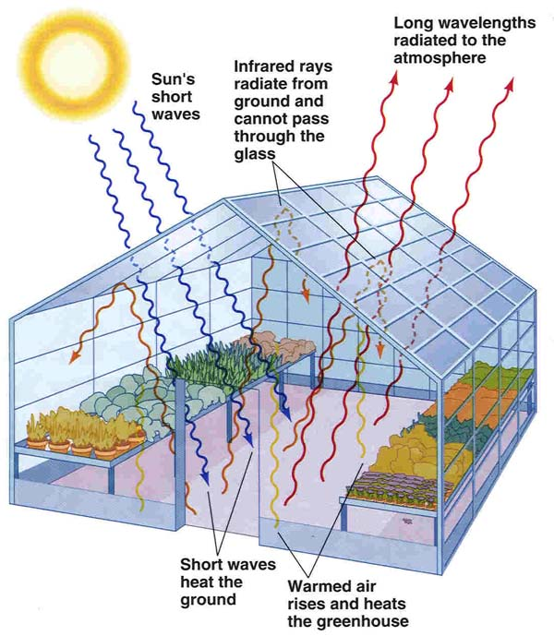
Effective Uses of Radiation Glass-House Effect
The warmth from the sun is not cut off by a sheet of glass but the warmth from a red-hot fire is. Why is this?

Slide 39
Effective Uses of Radiation Glass-House Effect
Light and short-wavelength infrared rays from the sun penetrate a glass-house (greenhouse) and are absorbed by the soil, plants, etc., raising their temperature. These in turn emit infrared radiation but, because of their relatively low temperature, this has a long wavelength and is not transmitted by the glass. The greenhouse thus acts as a ‘heat-trap’ and its temperature rises.
What does the presence of carbon dioxide in the atmosphere cause?

Slide 40
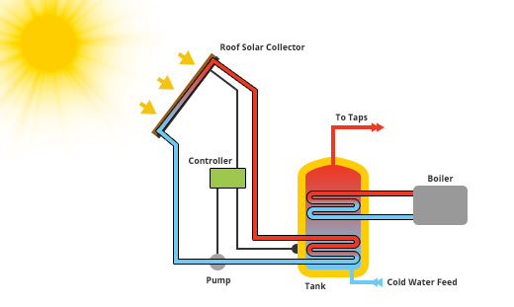
Effective Uses of Radiation Solar Water Heating
Solar water heating: Can you explain how these work?

Slide 41
Effects of CO₂ in the Atmosphere
What does the presence of carbon dioxide in the atmosphere cause? 1. Global warming 2. ______________

Slide 42
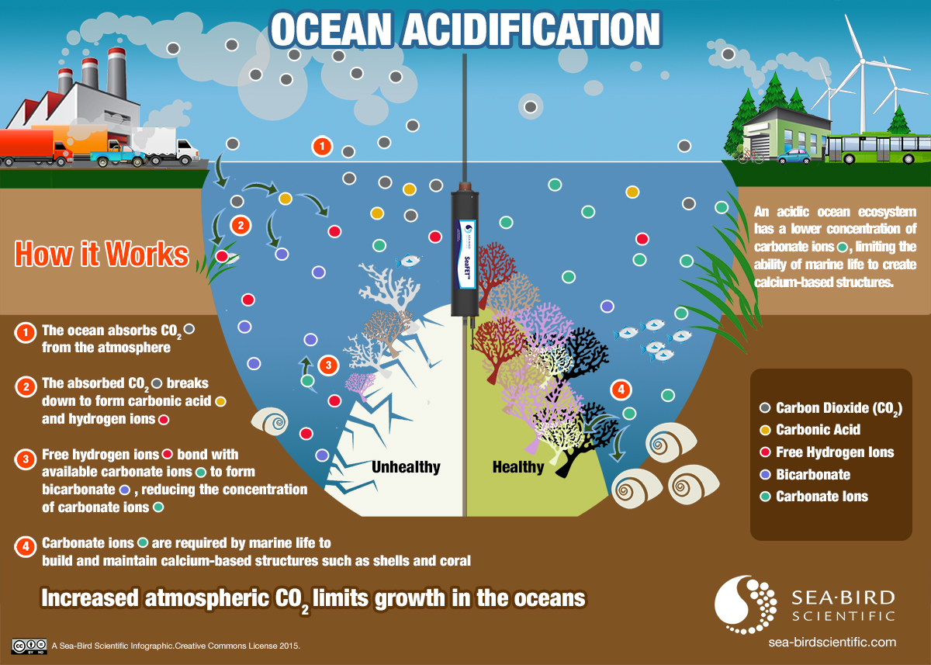
Effects of CO₂ in the Atmosphere

Slide 43
Questions
1. We feel the heat from a coal fire by: A convection B conduction C expansion D diffusion E radiation
2. Three cans are of identical size and shape: one can is painted matt black, one is dull white and one is gloss white. The cans are filled with boiling water. In which can will the water cool most quickly? Give a reason.

Slide 44
Questions
3. Why does radiation pass more readily into a glass-house than out of it?
4. a. The earth has been warmed by the radiation from the sun for millions of years yet we think its average temperature has remained fairly steady. Why? b. Why is the temperature less likely to fall on a cloudy night than on a clear one.

