Slide 1
Maintaining Health

Slide 2
Food & Nutrient Groups
Maintaining Health

Slide 3
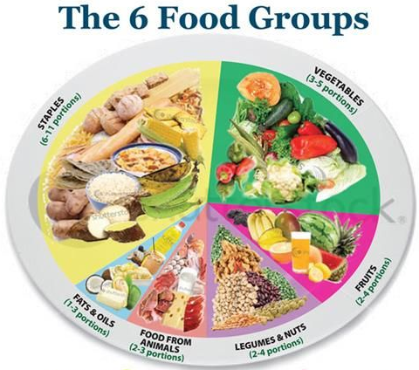
The Six Food Groups
Food is classified into six food groups. They are important for your health. They are:
1. Staples
2. Food from animals
3. Legumes
4. Fruits
5. Vegetables
6. Fats
A balanced meal consists of the right amount of food from each of the food groups.

Slide 4
Nutrients
Nutrients are those substances contained in food which are necessary for healthy bodies.
In addition to nutrient groups we also need water to dissolve substances in the body and to form fluids for example blood.
Nutrients | What they provide for the body
Carbohydrates | Energy
Proteins | Growth and Repair
Lipids/Fats | Energy
Vitamins | For proper working of the body
Minerals | For proper working of the body

Slide 5
Maintaining Health
Healthy Bodies

Slide 6
Your Health is Your Wealth
When our bodies are working perfectly we say we are healthy.
When our bodies are not working properly we say we are ill or have a disease.

Slide 7
Your Health is Your Wealth
It is important that we keep our bodies healthy.
In order to do this we have to eat correctly, exercise regularly, keep ourselves and our surroundings clean and protect ourselves from injury.

Slide 8
Major Groups of Diseases, Causes, Prevention, Treatment & Control
Maintaining Health

Slide 9
Types of Diseases
There are four major types of diseases:
1. pathogenic
2. deficiency
3. physiological
4. hereditary

Slide 10
Types of Diseases and Their Causes
Type of Disease | Definition | Examples
Pathogenic | Pathogens are organisms which cause diseases in plants or animals | Protozoa, parasitic worms, fungi, bacteria and viruses
Deficiency | Deficiency diseases are cause by a lack of any of the essential nutrients | Kwashiorkor – lack of protein or energy foods Rickets – lack of vitamin D Scurvy – lack of vitamin C Anaemia – lack of iron
Physiological | This is caused by improper functioning of the organs in the body | Hypertension and diabetes
Hereditary | These are passed on from parent to offspring | Haemophilia and sickle cell anaemia

Slide 11
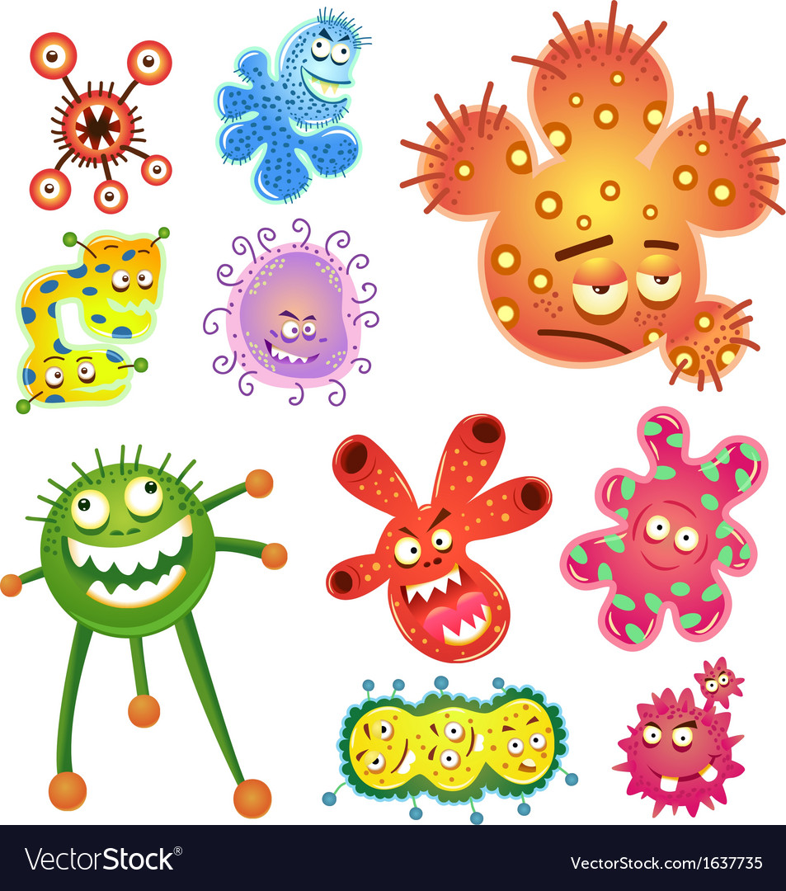
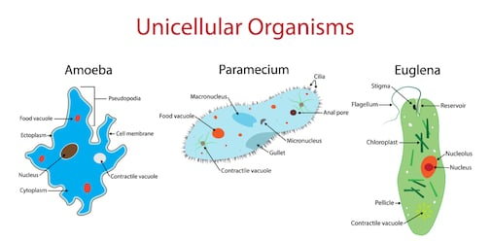
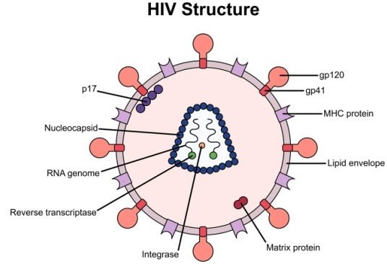
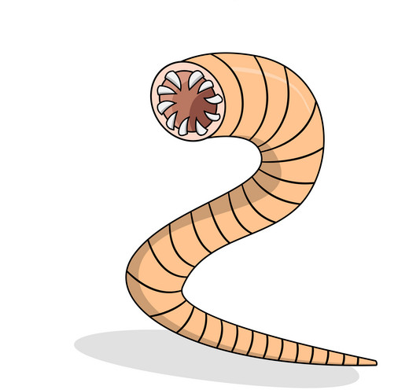
Examples of Pathogens
Parasitic worm
Different types of bacteria

Slide 12
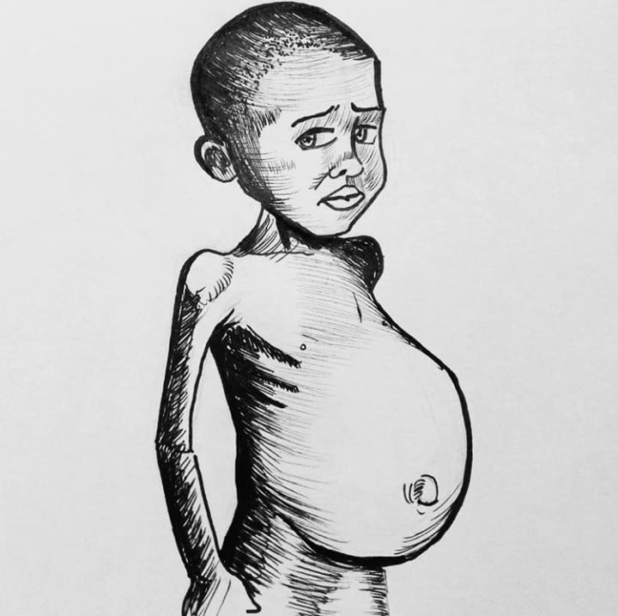
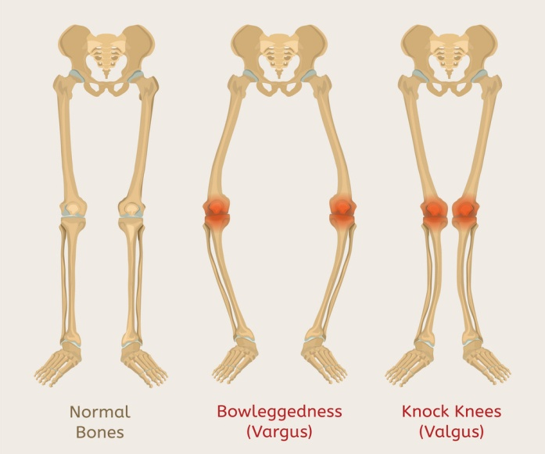
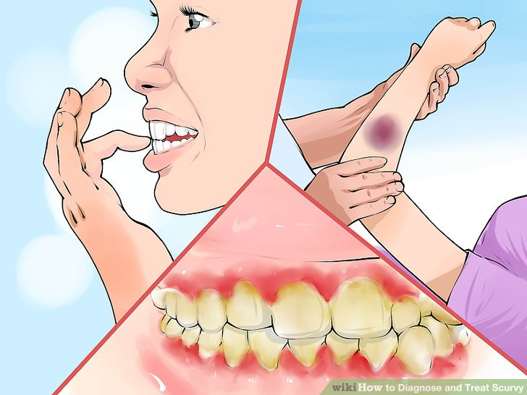
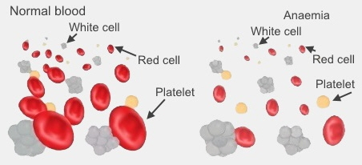
Examples of Diseases Caused by Deficiency
Scurvy
Kwashiorkor
Rickets
Anaemia

Slide 13
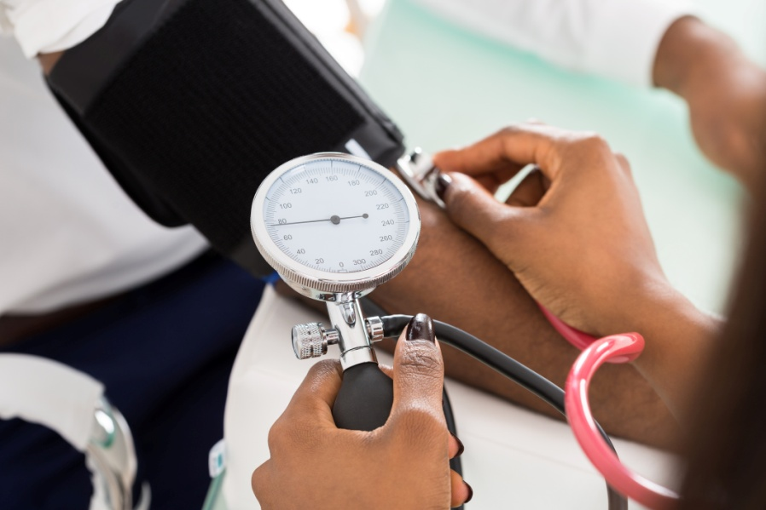
What is Hypertension & What Causes It?
Hypertension is when
a person has abnormally
high blood pressure.
It may be caused by poor
habits such as smoking,
consuming a diet of too much salty food or by working in stressful environments.
Eating a well balanced diet, working in environments that are not too stressful and exercising may lessen your likelihood of suffering from hypertension.

Slide 14
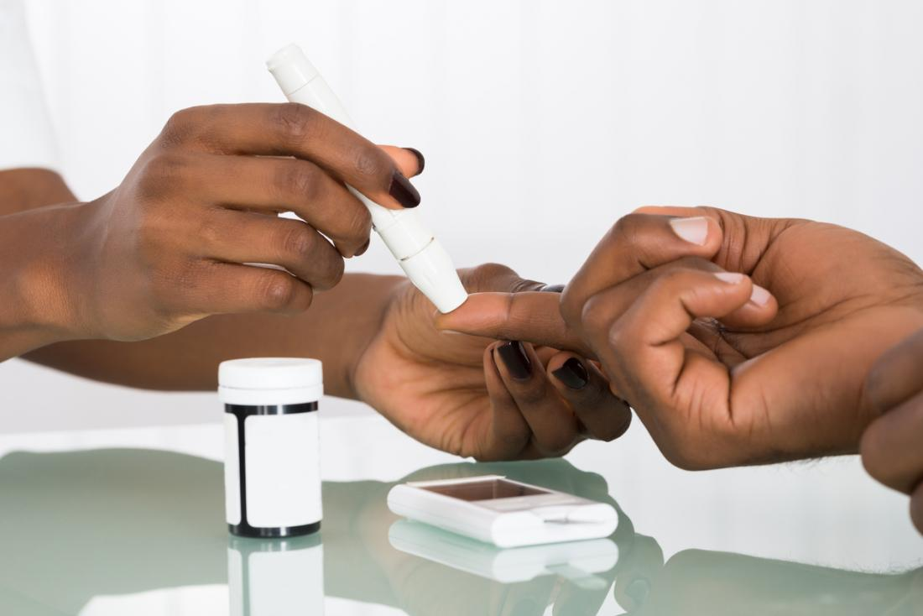
What is Diabetes & What Causes It?
Diabetes is a disease that
occurs when your blood
glucose, also called blood
sugar, is too high. This
arises when your body
doesn’t make enough – or any – insulin or doesn’t use insulin well. Glucose then stays in your blood and doesn’t reach your cells.
In a healthy human insulin, a hormone made by the pancreas, helps glucose from food get into your cells to be used for energy.

Slide 15
What is Diabetes & What Causes It?
Blood glucose is your main source of energy and comes from the food you eat.
Diabetes has no cure but can be managed by not eating too much sugary foods. People with severe diabetes may have to take insulin shots.
Some people are born with diabetes and some develop diabetes due to old age or pregnancy (in females).

Slide 16
What is Haemophilia?
Haemophilia is a mostly inherited genetic disorder that impairs the body’s ability to make blood clots, a process needed to stop bleeding.
If you have haemophilia you may bleed for a longer time after an injury than you would if your blood clotted normally.
Smaller cuts don’t pose much of a treat however large cuts or if the person may suffer from internal bleeding about their knees or elbows may damage their organs and tissues and may be life-threatening.

Slide 17
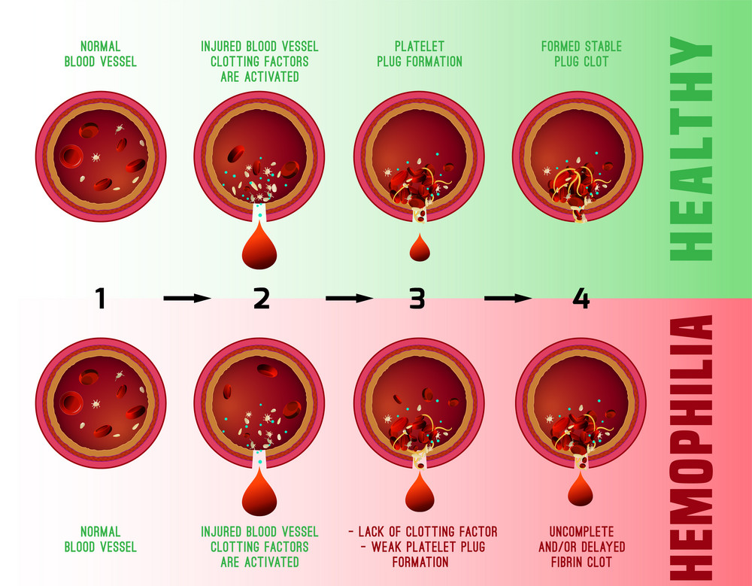
What is Haemophilia?

Slide 18
What is Sickle Cell Anaemia?
Sickle cell disease is a group of disorders that affects haemoglobin.
Haemoglobin is the molecules in red blood cells which delivers oxygen to cells throughout the body.

Slide 19
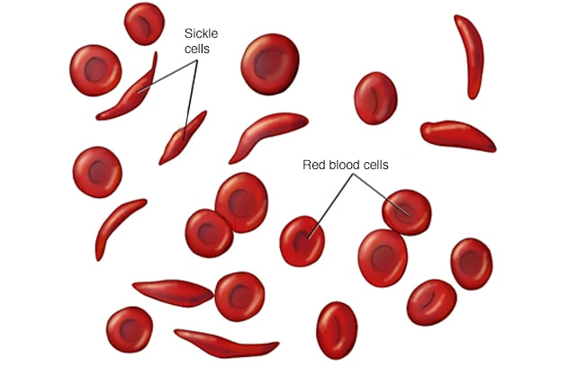
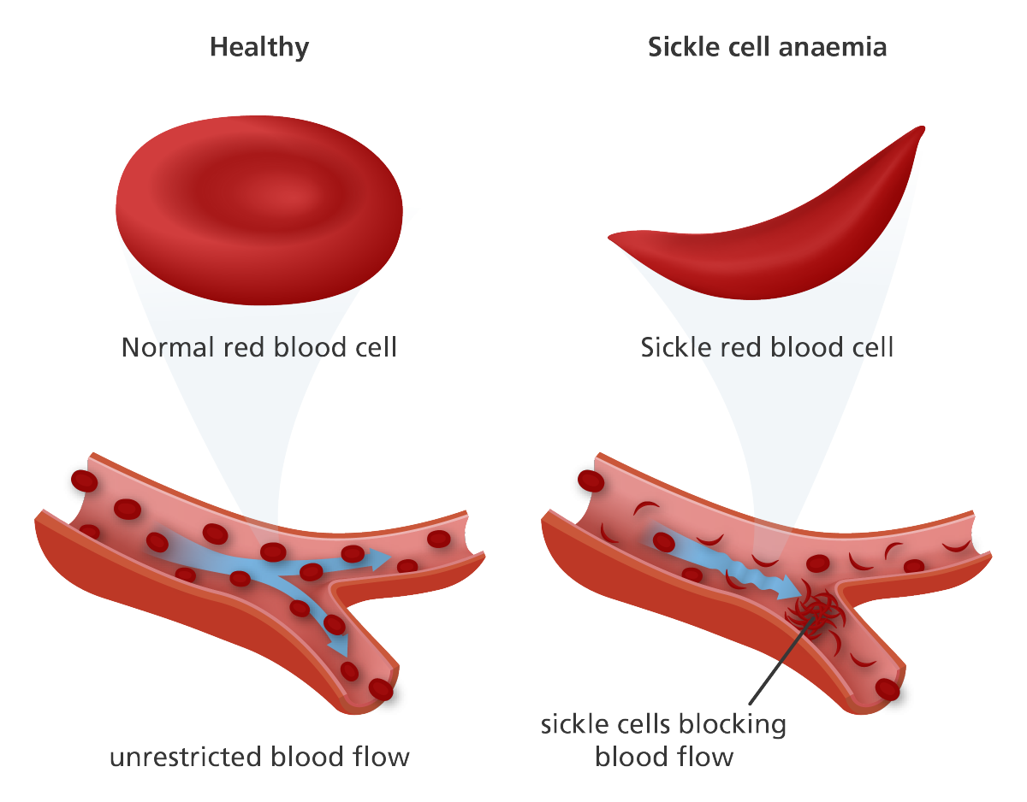
What is Sickle Cell Anaemia?
People with this disorder have cresent/sickle shaped haemoglobin molecules which makes it hard for it to combine well with oxygen molecules and they can also block blood vessels. This causes organs to be starved of oxygen from time to time. The sickle red blood cells can also cause blood vessels to become blocked in turn leading to hypertension.

Slide 20
What is Sickle Cell Anaemia?
People with sickle cell may suffer from pain, fatigue and jaundice which is the yellowing of eyes and skin.
Sickle cell anaemia may be managed or treated by using antibiotics, vitamins, blood transfusions, pain relieving medicine, possibly surgery to remove organs damaged by the presence of the disease.

Slide 21
Maintaining Health
Mosquitoes

Slide 22
Mosquitoes
Mosquitoes are considered to be the most dangerous insects on Earth.
They have probably killed more humans than all other insects combined throughout history.
Mosquitoes can carry viruses and parasites that they can pass on through their bite to an animal or a human.

Slide 23
Methods of Mosquito Control
Mosquito populations can be controlled in many ways some of which are tabulated below.
Methods of Mosquito Control | Examples
Biocontrol | Importing natural predators like dragonflies and fish
Chemical | Using insecticides and pesticides to kill larvae or adults
Exclusion | Mosquito nets and window screenings
Source of Reduction | Removal of stagnant water, drill holes in the bottom of garbage containers stored outside to drain off water, keep lawns cut, keep gutters clean and unclogged, keep swimming pools cleaned and chlorinated even when not in use, keep your property clear of items that can hold water example cans, bottle, tires

Slide 24
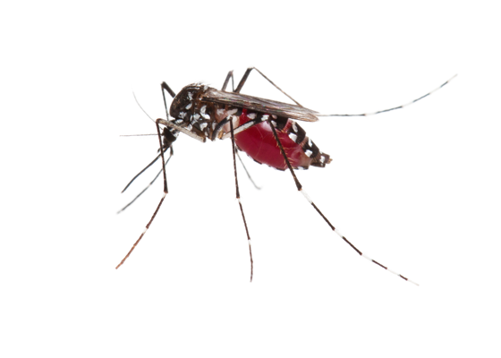
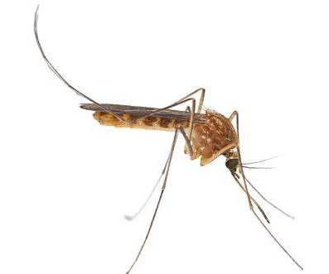
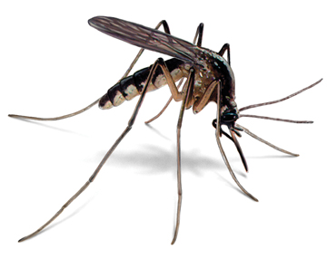
Mosquitoes and the Diseases They Cause
Mosquito | Features | Disease Caused | Symptom
Aedes | White spots on body | Yellow fever | Red face, Bleeding
 |  | Dengue | Headache, joint pains
Anopheles | Silent | Elephantiasis | Swollen limbs
Culex | Whines | Malaria | Nausea/vomiting
Aedes
Anopheles
Culex

Slide 25
HIV & AIDS
Acquired immunodeficiency syndrome (AIDS) is a disease of the human immune system
caused by the human immunodeficiency virus (HIV).
It destroys the immune system which causes the body to no longer be able to fight diseases.
HIV is transmitted through bodily fluid such as blood, semen, vaginal fluid and breast milk.
This transmission can involve anal, vaginal or oral sex, blood transfusion, contaminated hypodermic needles, exchange between mother and baby during pregnancy and breastfeeding.
MOSQUITOES DO NOT SPREAD AIDS!

Slide 26
Maintaining Health
Health Centres & Hospitals

Slide 27
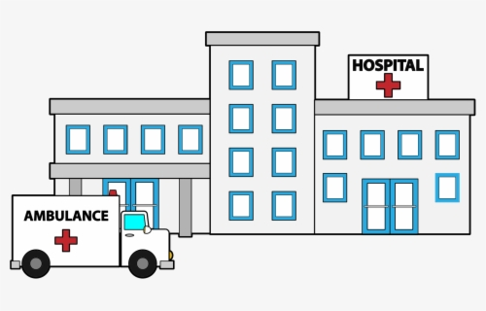
Health Centres & Hospitals
When we are unhealthy or have
a disease we see the doctor.
Doctors can be found at
hospitals and health centres.
Science and technology can be used to prevent, detect and treat many diseases.
Departments in a hospital make good use of science and technology used to detect, prevent or treat diseases. Parts of a hospital that makes good use of science and technology are the X-ray department, dispensary, mortuary and laboratory.

Slide 28
Maintaining Health
The Human Body

Slide 29
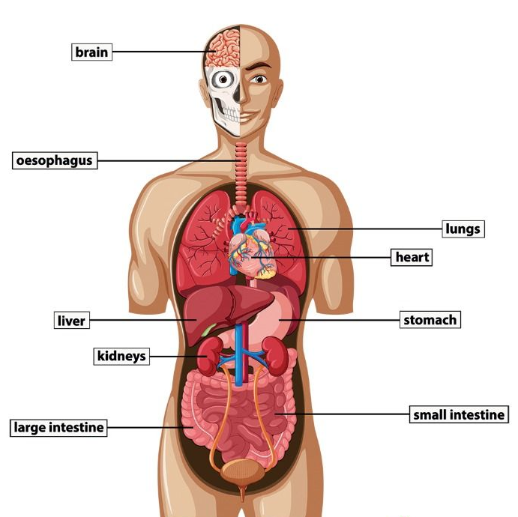
The Human Body
Human beings are
organisms.
An organism is any living
thing.
Cells grow and divide
to form tissues, which group together to form organs which work together to form systems.

Slide 30
The Human Body
An organism is made up of a number of systems which work together.
Cells → Tissues → Organs → System
Examples of cells are red blood cells, white blood cells, sperm and ovum.
Examples of tissues are nervous tissue, cartilage and muscle.
Examples of organs are the heart, eyes, ears, nose, tongue, brain, penis and vagina.

Slide 31
Systems of the Human Body
There are eight systems in the human body.
Each system is different. They are the cardiovascular, digestive, endocrine, musculo-skeletal, nervous, reproductive, respiratory and urinary systems.

Slide 32
Systems of the Human Body
The cardiovascular system refers to the heart.
The digestive system deal with the throat, stomach and intestines.
The endocrine system deals with hormone production.

Slide 33
Systems of the Human Body
The musculo-skeletal system deal with the bones, muscles, cartilage, tendons, ligaments, joints and other connective tissue of the body.
The nervous system deals with the nerves cells and fibres in the body.
The reproductive system refers to the functions of the sex organs of the male and female.

Slide 34
Systems of the Human Body
The respiratory system deals with the lungs to enable gas exchange.
The urinary system refers to the removal of toxic wastes from the kidneys, bladder, ureters and urethra.

