Slide 1
Static and Current Electricity

Slide 2

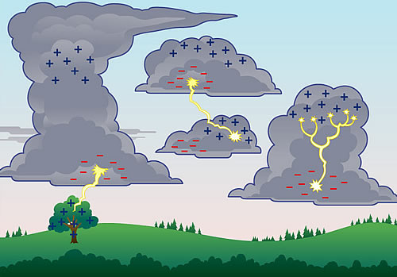
Static Electricity
Static electricity is an imbalance of electric charges within or on the surface of a material. The charge remains until it is able to move away by means of an electric current or electrical discharge.

Slide 3
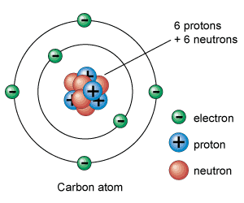
Static Electricity
Matter
Matter is composed of atoms.
Atoms are composed of three types of particles:
Protons - positive particle
Neutrons - neutral particle &
Electrons - negative particle
An atom has NO charge because
they have the same amount of positive as well as negative particles giving it a total charge of zero.

Slide 4
Separating Charges
Most materials are neutral.
Rubbing materials together can cause friction. This causes the movement of electrons from one material to the other.
The only particle that moves from material to material is the electron.
Why doesn’t the proton or the neutron move?
The transfer of electrons results in both of the materials becoming electrically charged:
A. When extra electrons enter an object the object becomes negatively charged.
B. When electrons leave an object the object becomes positively charged.

Slide 5
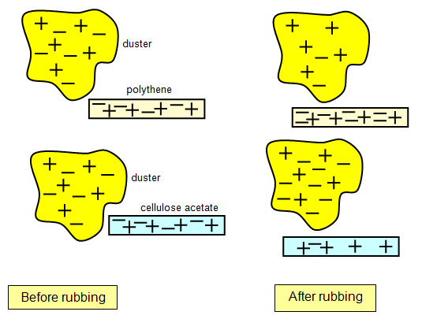
Separating Charges
Rubbing a polythene rod with a dry cloth will cause electrons to move from the cloth to the polythene rod.
The rod will become negatively charged because it has extra electrons and the cloth will become positively charged because it has fewer electrons than protons.
The opposite will happen when a Perspex rod is rubbed with a dry cloth. Explain what will happen using a drawing.

Slide 6
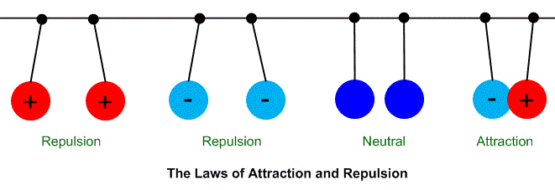
Forces Between Charged Objects
Opposite charges attract.
Like charges repel.

Slide 7
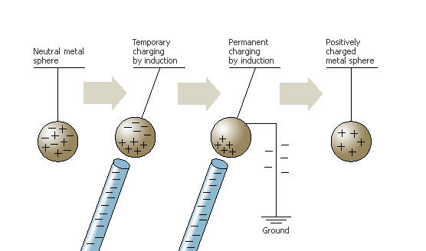
Induced Charge
A neutral object can become charged when a charged object is placed next to it.
This process is referred to as charging by induction.
What would happen if a Perspex rod was placed next to the sphere? Draw it below.

Slide 8
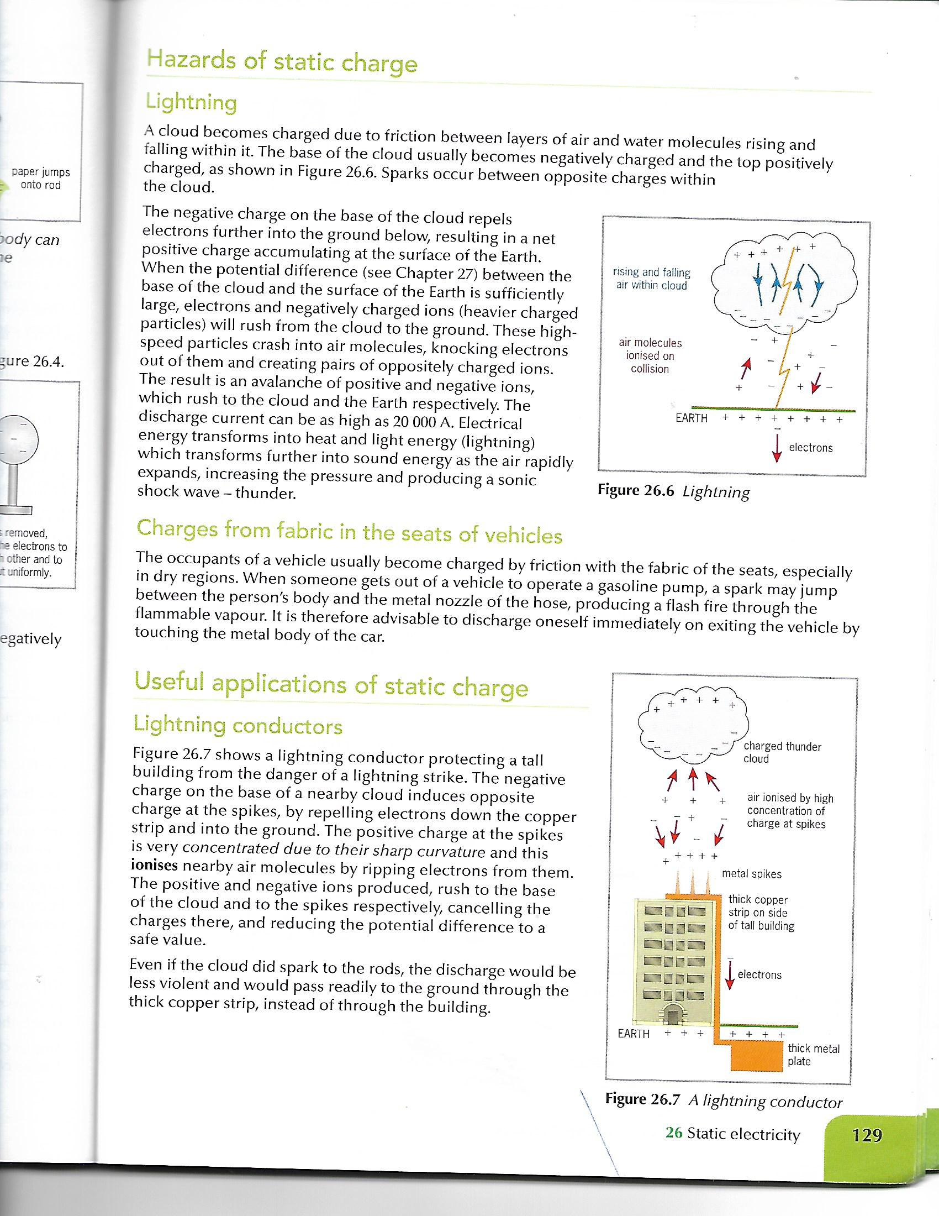
Useful Applications of Static Charge
Lightning Conductors
Tall buildings are fitted with
a thick copper strip
running along its length to
protect the building from
lightning strikes.

Slide 9
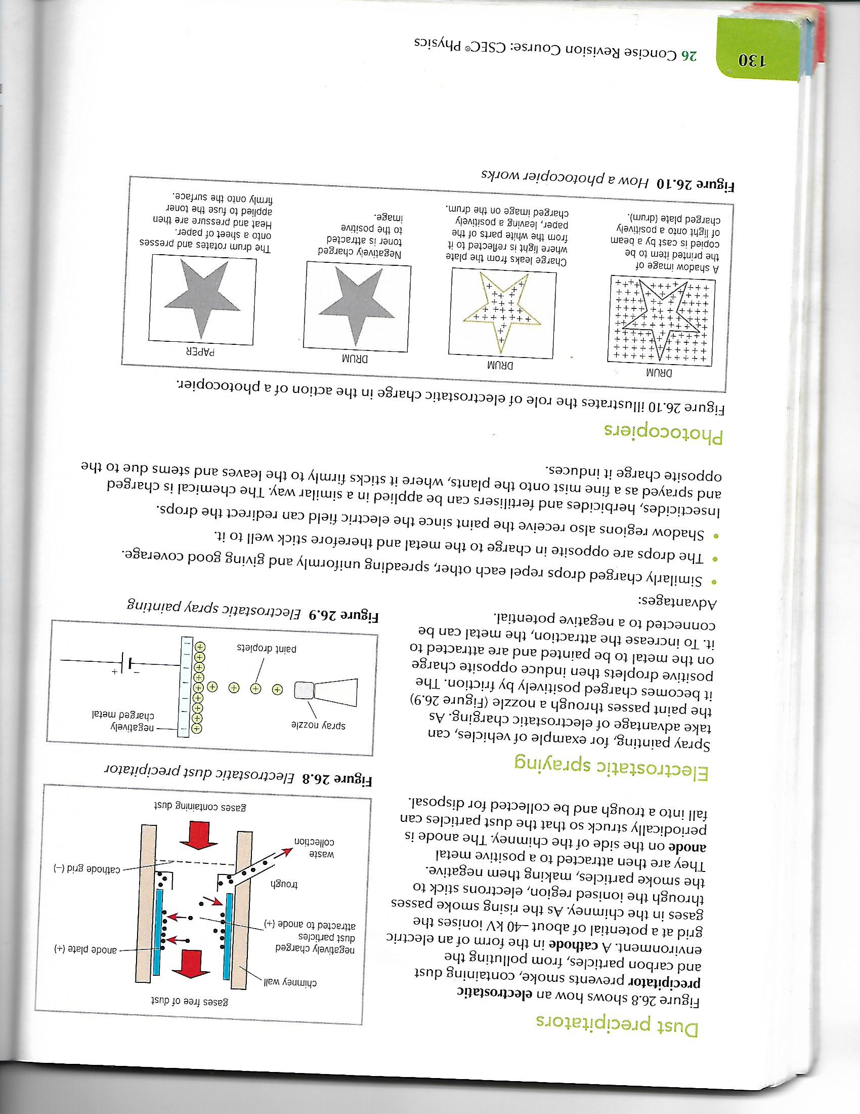
Useful Applications of Static Charge
Electrostatic spraying
When vehicles are
spray painted
electrostatic charging
is taken advantage of.
The paint passes through the nozzle and becomes positively charged due to friction.
The body of the car may become negatively charged via induction due to the positive particles or by being connected to a negative terminal. This attracts the positively charged paint particles.

Slide 10
Useful Applications of Static Charge
Photocopier

Slide 11
Hazards of Static Charge
Lightning
A cloud becomes charged due to friction between layers of air and water molecules rising and falling within it.
The base of the cloud usually becomes negatively charged while the top of the cloud becomes positive.
Sparks occur between opposite charges in the cloud.
The negative charge on the base of the cloud repels electrons further into the ground below.

Slide 12
Hazards of Static Charge
When the potential difference
between the Earth and the cloud gets large
enough electrons and negatively charged ions rush from the cloud to the ground.
The high speed particles crash into air molecules, knocking electrons out of them and creating pairs of oppositely charged ions.
This produces lightning which gives off heat and eventually sound (thunder) due to rapid air expansion and increasing air pressure which produces a shockwave.

Slide 13
Hazards of Static Charge
Charges from fabric in the seats of a vehicle.
This usually happens in dry regions or if the air in the car is dry.
The person can become charged by friction and this becomes a hazard if they are going to use a the metal hose of the gasoline pump which can cause a flash fire.
It is best to discharge oneself by touching the metal body of the car.

Slide 14
Hazards of Static Electricity
Refuelling of vehicles:
Large electrical charges can build up on vehicles when they move due to air resistance or other frictional forces which cause the transfer of electrons.
Car tyres can build up lots of friction which can cause explosions during refuelling. Modern cars are now fitted with special tyres to avoid the buildup of too much friction.
The refuelling of aircrafts, due to the movement of fuel, can cause a buildup of charge which could lead to an explosion. This is overcome by connecting the tank and the person who is refuelling the tank to a conducting cable to allow the charge to dissipate safely.

Slide 15
Hazards of Static Electricity
Mills:
In grain or flour mills where there is a lot of dry air and or powder in the air. Sparks can cause explosions.
Electronics:
Microprocessors and other integrated circuits can also be destroyed by static electricity.

Slide 16
Questions
1. A student walks along a nylon carpet and then reaches out to a door handle. A tiny spark is produced and the student feels an electric shock. Explain why this happens.
2. Dust particles are uncharged but they often stick to electrical equipment such as television screens. Why does this happen?

Slide 17
Electric Fields

Slide 18
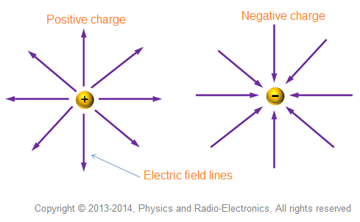
Electric Fields
An electric field is a region of space in which a charged object will experience a force.
The picture above shows the direction of electric fields near a positive point charge and a negative point charge

Slide 19
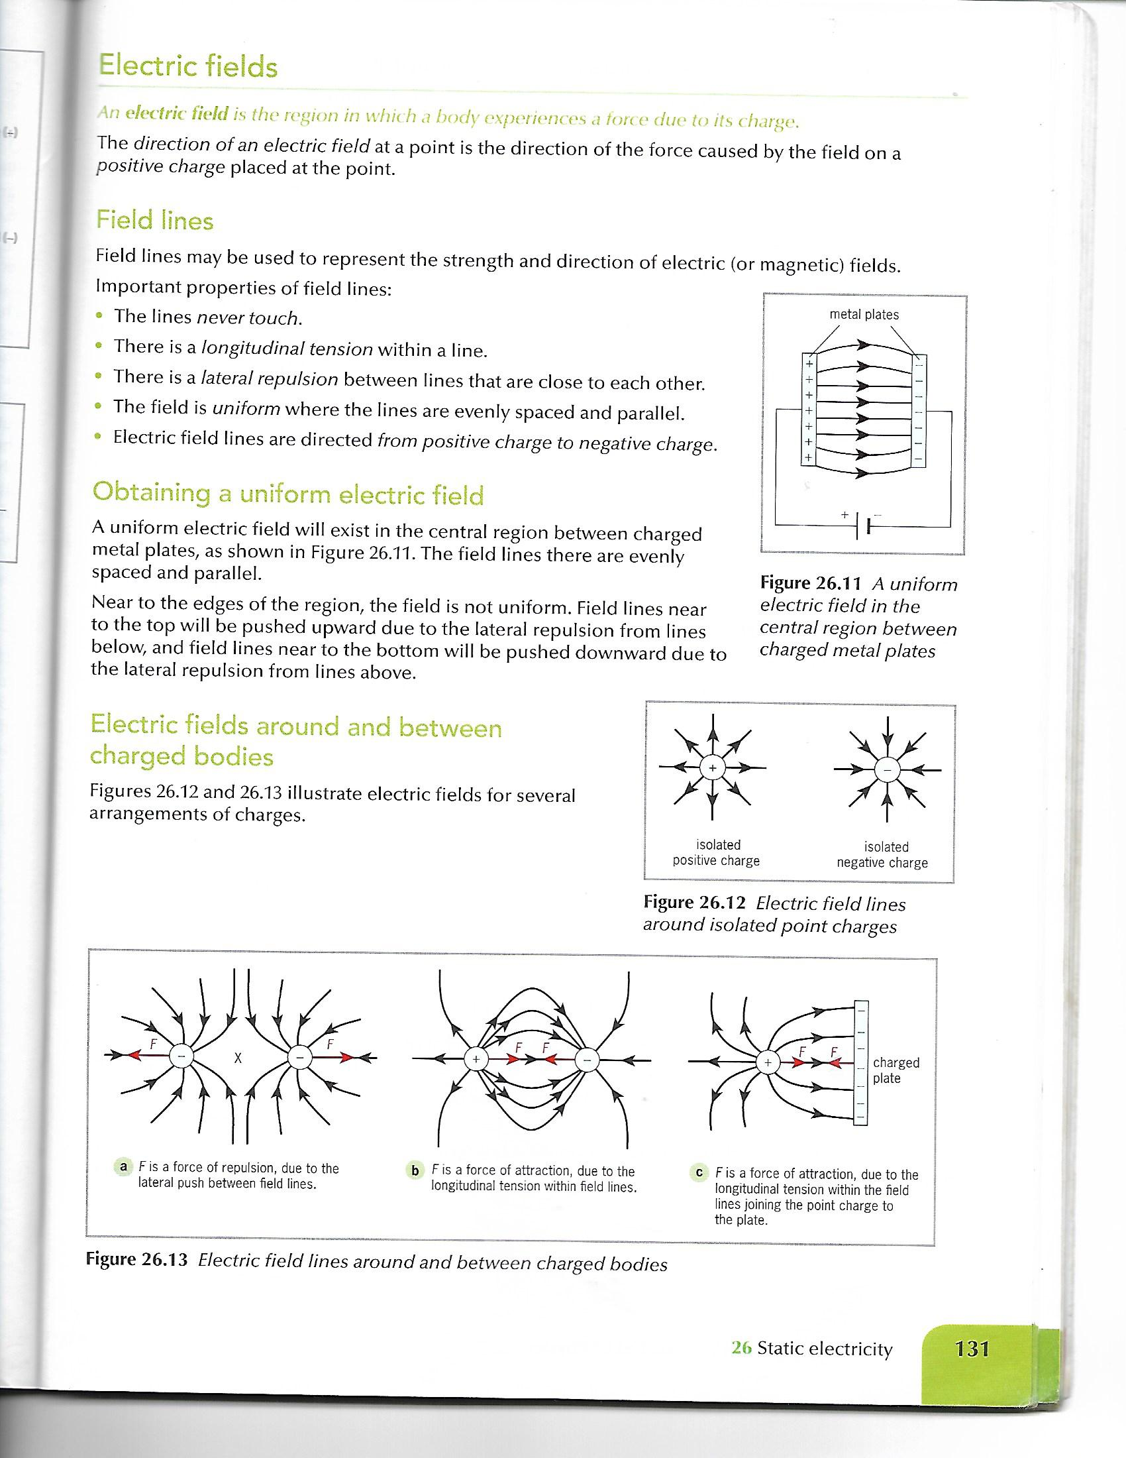
Field Lines
Field lines may be used to represent the strength and direction of electric (or
magnetic) fields.

Slide 20
Field Lines
Important properties of field lines are:
1. The lines never touch.
2. There is a longitudinal tension within a line.
3. There is a lateral repulsion between lines that are close to each other. Field lines at the top and bottom of the plate bulge because of lateral repulsion – these are not uniform.
4. The field is uniform where the lines are evenly spaced and parallel.
5. Electric field lines are directed from positive charge to negative charge.

Slide 21
Electric Field Lines Around and Between Charged Bodies

Slide 22
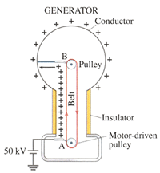
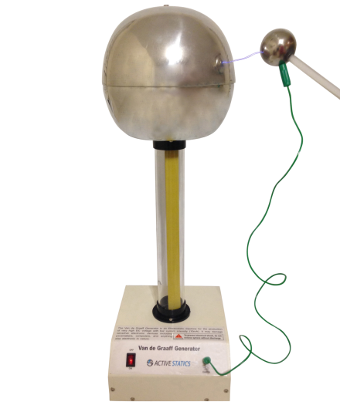
The Van de Graaff Generator
Rubbing a rod with a cloth can only separate a small amount of charge.
A Van de Graaff generator
can be used to investigate
the effects of electric charge.
To produce a larger build-up
of charge a Van de Graff (VdG)
generator can be used.

Slide 23
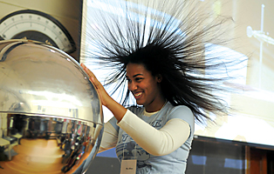
How the Van de Graff Generator Works
If you touch the (VdG) generator, all that electricity will go through your body giving you a big shock. It can actually be dangerous.
You can be protected from the ground by standing on a piece of rubber or plastic.
We say plastic and rubber are insulators since charges can't travel through them very easily. When you touch the generator now, the charges can't get to the ground.
You are now filled up with electrons. The electrons
don't like each other and are trying to get as far
away from each other as possible. Usually this makes
your hair stand up because it is filled with electrons
that are repelling each other.
Below are links to videos illustrating how the Van de Graaff generator
works.
Explanation of how the Van de Graff generator works:
https://youtu.be/EsZQS2GOMQE
Explanation of why you don’t get shocked while sitting in a car:
https://www.youtube.com/watch?v=eNxDgd3D_bU

Slide 24
Electric Current

Slide 25
Electric Current
The flow of electric charge is a current.
The flow of charge is caused by a potential difference between two points.
The unit of current is ampere, A.
Quantity of charge is measured using a unit called the coulomb, C, where:
Q = I t
Q = quantity of charge measured in units of coulombs, C
I = current measured in units of amperes, A
t = time measured in units of seconds, s
**1 C = 1 As (ampere second)

Slide 26
Current in Circuits
Electrical charges move around circuits in a current.
In an electrical circuit a current is used to transfer energy to electrical devices.
Current is the flow of electrons through a conductor.

Slide 27
Current in Circuits
Current is never used up as it travels throughout a circuit it just releases energy in the components making up the parts of the circuit as it passes through them.
It is the same mechanism blood uses in the human circulatory system. Blood passes on oxygen to all organs in the body to keep them alive, energized and replenished.

Slide 28
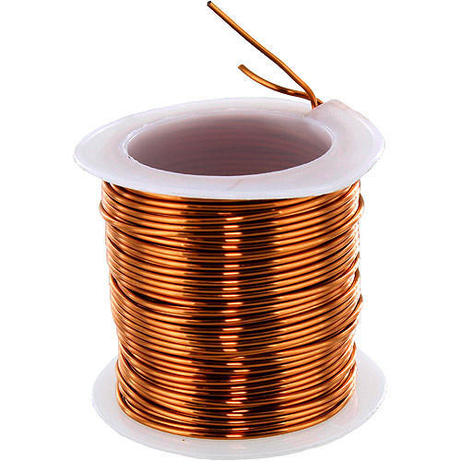
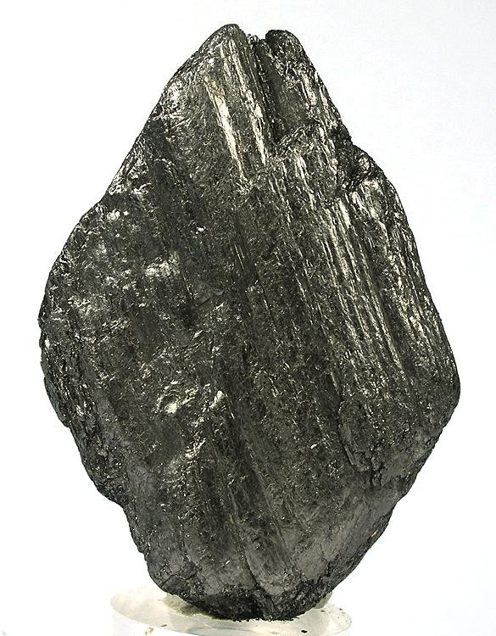

Electrical Conductors

Slide 29
What Conducts Electricity?
Materials which conduct electricity are called conductors.
There are three types of conductors:
Metals (via mobile electrons)
Graphite (via mobile electrons)
Electrolytes (via mobile ions)

Slide 30
What Conducts Electricity?
Metals are composed of a lattice of positive ions surrounded by a ‘sea’ of delocalized electrons which are mobile. This allows for the easy movement of electrons through it.

Slide 31
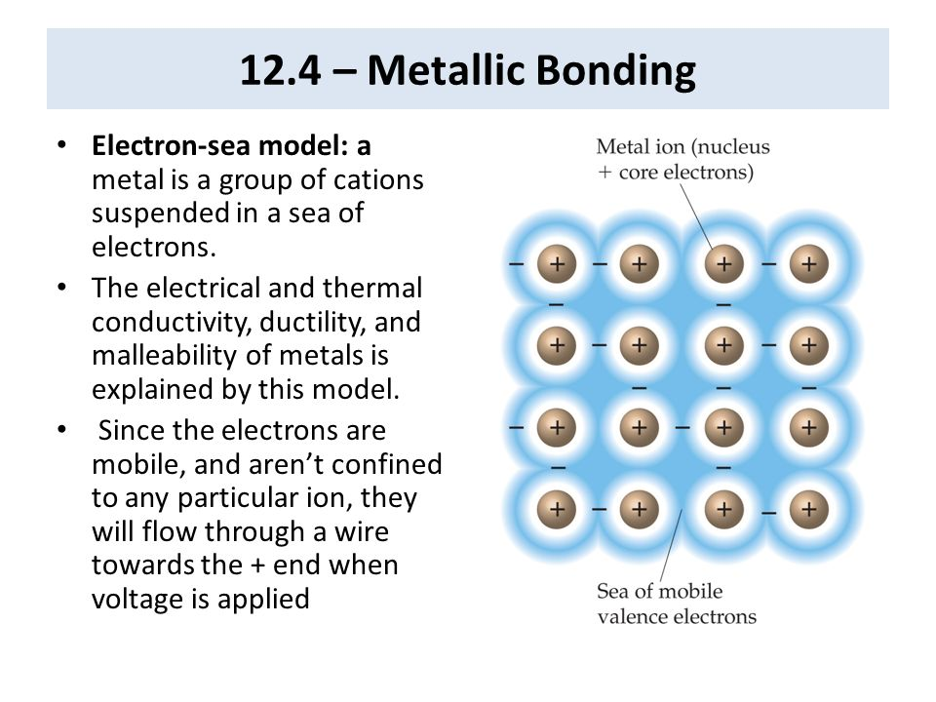
Why are Metals able to Conduct Electricity?

Slide 32
Why is Graphite able to Conduct Electricity
Graphite is composed of only carbon atoms which have 4 valence electrons.
They are arranged in a hexagonal shape forming planes which glide past each other.
Each carbon atom, within graphite, is bonded only 3 times to its neighbouring carbon atom leaving 1 electron free.
This makes graphite, a non-metal, a conductor of electricity because it contains mobile electrons just like in a metal.

Slide 33
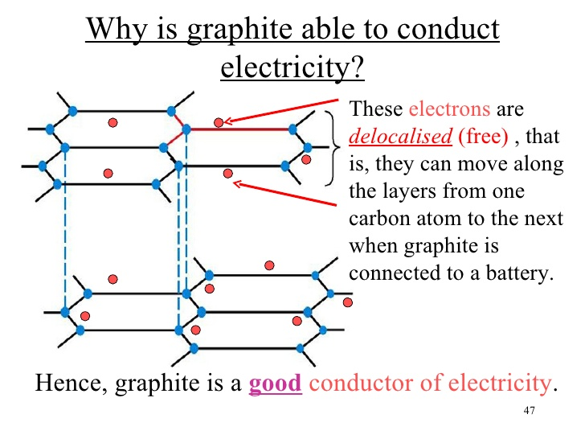
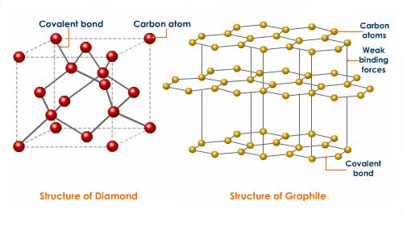
Why is Graphite able to Conduct Electricity

Slide 34
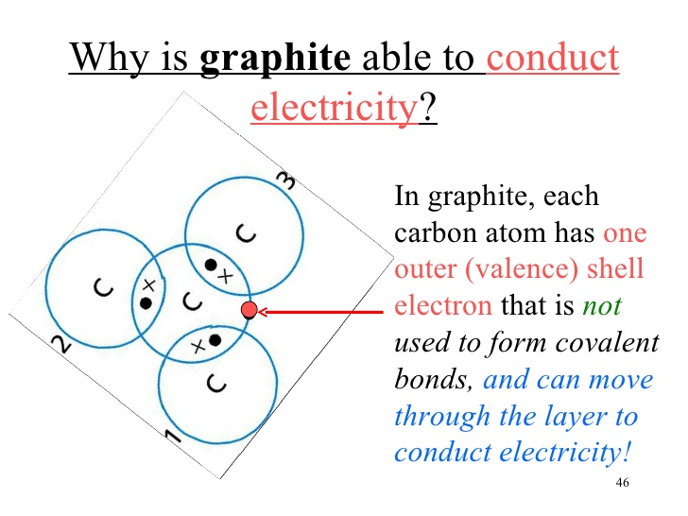
Another Perspective on Why Graphite is able to Conduct Electricity

Slide 35
What are Electrolytes and Why are they able to Conduct Electricity
Electrolytes can be aqueous salt solutions or molten salts.
Once a salt is dissolved in water in actuality the salt breaks apart into it its respective cation and anion.
A cation is a positive particle and an anion is a negative particle.
It is these ions which allow for the free movement of electrons through the solution via a process referred to as electrolysis.
Electrolysis is the decomposition of an electrolyte via an electric current.

Slide 36
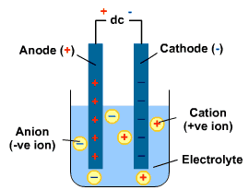
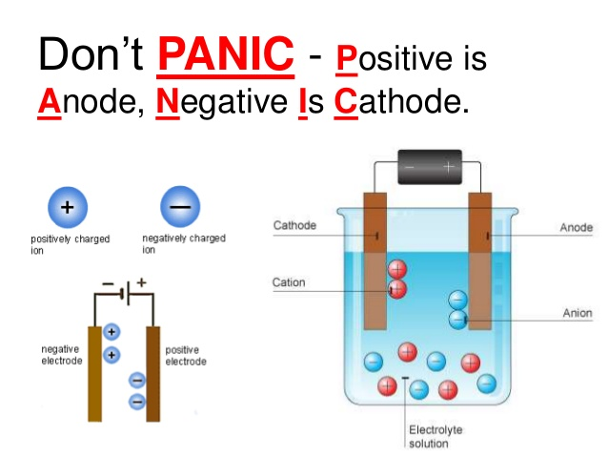
Electrolysis

Slide 37
Insulators
Materials that do not conduct electricity are referred to as insulators.
They do not contain any free electrons or other charge carriers making it difficult for current to flow through them.

Slide 38
Semi-Conductors
Semiconductors are materials which lie between conductors and insulators.
Silicon is a semiconductor and it is able to conduct electricity via human manipulation. Atoms of another semiconductor, example germanium, are added to it. This is a process called doping.
There are two types of doping: N-doping and P-doping where N means negative and P means positive.

Slide 39
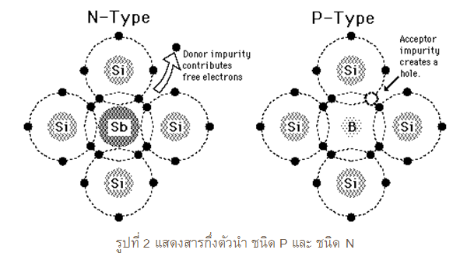
Semi-Conductors
Semiconductors are used in diodes and transistors.

Slide 40
Electrical Energy and Transformations
In circuits the positive terminal of a battery or power supply is at higher potential than the negative terminal.
The voltage produced by an electrical power source is called the electromotive force, e.m.f.
The voltage across an electrical component is called the potential difference, p.d.
Both are measured in volts and are often referred to as voltages.

Slide 41
Electrical Energy and Transformations
Potential difference is the cause of the movement of charge.
In electricity the energy change depends on the size of the charge and the potential difference it moves through.
Potential difference, p.d., is measured in voltage, V.
Potential difference = energy transferred × charge
OR
V = E Q

Slide 42
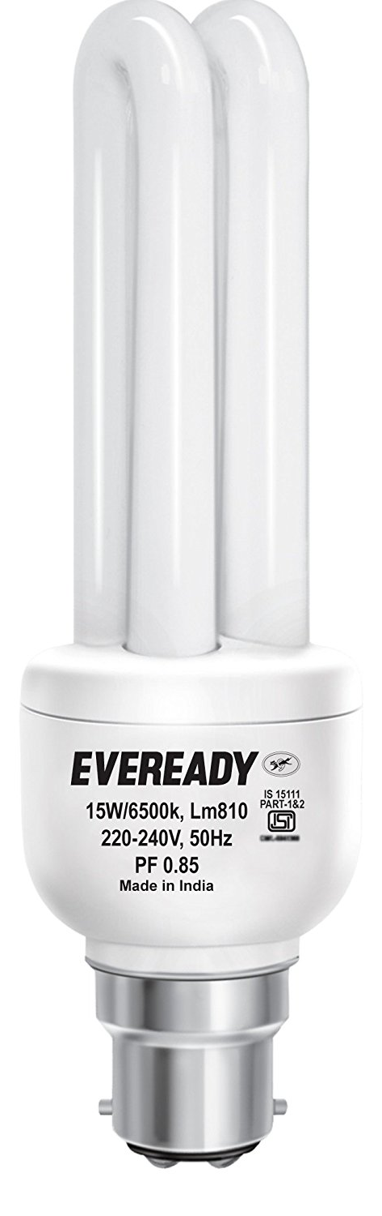
Electrical Power
The power of an electrical device is the
rate at which it transfers energy.
Electrical power is measured in watts, W,
where:
Power = Current × Voltage or P = I V
and If V = EQ where Q = I t then V = E I t
When transposing I V = E t
From above if P = I V then P = E t as well

Slide 43
Electrical Transformations
Electrical energy can be transformed in many useful ways.
For example:
A light bulb
Mechanical energy - switch is turned on
Electrical energy - circuit is completed in the switch to allow the flow of electrons
Light energy - the bulb gives off light
Heat energy - the bulb generates heat
Sound energy - the mechanisms of the bulb starts to buzz

Slide 44
Conversion of Energy
Scientists have looked at lots of energy changes, like lighting a bulb, and have carefully measured the total energy before and after the change.
They find that:
the total energy before a change = the total energy after a change.

Slide 45
Examples of Energy Conversions
Watching Television
When you watch TV, the energy change may be:
electrical → light energy + sound energy + heat energy
Shining a Torch/Flashlight
These are the energy changes which take place in a torch:
chemical energy (cells) → electrical energy (wires) → heat + light from the lamp

Slide 46
Examples of Energy Conversions
Using Solar Panels
Solar panels use energy radiated directly from the sun to heat the water that circulates through the black panels you see on some roofs:
solar energy (SUN) → heat energy stored in water inside the solar panel system
A Nuclear Power Station
Here the energy changes in a nuclear power station that generated electricity:
nuclear energy → heat energy in steam → kinetic energy of turbines in generator → electrical energy

Slide 47
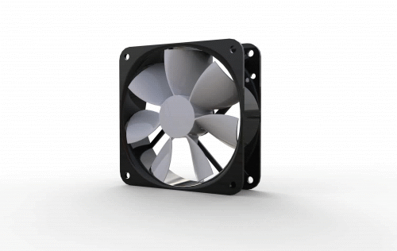
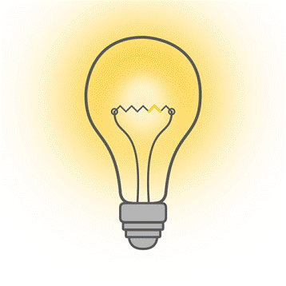
Appliances in the Home
The appliances we use at home are not 100 % efficient and so they waste energy via conversion of energy.
Appliance | Useful Energy | Wasted Energy
Fan | Kinetic | _______ and Heat
Cake Mixer | Kinetic | Sound and Heat
Light Bulb | __________ | __________

Slide 48
Conservation of Energy
The Conservation of Energy states:
Energy is neither created nor destroyed it is transferred from one form to another.
Most of the production of electricity relies on burning fossil fuels.
These fuels are only available in limited quantities and so reducing their use is important.
How can we conserve some of these resources?

Slide 49
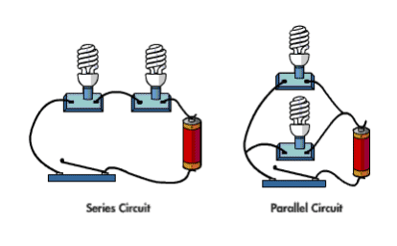
Circuitry

Slide 50
Simple Circuits and Components
There are TWO types of simple circuits:
Series - one pathway for current to flow, current is the same in all components
Parallel - different pathways for current to flow, current is not the same in all components

Slide 51
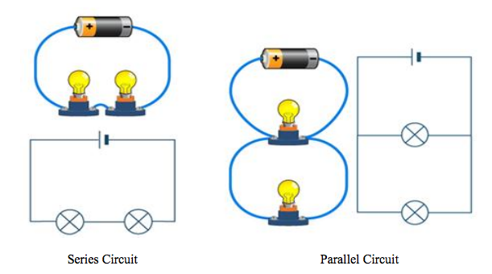
Comparing Series and Parallel Circuits

Slide 52
Combination Circuitry is Used to Wire a House
It is better to wire a house using a combination of series and parallel circuits because if a light blows or if an appliance stops working the other appliances in the household will continue to work.
If a house is wired using only series circuits what would happen?

Slide 53
Advantages of Parallel Connection of Domestic Appliances
Appliances can be switched on and off without affecting each other.
If they were connected in series switching off one appliance would cause all to turn off.
Most people rely on electrical appliances. However, they have to pay for the electrical energy they use.

Slide 54
Advantages of Parallel Connection of Domestic Appliances
Electrical boards measure energy consumption using electricity meters in homes.
The unit of energy used is call a kilowatt-hour (kWh).

Slide 55
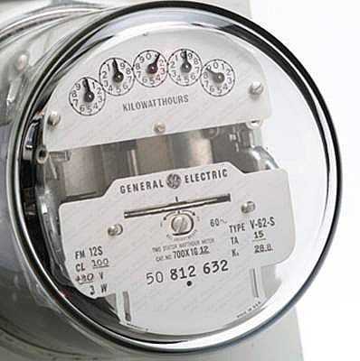
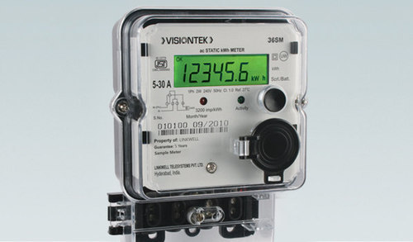
Advantages of Parallel Connection of Domestic Appliances
Electricity meters can either be analogue display (where the dials rotate for each digit)
or they can be digital display (where numbers change and can be read directly)

Slide 56
How are Meters Read?
Every month the electricity supplier sends someone to read the meter.
The amount of kilowatts used for the month is then recorded and you are charged accordingly.
In addition to the current you used, some companies make you pay a standing charge even if you did not use any electricity.

Slide 57
How are Meters Read?
Digital meters are modern meters which can be read directly.
An analogue meter has dials. Each dial represents one digit of the present reading. The dials move both clockwise and counter clockwise.
1. The dials are read from right to left and the numbers are written in the same order.
2. When the hand on any dial is between two numbers the smaller number is read.
3. When the pointer seems to be directly on a number write that number down.
4. When the number is between 0 and 9, 0 is considered as 10 hence 9 should be written down.
5. When the number is between 0 and 1, 0 should be written down.

Slide 58
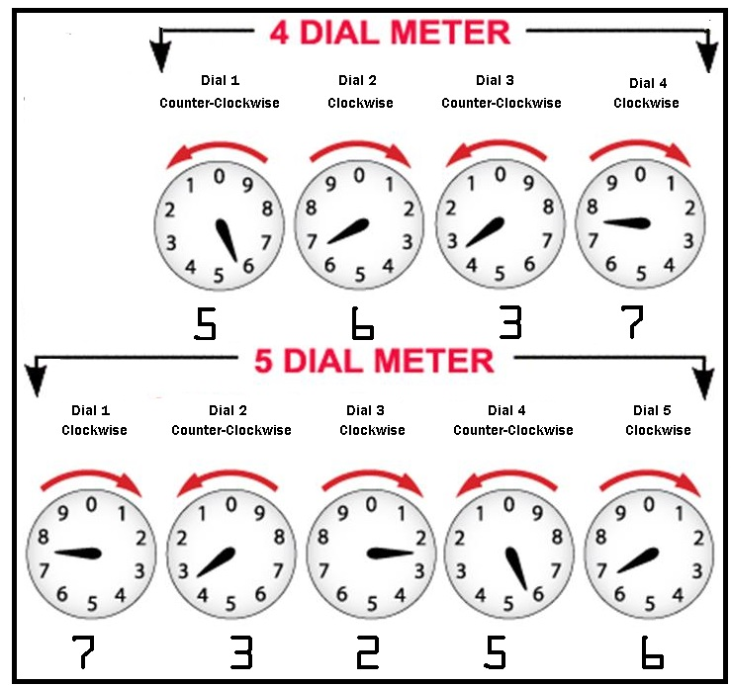
Reading Analogue Meters

Slide 59
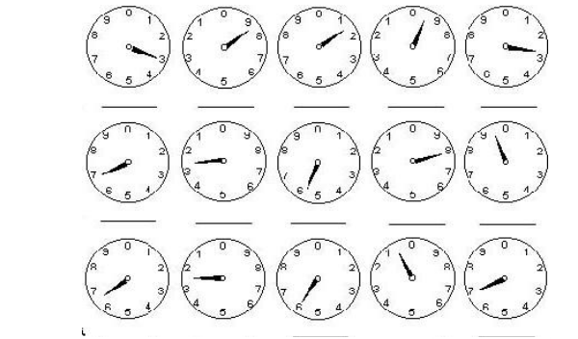
Reading Analogue Meters

Slide 60
Calculating Use of Electrical Energy
In order to determine the amount of electrical energy used, subtract the previous reading from the present reading to determine your usage.
The total cost is calculated based on the cost of one unit.

Slide 61
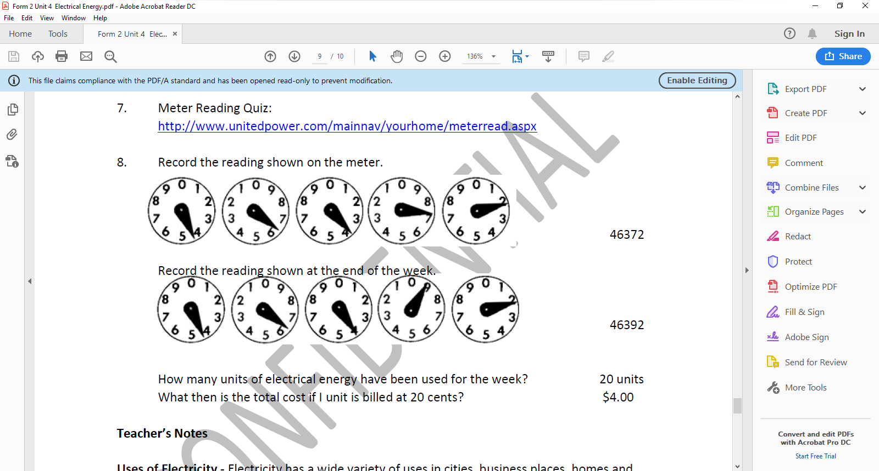
Calculating Use of Electrical Energy
An example of how to read the meters.
Meter reading the week before: 46372
Meter reading the week before: 46492
1. How many units of electrical energy have been used for the week?
(46492 – 46372) = 120 kWh ~ 120 units
What is the total cost if 1 unit is billed at 30 cents?
(120 units × 0.30 c) = $ 36

Slide 62
Calculating Use of Electrical Energy
The power rating of the appliance and the time frame in which it is used are needed in order to find out the electrical energy used.
If a light bulb of 15 W is used for 2 hours then the amount of electrical energy used is:
first convert 15 W to kW by dividing by 1000 then multiply by the amount of hours
0.015 kW × 2 h = 0.03 kWh
kWh may also be referred to as units. The kilowatt-hour (kWh) is the unit of energy shown on electricity bills and electricity meters.

Slide 63
Converting between kW → W and visa versa W → kW
To go from kW → W, multiply by 1000
To go from W → kW, divide by 1000
Try the following:
a. 2 kW = _______ W
b. 45 kW = _______ W
c. 780 kW = ______ W
d. 6000 W = _______ kW
e. 903 W = ________kW
f. 13 000 W = _______ kW

Slide 64
Calculating the Cost of Electrical Energy
A consumer used 100 units (kWh) of electricity in a month.
The first 50 units were charged on a Block 1 tariff of 60 cents per kWh, and the next 50 units were Block 2 at 70 cents per kWh. The fuel surcharge was 40 cents per kWh used.
What did the consumer pay for their electricity?

Slide 65
Calculating the Cost of Electrical Energy
Block 1 Charge : 0.60 c × 50 units = $ 30
Block 2 Charge : 0.70 c × 50 units = $ 35
Fuel Surcharge : 0.40 c × 100 units = $ 40
Cost of electricity bill = $ 30 + $ 35 + $ 40 = $105

Slide 66
Calculating the Cost of Electrical Energy
A consumer used 200 units (kWh) of electricity in a month.
50 units were charged on a Block 1 tariff of 60 cents per kWh, and the next 150 were Block 2, charged at 70 cents per kWh.
The fuel surcharge was 40 cents per kWh used.
What was the total electricity bill?

Slide 67
Calculating the Cost of Electrical Energy
Block 1 Charge : 0.60 c × 50 units = $ 30
Block 2 Charge : 0.70 c × 150 units = $ 105
Fuel Surcharge : 0.40 c × 200 units = $ 80
Cost of electricity bill
= $ 30 + $ 105 + $ 80 = $ 215

Slide 68
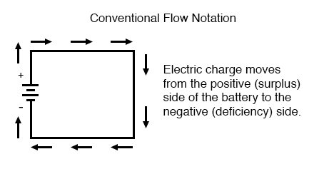
How Electrons Carry Energy
When an electron passes
through a cell or a power
source it gains energy.
This energy, gained by the
electrons, is transferred to
the components making up
the circuit, example bulbs, radios etc.
The electron loses all of the energy it gained from the cell or power source and goes back to its original energy before it entered it.
The whole process is started over again once the electron enters the cell or power source again.

Slide 69
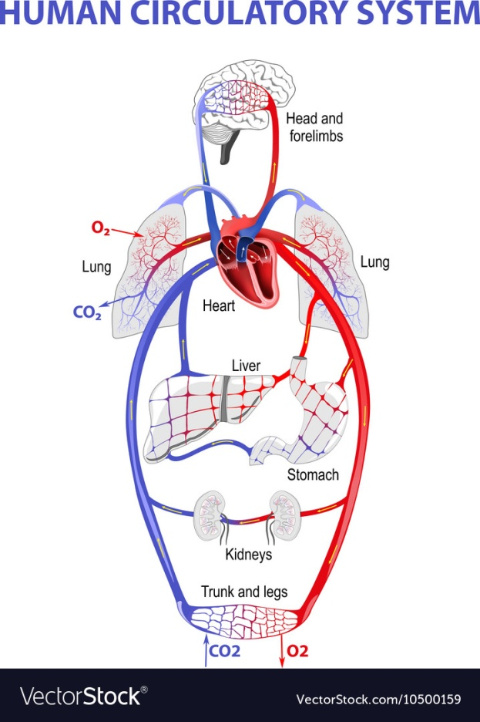
Human Circulatory System
The way an electron transfers
energy is synonymous to the way
blood, in the human body, transfers
oxygen to all of the organs.
Blood picks up oxygen in the lungs
while at the same time releasing
carbon dioxide from the body.
Oxygen is used by the body to replenish the organs which keeps them alive.

Slide 70
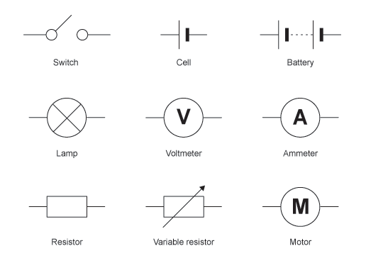
Symbols in Circuitry
…..more symbols can be viewed via the physics CSEC study guides.

Slide 71
Comparing Series and Parallel Circuits
Series | Parallel
The current has only one pathway | The current has many pathways
Current is the same in all of the components that make up the circuit | Current is not the same in all of the components that make up the circuit
Potential difference or voltage is not the same | Potential difference or voltage is the same

Slide 72
Cells and Batteries

Slide 73
Cells & Batteries
The electromotive force (e.m.f.) required to drive a current can be produced by chemical reactions between acids and metals.
Each cell has two terminals or electrodes:
One is POSITIVE and the other is NEGATIVE
Cells are restricted in the size of the current they can provide by their internal resistances which are due to their physical and chemical composition.

Slide 74
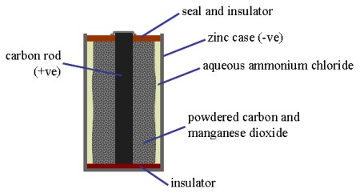
Typical Cell
A typical cell is a primary cell.

Slide 75
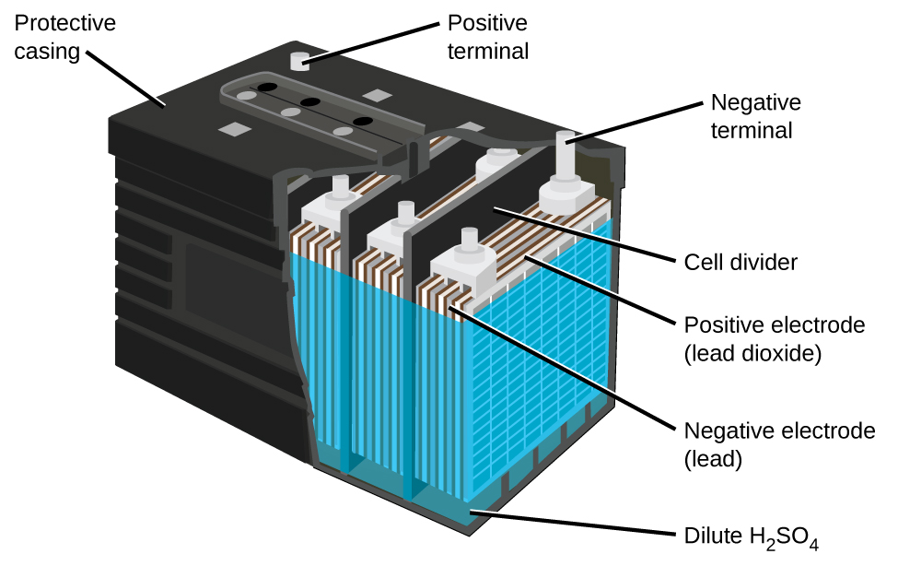
Car Battery
Car batteries are secondary cells.

Slide 76
Primary and Secondary Cells
Primary cells | Secondary cells
Most common type of primary cell is the zinc-carbon cell | Most common type of secondary cell is the lead-acid cell
The chemical reaction which produces the e.m.f. cannot be reversed | The chemical reaction which produces the e.m.f. can be reversed by applying a potential difference in the opposite direction to the cell.
They cannot be recharged or reused | They can be recharged and reused
An e.m.f. of 1.5 V is produced when the negative zinc case, positive carbon rod and aluminum chloride paste reacts | An e.m.f. of 2.0 V is produced when a reaction occurs between the negative lead plates and the positive lead oxide plates and dilute sulphuric acid.
They have high internal resistance therefore it can not produce very large currents, maximum being 1 A. | They have very low resistance and can provide very large currents
Once used, chemical reactions continue to take place even when they are not in use. Over time they become useless. | Chemical reactions only take place when in use so they last longer

Slide 77
Resistance

Slide 78
Resistance
Resistance is a measure of the opposition provided to an electrical current; it is the ratio of the pd across a conductor to the current through it.
When electrons flow through a conductor, they are obstructed by vibrating atoms in their paths. These atoms therefore decrease the rate of flow of the electrons and hence the current.

Slide 79
Using Electrical Meters
Electrical meters are used to measure both current and potential difference but the meters must be placed carefully in order to operate correctly.

Slide 80
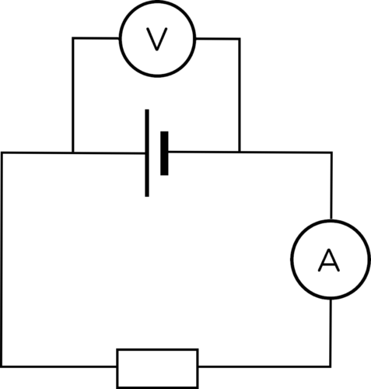
Typical Circuit Set Up Using Electrical Meters
The diagram above illustrates how a voltmeter (in parallel with the component being tested) and an ammeter (in series) is placed within a circuit

Slide 81
Resistance
All components have a resistance to a current.
Metal wires have low resistance while glass rods have a high resistance to current.

Slide 82
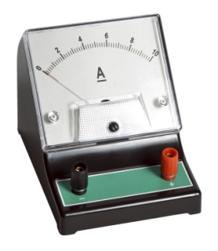
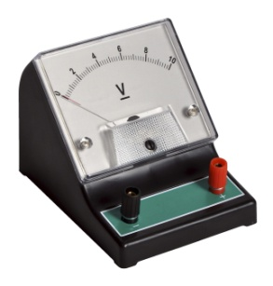
Comparing and Ammeter to a Voltmeter
Ammeter | Voltmeter
Used to measure the current at a point in a circuit | Used to measure the potential difference between two points in the circuit
It is placed in series with the other components, placing the meter in this position reduces the current | It is placed in parallel with the components that is measuring the potential difference across
Has very low resistance to allow the easy passage of current | Has very high resistance so that almost no current will pass through them

Slide 83
Calculating Resistance
R = V ÷ I
The unit for Resistance is the ohm, Ω

Slide 84
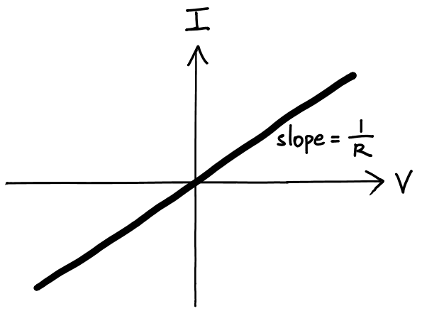
Ohmic Conductors
A simple metal wire will have a constant resistance as long as its physical properties and conditions do not change.
The relationship was discovered by Georg Ohm and is called Ohm’s law:
The current through a
conductor is directly
proportional to the
potential difference
across it
The constant of proportionality is RESISTANCE.

Slide 85
Ohmic Conductors
Materials which obey Ohm’s law, have constant resistance, they are called ohmic conductors.
If a material is an ohmic conductor, a graph of I against V, or V against I, is a straight line through the origin.
In some materials, resistance is NOT constant, this behaviour is classified as non-ohmic.

Slide 86
Ohmic Conductors
Metal wires conduct best when they are short and fat. They are ohmic conductors.

Slide 87
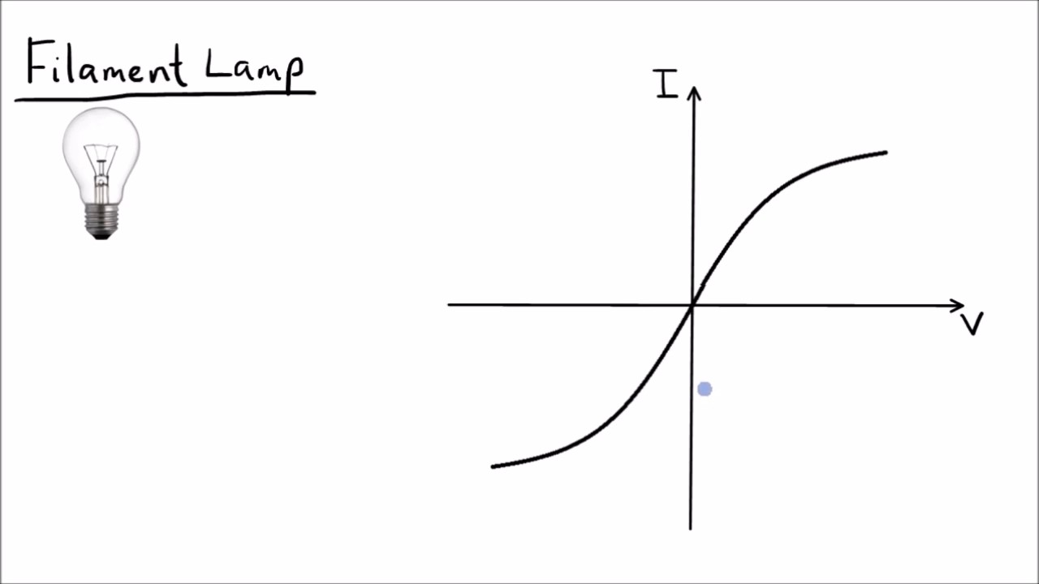
Ohmic Conductors
Filament lamps
conduct best when
current passing
through them is
low. If the current
is increased the
filament will get very
hot increasing resistance to the current passing through it. Filament lamps behave as ohmic conductors once the wire does not get too hot.

Slide 88
Ohmic Conductors
Ionic solutions or
electrolytes have
a higher resistance
to current than
metals. The more
concentrated the
electrolyte the less resistance there is to current passing through it. Instead of electrons the charge carriers are ions present in the electrolytic solution.

Slide 89
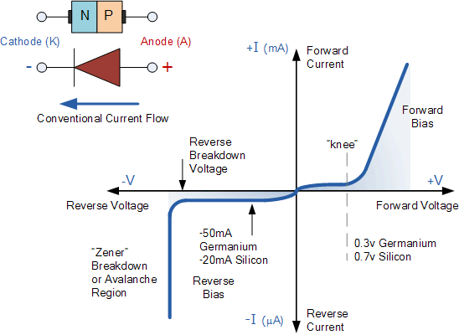
Ohmic Conductors
In semiconductor
diodes are not
ohmic conductors.
When a negative voltage
is applied to it the diode
experiences a very high
resistance so very little
current passes through it
and is said to be in reversed biased.
In forward biased the semiconductor diode has even higher resistance and almost no current passes through it.

Slide 90
Where, How and Why are Resistors used
Resistors are used within circuits to limit the amount of current entering components in order to protect them.
Variable resistors may be used instead of normal resistors because their resistance can be altered by turning a dial or moving a sliding contact.

Slide 91
Types of Resistors
Types of resistors | Description | Uses
Light-dependent | Have low resistance in bright light and very high resistance in low light | Can be used to build light sensors and switch on lighting systems automatically when it gets dark
Thermistor | Their resistance changes depending on temperature | Can we used to control heating or cooling systems

Slide 92
Calculating Resistance in Series and Parallel Circuits
To calculate the total resistance of resistors in series simply add:
R_{s} = R₁ + R₂ + R₃ …
To calculate the total resistance in parallel simply use the following equation:
1/R_{p} = 1/R₁ + 1/R₂ + 1/R₃ ...

Slide 93
Direct and Alternating Current

Slide 94
Direct and Alternating Current
Direct current (d.c.) | Alternating current (a.c.)
Produced via cells and batteries | Produced via a generator
Travels in one direction (from positive to negative) | Reverses its direction rapidly many times each second
Has a fixed size | Its size varies

Slide 95
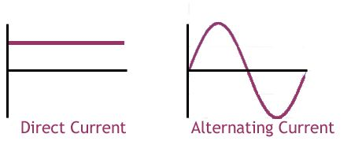
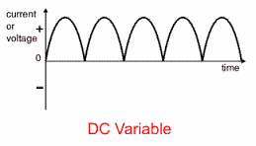
Direct and Alternating Current

Slide 96
Frequency
Frequency = 1 ÷ time it takes for one complete oscillation (T)
Frequency is measured in Hertz, abbreviated as Hz, or 1/s which is the same as s⁻¹.

Slide 97
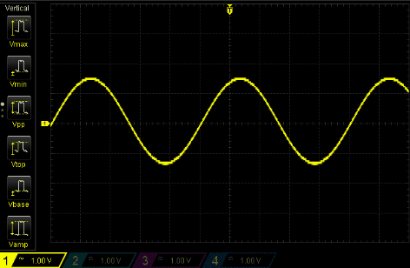
Digital Oscilloscope
Cathode-ray oscilloscopes are expensive and can be difficult to operate
Most waveform analysis is now carried out using digital oscilloscopes which can be connected directly to a computer.

Slide 98
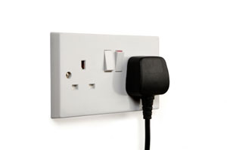
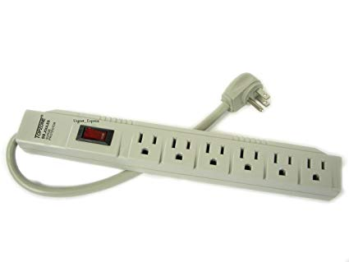
Plugs and Sockets

Slide 99
Mains Electricity in the Caribbean
Mains electricity is supplied as alternating current.
Mains supply is usually noisy due to interference from other electrical devices.

Slide 100
Mains supply in some Caribbean islands
Island | Voltage (V) | Frequency (Hz)
Barbados | 115 | 50
Cuba | 110 | 60
Jamaica | 110 or 220 | 50
St. Kitts and Nevis | 110 or 230 | 60
St. Martin | 120 or 230 | 50
Trinidad and Tobago | 115 | 50
The mains supply voltage and frequency varies from island to island in the Caribbean,
as illustrated above, for historical reasons.

Slide 101
Ring Mains
An electrical configuration called a ring main is used as the basis for the connection of domestic power sockets.
Two or three wires are used in the ring main and they are thick enough to provide a current to several devices at once without overheating.

Slide 102
The Wires of the Ring Mains
Type of wire | Colour of wire | Description
Live | Brown | Provides the power and operates at a high voltage
Neutral | Blue | Completes the circuit, allowing the current to flow in a closed circuit
Earth | Green & Yellow | Grounds the circuit to avoid severe shocks or even electrocution

Slide 103
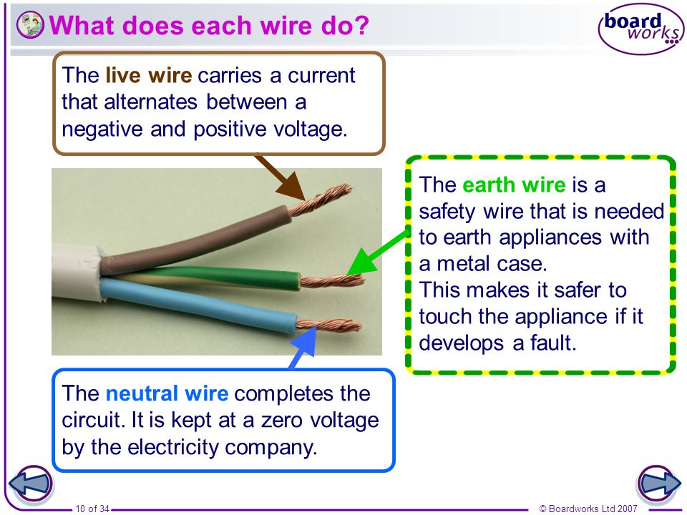
An illustration of the Wires Present in the Ring Mains

Slide 104
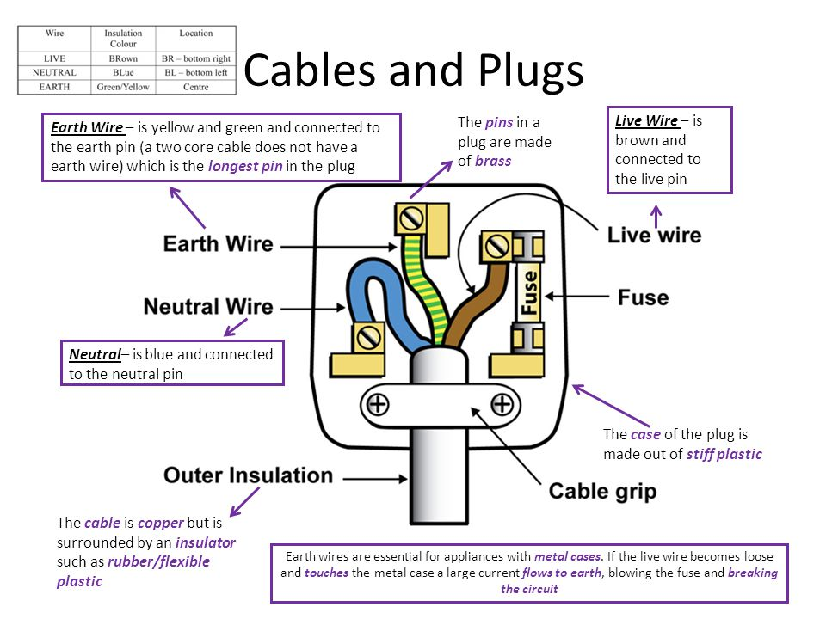
An illustration of how a three pin plug is wired

Slide 105
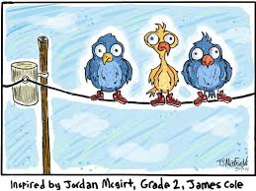
Why don’t birds get electrocuted but humans do if they perch on electrical lines?
https://www.youtube.com/watch?v=rN3QhtnlCSw

Slide 106
Plugs and Sockets
In the Caribbean there are two main plugs and sockets used and these are referred to as Type A and Type B.
Type A plugs have only two pins which connect to the live and neutral wires.
Type B plugs have three pins. The additional pin is connected to the earth wire.

Slide 107
Plugs and Sockets
A type A plug should not be inserted into a type B socket
What would happen if a 110 V device is connected to a 220 V device?
What would happen if a 220 V device is connected to a 110 V device?
Connecting a device designed to operate with a 50 Hz supply to a 60 Hz supply, or the reverse, is also likely to damage the device as its electrical components will not function correctly
Why shouldn’t you change the plug on an electrical device from a type B to a type A?
What advantages does a ring main provide?

Slide 108

Mains Safety
Mains electricity is dangerous. It can kill you!
Protective devices are used to reduce harm to you or the device being used.

Slide 109
Table showing some Protective Devices
Protective devices | Description | Effectiveness
Fuses | Prevents current overload in a device. It also prevents fires from starting. Its wire is so thin that it melts when too much current passes through it. | Does its job but has to be replaced once it has been used
Circuit breakers | Prevent current overload in a device. It uses an electromagnet to break the circuit when the current is too large. | It does its job faster than a fuse, it is more sensitive and does not have to be replaced it only has to be reset.
The Earth wire | The wire provides a low resistance route for the current to pass to Earth therefore the current will not pass through the user | Quite effective. Avoids shocks and or electrocution if the live wire become loose and defective.

Slide 110

Various Protective Devices

Slide 111

What if there were NO Earth Wire
If the case is metal and
is in contact with the live
wire, a user can receive a
fatal shock on touching it.
A fuse alone would not help
since touching would simply re-complete the circuit...the user being the path of least resistance for the current hence electrocution or shock.
Some devices automatically protect the user because they are made from insulating materials such as plastic.

Slide 112
Alternating and Direct Current

Slide 113
Conversion of alternating to direct current
Alternating current is much easier to produce from the generators in power stations.
Some devices, including computers, require current at very steady voltage levels to operate correctly.

Slide 114
Rectification
The process of converting an alternating current to a direct current is called rectification.
Rectification relies on the properties of diodes.
The most common function of a diode is to allow an electric current to pass in one direction (called the diode's forward direction), while blocking current in the opposite direction (the reverse direction).

Slide 115

Diagram of a Diode

Slide 116


Slide 117
Half-wave Rectification
The current provided by half-wave rectification is direct in the sense that it is only in one direction.
Applying a diode to obtain direct current is inefficient since there are gaps in the flow of current. To help with this a capacitor is used.

Slide 118

Capacitors
A capacitor is a device which stores charge for a short period of time. Adding it on to the simple half-wave rectifier (diode) produces a smoothed direct current.
When the voltage is rising and there is a current in the load some charge will be stored on the capacitor. When there is low voltage causing low current load the capacitor is able to release charge from its plates and provide a current. The capacitor provides continuity of current when a diode is being used making their use together more efficient.

Slide 119


Full-wave Rectification
In half-wave rectification you can see that only half of the alternating current is actually producing a useful direct current.
A more complicated circuit involving four diodes can be used to produce a positive potential difference even when the alternating supply is producing a negative voltage.
This gives full-wave rectification which supplies a much steadier d.c. supply.
Smoothed full-wave rectification

Slide 120
Logic Circuits

Slide 121
Logic Gates
Binary numbers can be represented physically in a number of ways.
In electronics they are represented as two voltage levels:
High which represents the digit 1 and is called logic 1
Low which represents the digit 0 and is called logic 0

Slide 122

Logic Gates
A logic gate is an electronic component which processes a binary input and produces a binary output based on a set of rules.
At this level below are the five logic gates you are expected to learn:

Slide 123
Truth Tables
Truth tables show the output states of a logic gate for all of the possible inputs to the gate.
These allow us to easily determine what the output would be when the gates are connected to input sources.

Slide 124
Logic gates and their truth tables
OR gate outputs may be
remembered like this:
A. nothing (0) from
nothing (0) gives you
nothing (0).
B. Something (1) from
nothing (0) gives you
something (1).
C. Nothing (0) from
something (1) gives
you something (1).
D. Something (1) from something (1) gives
you something (1).
NOR gates would give the opposite response. For example:
nothing (0) from
nothing (0) will NOT give you nothing (0) but will give you something (1).
AND gate outputs
may be remembered
like this:
A. 0 multiplied by 0 = 0
B. 0 multiplied by 1 = 0
C. 1 multiplied by 0 = 0
D. 1 multiplied by 1 = 1
Gate | Function High voltage = 1 Low voltage = 0 | INPUT A | INPUT B | OUTPUT
OR | OUTPUT = 1 If A OR B = 1 | 0 0 1 1 | 0 1 0 1 | 0 1 1 1
AND | OUTPUT = 1 If A AND B = 1 | 0 0 1 1 | 0 1 0 1
NOR | OUTPUT = 0 If A OR B = 1 | 0 0 1 1 | 0 1 0 1
NAND | OUTPUT = 0 If A AND B = 1 | 0 0 1 1 | 0 1 0 1
NOT | OUTPUT = 1 If INPUT = 0 OUTPUT = 0 If INPUT = 1 | 0 1 | - - | 1 0
The OR gate can
be seen as an addition
gate while the AND
gate can be seen as
a multiplier gate.

Slide 125
Combining Logic Gates
Logic gates by themselves are limited in their use.
However, when they are combined together they can be used to process information and cause actions to be taken.
To work out the output for any collection of gates draw up a truth table representing all of the possible input combinations. For each set of inputs in turn work your way through the logic combinations and find the output. Keep going until you have found the outputs for all of the possible input combinations.

Slide 126
Logic Sensors

Slide 127
Impact of Electronic and Technological Advances in Society
Pros:
A. Businesses get a competitive edge when they use advanced technologies.
B. The global pooling of information increases the rate of research and development.
C. Improved transport through airplanes and trains, as well as better communicating devices such as cell phones and computers, has led to more efficient business transactions and to an increase in social contact.
D. Better machinery leads to increased and improved productivity.
E. Electronic banking has facilitated the process of financial transactions.

Slide 128
Impact of Electronic and Technological Advances in Society
Cons:
A. Incorrect information is common on the internet.
B. Individuals can be addicted to social networking to such an extent that their productivity decreases.
C. Excessive virtual communication may lead to lack of real communication and to a fall in social skills.
D. Exposure to movies with immoral sexual content and violence can eventually lead to some persons accepting these acts as the norm.
E. Hackers can intrude on computers and manipulate information such as bank accounts.
F. More efficient machinery can result in a decrease in available jobs.

Slide 129
Comprehension
1. What is meant by half-wave rectification?
2. Describe how ac can be converted to dc using half-wave rectification.
3. Sketch graphs to show how each of the following vary with time:
a) domestic supply ac voltage
b) domestic supply ac voltage converted to dc by a diode
c) voltage output from a battery
4. Draw TRUTH TABLES for each of the following logic gates:
a. AND b. OR c. NAND d. NOT

Slide 130
Comprehension
5. A warning light is to glow on a motor cycle if the key is placed in the ignition (logic 1) while either the tyre pressure is below 80 PSI (logic 1) or the oil level is low (logic 1). The warning light glows when logic 1 is input to it.
Draw a truth table and a circuit appropriate to this application.

Slide 131

Magnetic Energy

Slide 132

Magnetism
Magnetism is the force that attracts certain materials such as iron, nickel and cobalt.
A magnetic field is the space around a magnet where its magnetic effects can be felt.

Slide 133

Earth as a Magnet
The Earth is a large but weak magnet.
If a bar magnet is freely suspended it aligns itself in the direction of the Earth’s magnetic field.

Slide 134
Earth as a Magnet
The North Pole of Earth should be referred to as the North Seeking Pole since it is actually a South Pole attracting the North Pole of the magnet in a compass. Likewise for what is referred to as the South Pole of the Earth.
The South Pole of the Earth should be referred to as the South-seeking Pole since it is actually a North Pole attracting the South Pole of the magnet in a compass.

Slide 135

Magnetic Poles
The poles on a magnet are the areas where its magnetic strength is strongest.
A magnet is dipolar which means that it has two poles.

Slide 136
Laws of Magnetism
The laws of magnetism are:
1. Like poles repel
2. Unlike poles attract

Slide 137



Magnetic Materials
A magnetic material is a material which is attracted to a magnet or which can be magnetized.
Cobalt
Nickel
Iron

Slide 138



Magnetic Materials
Nickel, Iron and Cobalt are the ONLY naturally occurring magnetic materials.
Other magnetic materials are alloys such as steel which is a mixture of iron and carbon.
Magnets come in a variety of shapes and sizes: bar, horse shoe, U shaped and ringed.

Slide 139

Types of Magnets
There are two types of magnets:
Permanent
and
Temporary
Steel is a permanent magnet
Iron is a temporary magnet

Slide 140
Types of Magnets
Iron and mumetal are classed as soft magnetic materials and are used to make temporary magnets. They are easy to magnetise but do not retain magnetism well.
Steel is classed as a hard magnetic material. It is more difficult to magnetise but it will retain its magnetism for longer. It is used to make permanent magnets. Magnadur magnets are also permanent.

Slide 141
Comparing Permanent and Temporary Magnets
Permanent Magnets | Temporary Magnets
A permanent magnet will remain magnetized even after the cause of magnetizing is discontinued | A temporary magnet loses its magnetic properties when the cause of magnetizing is discontinued
Its strength is constant | Its strength is varied
Steel is used to make permanent magnets | Iron is used to make temporary magnets
Clasps for jewelry, compasses, credit cards (the black metallic strip at the back), doors of refrigerators and dishwashers, ornamental articles attachable to refrigerators etc. | Cranes, electric guitars, door bells, microphones, generators, in industry to lift iron and steel road and sheets, motors, loud speakers, medicine for MRI (magnetic resonance imaging), telephones, television and computer monitors,

Slide 142
Induction of Magnetism
Magnetism may be induced in some metals by a process called induction.
Magnetic induction is the process by which magnetic properties are transferred from one body to another without physical contact.

Slide 143



Induction of Magnetism
Induction may involve stroking or the application of a current to a metal.
Single Stroking
Application
of Current
Double Stroking

Slide 144

Induction of Magnetism
Magnets contain domains/dipoles.
In magnetized metals the domains/dipoles are aligned.

Slide 145
Induction of Magnetism
In metals that are un-magnetized the tiny magnets referred to as domains/dipoles are NOT aligned.

Slide 146
Induction of Magnetism
Inducing magnetism in un-magnetized metals causes the domains to align making the metal become magnetic.

Slide 147
Electromagnet
An electromagnet is made by passing an electric current through a coil of wire.

Slide 148

Electromagnets
The strength of an electromagnet is increased by:
a. Increasing the amount of current being passed through the coil
b. Increasing the number of turns of the coil around it and by
c. Using a magnetic core inside of the coil

Slide 149
Testing for Magnetism
How would you test a metal to determine if it is a permanent magnet?
A permanent magnet causes repulsion with one pole when both poles are, in turn, brought near to a suspended magnet.
An unmagnetized magnet material would give attraction with both poles of the suspended magnet.
Repulsion is the only sure test for a magnet.

Slide 150
Comprehension
Why are electromagnets more commonly used than permanent magnets?
How may electromagnets be made stronger?
Where are electromagnets used?

Slide 151
Current and Magnetic Fields

Slide 152
Currents and Magnetic Fields
The charges moving in a wire produce a magnetic field around the wire.
Current can be made to pass perpendicularly through a sheet of horizontal card/paper. Using iron filings or the compass method they will show that there is a circular field around the wire.
To determine which way the field lines loop you can use the ‘right-hand grip rule’.

Slide 153

What if the current was going in the opposite direction determine the direction of the field line using the right hand grip rule.

Slide 154
Solenoids
The magnetic field around a single wire is not strong and so coils of wire called solenoids are used.
One end of the coil acts as a north pole and other acts as a south pole.

Slide 155

Solenoids
To find the direction of the field from the direction of the current, we can use our right hand again.
Your fingers follow the direction of the current curving around the coil.
Your thumb will point in the direction of the magnetic field - NORTHWARDS.

Slide 156
Solenoids
The strength of a magnetic field produced by a solenoid may be increased by:
1. Using more loops (turns) of wire
2. Increasing the current in the wire
3. Placing an iron core inside the solenoid (this has the effect of concentrating the field lines creating a strong field at the end of the core)

Slide 157

Solenoids
Powerful electromagnets can be produced by using all of these measures.
An electromagnet
can be made by
wrapping a wire
multiple times
around a nail which is
connected to a
power source.

Slide 158

Solenoids

Slide 159

Forces from the Magnetic Field
When a wire carries a current there will be a magnetic field surrounding the wire.
If the wire is placed inside the magnetic field produced by a permanent magnet then the two magnetic fields will interact with each other.
A force will act on the wire
and the permanent magnet.
This will happen provided
that the wires are not placed
parallel to the magnetic field
lines. This is called the
motor effect.

Slide 160
What Affects the Strength of a Magnetic Field
The size of the force acting on the wire will depend on the following:
1. The current in the wire: the larger the current the stronger the magnetic field
2. The strength of the magnetic field from the permanent magnets
3. The length of the wire inside the permanent magnet’s field. The force will be greater the longer the wire is.

Slide 161
Using Flemming’s Left Hand Rule
It can be difficult to work out the direction of the force acting on a wire in a magnetic field.
Fleming’s left-hand rule (also known as the motor rule) lets us find the direction of the force acting on the wire when we know the direction of the current and the magnetic field.

Slide 162

Remember to Use Your Left Hand When a Motor is Involved!

Slide 163
Comprehension
Using Fleming’s left hand rule answer the following question:
The below shows a current-carrying wire. A magnetic field is acting into the paper. In which direction is the force acting on the wire?
In this question the magnetic field is going into this paper.
Direction of Current

Slide 164

It is the cutting of the magnetic field lines of force by the wire which places a force on the electrons within the wire which causes an induced current.

Slide 165

Investigating Induction
Pushing the magnet (north pole
first) into the solenoid
so that the magnetic field lines
pass through the loops
of wire induces a current in the
wire.
Pulling out the magnet induces a
current in the opposite
direction.
Reversing the direction of the magnet (pushing in the south pole) will also reverse the direction of the current.

Slide 166
Investigating Induction
The faster the magnet is moving
relative to the coil the greater the
current. This shows that it is the
rate that the wire moves through
the field lines that is the cause of
the increased current.
The more loops of wire in the solenoid
the greater the induced current.
The stronger the magnet the larger the induced current is.
Leaving the magnet inside the coil does not produce a current. There is no relative movement between the magnet and the conductor so no field lines are being cut.

Slide 167
Investigating Induction
The current induced in the coil will
change direction as the magnet is
moved in and out of the coil
(an alternating current).
To determine the direction of the
current in a solenoid as the magnet
moves the following solenoid rule is used:
The current induced in a solenoid always acts in such a direction as to oppose the change that causes it.
Therefore when the north end of the magnet is pushed into the coil that end of the coil acts as a north pole but when the magnet is withdrawn the magnetic field reverses.

Slide 168

D.C. Motor and A.C. Generator

Slide 169
Direct Current Motor
A direct current motor uses the motor effect to exert a force on a current-carrying wire.
The motor is designed to cause a coil of wire to rotate.

Slide 170

Direct Current Motor

Slide 171
Direct Current Motor
When the coil has rotated a half-turn the commutator will reverse the current in the coil. This means that the direction of the force on the coil will still cause the left side to be pushed upwards while the right side is pushed downwards.
As the force remains in the same direction the coil continues to spin, producing a turning moment which can be used to do work.
What would happen if the battery is turned in the opposite direction?

Slide 172
Direct Current Motor
Electrical motors are used in a wide range of devices:
1. Fans
Cars
Toy planes etc.
A d.c. motor transfers electrical energy into kinetic energy using the motor effect it uses a current-carrying coil of wire which is made to rotate inside a magnetic field.

Slide 173
Alternating Current Generators
Alternating current generators use induction to produce a current in a wire by rotating a coil inside a magnetic field.
They are similar to direct current motors physically however kinetic energy is transformed into electrical energy.

Slide 174

Alternating Current Generators

Slide 175

Alternating Current Generators
During a full rotation the coil will produce an alternating e.m.f. as shown in the figure below.
When the coil is horizontal it cuts field lines at a high rate and a large e.m.f. is produced.
When the coil is vertical it does not cut field lines and so no e.m.f. is induced.

Slide 176


Slide 177
Alternating Current Generators
If the coil in an a.c. generator is rotated faster a larger e.m.f. is produced. It will also increase the frequency of the a.c. supply.
Some power station generators are spun 50 times each second providing a frequency of 50 Hz while others are spun 60 times each second _________ Hz.

Slide 178
Summary
Fleming’s Left Hand Rule | Fleming’s Right Hand Rule
Used when dealing with Motors | Used when dealing with Generators or Dynamos
In problems the direction of current and magnetic fields are given | In problems the direction of force/motion and magnetic fields are given
Force/Direction of motion of the wire is to be derived | Direction of Induced Current in the wire is to be derived

Slide 179




Transformers

Slide 180

Transformers
The voltage of an alternating current can be changed with a device called a transformer.
The transformer also changes the
size of the current.
When electrical energy is transmitted over long distances it is best to do so at HIGH voltage and LOW current. Why?

Slide 181

Transformers
A transformer consists of two coils of wire wrapped around opposite arms of a laminated iron core as shown below.
The primary coils are the input coils and the secondary coils are the output coils.

Slide 182
Transformers
A transformer can not work with direct current because it works by using changes in magnetic fields.
Transformer equation: Vs/Vp = Ns/Np = Ip/Is

Slide 183



Transformers

