Slide 1
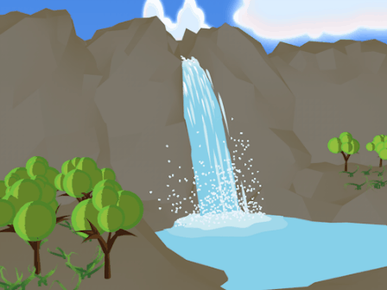
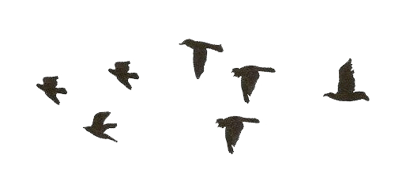

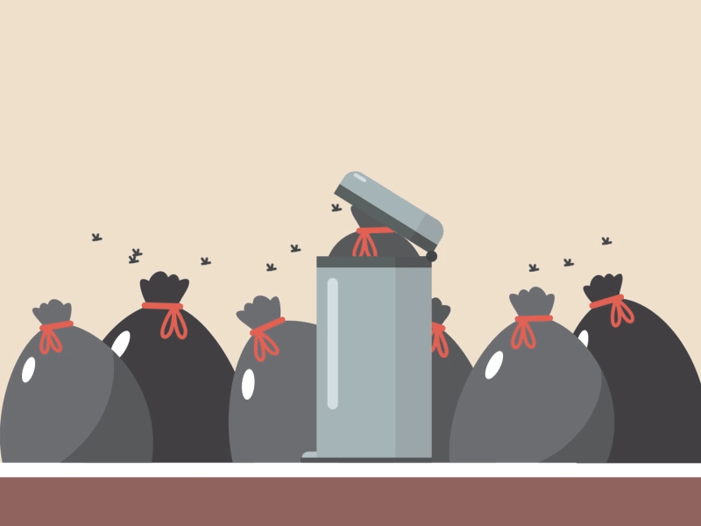
Health & Sanitation

Slide 2
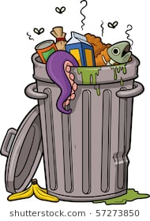

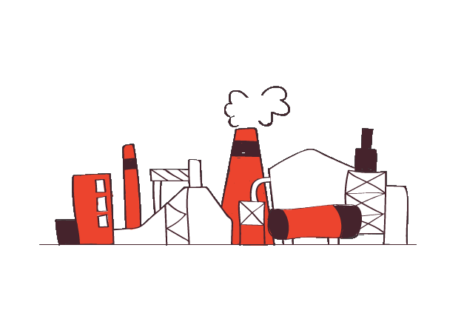
Keeping Clean
Types of waste:
Domestic
Biological &
Industrial

Slide 3
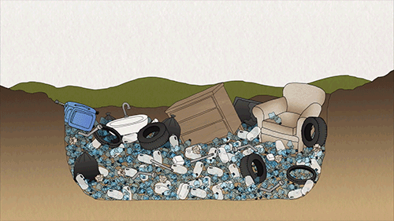
Keeping Clean
Domestic Waste
Domestic waste is waste we produce from our homes which is taken to a landfill.
At a landfill, waste is
buried underground.
Plastic waste is now
being made biodegradable so that microorganisms can break them down in a few months.

Slide 4
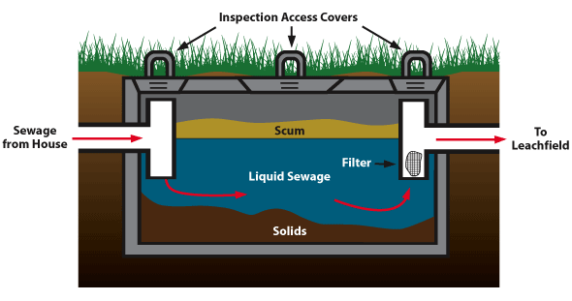
Keeping Clean
Biological Waste
Biological waste is waste produced from our bodies from metabolism.
We egest waste everyday and such waste is collected in sewage tanks from our homes.
When the tanks fill up the
waste is taken away by large
trucks to a treatment plant
where it is broken down by
many microorganisms in
large tanks that have in plenty
of air.
When the liquid is purified sufficiently it is passed back into rivers or seas.

Slide 5
Keeping Clean
Industrial Waste
Industrial waste, is waste produced by industries that process chemicals.
Many industrial sites that process chemicals produce toxic or unsightly waste that must be made safe before releasing it into the environment.

Slide 6
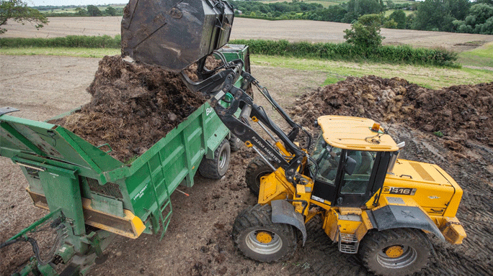
Uses of Waste
Solid sludge that is left after sewage has been treated can be sterilised and used as fertiliser on fields.
Glass, paper, iron/steel and aluminum can be recycled.
Plastic is a little harder to recycle since there are so many different types.
Recycling of plastics can be made easier if its packaging indicates what it is made up of.

Slide 7
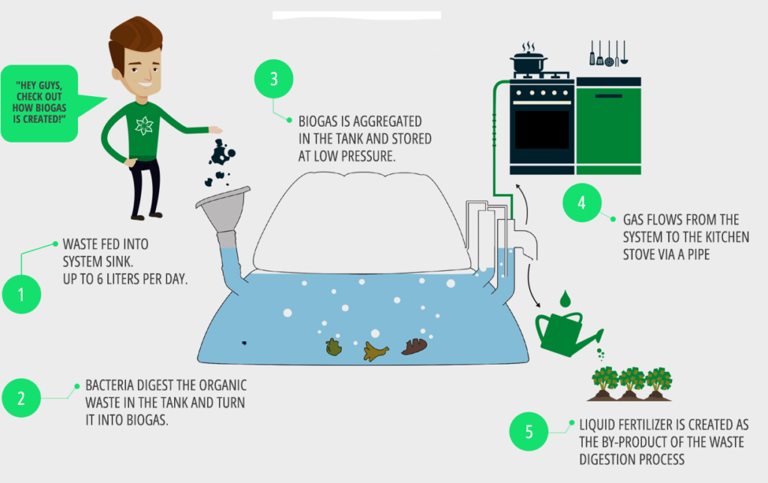
Uses of Waste
Biogas can be generated by the action of microorganisms on organic waste. The gas can be burned to generate electricity.

Slide 8

Community and Personal Hygiene
When it becomes legal for you to work a percentage of your wage or salary will go to taxes to pay your country’s government to help pay costs towards keeping your environment clean and healthy.
If this is not done, rubbish and human waste would soon build up and become a breeding ground for all kinds of pests and parasites, and the diseases they carry.

Slide 9
Comprehension
Give an example of the following types of waste:
a. Domestic
b. Biological
c. Industrial
Rubbish in a landfill site gives off flammable methane gas. What use could be made of the gas?

Slide 10
Comprehension
How can a landfill site contaminate drinking water supplies?
Predict the consequences if a government was to run out of money and could no longer afford to remove and dispose of waste from homes and businesses for six months.

Slide 11
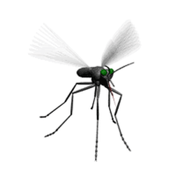

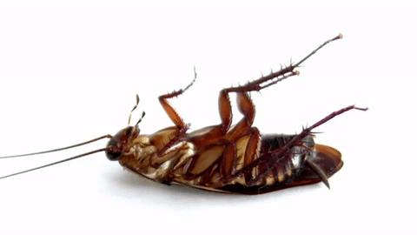
Pests and Parasites

Slide 12
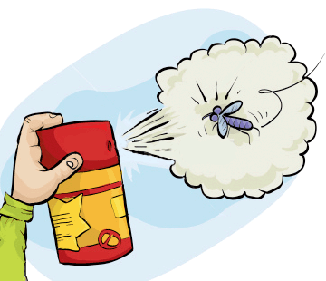
Pests and Parasites
Pests are organisms that cause us inconvenience at best, and at worst, can cause illness and even death.
Mosquitoes are pests that can spread diseases like dengue which can be fatal.
Mosquito populations can be controlled by spraying marshy or swampy areas. However, care must be taken when spraying areas in that they do not harm the environment or
the food chains in the ecosystem.

Slide 13
Mosquitoes
If you live in an area where there are a lot of mosquitoes you should not encourage their livelihood by leaving open containers of water around.
Mosquitoes lay their eggs in water then progress into wrigglers (larval stage) then into the pupa and eventually into an adult mosquito.
Other measures you may take to protect yourself from mosquitoes is to fit window and doors with screens, fit beds with nets, when you are outdoors you can apply mosquito repellent spray.

Slide 14
Ways to Interrupt the Life cycle of a Mosquito
1. Throw away stagnant water.
2. Pour oil on top of water to suffocate the eggs, larva or pupa of the mosquito.
3. You can introduce biological controls such as:
a. Fish that indulge in eating mosquito larva and
b. Dragonflies, frogs & birds that all feed on adult mosquitoes.

Slide 15
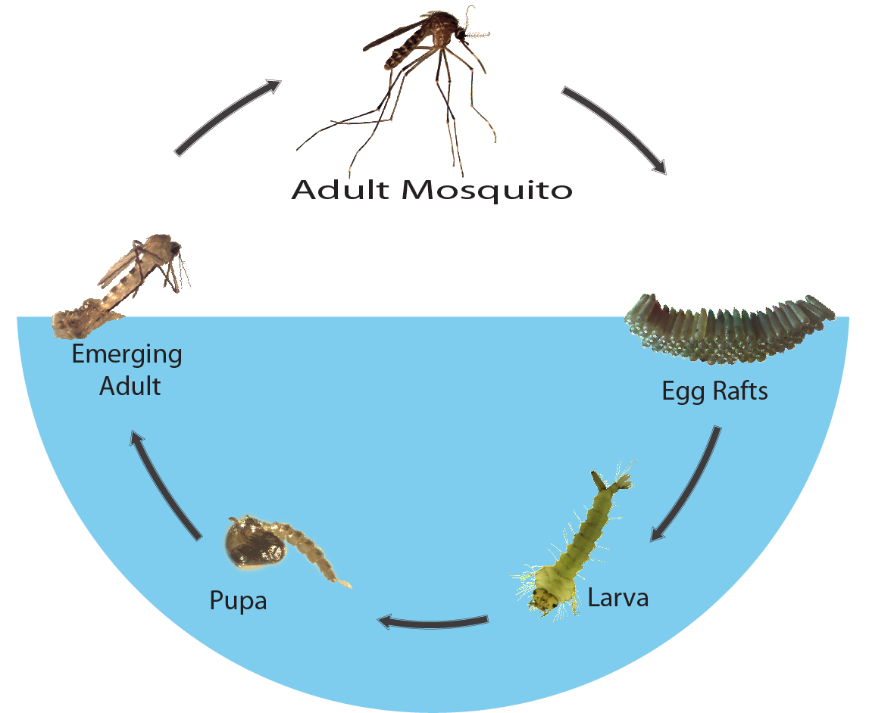
Life Cycle of the Mosquito

Slide 16
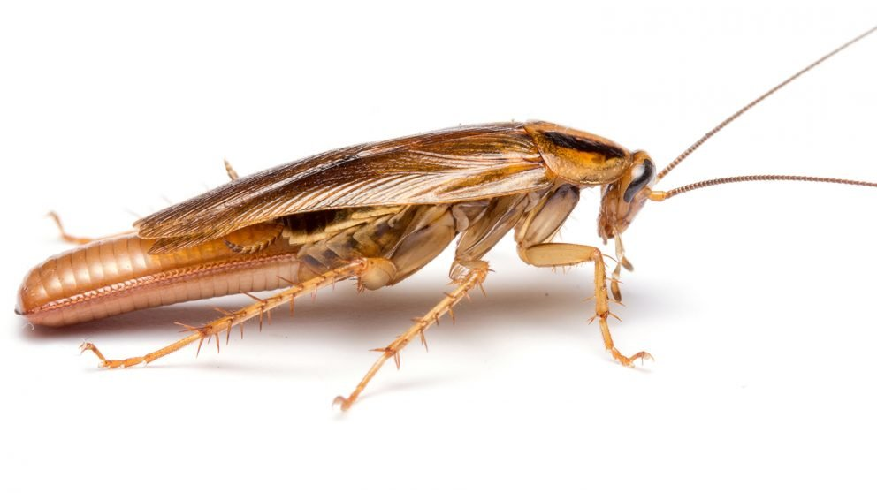
Cockroaches are PESTS TOO!
Cockroaches thrive where they find food, water and shelter.
To stop a cockroach infestation a house must be kept clean and dark, holes and cracks in walls should be filled.
Thriving cockroach populations will cause diseases such as gastro-enteritis, typhus and skin diseases. They also provoke allergic reactions that cause dermatitis, asthma and bronchitis.

Slide 17
Cockroaches are PESTS TOO!
The population of cockroaches may be controlled chemically with insecticides.
Chemicals used to kill cockroach infestations are very potent and therefore poisonous and should be carried out by professionals.
Borax is a less harmful substance that is effective against killing cockroaches.

Slide 18

Other Pests and How they are Controlled
In agriculture, biological methods are used to control pests. For example lady bugs are used to control the aphid population while spiders are used to control the fly population.
Rats are also pests. They are attracted to rubbish and must be controlled by chemical means like RAT POISON or by mechanical means such as using BAITED TRAPS.

Slide 19
Comprehension
Mice are seen as pests once they infest a home. Give a:
a. Biological
b. Chemical
c. Mechanical
Method that could be used to control them.
Explain where you might find cockroaches in a kitchen.

Slide 20
Comprehension
Why do mosquitoes pose such a threat to humans?
What is the difference between a pest and a parasite?

