Slide 1
Light Energy

Slide 2
What is Light?
Light is a form of energy
It is a particle and also a wave.
It comprises of photons which are packets of energy.

Slide 3
What is Light?
Light travels in straight lines.
Its speed is 3 × 10⁸ m/s in a vacuum.
Therefore it does not need matter to travel.

Slide 4
Luminous and NON-Luminous sources of light
Objects which make their own light are luminous sources of light. For example: the flame of a candle or the Sun.
Objects which do not make their own light are NON-luminous sources of light. For example: a book or a desk.

Slide 5
Luminous and NON-Luminous sources of light
Luminous sources enable us to see NON-luminous sources.
For example in the night we can hardly see the trees clearly in your backyard. When day breaks you can see them clearly.

Slide 6
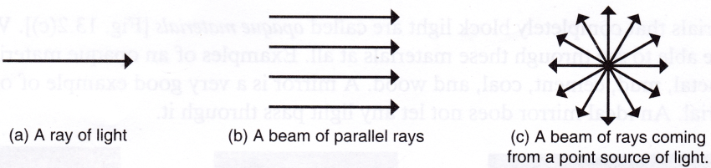
Rays make Beams
A ray of light is the direction of the path in which light is travelling. It is often depicted as an arrow.
A beam of light is made
up of many rays of light.
A light beam may be
parallel, spreading out
(diverging) or getting
narrower (converging).

Slide 7
Shadows

Slide 8
How are Shadows formed?
Light is able to pass through objects which are
a. Transparent and
b. Translucent
Light can not pass through opaque objects.
When an opaque object is in the path of light a shadow is formed.

Slide 9
Do shadows move?
Trees are opaque objects which can block the Sun.
The Sun changes position throughout the day. As the direction from which the Sun’s light reaches the tree changes, the shadows change in
a. Direction
b. Length
c. Shape

Slide 10
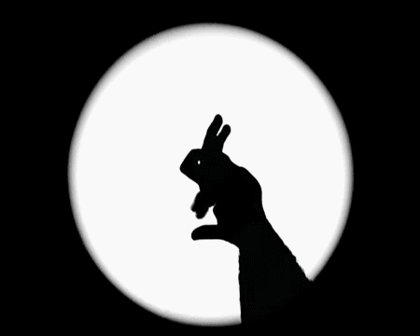
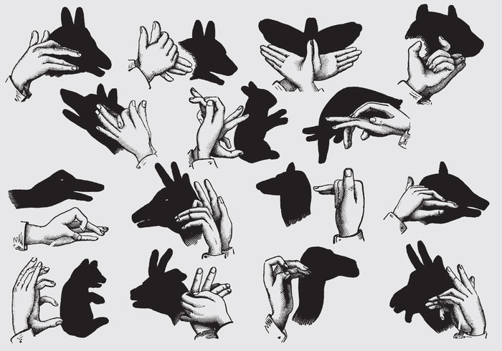
Hand Puppets
The art of making hand puppets via the manipulation of shadows is quite fun and engaging.
Your hand is
opaque and
this can be
achieved if
you place it
in front of a
lamp or candle
which are both
luminous objects.

Slide 11
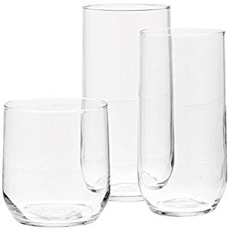

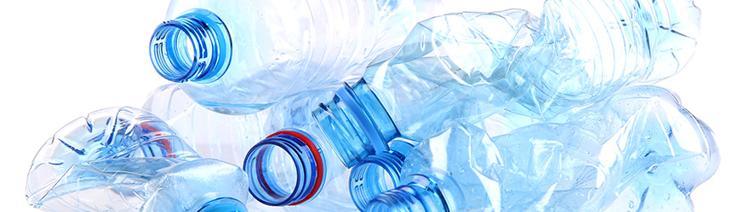
Examples of Transparent, Translucent and Opaque objects
Transparent | Translucent | Opaque
Glass | Wax paper | Wood
Clean water | Plastic bag | Book

Slide 12
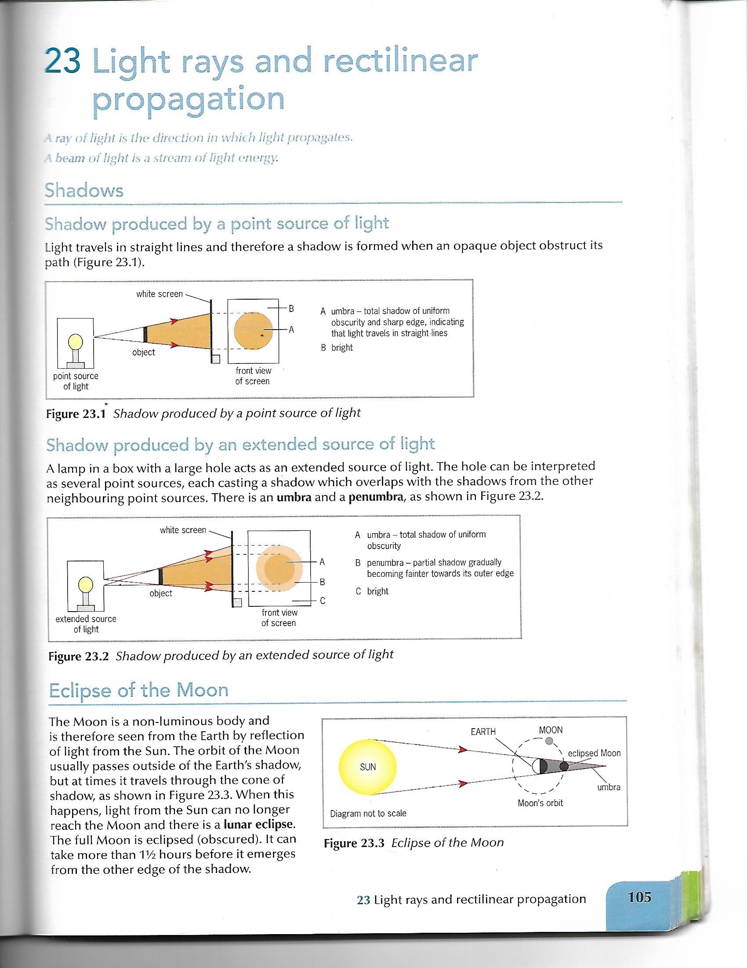
What is a point source?
When a shadow is formed from a point source you get a shadow that is equally dark all over and it has sharp edges, this is called the umbra.

Slide 13
What is an extended source of light?
When a shadow is formed from an extended source of light you get a shadow that is dark at the centre and not so dark at the edges.
The darkest area is called the umbra while the grey area is called the penumbra.

Slide 14
Eclipses

Slide 15
Eclipses
Eclipses occur when the Earth, Sun and Moon are in a special position in relation to each other.

Slide 16
Solar Eclipse
A solar eclipse occurs when the Moon’s orbit takes it directly between the Earth and the Sun.
The parts of the Earth in total shadow experience a total eclipse. Those parts in the penumbra experience a partial eclipse.

Slide 17
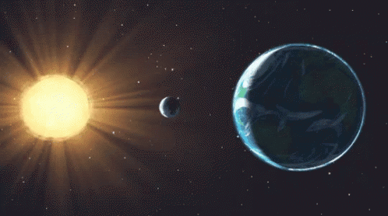
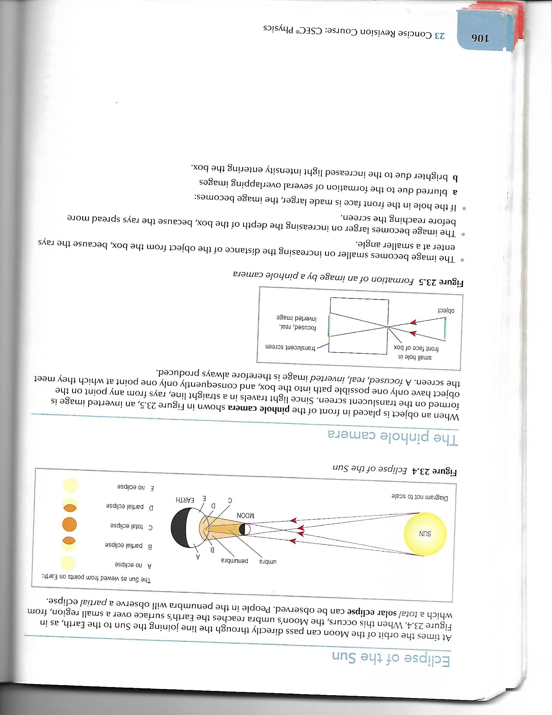
Eclipse of the Sun
The Sun becomes
eclipsed when the
Moon passes
between it and Earth
(SME).

Slide 18
Lunar Eclipse
A lunar eclipse occurs when the Earth comes between the Sun and the Moon.
The Moon passes between the Earth’s shadow and becomes almost completely dark.

Slide 19
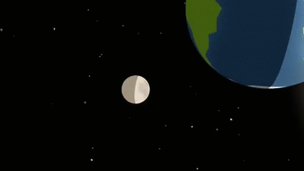
Eclipse of the Moon
The moon is a
non-luminous
body. It reflects
light from the
Sun.
An eclipse of the moon occurs when the Earth is between it and the SUN (SEM).
An eclipse
of the moon
is referred to
as a lunar eclipse.

Slide 20

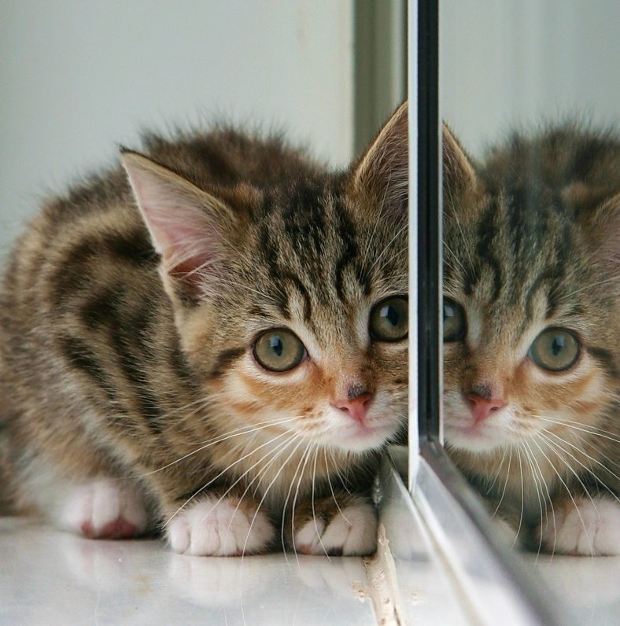

Reflection

Slide 21
Reflection of Light
When light travels to a surface like a mirror and bounces back again, we say that the light is reflected.
This is how you are able to see your own reflection in a mirror.
Your reflection is referred to as the image.

Slide 22
Reflection of light
Here are some facts about images that are formed in a plane mirror:
1. The image is the same size as the object.
2. The image is the same distance behind the mirror as the object is in front of it.
3. The image formed is laterally inverted. This means that the left side of the objects is the right side of the image.
4. The image is virtual. The term virtual is used to describe an image that does not actually exist but appears to exist at the some place.

Slide 23
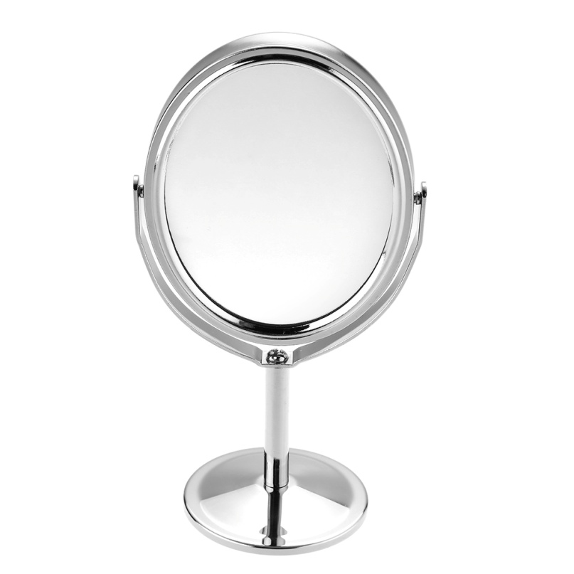
Reflection of Light
You can see reflections of yourself in:
a. Mirrors
b. Pool of water

Slide 24
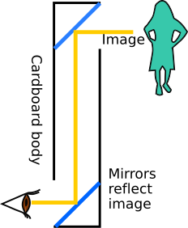
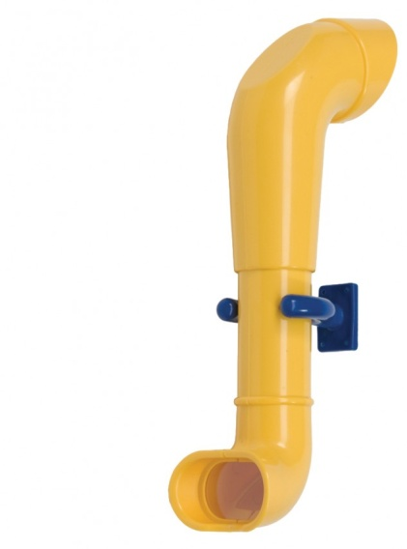
Reflection of Light
The following are some devices that make use of plane mirrors:
1. Cars (to see the behind of the car)
2. Periscopes (to see above tall objects, used in submarines)
3. Traffic (used to help cars see around corners)

Slide 25
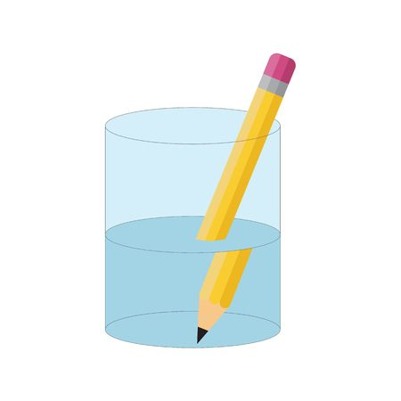
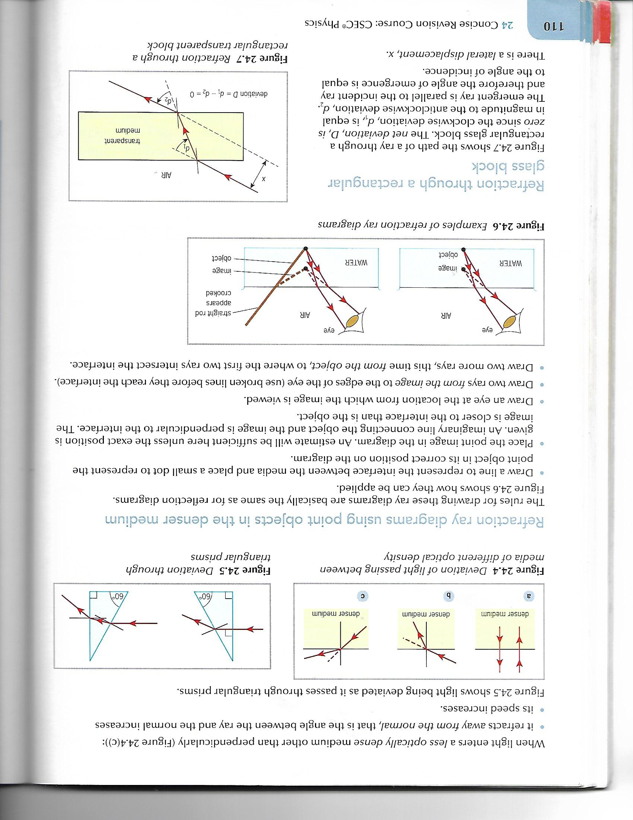
Refraction

Slide 26
Refraction
Refraction is the bending of light passing from one medium to another.
For example light bends when it passes from air to water. Here, air and water are mediums.
Light slows down when it passes from a less dense medium to a denser one. Here, air is less dense than water.

Slide 27
Refraction of Light
Objects appear bent in water because of the refraction of light.
We see the light as if travelling in a straight line that is why:
a. objects appear closer to the surface than they really are
b. objects appear bent.

Slide 28

Refraction
White light is comprised of seven colours:
RED, ORANGE, YELLOW, GREEN, BLUE, INDIGO, VIOLET.
The rainbow is a result of refraction. For a rainbow to result two things must happen:
a. It must be misty or rainy and
b. The Sun should not be covered

Slide 29
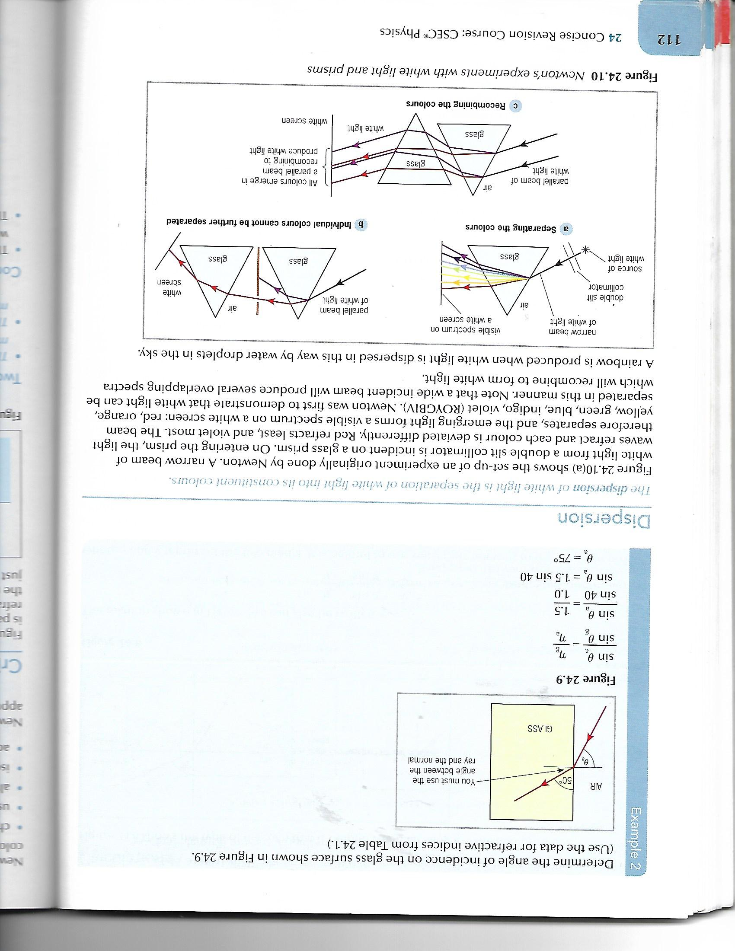
Refraction
When light passes through a prism or water it refracts, slows down and disperses into its seven different colours.
Red light bends/refracts
the least while violet
light bends the most.

Slide 31
Refraction
Experiments
To disperse white light you could
a. Use a torch or sunlight
b. A prism

Slide 32
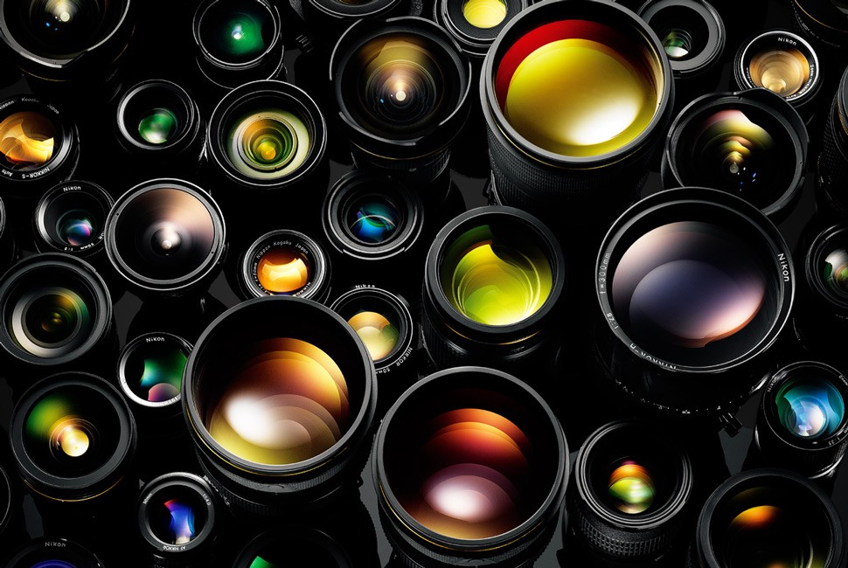
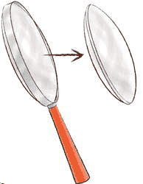
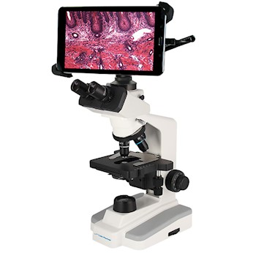
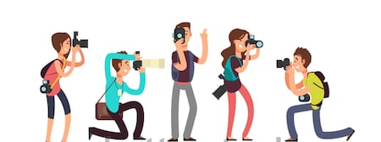
Lenses

Slide 33
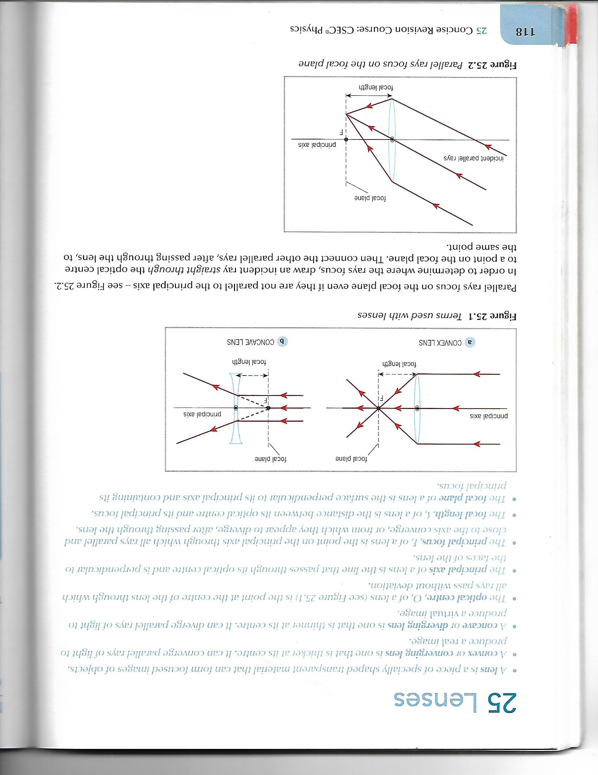
Terms used with Lenses

Slide 34
Some Useful Definitions
A lens is a piece of specially shaped transparent material that can form focused images of objects.
A convex or converging lens is one that is thicker at the centre. It can converge parallel rays of light to produce a real image.

Slide 35
Some Useful Definitions
A concave or diverging lens is one that is thinner at its centre. It can diverge parallel rays of light to produce a virtual image.
The optical centre, O, of a lens is the point at the centre of the lens through which all rays pass without deviation.

Slide 36
Some Useful Definitions
The principal axis of a lens is the line that passes through its optical centre and is perpendicular to the faces of the lens.
The principal focus, F, of a lens is the point on the principal axis through which all rays parallel and close the axis converge, or from which they appear to diverge, after passing through the lens.

Slide 37
Some Useful Definitions
The focal length, f, of a lens is the distance between its optical centre and its principal focus/focal point.
The focal plane of a lens is the surface perpendicular to its principal axis and containing its principal focus.

Slide 38
Parallel Ray Focus on the Focal Plane

Slide 39

Magnification
Magnification, m, is the ratio of the size of the image to the size of the object where:
a. magnification = image height ÷ object height
b. magnification = distance of image from lens ÷ distance of object from lens

Slide 40
Real and Virtual Images
Real images are
those produced
at a point to which
light rays converge.
Virtual images are
those produced at
a point from which
light rays appear to
diverge.

Slide 41
Examples of Real Images and Virtual Images
Examples of real images | Examples of virtual images
Image produced on the retina | Image produced in a mirror
Image produced in a camera | Image produced by a convex lens acting as a magnifying glass
Image produced on the screen at the cinema | Image produced by a concave lens

Slide 42
Features of real and virtual images of real objects produced by a lens
Real images formed by lenses | Virtual images formed by lenses
Can be formed on a screen | Cannot be formed on a screen
Are produced by the convergence of rays | Are produced due to the divergence of rays
Are located on the side of the lens opposite to the object | Are located on the same side of the lens as the object
Are inverted | Are erect

Slide 43
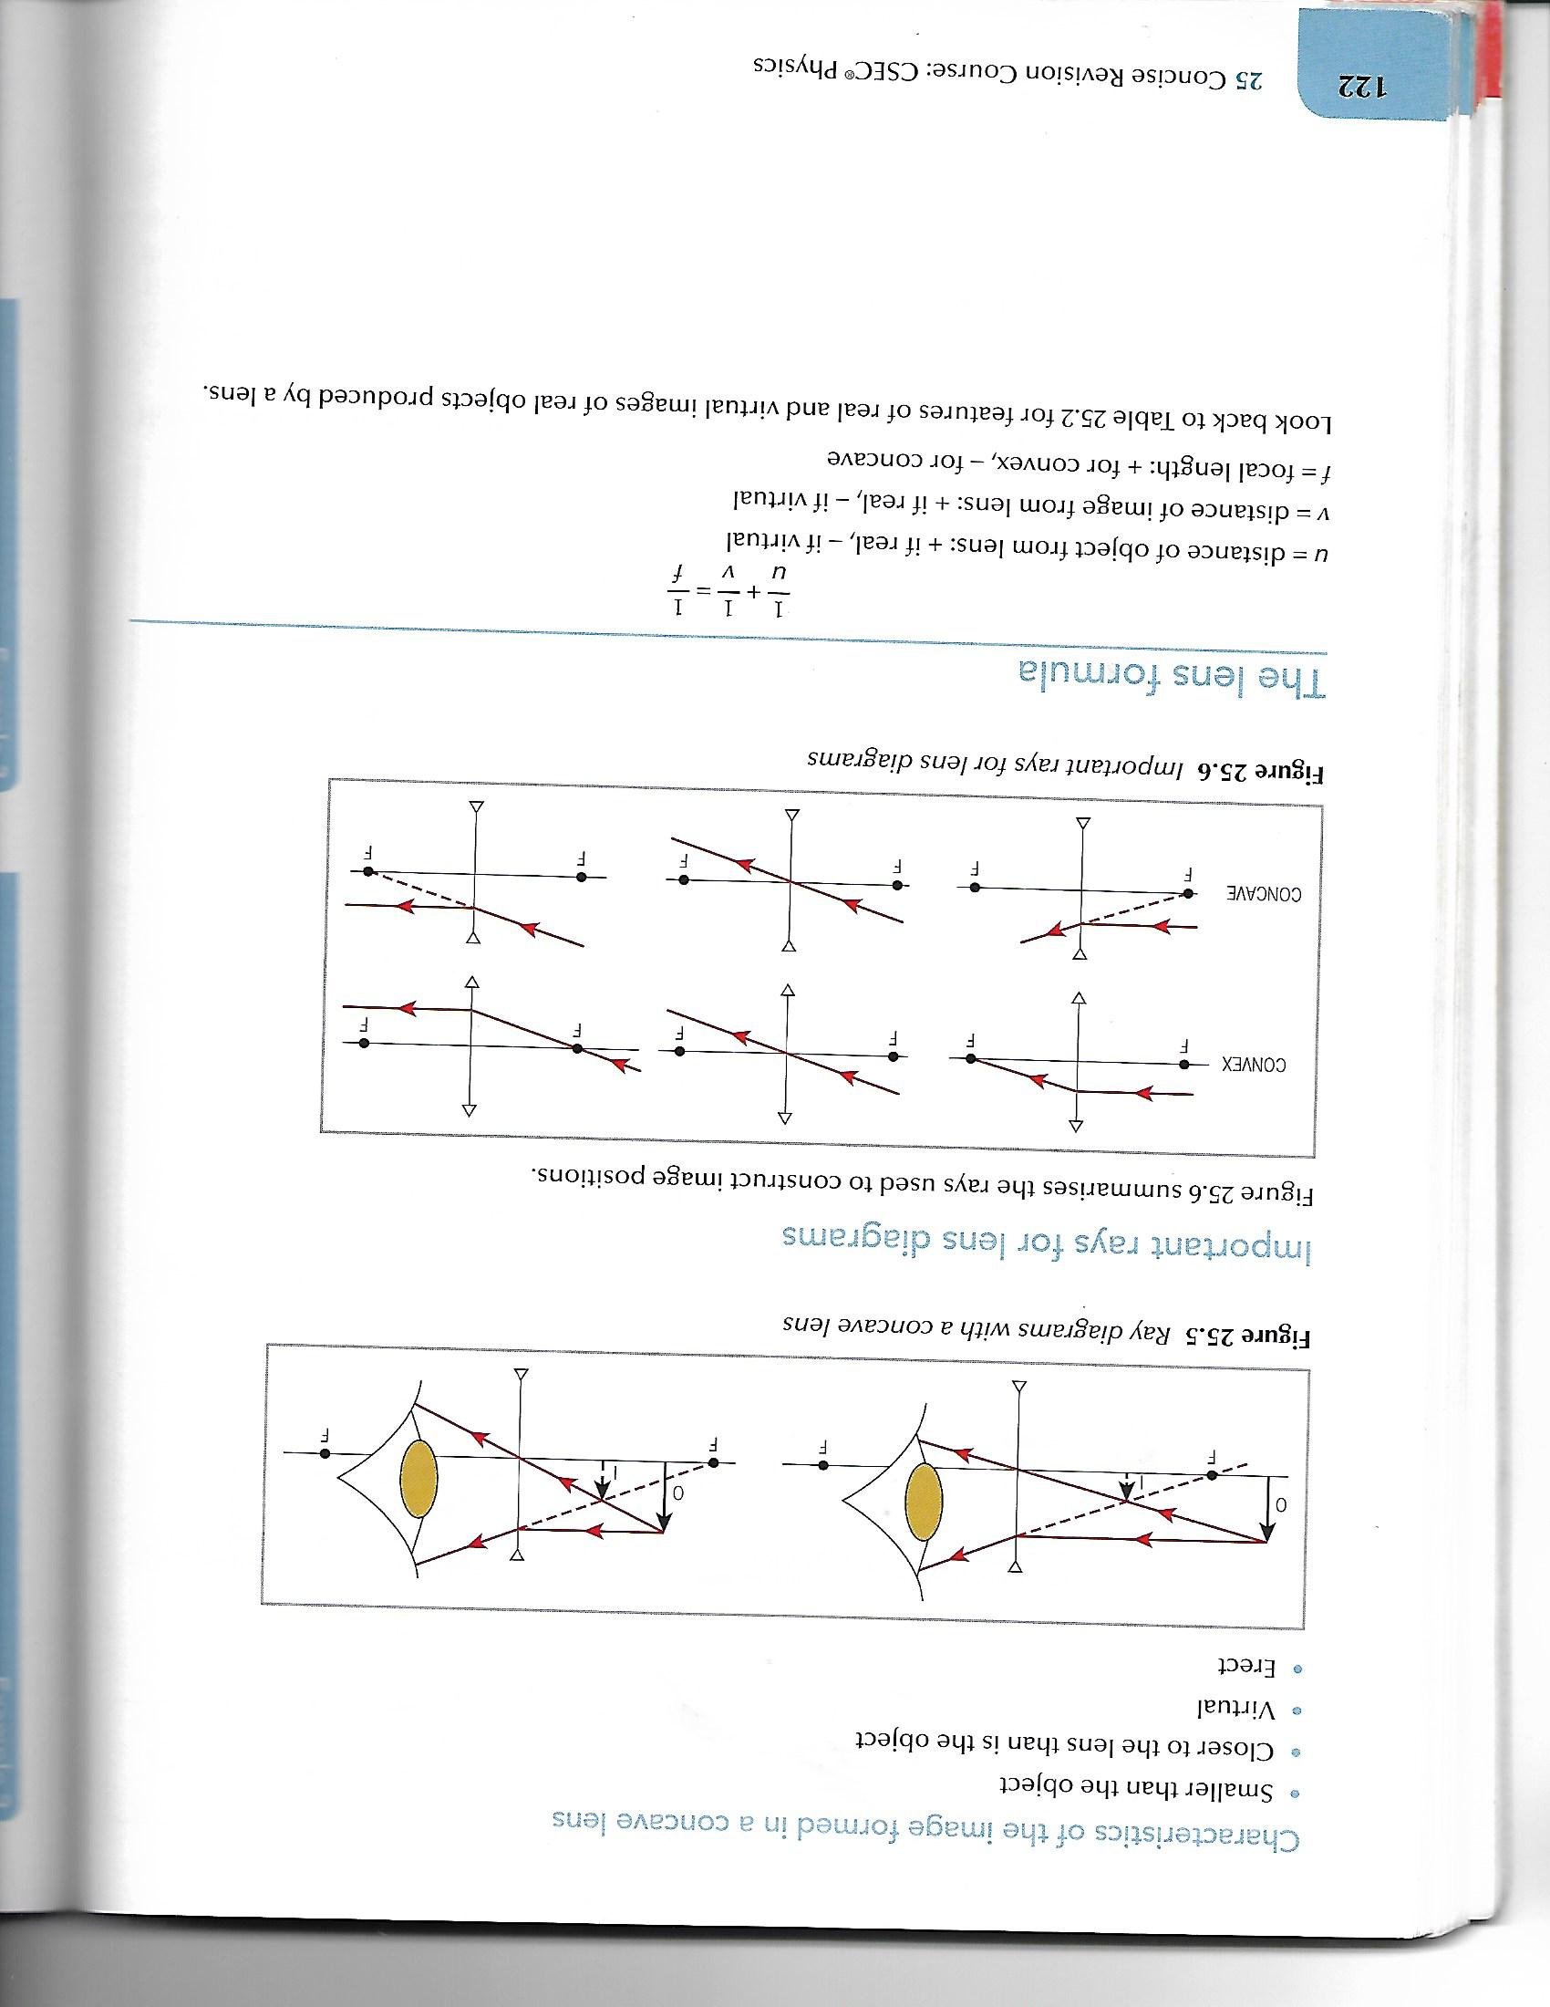
Characteristics of the Image formed in a Concave Lens
Smaller than the object
Closer to the lens than is the object
Virtual
Erect

Slide 44
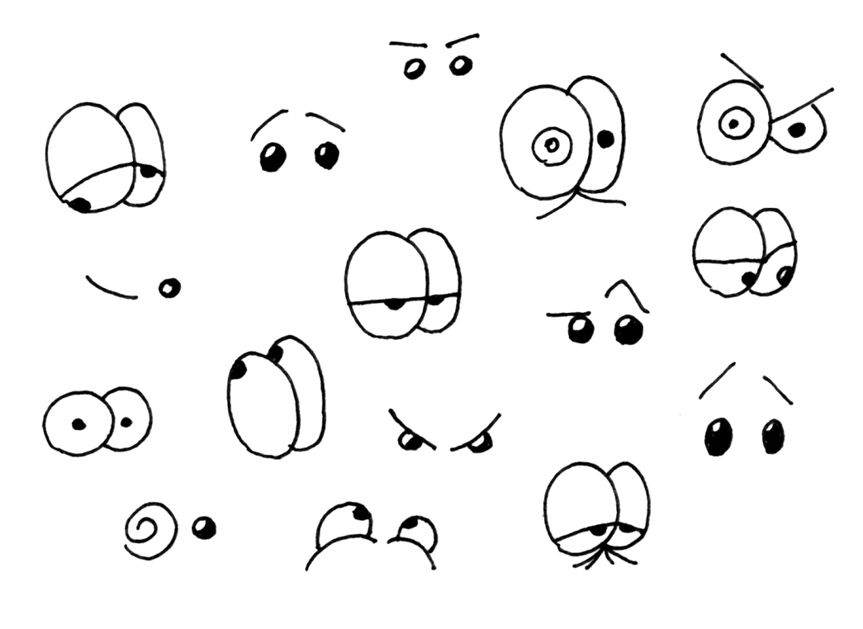
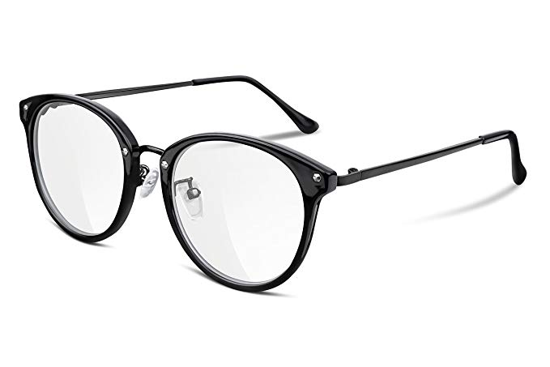

The Eye

Slide 45
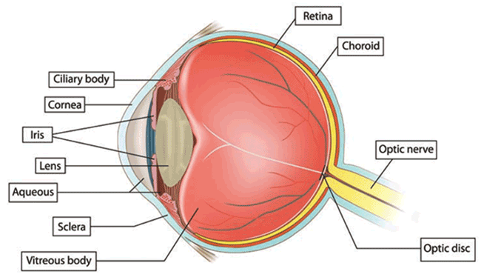
The Eye

Slide 46
Eye Defects
Short-Sightedness
People who are short sighted can see near objects clearly but cannot focus the light from distant objects. This is because their lens is refracting light too strongly. This makes the rays of parallel light focus in front of the retina.
To rectify this spectacles or contact lens made of concave or diverging lens are used to bend the light outwards before they enter the eye.
People often wear this type of spectacles when driving.

Slide 47
Eye Defects
Long-Sightedness
People who are long sighted can see distant objects but close-up objects are blurred. Their lens cannot bend the light inwards enough to focus the rays on the retina.
To rectify this, spectacles or contact lens made of convex or converging lens are used to bend the light inwards before they enter the eye.
People often wear these type of glasses for reading.

Slide 48
Eye Defects
Astigmatism
Astigmatism is a growing problem in Caribbean countries.
This is where the cornea or lens is not the correct shape.
It can result in blurred vision and long – or short-sightedness.
It can usually be corrected by using spectacles or contact lenses, but severe cases need surgery.

Slide 49

Protection for the Eyes
People are encouraged to wear sunglasses with ultra violet protection in the sunshine. People are also encouraged not to look directly into the sunlight or luminous sources.
Sunlight contains ultraviolet light which can damage the front part of the eyes for example the cornea. Very bright light can damage the retina which is found at the back of the eye.

