Slide 1
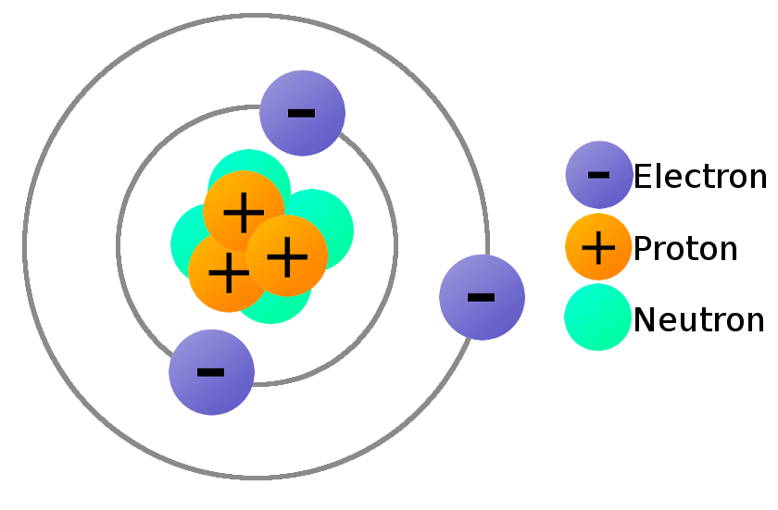
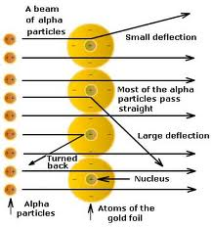
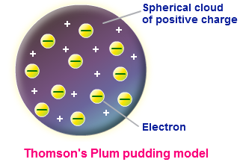
Electrons

Slide 2
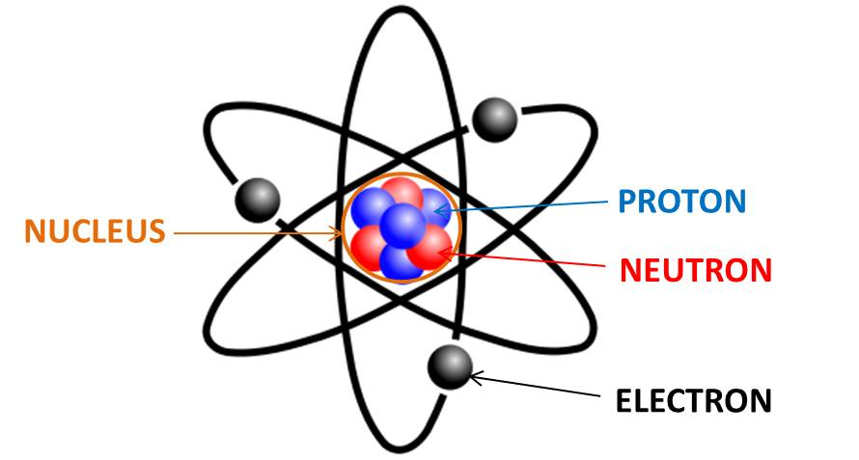
Electrons
Today, our idea of matter revolves around the presence of atoms.
Owing to this, we define matter as being made up of atoms.

Slide 3
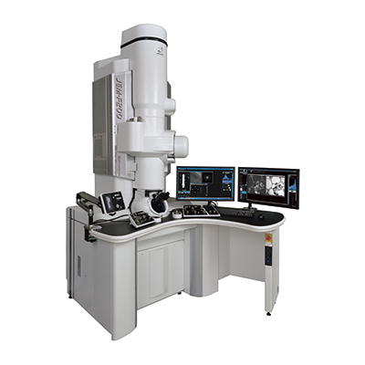
Electrons
Atoms are tiny particles that can not be seen with the naked eye. To see them an electron microscope may be used. They are composed of electrons, protons and neutrons.
Our referral to the atom, its parts and its involvement in science may be credited to scientists such as Democritus, Thomson, Rutherford, Bohr and Chadwick.

Slide 4
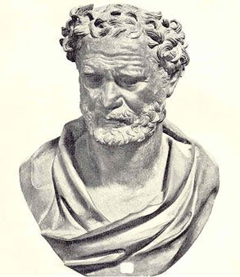
The Greeks
In about 400 BC the Greek philosopher, Democritus, suggested that matter consisted of small indivisible particles. He called these particles ‘atomos’, from the Greek word for indivisible.

Slide 5
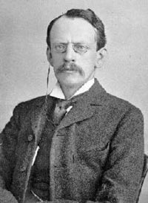
J. J. Thomson Plum Pudding Model
In 1897 Thomson discovered that heating metal could release small particles (electrons).
He proposed that the electrons were released from inside the atoms and therefore the atom was not the smallest possible particle.

Slide 6
J. J. Thomson Plum Pudding Model
Thomson also realised that electrons were charged particles since they could be deflected by magnetic and electric fields. He then proposed a model where electrons in an atom were trapped inside a positively charged ‘sponge’. This was known as the …………………….. model of the atom.

Slide 7
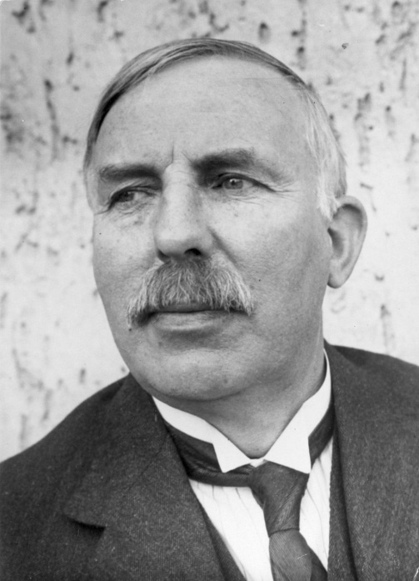
Rutherford Nucleus
In 1911 Ernest Rutherford proposed that most of the atom is empty space and that it contains a nucleus of very concentrated positive charge.
He suggested that small negatively charged particles exist in a surrounding ‘electron cloud’, making the net charge zero.

Slide 8
Rutherford Nucleus
A few years later Ernest Rutherford asked two of his research students, Hans Geiger and Ernest Marsden, to investigate the structure of an atom, using a beam of alpha particles.

Slide 9
Rutherford Nucleus
When the alpha particles were fired at a thin gold foil they found that: a. Most of the alpha particles passed straight through the foil with a very small deflection b. Some of the alpha particles were deflected through large angles c. And some of the alpha particles bounced straight back.

Slide 10
Rutherford Nucleus
Since his findings could not be explained by J. J. Thomson’s plum pudding theory Rutherford’s team determined that: a. since most of the alpha particles pass straight through the gold foil, most of the atom must be composed of empty space. b. As some alpha particles are deflected they must be repelled by a dense positively charged part of the atom later named the ______________ which contained ________________________ and most of the mass of the atom. c. The apparent radius of atoms was much greater than the measured size of the nucleus. As the electrons were known to be very small, it was suggested that they occupied the space around the nucleus in a way similar to the planets orbiting the Sun.

Slide 11
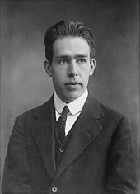
Bohr Energy Levels & Electrons
In 1913 Niels Bohr suggested that the negatively charged electrons orbit the nucleus in particular shells. He further suggested that a unique energy value is required by an electron to exist within any shell.
All previous models of the atom could not explain the behaviour of the electrons and why they did not fall into the nucleus due to electromagnetic forces.

Slide 12
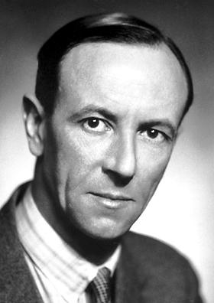
Chadwick Neutrons
In 1932 James Chadwick discovered neutrons, uncharged particles that exist together with protons within the nucleus of an atom.
Neutrons were difficult to detect because, unlike protons and electrons, they have no charge and therefore can not be affected by electric and magnetic fields.

Slide 13
Recap
1. Matter is made up of atoms.
2. Everything is made up of matter.
3. Atoms can NOT be seen with the naked eye however, can be viewed using an electron microscope.

Slide 14
Recap
4. Democritus suggested that matter is made up of atoms and that atoms were the smallest particles known to man.
5. Thomson suggested that the atoms were not the smallest particles known to man since electrons could be emitted from them.
6. Rutherford suggested the presence of a nucleus.

Slide 15
Recap
7. Bohr suggested that electrons orbited the nucleus in energy shells.
8. Chadwick suggested the presence of neutrons.

Slide 16
COMPREHENSION
1. In the ‘plum pudding’ model: a. What charge do electrons have? b. What is the remainder of an atom composed of? c. What force holds the electrons in place?
2. During the Geiger-Marsden experiment: a. Why did most of the alpha particles pass through the gold foil without deflection? b. Why were some of the alpha particles directed straight back?

Slide 17
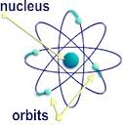
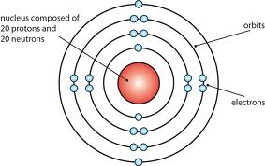
Electrons, the nucleus and the periodic table

Slide 18
Experiments have now shown that there are three types of different particles which makes up the atom. They are: 1. ________________________________ 2. ________________________________ 3. ________________________________ Neutral atoms have the same number of electrons and protons. Protons and neutrons together in the nucleus are referred to as nucleons.
Particle | Location in the atom | Mass | Electric charge
Proton |  | 1.67 × 10⁻²⁷ kg
Neutron |  | 1.67 × 10⁻²⁷ kg | 0
electron |  | 9.11 × 10⁻³¹ kg

Slide 19
The Atom
An atom is composed of protons, neutrons and electrons.
Protons and neutrons can be located within the nucleus of an atom while the electrons can be found in energy shells or energy levels.
The mass of an atom is based on the mass of both protons and neutrons. The mass of an electron is so small that it is considered negligible.

Slide 20
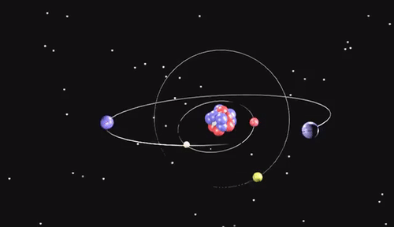
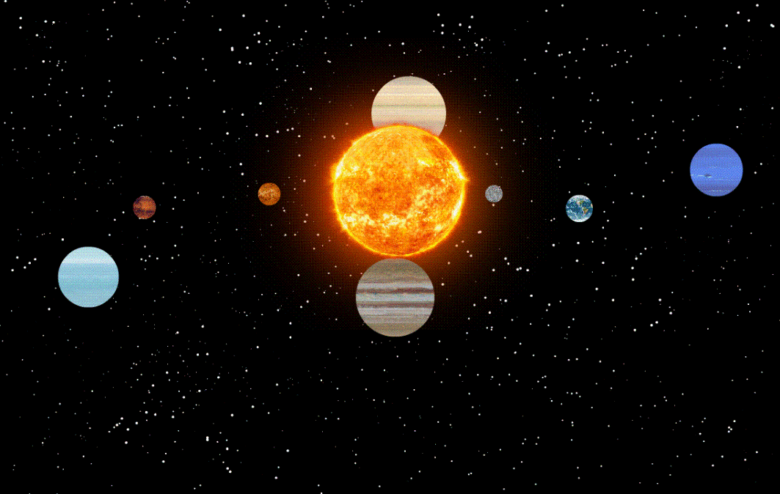
The Atom
If you know of how the the Solar System is arranged then you can think of the Sun as being the nucleus and the planets orbiting it as the electrons.

Slide 21
The Atom
Electrons can be located in the energy levels. The first energy level holds a maximum of 2 electrons, the second holds 8 and the third holds 18. This is as far as we will go at this level.
Energy Level/Shells | Maximum amount of electrons energy level holds
1 | 2
2 | 8
3 | 18

Slide 22
The Atom
For example carbon has 6 electrons therefore its electronic configuration would be: 2.4 such a configuration says that carbon is in Period two because it only has two numbers and is in Group four because the last number is a 4.

Slide 23
The Atom
Magnesium has an electron count of 12 and therefore has an electronic configuration of 2.8.2. Its configuration says that magnesium is in Period three and Group two.
Each atom is different. They are depicted in the Periodic Table.

Slide 24
Periodic Table

Slide 25
Periodic Table
All elements in their neutral state are represented within a Periodic Table.
They are categorized based on their Groups and Periods.
Groups run vertically while Periods run horizontally within the Periodic Table.

Slide 26
Periodic Table
Groups indicate the number of valence electrons an atom has while Periods indicate how many energy levels an atom has. For example the sodium atom, Na, is in group 1 and period 3 therefore Na has 1 valence electron and 3 energy levels.
Valence electrons are those electrons available for bonding. In other words they make bonding between atoms possible.

Slide 27
NUCLEAR NOTATION
The proton number may be referred to as the atomic number and is represented by the capital letter Z. The total number of protons and neutrons (referred to as nucleons) is equal to a neutral atom’s mass number and is often represented by the capital letter A.

Slide 28
NUCLEAR NOTATION
The number of neutrons, the neutron number, is represented by the capital letter, N. Given above the atomic notation for any given symbol represented here as X may be represented as: ^{A}_{Z}X. The neutron may be determined by: # of neutrons = mass number – atomic number where (N = A – Z)

Slide 29
Periodic Table Comprehension
Write out the atomic notation for the following: a. Magnesium which has an atomic number of 12 and a mass number of 24. b. Boron which has an atomic number of 5 and a mass number of 10. c. Iron which has an atomic number of 26 and a mass number of 56. For the above, determine how many protons are present in each of the elements stated.

Slide 30
Periodic Table Isotopes
Nuclei of a neutral element always have the same number of protons and so have the same atomic/proton number.
Sometimes the nuclei may contain a different number of neutrons. In this case atoms with the same proton number but different nucleon numbers are referred to as isotopes.
An example of isotopes of carbon are: ¹²₆C; ¹³₆C; ¹⁴₆C; here the atomic/protonic numbers are the same however the neutron count is different. Compute the amount of neutrons present in each isotope of carbon above.

Slide 31
Periodic Table Isotopes
As proton number identifies the name of the element it is often more convenient to write isotopes in a simpler format: carbon-12, carbon-13 or carbon-14.
Nuclei that share the same number of protons and neutrons are referred to as nuclides. So carbon-12, 13 and 14 are nuclides of each other.

Slide 32
Comprehension
Questions: 1. Fluorine has a proton number of 9 a. How many electrons does a neutral fluorine atom have? b. Sketch the arrangement of these electrons. c. In what Group of the Periodic Table is fluorine placed? 2. Copy the following table then calculate and fill in the missing values.
 | Atom | # of protons, Z | Nucleon number, A | Number of neutrons, N | Number of electrons
A | Carbon | 6 | 12
B | Sodium | 11 |  | 12
C | Gold |  | 197 |  | 79
D | Osmium | 76 |  | 114

Slide 33
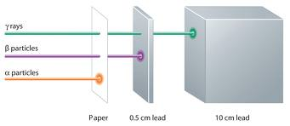
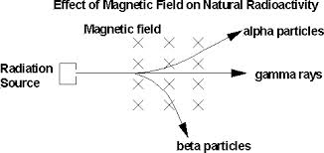
Radioactive emissions
Radioactivity in an electric field

Slide 34
Radioactive Elements
Some elements emit ionisation energy all the time and are referred to as radioactive elements.
Ionisation energy is the quantity of energy that an isolated, gaseous atom in the ground electronic state must absorb to discharge an electron, resulting in a cation (positive particle). This energy is usually expressed in units of kJ/mol, or the amount of energy it takes for all the atoms in a mole to lose one electron each.

Slide 35
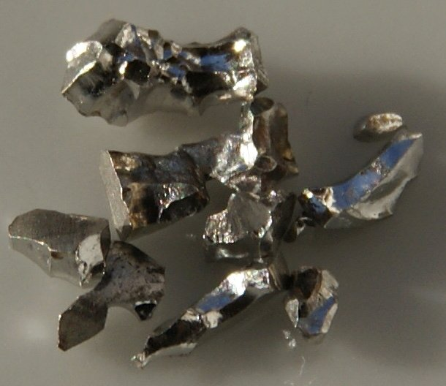
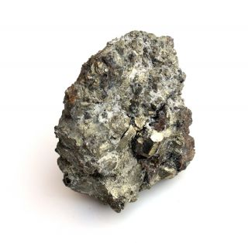
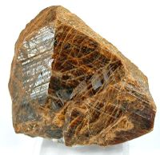
Radioactive Elements
Radioactive elements are naturally found in the environment. They emit background radiation.
Examples of radioactive elements are shown below:
Uranium
Thorium
Iridium

Slide 36
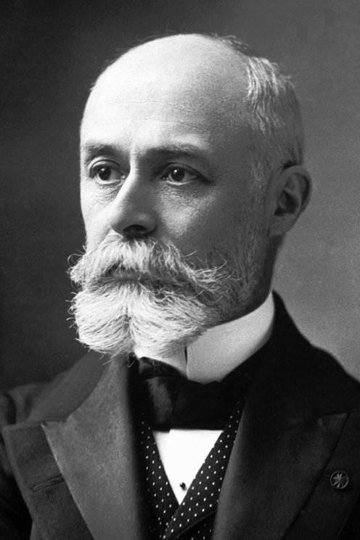
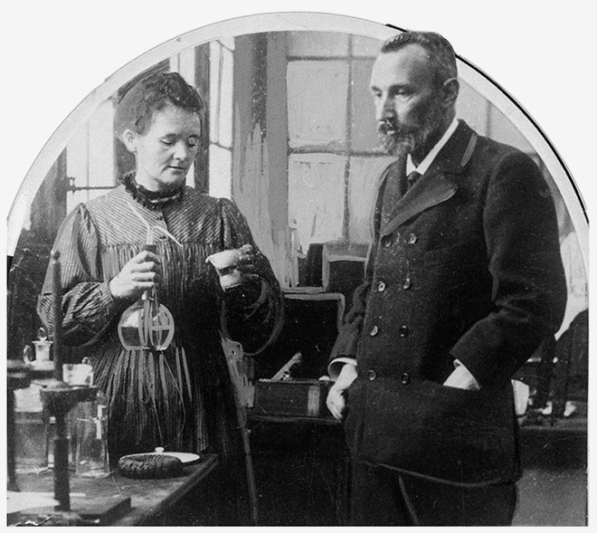
The Pioneers of Radioactive Elements
In 1896 Henri Becquerel noticed that, after leaving a sample containing uranium in a drawer near some photographic film, the film became exposed. He theorised that the uranium was producing ‘invisible rays’ which caused a chemical reaction in the film. Over the next few years Marie and Pierre Curie investigated other minerals and isolated radium in sufficient amounts to allow the study of its properties.

Slide 37
The Pioneers of Radioactive Elements
Background radiation There is always small amounts of background radiation around us. From where do you think?

Slide 38
Investigating Nuclear Radiation
Investigating nuclear radiation Three different types of nuclear radiation have been discovered: a. Alpha (α) b. Beta (β) and c. Gamma (γ) Alpha particles are strongly positively charged. They penetrate materials and are easily absorbed. Beta particles are negatively charged and penetrate material more than alpha particles but are absorbed less. Gamma rays have NO charge, penetrate materials the best and are the least absorbed of the three types of particles mentioned.

Slide 39
Investigating Nuclear Radiation Geiger-Muller Tube
A Geiger counter can be used to detect ionising radiation. A radioactive particle passing through a Geiger-Muller tube produces an electrical pulse which is logged by a counter attached to the tube. By placing different materials between the source and the Geiger counter, the penetrating power can be investigated.

Slide 40
Behaviour of Alpha, Beta and Gamma Particles
If a beam of radiation enters a magnetic field the alpha particles will be deflected and so will the beta particles but in opposite directions of each other gamma radiation is un-deflected by magnetic radiation.
If a beam of radiation enters an electric field the alpha particles will deflect to the negative metal plate beta particles will deflect to the positive metal plate however, gamma radiation is unaffected they just pass straight through.
The cloud chamber Even though we are unable to see alpha particles, beta particles or gamma rays, we can see the tracks they make when water droplets condense on ions formed in a cloud chamber.

Slide 41
Properties of Alpha, Beta and Gamma Radiation
 | Alpha particles | Beta particles | Gamma rays
Symbol | α | β | γ
Nature | A particle consisting of 2 protons and 2 neutrons ejected from the nucleus | A fast moving electron ejected from the nucleus | Electromagnetic radiation emitted by the nucleus. A high energy photon
Electric charge | +2 e (charge of 2 electrons) | - 1e (charge of one electron) | None
Penetrating power | Can travel only a few centimetres in air. Blocked by paper or skin. | Can travel a few metres in air. Blocked by metal foil. | Can travel long distance in air. Intensity reduced by thick metal plating such as lead.
Ionising power | Strongly ionising as it is massive and highly charged | Ionising | Some ionisation
Effect of magnetic and electric fields | Deflects the alpha particle | Deflects the beta particle in the opposite direction to an alpha particle | No effect

Slide 42
Comprehension
Questions: 1. Why would these careers possibly lead to you having a higher than average annual dose of radiation? a. Radiographer in a hospital b. Airline pilot c. Miner 2. What type(s) of nuclear radiation: a. Can penetrate your skin? b. Causes the most ionisation? c. Are deflected by a magnetic field? d. Can travel the farthest in air?

Slide 43
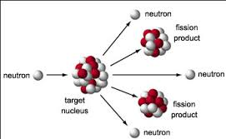
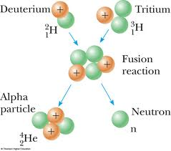
Nuclear decays and reactions

Slide 44
Nuclides
Many nuclides are stable. This simply means that the nucleus has the correct balance of protons and neutrons and does not break apart. However, some nuclides have too many neutrons or too many protons and this makes them unstable causing the nucleus to decay (break apart) over time. For example, carbon – 12 is a stable nuclide but carbon – 14 is NOT. Carbon – 14 nuclei will decay over time changing into nitrogen – 14 nuclei. When a decay occurs it can be described in these simple terms: parent nucleus → daughter nucleus + alpha, beta OR gamma radiation

Slide 45
Alpha Decay
The general form of an alpha decay equation is: ^{A}_{Z}X → ⁴₂ α + ^{A-4} _{Z-2}Y where X and Y are any particular atom at the time.
During alpha decay an unstable parent nucleus releases 2 protons and 2 neutrons bound together forming an alpha particle. The alpha particle is ejected from the parent nucleus leaving a daughter nucleus with less mass. As two protons have left the nucleus the resulting daughter is a different element than the parent.

Slide 46
Beta Decay
The general form of a beta decay equation is: ^{A}_{Z}X → ⁰₋₁ β + ^{A} _{Z+1}Y
A beta particle is a fast moving electron produced when a neutron converts to a proton inside the nucleus. The electron was not originally present. After decay there is an additional proton in the nucleus and so the daughter nuclide is a different element from the parent.

Slide 47
Gamma Decay
The general form of a gamma decay equation is: ^{A}_{Z}X → ⁰₀ γ + ^{A} _{Z}X An alpha or beta decay may leave the daughter nucleus with some excess energy. The nucleus is said to be in an excited state. This energy may be released by a gamma decay. Gamma decay does not cause any change in the number of protons or neutrons in the nucleus and so the product of the decay is the same element as the parent nuclide.

Slide 48
Nuclear Fission
Large nuclei can split into two smaller nuclei, releasing energy. This process is usually caused by hitting the nucleus with a neutron in induced fission. The neutron is absorbed and then the nucleus becomes so unstable that it splits up. During fission several neutrons are released alongside the two new nuclei. In nuclear reactors these neutrons are used to cause further fissions and form a chain reaction. ²³⁵₉₂U + ¹₀n → ¹⁴¹₅₆Ba + ⁹²₃₆Kr + 3¹₀n

Slide 49
Nuclear Fusion
Stars produce their energy using the process of nuclear fusion. In this process small nuclei are merged together to form larger ones. The Sun produces all of its energy by nuclear fusion processes, mostly fusing isotopes of hydrogen to form helium isotopes. An example of a fusion reaction is shown below. ²₁H + ¹₁H → ³₂He + γ

Slide 50
Comprehension
1. Write complete decay equations for the following. a. The alpha decay of americium-241 (²⁴¹₉₅Am) into an isotope of neptunium (Np). b. The beta decay of caesium-137 (¹³⁷₅₅Cs) into an isotope of barium. c. What is the decay equation for alpha decay of polonium-210 into an isotope of lead, ²⁰⁶₈₂Pb?

Slide 51
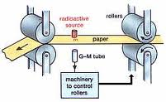
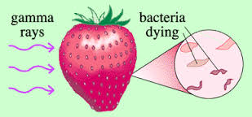
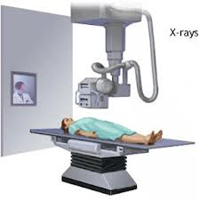
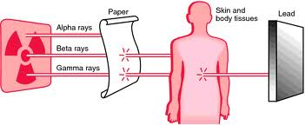
Applications of radioisotopes

Slide 52
Radioactive Decay
Radioactive decay is a random process because a very large number of identical nuclei are involved.
For an effective model of the decay process all of the particles involved need to be identical so that they each have exactly the same chance of decaying.
Although radioactive materials are potentially very dangerous they are also very useful in fields from medicine to archaeology.

Slide 53
Medical Uses of Radioisotopes Medical Tracers
Compounds containing radioisotopes can be used as tracers inside of patients. They are injected into the body and move through the blood stream, gathering in target organs. The tracers emit gamma radiation which are detected outside of the body with a gamma camera. A computer produces images from the information and problems such as blockages in blood vessels can be identified. Techecium-99m (Tc-99m) is the most common tracer used in diagnostic medicine. This isotope decays by releasing gamma radiation which is easily detectable by gamma cameras. Tc-99m also has a short half-life and therefore does not stay in the patient for a long time.

Slide 54
Medical Uses of Radioisotopes Radiotherapy
Radioactive emission can be highly ionising and can cause cancers. However, cancer cells are more susceptible to damage from gamma rays than normal cells and so can be destroyed by the gamma radiation. During radiotherapy a high intensity beam of gamma radiation is directed at a tumour. The cancer cells receive a high dose of the radiation and, hopefully, die off. The gamma ray may be produced by cobalt-60.

Slide 55
Industrial and Civilian Applications Radio carbon dating
All organisms contain carbon atoms absorbed from the atmosphere during its lifetime. Most of the carbon absorbed is carbon-12 which is a stable isotope but a small proportion is carbon-14 which is a beta emitter. When carbon-14 decays it forms a stable isotope known as nitrogen-14. ¹⁴₆C → ¹⁴₇N + ⁰₋₁β

Slide 56
Industrial and Civilian Applications Radio carbon dating
The proportions of carbon-12 and carbon-14 in the atmosphere are constant, as new carbon-14 is produced by interaction with cosmic rays, at the same rate, carbon-14 decays. This means that all living organisms maintain a constant ratio of carbon-14 to carbon-12. Once the organism dies it no longer takes in new carbon. The carbon-12 nuclei are stable but the carbon-14 nuclei continue to decay and so the ratio of carbon-14 to carbon -12 decreases over time. Scientists can measure the ratio of the two isotopes by measuring the activity of a sample of carbon taken from biological remains. This ratio can then be used to find out how long ago the organism died. Carbon-14 has a half-life of 5700 years and so the remains of an organism which died 5700 years ago would have half as much carbon-14 as an organism that died today.

Slide 57
Half-Life
The half –life of a radioisotope is the time taken for the mass (or activity) of a given sample of it to decay to half of its value.
The half-life of a radioactive material is NOT affected by conditions external to the nucleus this includes: 1. Physical conditions such as temperature and pressure 2. Chemical conditions such as whether or not the isotope is in its pure state or chemically combined with some other element in the compound.
Radioactive decay is exponential with time.

Slide 58
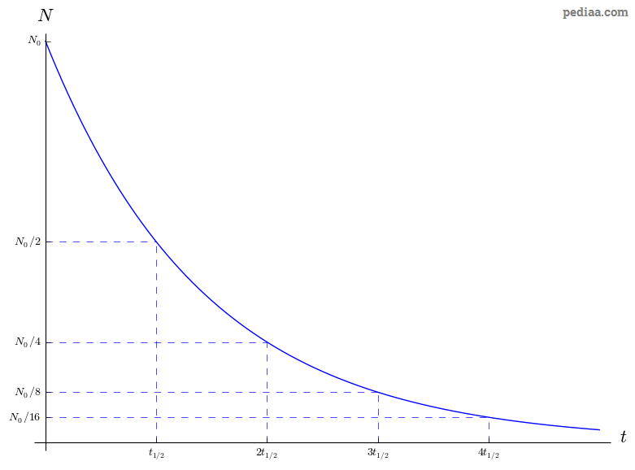
Half-Life Decay Curve

Slide 59
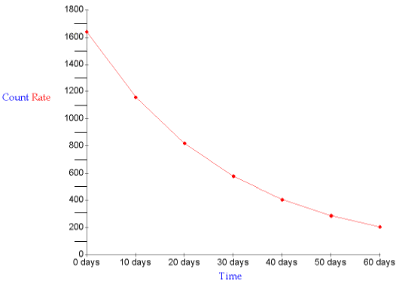
Half-Life Decay Curve

Slide 60
Comprehension
1. Why would an alpha particle emitter not be suitable for use as a medical tracer?

Slide 61
Comprehension
2. A sample of wood taken from an arrow is found by radiocarbon dating to have an activity 1/8 of that for a modern piece of the same type of wood. Estimate the age of the arrow.

Slide 62
Comprehension
3. An ancient piece of cotton cloth is found to have an activity, due to carbon-14 decay, ¼ of that of a modern cotton sample. Estimate the age of the ancient piece of cloth.

Slide 63
The release of nuclear energy

Slide 64
Conservation of Energy
What is the law of conservation of energy?
Albert Einstein realised that mass was equivalent to energy and this relationship was given by his famous equation: _______________________________ (N.B. Mass must be in kg and c in m/s)

Slide 65
Converting Mass to Energy
Whenever there is a change in energy there is an associated change in mass.
This also means that mass can be transformed into energy.

Slide 66
Converting Mass to Energy
In nuclear fission (splitting) a large nucleus is split into two small nuclei. The mass of these smaller nuclei is less than the original nucleus and this mass change leads to a large release of energy.

Slide 67
Converting Mass to Energy
How much energy is released during the nuclear fission shown in this equation? ²³⁵₉₂U + ¹₀n → ¹⁴⁴₅₆Ba + ⁹⁰₃₆Kr + 2¹₀n mass of uranium-235 = 3.902996 × 10⁻²⁵kg mass of barium-144 = 2.389897 × 10⁻²⁵kg mass of kryton-90 = 1.493157 × 10⁻²⁵kg mass of a neutron = 1.674927 × 10⁻²⁷kg use ΔE = Δmc²

Slide 68
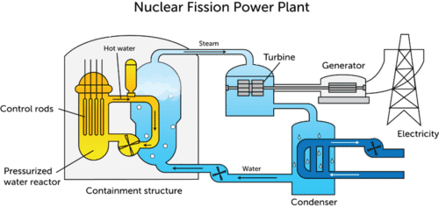
Nuclear Fission
Nuclear fission power stations use the thermal energy released to heat water into steam which drives turbines. These are then used to drive generators which produce electricity.

Slide 69
Nuclear Fission
Induced fission is caused by a neutron colliding with a large nucleus. During this process several other neutrons are released and these can be used to split other nuclei, releasing more energy and yet more neutrons. This process is called a chain reaction.
²³⁵₉₂U + ¹₀n → ¹⁴⁴₅₆Ba + ⁹⁰₃₆Kr + 2¹₀n

Slide 70
How much energy would be released if 1 gram of matter were completely converted into energy?

Slide 71
Arguments for and against the use of nuclear power
For | Against
Running costs are low | Commissioning (building) and decommission (dismantling) costs are high
Only a small amount of waste produced | Nuclear waste contains radioactive isotopes
Large supplies of nuclear fuel available | Waste products can be used in nuclear weapons
No carbon dioxide is produced so no contribution to global warming | Accidents such as occurred in Chernobyl and Fukushima can contaminate large areas

Slide 72
Nuclear fusion in stars Nuclear energy is also released when very small nuclei combine to form larger ones. This process occurs in the cores of stars and is only possible at very high temperatures and pressures, which have not yet been reproduced sustainably.

Slide 73
Questions: 1. What is a nuclear chain reaction? 2. A sugar cube has a mass of 12g. How much energy is equivalent of this mass? 3. Research the advantages and disadvantages of nuclear energy. Write a report arguing for or against construction of a power station on your island. 4. Find out what went wrong in Chernobyl and Fukushima and how long it will take to clear up the contaminated land.

