Slide 1

16. pH, Acids, Bases and Salts

Slide 2
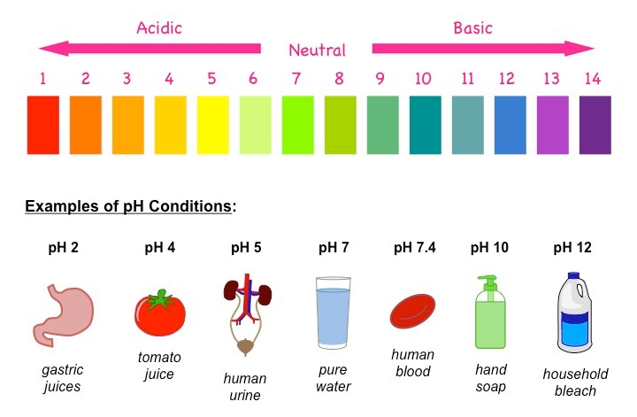
The pH Scale
The pH scale is a number scale which indicates whether a solution is alkaline, acidic or neutral.

Slide 3
The pH Scale
Acidic solutions have a pH of less than 7
Neutral solutions have a pH of 7
Alkaline (basic) solutions have a pH of more than 7
How do you think the pH of a solution may be decreased? _____
How do you think the pH of a solution may be increased? _____

Slide 4
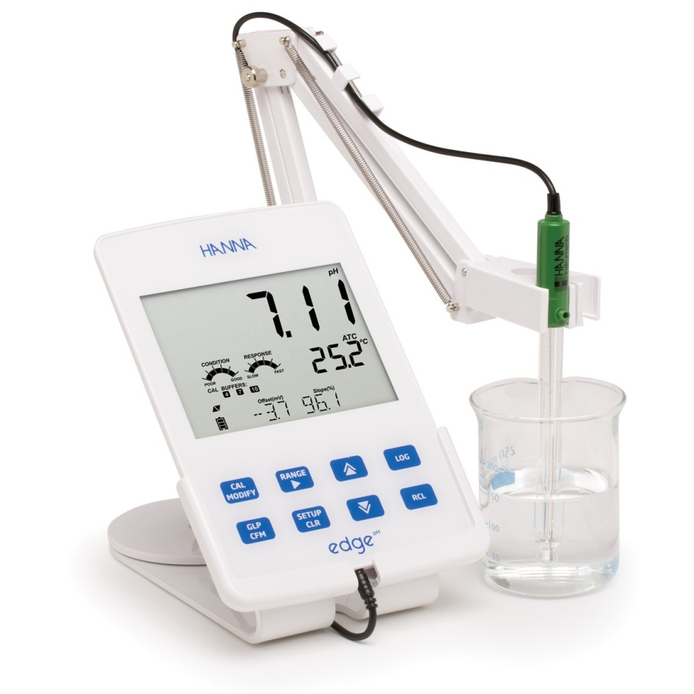
What can be used to measure pH?
The pH meter measures the pH of a solution precisely.

Slide 5
Indicators
Indicators are used to determine when there has been a change in pH based on colour change.
Most general indicator papers or indicator solutions can only be used to determine whether a solution is acidic, alkaline or neutral.
Indicators are dyes which are one colour in an acidic solution and another colour in an alkaline solution.
Full range, or universal, indicators are mixtures of indicators. They are more useful than single indicators because they give approximate pH values of solutions being tested.

Slide 6
Indicators
The table below shows the colour changes of some common indicators
Indicator | Litmus | Methyl Orange | Screened Methyl Orange | Phenolphthalein
Colour with acid | Red | Red | Light red | Colourless
Colour with base | Blue | Yellow | Green | Pink

Slide 7
Characteristics of Acids
1. They give particular colours with indicators, the exact colour depending on the pH of the acid
2. With active metals (e.g. Magnesium and zinc) acids react to produce a salt and hydrogen gas.
metal + acid → salt + hydrogen gas
For example:: Zn_{(s)} + 2HCl_{(aq)} → ZnCl_{2(aq)} + H_{2(g)}

Slide 8
Characteristics of Acids
3. Acids react with metal oxides (and hydroxides) to form a salt and water only.
metal oxide + acid → salt + water
For example:: MgO_{(s)} + H₂SO_{4(aq)} → MgSO_{4(aq)} + H₂O_{(l)}
metal hydroxide + acid → salt + water
For example:: Mg(OH)_{2(aq)} + H₂SO_{4(aq)} → MgSO_{4(aq)} + 2H₂O_{(l)}

Slide 9
Characteristics of Acids
4. Acids react with carbonates and hydrogencarbonates to yield salt, water and carbon dioxide.
metal carbonate + acid → salt + carbon dioxide + water
For example::
Na₂CO_{3(s or aq)} + 2HNO_{3(aq)} → 2NaNO_{3(aq)} + CO_{2(g)} + H₂O_{(l)}
metal hydrogencarbonate + acid → salt + carbon dioxide + water
For example::
NaHCO_{3(aq)} + HNO_{3(aq)} → NaNO_{3(aq)} + CO_{2(g)} + H₂O_{(l)}

Slide 10
Acids have the Following Properties
1. Aqueous solutions of acids conduct electric currents
2. Acids have sour tastes (BEWARE!)
3. All acids have hydrogen in their formulae. However, NOT all hydrogen-containing compounds are acids.

Slide 11
Acids have the Following Properties
Pure anhydrous acids may be:
1. solids e.g. Citric acid and ascorbic acid (vitamin C),
2. liquids e.g. Nitric acid and phosphoric acid
3. gases (which dissolve in water to form acids) e.g. SO₂ (sulphuric acid) and NO₂ (nitric acid and nitrous acid).
What does the word anhydrous suggest/mean?

Slide 12
Important Things to Note
a. Anhydrous ethanoic acid does not give a colour reaction with litmus or other indicators. Ethanoic acid only behaves like an acid when dissolved in water.
b. Hydrogen chloride does not show acidic properties when it is dissolved in a non-aqueous solvent such as methylbenzene, but does when dissolved in water.
All acids liberate hydrogen ions when they are dissolved in water.
The freed hydrogen ions are responsible for the observed behaviour of acids.
When acids come in contact with water, chemical changes take place.
Acids may be grouped in different ways:
as mineral acids or organic acids
as strong acids or weak acids
as monobasic, dibasic or tribasic

Slide 13
Important Things to Note
Mineral Acids are acids that were originally obtained from minerals: HCl, HNO₃, H₂SO₄ and H₃PO₄
Organic Acids are acids that were originally from plant and animal material: CH₃COOH (vinegar), C₄H₆O₆ (tartaric acid found in grapes) and C₆H₈O₆ (citric acid found in citrus fruits).

Slide 14
Important Things to Note
Strong acids are those acids which are completely ionised in aqueous solutions. Their aqueous solutions conduct electricity well: HCl, H₂SO₄ and HNO₃
For example::
ionisation of hydrochloric acid
HCl_{(aq)} → H⁺_{(aq)} + Cl⁻_{(aq)}
ionisation of sulphuric acid
H₂SO_{4(aq)} → 2H⁺_{(aq)} + SO₄²⁻_{(aq)}

Slide 15

Important Things to Note
Weak acids are those acids which are only partially ionised in aqueous solutions. Their aqueous solutions conduct electricity to a small extent.
Examples of weak acids include ethanoic acid (CH₃COOH) which can be found in vinegar, lactic acid (C₃H₆O₃) which is present in sour milk and ethanedioic acid (C₂H₂O₄) which is also known as oxalic acid that is present in chocolate.
For example:: CH₃COOH_{(aq)} CH₃COO⁻_{(aq)} + H⁺_{(aq)}

Slide 16
Important Things to Note
Monobasic acids are those acids which yield one free H⁺ ion for each molecule of acid in aqueous solution. HCl, HNO₃ and CH₃COOH are examples of monobasic acids.
What do you think are dibasic and tribasic acid and can you give examples of each?
What is the meaning of the saying, “ionisation of an acid”?

Slide 17
Important Things to Note
A. STRONG and WEAK do NOT mean CONCENTRATED or DILUTE.
Do NOT confuse the two!
B. Do NOT confuse the terms STRONG and WEAK with REACTIVE and UNREACTIVE!
C. The STRENGTH of an acid depends on its ability to provide free hydrogen ions in aqueous solutions!
Why do you think HCl is a strong acid? Express this using an equation. HCl_{(aq)} → H⁺_{(aq)} + Cl⁻_{(aq)}
Why do you think ethanoic acid, CH₃COOH is a weak acid? Express this using an equation. CH₃COOH_{(aq)} CH₃COO⁻_{(aq)} + H⁺_{(aq)}

Slide 18
Water of Crystallization
Water molecules may become part of the crystal structure of salts when these are formed by crystallization from aqueous solutions. Such water is known as water of crystallization.
The water of crystallization should be included as part of the formula of the salt. The dot in the middle of the formula, just before the H₂O, indicates water of crystallization.
Salts with water of crystallization are also known as _________ salts.

Slide 19
Water of Crystallization
Examples of salts with water of crystallization are::
CuSO₄.5H₂O - copper(II) sulphate-5-water
CaCl₂.6H₂O - calcium chloride-6-water
What do you think is the name of this next compound? FeSO₄.7H₂O? _____________

Slide 20
Bases/Alkalis
Bases are the hydroxides and oxides of metals.
However, a base may be defined as any substance which reacts with acids to form salts and water only.
The following are examples of bases reacting with various acids.
Metal oxide or a metal hydroxide + acid → salt + water
MgO_{(s)} + 2HCl_{(aq)} → MgCl_{2(aq)} + H₂O_{(l)}
NaOH_{(aq)} + HNO_{3(aq)} → NaNO_{3(aq)} + H₂O_{(l)}
2KOH_{(aq)} + H₂SO_{4(aq)} → K₂SO_{4(aq)} + H₂O_{(l)}
NH₃.H₂O + HCl_{(aq)} → NH₄Cl_{(aq)} + H₂O_{(l)}

Slide 21
Bases/Alkalis
Some bases are soluble in water (e.g. KOH, NaOH and Na₂O), while others are not (e.g. Cu₂O, Fe₂O₃ and Cu(OH)₂).
Soluble bases are commonly known as alkalis. These bases dissolve in water to produce the hydroxyl ion : OH⁻. These solutions have a pH greater than seven.
Alkalis are:
a. Slippery to touch. Strong alkali can damage skin. The soapy feel of alkali results from the conversion of oils on the skin to soap
b. Conductors of electricity in aqueous solutions
c. Neutralized by acids to form salt and water

Slide 22
Bases/Alkalis
STRONG ALKALIS
Alkalis give characteristic colours with indicators, e.g. They turn red litmus ___________ and phenolphthalein from colourless to ____________.
Alkalis may be strong or weak. Strong alkalis __________ completely in aqueous solutions.
NaOH_{(s)} → Na⁺_{(aq)} + OH⁻_{(aq)}

Slide 23
Bases/Alkalis
WEAK ALKALIS
Weak alkalis partially ________________ in aqueous solutions.
Ammonia, NH₃, is an example of a weak base. It turns red litmus blue. Ammonia is less dense than air and is readily soluble in water.
Ammonia is readily identifiable by its _____________, by its reaction on litmus and by the fact that it forms dense white fumes with HCl.
NH_{3(g)} + HCl_{(g)} → NH₄Cl_{(s)}

Slide 24
Preparation of Ammonia
Ammonia is prepared by heating an intimate mixture of an ammonium salt (e.g. Ammonium sulphate, (NH₄)₂SO₄) and a base such as Ca(OH)₂.
(NH₄)₂SO_{4(s)} + Ca(OH)_{2(s)} → 2NH_{3(g)} + 2H₂O(l) + CaSO_{4(s)}
The gas is dried by passing it through a tower of quicklime (CaO) and collected by downward displacement of air.

Slide 25
What are Oxides?
An oxide is a compound formed between oxygen and ONE other element.
The acid/base properties of oxides allow oxides to be put into the following groups::
a. Acidic oxides
b. Basic oxides
c. Amphoteric oxides
d. Neutral oxides

Slide 26
Acidic Oxides
(Formation of Acids)
Acidic oxides are the oxides of non-metals in their higher oxidation states.
Acidic oxides dissolve in water to form acids and are therefore often referred to as acid anhydrides. Below are examples of acidic oxides.
SO_{2(g)} + H₂O_{(l)} → H₂SO₃(aq) sulphurous acid
SO₃(g) + H₂O_{(l)} → H₂SO₄ sulphuric acid
CO₂(g) + H₂O_{(l)} → H₂CO₃ carbonic acid
N₂O₅(g) + H₂O_{(l)} → 2HNO₃ nitric acid
2NO₂(g) + H₂O_{(l)} → HNO_{2(aq)} + HNO_{3(aq)} nitrous acid and nitric acid respectively

Slide 27
Basic Oxides
(Formation of Salts)
Basic oxides are oxides that are formed by most metals.
Basic oxides react with acids to give a salt and water ONLY. Try completing these equations::
CuO_{(s)} + H₂SO_{4(aq)} → _______________ + _________________
MgO_{(s)} + 2HCl_{(aq)} → _______________ + __________________
Soluble basic oxides include those of Na, K and other Group 1 elements. These dissolve in water and are therefore alkalis.
Na₂O_{(s)} + H₂O_{(l)} → 2NaOH_{(aq)}

Slide 28
Amphoteric Oxides
Amphoteric oxides can react with both acids and bases.
They are formed by some metals, including lead, aluminum and zinc.
The following are some examples:
PbO_{(s)} + 2HNO_{3(aq)} → Pb(NO₃)_{2(aq)} + H₂O_{(l)}
PbO_{(s)} + 2NaOH_{(aq)} → Na₂PbO_{2(aq)} + H₂O_{(l)} the product is sodium plumbate
ZnO_{(s)} + H₂SO_{4(aq)} → ZnSO_{4(aq)} + H₂O_{(l)}
ZnO_{(s)} + 2NaOH_{(aq)} → Na₂ZnO_{2(aq)} + H₂O_{(l)} the product is sodium zincate

Slide 29
Neutral Oxides
Neutral oxides are formed by certain non-metals in low oxidation states and include CO, NO and N₂O.
These oxides react with NEITHER acid NOR bases.

Slide 30
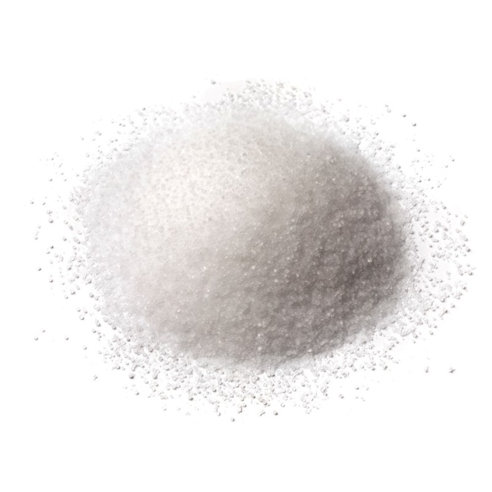
Salts
Salt has been used for flavouring and preserving food. It has also been used in tanning, dyeing and bleaching, and in the production of pottery, soap, and chlorine.
Today, it is widely used in the chemical industry.

Slide 31
Solubility Rules
Some salts are soluble while some are insoluble and some are sparingly soluble. Soluble salts dissolve completely in water while insoluble salts do NOT dissolve at all in water. Sparingly soluble salts partially dissolve in water and might require a bit of heat or more solvent to get it to dissolve in water.
Here is a table that will help you determine which salts would need to be obtained via separation methods involving evaporation or precipitation. Soluble salts may be obtained via evaporation while insoluble salts may be obtained via precipitation.
Na⁺, K⁺ and NH₄⁺ salts | All soluble
Nitrates (NO₃⁻) | All soluble
Ethanoates (CH₃COO⁻) | All soluble
Chlorides (Cl⁻), bromide (Br⁻), iodides (I⁻) | All soluble EXCEPT for Pb²⁺ and Ag⁺
Sulfates (SO₄²⁻) | All soluble EXCEPT for Pb²⁺, Ba²⁺ and Ca²⁺
Carbonates (CO₃²⁻) | All insoluble EXCEPT for Na⁺, K⁺ and NH₄⁺
Hydroxides (OH⁻) | All insoluble EXCEPT for Na⁺, K⁺ and NH₄⁺

Slide 32
Formation of Salts
Salts are formed when metal ions OR ammonium ions take the place of the replaceable hydrogen(s) of an acid. NaOH_{(aq)} + HCl_{(aq)} → NaCl_{(aq)} + H₂O_{(l)}
A normal salt is formed if all the replaceable hydrogen of the acid is removed. For example::
2NaOH(aq) + H₂SO_{4(aq)} → Na₂SO_{4(aq)} + 2H₂O_{(l)}
What products then are produced when 3KOH_{(aq)} + H₃PO_{4(aq)} → _____ + _____
An acid salt is formed only if part of the replaceable hydrogen is removed. For example::
NaOH_{(aq)} + H₂SO_{4(aq)} → NaHSO_{4(aq)} + H₂O_{(l)}
metal hydroxide
acid
salt
water

Slide 33
Formation of Salts
The method used to prepare a salt depends on whether the salt is soluble or not.
Soluble in this context means having the ability to dissolve in water while insoluble refers to NOT being able to dissolve in water.
SOLUBLE SALTS can be prepared by
a. the action of acids on alkalis::
NaOH_{(aq)} + HNO_{3(aq)} → NaNO_{3(aq)} + H₂O_{(l)}
and by →

Slide 34
Formation of Salts
b. the action of acids mixed with excess metal, metal oxide, metal carbonate or hydrogencarbonate: Try completing the following::
(I) Zn_{(s)} + H₂SO_{4(aq)} → ……………………………………………………………………………….
(II) PbO_{(s)} + 2HNO_{3(aq)} →…………………………………………………………………………..
(III) CaCO_{3(s)} + 2HCl_{(aq)} → ………………………………………………………………………….
(IV) 2NaHCO_{3(s)} + H₂SO_{4(aq)} → …………………………………………………………………..
Let’s recall that:
metal + acid → salt + hydrogen gas
metal oxide + acid → salt + water
metal hydroxide + acid → salt + water
metal carbonate + acid → salt + water + carbon dioxide
metal hydrogencarbonate + acid → salt + water + carbon dioxide

Slide 35
Formation of Salts
It is common practice whenever a solid and an acid are used in such preparations to use excess of the solid. What does this practice ensure?
Under these conditions the acid is the limiting reagent. On completion of the reaction, excess (unreacted) solid is removed by filtration.
A sample of the salt can then be obtained from the filtrate by carrying out the following steps::
a. Concentrate the filtrate by gentle evaporation (use a water bath)
b. Cool the concentrate, testing for crystal formation. Slow cooling leads to the formation of big crystals.
c. Filter the crystal
d. Carefully wash and dry the crystals

Slide 36
Formation of Salts
Insoluble salts can be prepared by direct combination eg.
Fe_{(s)} + S_{(s)} → _______________{(s)}
2Fe_{(s)} + 3Cl_{2(g)} → _________________{(s)}
or by precipitation.
A precipitate sometimes forms when two solutions of soluble salts are mixed. The soluble salts, between them, provide the ions needed to make the insoluble salt. The procedure is as follows::
a. The aqueous solutions are mixed
b. The mixture is then warmed, if necessary, and filtered
c. The residue is washed and dried
example:: Ba(NO₃)_{2(aq)} + K₂SO_{4(aq)} → BaSO_{4(s)} + 2KNO_{3(aq)}

Slide 37
Formation of Salts
Addition of salts to water can alter the pH of the original solvent. For example NaCl added to water has a pH of 7 whereas (NH₄)₂SO₄ dissolves in water to give a solution of pH 5.5 which is quite acidic.
When soils have been repeatedly treated with ammonium fertilizers farmers call such soils ‘sour soils’. Can you suggest a reason for this name? _____________
Sour soils can be made neutral by treating them with lime (CaO).

Slide 38
Extended Solubility Rules
 | nitrate | chloride | sulphate | ethanoate | carbonate | hydroxide
ammonium | Ammonium nitrate | Ammonium chloride | Ammonium sulphate | Ammonium ethanoate | Ammonium carbonate | Ammonium hydroxide
potassium | Potassium nitrate | Potassium chloride | Potassium sulphate | Potassium ethanoate | Potassium carbonate | Potassium hydroxide
sodium | Sodium nitrate | Sodium chloride | Sodium sulphate | Sodium ethanoate | Sodium carbonate | Sodium hydroxide
barium | Barium nitrate | Barium chloride | Barium sulphate | Barium ethanoate | Barium carbonate | Barium hydroxide
calcium | Calcium nitrate | Calcium chloride | Calcium sulphate | Calcium ethanoate | Calcium carbonate | Calcium hydroxide
magnesium | Magnesium nitrate | Magnesium chloride | Magnesium sulphate | Magnesium ethanoate | Magnesium carbonate | Magnesium hydroxide
aluminum | Aluminum nitrate | Aluminum chloride | Aluminum sulphate | Aluminum ethanoate | Aluminum carbonate | Aluminum hydroxide
zinc | Zinc nitrate | Zinc chloride | Zinc sulphate | Zinc ethanoate | Zinc carbonate | Zinc hydroxide
iron | Iron nitrate | Iron chloride | Iron sulphate | Iron ethanoate | Iron carbonate | Iron hydroxide
lead | Lead nitrate | Lead chloride | Lead sulphate | Lead ethanoate | Lead carbonate | Lead hydroxide
copper | Copper nitrate | Copper chloride | Copper sulphate | Copper ethanoate | Copper carbonate | Copper hydroxide
silver | Silver nitrate | Silver chloride | Silver sulphate | Silver ethanoate | Silver carbonate | Silver hydroxide
Soluble or aqueous (aq) | Insoluble or solid (s) | Almost insoluble/slightly soluble or solid (s) can easily re-dissolve in solvent

Slide 39
The pH of some common fluids
Common Name | Description/Comments | pH
Lye | 0.1 mol/dm3 NaOH, removes grease and stubborn dirt | 13
Household ammonia | Effectively, a dilute solution of ammonia; used in cleaning glass panes, counter tops etc. | 11 – 12
Lime water | A saturated solution of Ca(OH)₂ used to detect the presence of CO₂ | 10.6
Borax | A compound of boron used to remove wine and tea stains | 9.3
Baking soda | Sodium hydrogencarbonate, used as a raising agent in baking etc.; it reduces the acidity of citrus fruits; also used in stain removal and in cleaning jewellery | 8.5
Vinegar | A dilute solution of ethanoic acid used in preserving pickling foods | 3
Lemon juice | Contains citric acid, a widely distributed plant (organic) acid, used in foods to provide a tart taste | 2
Gastric fluid | Contains hydrochloric acid | 1.3 – 1.5
Salts used in everyday life
Salt | Colour and other characteristics | Uses
Ammonium chloride | White crystals | Dry cells (batteries), fertilizers
Ammonium sulphate | White crystals | Fertilizers
Calcium carbonate (marble, limestone) | White but can be coloured | Decorative stones, manufacture of cement and lime
Calcium sulphate (plaster of paris, gypsum) | White crystals | Plastering walls; making casts, etc
Magnesium sulphate (Epsom salts) | White crystals | Purgative
Copper(II) sulphate | Blue crystals | Fungicides
Sodium carbonate (washing soda) | White crystals or powder | In cleaning, in laundry as a softener, in the manufacture of glass

