Slide 1


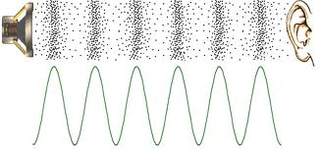
Sound waves

Slide 2
Sound
Sound intensity or loudness is determined by the amount of energy that sound waves carry.
A loud sound has a high sound intensity.
The unit of sound intensity is decibels (dB).
The safe sound intensity for the human ear is 85 dB.

Slide 3

Production and Propagation of Sound Waves
Sound cannot travel/propagate through a vacuum like light can.
Sound waves can only travel through a material medium such as air. Hence sound requires matter in order to travel
Sound waves are produced by
mechanical vibrations.

Slide 4
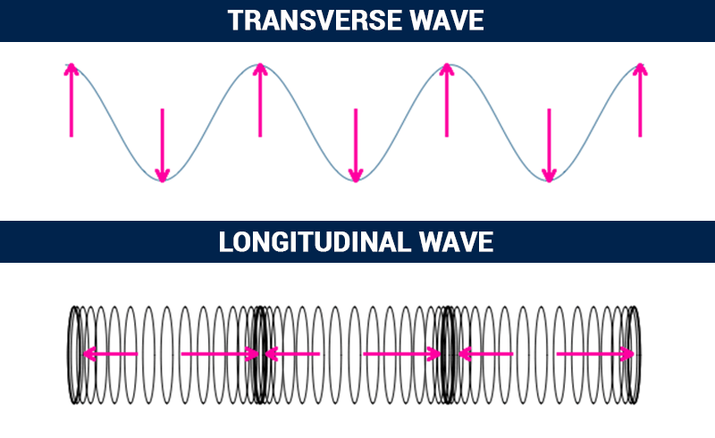
Types of Waves
A transverse wave has vibrations perpendicular to its direction of propagation.
A longitudinal wave is one that has vibrations parallel to its direction of propagation.

Slide 5
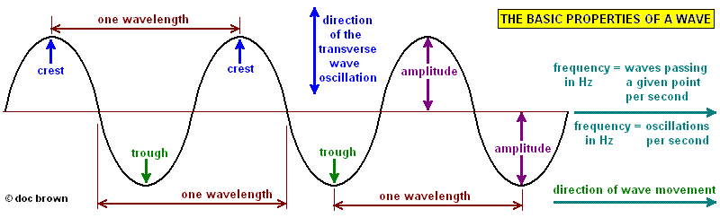
Parts of a Wave

Slide 6

Longitudinal Waves
Sound travels as a wave referred to as progressive longitudinal.
Sound gives interference and diffraction effects and is often believed to be a form of energy because of that.
A longitudinal wave can
be sent along a spring.

Slide 7
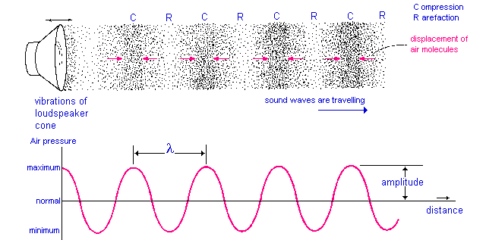
Longitudinal Waves
When a spring is pushed in a back and forth motion compressions, C, where the coils are closer together, and rarefactions, R, where the coils are farther apart, travel along the spring. This is demonstrated below.

Slide 8
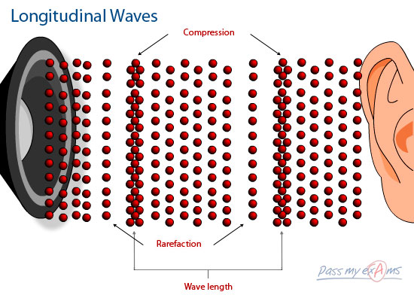
Longitudinal Waves
In a longitudinal wave the particles of the transmitting medium vibrate to and fro along the same line as that in which the wave is travelling, not at right angles to it as in a transverse wave. What is a transverse wave?

Slide 9

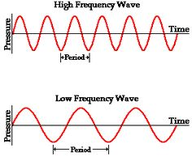
Pitch & LOUDNESS
A wave of greater frequency produces a sound of higher pitch.
Frequency is the number
of vibrations occurring in
one second. The unit of
frequency is per second
1/s or Hertz
(Hz)
What type of sound
would a low frequency
produce?

Slide 10
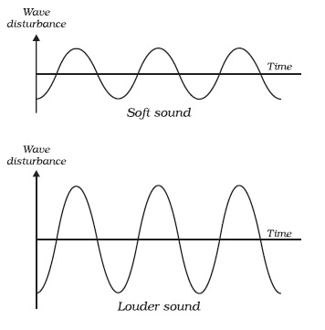
Pitch & LOUDNESS
A greater amplitude wave gives a higher/louder volume

Slide 11
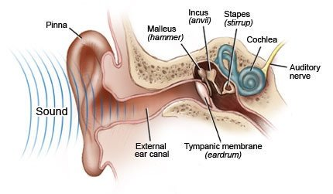
Ultrasound and Infrasound
Frequencies below 20 Hz is referred to as infrasound
The human audible range for hearing is between 20 Hz to 20, 000 Hz.
Frequencies above
20, 000 Hz is
referred to as
ultrasound.
As one gets older the
upper limit gradually
reduces to about 16, 000 Hz.

Slide 12


Uses of Ultrasound
1. Medicine
Also known as diagnostic imaging ultrasound is used to view babies inside of the womb. It is also used to examine internal organs.
2. Communication
Animals such as dolphins use
ultrasound to communicate
with each other.

Slide 13
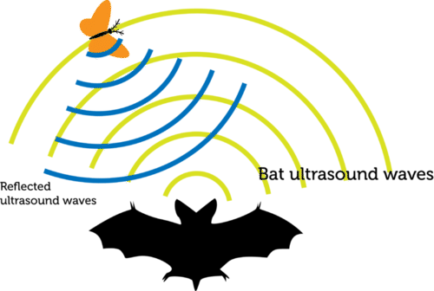
Uses of Ultrasound
3. Measuring distance
a. Bats are nocturnal and blind. To judge how far they have to fly they emit ultrasound which reflects/echoes off of objects to assess their distance from it.

Slide 14
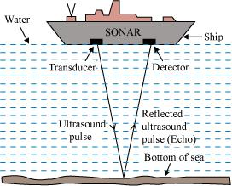
Uses of Ultrasound
3. Measuring distance
b. Depth sounding is the use of
ultrasound by boat operators
to determine the depth of an
ocean floor based on the time
it takes the ultrasound to reflect.
Since the sound wave travels
twice then to find the distance
of the bat from its prey or the
boat from the ocean floor the
following equation may is used:
s = 2d/t
Where:
s means speed of sound in meters per second (m/s)
d means distance in metres (m)
t means time in seconds (s)

Slide 15

Reflections and Echoes
Sound waves are reflected well from hard, flat surfaces such as walls or cliffs and obey the same laws of reflection as light.
What are the laws of reflection of light?

Slide 16

Reflections and Echoes
Reflected sound forms an echo.
If a reflecting surface is nearer than 15 m, the echo joins up with the original sounds which makes the sound seem prolonged. This is called reverberation.
What is often done to
lessen reverberation
in concert halls or
movie theatres?

Slide 17
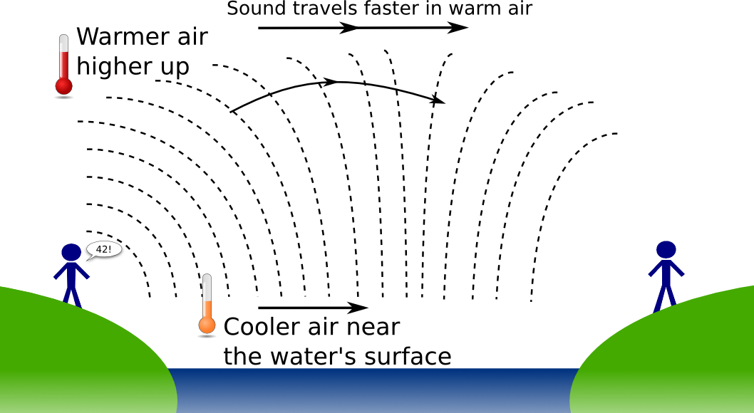
Speed of Sound
In air the speed of sound is about 330 m/s at 0 ºC.
The speed of sound increases at higher temperatures.
In steel the speed of sound is 6000 m/s.

Slide 18

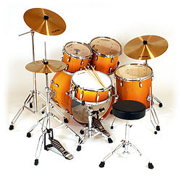
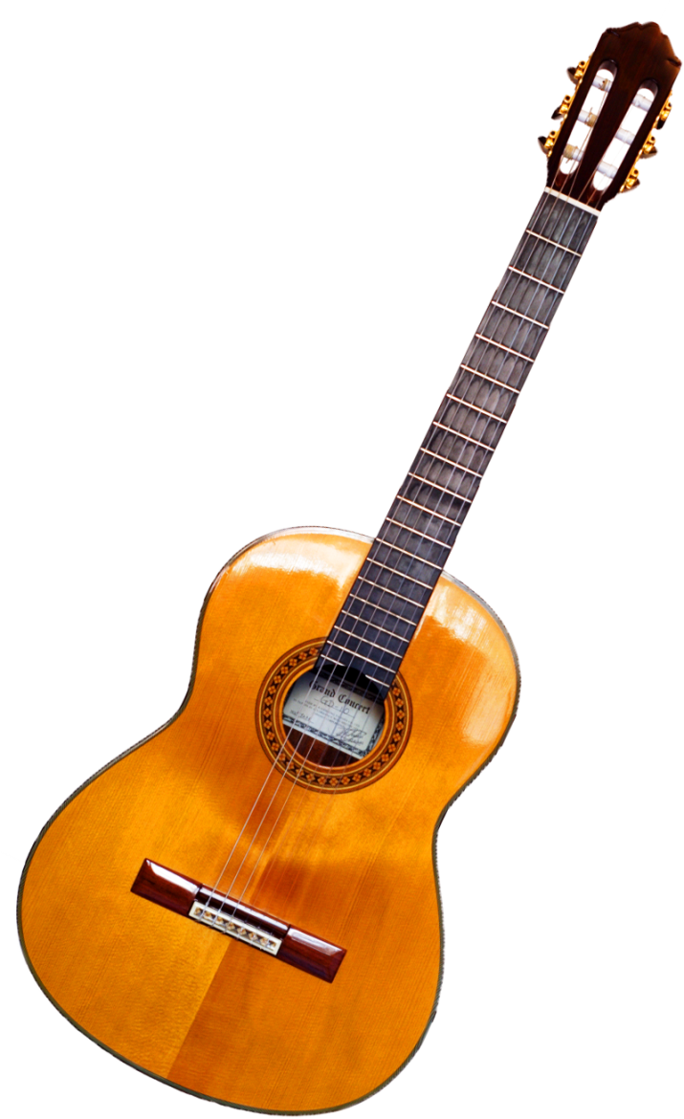
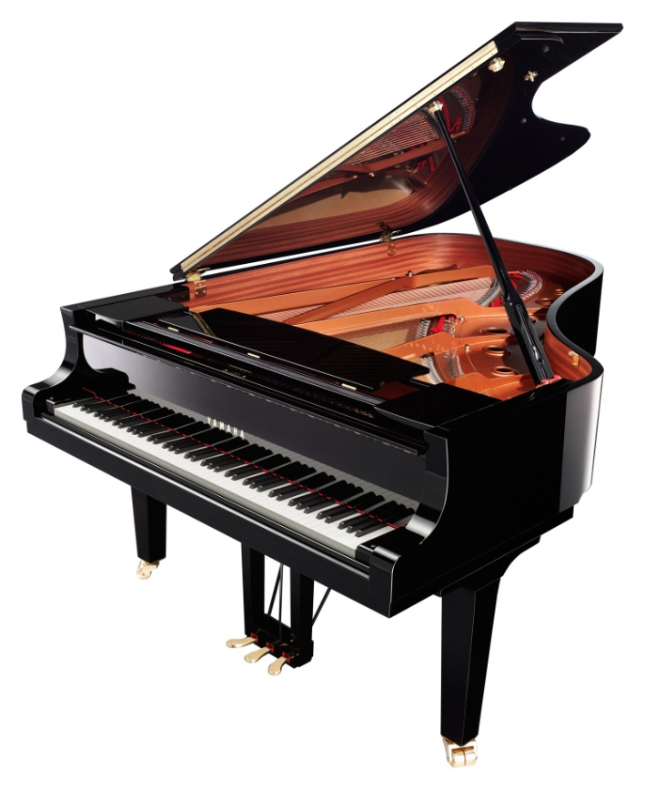
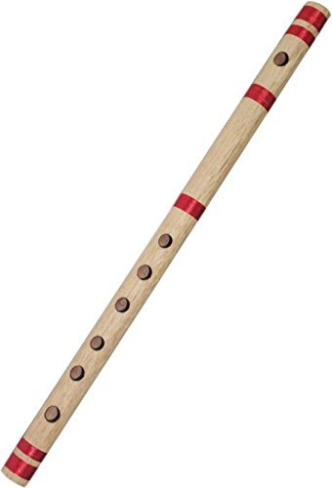
Musical notes

Slide 19
What is noise caused by?
Musical notes are made up of three properties:
1. pitch
2. loudness
3. quality

Slide 20
Pitch
The pitch of a note depends on the frequency of the source of sound.
A high-pitched note has a high frequency and a _________________ wavelength.
The frequency of middle C is 262 vibration per second or 262 Hz and that of upper C is 524 Hz.
Notes are an octave apart if the frequency of one is twice that of the other.

Slide 21
Loudness
A note is louder when more sound energy enters our ears per second than before and is caused by the source vibrating with a larger amplitude.
What does the word source mean here?

Slide 22
Quality
Does the same note on different instruments sound the same or different? Explain your answer.
The difference in sound arises because no instruments, except a tuning fork and a signal generator, emits a pure note, meaning of one frequency.
Notes consist of a main or fundamental frequency mixed with others, called overtones, which are usually weaker and have frequencies that are exact multiples of the fundamental.
Overtones of 262 Hz are 524 Hz, 786 Hz and so on. What would be the next overtone?

Slide 23
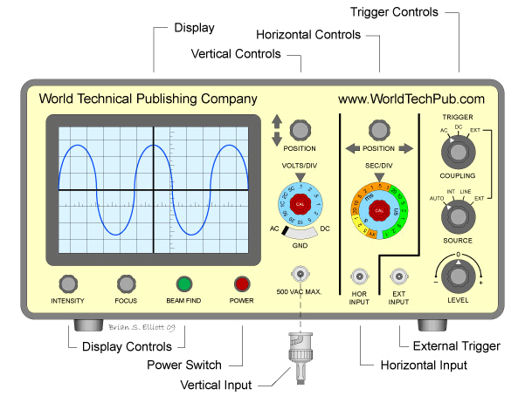
The waveform of a note played near a microphone connected to an oscilloscope can be displayed on the screen. What is an oscilloscope?
Notes produced by different devices can have the same frequency (pitch) but will have different quality (timbre).

Slide 24
CLASSWORK ☺
1. On what does:
a. the loudness
b. the pitch
of a sound depend on?
2.
a. Draw the waveform of
(i) a loud, low-pitched note and
(ii) a soft, high-pitched note
b. If the speed of sound is 340 m/s, what is the wavelength of a note of frequency
(i) 340 Hz
(ii) 170 Hz
For homework look up waveforms for the note produced by at:
1. tuning fork
2. piano
3. violin

