Slide 1
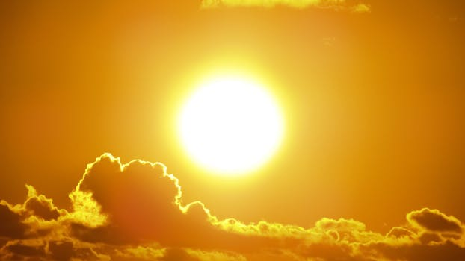
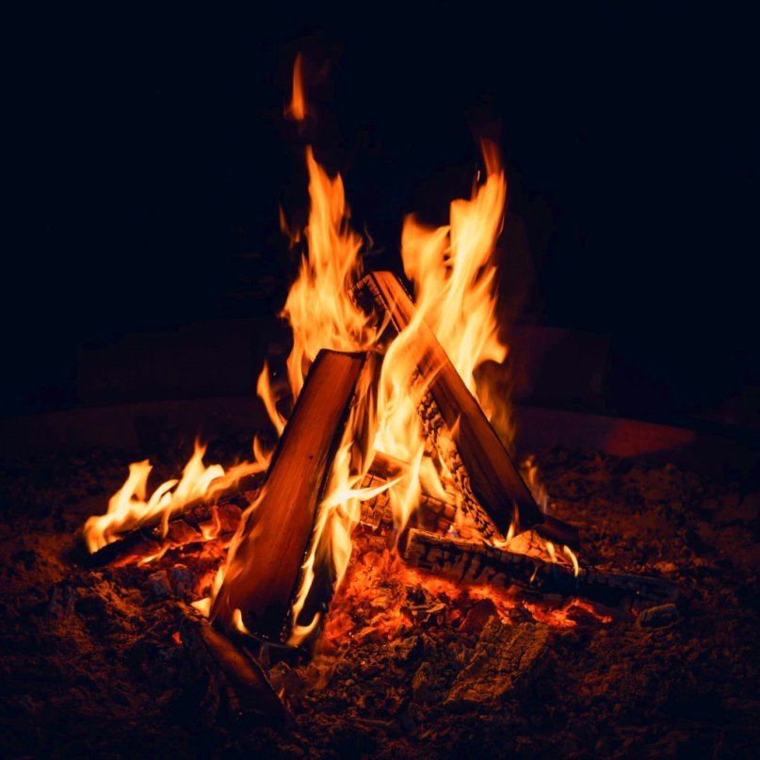
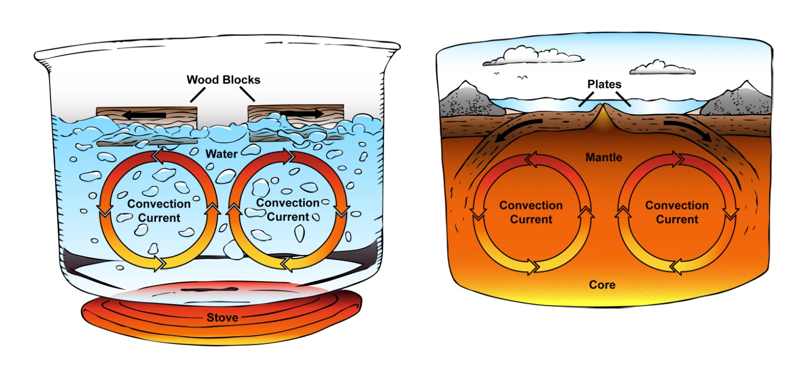
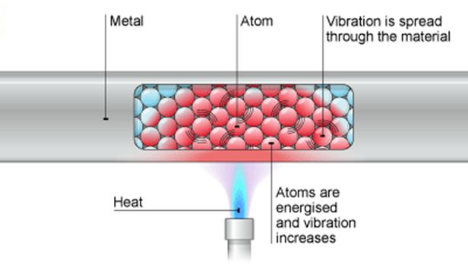
How is Energy Transferred

Slide 2

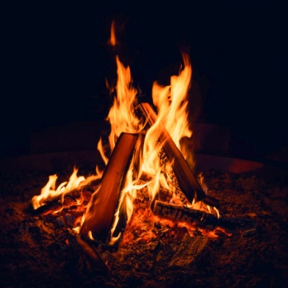
Ways in Which Heat is Transferred
Heat is transferred in 3 ways
1. Conduction
2. Convection
3. Radiation

Slide 3
Conduction
Metals are good conductors of heat. They are referred to as thermal conductors.
Examples of good conductors are steel, aluminum and copper.
The best conductors allow heat to pass through it quickly.

Slide 4
Conduction
When one end of a metal is heated the heat is transferred through it via vibrations. This is called conduction.
The heat vibrates the particles (atoms, molecules or ions) within the metal and such vibrations are passed along to other particles within the metal which eventually heats up the entire metal.

Slide 5
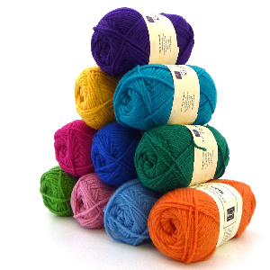
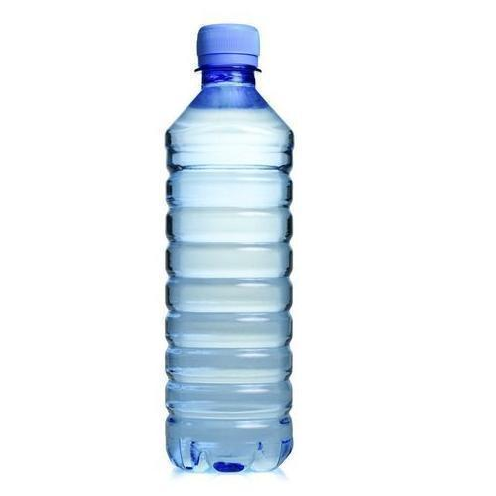

Conduction
Materials which are unable to conduct heat are referred to insulators.
Examples of insulators are wool, plastic and wood.

Slide 6
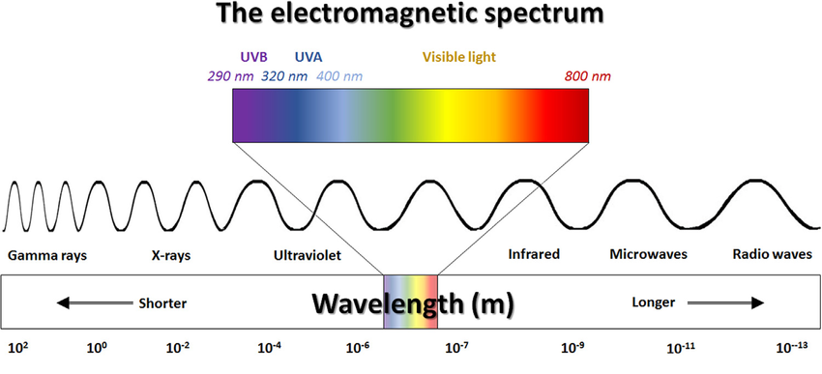
Radiation
Radiation is the transfer of heat energy in the form of electromagnetic waves such as infrared radiation.

Slide 7
Radiation
Radiation is emitted by hot objects such as fire and the Sun.
The Sun’s energy travels through space at
3 × 10⁸ m/s. It does not need particles to travel since it can travel through space which is a natural vacuum.

Slide 8
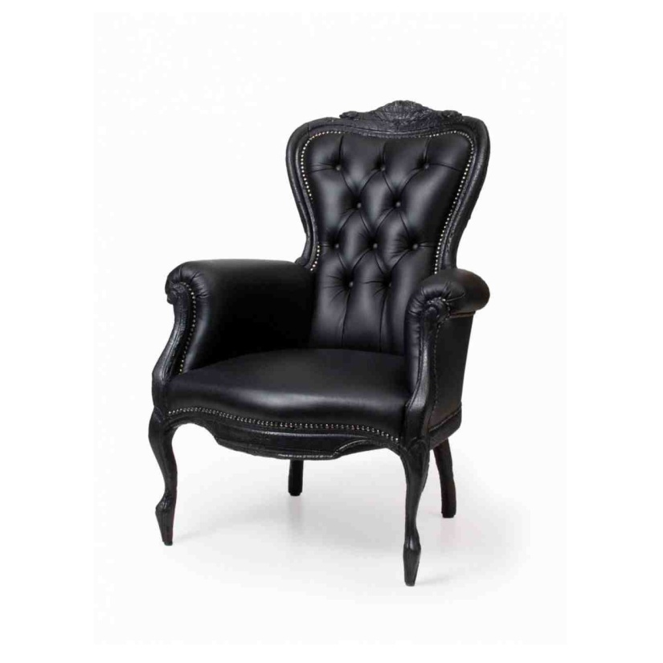
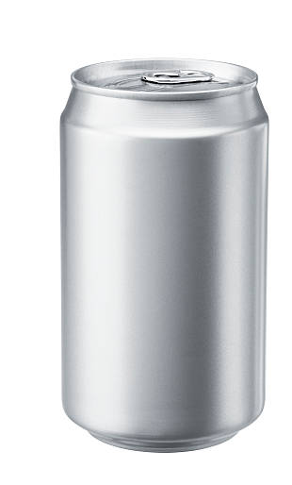
Radiation
Dull black objects absorb heat well.
Shiny and white objects reflect heat well.

Slide 9
Energy Transfer in Fluids
Convection
Liquids and gases are referred to as fluids.
Heat is transferred within a fluid via convection currents.
When a fluid is heated its particles move around more quickly.
As a fluid warms up, it expands and its density decreases. This is because the heated particles of the fluid will float upwards.

Slide 10
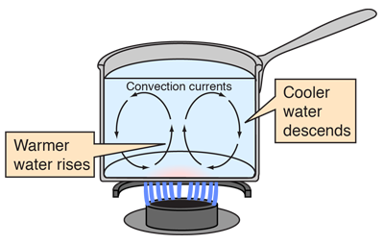
Energy Transfer in Fluids
When heat energy is transferred by hot particles moving from a warmer to a cooler place it is referred to as convection.

Slide 11
Examples of Natural Convection Currents Occurring
Two examples of natural convection currents occurring are:
1. Breeze (Land and Sea Breeze)
2. Movement of land masses

Slide 12
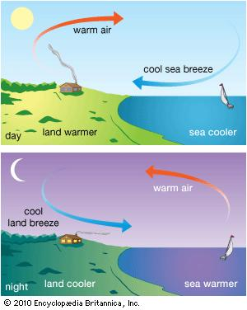
Land Breeze and Sea Breeze
Land breezes occur during the night time while sea breezes occur during the day time.

Slide 13
Land Breeze and Sea Breeze
Land breezes occur during the night time while sea breezes occur during the day time.
In sunlight the land warms up more quickly than the sea so air above the land rise while cooler air from above the sea rushed in the take its place.
At night the land cools down while hot air from the sea rises up as cooler air from over the land rushes out to take its place.

Slide 14
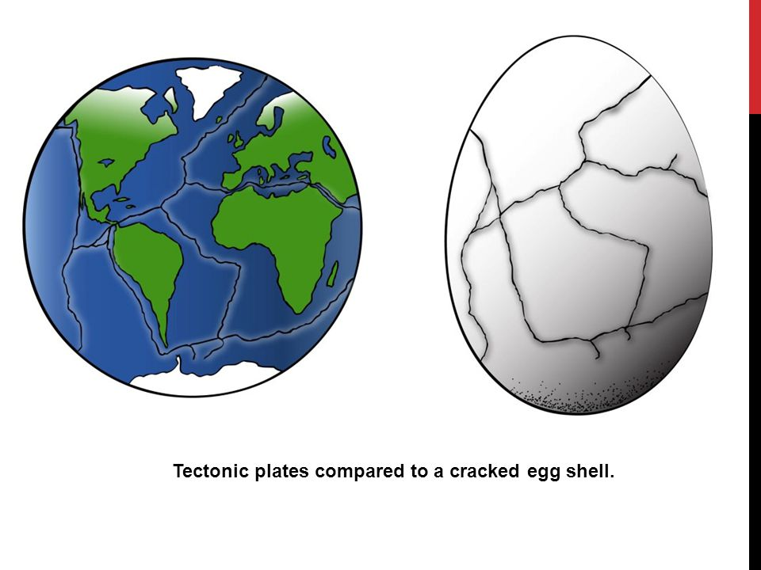
Movement of Land Masses
The Earth’s crust resembles a cracked egg shell. They are referred to as tectonic plates.

Slide 15
Movement of Land Masses
The Earth’s crust resembles a cracked egg shell. They are referred to as tectonic plates.
Below the Earth’s crust is molten rock referred to as magma. It is very hot.
The convection currents within the hot magma cause the tectonic plates to move slowly. Sometimes these plates collide and cause an earthquake.

Slide 16
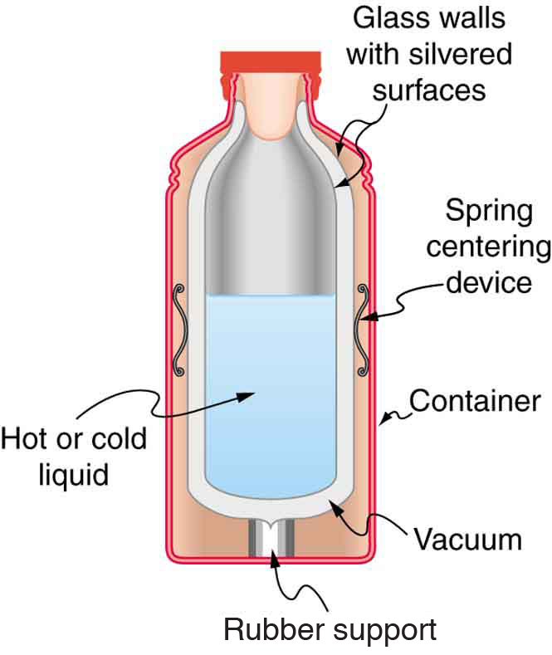
How a Thermos or Vacuum Flask Works
A thermos or vacuum flask is used to keep hot food or fluid, hot and cold food or fluid, cold.
In a thermos or vacuum
flask it has a
double-walled
glass or plastic
container.

Slide 17
How a Thermos or Vacuum Flask Works
Inside the surfaces of the walls are silvered to stop radiation.
The space between the double walls are airless. This prevents conduction and convection from taking place.

Slide 18
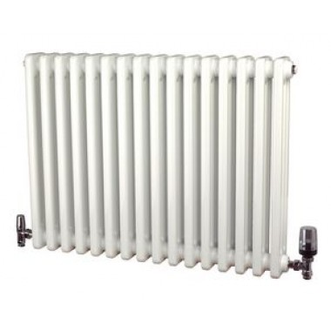
Mechanism of a Radiator
A radiator is used to heat up a room in very cold countries.
They do this by heating up the air in the room via convection currents as opposed to its name. Hot air floats upwards pushing cooler or cold air downwards, closer to the radiator which in gets heated. This process eventually heats up the room effectively.

Slide 19
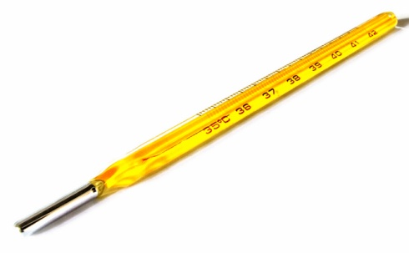
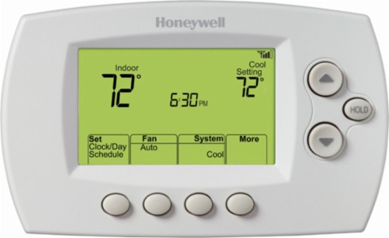
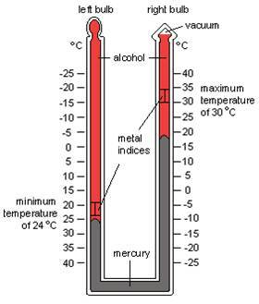
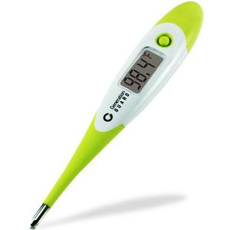
Thermostats and Thermometers

Slide 20
Themostats
Themostats are devices that can switch the electric current off automatically once a certain temperature has been reached.
The circuit will be switched back on automatically once it cools down below that temperature.
A thermostat can keep a device at a certain temperature without you having to switch them on and off all the time yourself.

Slide 21
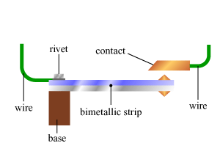
Themostats
A thermostat can keep a device at a certain temperature without you having to switch them on and off all the time yourself.
It contains a bimetallic strip which bends to break the circuit when it gets too hot but straightens to close the gap in the circuit when it not too cold.

Slide 22
Thermostats
A bimetallic strip is made up of two different metals.
For example brass and steel can be welded together. In this case brass expands more than steel when it gets hot so the strip will bend.

Slide 23
Household Appliances that use Thermostats
Air conditioner:
When the air conditioner reaches to a certain temperature a message is sent to the boiler in this way a steady temperature may be maintained.
Iron:
A knob is used the set the distance between the bimetallic strip and the contact point.

Slide 24
Thermometers
There are several different types of thermometers:
a. Laboratory
b. Alcohol
c. Clinical
d. Maximum-minimum
e. Digital

Slide 25
Laboratory Thermometer
This is referred to as a
liquid-in-glass thermometer.
These types of thermometers contain mercury. Mercury is cancerous and it is a silver liquid at room temperature.
Mercury is a great conductor of heat and can measure a wide range of temperatures between -10ºC and 110ºC.

Slide 26
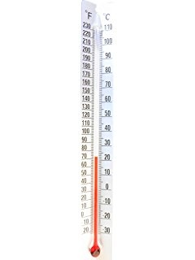
Alcohol Thermometer
This is also referred to as a liquid in glass thermometer.
However unlike a laboratory thermometer it contains alcohol.
The alcohol is colourless so it is dyed red to make reading the thermometer easier.
Alcohol boils at 78ºC so this type of thermometer can NOT be used to measure high temperatures.

Slide 27
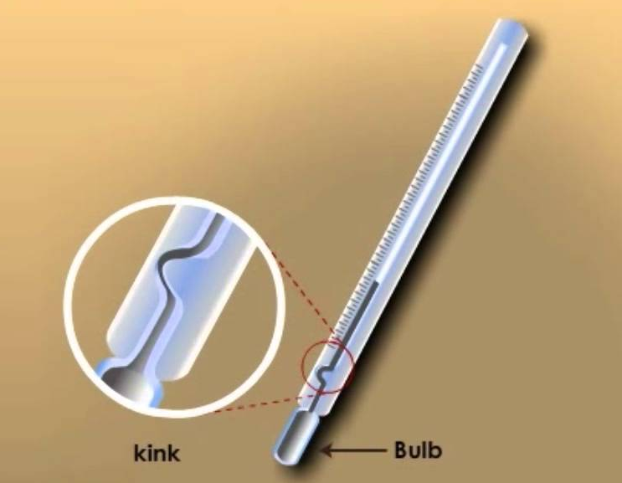
Clinical Thermometer
A clinical thermometer is also
a liquid in glass thermometer.
The liquid is mercury.
It is used to measure body temperature.
They have a narrow range of 34ºC to 43ºC.
The bore has a narrow kink called a constriction which allow mercury upon expansion to pass up it but not down it hence the thermometer has to be shaken to return the mercury to the bulb.

Slide 28
Maximum-minimum Thermometer
These are liquid-in-glass
thermometers which contain
alcohol and mercury.
They are used to keep records of
the weather.
They have alcohol on top of mercury in a U-shaped tube. A marker, such as a steel disc, is left at the minimum in one arm of the tube at the maximum in the other arm.
The markers can be reset using a magnet.

Slide 29
Digital Thermometers
These give a read-out in numbers on a liquid-crystal-display.
They are metal probes, such as those used in cooking to insert into meat to see how hot it is inside.

Slide 30
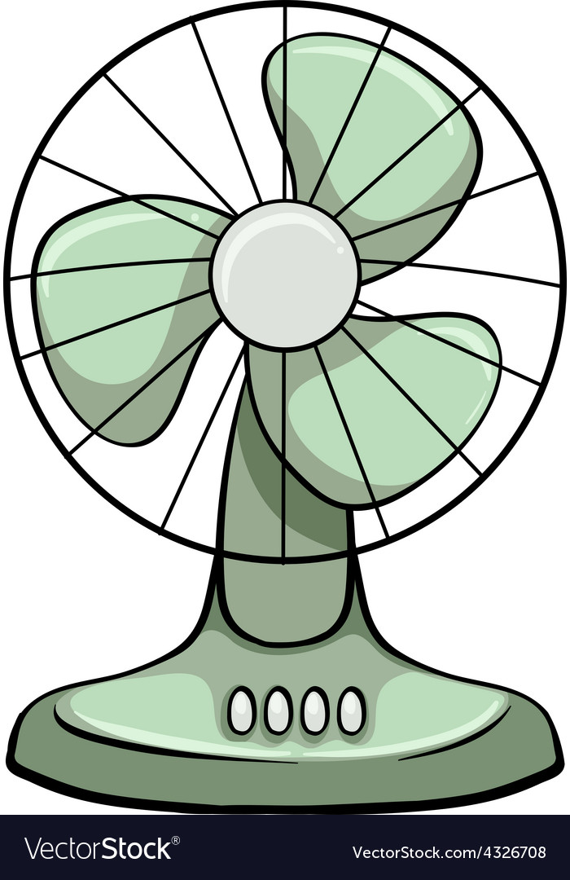
Evaporation and Cooling

Slide 31
Evaporation
Evaporation is the change of state when a liquid turns into its gas or vapour.
Evaporation, unlike boiling occurs at any temperature.
Liquids do not have to boil in order to change from a liquid to a gas.

Slide 32
Evaporation
Liquids contain particles with high, low and average energy particles.
Particles with the highest energies evaporate off first. This causes the energy of the remaining particles to be lowered. This in turn decreases the temperature of what is left of the liquid.
The weaker the forces of attraction between its particles are, the faster a liquid evaporates.

Slide 33
Cooling Your Body Down
The faster your metabolic rate the more heat energy is released and the hotter you get. (For example exercising)
Your body cools itself by sweating.
The water in the sweat evaporates, absorbing energy from your body as the water particles escape, cooling you down.

Slide 34
Humidity & Ventilation

Slide 35
Factors that affect the rate of Evaporation
1. Temperature (higher temperature increases evaporation)
2. Surface Area (larger surface area increases evaporation)
3. Humidity (lower humidity causes faster evaporation)
4. Nature (Substances with weak intermolecular forces evaporate faster)

Slide 36
Relative Humidity
The relative humidity is the amount of water vapour in the air measured as a percentage of the maximum amount of water vapour the air could hold on a particular day.
These days are referred to as sticky days. Your clothes tend to stick to you skin since it is hard for it to evaporate due to high humidity (the air can not hold any more water so low evaporation rates come about).
High humidity can cause people to suffer from heat exhaustion.

Slide 37
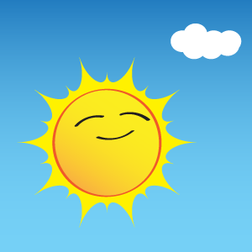
Too Much Sun
The sun emits ultraviolet radiation. Too much of it being exposed to the skin can burn it.
Lighter people suffer from sun burns easier than darker people because they lack sufficient melanin. However dark and light persons need to wear sun block to protect their skin from the ultraviolet rays given off by the Sun.

Slide 38
Heatstroke
Heatstroke is when your core body temperature rises to dangerous levels. If it rises to about 42ºC it can be fatal.
In very hot weather a person will be unable to get rid of heat energy quickly enough.
Victims of heatstroke can feel sick, tired, weak. This can make them dizzy, nauseous, suffer from headaches and muscle cramps. Sometimes a person may fall into a coma.

Slide 39
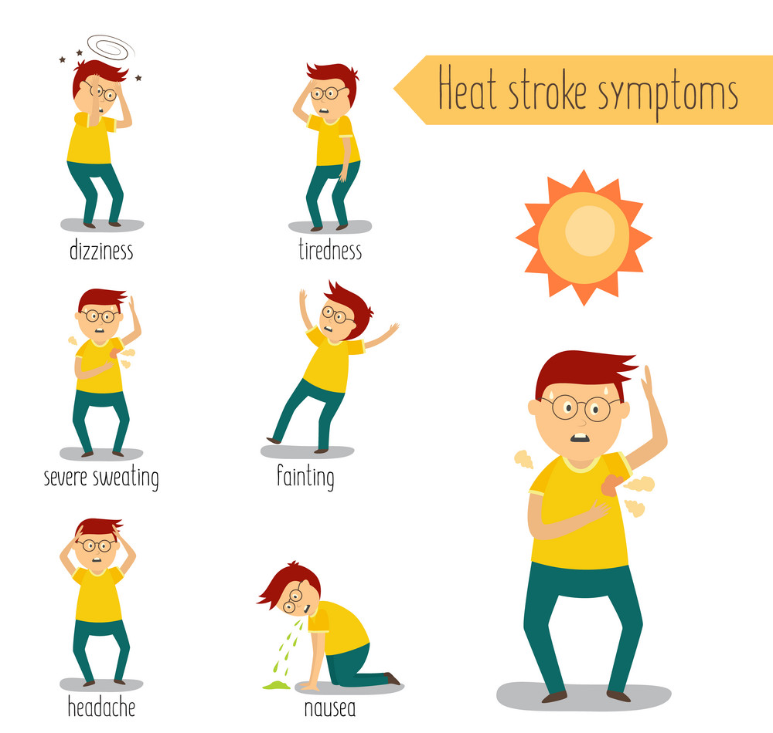
Heatstroke

Slide 40
The Importance of Good Ventilation
Effective ventilation is needed in buildings to make them comfortable to live and work in.
If air is not allowed to circulate and fresh air is not introduced the air inside the building will get stale.
This can cause unsafe situations in which microorganisms can thrive in.

Slide 41
The importance of Good Ventilation
To achieve a well ventilated place a high window and a low window should be placed in the building.
They should be opened so that hot air can leave from the top window while cool air enters the bottom window.
Air conditioners can also be used to remove stale air by cleaning or recycling it.
Humidifiers introduce water vapour into a building if the air gets too dry. Dry air can make people uncomfortable. Humidifiers can help maintain a comfortable work space.

Slide 42
Comprehension
1. In a fluid, heat is transferred via
a. conduction b. convection
c. diffusion d. radiation
2. Which of the following materials conduct heat best?
a. wool b. rubber c. brass d. glass
3. Conduction occurs in which of the following
a. water b. Pyrex
c. rubber d. gold chain
4. When an egg is placed into boiling water it cooks via
a. conduction b. Osmosis
c. Diffusion d. convection

Slide 43
Comprehension
5. Breeze is an example of
a. convection b. conduction
c. radiation d. osmosis
6. In which thermometer is there a constriction in the capillary tube present?
a. gas b. clinical
c. digital d. mercury
7. The speed of light is
a. 3 × 10⁸ m/s b. 3 × 10⁷ m/s
c. 3 × 10⁶ m/s d. 3 × 10⁵ m/s
8. The movement of land masses is due to
a. radiation b. convection
c. conduction d. osmosis

Slide 44
Comprehension
9. All of the following explains evaporation except
a. it occurs at one temperature
b. it occurs at any temperature
c. it occurs faster with greater surface area
d. it occurs in any liquid
10. A hot air balloon rises because
a. the balloon is lighter than the air
b. there is an electric fan inside
c. the hot air inside rises up and becomes less dense
d. the cool air rises up and becomes less dense

