Slide 1
Abdominal Trauma
David J. Milia
Medical Director, Froedtert Trauma Program
Division of Trauma and Acute Care Surgery
Medical College of Wisconsin

Slide 2
Outline
What is the abdomen?
Initial evaluation
Diagnostic Tools
Therapeutic Options
What’s next?

Slide 3
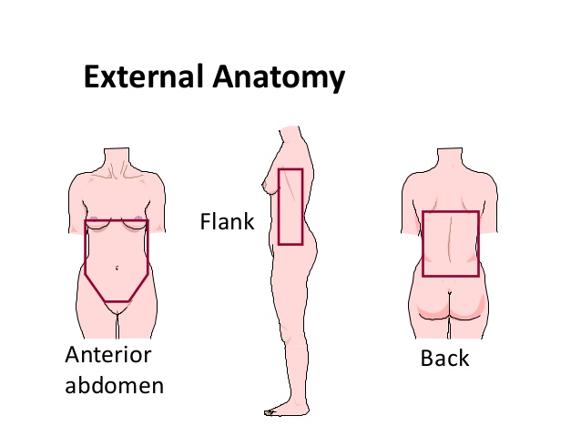

Slide 4
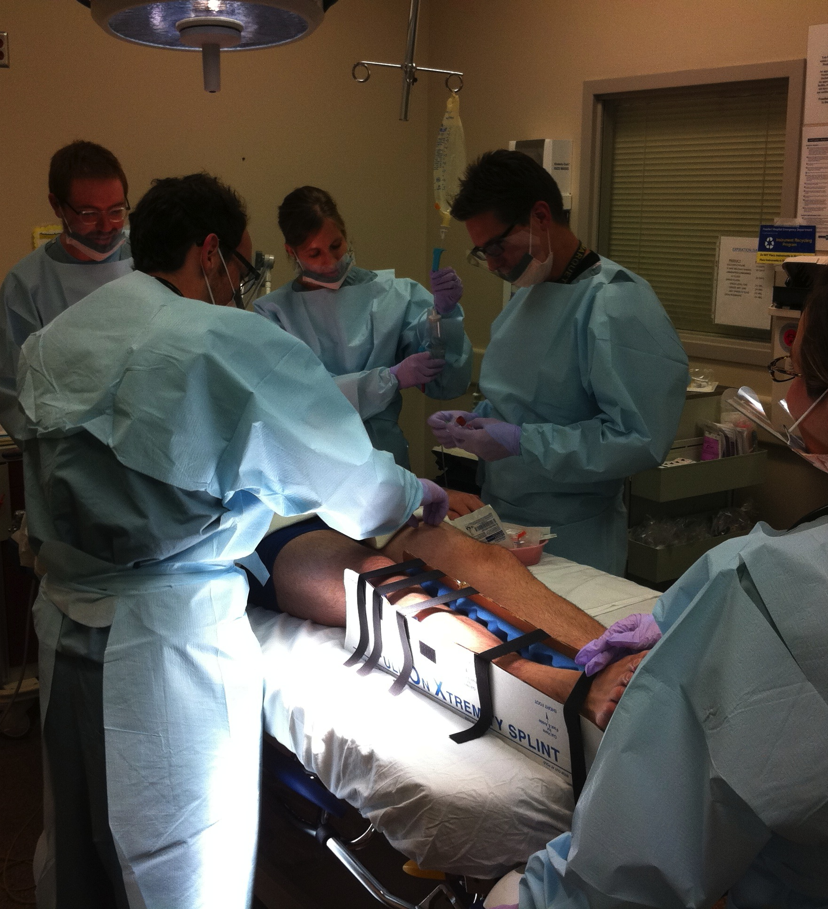
Initial Evaluation
Remember the Alphabet
  A, B, C, D, E
Physical Exam
  Penetrating wounds
  Seat Belt sign
  Lacerations
  Tenderness

Slide 5
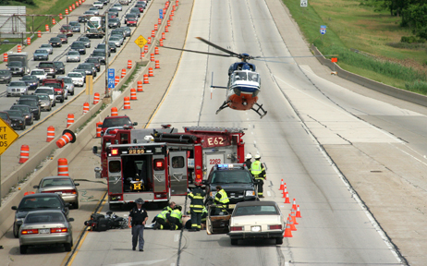
Blunt Trauma

Slide 6
Trauma Alert
M: 28 y/o helmeted male in motorcycle crash at highway speeds.
I: Left leg deformity
S: GCS 12, HR 114 BP 90/P at the scene
T: Intubated for declining GCS, 2 x PIV 800L Crystalloid infused

Slide 7
Primary survey
  Airway- Intubated
  Breathing- BS equal
  Circulation- HR 135 BP 86. Thready pulses
    1 L saline
    2 units blood next
    HR 130

Slide 8

Where is he bleeding from?
Where does anyone bleed from?
  Externally
  Thoracic Cavity
  Pelvis / Retroperitoneum
  Long bones
  Abdomen

Slide 9
Is it his abdomen?
Diagnostic options
  DPL/DPA
  Ultrasound (FAST)
  CT scan

Slide 10
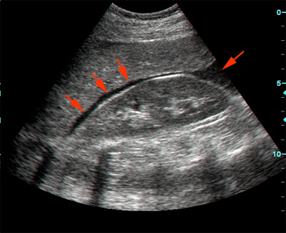
FAST exam
Focus Abdominal Sonogram for Trauma
  Pericardial
  RUQ - Subhepatic
  LUQ - Perisplenic
  Pelvic
Does not evaluate retroperitoneum

Slide 11
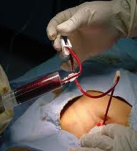
DPA/DPL
Diagnostic Peritoneal Aspirate
  10 cc of blood
Diagnostic Peritoneal Lavage
  Insert a Multihole catheter into pelvis
  Infuse 1000 cc saline
  Passive return of fluid
  >100 K RBC or 500 WBC

Slide 12
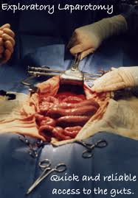
Surgical Exploration
Blood availability
IV/IO access
Antibiotics
Incision
  Vasculature
  Spleen
  Liver
  Bowel (Sm & Lg)

Slide 13
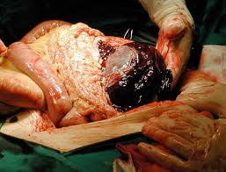
Trauma Ex Lap
Control Hemorrhage
  Pack all 4 quadrants
Control Contamination
Explore
  Damage Control or
  Definitive repair

Slide 14
Primary survey
  Airway- Intubated
  Breathing- BS equal
  Circulation- HR 135 BP 86. Thready pulses
    2 L saline in
    2 units blood next
    HR 90 BP 120/80

Slide 15
Responder
Finish primary and secondary survey
CXR and Pelvic XR negative
Foley- no blood
Left femur fracture, palpable DP pulse
Lower abdominal tenderness

Slide 16
How is this case different?
‘Fluid responder’
  Allows the luxury of further diagnostic imaging
  Specifically, CT

Slide 17
Abdominal CT scan
Use only in hemodynamically stable patients
High Sensitivity and Specificity
Good for retroperitoneum
May miss hollow viscus and diaphragm injuries

Slide 18
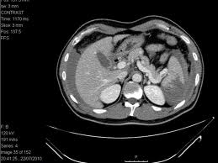
Spleen
Most commonly injured organ in blunt trauma (40-55%)
Nonoperative management
  Successful >90%
  Lower rates for higher grade injuries

Slide 19
Spleen
Indications for splenectomy
  Hemodynamically unstable
  Not responding to resuscitation
  Need to address other injuries (perhaps)
  Unable to closely monitor
Risk of failure of Non-op mgmt.
  Grade IV, V
  Active extravasation (‘blush’ on CT)
  Concurrent anticoagulant

Slide 20
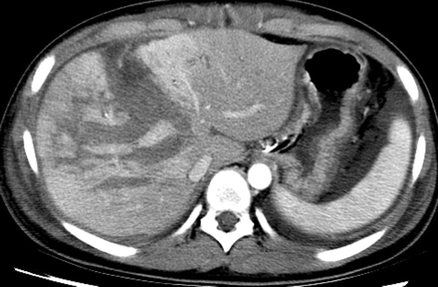
Liver
2nd most common injury 35-45%
Nonoperative management
Monitor in ICU for > grade III

Slide 21
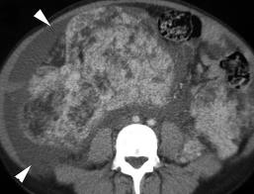
Diagnosis?
Free fluid in the abdomen
No solid organ injury
Observe or operate?

Slide 22
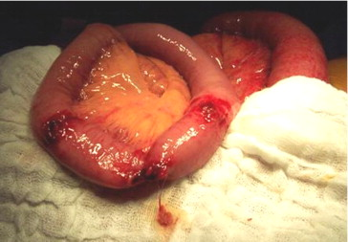
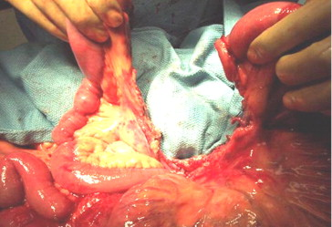
Hollow Viscus Injury
3rd most common injury in blunt trauma
Can be easily missed
Needs an operation

Slide 23
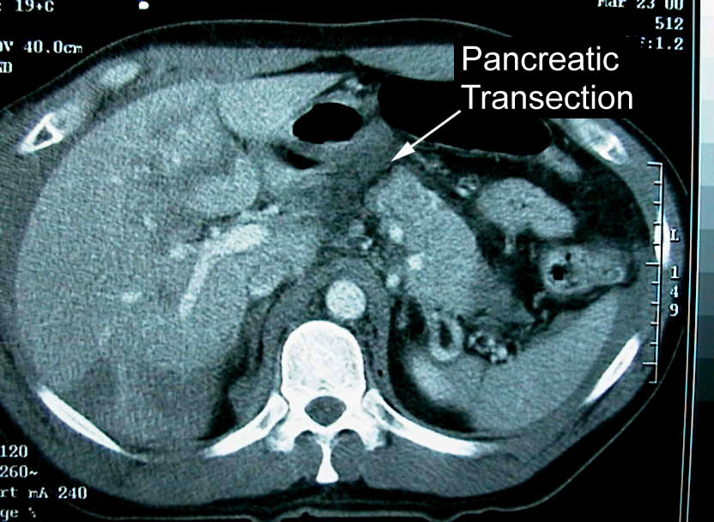
Pancreas
Often Missed
Operative intervention depends on pancreatic duct (usually)
Low grade injuries can be managed non op

Slide 24
Responder
Finish primary and secondary survey
Pelvic Fracture on plain film
Foley- Gross Hematuria
Left femur fracture, palpable DP pulse
Distended abdomen

Slide 25
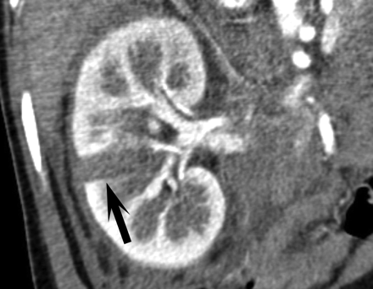
Renal Injury
Can be treated non operatively if low grade
May need surgery if involves collecting system

Slide 26
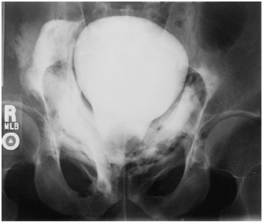
Bladder
Gross Hematuria in foley
Cystogram
CT cystogram
Intraperitoneal- needs to be fixed
Extraperitoneal- Foley

Slide 27
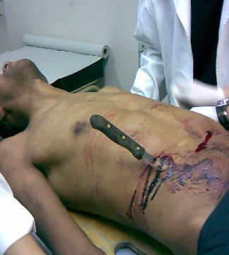
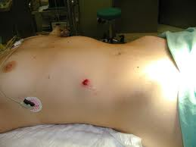
Penetrating Trauma

Slide 28
Trauma Alert
M: 30 y/o male GSW x 2 to abdomen
I: Lots of blood loss at the scene
S: HR 100 BP 100/P GCS 15
T: PIV x 1; 900cc IVF

Slide 29
Immediate exploration?
Gun Shot Wound
Stab wound
80% chance of injury needing repair
High velocity projectile
CT if strongly feel tangential
Can observe some RUQ injuries
20% chance of injury needing repair
Operate for:
  Shock
  Evisceration
  Peritonitis
Local wound exploration
  Observe v Dx Lapsc
Diaphragm Injuries

Slide 30
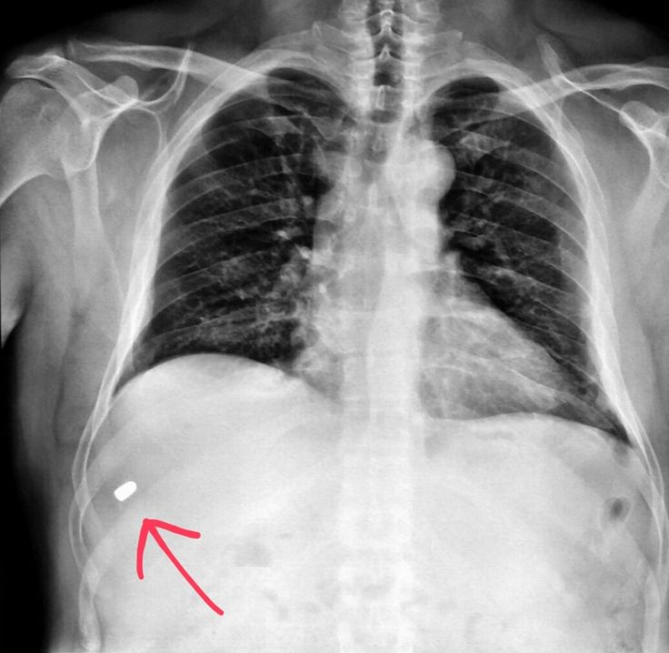
Diagnostics?
X-rays
  Holes + Missiles = Even number
CT
  Rarely
Laparoscopy
  Rarely for GSW
  More common for SW
Ultrasound
  Rare in GSW

Slide 31
Trauma Ex Lap
Control Hemorrhage
  Pack all 4 quadrants
Control Contamination
Follow the Missile Tract
Damage Control or
Definitive repair

Slide 32
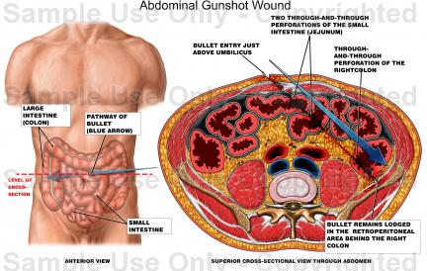

Slide 33
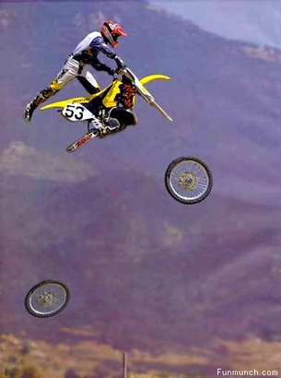
Damage Control
Live to fight another day
Abbreviated Laparotomy
Lethal Triad
  Acidosis
  Coagulopathy
  Hypothermia

Slide 34
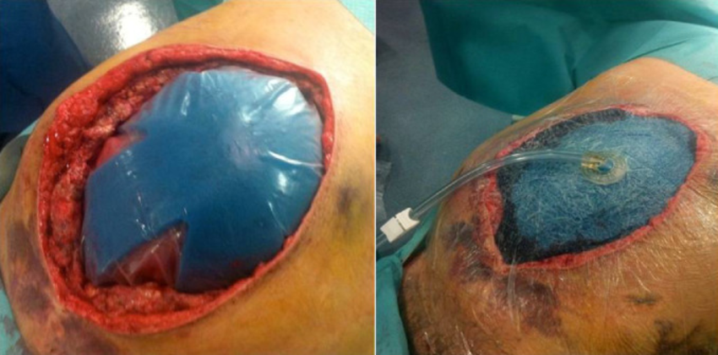
Damage Control
Resuscitate in ICU
  Rewarm
  Correct coagulapathy
  Diurese
Bring back to OR→ Definitive repair
May need multiple trips to close

Slide 35
The future is now…
ResQ Foam
Aortic Tourniquet
REBOA

Slide 36
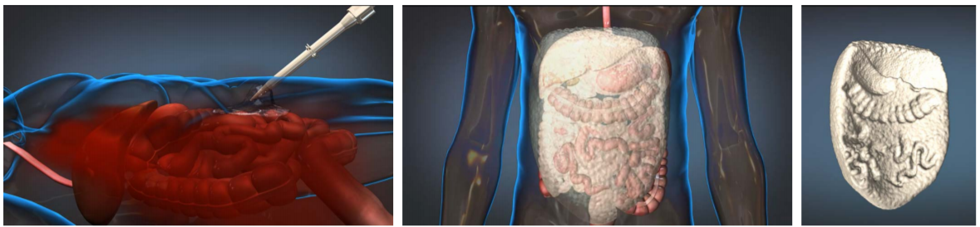
ResQ Foam
Two part liquid injected into body
Chemical rxn creates a solid conformal device
Provides Intra-abdominal compression
Removed at surgery

Slide 37
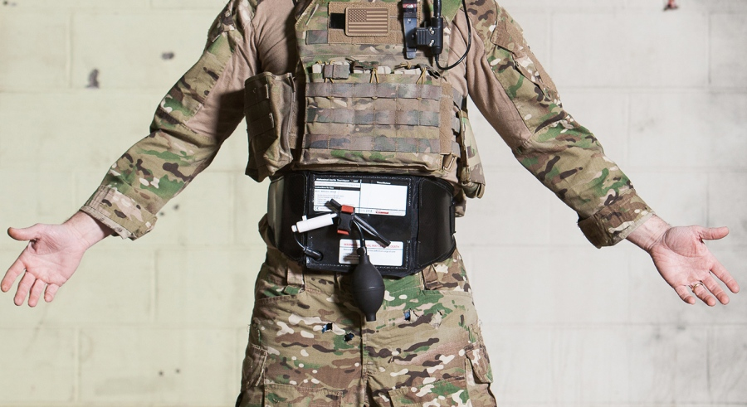
Aortic Tourniquet

Slide 38
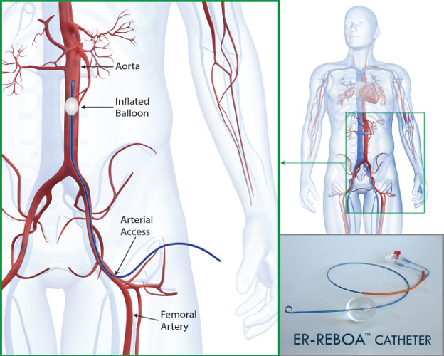
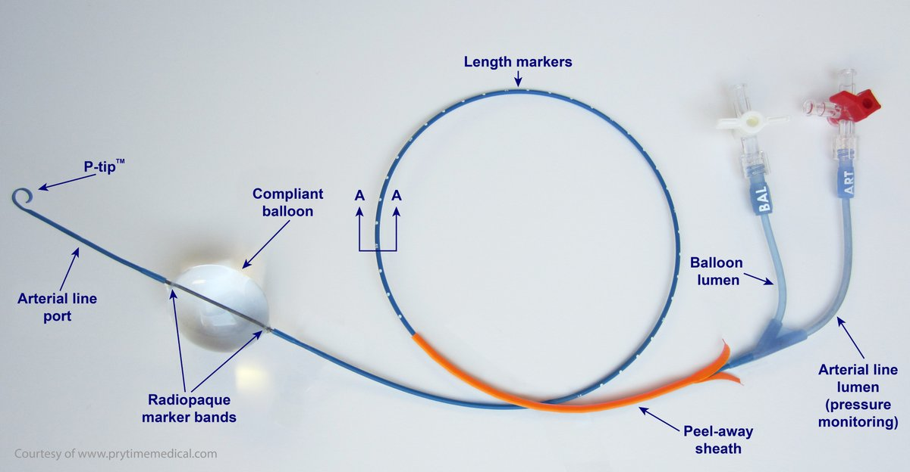
Resuscitative Endovascular Balloon Occlusion of the Aorta-REBOA

Slide 39
**REBOA contraindicated with abnormal mediastinum on CXR or HTx
**Max REBOA Balloon time – Zone I → 30 mins; Zone III→60 mins
Sustained SBP < 90mmHg
Place 5f Femoral a-line
Concern for Thoracic Hemorrhage?
yes
REBOA Contraindicated
no
Place REBOA
Record BALLOON Time**
Blunt
Penetrating
FAST
Position REBOA Zone I**
OR For Exploratory Laparotomy
+
-
Pelvic Fx
Pelvic Fx
yes
no
no
yes
Stabilize Pelvis
Position REBOA Zone I**
Exploratory Laparotomy
***If still unstable***
Replace REBOA to Zone III**
Extraperitoneal Pelvic Packing for ongoing HD instability
Pelvic Angiography
Position REBOA Zone I**
OR For Exploratory Laparotomy
No REBOA
Determine Source of Shock
Stabilize Pelvis
Position REBOA Zone III**
Extraperitoneal Pelvic Packing
Pelvic Angiography
***If still unstable***
Consider FAST/DPA/Mini-Laparotomy

Slide 40





Thank You

