Slide 1
How To Treat After the Heat: Initial Burn Care
Nicholas Meyer, MD
Ascension-CSM Burn Center
14. October 2022

Slide 2
Burn Injury
1.5 million burn injuries per year
20,000 are hospitalized in burn centers
3200 die annually
Fourth leading cause of traumatic death

Slide 3
Summary
Pathophysiology
Airway management
Inhalation injury/CO poisoning
IV access and fluid resuscitation
Wound management
Transfer criteria

Slide 4
Types of Burns
Mechanisms of injury include:
Thermal
scald, flame, contact
Electrical
Chemical
Radiation
Cold

Slide 5
Burn Effects
Coagulate proteins (collagen)
Disrupt cellular membrane proteins in skin
Release of inflammatory mediators
Pain

Slide 6
Skin Function
Protect from infection and injury
Prevent loss of body fluid
Regulate body temperature
Facilitate sensory contact with the environment

Slide 7
Thermal Burns
Extent of injury determined by amount of heat transferred to patient
Amount of heat transferred depends on:
Temperature
Duration
Concentration of heat energy

Slide 8
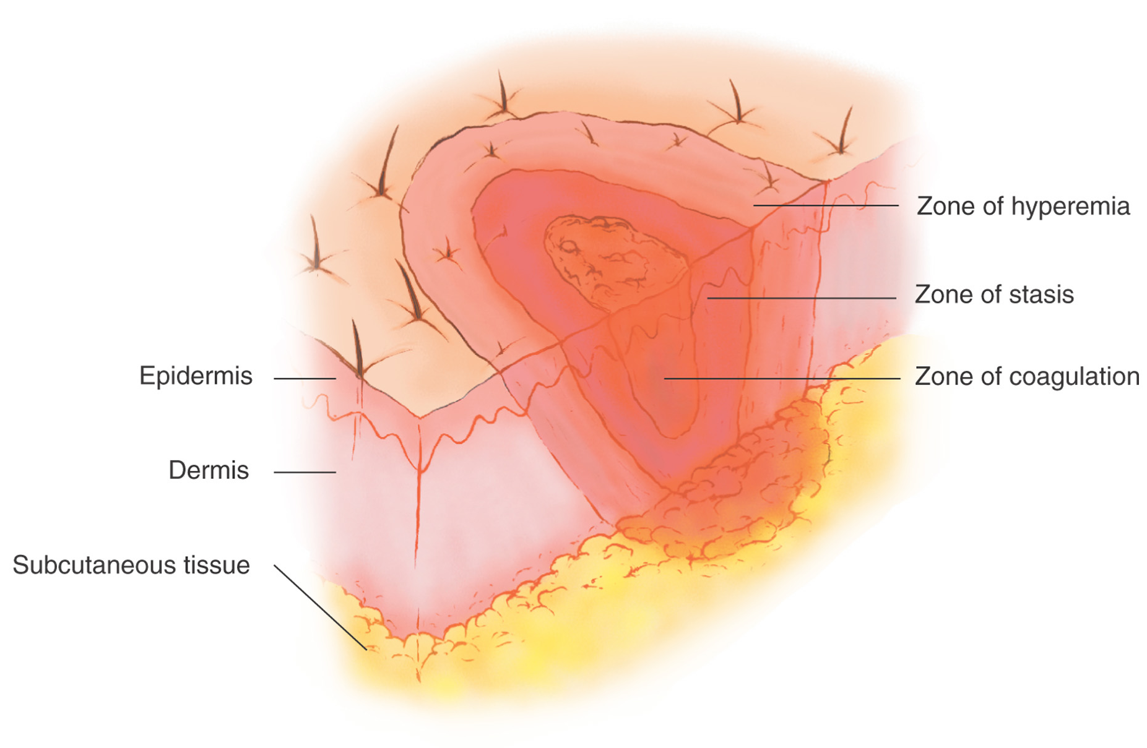
son’s Theory of Thermal Wounds (1 of 3)
Anatomy Of a Burn
Zone of coagulation
Skin nearest heat source suffers most serious injury
Cell membranes rupture
Coagulation occurs
Proteins denature
If zone of coagulation penetrates the dermis, burn is considered third degree

Slide 9
Pathophysiology (1 of 3)
Classified into four phases:
Emergent
Fluid-shift
Hypermetabolic
Resolution

Slide 10
Pathophysiology (2 of 3)
Emergent phase
Initial reaction to burn
Pain response
Catecholamine release

Slide 11
Pathophysiology (3 of 3)
Fluid-shift phase
Reaches peak in 6–8 hours, lasts from 18–24 hours
Damaged cells release substances that initiate inflammation response
Increased blood flow to injury site
Increased vascular permeability
Migration of white blood cells and others into injured tissues
Plasma proteins also migrate
Loss of oncotic pressure, fluid shift to interstitial space

Slide 12
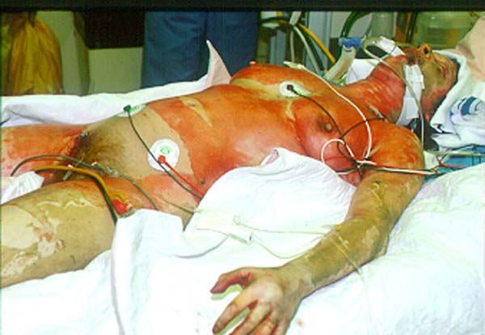

Slide 13
Initial Assessment
Same as for other trauma patients
Airway maintenance with cervical spine protection
Breathing and ventilation
Circulation with bleeding control
Disability (assess neurologic deficits)
Expose/examine (undress patient fully but protect from hypothermia)

Slide 14
Initial Intervention
Stop further burning
Secure airway
IV access
Begin fluid resuscitation
Prevent hypothermia

Slide 15
Airway
Respiratory distress
Airway burns
Deep facial burns
>50% TBSA burn
Inhalation injury
Early intubation
7.5 or 8.0 ET tube

Slide 16
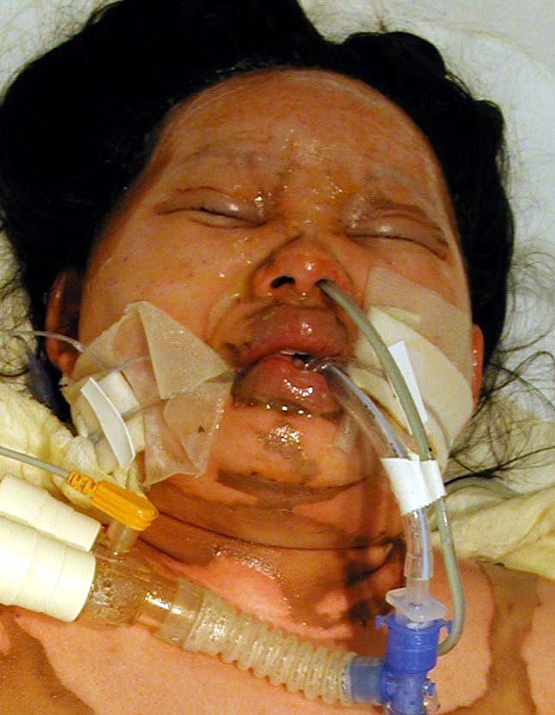
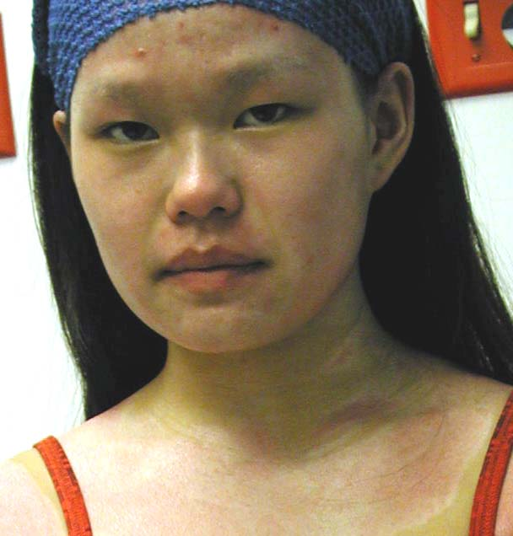

Slide 17
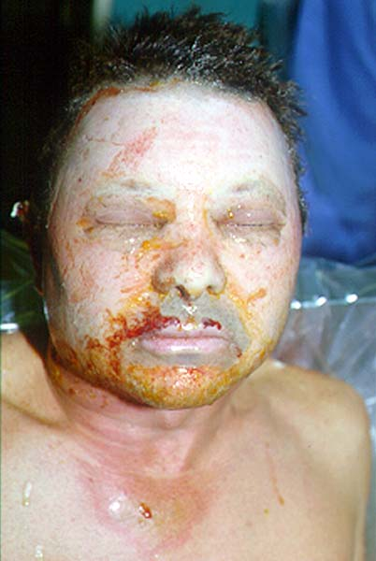

Slide 18
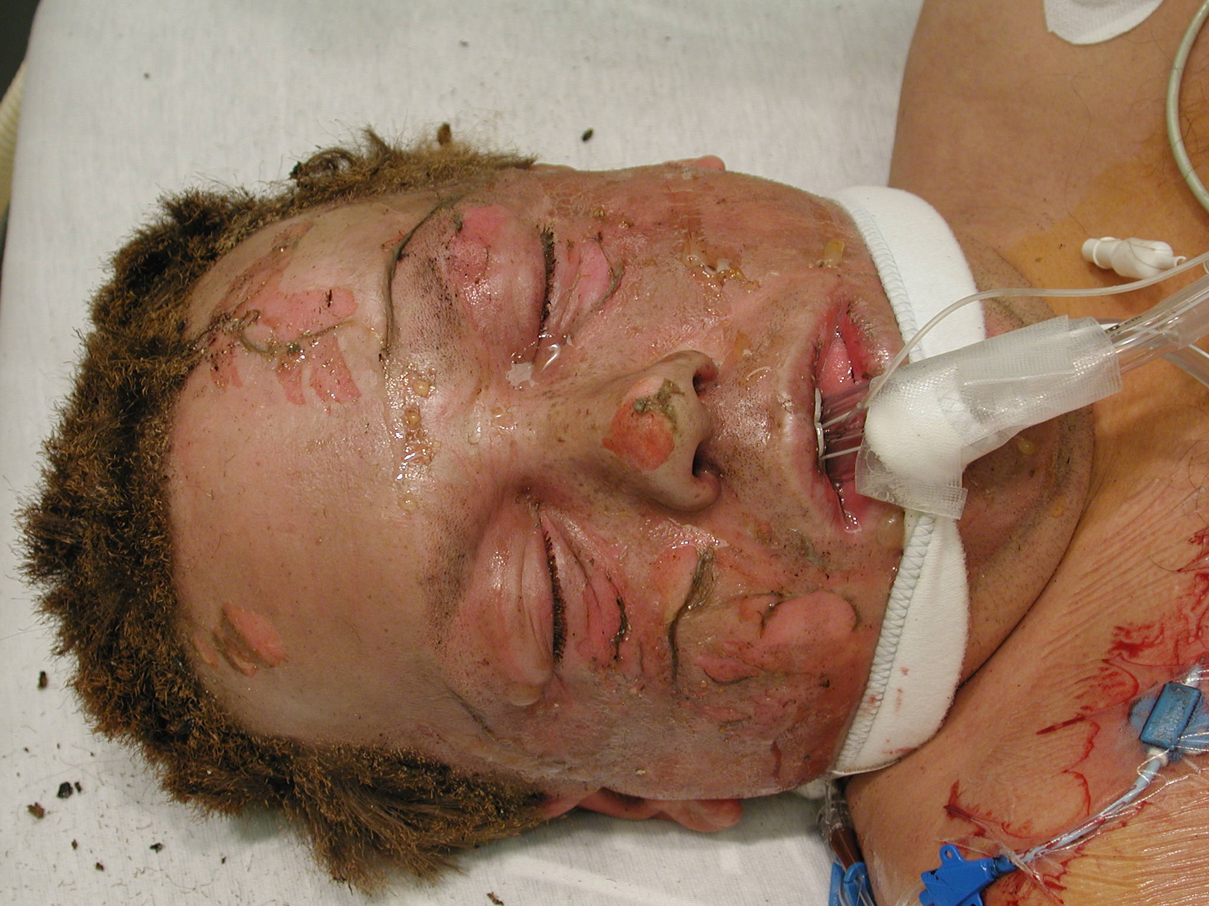

Slide 19
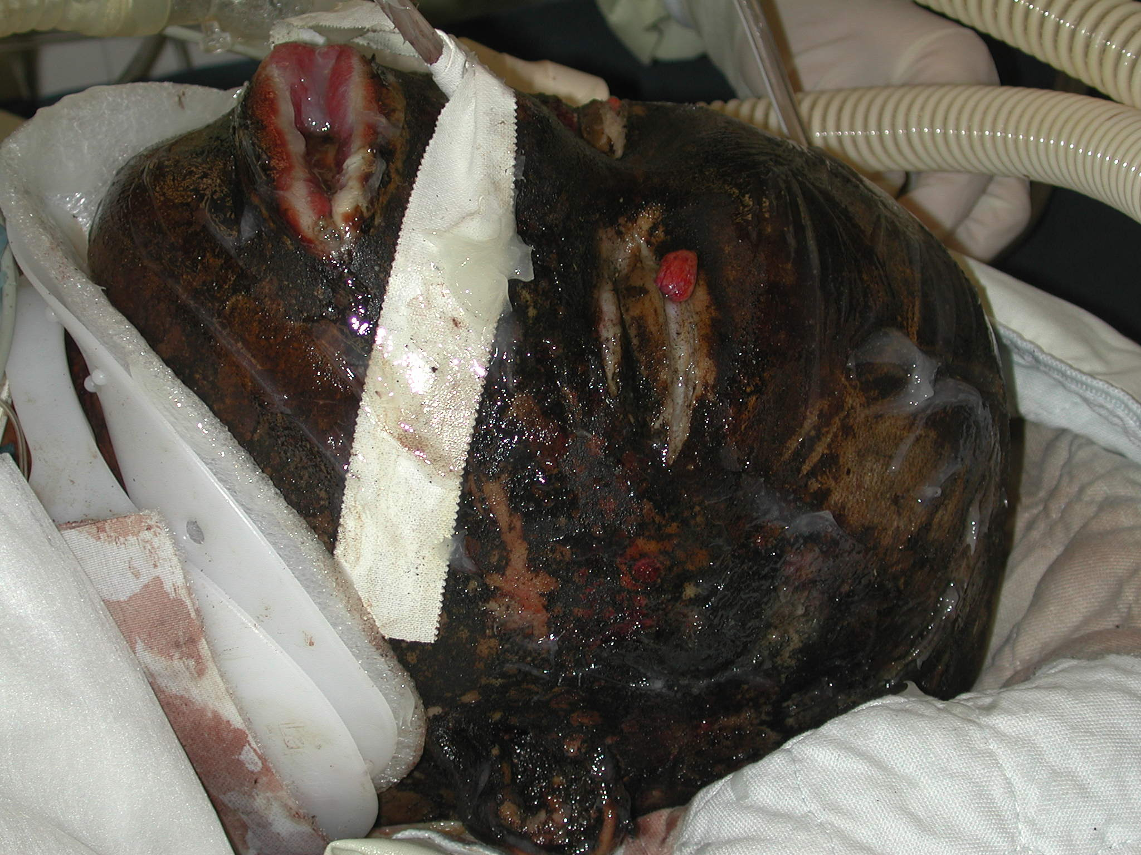

Slide 20
Inhalation Injury Suspicion
Flame injury
Enclosed space
Loss of consciousness
Deep face burns
Hoarse voice
Respiratory distress

Slide 21
Breathing and Ventilation
Verify bilateral breath sounds
Assess adequacy of respirations
Administer high-flow, 100 percent oxygen via appropriate device
Closely monitor circumferential full-thickness burns of the trunk

Slide 22
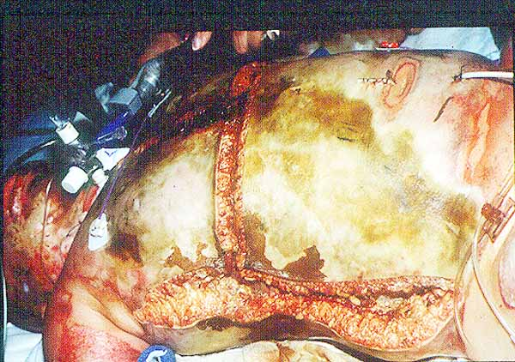

Slide 23
Circulation
Evaluate:
Blood pressure
Heart rate (100-120)
Mental status/LOC
Intravenous initiation
Fluids
Analgesics
Anxiolytics

Slide 24
Major Burns
Over 20% TBSA
>10% if over 60 or under 10

Slide 25
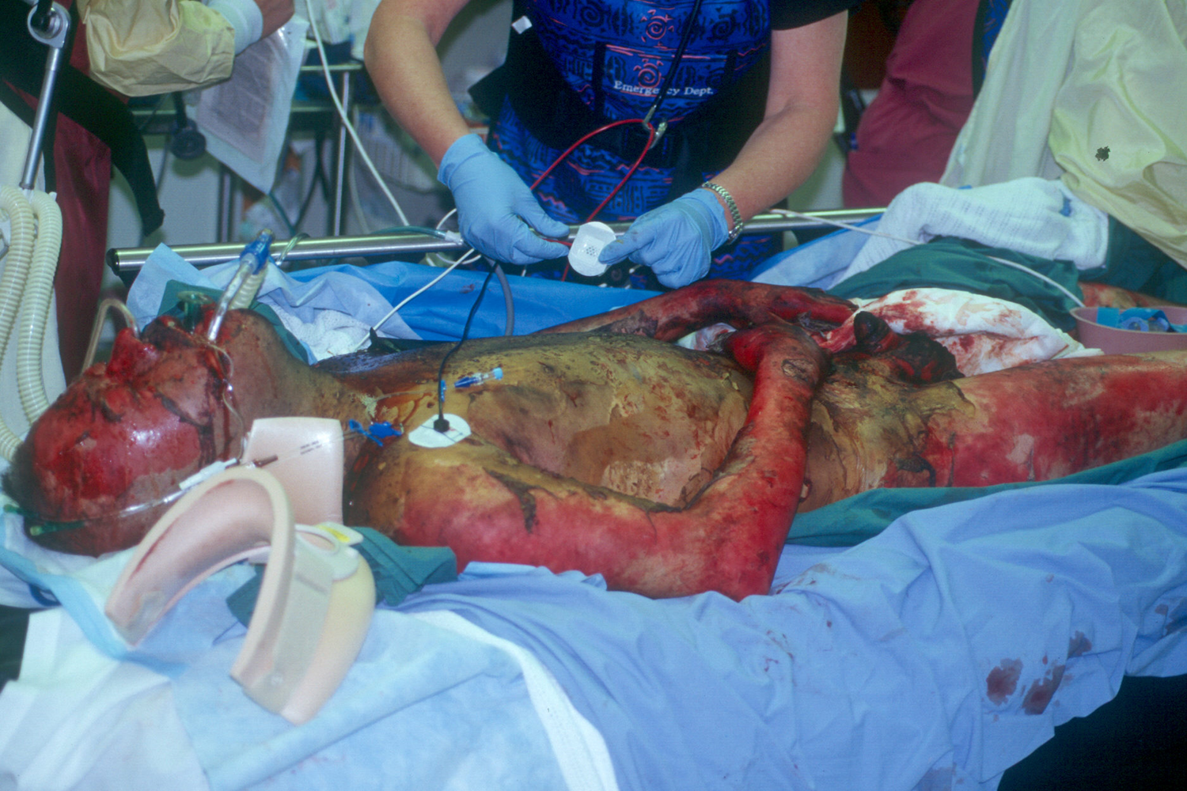
Establish IV Access

Slide 26
Fluids
0.9% NS
Na 154
Cl 154
Osm 308
pH 5.0
LR
Na 132
K 4
Cl 109
Ca 2.7
Lactate 28
Osm 273
pH 6.5
Plasma
Na 140
K 4
Cl 109
Ca 5
CO2 23
Osm 275
pH 7.4

Slide 27
Fluids (Primary Survey)
125ml/hr if 5 or younger
250ml/hr if 6-13 years
500ml/hr if 14 or older

Slide 28
Fluids (First 24 hour estimation)
2ml x kg x %TBSA burn
3ml x kg + %TBSA burn <14yo
3ml x kg x %TBSA + D5LR maint. <30kg
4ml/kg/%TBSA if electrical burn

Slide 29
Fluid Resuscitation
More fluid likely:
Associated injuries
Electrical injury
Inhalation injury
Delayed resuscitation
Pre-existing dehydration
Very deep burns (i.e., fourth degree)
Extra consideration:
Elderly
Young
Patients with pre-existing cardiac disease

Slide 30
Disability, Neurologic Deficit
Pure thermal injury—no neuro deficit
Neurologic deficit:
Hypoxia
Carbon monoxide poisoning
Associated injuries
Trauma
Hypovolemia
Head trauma
Substance abuse
Medical

Slide 31
Examine/Exposure
Remove all clothing and jewelry
Maintain temperature
Apply blankets
Give warmed fluids

Slide 32
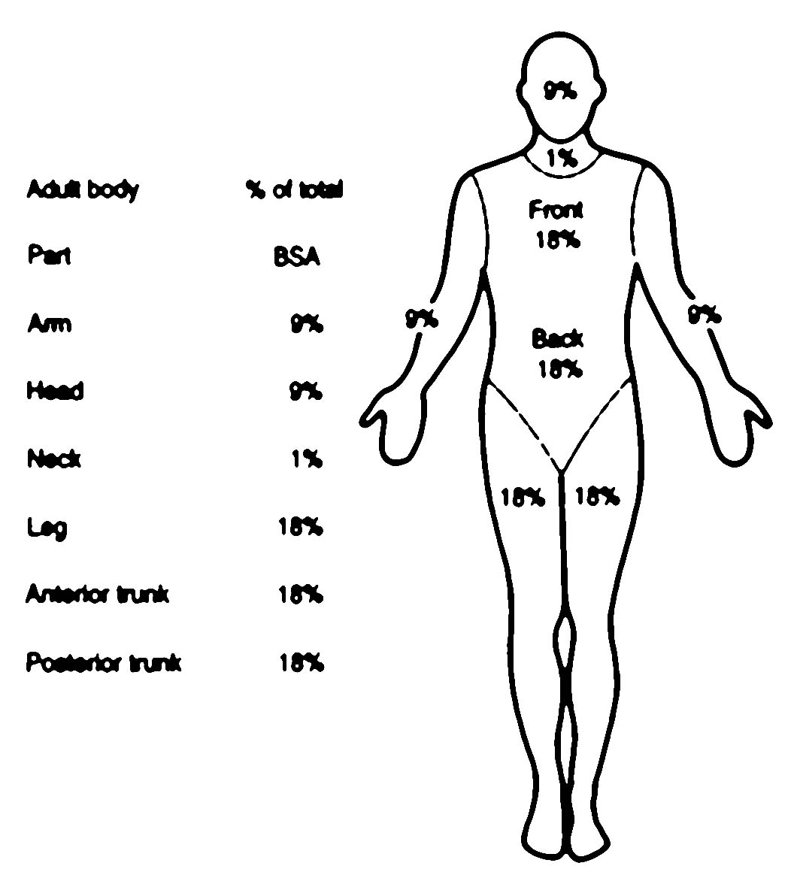
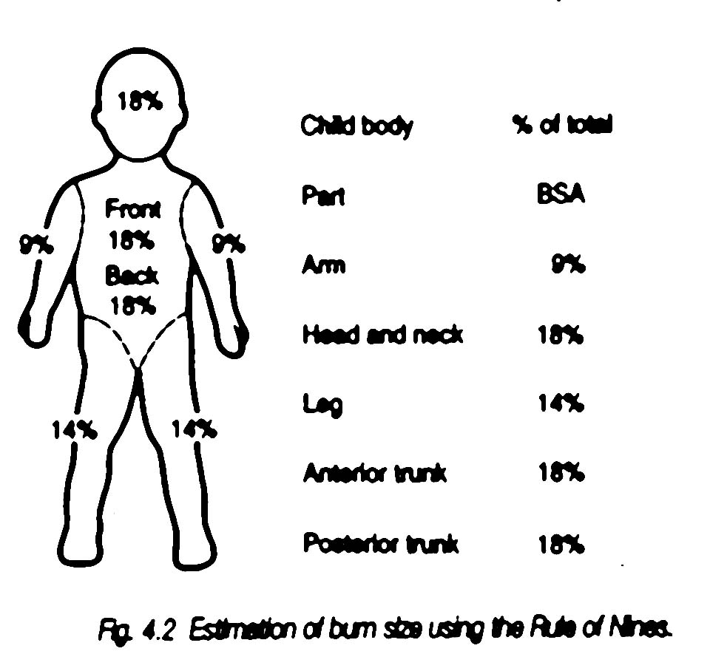
Rule of Nines

Slide 33
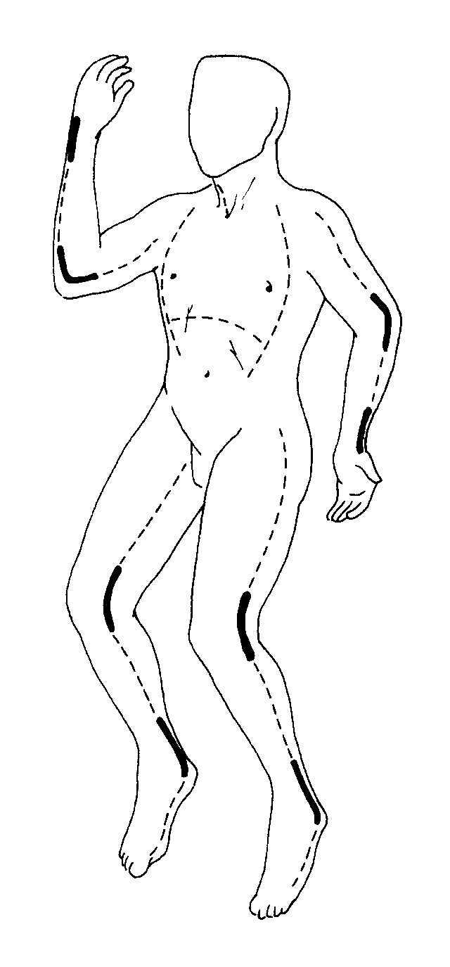
Escharotomy/Fasciotomy
Indications
Circumferential burns
Very deep burns
Delayed resuscitations
Cyanosis refractory to airway management
Deep tissue pain
Progressive decrease or absence of pulses
Compartment syndrome
Progressive paresthesias
From Rue, L.W., & Cioffi, W.G. [1991]. Resuscitation of thermally injured patients. Crit Care Nurs Clin North Am 3(2): 181-189.

Slide 34
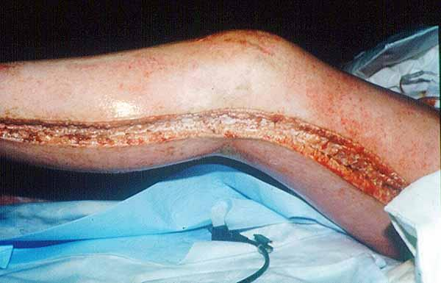
Escharotomy

Slide 35
Burn Classification

Slide 36
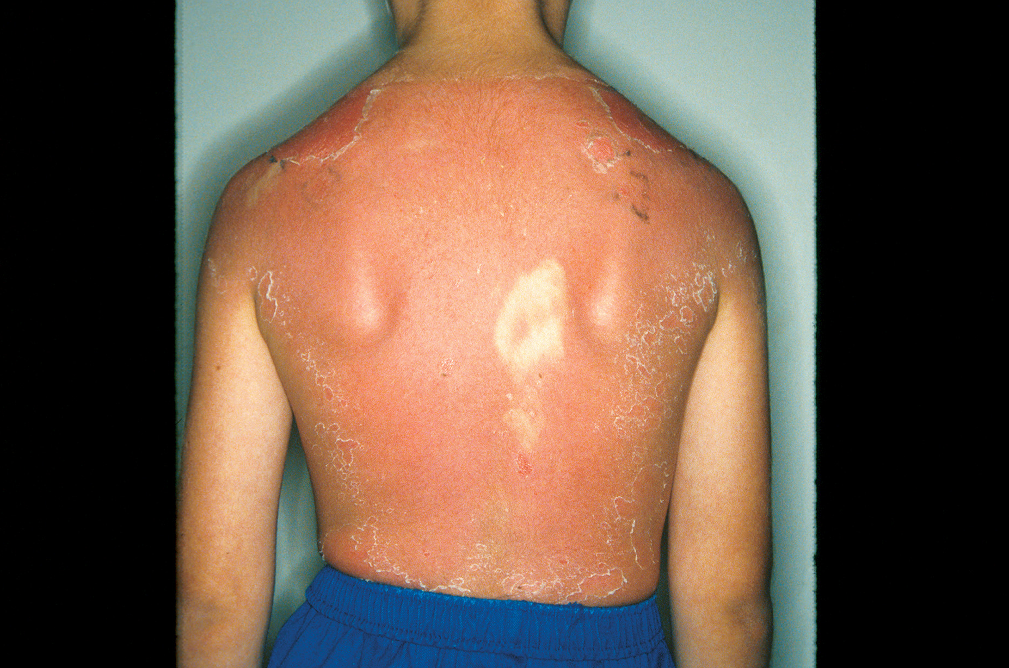
Superficial Burns (First Degree)
Charles Stewart and Associates

Slide 37
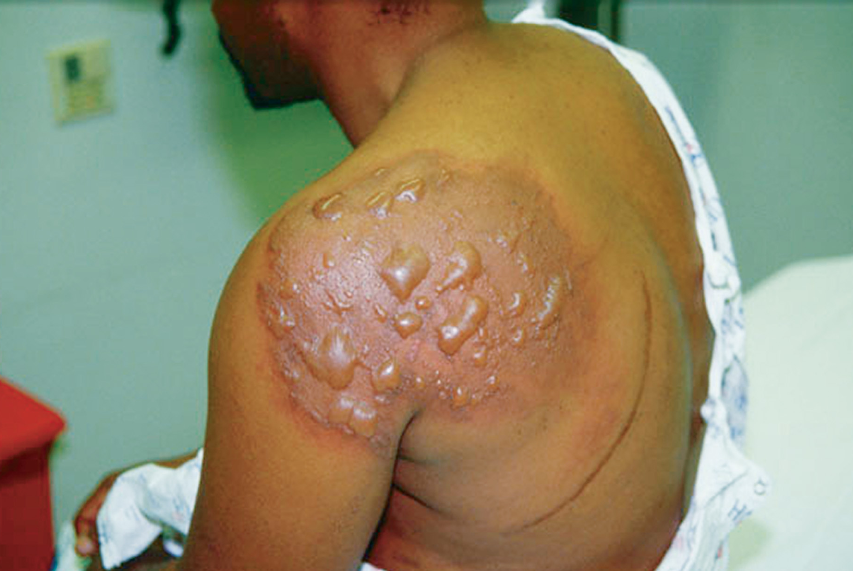
Partial-Thickness Burns (Second Degree)
Edward T. Dickinson, MD

Slide 38
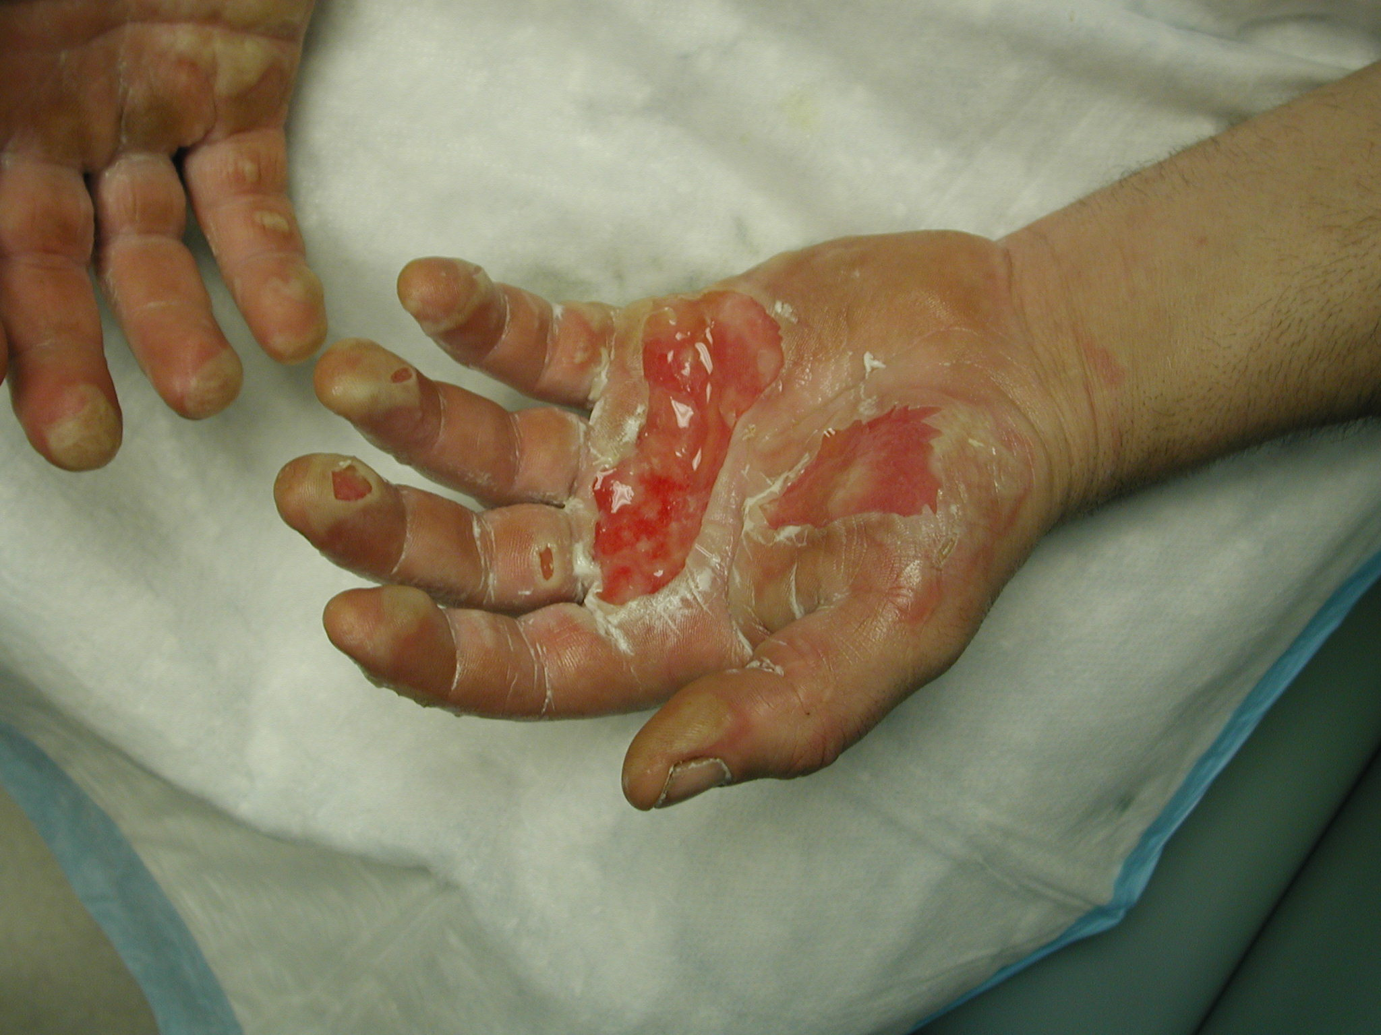

Slide 39
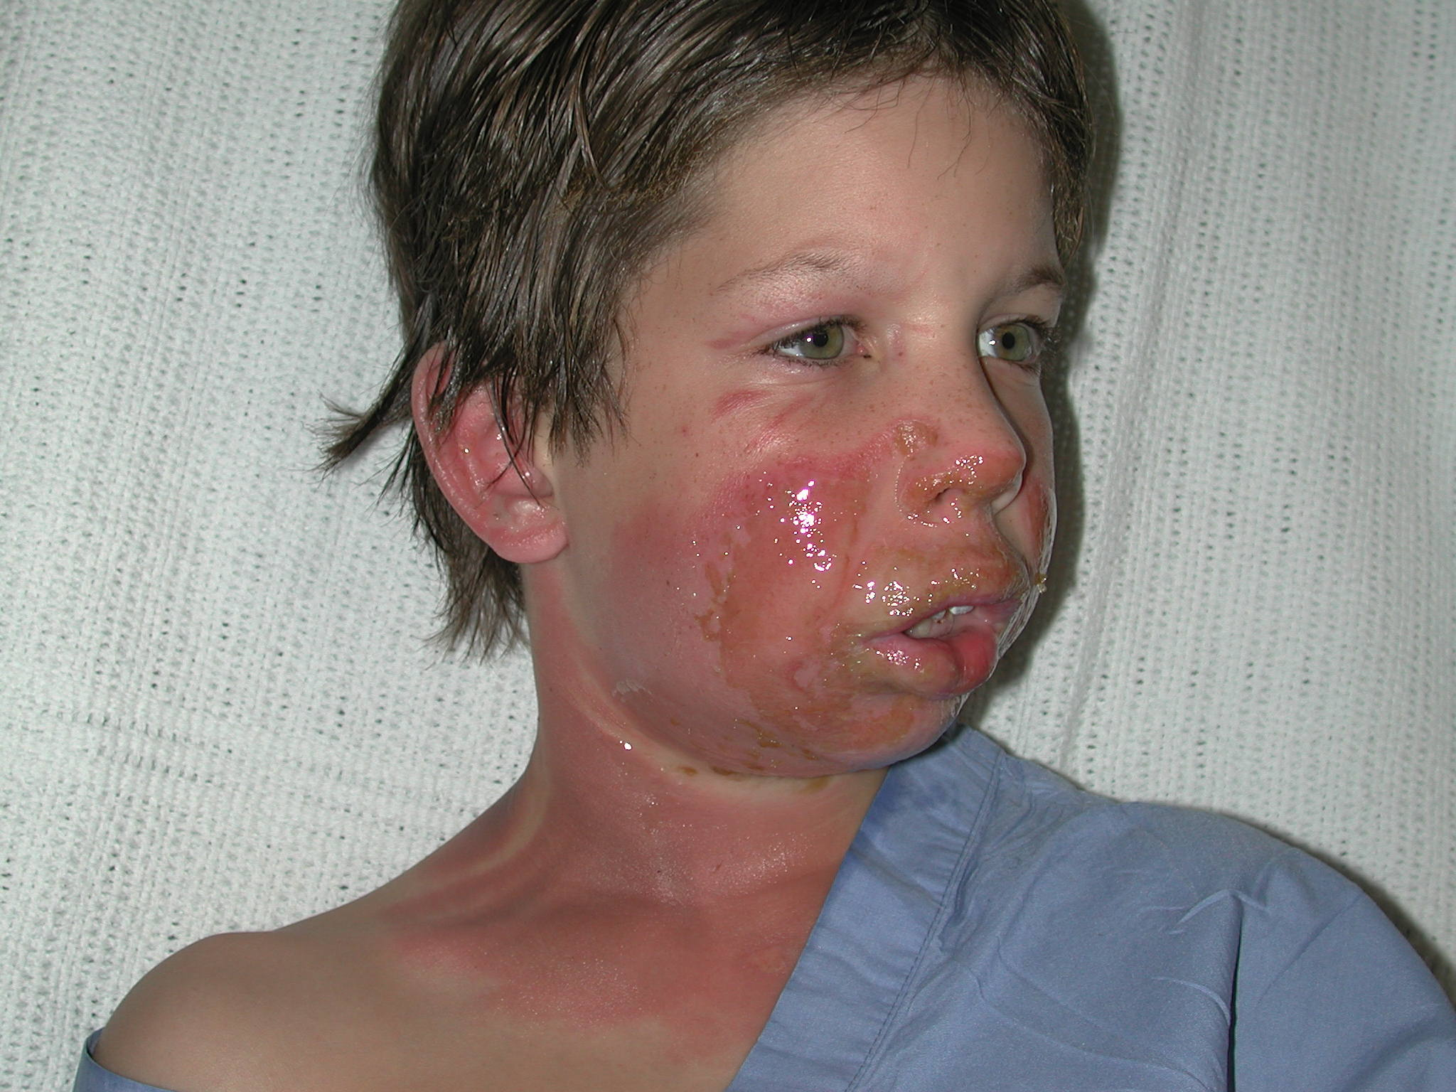

Slide 40
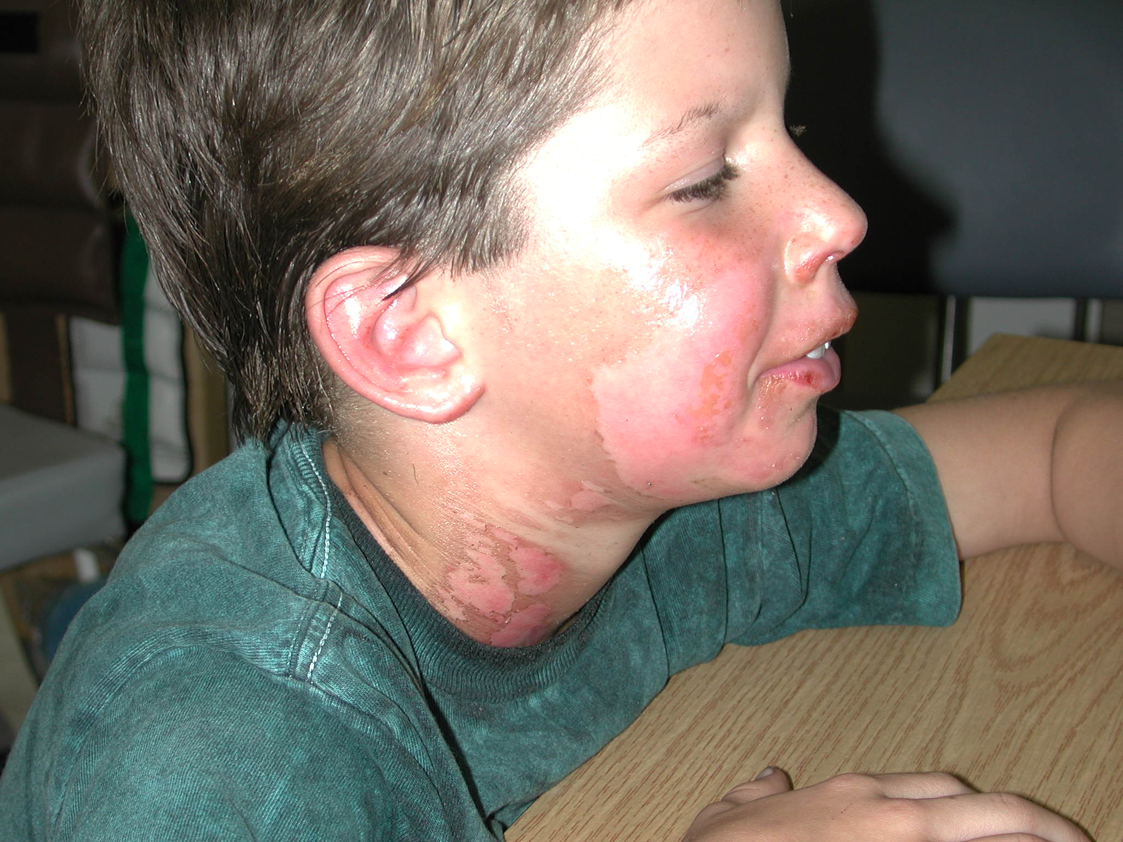

Slide 41
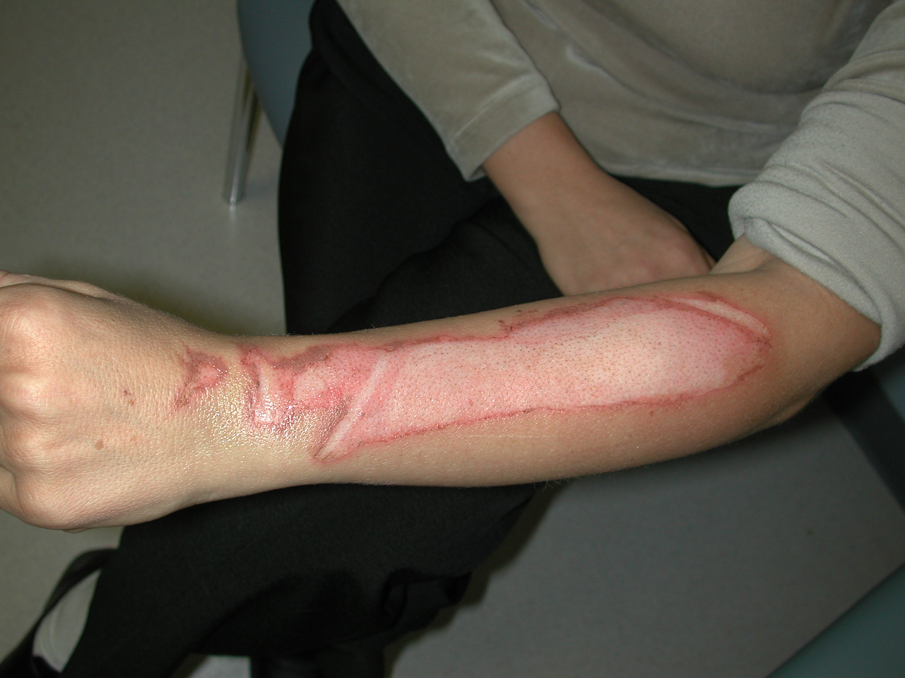

Slide 42
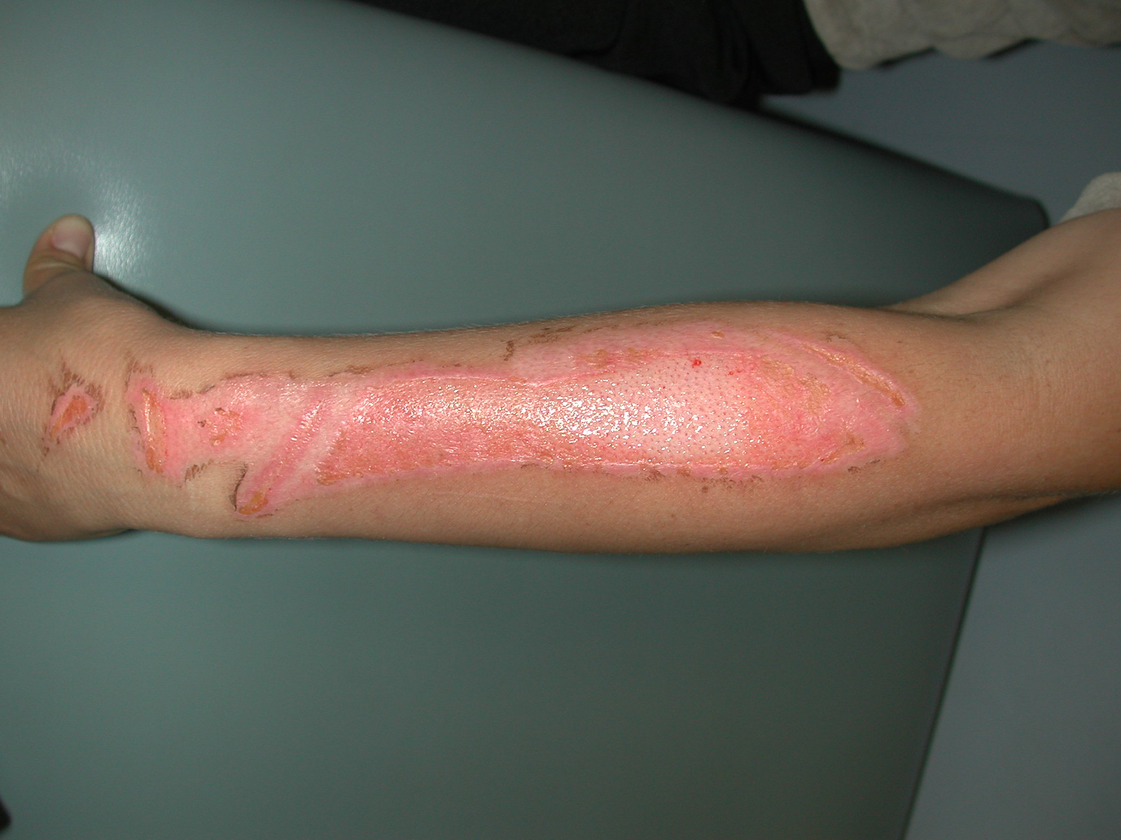

Slide 43
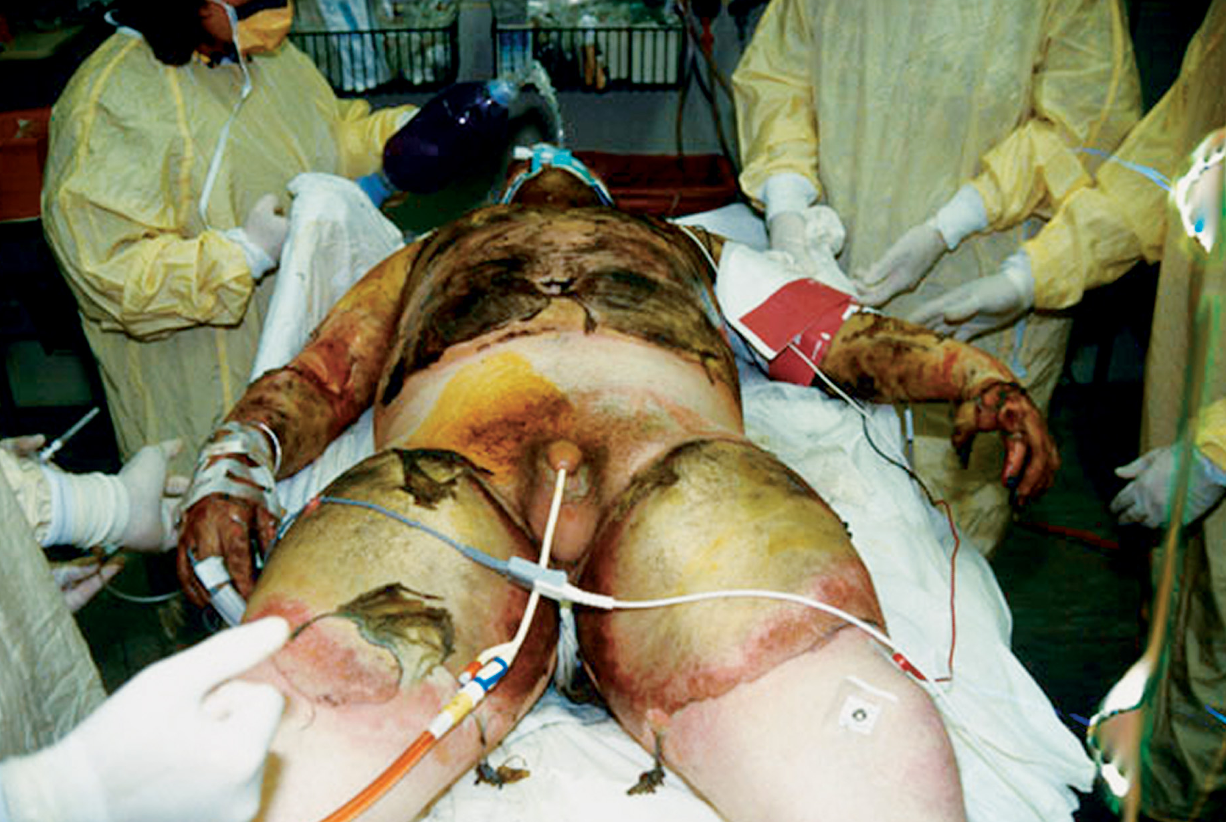
Full-Thickness Burns (Third Degree)
Edward T. Dickinson, MD

Slide 44
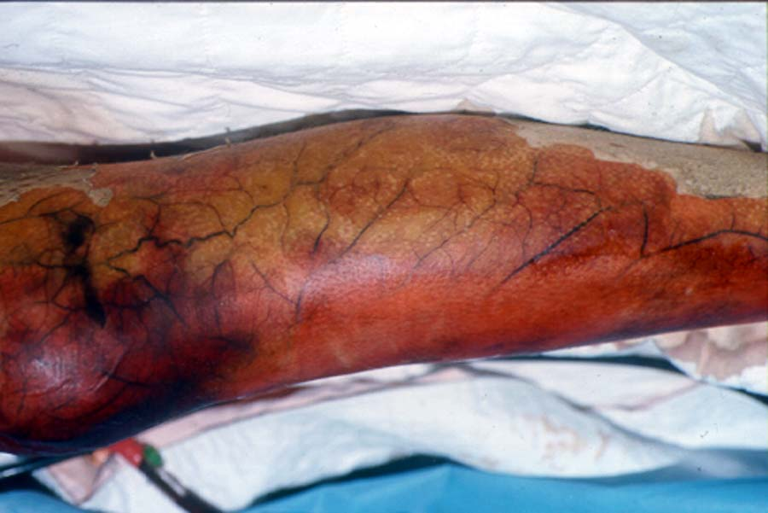

Slide 46
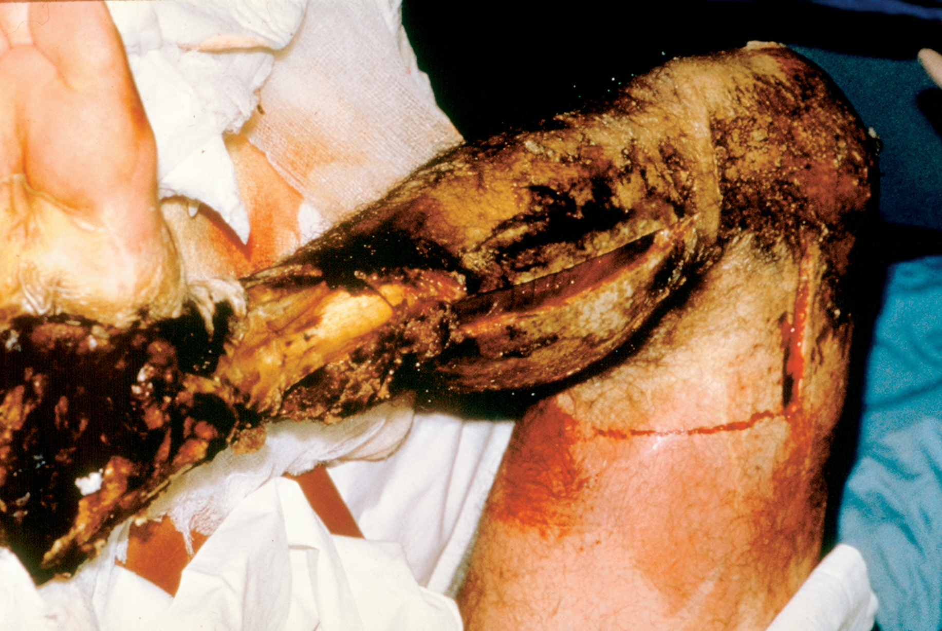
Fourth-Degree Burns
Roy Alson, MD, FACEP

Slide 47
Pain Control
Avoid air exposure
Morphine IV

Slide 48
Wound Care
Prevent contamination
Protect from hypothermia
Injuries <10 percent TBSA
Acceptable to apply wet sterile dressings
Injuries >10 percent TBSA
Use dry sterile dressings only; plastic wrap

Slide 49
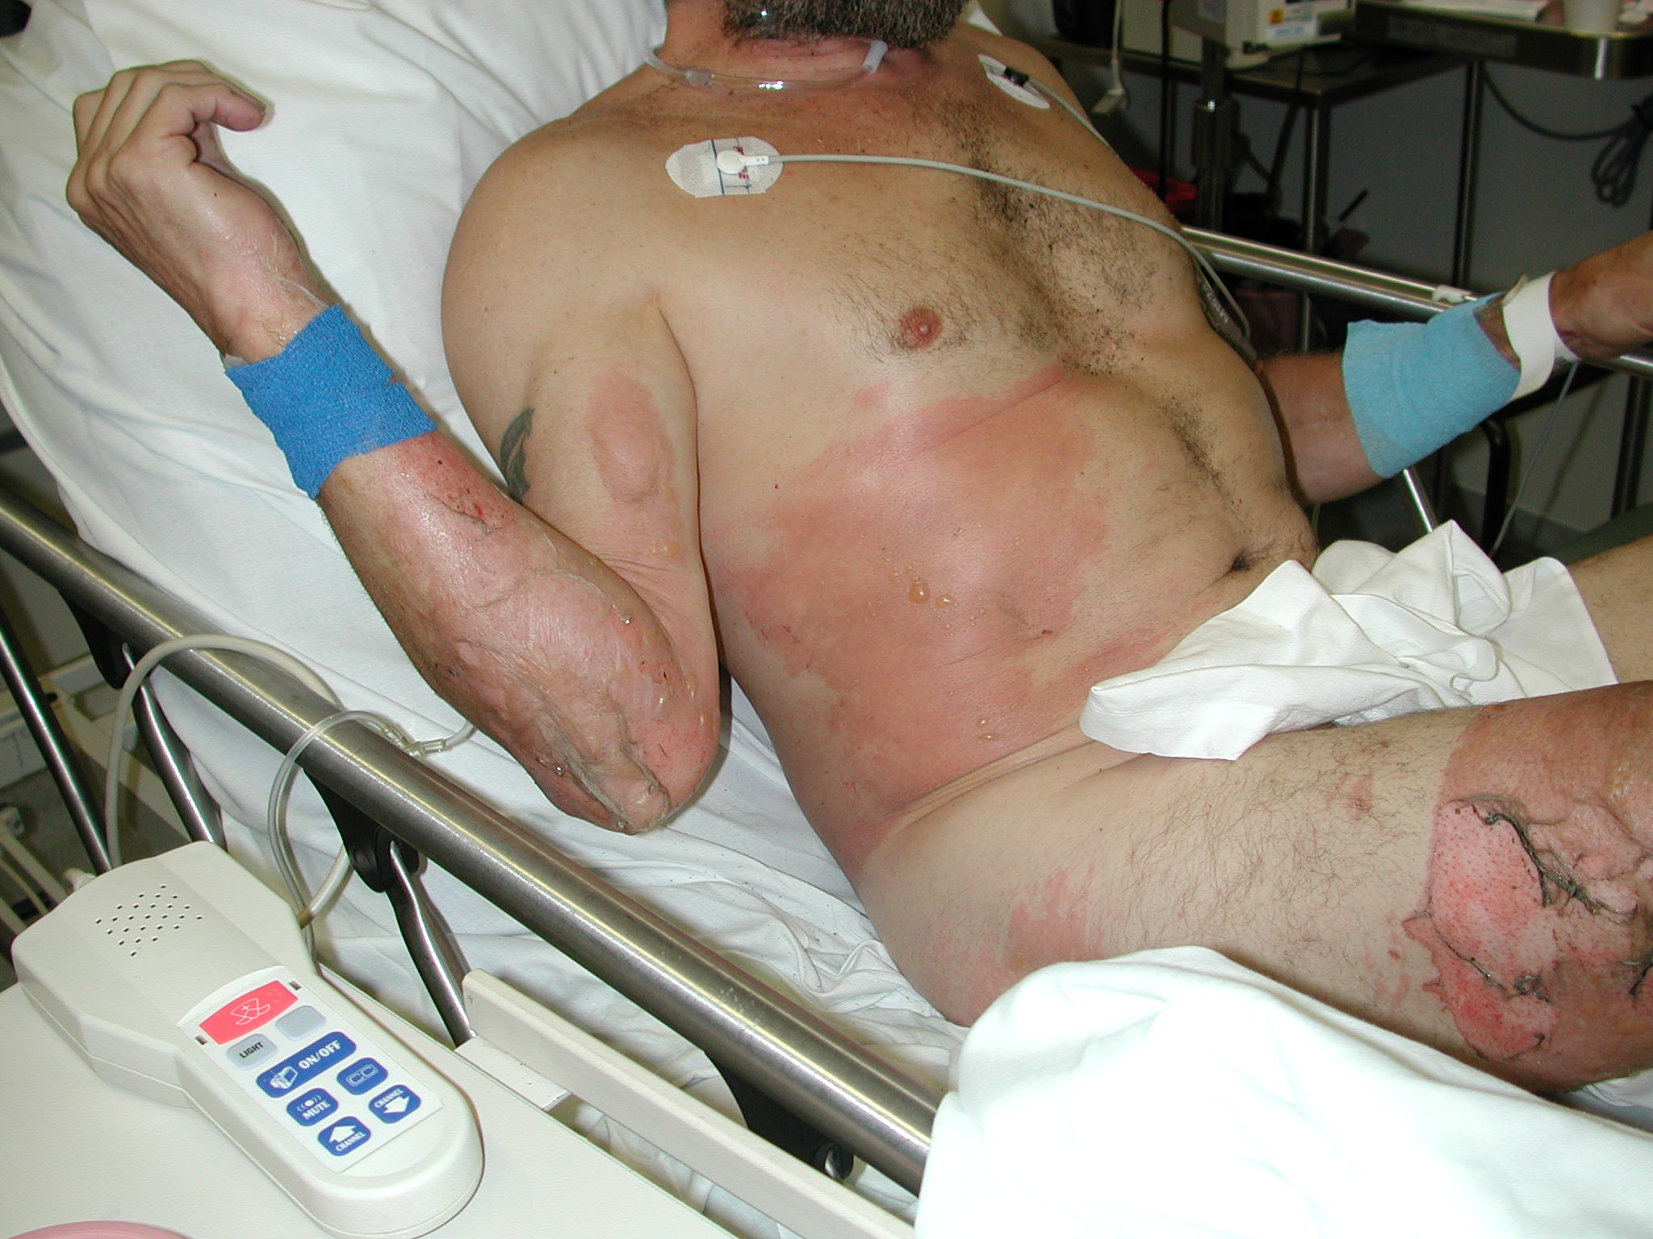
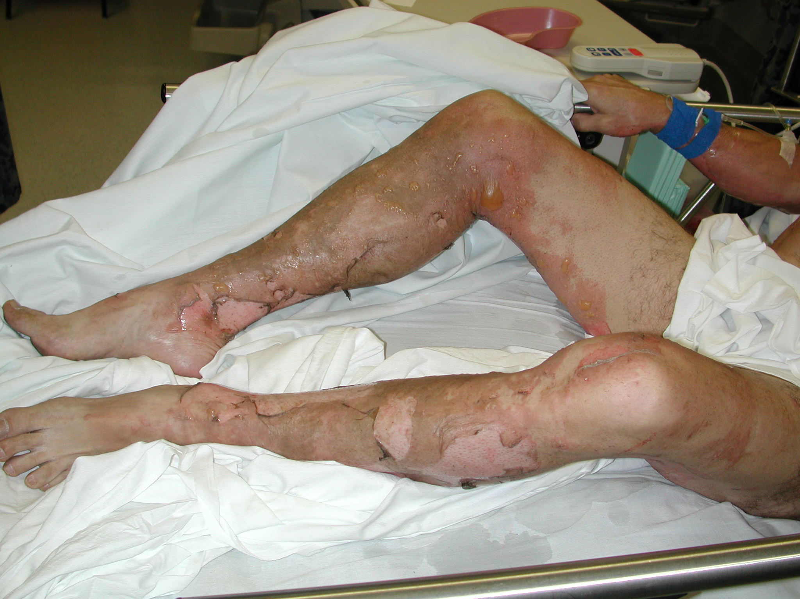
Wound Management

Slide 50
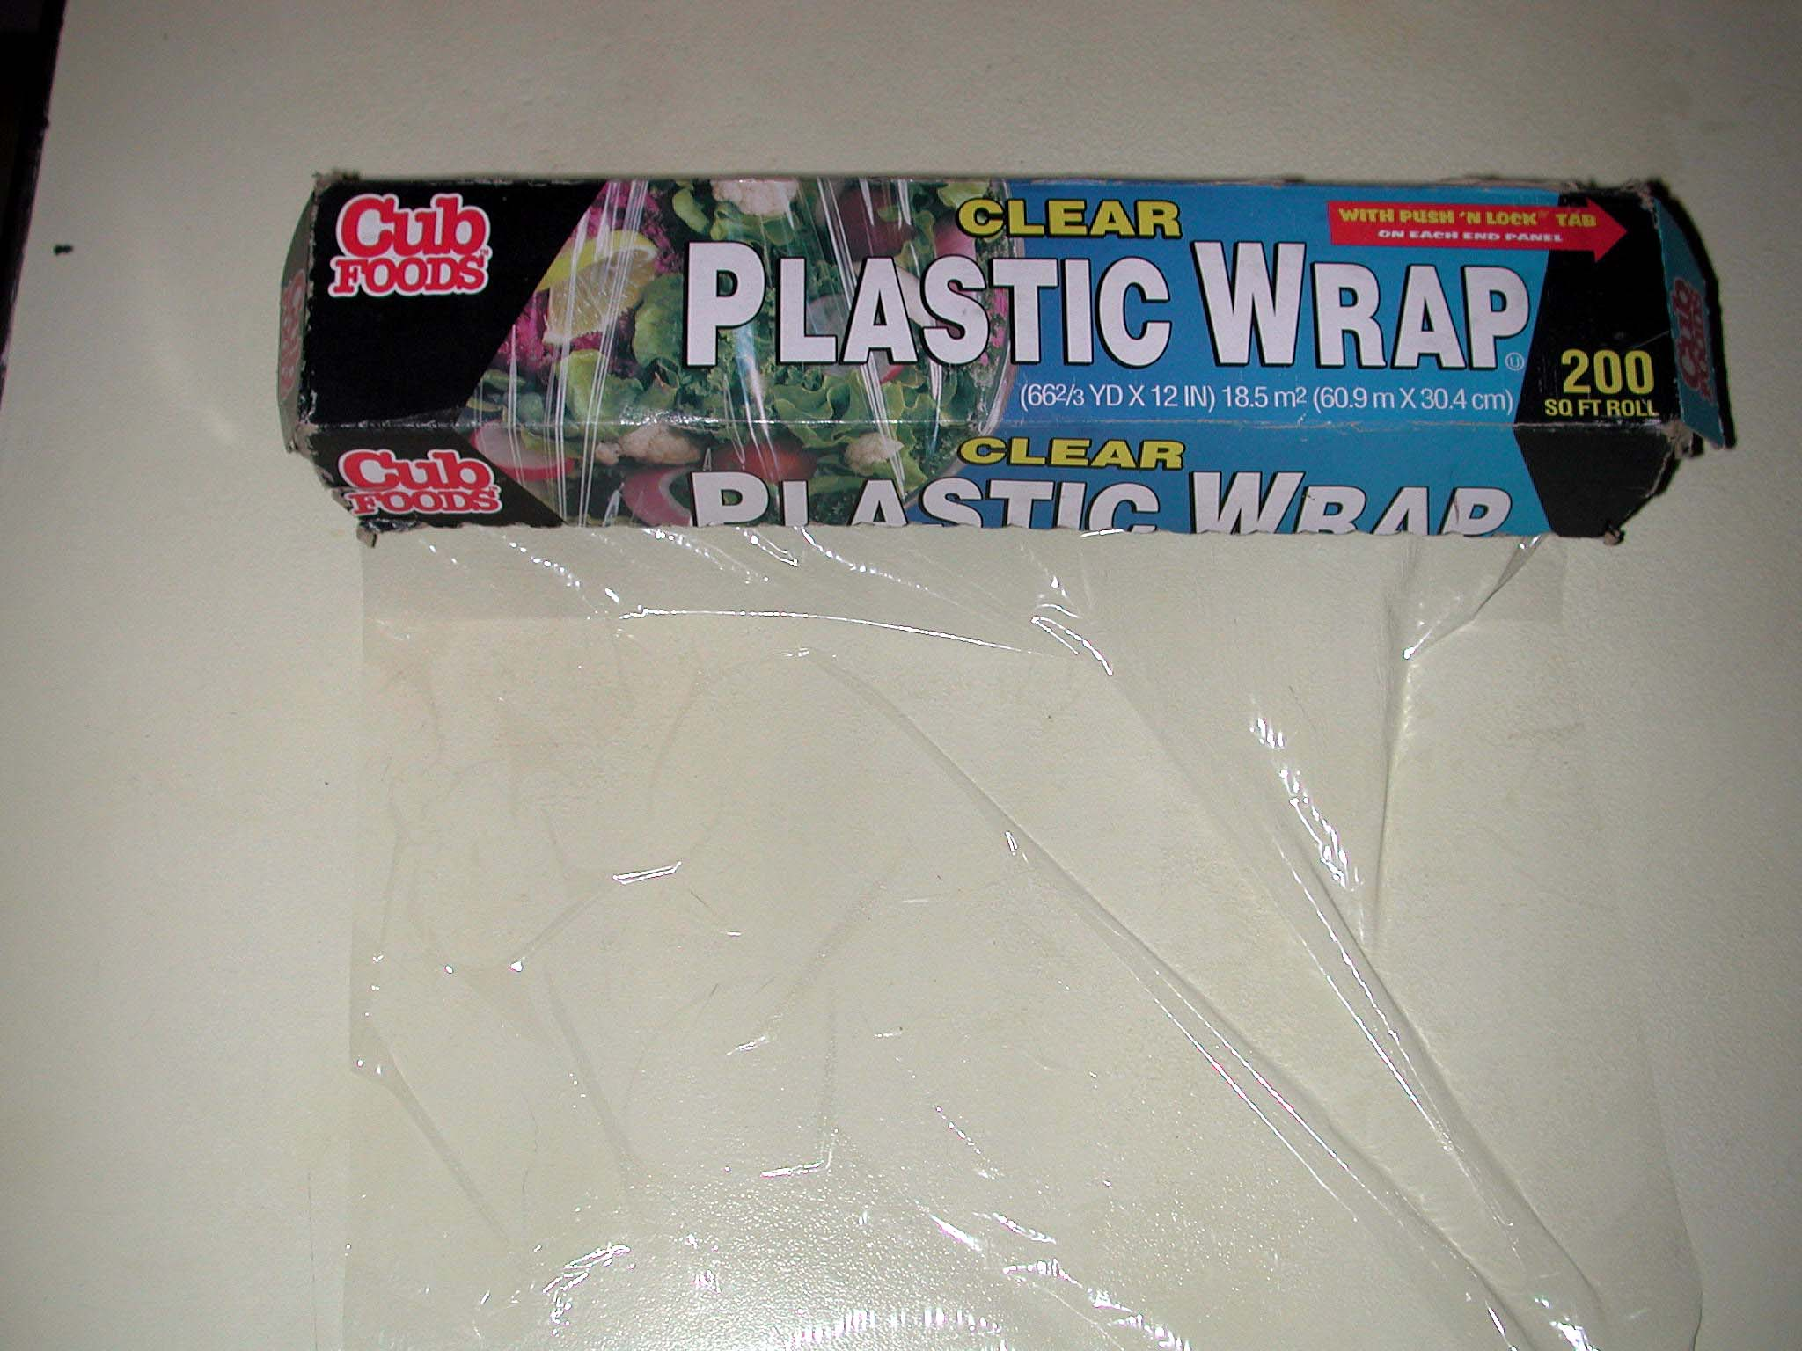
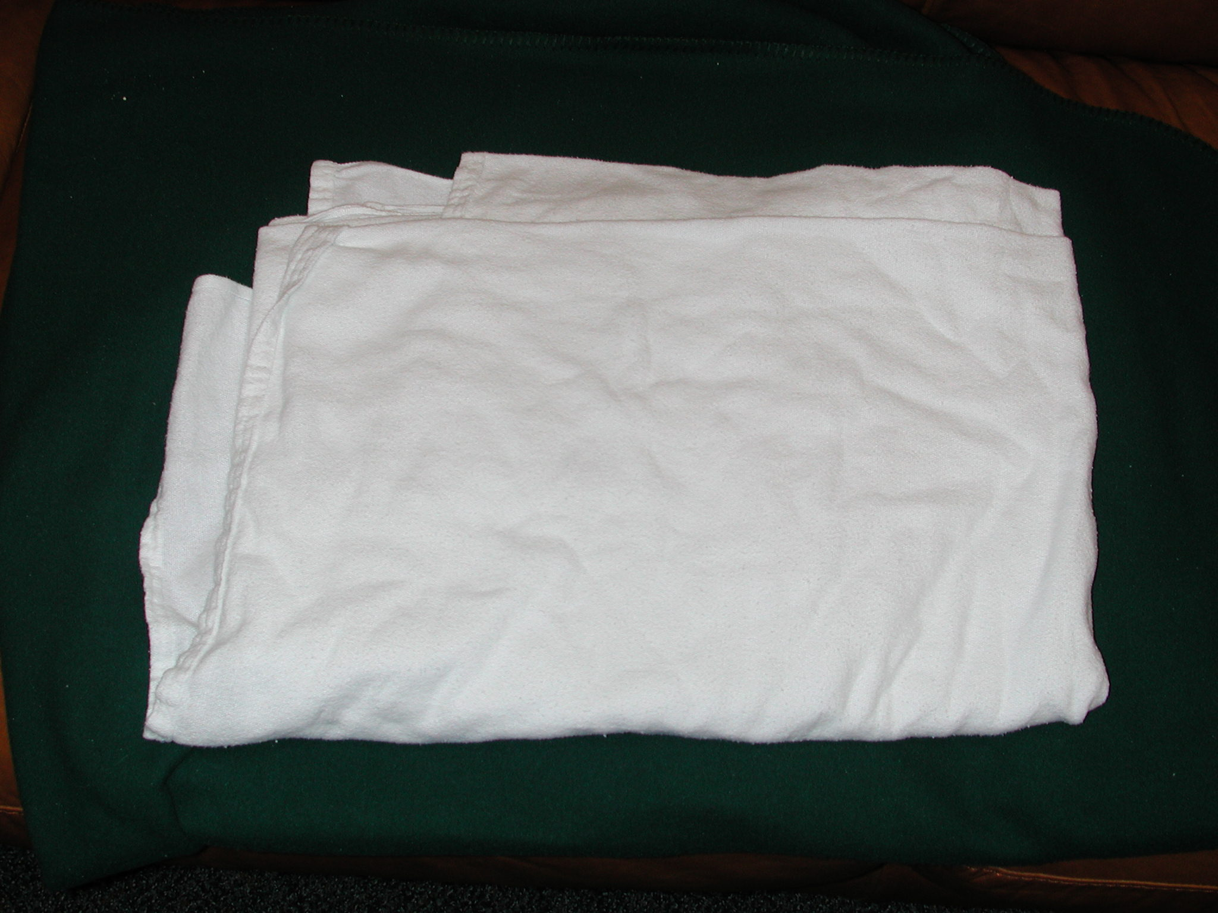

Slide 51
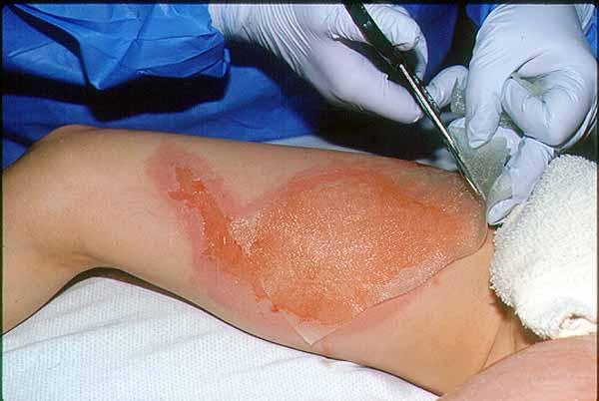
Simple Dressing

Slide 52
Prevent Hypothermia
Exposure
Evaporative losses
Loss of intrinsic regulation

Slide 53
American Burn Association Referral Criteria
Total burns >10% of BSA
Full thickness burns

Slide 54
American Burn Association Referral Criteria
Critical locations
face, hands, feet, genitalia, perineum, major joints
circumferential burns of extremities, chest

Slide 55
American Burn Association Referral Criteria
Electrical injury
Chemical injury
Inhalation injury

Slide 56
Additional Management
Standard studies performed during evaluation
Hematocrit/hemoglobin levels
Electrolyte levels
Blood urea nitrogen levels (BUN)
Urinalysis (UA)
Chest X-ray
Arterial blood gas (ABG) analysis
Carboxyhemoglobin levels
ECG with all electrical burns and pre-existing cardiac problems
Glucose levels (especially in pediatric patients)

Slide 57
Preparing Patients for Transport
Ensure:
Adequate airway patency
Adequate ventilation/oxygenation
Adequate circulatory support
Central venous access preferred
Initiation of fluid replacement
Foley catheter used
NG/OG tubes
Wounds covered with dry, sterile dressings
Analgesia
Tetanus prophylaxis
Protect against hypothermia

Slide 58
Summary
Appropriate initial care important to reduce morbidity and mortality
ABCs are paramount
Begin fluid resuscitation early
Important wound management
Keep patient warm
ABA transfer criteria

