Slide 1

SALT Mass Casualty Triage
A Lecture by
J. Marc Liu, MD, MPH, FAEMS
Division of EMS Medicine
Department of Emergency Medicine
Medical College of Wisconsin

Slide 2
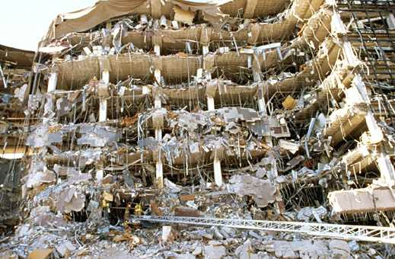
Definitions?
Mass Casualty

Slide 3
Definitions
Mass Casualty – exceeds facility or system resources
Multiple Casualty – does not exceed facility resources

Slide 4
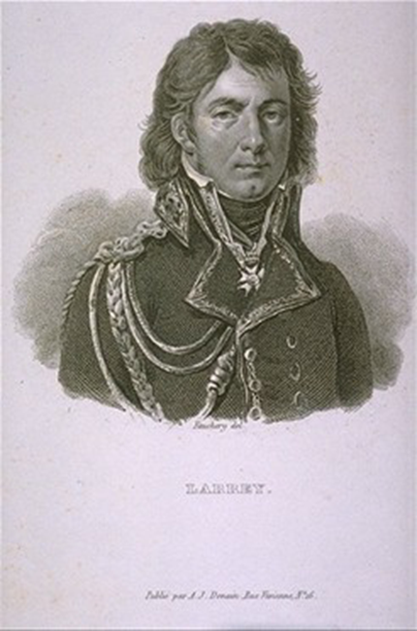

In a mass casualty incident, what is the most important clinical role?

Slide 5
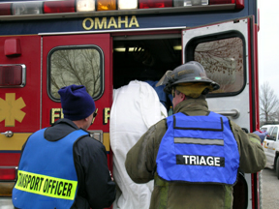
Triage!
“To sort”
Categorize patients by severity/priority
Remember, there are limited resources…

Slide 6
The most important concept of triage…
“The needs of the many outweigh the needs of the few, or the one.”

Slide 7
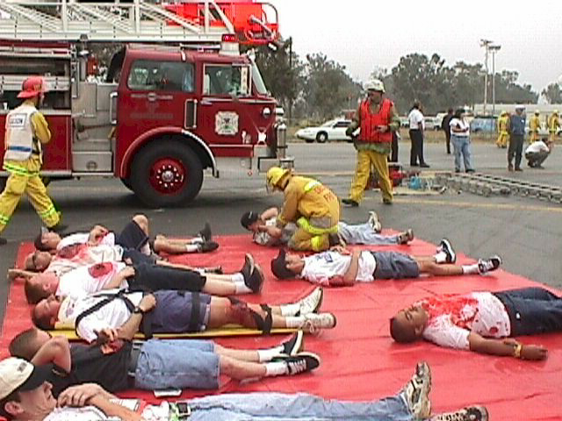
Triage
Important
Challenging
The most experienced/skilled clinicians available

Slide 8
Before we START, take it with a grain of SALT…
Numerous triage systems – not enough data to show if one is superior!
Know the mass triage system that your community uses!

Slide 9
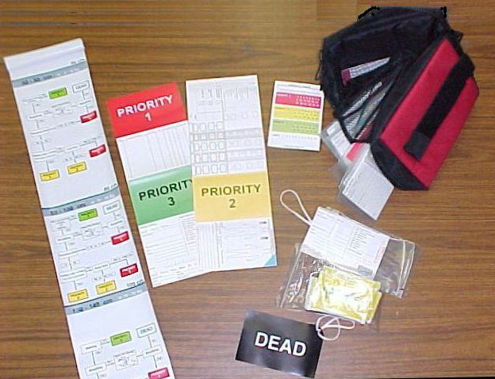
The Triage Categories
Immediate/Emergent (Red)
Delayed/Urgent (Yellow)
Minor/Non-Urgent (Green)
Expectant (Gray)
Dead (Black)

Slide 10
Sort – Assess –
Lifesaving Treatment/Transport
(SALT)
Mass Casualty Triage Algorithm

Slide 11
SALT Mass Casualty Triage
Walk
Assess 3rd
Step 1 – Sort:
Global Sorting
Wave / Purposeful Movement
Assess 2nd
Still / Obvious life threat
Assess 1st
Step 2 – Assess:
Individual Assessment
Obeys Commands?
Has Peripheral Pulse ?
Not in respiratory distress?
Major hemorrhage is controlled?
Minor Injuries
only?
LSI:
Control major hemorrhage
Open airway (if child consider 2 rescue breaths)
Chest decompression
Auto injector antidotes
Yes
All Yes
Yes
Minimal
Breathing?
No
Any No
No
Likely to survive given current resources?
Delayed
Dead
Yes
Immediate
No
Expectant

Slide 12
STEP 1: Global Sorting
12

Slide 13
Step 2: Individual Assessment -- Lifesaving Interventions
13

Slide 14
Individual Assessment –
Assign Category
Triage Categories:
  Immediate
  Delayed
  Minimal
  Expectant
  Dead
14

Slide 15
Other things about triage…
SALT is just a guideline!
Triage is dynamic.

Slide 16
Other things about triage…
The triage officer/team only triages, and does not treat!
  Basic airway maneuvers
  Basic hemorrhage control
  Basic splinting/immobilization

Slide 17
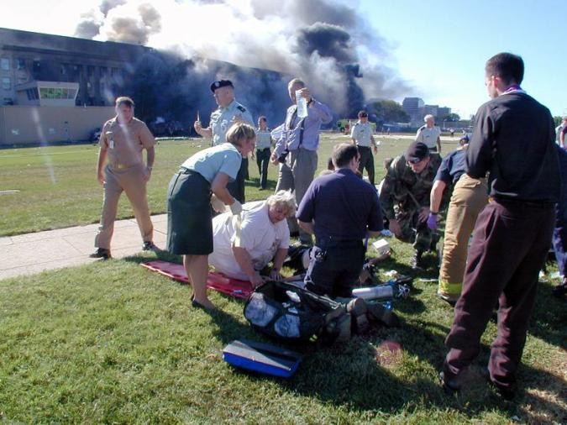
The Concept of Mass Casualty Triage
The greatest good for the greatest number.

Slide 18
Practice Makes Perfect…
Triage the following patients to a triage category using the SALT algorithm:

Slide 19
Patient 1
28 yo male brought in on a stretcher, who is able to answer questions, has a palpable radial pulse, and a regular respiratory rate of 20. He complains of abdominal pain.

Slide 20
Patient 1
28 yo male brought in on a stretcher, who is able to answer questions, has a palpable radial pulse, and a regular respiratory rate of 20. He complains of abdominal pain.
Sort – 2nd Group (able to wave/purposeful movement)
Assess (Triage Category) – Delayed (follows commands, peripheral pulse, no resp distress, and no bleeding, but possibly more than minor injuries)

Slide 21
Patient 2
45 yo female who walks toward you with a visible open forearm fracture. She has no palpable radial pulse on that arm, but is breathing well.

Slide 22
Patient 2
45 yo female who walks toward you with a visible open forearm fracture. She has no palpable radial pulse on that arm, but is breathing well.
Sort – 3rd Group (able to walk)
Assess (Triage Category) – Immediate (if active hemorrhaging) vs. Delayed (if bleeding controlled)

Slide 23
Patient 3
35 yo female found by EMS lying on the ground. She states she is too dizzy to walk. Her respirations are even, and has a palpated pedal pulse. She follows your commands.

Slide 24
Patient 3
35 yo female found by EMS lying on the ground. She states she is too dizzy to walk. Her respirations are even, and has a palpated pedal pulse. She follows your commands.
Sort – 2nd Group (able to wave/purposeful movement)
Assess (Triage Category) – Delayed (follows commands, peripheral pulse, no resp distress, and no bleeding, but possibly more than minor injuries)

Slide 25
Patient 4
60 yo male, who is lying on the ground. He is does not respond to you, but you feel a weak radial pulse. He is not breathing.

Slide 26
Patient 4
60 yo male, who is lying on the ground. He is does not respond to you, but you feel a weak radial pulse. He is not breathing.
Sort – 1st Group (still)
Assess (Triage Category) – Open airway first (lifesaving intervention), then
  If breathing, then Immediate (not following commands, resp distress)
  If not breathing, then Dead

Slide 27
Patient 5
8 yo female who is carried to you by a rescuer who found her walking around and crying. She is breathing, has a good pulse, and no visible injuries. When you ask her what hurts, she cries, points to her left arm, and asks you, “Where is my mommy?”

Slide 28
Patient 5
8 yo female who is carried to you by a rescuer who found her walking around and crying. She is breathing, has a good pulse, and no visible injuries. When you ask her what hurts, she cries, points to her left arm, and asks you, “Where is my mommy?”
Sort – 3rd Group (able to walk)
Assess (Triage Category) – Minimal (follows commands, peripheral pulse, no resp distress, no bleeding, and has no discernable severe injuries)

Slide 29
Patient 6
18 year old male with a left leg injury. The injury is spurting blood. His radial pulse is 110, respirations 20. He is calling for help.

Slide 30
Patient 6
18 year old male with a left leg injury. The injury is spurting blood. His radial pulse is 110, respirations 20. He is calling for help.
Sort – 2nd Group (able to wave) or 1st Group (visible life threat)?
Assess (Triage Category) – Control hemorrhage first (lifesaving intervention), then
  If bleeding not controlled, then Immediate (major hemorrhage)
  If bleeding stopped, then Delayed (follows commands, peripheral pulse, no resp distress, no bleeding, but more than minor injuries)

Slide 31
Questions?

