Slide 1
“ A Community Disaster” Panel Discussion Advocate Aurora- Summit Teams Members AL Davies, RN CHEC- Incident Command Lisa Heinz RN- Charge RN for event Christopher George MD ED Physician for event

Slide 2
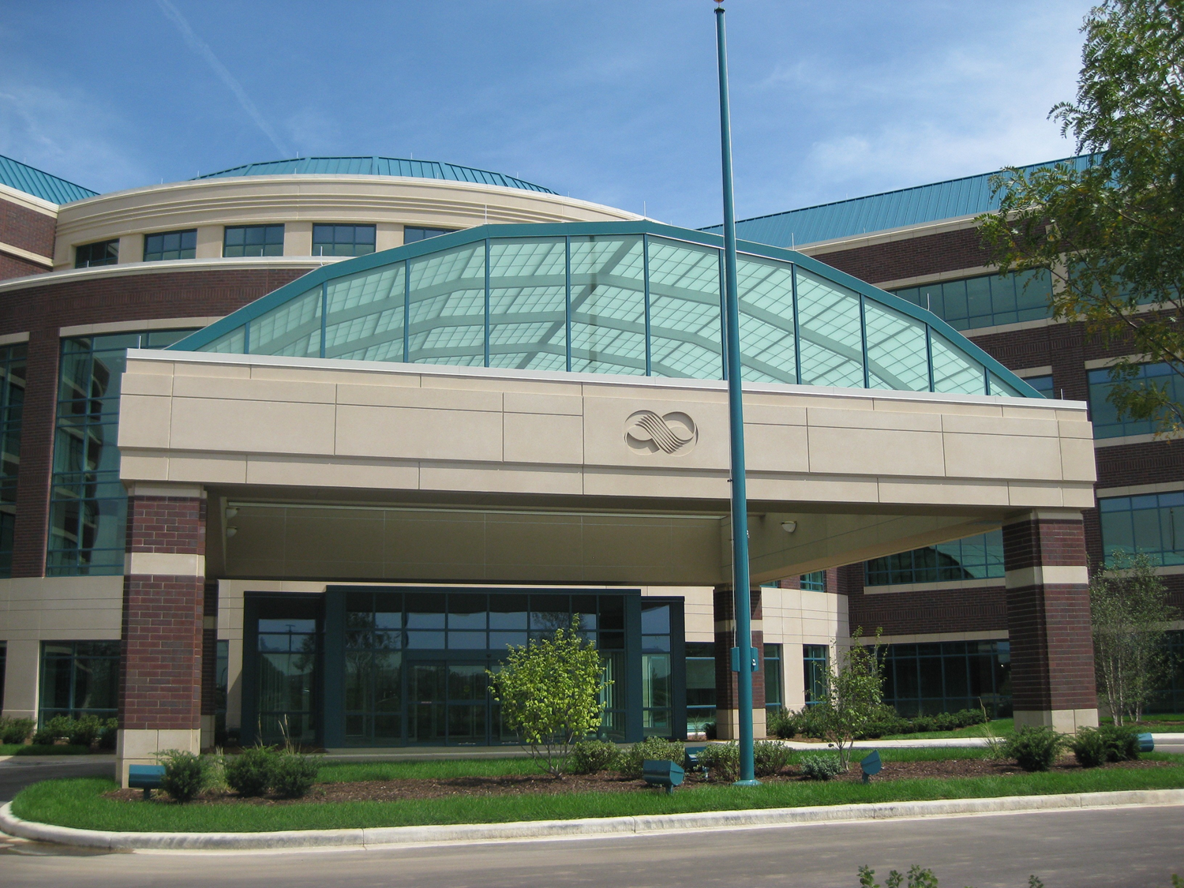
Waukesha Holiday Parade Event (MCI)
11/21/21 ( 16:30- 21:35)
Summary of events
13 MCI patients seen & treated
4 patients taken to surgery or IR suite
Full onsite Incident Command Activation
MCI Plan activated, including 3 Surgical teams inhouse

Slide 3
Waukesha Holiday Parade Event (MCI)
Summary of events in MCI Event
First patient to present to Aurora Summit was a walk-in
12 additional patients by ambulance
5 pediatric patients
ED remained open for the duration of the event

Slide 4
Waukesha Holiday Parade Event (MCI)
Summary of events during MCI Event
5 pediatric patients
17yo with bowel perforation taken to surgery immediately
1 with multi-trauma transported to CHOW
3 treated and discharged

Slide 5
Waukesha Holiday Parade Event (MCI)
Summary of events during MCI Event
8 Adult patients
Elderly patient with epidural -> surgery
Patient w/ complex pelvic fractures
-> MTP activation,
-> Taken to IR for embolization of arterial
bleeding

Slide 6
Waukesha Holiday Parade Event (MCI)
Summary of events of MCI Event
2nd elderly with multi-trauma and MTP activation
1 patient admitted for chest trauma and rib fractures
Remaining adults treated and discharged from the ED

Slide 7
Waukesha Holiday Parade Event (MCI)
Summary of events of MCI Event
Multi-tier response by support staff including; front line caregivers , support an ancillary staff
Red Cross / Salvation Army on site assisting with family reunification
Media relations onsite to assist Comm OPS with inquiries calls
Debriefing session established with WCC-CISD & AAH Teams

Slide 8
Waukesha Holiday Parade Event (MCI)
Hot Wash points for Discussion
Initial notification was by individuals on scene and social media (1641pm)
EM Resource not online to receive initial notification

Slide 9
Waukesha Holiday Parade Event (MCI)
Hot Wash points for Discussion
Local /national media channels contacting ED directly for updates
Local LE / IC requesting list of patients seen and disposition
**Development of “virtual IC” utilizing TEAMS platform

