Slide 1
Pediatric readiness…are you ready?
Southeast regional trauma advisory council Cutting Edge in Trauma conference
Lorin R. Browne, DO, FAAP
Associate Professor, Pediatrics and Emergency Medicine Director, Pediatric Readiness
Medical College of Wisconsin Children’s Wisconsin

Slide 2
objectives
Define and review Pediatric Readiness
Detail specifics of the National Pediatric Readiness Program
Discuss impact of Readiness inclusion in ACS Trauma Verification
Introduce strategies for getting started with Readiness

Slide 3
Disclaimer #1
I have no relevant financial relationships to disclose

Slide 4
Disclaimer #2
I recognize the challenges faced by general EDs
  65-year-old with chest pain
  35-year-old motor vehicle collision
  23-year-old with first trimester bleeding
  4-year-old with radius/ulna fracture
  84-year-oldwith altered mental status
  6-month-old with difficulty breathing

Slide 5
What is Pediatric Readiness?
US EDs
ED Visits
141 million
< 15 yrs
28 million
General EDs
~5,000
23 million
(83%)
(20%)
< 15 peds/day
16 million
(69%)

Slide 6
What is Pediatric Readiness?
US EDs
ED Visits
141 million
< 15 yrs
28 million
General EDs
~5,000
23 million
(83%)
(20%)
< 15 peds/day
16 million
(69%)

Slide 7
What is Pediatric Readiness?
US EDs
ED Visits
141 million
< 15 yrs
28 million
General EDs
~5,000
23 million
(83%)
(20%)
< 15 peds/day
16 million
(69%)

Slide 8
What is Pediatric Readiness?
US EDs
ED Visits
141 million
< 15 yrs
28 million
General EDs
~5,000
23 million
(83%)
(20%)
< 15 peds/day
16 million
(69%)

Slide 9
What is pediatric readiness?
2006 - the IOM noted the following deficiencies in pediatric ED care:
  availability of pediatric-sized equipment
  access to other pediatric supplies and medication dosing
  pediatric training for physicians, nurses, and staff
  policies incorporating the unique needs of children
Institute of Medicine (now National Academy of Medicine), Committee of the Future of Emergency Care in the US Health System. Emergency Care for Children: Growing Pains. Washington, DC: National Academies Press; 2006.

Slide 10
What is pediatric readiness?
2009 - “Guidelines for the Care of Children in the Emergency Department” revised (also revised in 2018)
  expert consensus statement
  authored by ACEP, AAP, and ENA
  supported by EMS-C
Remick K, Gausche-Hill M, Joseph MM, Brown K, Snow SK, Wright JL, Pediatric Readiness in the Emergency Department. Ann Emerg Med. 2018 Dec;72(6):e123-e136.

Slide 11
What is pediatric readiness?
2013 – National Pediatric Readiness Project (Phase 1)
  multi-phase quality improvement initiative to ensure all U.S. EDs have the essential guidelines and resources in place to provide effective emergency care to children
  voluntary, self-administered, online assessment
  provides a raw score and gap analysis to responding EDs
  open to all US EDs
  maintained by EMSC Innovation and Improvement Center

Slide 12
National Pediatric Readiness Project (NPRP)
Purposes are to:
  establish a composite baseline of the nation’s capacity to provide care to children in the ED
  to create a foundation for EDs to engage in pediatric QI processes
  to establish a benchmark that measures an ED improvements over time

Slide 13
National Pediatric Readiness Project (NPRP)
Highlights from the 2013 NPRP assessment (4,000+ EDs, 83%)
  median score 70/100
  higher median scores observed with increasing pediatric volumes
  52% had pediatric physician coordinator, 60% had nurse coordinator
  55% had no pediatric QI processes
  53% did not include pediatric needs in disaster planning
  trauma center status was not associated with higher pediatric readiness

Slide 14
National Pediatric Readiness Project (NPRP)
Highlights from the 2013 NPRP assessment (4,000+ EDs, 83%)
  median score 70/100
  higher median scores observed with increasing pediatric volumes
  52% had pediatric physician coordinator, 60% had nurse coordinator
  55% had no pediatric QI processes
  53% did not include pediatric needs in disaster planning
  trauma center verification was not associated with higher pediatric readiness

Slide 15
National Pediatric Readiness Project (NPRP)
Why does the NPRP matter?

Slide 16
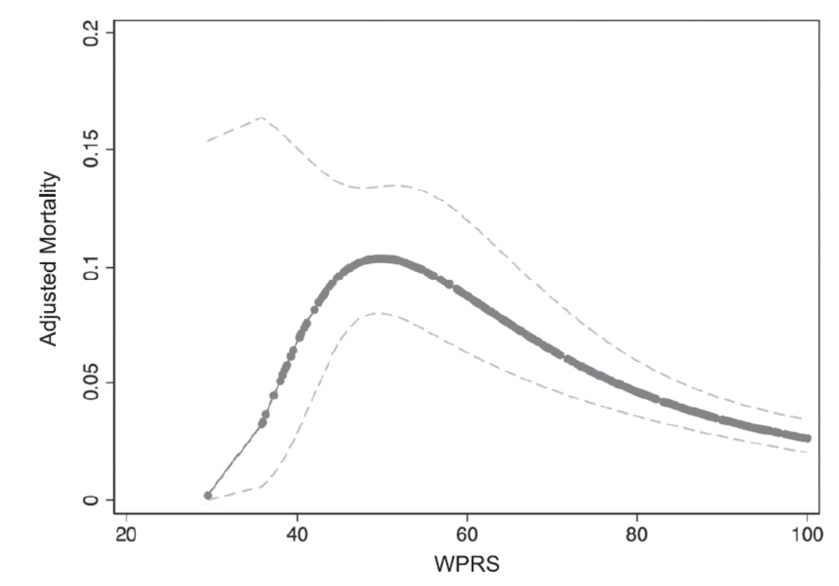
National Pediatric Readiness Project (NPRP)
Why does the NPRP matter?
In over 20,000 critically ill children seen in more than 400 EDs
Ames SG, Davis BS, Marin JR, Fink EL, Olson LM, Gausche-Hill M, Kahn JM. Emergency Department Pediatric Readiness and Mortality in Critically Ill Children. Pediatrics. 2019 Sep;144(3):e20190568

Slide 17
National Pediatric Readiness Project (NPRP)
In response to the 2013 NPRP assessment,
  the AAP, ACEP, and ENA joint policy statement was updated
  the NPRP assessment was revised and was readministered in 2021

Slide 18
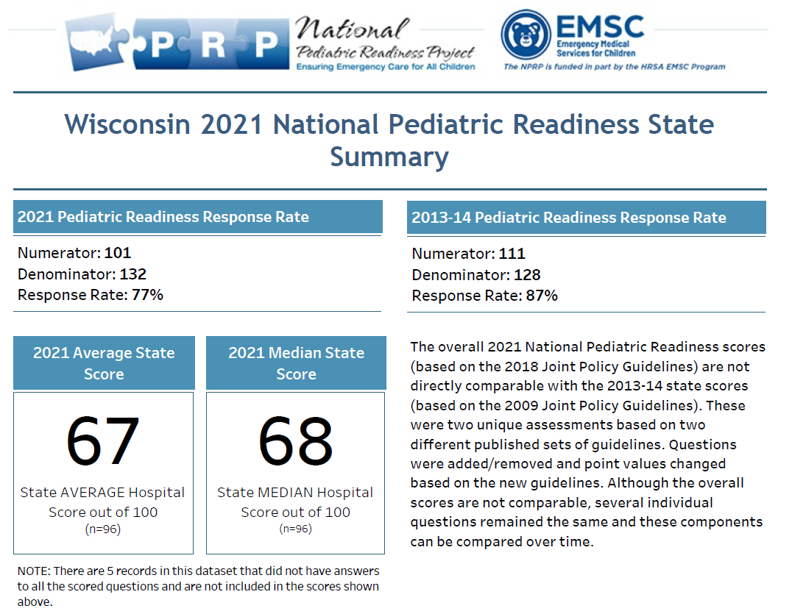
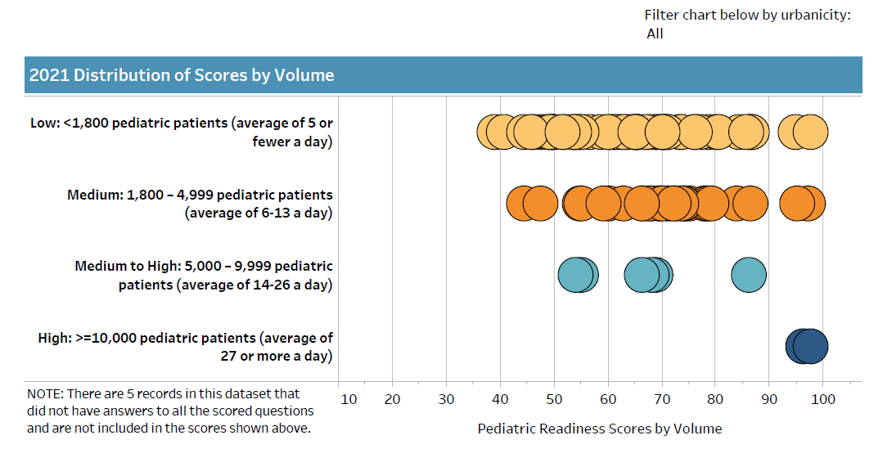
National Pediatric Readiness Project (NPRP)

Slide 19
National Pediatric Readiness Project (NPRP)
Essential domains in the 2021 NPRP assessment
  Administration and Coordination of Care (19 points)

Slide 20
National Pediatric Readiness Project (NPRP)
Essential domains in the 2021 NPRP assessment
  Administration and Coordination of Care (19 points)
  Physicians and Providers (10 points)

Slide 21
National Pediatric Readiness Project (NPRP)
Essential domains in the 2021 NPRP assessment
  Administration and Coordination of Care (19 points)
  Physicians and Providers (10 points)
  Quality Improvement (7 points)

Slide 22
National Pediatric Readiness Project (NPRP)
Essential domains in the 2021 NPRP assessment
  Administration and Coordination of Care (19 points)
  Physicians and Providers (10 points)
  Quality Improvement (7 points)
  Pediatric Patient Safety (14 points)

Slide 23
National Pediatric Readiness Project (NPRP)
Essential domains in the 2021 NPRP assessment
  Administration and Coordination of Care (19 points)
  Physicians and Providers (10 points)
  Quality Improvement (7 points)
  Pediatric Patient Safety (14 points)
  Policies, Procedures, and Protocols (17 points)

Slide 24
National Pediatric Readiness Project (NPRP)
Essential domains in the 2021 NPRP assessment
  Administration and Coordination of Care (19 points)
  Physicians and Providers (10 points)
  Quality Improvement (7 points)
  Pediatric Patient Safety (14 points)
  Policies, Procedures, and Protocols (17 points)
  Equipment, Supplies, and Medications (33 points)

Slide 25
ACS Trauma verification and NPRP
43% of US children live farther than 30 miles from a verified pediatric trauma center

Slide 26
ACS Trauma verification and NPRP
43% of US children live farther than 30 miles from a verified pediatric trauma center
Trauma center verification DOES NOT track with pediatric readiness independently of pediatric specialty centers

Slide 27
ACS Trauma verification and NPRP
43% of US children live farther than 30 miles from a verified pediatric trauma center
Trauma center verification DOES NOT track with pediatric readiness independently of pediatric specialty centers
Beginning in March 2023, NPRP assessment will be required by all centers seeking initial or ongoing ACS Trauma Verification

Slide 28
ACS Trauma verification and NPRP
43% of US children live farther than 30 miles from a verified pediatric trauma center
Trauma center verification DOES NOT track with pediatric readiness independently of pediatric specialty centers
Beginning in March 2023, NPRP assessment will be required by all centers seeking initial or ongoing ACS Trauma Verification

Slide 29
ACS Trauma verification and NPRP
[Discuss impact on general medical centers]

Slide 30
Getting starting with NPRP
[One slide on each of the following]
Take the assessment
Review your score and gap report
Determine which gap to address
Use available resources (EIIC, Wisconsin toolkit, children’s hospitals)

Slide 31
Questions
THANK YOU!
Lorin Browne
lbrowne@mcw.edu

