Slide 1
Froedtert Menomonee Falls Hospital
Menomonee Falls, WI
Panel Discussion:
A Community Disaster
Courtney Lauer BSN RN
Jim McCullough BSN RN
presented: October 2022

Slide 2
Disclosures
We have no disclosures

Slide 3
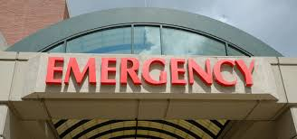
Status of ED
Sunday late afternoon
25 patients in the department
Call from paramedic base- expect 6-8 patients
Call to house sup
Incident command activated at 5:50 pm
Request by ED charge to move admitted patients and request for more staff
Condensed assignments to accommodate patients
Called in additional staff
Notes:
Initial information from the scene indicated that the MCI was a result of an active shooter; preparations were initiated to receive patients suffering from this type of injury. Follow-up details received indicated the nature of the injuries were from physical impact with an automobile.
IC effectively identified three critical objectives to meet staffing, hospital safety and security along with all patient care needs.

Slide 4
Patients
Patient Sex | Age | ED Arrival Mode | Chief Complaint
Female | 64 | Ambulance | Abdominal pain
Male | 45 | Ambulance | Ankle pain, laceration
Female | 57 | Ambulance | Abdominal pain, hip, ankle
Male | 8 | Private Vehicle | Ankle pain
Male | 20 | Ambulance | Confusion
Notes:
Talk about time between patients, talk about EMS reports, how the assignments were made, who was there to help in the department, tone of the department

Slide 5
Disposition
Patient | Age | Injuries | Disposition
Female | 64 | Aortic Tear | Transferred
Male | 45 | Road rash, laceration, concussion | Discharged
Female | 57 | Metatarsal Fracture | Discharged
Male | 8 | Tibia Fracture | Discharged
Male | 20/ 12 | Skull fracture/ Head bleed | Transferred
Notes:
In total 5 patients were received and treated, 4 from EMS, 1 self-presented – of those patients 1 was transferred to CHOW and 1 to higher level of care. At 9:01 p.m., IC was closed, an all-clear message was sent.

Slide 6
Opportunities
Incidentally found to be 12 (determined when mother arrived)
EMS report indicating the patient as a 20 year impacted the care and assessment.
Acting inappropriately for a 20 year but appropriate for a scared 12 year old
Overall EMS report on all patients was vague
Phone calls with requests for information

Slide 7
Key Take a Ways
Incident command activation was expedited quickly
Moving patients off floor
Calling in staff
Long wait between initial notification to patient arrival
Staff burnout related to other events (13 y/o GSW same weekend)
Updating EM Resource- great tool
Notes:
Effective use of EM-resource by the ED staff providing availability to on-scene first responders.

Slide 9
“ A Community Disaster” Panel Discussion Advocate Aurora- Summit Teams Members AL Davies, RN CHEC- Incident Command Lisa Heinz RN- Charge RN for event Christopher George MD ED Physician for event

Slide 10
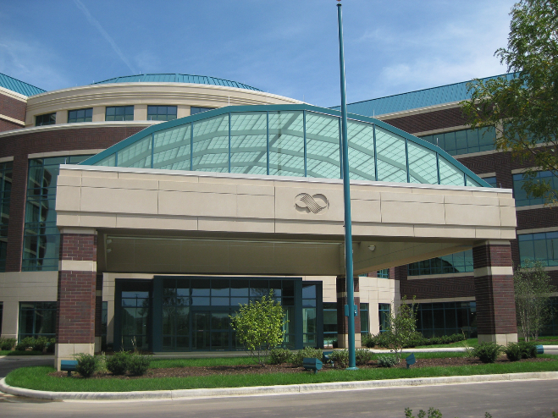
Waukesha Holiday Parade Event (MCI)
11/21/21 ( 16:30- 21:35)
Summary of events
13 MCI patients seen & treated
4 patients taken to surgery or IR suite
Full onsite Incident Command Activation
MCI Plan activated, including 3 Surgical teams inhouse

Slide 11
Waukesha Holiday Parade Event (MCI)
Summary of events in MCI Event
First patient to present to Aurora Summit was a walk-in
12 additional patients by ambulance
5 pediatric patients
ED remained open for the duration of the event

Slide 12
Waukesha Holiday Parade Event (MCI)
Summary of events during MCI Event
5 pediatric patients
17yo with bowel perforation taken to surgery immediately
1 with multi-trauma transported to CHOW
3 treated and discharged

Slide 13
Waukesha Holiday Parade Event (MCI)
Summary of events during MCI Event
8 Adult patients
Elderly patient with epidural -> surgery
Patient w/ complex pelvic fractures
-> MTP activation,
-> Taken to IR for embolization of arterial
bleeding

Slide 14
Waukesha Holiday Parade Event (MCI)
Summary of events of MCI Event
2nd elderly with multi-trauma and MTP activation
1 patient admitted for chest trauma and rib fractures
Remaining adults treated and discharged from the ED

Slide 15
Waukesha Holiday Parade Event (MCI)
Summary of events of MCI Event
Multi-tier response by support staff including; front line caregivers , support an ancillary staff
Red Cross / Salvation Army on site assisting with family reunification
Media relations onsite to assist Comm OPS with inquiries calls
Debriefing session established with WCC-CISD & AAH Teams

Slide 16
Waukesha Holiday Parade Event (MCI)
Hot Wash points for Discussion
Initial notification was by individuals on scene and social media (1641pm)
EM Resource not online to receive initial notification

Slide 17
Waukesha Holiday Parade Event (MCI)
Hot Wash points for Discussion
Local /national media channels contacting ED directly for updates
Local LE / IC requesting list of patients seen and disposition
**Development of “virtual IC” utilizing TEAMS platform

