Slide 1
Saving Patients, Saving Blood
Angela Treml, MD Medical Director, Blood Bank, WDL & Froedtert Hospital Medical Director, Versiti Wisconsin

Slide 2
Nothing to disclose

Slide 3
Objectives
Describe how the MTP helps the blood bank improve patient care and safety
Discuss how MTPs and blood products are tailored for each hospital
Explain the importance of blood donation

Slide 4
MTPs from the blood bank perspective
Scenario 1:
Call to blood bank- My patient is bleeding, we need blood. Send lots of blood.
Blood Bank- Who is this for? Location? What do you want us to send?
Scenario 2:
Call to blood bank- This is Luke S. Dr. Yoda is activating the MTP on Darth Vader in the ER bay 10.
Blood Bank- Okay. Will you call for each cooler or is this a continuous activation?

Slide 5
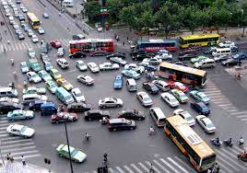
MTPs
Scenario 1
Scenario 2

Slide 6
MTPs- the blood bank perspective
Why we appreciate the MTP?
It streamlines the process when every minute counts
It usually avoids numerous calls from different providers requesting products
More calls = longer time to get blood
We know what you want and need vs guessing or having to suggest perhaps it’s time for plasma

Slide 7
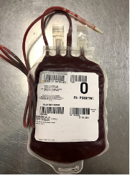
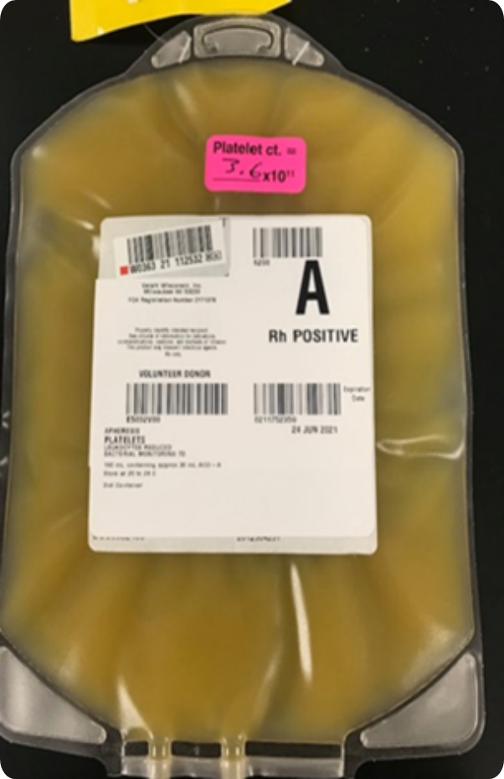
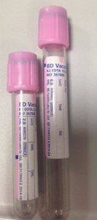
MTPS – blood bank perspective
Timeline:
Call comes in activating the blood bank
Info being documented and then announced to the staff
Each person has a set role
Someone is setting up plasma
Other gets the rbcs
Someone else is setting up the cooler
Platelet is being issued
Once that cooler/set is out the door, we set up another
And we are probably asking for a sample!
It is never too late to send us one

Slide 8
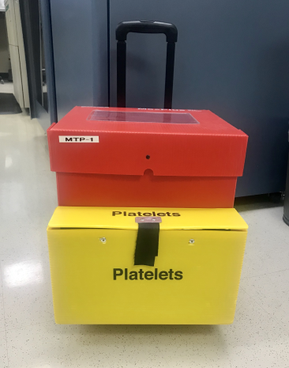
MTPs- blood bank perspective
It’s not always perfect!
Practice and simulations are needed especially in areas with low volume
Practice makes perfect
Consider involving blood bank in your simulations
Important/Imperative that blood bank is involved in discussions about the MTP and changes
There are often things blood bank must do or regulations to abide by
But when it works, it works

Slide 9
MTPs and products
Each hospital must tailor their MTP coolers/packs
PROPPR Trial: 1:1:1 vs 1:1:2
Number of RBCs, FFP, platelet in a cooler will vary depending on hospital
Don’t expect it to be the same from place to place

Slide 10
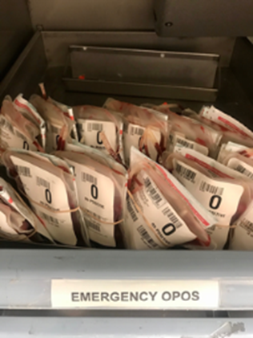
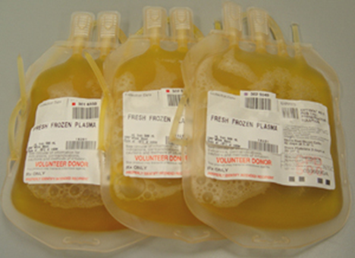
MTPs and products
What everyone is doing:
RBCs
Cold stored
Probably O pos or O neg
Usually, first cooler is uncrossmatched
Thawed plasma
Cold stored
May or may not come in first cooler
Depends on if blood bank has thawed plasma
Apheresis platelet- room temp product
Examples:
2 Rbcs, 2 plasmas
4 Rbcs, 2 plasmas, 1 plt
6 Rbcs, 6 plasmas, 1 plt

Slide 11
“Paradigm Shift”
Emergency-release uncrossmatched blood
O-

Slide 12
Why the shift?
ABO Type | Rh Type | How Many Have It
O | Positive | 37.4%
O | Negative | 6.6%
A | Positive | 35.7%
A | Negative | 6.3%
B | Positive | 8.5%
B | Negative | 1.5%
AB | Positive | 3.4%
AB | Negative | 0.6%
<7% of the US population is O Rh Negative…
In 2013, 8.6% of all RBCs transfused in the US were O negative…
In 2015 it was 10.2% In 2017, it was 11.2%
In 2019….??
The 2014-2015 AABB Blood Collection and Utilization Survey Report, AABB 2018
Sapiano MRP, et al. Supplemental findings of the 2017 National Blood Collection and Utilization Survey. Transfusion 2020;60;S17–S37
Notes:
Over 600 hospitals respond in the NBCUS…

Slide 13
Why is this happening?
Reasons for ↑ Demand:
Massive transfusion protocols
Remote blood refrigerators
EMS carrying blood on helicopters
Overall usage of O Rh Negative RBC
Reasons for ↓ O Neg Supply:
Donor fatigue; committed people opt out of donation following repeated donation requests
Mitigation strategies or requirements related to donor iron stores may further impact donor eligibility
An aging donor base that continues to erode existing donor pools
Beckman N, Yazer M, Land K, et al. Transfusion Medicine 2016;26:170–176.
Notes:
Overall usage of O Neg —BB staff are uncomfortable with lower inventory levels, but also do not want to waste this precious donation. This causes a cycle of over-stocking, utilizing for non- O Neg patient as O Neg becomes short dated and ordering more to replace.
Aging population – individuals aged 65 or older is projected to increase from current 15% of total population to 20% of population by 2030.

Slide 14
Benefits of using O positive RBCs
~85% of the population is Rh+
Only ~7% of the population is O-
By using O+ RBCs for MTPs and traumas, we save O- units for those who truly need them
Recent studies have shown the rate of alloimmunization to D in this situation is between 20-30%
My own experience in trauma and MTPs:
26 Rh negative patients with MTP activations in 2019-2020
17 (65%) received Rh positive RBCs
1-79 units
8/17 had follow-up type and screens
No anti-D alloantibodies seen

Slide 15
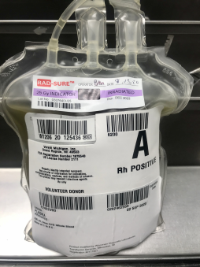
What other blood products are available?
Liquid plasma
Only approved for use in bleeding pts
Has a long shelf-life
Avg 26 days vs 5 days for a thawed plasma
More and more blood banks are bringing in
Decrease wastage and outdates

Slide 16
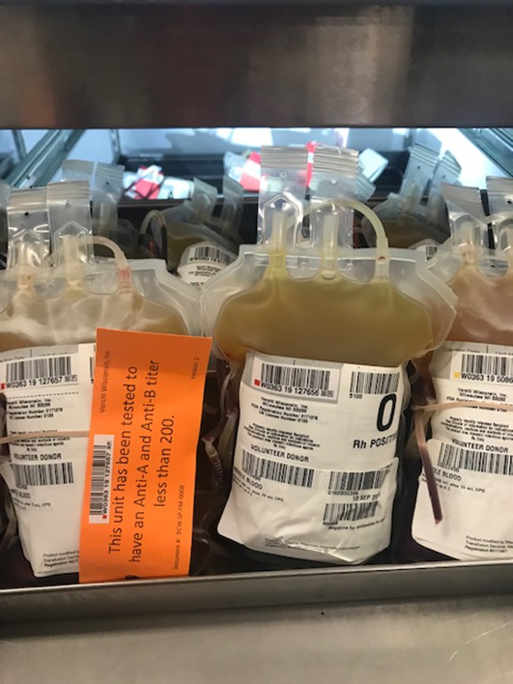
Low titer O whole Blood (LTOWB)
500 mL
Good for 21 days
Can be Non-leukoreduced or Leukoreduced
Titer for anti-A and B must be done
Contains RBCs, plasma and plts
Used in MTPs often trauma pts

Slide 17
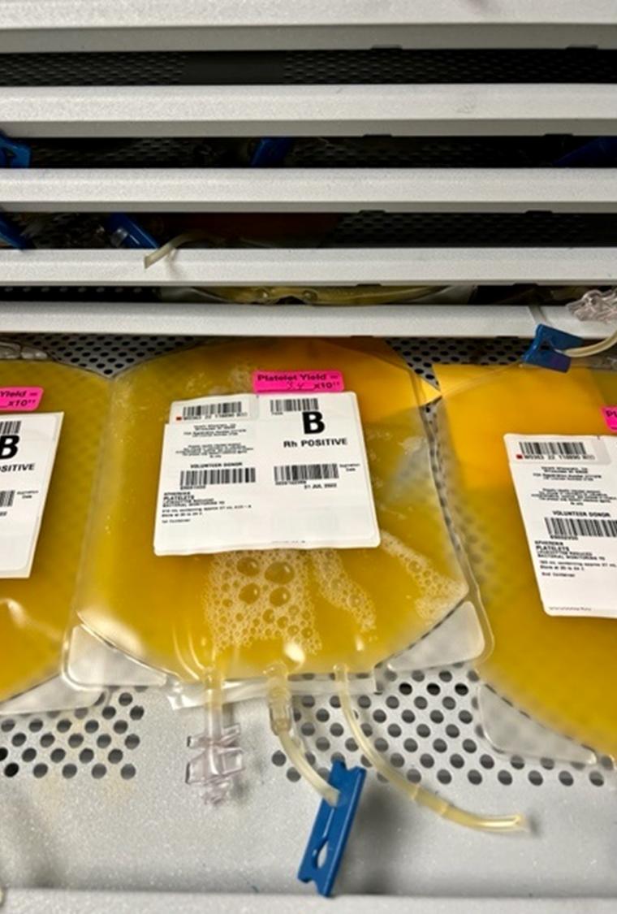
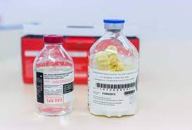
Future products for trauma
Cold stored platelets
Plts put in the fridge
Work really well at stopping the bleed
Not so good for prophylactic transfusions
3 day shelf life!
Room temp plts have 5-7 days
Spray dried or Freeze-dried plasma
Currently not available in the US
Goal at least 1 year shelf life not in a fridge
Reconstitute when needed
In field or hospitals

Slide 18
Let’s talk about blood donation….

Slide 19
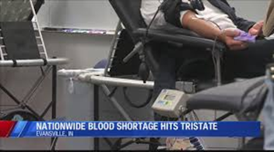
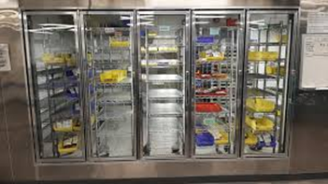
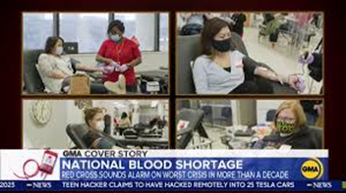
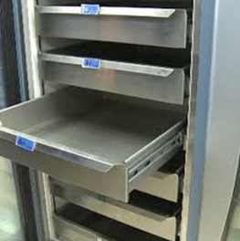
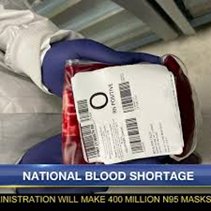
Ripped from the headlines

Slide 20
Importance of blood donation
There is NO substitute for blood
Many attempts
None successful
Rely on volunteer donors
Not paid
Change in the 1970’s which dramatically dropped rate of Hep B and C transmission by blood transfusion
Only ~3% of eligible people donate blood
13.6 million units
Most dedicated donors are aging out

Slide 21
Frequency of Blood Types
AB Neg .06%
B Neg 1.5%
AB Pos 3.4%
A Neg 6.3%
O Neg 6.6%
B Pos 8.5%
A Pos 35%
O Pos 37%

Slide 22
What can be done?
Blood suppliers:
Optimizing blood donor participation
Studying and addressing issues such as motivating younger and more diverse donors
Increasing access for donors
Recruiting and requalifying donors previously deferred for various reasons that have been determined to no longer improve blood safety
Hospitals/Customers/Community
Hosting blood drives
Thousands of drives have been canceled due to the pandemic
Good percentage of donations Fall-Spring are from high schools and colleges
Encouraging family members to donate
Allowing employees time to donate at hosted drives

Slide 23
Importance of communication
Any potential changes need to be communicated to your blood bank and in turn the blood supplier
Lessons learned from COVID, blood supply doesn’t do well with the sharp ups and downs.
Blood is not instantly available

Slide 24
Versiti by the Numbers:
600,000+
5th
13,000
310,000
donations collected annually
largest blood provider in the US
community blood drives annually
annual donors
650,000+
1,750,000+
2,200
110,000
donations tested annually
Products delivered
staff
genotyped donors across Versiti
Notes:
Donations include blood, plasma, platelets, specialty products like granulocytes.
Products include: pharmacy, blood products, (diagnostic and donor) tests, organ and tissue
We have the worlds largest genotyped library of over 110,000 donors – which means we are better positioned to match patients that need a special blood product than anyone else in the world. Hospitals and researcher around the world know who we are.
Larger blood providers are Red Cross, Vitalant, One Blood, NY
People – blood donors, staff, drive hosts, volunteers

Slide 25
Community Disaster – blood bank perspective
Waukesha Parade
Patients went to multiple hospitals which were all served by one blood supplier
Many of those blood banks had one staff member working
Extra staff and managers were called in
Extra group O RBCs, plasma, and platelets needed to be brought in
Used Milwaukee County Sheriff to deliver blood from Versiti
Afterward, huge outpouring from the community for blood donation
Centers stayed open late
Tried to spread the donations out over days and the next week

Slide 26
Thanks for your time and attention!
Questions?

Slide 27
References
AABB Technical Manual, current edition
AABB standards, current edition
Baraniuk S, Tilley BC, del Junco DJ, Fox EE, van Belle G, Wade CE, Podbielski JM, Beeler AM, Hess JR, Bulger EM, Schreiber MA, Inaba K, Fabian TC, Kerby JD, Cohen MJ, Miller CN, Rizoli S, Scalea TM, O'Keeffe T, Brasel KJ, Cotton BA, Muskat P, Holcomb JB; PROPPR Study Group. Pragmatic Randomized Optimal Platelet and Plasma Ratios (PROPPR) Trial: design, rationale and implementation. Injury. 2014 Sep;45(9):1287-95. doi: 10.1016/j.injury.2014.06.001. Epub 2014 Jun 10. PMID: 24996573; PMCID: PMC4137482.
Sperry JL, Guyette FX, Brown JB, Yazer MH, Triulzi DJ, Early-Young BJ, et al. PAMPer Study Group. Prehospital Plasma during Air Medical Transport in Trauma Patients at Risk for Hemorrhagic Shock. N Engl J Med. 2018;379:315–26.
Pollack W. et al. Studies on Rh prophylaxis II. Rh immune prophylaxis after transfusion with Rh-positive blood. Transfusion 1971;11:340-344.
Gonzalez-Porras JR. et al. Prospective evaluation of a transfusion policy of D+ red blood cells into D- patients. Transfusion 2008;48:1318-24.
Meyer E. and Uhl L. A case for stocking O D+ red blood cells in emergency room trauma bays. Transfusion 2015;55:791-795
Yazer MH et al. It is time to reconsider the risks of transfusing RhD negative females of childbearing potential with RhD positive red blood cells in bleeding emergencies. Transfusion 2019;59:3794-3799.

