Slide 1
Not a drill! The truths of an mci during the pandemic!

Slide 2
CITY OF WAUKESHA CHRISTMAS PARADE MASS CASUALTY RESPONSE
Downtown Waukesha
November 21, 2021

Slide 3
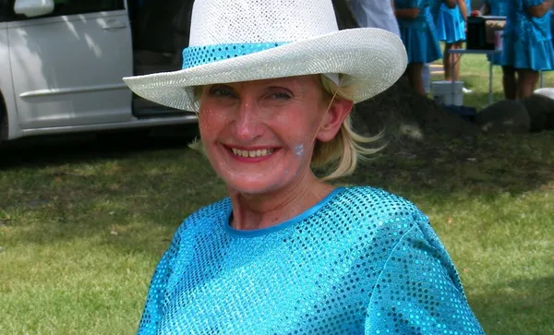
We Start By Remembering
Jackson Sparks
Jane Kulich
Virginia 'Ginny' E. Sorenson
Wilhelm “Bill” Hospel
Tamara L. Carlson Durand
Leanna “Lee” Owen
All those that lost a little bit of innocence that day, the Injured, the Parade Participants, Parade Goers, Responders, Our Greater Waukesha Community, and the World that witnessed this senseless act.

Slide 4
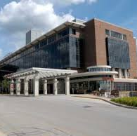
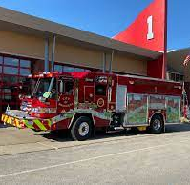
Topics/objectives
Overview of Parade Event
The Attack
Waukesha Fire Department
Response
Successes
Areas of Learning
Waukesha Memorial Emergency Department
Managing flow of patients during mci
Communication in high stress
Tunnel vision

Slide 5
58th Annual Christmas parade “comfort and joy”
4 pm-6 pm
67 Groups/Entities Registered
Weather
Temperature: approximately 25 degrees
Wind Speed: 15-20 mph
Parade route approximately 1 mile
Approved event with WKPD IAP
People in position

Slide 6
The attack approximately 1635 hours
Road initially wide open, but narrows

Slide 7
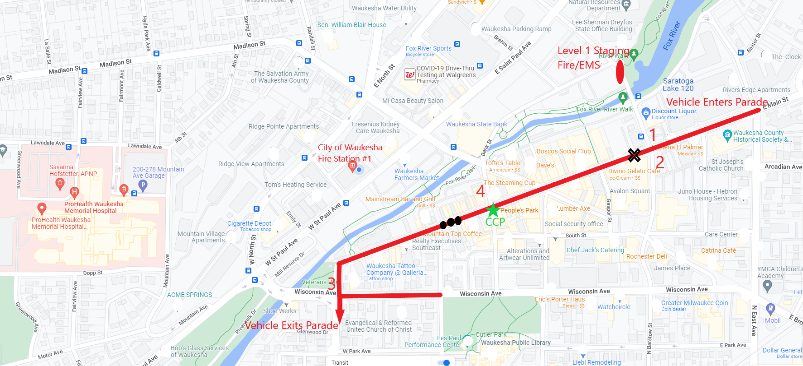
Waukesha fire department response
- Engine 1 returned from parade detail (Aware of possible man with a knife incident at Frame Park)
- Dispatched for Unknown Problem
- Then updated vehicle vs. pedestrians at the Christmas parade
- Dispatch sends tone for “Unknown Problem” to all stations
- Active shooter?
- 26 firefighters on duty
- Deployed from 5 fire houses (3 Engines, 2 Trucks, 5 Ambulances)
- Moments later : police radio : “many people down likely dead.”
- PD/RO alerts dispatch of multiple injured at parade.
5

Slide 8
Managing the incident
Waukesha fire department response
Implementation of ICS early in incident
Ems challenges:
Overcoming fleeing parade-goers
Determining type and extent of incident
A report of shots fired at the incident-active Shooter?
Recognition of mass casualty
Casualty field extended approximately 0.4 miles
Triage patients: large crowd, cold weather
Medical treatment
Psychological Challenge: Pleading families (sick, not as sick, scared, dead)
5

Slide 9
Managing the incident
Waukesha fire department response
Casualty Collection Point (CCP) Established
Off-duty WFD Battalion Chief assumed control of CCP
Transportation officer established
EMS liaison established at wmh
Mutual aid activation (First and Second Alarm)
off-duty police, fire, doctors, and nurse’s assisted
Additional ems challenges:
Power outage in downtown due to high winds
Street with multiple injured now completely dark
Unrelated to tragedy : or was it?
5

Slide 10
Chronology of incident
1638
Call entered in CAD
1639
E1 and A51 dispatched for Unknown Problem
1639
B10 upgrades assignment Station 2 and A54 based off report of Vehicle vs Pedestrians at parade
1640
B10 upgrades to all available units
1642
Station 1 on scene, 27 seconds later B10 arrives and establishes Command
1646
MABAS Life Safety Box alarm requested
1655
A54 transports 1st patient
1702
Chief 2 arrives on scene and assigned Transport Officer
1704
Incident upgraded to MABAS Life Safety 2nd Alarm
1713–1740
Multiple transports to multiple hospitals

Slide 11
Lessons learned-successes
Command and control of incident
Stay disciplined to Process/objectives in the presence of emotional appeals
Priority placed on triaging casualty field
Mass casualty principles applied
Casualty collection point established
Early request for additional resources/distribution of resources
MABAS 2nd Alarm Life Safety
Transportation officer-Patients distributed to various hospitals
Area hospitals quickly prepared for Mass Casualty
EMS-Hospital Liaison assigned by IC

Slide 12
Lessons learned-successes
Off-duty 1st responders and medically trained staff available to assist
Personnel aided by civilians to assess and psychological support patients(***neighbors helping neighbors)
Continual training on mass casualty plan (WFD refreshed within 60 days as part of CE)
Addressing mental health of responders and civilians

Slide 13
Lessons learned-challenges/areas of improvement
Intangibles:
Difficulty assessing mass casualty field due to:
cold weather
large volume people
Emotional pleas of bystanders to help their “person”/pediatric patients
Quantifying victims- removed from weather and chaos, and taken inside near-by buildings
Implementing mass casualty triage equipment
Current Triage Tagging and Trauma Bag Employment
Limitation of supplies- emphasize responding ambulances to dump supplies before departure from scene
Law enforcement transport of patients
Impact to closest hospital that EMS also will use

Slide 14
Lessons learned-challenges/areas of improvement
Limitations of technology for documentation of patient information and care
Following the incident, completing documentation with limited information due to HIPAA compliance
Providing accurate information in a timely manner
Impact of social media

Slide 15
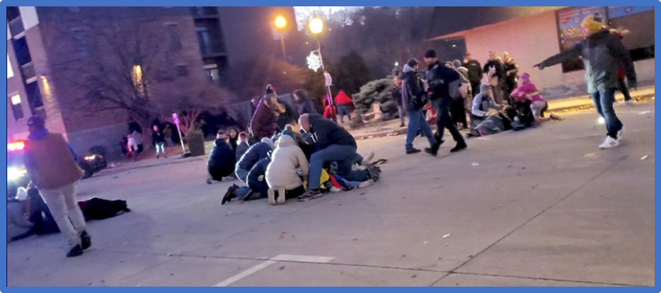
Hospital overview

Slide 16
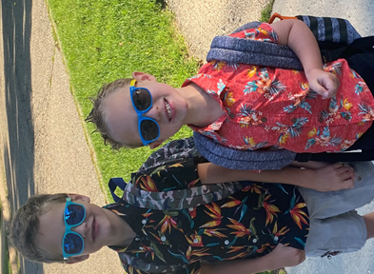
Life Changing phone call
Where is your MCI equipment ?
Where are you going to put patients?
How many traumas can your hospital handle?
What are you going to put them on?
Who is going to care for them?
Hospital resources at that moment.
How will you emotionally handle this situation?
How will your co workers handle it?
Where are your loved ones?
Notes:
Synopsis of the life changing phone call and having a short amount of time to prepare.
Want you all to close your eyes. ….talk about the feeling and thoughts of that phone call (2 min) , now open your eyes….. We will cover how to get through this and with the best outcomes.

Slide 17
First critical steps
Huddle (tell your staff)
Phone calls
Activating MCI protocol and send word now
Expedite dispositions on patients/boarding patients
More equipment and people
MCI stations, green, yellow, red, black
Staff assignments, knowing your staff strengths/ weaknesses
Hold on tight.
Notes:
Huddle -This will be bad, find a patient, hold pressure, stop the bleeding, and stay with that one patient until they are discharged. That is all you have to do!
Equipment – bandages, gauze, splints, tourniquets, wheelchairs, blood pressure machines, pulse ox, beds, and ect.
Boarding patients out of the ED, phone calls, mobilizing MCI set up, delegating staff assignments, more equipment, more staff initially.
Wheel chairs, beds, chairs. Had a tech grab a bin and through gauze, wraps and splinting for initial trauma intervention in the ambo bay and then had another tech do a bin for the main triage areas.

Slide 19
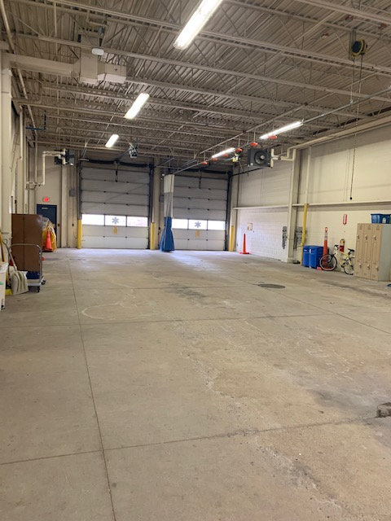
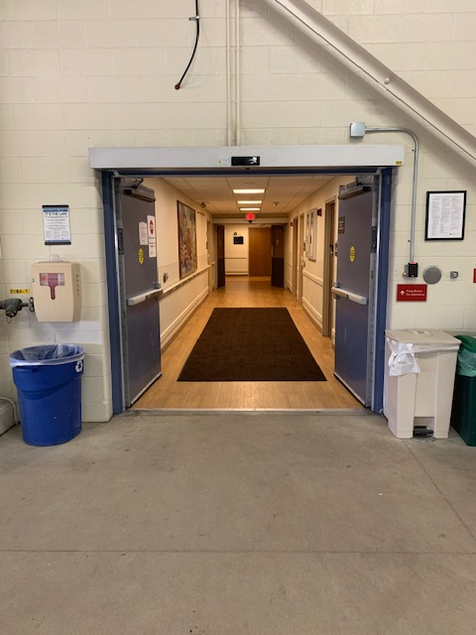
Midst of chaos
These are pediatric trauma patients!
Many of them needed rapid intubation
PHARMACIST RESOURCE/RSI MEDS
Self presenting
PD presenting
EMS presenting
More staff arriving
More family members arriving
Notes:
Approx. 6 minutes after the first phone call first patient arrived. Total of 11 pediatric trauma arrive in 13 minutes; 10 out of the 11 were head bleeds and 5 needed RSI upon arrival.
Obstacles, there were tons of people who started to arriving. Trying to see who was a patient/ injured verses family or staff. Staff coming in, were in street clothes or with family members.
Flow of patients- funneled through the ambo bay and tagged there (1 entrance is KEY!!), then moved either to a bed, which is red, or into the green or yellow which was our main triage area. Black was in the deacon room.
MCI closet was out of date. Wrote on paper, Green, yellow and put them in the areas we wanted those patients.
Fanny packs with color tagging bands work great for initial, and then patient gets banded in secondary triage or by registration.

Slide 20
Chronology of incident
1640/1641
ED Staff at parade calls in with “heads up”
1651
Active Shooter Alert
1655
ED Leadership arrives to ED
2000
All Clear Message sent to staff/leadership
2045
Incident Command Terminated
1638
Call entered in CAD
1639
E1 and A51 dispatched for Unknown Problem
1639
B10 upgrades assignment Station 2 and A54 based off report of Vehicle vs Pedestrians at parade
1640
B10 upgrades to all available units
1642
Station 1 on scene, 27 seconds later B10 arrives and establishes Command
1646
MABAS Life Safety Box alarm requested
1655
A54 transports 1st patient
1702
Chief 2 arrives on scene and assigned Transport Officer
1704
Incident upgraded to MABAS Life Safety 2nd Alarm
1713–1740
Multiple transports to multiple hospitals
1647 - 1700
First Patient arrives with PD, Total of 11 pediatric trauma arrive in 13 minutes
1700
Active Shooter Updated – ALL Clear
1720
Hospital Incident Command up an running
1747
26 MCI patients triaged/treated in the 1st hour
Notes:
How much can you get done in 6 minutes?
First 5-30 minutes with only typical staff (3 MD’s *(we had 4), 2 PA’s, 10 RNs (we had 11 + 2 on orientation), 5 techs (+2 on orientation), 2 HUCs
Security, house supervisor, send word now, using in house staff in crisis circumstance. Ex anesthesiology, extra CNAs, ICU RNs and registration.
Lock down due to active shooter alarm
Some equipment was delayed due to active shooter alarm going off, doors locked and staff upstairs were to remain on units.
Food for thought- every MCI the extra staff coming in takes at least 20-60 min to arrive, knowing what your resources are before they get there is essential.

Slide 21
Staying in tune
Combating tunnel vision
Tunnel vision impairs hearing
Tunnel vision = missing key facts
Communication
Situational awareness
PLEASE BREATHE!!!
Notes:
Show of hands who has ever had tunnel vision.
Simple statements, when communicating in high stress environments. Asking if they understand!
Situational awareness, mindfulness, breathing, observing, and going back to your training. Keep assessing the situation.
Tunnel vision = missing key facts
It will also impair your hearing and vision.

Slide 22
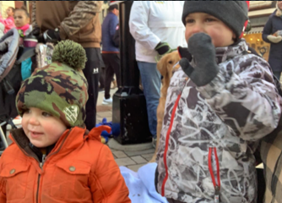
Are we caught up?
Where did all the patients go?
Who’s left in triage
Admitted
Discharged
Transferred
WOW we have a lot of staff here
Is it time to cut staff
Not until…
Documentation
Take a moment to review your charts
Your staff that is working the rest of the shift has time to take a break and process
What about tomorrow?
Empathy
Notes:
We were already caught up but EPIC still had 12 names on the board in triage – Key role: nonclinical (PSR) at the door to check pts out that leave without being seen. Once you have the staff available have someone work with the PSR so you can accurately remove patients from the track board.
Admit – 5
Discharge –17
Transfer – 11 *THIS was key in our success. The relationship we had with CHOW. Directly line was set up almost immediately to call report/set up critical transfers. We also had ambulances on standby near our ambo bay ready for transports. This was chaotic at first, ended up with more than needed but it worked. *Having Radiology and ED MD in CT was key to quick reads and dispos.
In total we saw 36 patients at PHC the day of or day after directly linked to the MCI.

Slide 23
Process improvement
Almost too many staff. Not enough jobs for everyone. What if the MCI went on for an extended period of time
COMMUNICATION! Incident Command, ED Command Desk, Scene, and Triage Area
Create a disaster cart/bin with SALT triage supplies (tags, colored signs for triage areas), paper, pens, etc.
Create a form to track patient transfers
Review and update the ED’s surge/disaster plan and Job Action Sheets
Better way to identify staff, visitors and patients. It was difficult to know who was who walking around the E.D.

Slide 24
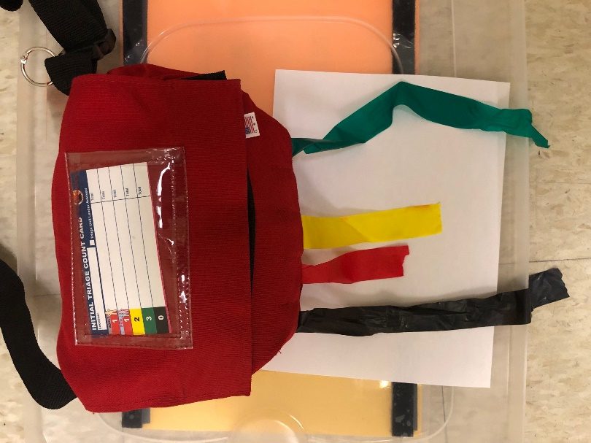
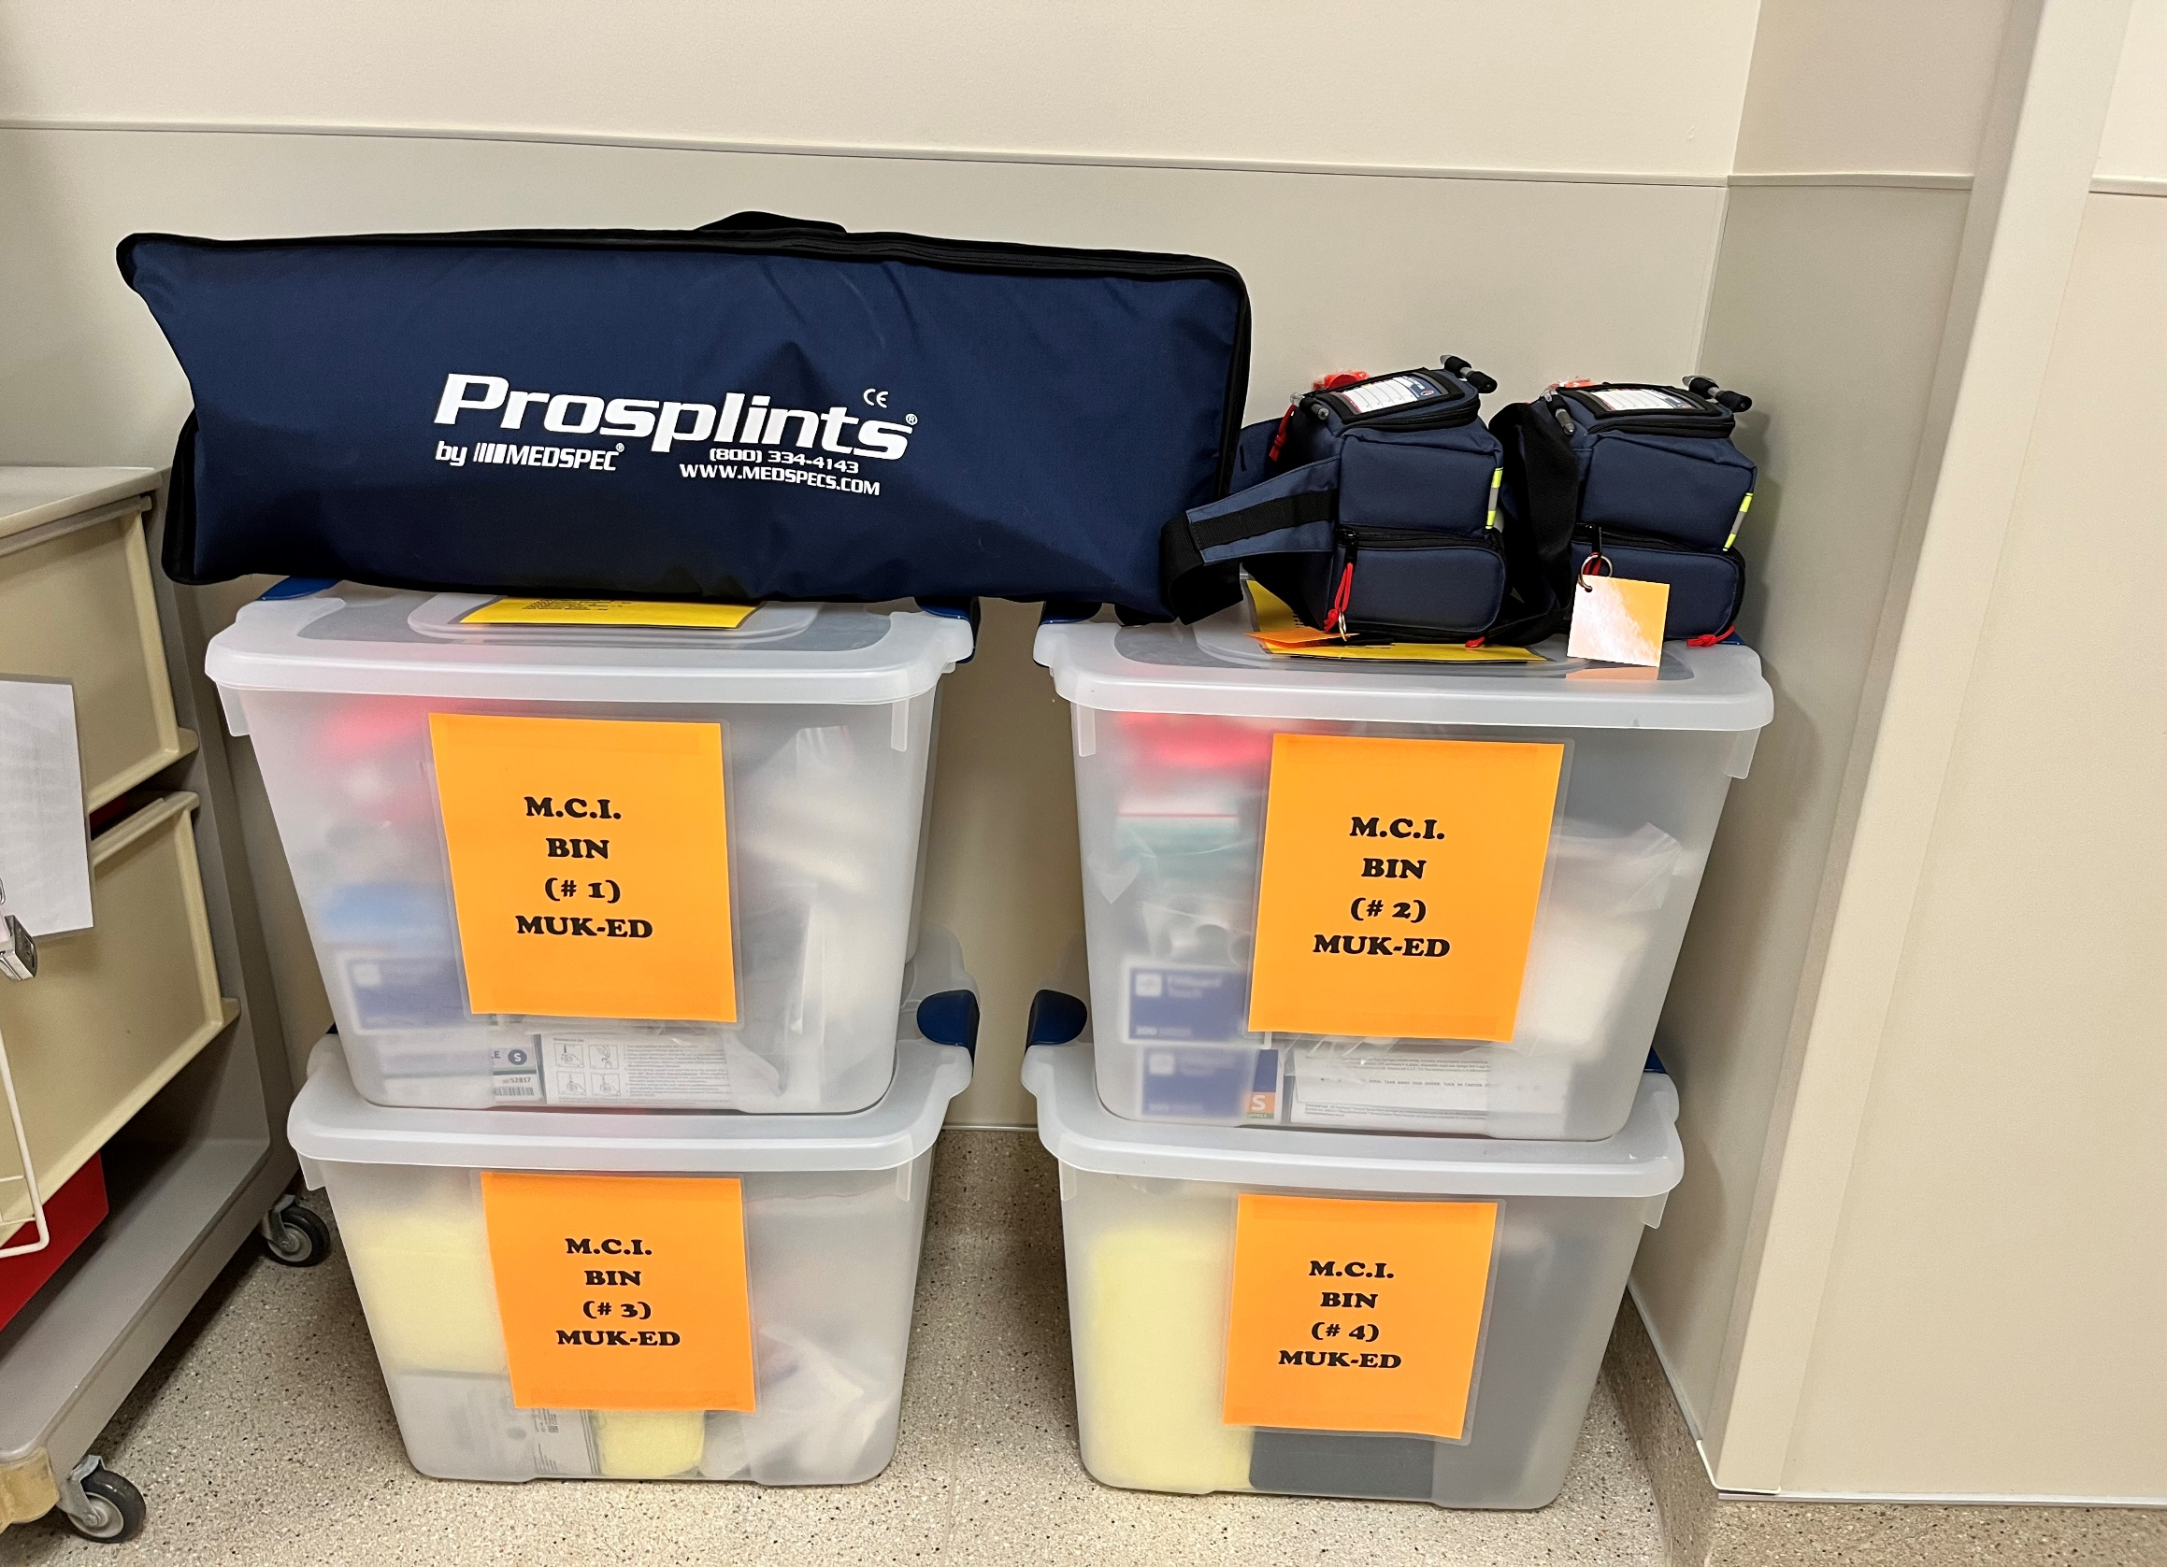

Slide 25
Summary-Lessons learned
Importance of good leadership making good and quick decisions
Early request for additional Resources
Stay disciplined to process despite chaos/distractions
Impossible to simulate all intangibles-need good training and decision making in real time
Importance of good communication
Do not underestimate significant stress/mental health issues

Slide 26
Questions?
Thank you for attending

