Slide 1
GENDER PAY GAP REPORT
2024
REIVER

Slide 2
At REIVER, gender equality isn’t a reporting exercise, it’s how the business has been built from day one.
Our 2024 gender pay data shows a 0% median gender pay gap, reflecting equal pay at the heart of the organisation, and continued progress in a sector that has historically lacked balance. Women are fully represented at the highest pay quartile, and gender distribution across the wider business remains even, reinforcing our belief that opportunity should never be limited by gender.
We don’t operate a bonus scheme, ensuring transparency and consistency in how people are rewarded. Where pay differences exist, this reflects a small number of specialist roles where external market rates apply.
Crucially, our focus extends beyond pay. From leadership to coaching roles, we are actively building diverse teams in areas where representation has traditionally been narrow. That’s how lasting change happens, by shaping the future pipeline, not just the current snapshot.
We chose to publish our gender pay data voluntarily because we believe openness drives accountability, and accountability drives progress, not just for REIVER, but for the industry as a whole.
“Real progress comes from changing who gets access to opportunity. Pay parity matters, but representation is where the future is shaped.”
REIVER

Slide 3

CLARITY ON OUR CALCULATIONS
The mean gender pay gap is the difference in the average hourly pay for women compared to men, within a company.
MEAN GENDER PAY GAP
With regards to the findings in this report, we have calculated REIVER’s gender pay gaps using the methodology as required legislatively for publishing gender pay gaps.
It is also worth noting that whilst we are not required to report our gender pay figures, we chose to. Simply because it’s the right thing to do.
MEDIAN GENDER PAY GAP
The median represents the middle point of a population. If you lined up all the women in a company and all the men,
the median pay gap is the difference between the hourly pay rate for the middle woman compared to the middle man.
MEAN BONUS PAY GAP
The mean bonus pay gap is the difference between the bonus earnings for women compared to men who received a bonus, within a company
MEDIAN BONUS PAY GAP
The median bonus pay gap is the difference between the midpoints
in the ranges of bonus earnings for women compared to men who received a bonus, within a company
REIVER

Slide 4
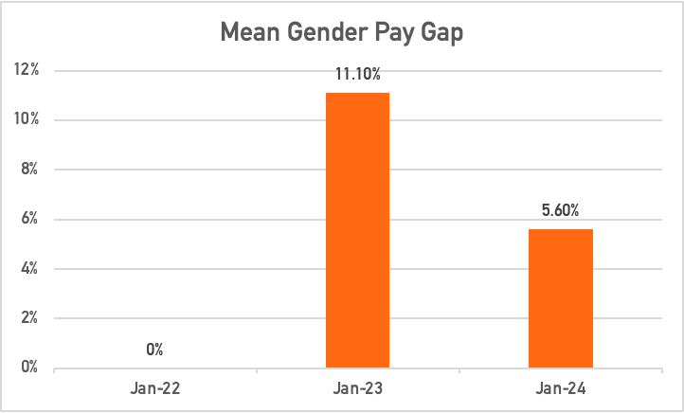
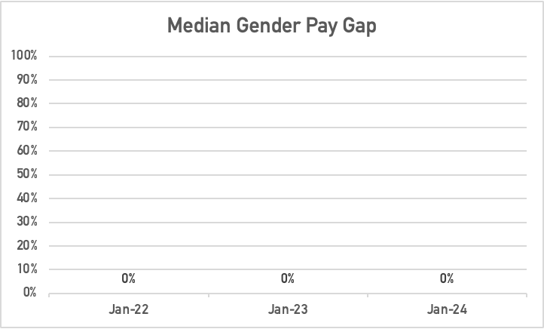
REIVER’S OVERALL PAY GAP DATA
Mean Gender Pay Gap | 2024 | 5.6%
 | 2023 | 11.1%
 | 2022 | 0.0%
Median Gender Pay Gap | 2024 | 0.0%
 | 2023 | 0.0%
 | 2022 | 0.0%
REIVER

Slide 5
REIVER’S OVERALL BONUS PAY GAP
We do not operate a bonus scheme across our business.
As such, there is no data to report as no individual received a bonus payment.
REIVER

Slide 6
EMPLOYEE REPRESENTATION ACROSS THE BUSINESS
However, for us, gender equality is more than just pay. It’s about ensuring there is an equal opportunity for everyone regardless of their gender. As such we are proud of our leadership and coaching gender split. Two metrics that have been historically underrepresented in the industry,
In line with our pay philosophy, all roles at REIVER are paid the same, regardless of the individual incumbent. As a result this gives us a very clean split of gender pay. The exceptions to this being individual roles where market forces drive a higher level of pay.
Due to the size of our workforce, quartile data should be interpreted as directional rather than statistically representative.
Role | % of male employees | % of female employees
Leadership Team | 66% | 33%
Coaching Team | 50% | 50%
Upper pay quartile | Male | 0%
 | Female | 100%
Upper-middle pay quartile | Male | 100%
 | Female | 0
Our pay outcomes are a direct result of the choices we make earlier in the talent pipeline — by building balanced entry pathways, developing diverse coaching capability, and promoting equitably into leadership, pay parity becomes an outcome of structure rather than a corrective action.
Lower-middle pay quartile | Male | 50%
 | Female | 50%
Lower pay quartile | Male | 50%
 | Female | 50%
REIVER

