Slide 1
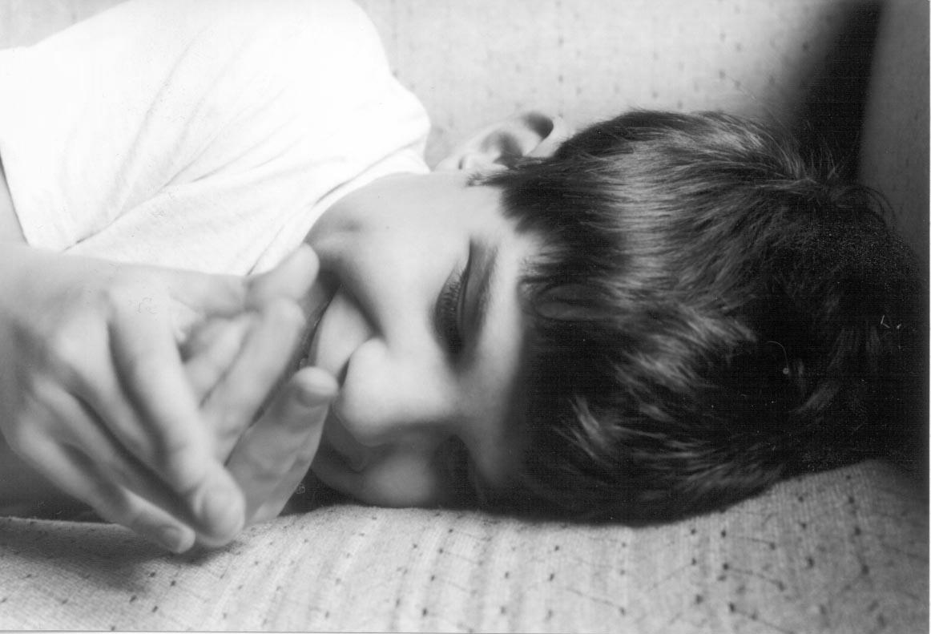
Understanding Behavior in CHARGE Syndrome
Timothy S. Hartshorne, Ph.D.
Central Michigan University

Slide 2
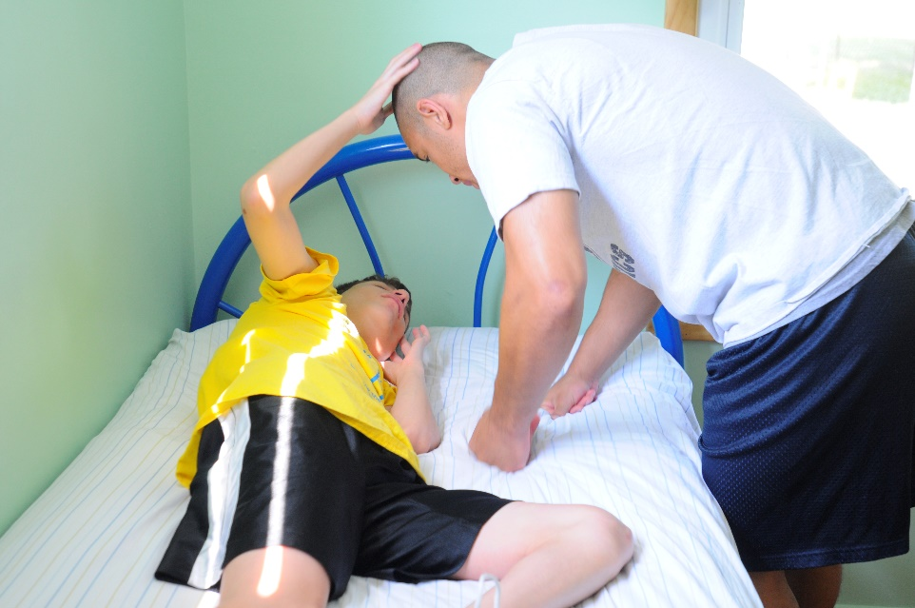
Essential Understanding
All behavior has a purpose.
All behavior is communication.
Once you understand the purpose of the behavior, and recognize what it is telling you, the behavior often makes sense.

Slide 3
The Big Three
PAIN
SELF-REGULATION
SENSORY ISSUES
ANXIETY

Slide 4
The Big Three
PAIN
SELF-REGULATION
SENSORY ISSUES
ANXIETY

Slide 5
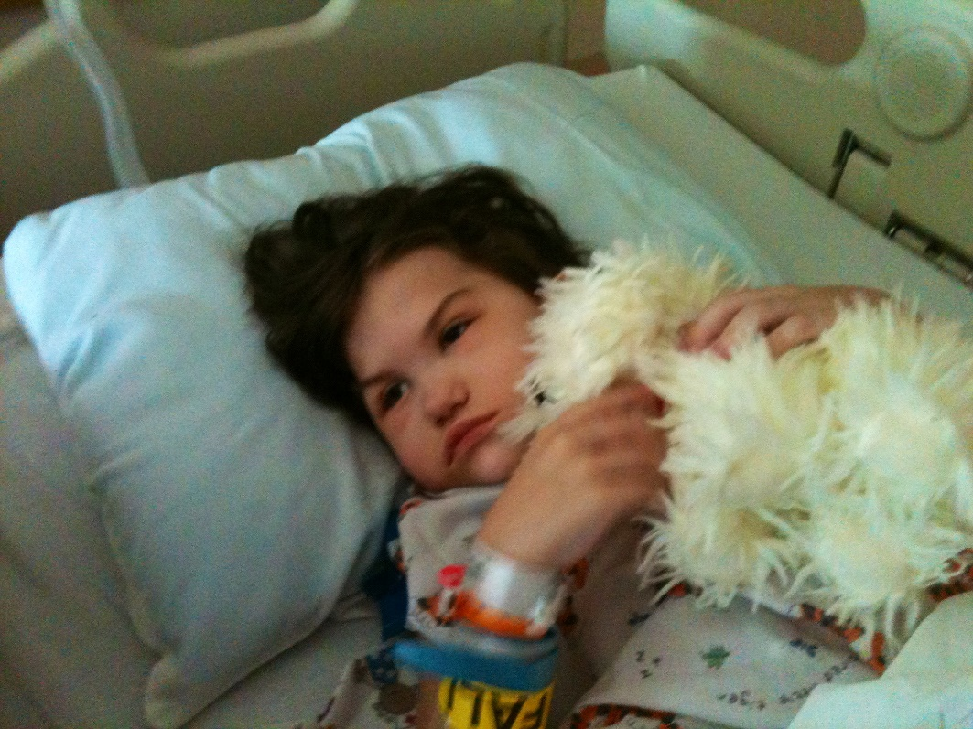
Always consider pain first
The myth of the high pain threshold
The reality of high pain tolerance

Slide 6
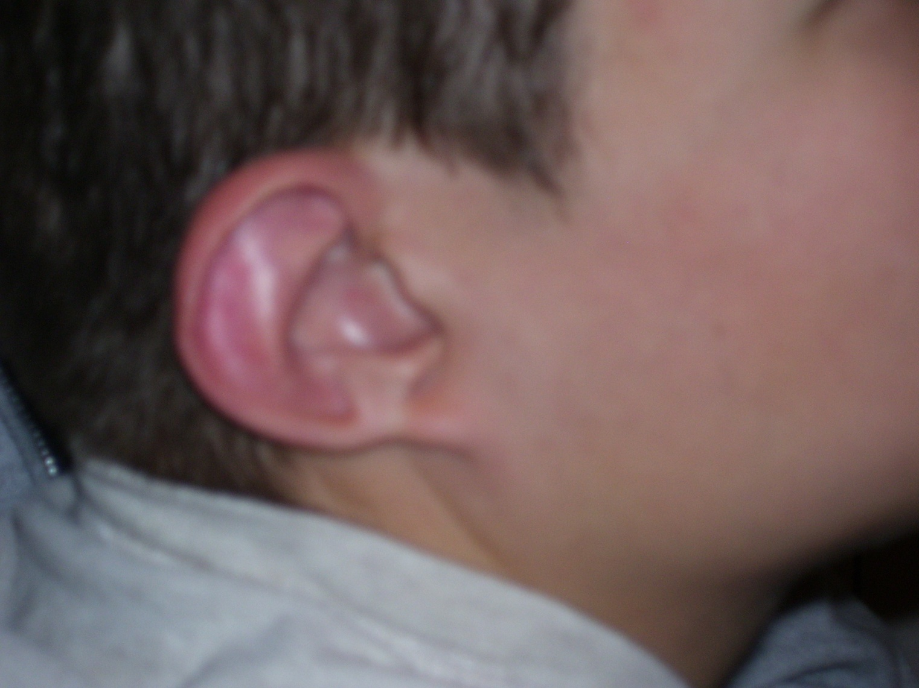
Pain: Jacob’s ear

Slide 7
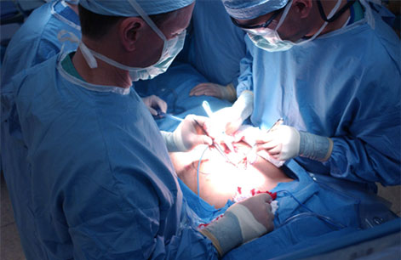
Possible sources of pain
Illness
Surgery
Procedures
Doctor visits
Syndrome “related” pain

Slide 8
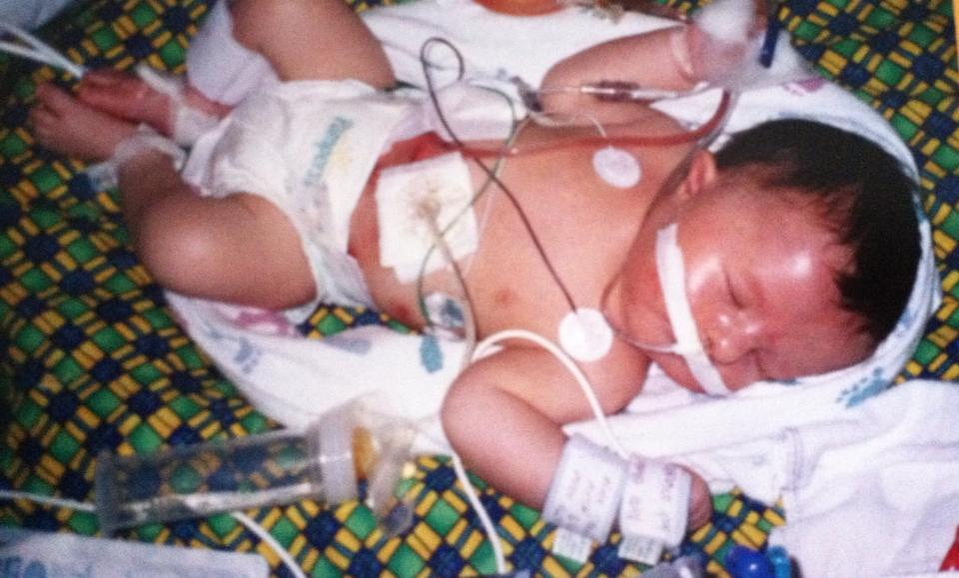
Sources of Pain in CHARGE
Otitis Media¹
Sinus infections
Migraines¹
Abdominal Migraines^{1,2}
Gastroesophageal reflux disease (GERD)²
Gas
Constipation^{1,2}
Muscle pain²
Tactile defensiveness
Stoma pain
Oral pain/teeth
Surgery¹

Slide 9
Why pain is so important
Can affect normal brain and neurological development
Can affect sleep
Can interfere with exploration of the environment and learning
Can interfere with the development of attachment and trust
Once tolerated may be ignored even while it is affecting health and behavior
Is communicated through behavior

Slide 10
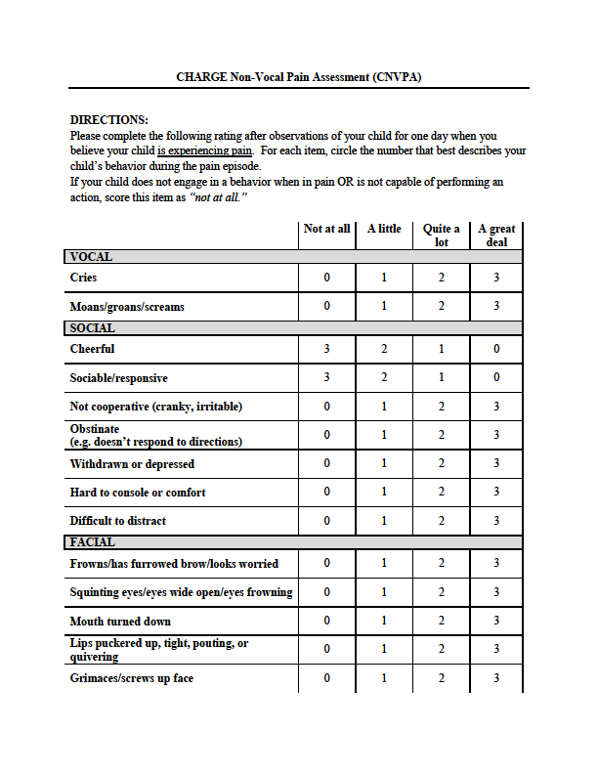
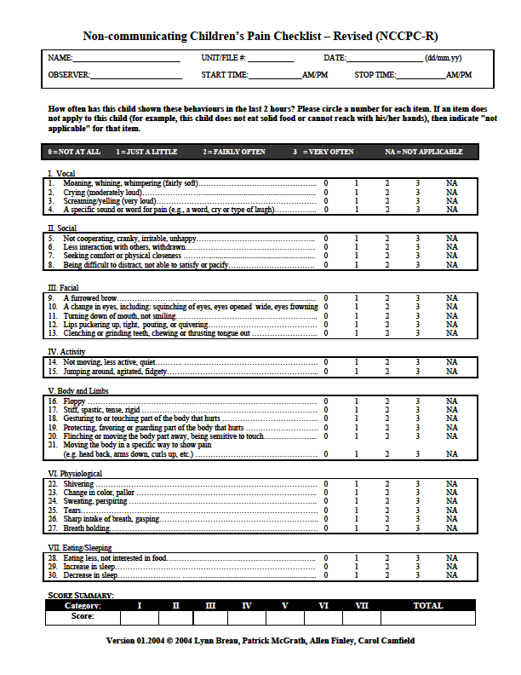
Check for Pain First
Non-communicating Children’s Pain Checklist – Revised (NCCPC-R)
Pediatric Pain Profile
CHARGE Non-vocal Pain Assessment

Slide 11
The Big Three
PAIN
SELF-REGULATION
SENSORY ISSUES
ANXIETY

Slide 12

Sensory Deficits
Hearing – sensorineural hearing loss
Vision – coloboma
Smell – anosmia
Taste – prefer strong tastes
Tactile – defensiveness
Vestibular – balance issues
Proprioceptive – awkwardness

Slide 13
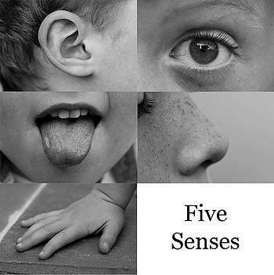
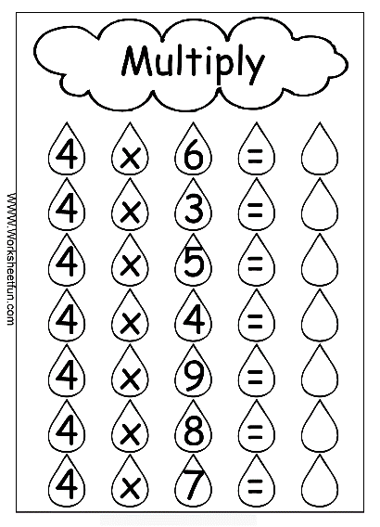
Multi-sensory impairment
The loss of each sensory system multiplies the impact on the child and the child’s development
Which sense would you be willing to dispense with?

Slide 14
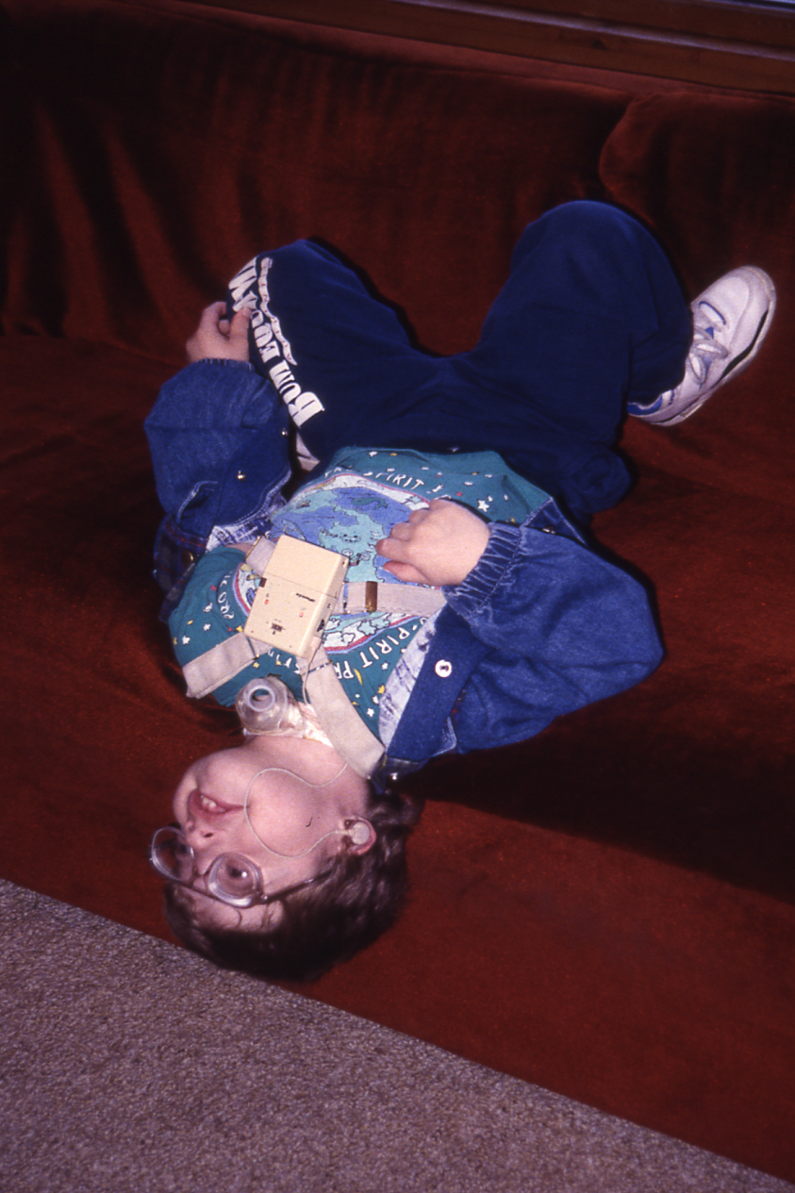
This is normal viewing posture…
…when you have no vestibular sense, upper visual field loss, poor tactile & proprioceptive perception, & low muscle tone.

Slide 15
Sensory Issues
Missing, partial, distorted, fragmented information
Over-sensitivity or Under-sensitivity
Processing time may be longer
Confusion & the need for consistency & predictability
Idiosyncratic behaviors & misinterpretation
Movement and postural differences
Communication issues (receptive & expressive)
Developmental delay
Fatigue

Slide 16
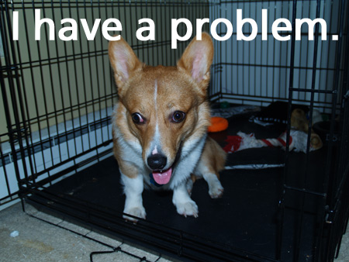
When it fails to coordinate
When information does not get into the brain properly
When the brain fails to correctly interpret the information
When the brain cannot sort out information from different sensory systems
When the brain over-reacts or under-reacts to sensory input
THERE IS A PROBLEM

Slide 17
The Big Three
PAIN
SELF-REGULATION
SENSORY ISSUES
ANXIETY

Slide 18
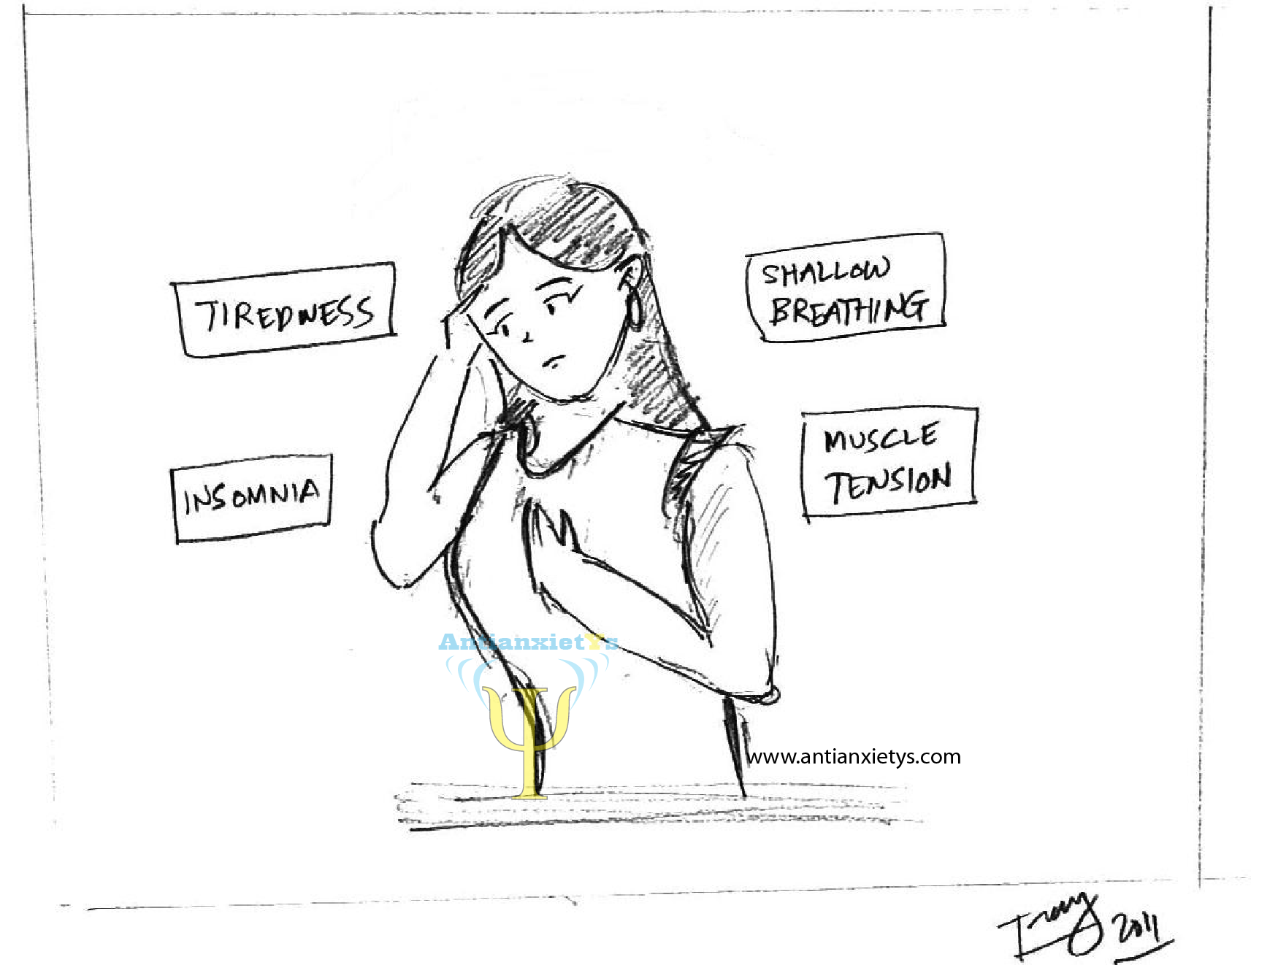
Anxiety
“A feeling of worry, nervousness, or unease, typically about an imminent event or something with an uncertain outcome.”

Slide 19

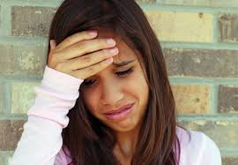

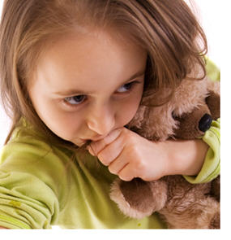

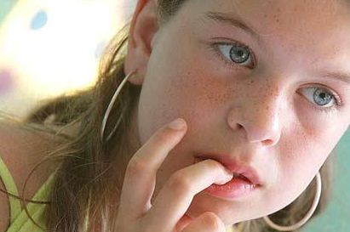
What does anxiety look like in children?

Slide 20
*Pessimism and negative thinking patterns
*Anger, aggression, restlessness, irritability, tantrums, defiance
*Constant worry about things that might happen or have happened
*Crying
*Physical complaints such as stomachaches, headaches, fatigue
*Avoidance behaviors
*Sleeping difficulties
*Perfectionism
*Excessive clinginess and separation anxiety
*Procrastination
*Poor memory and concentration
*Withdrawal from activities and family interactions
*Eating disturbances
http://www.kathyeugster.com/articles/article004.htm

Slide 21

One difficulty is that the same behavior can reflect different experiences
Sleep problems
  Pain
  Circadian rhythm and melatonin problems
  Self-regulation issues
  Anxiety
Tantrums
  General complaints
  Frustration and Anger
  Pain
  Anxiety

Slide 22

Things to be anxious about
Novelty
Predictability
Event uncertainty
Imminence
Duration
Temporal uncertainty
Ambiguity

Slide 23
The Big Three
PAIN
SELF-REGULATION
SENSORY ISSUES
ANXIETY

Slide 24
Self-Regulation
The primarily voluntary regulation of cognition, behavior, emotion
and physiological states for the purpose of goal-directed actions
But it needs to be developed and learned

Slide 25
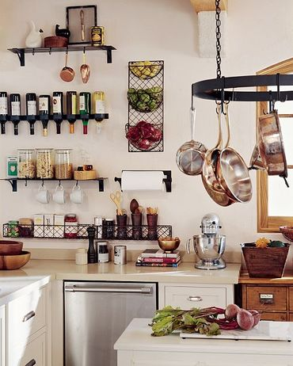
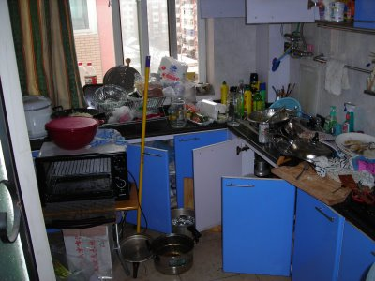
Two ends of the spectrum
Totally regulated
Completely dysregulated

Slide 26
Self-Regulation
Cognitive
Regulation
Behavior
Regulation
Emotion
Regulation
Physiological
Regulation
Underlying Mechanisms
Genetic, Somatic, Neurological, Sensory
Jude Nicholas and Tim Hartshorne, 2009

Slide 27
Self-regulation scale
I have a hard time paying attention and my mind tends to wander.
When I really need to pay attention I can focus my mind.
I can readily prioritize the things I need to get done in a day.
I become overwhelmed when faced with too many things to take care of.
I get upset a lot and cannot find any way to get rid of those feelings.
When I really need to control my feelings I can do it.
When there is nothing going on I have to create it.
When I am in a noisy crowd I have to find a way to leave.

Slide 28
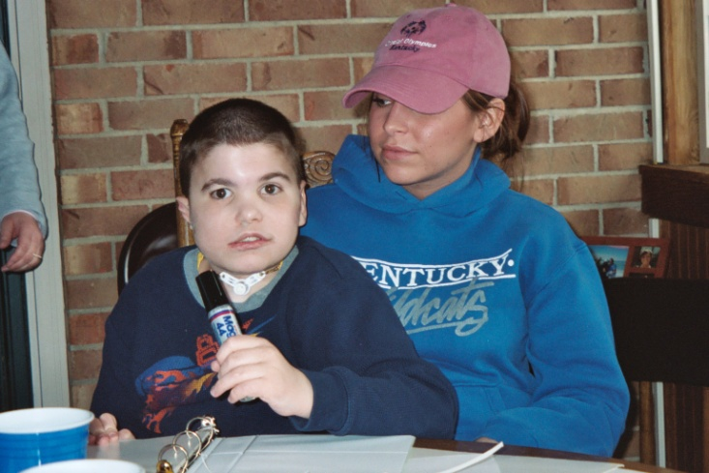
Self-Regulation
Managing the threshold of arousal
Processes of self-control
Both suppresses and encourages; inhibits and promotes
Supports homeostasis of the
system
Critical to development

Slide 29
Self-regulation problems in CHARGE
Rapid changes in arousal levels
Melt downs
Unfocused behavior
Diagnoses
  OCD – a way to reduce stimulation and exercise control
  ADHD – a problem with regulating sensory and behavioral stimulation and focusing on a goal
  Tic disorder – a stress response to lack of control over environment
  Autistic-like behavior – the failure of regulation strategies, and the adoption of dysregulated behavior
Is it PAIN, is it SENSORY, is it ANXIETY?

Slide 30
Self-regulation of pain
Pain anxiety and pain catastrophizing
Tension, distress, nervousness, irritability
The role of stress
Changing one’s thoughts and expectations
Meditation
Distraction

Slide 31
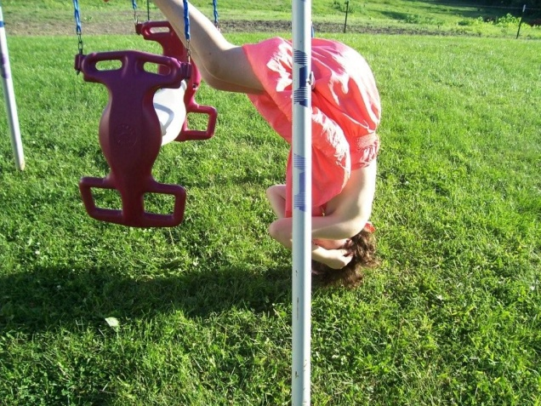
This is self-regulation of sensory systems
HOW?

Slide 32
Imagine waking up and…
No idea what time it is
No idea of what will happen today
No idea how soon something might happen
No idea of the expectations for what will happen
Problems detecting the true passage of time
  “Today the minutes seem like hours, the hours go so slowly, and still the sky is light.”
Will I like it?
ANXIETY

Slide 33
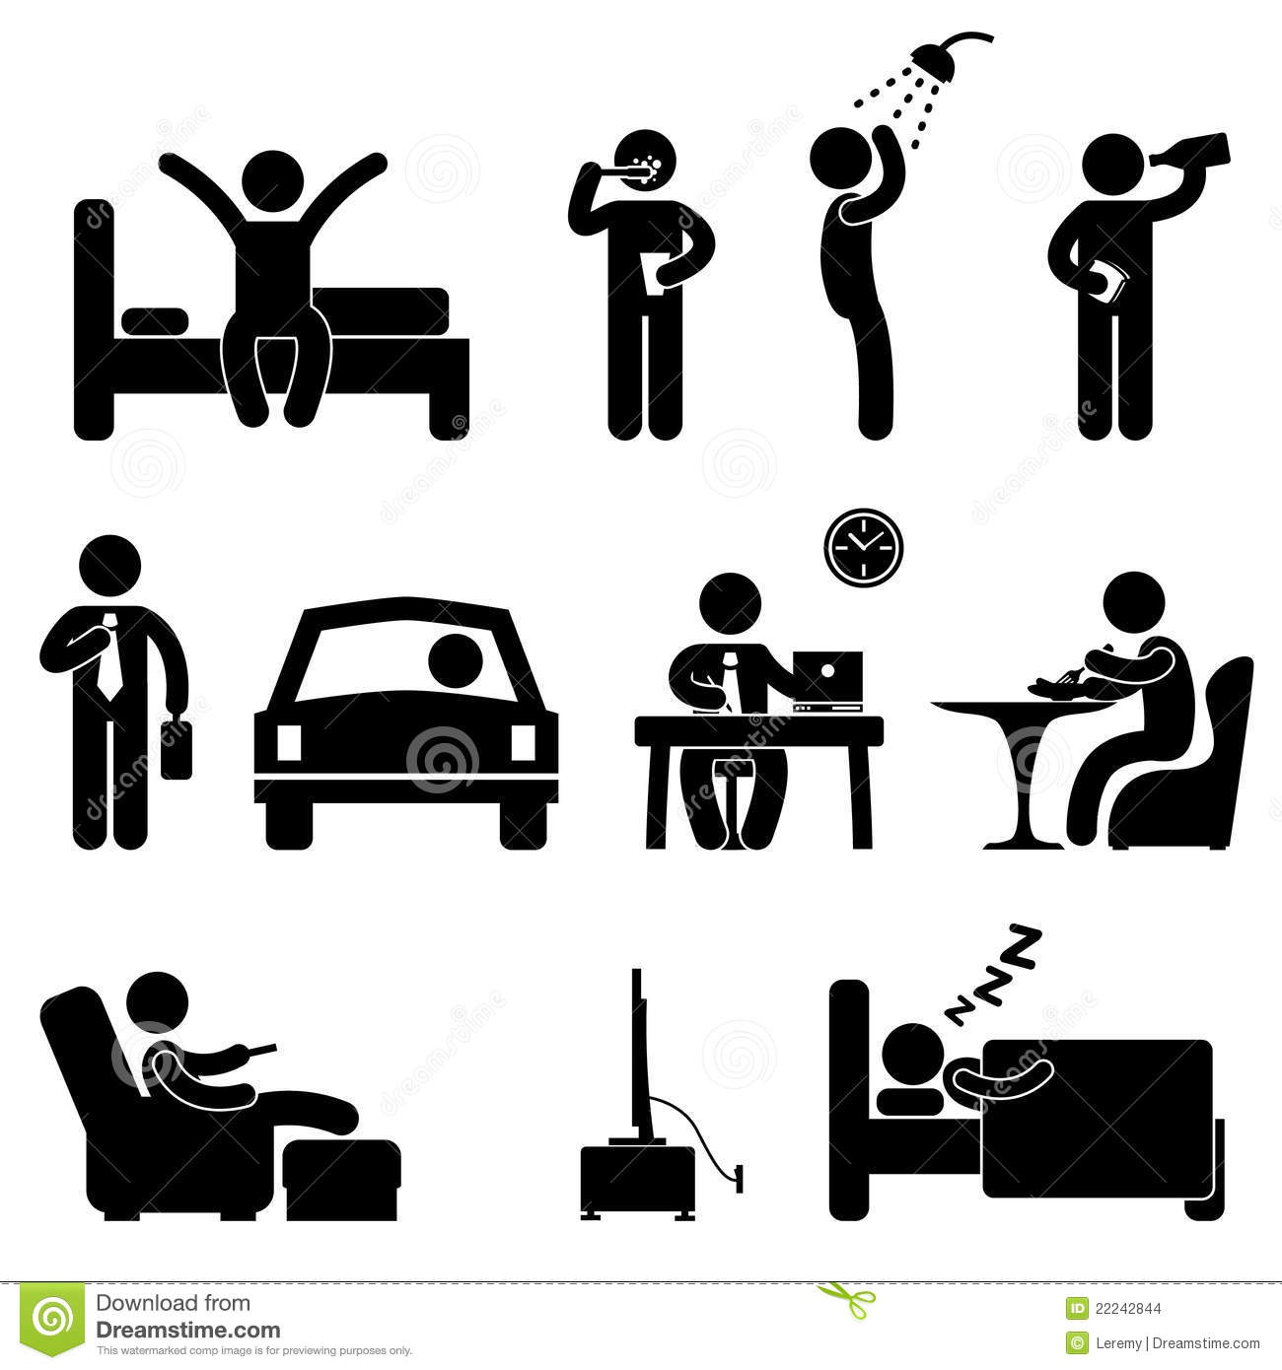
Help with self-regulation
Making life more regulated
  Routine
  Predictability

Slide 34
Passage of time
From when you got up this morning
  Your plan for the day
To when you get home this evening
  Future plans
Reflecting back on the day
  “Wow, the presentations were great!”
This is so much of what we talk about.

Slide 35
To start a calendar system
The child needs to have a communication system of some kind and a plan for its development
  Objects
  Pictures
  Signs
  Words
Activity routines must be in place
  A calendar makes things more predictable
  So you have to have a predictable schedule

Slide 36
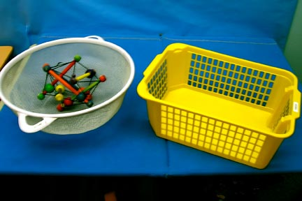

Slide 37
This is an anticipation calendar
Two distinctive baskets
One has an object that represents an activity
The other is the finish basket where the object will be placed once the activity is done.
The object may represent “free play time.”
When the child feels the object, the child knows it is time to go into the play room and do whatever he or she wishes.
When play time is over, the object will be put in the finish basket by the child.

Slide 38
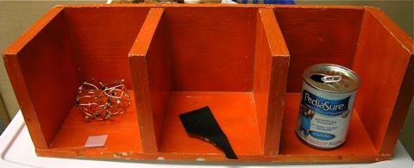
A bit more sophisticated
This is a simple daily calendar. It shows a sequence of events.

Slide 39
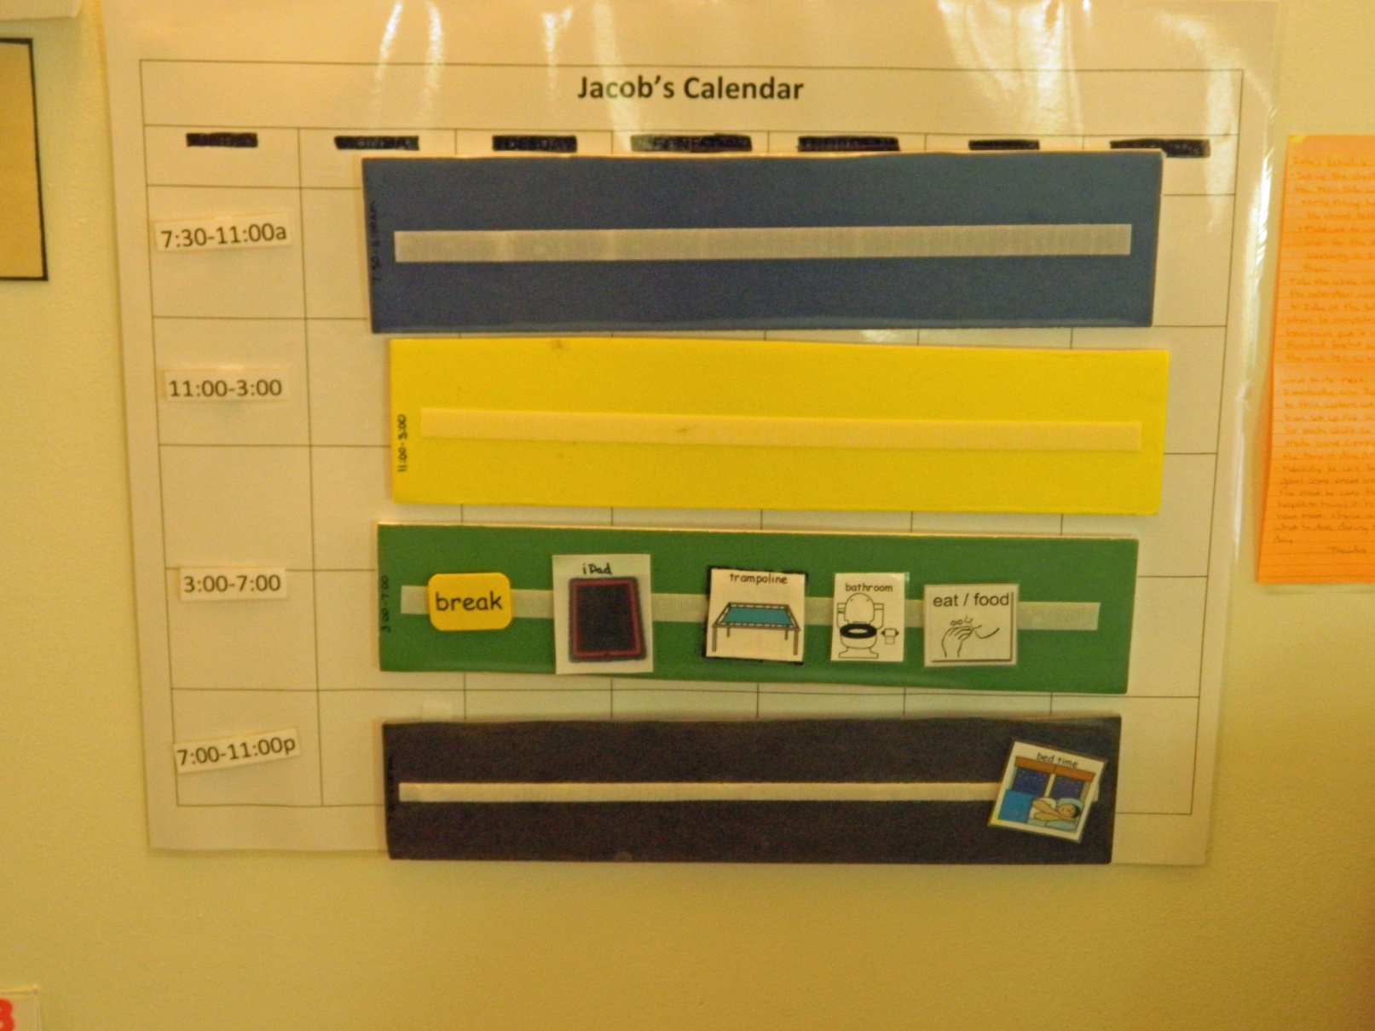
Shift planning

Slide 40
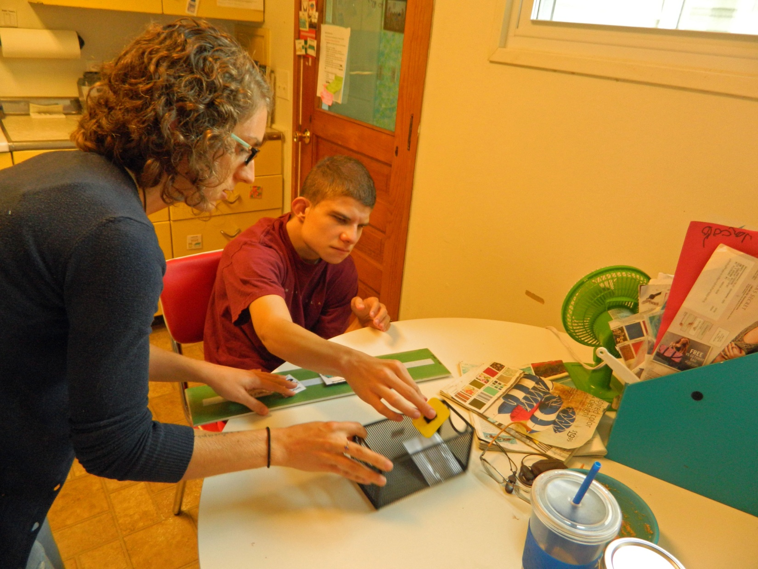
Finished

Slide 41
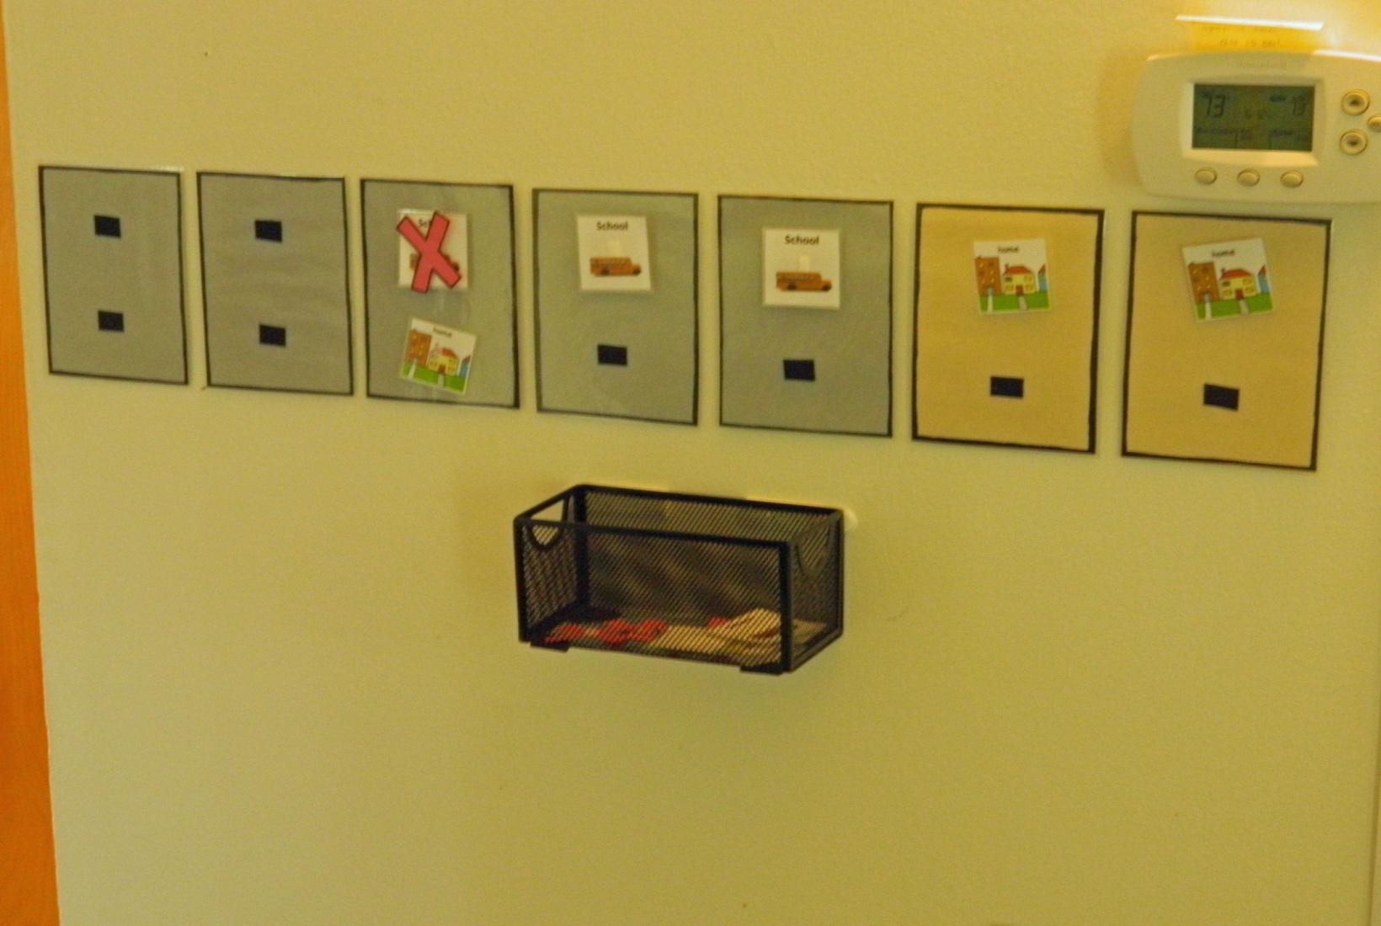
Predicting the week

Slide 42
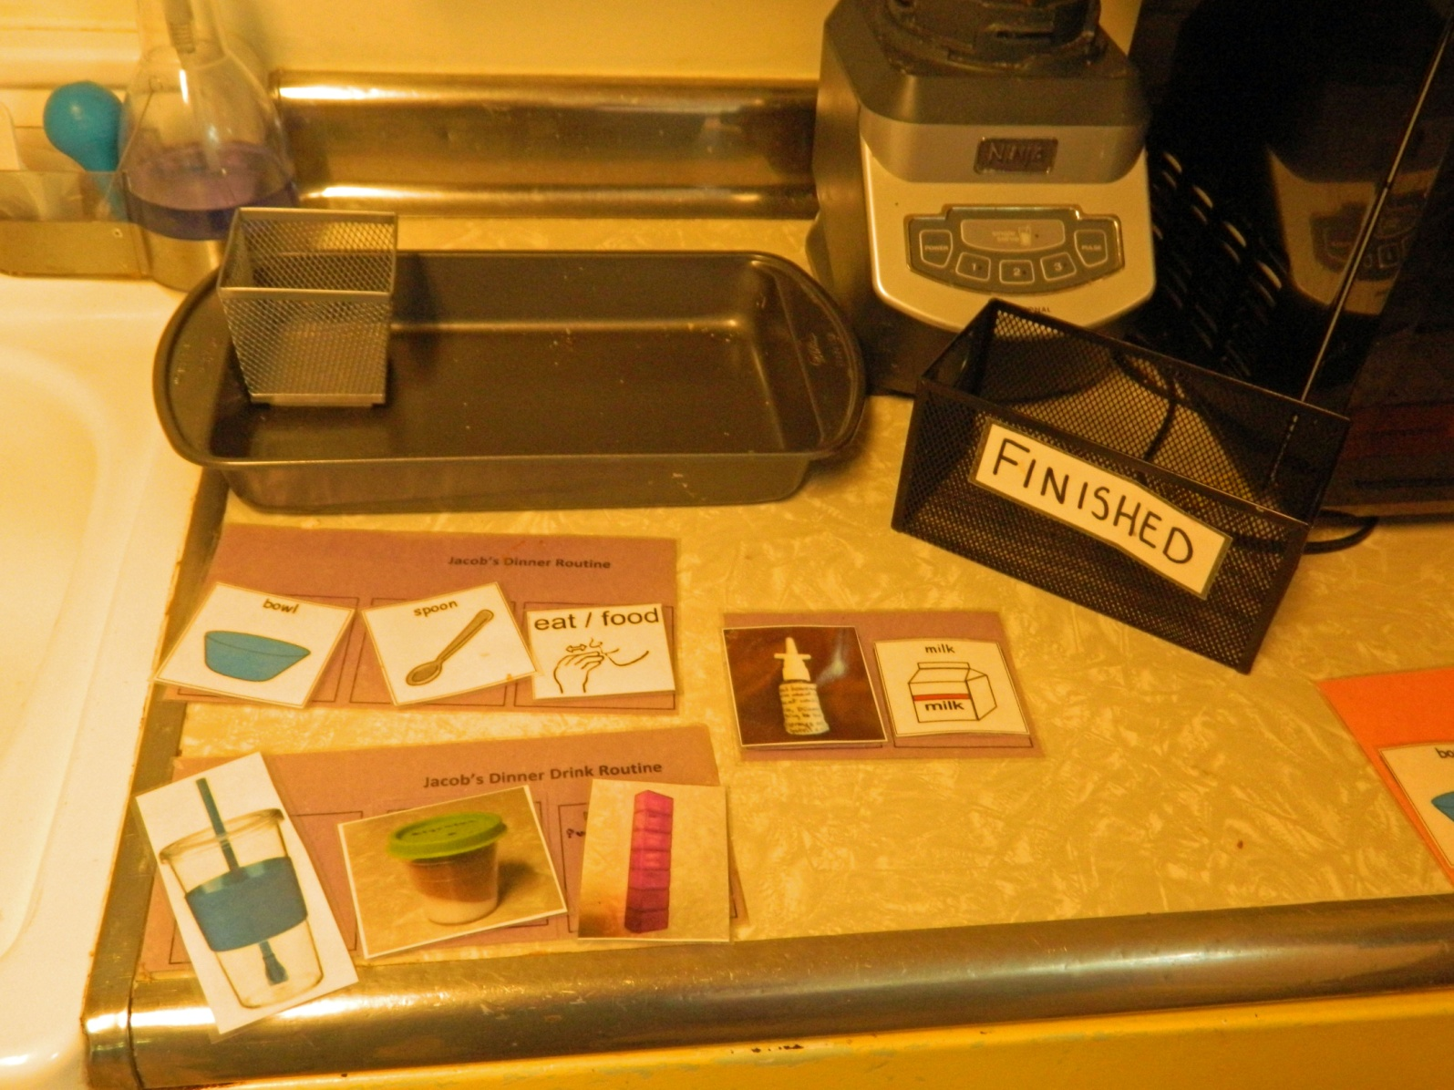
Activity routines

Slide 43
Changes
There will always be unanticipated changes in routine
In advance you can
  Read a social story about the upcoming change
  Adjust the calendar to reflect the change
  Talk about it
When it could not be anticipated
  Point to the change on the calendar
  Put it in context for the day – where does it fit in?
  Communicate about what the change is and what it means

Slide 44
Communication
Calendars provide an opportunity for conversation around the schedule.
  What we are doing now
  What we are doing later
  What we just did
At the end of each shift ideally go through the finish box and talk about what happened
Life is good with a bit of predictability and review

Slide 45
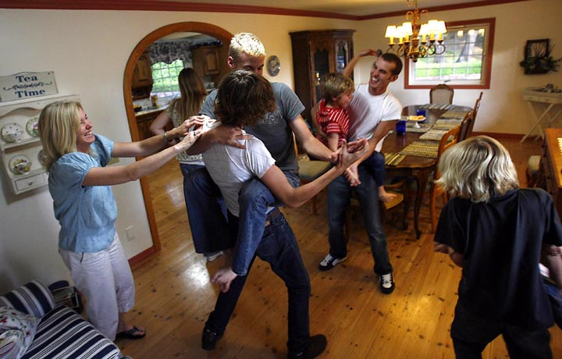
Creating an environment that facilitates self-regulation

Slide 46
Things that help
Communication, communication, communication
  All behavior is communication; Learn to read it
Recognizing and supporting goals
  Self-regulation happens in order to achieve goals
Trust (and follow) the child
  Their behavior is often their method
Mindfulness
  Tai Chi, yoga, meditation, being still and calm
Order and routine – making life predictable
  Use calendar systems

Slide 47
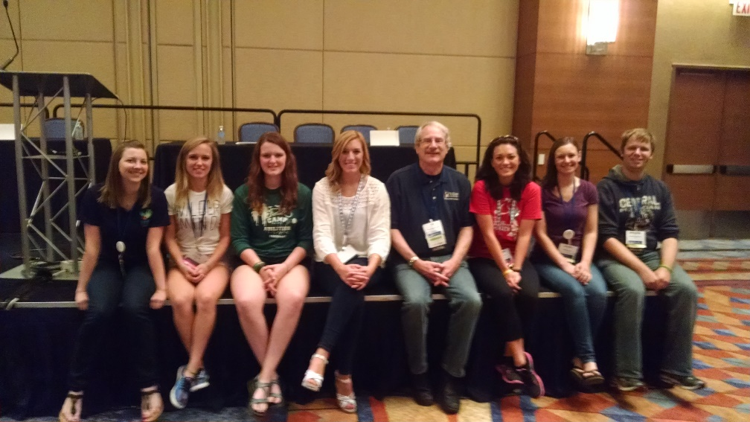
Thanks to my Lab
  Ben Kennert
  Megan Schmittel
  Gretchen Imel
  Claire Latus-Kennedy
  Shanti Madhavan
  Rebecca Jokinen
  Bree Kaufman
  Debora Ferreira
www.chsbs.cmich.edu/CHARGE
Like us on facebook!!

