Slide 1
Palmer Lake Beach Club (PLBC)
Meeting Minutes, 2020-10-30 Fall General Member Meeting
Board Members Present: Robert Perry, President; Jeffery Prestage, 1st VP; Kim Hunsaker, 2nd VP; Dolores Starr, Treasurer; Jada French, Alternate acting as Secretary due to Sarah Watkins excused absence due to medical issues.
27 members, representing 36 properties attended. 2 members, representing 7 properties were ineligible to vote due to delinquent accounts.
These minutes are noted onto the actual presentation materials, with notes at end for additional meeting content.
Due to COVID-19, most members attended by Zoom.

Slide 2
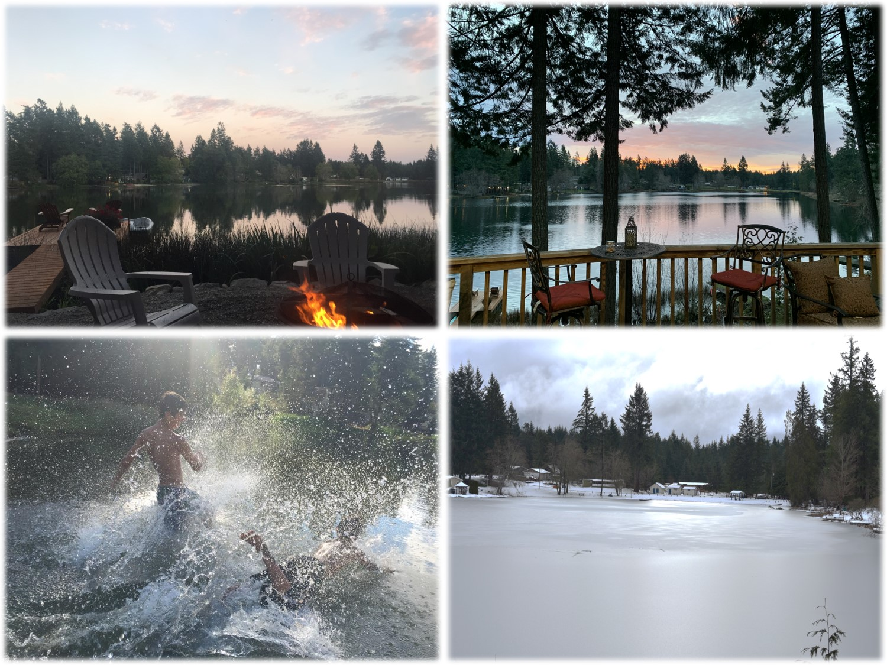
Palmer Lake Beach Club (PLBC)
Fall 2020 General Member Meeting 2020-10-31

Slide 3
Agenda
See notes on last page regarding additional motions and discussions.
The meeting was called to order at 10:03am.

Slide 4
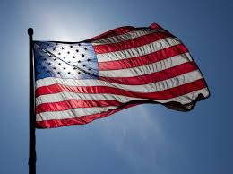
Pledge of Allegiance
(Optional)

Slide 5
Review of Process & Agenda Additions
Robert Perry reviewed the process of Board Elections, Officer Elections and meeting process.
Then Robert Perry reviewed the agenda and asked for additional agenda items. While none were noted at that time, during review of agenda items additional discussions were held

Slide 6
Interim Financial Report
Dee Starr, Treasurer

Slide 7
Financial Report Excerpts
FY 2020~2021 (July 1 to Oct 29, 2020)
Books are maintained on a cash basis. This excerpt uses cash basis for the Income statement, and accrual basis for the balance sheet

Slide 8
COVID-19 Impact
Gov. Inslee’s proclamation impact and implementation
HOA Operations & Tempo
Robert Perry explained that because a member brought the Governor’s Proclamations to our attention, we consulted with PLBC counsel, and created an execution plan. We posted the execution plan on the PLBC website, and have fully executed the elements of the plan, including crediting or refunding late fees for the 2020-2021 dues collection period.

Slide 9
FY2021~2022 Budget Committee
Each year a group of member volunteers, with the assistance of our Treasurer, reviews the budget and makes a recommendation to the Board. The Treasurer is a member of the committee.
Then, the Budget is formalized and presented for member approval at the Spring general member meeting.
If approved, it becomes the formal budget. If not approved, the prior FY budget is used (RCW).
It takes about 3 hours, all the prep work is done in advance, and Bob buys the snacks!
Who would like to volunteer?
Volunteers: Tony Russo, Brenda Hill, Carol Opalinski

Slide 10
Audit Committee
Each year a group of member volunteers, with the assistance of our Treasurer audit the books of PLBC. The Treasurer is not a member.
This involves looking at expenditures and back-up documents, looking for discrepancies.
Then the Committee creates a report. It can be as simple as a paragraph, or as detailed as desired regarding the audit findings.
This report is presented to the members at the Spring general member meeting.
It takes about 3 hours and Bob buys the snacks!
Who would like to volunteer?
During the discussion of the Audit Committee, there was a discussion regarding the Lien Process as well as a related motion. This is documented at the end of these minutes.

Slide 11
Member Feedback on Reserve Studies
Each year the PLBC Board makes a formal decision regarding having a formal reserve study performed, to ensure that we understand how much reserves we should maintain, and are our financial assets sufficient to meet reserve requirements.
Each year we explain this to the membership and ask for input.
Our uninsured reserve risk is estimated at about $10,000. Our assets are substantially in excess of this amount. The Board has historically voted to not have a reserve study performed.
A reserve study typically costs about $10,000, and under the RCW the Board can waive having one performed.
No motions were made regarding the reserve study discussion.

Slide 12
Independent Audit
The RCW requires that the membership vote each year to require or waive the requirement for an outside independent audit of the PLBC books. This has been waived every year of our existence, because:
We have an independent CPA review our books and prepare our tax returns each year.
Our member audit committee reads the CPA review report and considers it.
We use an outside bookkeeping service for payroll, which is reviewed by our member audit committee.
An independent audit costs at least $10,000, which is about 12.5% of our annual budget. We would need to increase the budget for such a cost.
The Board recommends the membership continue to waive the audit.
After discussion, a motion was made by Nancy Carr to waive the independent audit. Motion was seconded by Carol Opalinski. Motion carried by a vote of 19 yea, 5 nay.

Slide 13
Community Investment Committee
The lake overflow drainage project is completed.
Now that the risk of lake overflows damaging assets on the beaches is gone, we have a committee studying how to improve PLBC common areas.
Some thoughts under discussion:
  Install play equipment on the south beach.
  Add & upgrade picnic pavilions on the south and north beaches.
  Improve/enlarge parking on the north beach.
  Add a water slide to one of the floating swim platforms.
  Improve the ball field
If you are interested in joining the committee, send us an email! You’ll meet some new people, make friends, have fun and help the community!

Slide 14
Lake Overflow Drainage Project Status
Done. Complete. Final.
Thanks to everyone’s hard work, and the approval of the membership!

Slide 15
Lake Water Quality
Over the past several months we have had algae cautions and closures. We are currently closed.
We are studying a number of options to improve water quality for the safety and enjoyment of the community…..
  Aeration/Oxygenation
  Flow improvement
  Treatment options
We are considering the formation of a committee. Who would be interested in being on such a committee?
After discussion, Patrick Pockat agreed to chair a committee to study this issue

Slide 16
Community Events…
Best Christmas Decorations?
Spring Easter Egg Hunt?
National Night Out?
Summer Barbeque?

Slide 17
Crime & Security
Overall, calls for service/crime reports are still down from 4 years ago, but have creeped up a bit over 2019.
We continue to employ off-duty deputies to supplement the normal county coverage.
Basic security practices are still very important to avoid being a target of opportunity:
Have outdoor lighting.
Keep your doors and vehicles locked.
Do not leave out valuable items – outside or visible in your car.
Do not leave your car running unattended.
Work with your neighbors and be a good neighbor to keep watch.
Report everything to the Sheriff’s Department.

Slide 18
Additional Discussion Topics/Motions
During the meeting, there was a discussion of liens. Russell Engdahl made a motion that up to $7,000 be spent for an independent audit of the 2019/2020 liens process, mailing, tracking and notification process be performed. Brenda Hill seconded the motion. After a short period of discussion, there were 5 yes votes, and 19 no votes. The motion was not carried.
During the meeting, a member requested that we hold the monthly board meetings by Zoom, the Board agreed to consider this and respond.

Slide 19
Wrap Up….
It’s your HOA and community, please get involved & help!
Monthly board meetings are the 4th Thursday of each month, 7:00pm, south beach, center building. Open to members.
Communicate with us when you have a question or problem.
Lots of good info on the web site www.palmerlakebeachclub.com
Be safe, stay healthy and have a wonderful fall & holiday season!

