Slide 1
CERAKURE’s IQure Smart Curing Technologies
Where manufacturing meets its Cure

Slide 2
The biggest challenge for Manufacturers using Coating on their products, is the amount of time, space, and energy needed to cure that coating with traditional methods.
  Polytetrafluoroethylene (PTFE), commonly known as Teflon(TM), is widely used as a nonstick and chemically resistant coating.
    Curing PTFE coatings typically requires oven temperatures approaching 700°F (370°C) to achieve sufficient crosslinking.
      At these elevated temperatures, PTFE can begin to thermally degrade, releasing hazardous PFAS compounds - raising serious health, environmental, and regulatory concerns.
      These high-temperature curing processes are also energy-intensive and time-consuming, requiring large industrial ovens and long heat cycles.
(Despite efforts to develop low-temperature methods, conventional systems fail to fully crosslink PTFE without entering its thermal decomposition range.)
IQure smart curing technology can decrease the overall carbon footprint left by these Manufacturers by decreasing all of those pain points.

Slide 3
Market Opportunities
A large number of Manufacturers use coatings to protect their products from regular wear and tear. This technology makes curing those coatings efficiently, more accessible to these industries.
Aero Space
Automotive
Firearms
Kitchen / Bath
Oil & Gas
EV
Medical

Slide 4
How does IQure work?
Our proprietary UI fine tunes IR wavelengths to cure the chemical makeup of the coating. All coatings have a preloaded recipe built in. The user selects which coating they are putting in and the system does the rest.
The innovation lies in the tuning and control of catalytic IR emitter plates, combined with a precisely regulated gas system and thermal control logic. The coating surface reaches curing temperatures through direct molecular excitation, rather than ambient heat transfer.
When this method is used for PTFE coatings, it prevents PFAS off-gassing, dramatically reduces energy consumption, and completes the curing cycle in just 15 minutes — a fraction of the time required by conventional ovens.
Our method allows the coating to be cured at surface temperatures below the decomposition point of PTFE. By emitting infrared radiation at a wavelength absorbed efficiently by PTFE — which initiates crosslinking without requiring the chamber temperature to exceed 180°F.

Slide 5
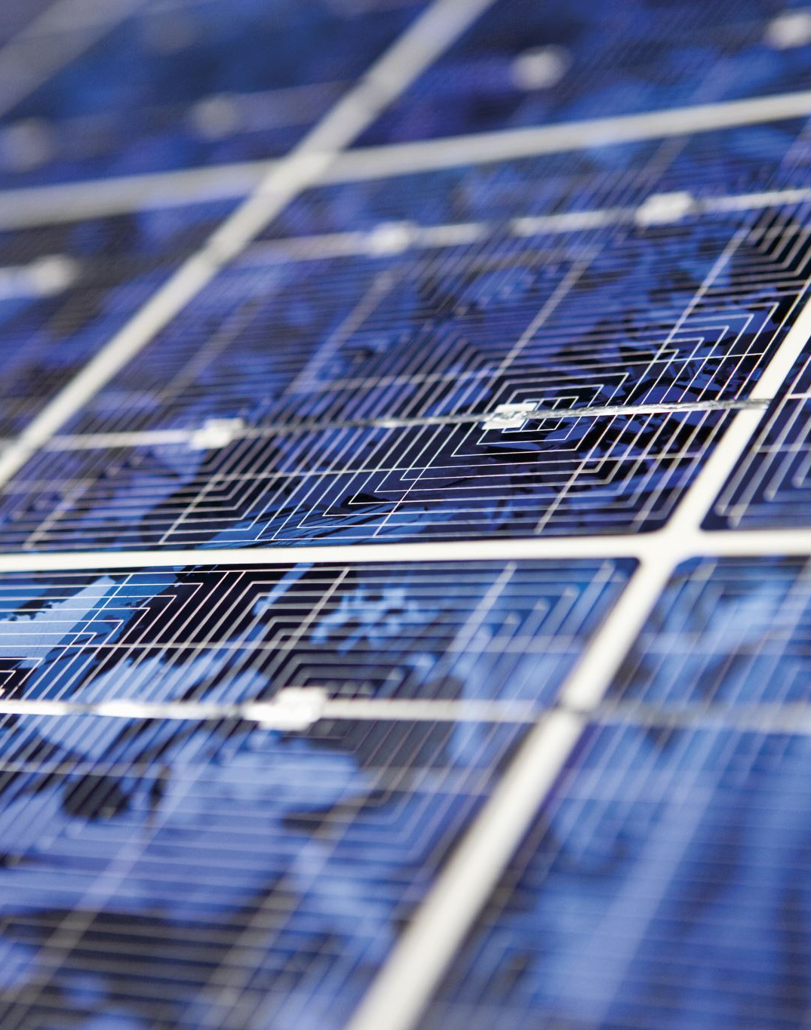
Why IQure?
Less energy consumed means less overall energy cost and a smaller carbon footprint
A significantly faster curing time means that manufacturers can produce more in a much shorter span of time
Cures PTFE at sub-decomposition temperatures (~250°F surface temperature, ~180°F ambient), eliminating PFAS emissions.
No modification to catalytic IR plates — only control over operational parameters.
Significantly reduced energy usage compared to traditional high-temp ovens.
Rapid cure cycle, improving throughput and efficiency.
Compatible with future automated production lines or robotic workflows.
Scalable for different oven sizes and part geometries.

Slide 6
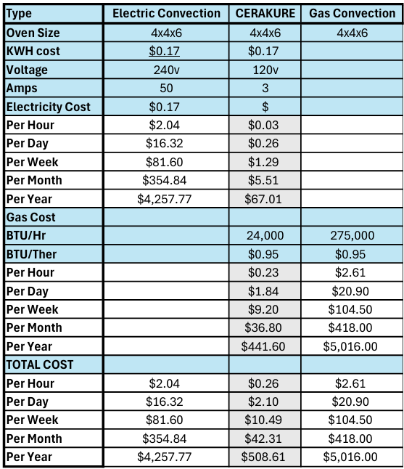
Less time means less overhead cost
We are able to cure coatings in 1% to 10% of the time as other methods, allowing manufacturers to cut down on time and cost.

Slide 7
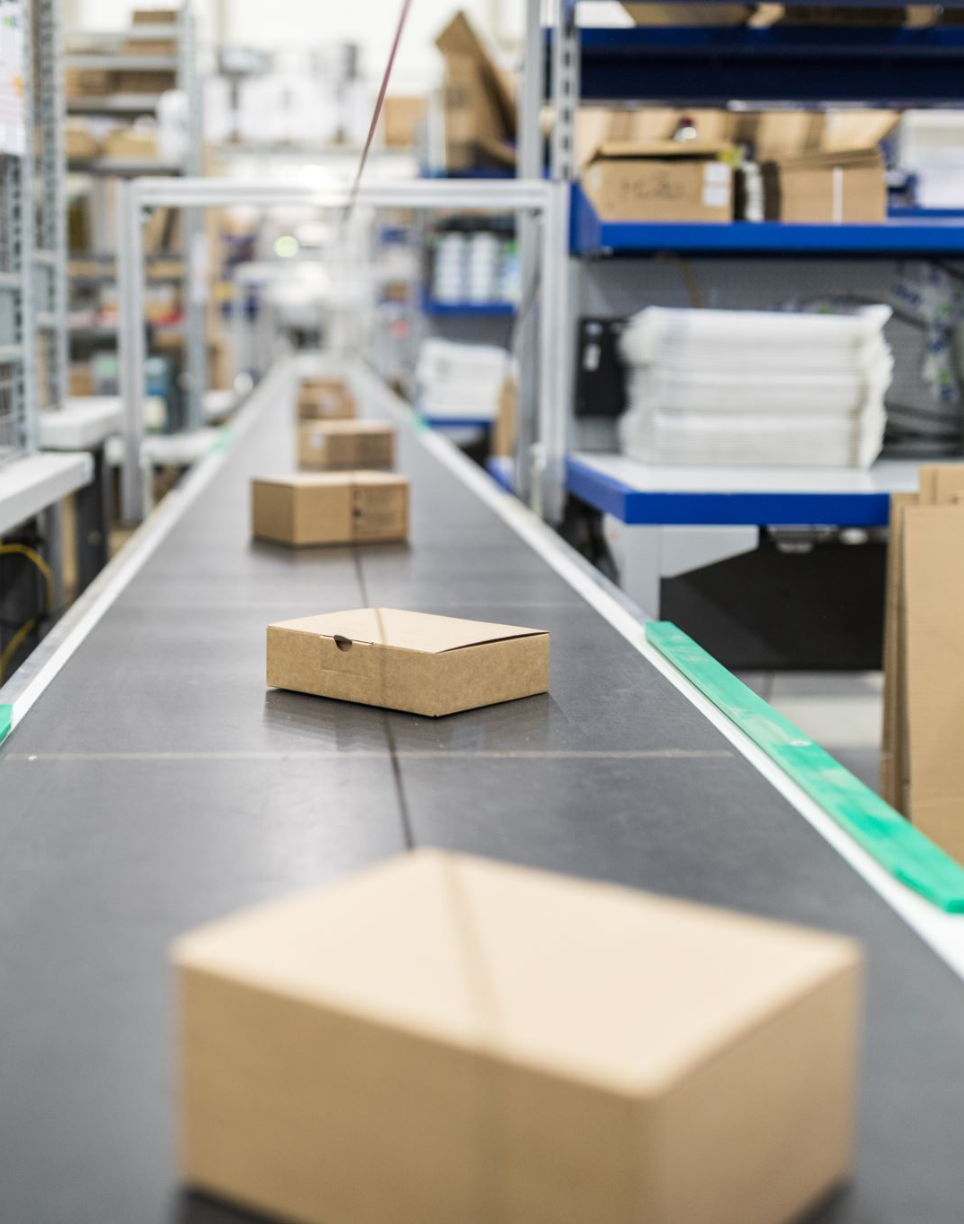
The Ask:
We are in need of funds to allow us to dedicate resources and a facility to R & D and launch our product.

Slide 8

The CERAKURE Team:
Mike Hernon
Mike’s career in infrared technologies began at Thermal Control, where he first explored the potential of IR wavelengths and their wide-ranging industrial applications. After moving on to Cefla and the finishing industry, he quickly established himself as a leader in the infrared community. Colleagues and industry professionals regularly turned to Mike for solutions to challenges with catalytic IR, recognizing both his technical expertise and innovative approach.
Over the years, Mike has been at the forefront of numerous groundbreaking advancements in infrared technology, continually pushing the boundaries of what’s possible. His most recent work has been especially significant in the PTFE industry, marking a monumental step forward in coating and curing applications.
Jackie began his career at Oklahoma State University, studying Renewable Energy, before spending a decade in the wind industry. He started hands-on in turbine repair, later advancing to construction, and ultimately leading a major component task force. In that role, he directed teams responsible for repairing and replacing large-scale components.
His career path then shifted to the finishing industry with Cefla, where he spent three years installing and servicing automated finishing lines. It was during this time that Jackie was introduced to infrared curing technology—and to his future business partner, Mike Hernon.
After achieving major breakthroughs together in the ceramic coating industry, Jackie and Mike co-founded Cerakure, where he continues to apply his technical expertise and leadership to drive innovation in curing technologies.
Jackie Coleman

Slide 9
Our plan if funds are obtained, is to find and lease, a facility with proper ventilation and PPE so that we can continue R & D and establish manufacturing.

