Slide 1

Prioritization: Updating SMS
Presentation to [ Organization ]
[ Date ]
Notes:
Host
Welcome to this webinar/presentation/session on the upcoming changes to FMCSA’s Safety Measurement System, often known as SMS.

Slide 2
Safety is FMCSA’s top priority and core mission.
FMCSA…
Invests in sound data and analysis
Equips motor carriers with the proactive tools needed to improve their safety compliance
Uses SMS to identify behaviors most closely linked to crashes and prioritizes interventions
Focuses resources where they will have the greatest impact to prevent crashes
Notes:
Host
[ read slide ]

Slide 3
Still, more than 4,000 people die in large truck and bus crashes each year.
We can and must do more.
Source: FMCSA Pocket Guide to Large Truck and Bus Statistics (taken from NHTSA, FARS)
Notes:
Host
[ read slide ]

Slide 4

With input from all stakeholders—government at all levels, industry, researchers, safety advocates, and the public—FMCSA has identified a set of changes that build on the sound design of the current Safety Measurement System (SMS).
4
Notes:
Host
[ read slide ]

Slide 5
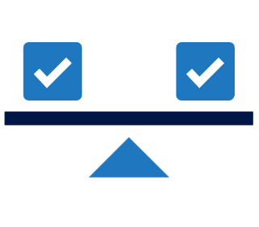


These changes continue our commitment to improve…
FAIRNESS
Ensuring greater consistency in results by holding similar carriers to the same standard, regardless of how their safety issues are documented.
ACCURACY
Continually improving the quality of the data we use to stay focused on the motor carriers in most need of intervention.
CLARITY
Helping motor carriers better understand their results and how to use them to adopt safer behaviors.
The crash rate for carriers prioritized using the new methodology is 10% higher
than under the current SMS.
Notes:
Host
[ read slide ]

Slide 6
Timeline
Phase 1:
Prioritization Preview
Phase 2:
Revise Prioritization
Phase 3:
Update Prioritization
Engage enforcement & industry stakeholders
FMCSA seeking comments
FMCSA reviews comments
Update SMS methodology and web system to incorporate recommendations that align with our safety mission
FMCSA implements final methodology, launches updates SMS web system
Enforcement will use these results to prioritize carriers for CSA Interventions
Notes:
Host
As a reminder, here is where we are in the project timeline.
We are in phase 2, during which FMCSA is revising the methodology and re-designing the SMS website to accommodate the approved changes.
The changes to SMS will not go into effect until the next phase; FMCSA will release a follow-up announcement closer to the anticipated “go-live” date.
This presentation is meant to help the motor carrier industry and the public understand the forthcoming changes in before they go into effect.

Slide 7
WHAT ARE THE APPROVED CHANGES TO THE SMS METHODOLOGY?
Prioritization: Updating SMS
Notes:
Host
We’ll now go through the approved changes you can expect to see in the next version of SMS.

Slide 8
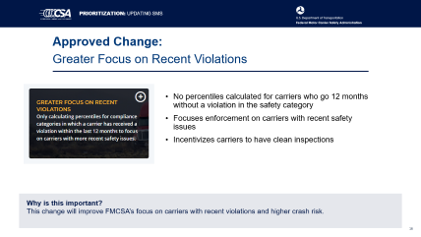
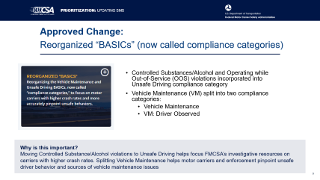
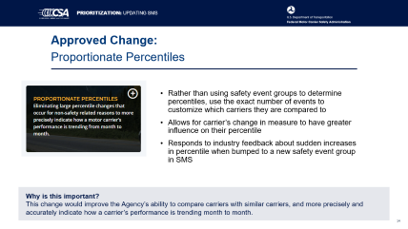
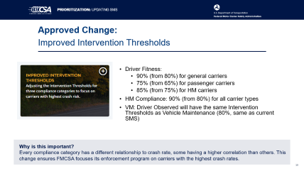
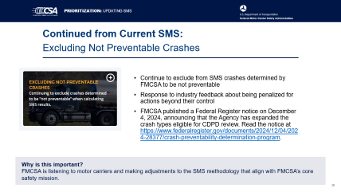
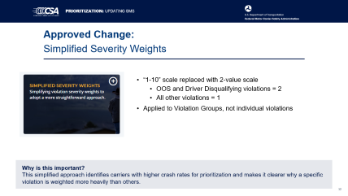
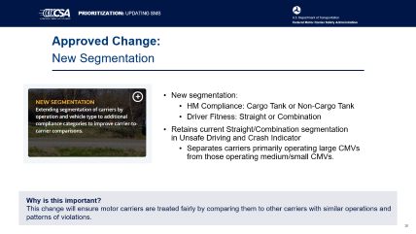
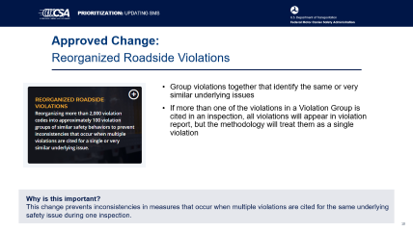
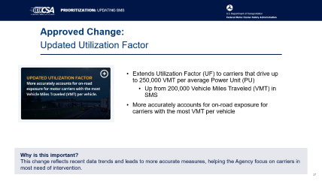
Approved Changes to SMS
Notes:
Host
[ click on a tile to “zoom” to that slide, then click anywhere on the screen to come back to this summary slide ]

Slide 9
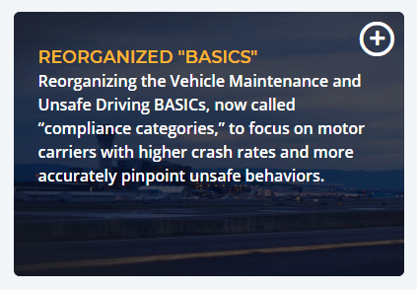
Approved Change:
Reorganized “BASICs” (now called compliance categories)
Controlled Substances/Alcohol and Operating while Out-of-Service (OOS) violations incorporated into Unsafe Driving compliance category
Vehicle Maintenance (VM) split into two compliance categories:
  Vehicle Maintenance
  VM: Driver Observed
Why is this important?
Moving Controlled Substance/Alcohol violations to Unsafe Driving helps focus FMCSA’s investigative resources on carriers with higher crash rates. Splitting Vehicle Maintenance helps motor carriers and enforcement pinpoint unsafe driver behavior and sources of vehicle maintenance issues
Notes:
Host
The first approved change is to make some adjustments to how we organize the BASICs—which, in the new methodology, are just called “compliance categories” to get rid of the long BASICs name. Under the new methodology:
The Controlled Substances/Alcohol BASIC will go away, and all those violations will be incorporated into the Unsafe Driving Compliance Category
We have split Vehicle Maintenance into two categories:
Vehicle Maintenance, which includes violations that are identified by a mechanic or during a Full (Level 1) roadside inspection
Vehicle Maintenance: Driver Observed, which includes violations that could reasonably be observed by a driver or detected as part of a Walk-Around (Level 2) roadside inspection
This proposed change was the result of work done as part of the IRT study.

Slide 10
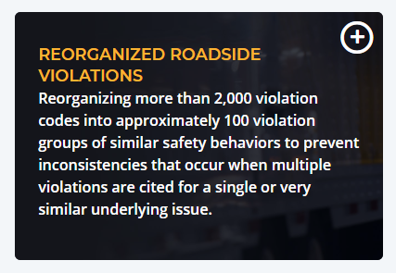
Approved Change:
Reorganized Roadside Violations
Group violations together that identify the same or very similar underlying issues
If more than one of the violations in a Violation Group is cited in an inspection, all violations will appear in violation report, but the methodology will treat them as a single violation
Why is this important?
This change prevents inconsistencies in measures that occur when multiple violations are cited for the same underlying safety issue during one inspection.
Notes:
Host
The next approved change is to reorganize the more than 2,000 roadside violations into around 100 Violation Groups, grouping together violations that identify the same or very similar underlying safety issue.
This change was also the result of work done as part of the IRT study—this started off as a way to simplify the data going into the model to improve run time— and resulted in a simplified approach that also helps illustrate and explain safety issues for carriers.
The new methodology will look at all the violations that are cited during a roadside inspection, then determine if more than one of those violations belongs to a single Violation Group. If so, the methodology will treat all violations within the Violation Group as a single violation when calculating the percentile for that compliance category.
All violations that are cited will continue to appear on the inspection report, this grouping is strictly for prioritization purposes.

Slide 11
Reorganized Roadside Violations – Example
The following Hours of Service violations fall under the same Violation Group:
  395.3A2-PROP: Driving beyond 14 hour duty period (Property Carrying Vehicle)
  395.3A3-PROP: Driving beyond 11 hour driving limit. (Property Carrying Vehicle)
  395.3(a)(3)(ii): Driving beyond 8 hour driving limit since the end of the last on duty, off duty, or sleeper period of at least 30 minutes
  395.3B2: Driving after 70 hours on duty in an 8 day period (Property Carrying Vehicle)
If all 4 of these violations were cited in a single inspection, the methodology would treat it as one violation when calculating percentiles.
For prioritization purposes, based on the FMCSA’s data analysis,
determining whether a safety issue is identified
is more important than how many ways it was documented.
Notes:
Host
As an example, on this slide you see multiple violations that all belong in the same Violation Group. If all of these violations were cited during a single inspection, the methodology would treat them as one violation when calculating the percentile.
Why? Because our data analysis showed that, for prioritization purposes, determining whether a safety issue is identified is more important than how many ways it was documented.
Again, this is just for prioritization purposes, enforcement will still be able to view all the violations that were cited when looking into a carrier for enforcement purposes.

Slide 12
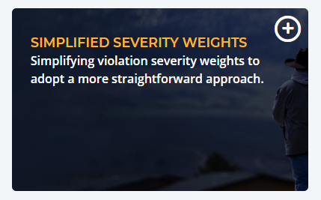
Approved Change:
Simplified Severity Weights
“1-10” scale replaced with 2-value scale
  OOS and Driver Disqualifying violations = 2
  All other violations = 1
Applied to Violation Groups, not individual violations
Why is this important?
This simplified approach identifies carriers with higher crash rates for prioritization and makes it clearer why a specific violation is weighted more heavily than others.
Notes:
Host
The next approved change is to replace the “1-10” scale currently used for severity weights with a two-point scale. Because violations are grouped, these severity weights are applied to the Violation Group, not individual violations.
The scale works like this:
If a Violation Group includes any Out-of-Service or Driver Disqualifying violations, that group will be assigned a severity weight of 2.
If not, the Violation Group receives a severity weight of 1.
This makes it clearer why certain violations get a stronger weight, and helps identify carriers with higher crash rates.

Slide 13
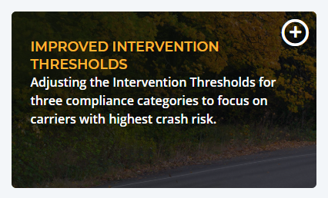
Approved Change:
Improved Intervention Thresholds
Driver Fitness:
  90% (from 80%) for general carriers
  75% (from 65%) for passenger carriers
  85% (from 75%) for HM carriers
HM Compliance: 90% (from 80%) for all carrier types
VM: Driver Observed will have the same Intervention Thresholds as Vehicle Maintenance (80%, same as current SMS)
Why is this important?
Every compliance category has a different relationship to crash rate, some having a higher correlation than others. This change ensures FMCSA focuses its enforcement program on carriers with the highest crash rates.
Notes:
Host
Next, we’re adjusting some of the Intervention Thresholds.
Driver Fitness Intervention Thresholds will be:
90% for general carriers (this is currently 80%)
75% for passenger carriers (currently 65%)
85% for HM carriers (currently 75%)
The HM Compliance Intervention Threshold will be 90% (currently 80%) for all carrier types.
This is part of our continual improvement to make sure we’re focusing on the carriers with the highest crash rates.

Slide 14
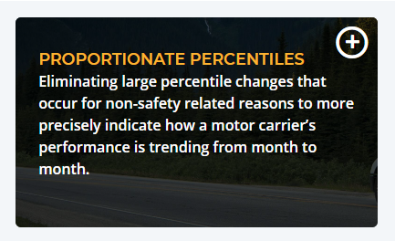
Approved Change:
Proportionate Percentiles
Rather than using safety event groups to determine percentiles, use the exact number of events to customize which carriers they are compared to
Allows for carrier’s change in measure to have greater influence on their percentile
Responds to industry feedback about sudden increases in percentile when bumped to a new safety event group in SMS
Why is this important?
This change would improve the Agency’s ability to compare carriers with similar carriers, and more precisely and accurately indicate how a carrier’s performance is trending month to month.
Notes:
Host
The next approved change responds to a frequent critique we’re received from the industry when they receive sudden unexpected increases in their percentile after jumping to a new safety event group.
The new SMS methodology eliminates this by customizing which carriers a carrier is compared to, using the exact number of safety events, rather than the arbitrary cutoffs of safety event groups.
This allows for the carrier’s measure to have a greater influence over a change in their percentile, and will “smooth out” those sudden jumps. This gives the Agency a more precise and accurate view of how a carrier’s performance trends from month to month.

Slide 15
Proportionate Percentiles - Example
Example Carrier | Under Current SMS | Under Updated SMS
Carrier with 10 inspections | Measure: 1.51 | Measure: 1.51
 | Percentile: 53.0% | Percentile: 67.4%
Same carrier after receiving 1 additional inspection with no violations (moving to next largest safety event group) | Measure: 1.37 ( .14) | Measure: 1.37 ( .14)
 | Percentile: 75.0% ( 22%) | Percentile: 67.0% ( .4%)
This change eliminates substantial percentile increases without a corresponding measure increase
Notes:
Host
In this example, you can see that this carrier had 10 inspections, then moved to the next safety event group after having one additional clean inspection.
Under the current SMS methodology, using only safety event groups, even though the carrier’s individual measure improves, it has a significant jump in percentile, simply because they have moved to a new safety event group.
Under the new SMS methodology, the carrier’s percentile improves as the measure improves.
This change eliminates substantial percentile increases without a corresponding measure increase—giving us more accuracy.

Slide 16
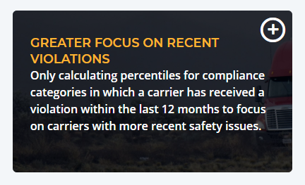
Approved Change:
Greater Focus on Recent Violations
No percentiles calculated for carriers who go 12 months without a violation in the safety category
Focuses enforcement on carriers with recent safety issues
Incentivizes carriers to have clean inspections
Why is this important?
This change will improve FMCSA’s focus on carriers with recent violations and higher crash risk.

Slide 17
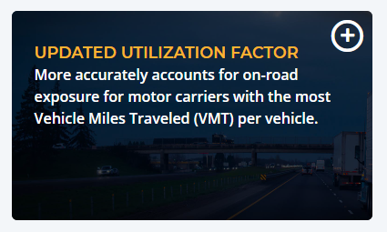
Approved Change:
Updated Utilization Factor
Extends Utilization Factor (UF) to carriers that drive up to 250,000 VMT per average Power Unit (PU)
  Up from 200,000 Vehicle Miles Traveled (VMT) in SMS
More accurately accounts for on-road exposure for carriers with the most VMT per vehicle
Why is this important?
This change reflects recent data trends and leads to more accurate measures, helping the Agency focus on carriers in most need of intervention.
Notes:
Host
The next approved change is an update to the Utilization Factor, or UF. UF helps ensure that measures account for carriers’ different levels of exposure to inspections and crashes—it’s used only in the Unsafe Driving and Crash Indicator compliance categories.
Currently UF applies to carriers that drive up to 200,000 VMT, we are proposed extending that to carriers that drive up to 250,000 VMT.
This more accurately accounts for on-road exposure for carriers with the most VMT per mile. This is one way we are adapting to reflect recent data trends.

Slide 18
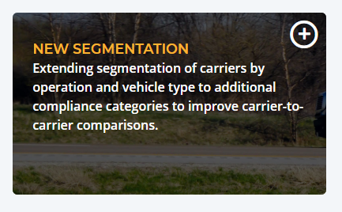
Approved Change:
New Segmentation
New segmentation:
  HM Compliance: Cargo Tank or Non-Cargo Tank
  Driver Fitness: Straight or Combination
Retains current Straight/Combination segmentation in Unsafe Driving and Crash Indicator
  Separates carriers primarily operating large CMVs from those operating medium/small CMVs.
Why is this important?
This change will ensure motor carriers are treated fairly by comparing them to other carriers with similar operations and patterns of violations.
Notes:
Host
The last approved change is to add some new segmentation.
In the current SMS, carriers are only segmented when calculating percentiles for the Unsafe Driving and Crash Indicator BASICs.
The new SMS methodology would keep this segmentation, and would also segment the following compliance categories:
HM Compliance would segment by Cargo Tank and Non-Cargo Tank
Driver Fitness would segment by Straight and Combination carriers.
This helps ensure carriers are compared to carriers with similar operations and patterns of violations.

Slide 19
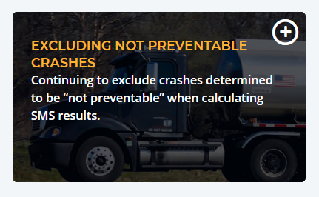
Continued from Current SMS:
Excluding Not Preventable Crashes
Continue to exclude from SMS crashes determined by FMCSA to be not preventable
Response to industry feedback about being penalized for actions beyond their control
FMCSA published a Federal Register notice on December 4, 2024, announcing that the Agency has expanded the crash types eligible for CDPD review. Read the notice at https://www.federalregister.gov/documents/2024/12/04/2024-28377/crash-preventability-determination-program.
Why is this important?
FMCSA is listening to motor carriers and making adjustments to the SMS methodology that align with FMCSA’s core safety mission.
Notes:
Host
Lastly, while this is not a change, we want to affirm that the new SMS methodology will continue to exclude crashes determined to by not preventable by the Crash Preventability Determination Program. This is one example of a recommendation from the industry that aligns with our safety mission.

Slide 20
WHERE CAN I LEARN MORE ?
Prioritization: Updating SMS
Notes:
Host
FMCSA has created a number of resources about these forthcoming changes…

Slide 21
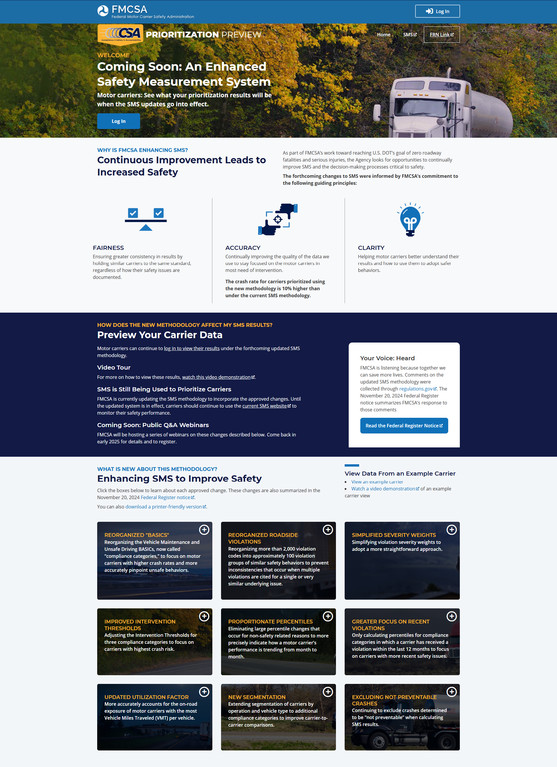
CSA Prioritization Preview
Summarizes the approved changes and explains how they will enable FMCSA to improve safety
To learn more about the forthcoming changes:
  Visit the CSA Prioritization Preview website
  Download the resources
The new SMS methodology will make it easier to identify and address the root causes of safety issues – before crashes can happen.
https://csa.fmcsa.dot.gov/prioritizationpreview
Notes:
Host
You can learn more about the forthcoming changes on the CSA Prioritization Preview website.
[ read slide ]

Slide 22
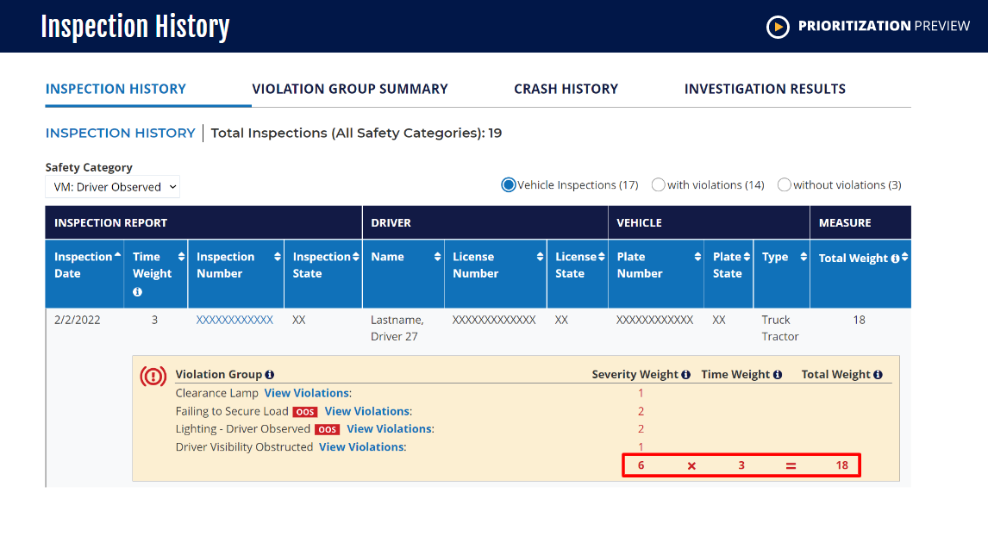

For more on how to read your results,
watch the informational video.
https://csa.fmcsa.dot.gov/PrioritizationPreview/resources/demo/story.html
Notes:
Host
You can also watch a video we’ve created to learn more about how to read prioritization results in the preview website.
Since the re-designed SMS will build off this design, it would be a good idea to start getting familiar with the new display now.

Slide 23

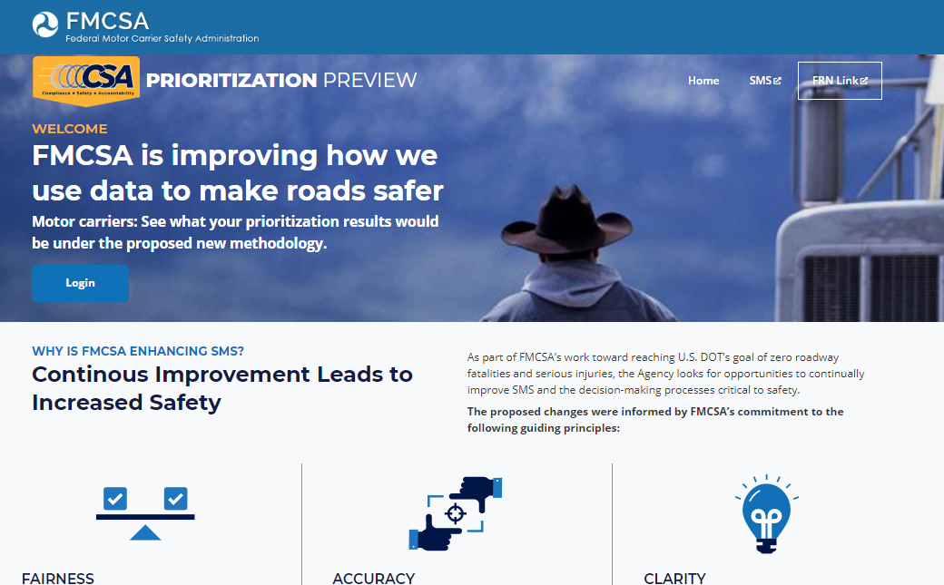



Suggested Next Steps
Visit the CSA Prioritization Preview website
Learn about the approved changes
Log in and view what your carrier’s results would be under the new SMS methodology
Use results to identify areas to improve your safety performance
https://csa.fmcsa.dot.gov/prioritizationpreview
Notes:
Host
Since the new SMS has not launched yet, there are no required action items for carriers right now.
However, carriers are encouraged to take the steps on the screen.
[ read slide ]

Slide 24
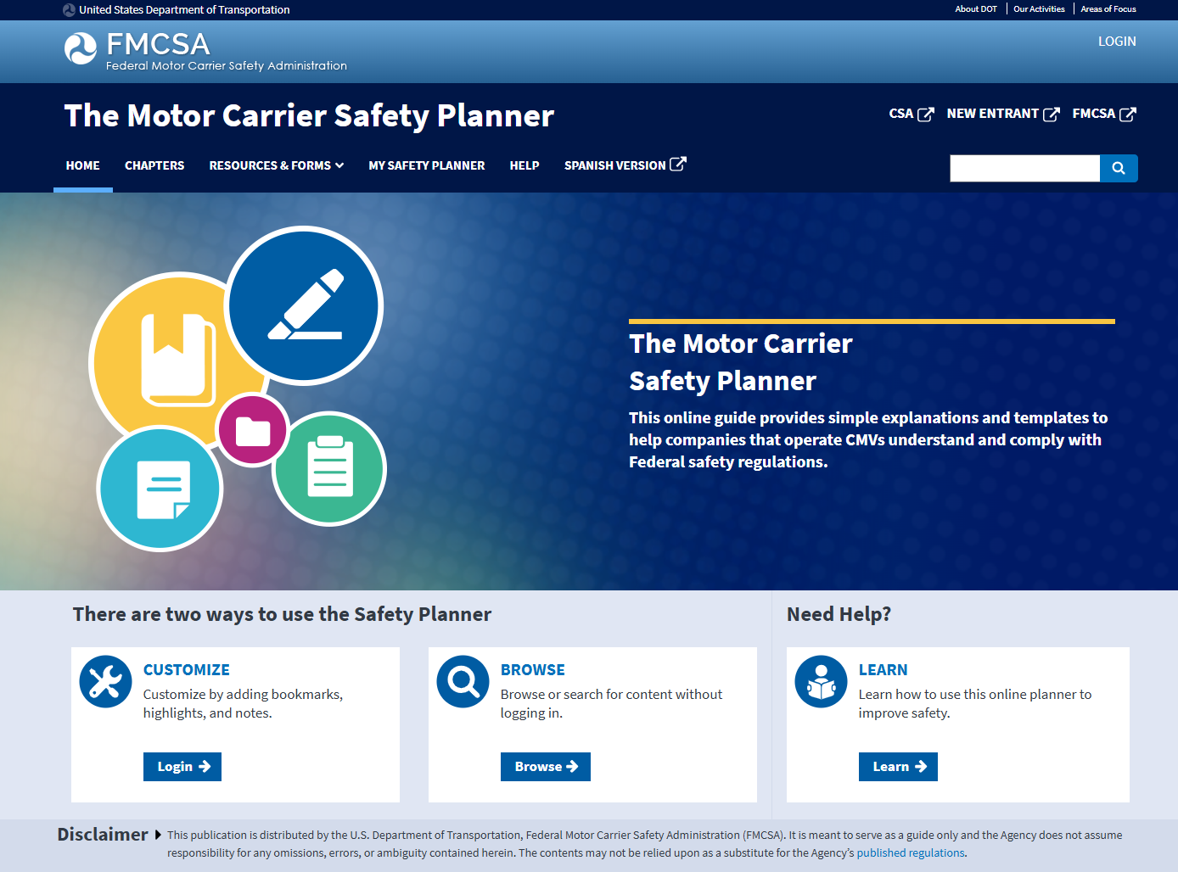
Learn More about Safety Regulations
Use FMCSA’s Motor Carrier Safety Planner
Plain language summaries of regulations
Examples forms and checklists
Log in to create your own customized planner
Free and open to the public
https://csa.fmcsa.dot.gov/safetyplanner/
Notes:
Host
If, as part of improving safety performance, a carrier would like to learn more about the Federal Motor Carrier Safety Regulations, a great tool is FMCSA’s Motor Carrier Safety Planner.
[ read slide ]

Slide 25

Your voice. Heard.
Because together, we can do more.
When it comes to improving safety, every voice counts.
Notes:
Host
We greatly appreciate all the comments we received from the public during phase 1. Your feedback helps us better understand how to implement safety enhancements.

Slide 26

Questions?
Q&A
Notes:
Host
[ pause for questions ]

Slide 27

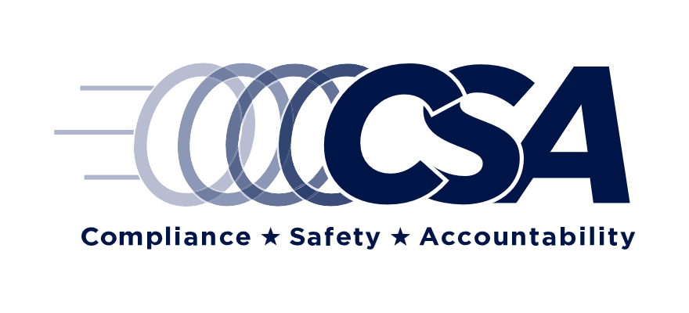
Contact Us
CSA Help Line
Ask questions on how to read and understand the preview website, or the approved changes
877-688-2984 or https://csa.fmcsa.dot.gov/CSA_Feedback.aspx
Notes:
Host
If you have any other questions about the approved changes, or about how to read the preview website, you can contact the CSA Help Line. The contact information is on the screen.
Thank you very much for participating!

