Slide 1


2025 CSFP Breakout Session

Slide 2


Our CSFP Business Model – Agency Network
69 partner agencies that run their own CSFP programs, including sub-contracts with two Regional Food Banks.
Serving 10 of the 15 Arizona Counties
Caseload: 17,305
Serving 98.9% of caseload since April (stretch goal = 98%)
Notes:
Bullet 3: 2025 SMFB caseload was reduced from 17,990 to 17,305, with SMFB and Yuma absorbing the lion’s share of the reduction.
Bullet 4: Strong work from our CSFP agencies for collectively serving at or above 98% this year, while working to avoid overserving the caseload!

Slide 3
3-Month Reallocation Strategy
Provides 4 opportunities throughout a 3-month period to readjust caseload
Use a 3-month average for each agency to identify unused caseload
Use Link2Feed to identify partner agencies with a waitlist
Allows seniors to naturally become inactive based on 2- month no show rule

Slide 4
3-Month Reallocation Strategy

Slide 5
Utilizing Case Load with Waitlist
End of the Month Waitlist
  Beneficial for Agencies with multiple distribution dates in a month
  Pick a date at the end of the month to send out a last call to current clients
  After Cut Off Date, pull Waitlist Clients and call to pick up box
  Helps to increase percentage of caseload served, in order to prevent losing caseload during the reallocation process
  Proactively contact waitlist clients every 6 months to confirm interest and eligibility to remain on waitlist

Slide 6
Caseload Best Practices
Do maintain sufficient Active Clients (100-110% of C/L).
Do utilize Waitlist to meet monthly caseload.
Do continue to verify participant/proxy identification at each distribution
Do not overserve caseload.
Do not allow neighbors to “double-dip”.
Notes:
Bullet 1: Track Link2Feed Auto-Suspensions occurring on the 1st of the month and backfill by moving Waitlisted seniors to Active status.
Bullet 2: Carrying up to 10% more Active seniors than caseload can help to reach the 98% goal but is not a good strategy for agencies whose seniors all show up each month!
Bullet 4: When extra CSFP product is on-hand (unused from prior month, pre-allocations arrive for upcoming month, or a caseload reduction occurs), do not serve beyond current caseload.
Bullet 5: Neighbors receiving CSFP product at other than their designated food bank should be provided a gentle reminder. Those who “double-dip” within the same month must be informed that another occurrence will result in removal from the program.

Slide 7
Reporting Best Practices
Begin with an accurate physical count of ending inventory.
Carry forward leftover product from prior month to lines 1 and 3 of the MIR.
Link2Feed visits must match the MIR!
Check math twice prior to reporting thoroughly investigated losses on lines 7 and 8 (include a detailed explanation in the designated space).
Within 48 hours of final distribution, send MIR, Link2Feed reporting,
and agency invoice/s to: csfp@stmarysfoodbank.org
Notes:
Bullet 1: Physically counting ending inventory, as opposed to calculating it, provides for accurate data. Don’t be an agency that “backs into” their remaining-inventory numbers by subtracting product served from product delivered/on hand!
Bullet 2: Believe it or not, both CSFP and TEFAP reports are sent back to agencies each month because the prior month’s ending inventory wasn’t carried forward.
Bullet 3: When reports don’t match what is showing in Link2Feed, it is often due to missing visits needing to be entered in L2F, or at times visits having been deleted in error.
Bullet 4: Losses must be investigated (for TEFAP too): are visits not being entered in L2F?; are volunteers mistaking CSFP or cases of cheese for EFBs?; are clients who double-dip receiving a warning?; could there be theft occurring?; what type of training do staff/volunteers receive to help avoid losses?; How often is inventory verified – Best Practice is to count daily or weekly, but please don’t wait until EOM to true-up your inventory.

Slide 8
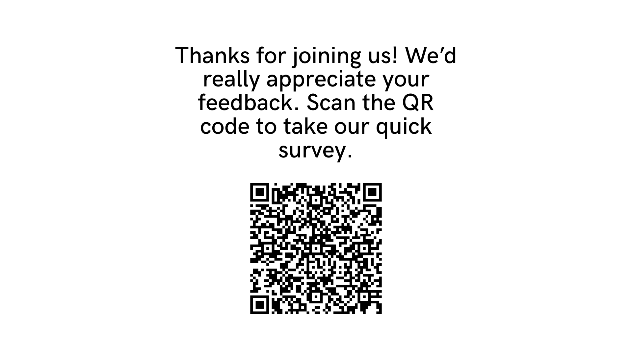
Thank You!

