Slide 1
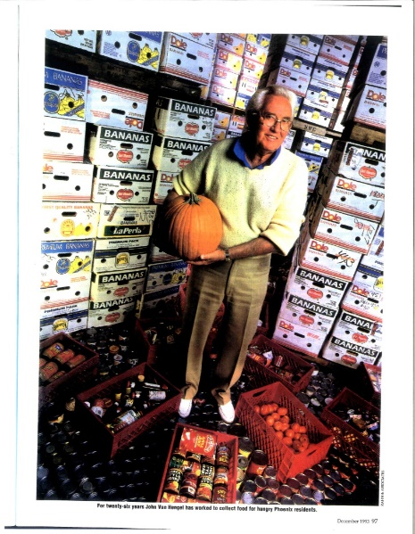
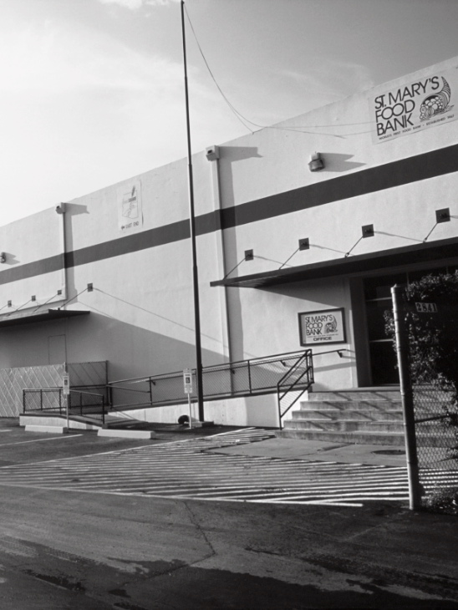
Our Founder – John van Hengel

Slide 2

Mission Statement
To alleviate hunger through the gathering and distribution of food while encouraging self-sufficiency, collaboration, advocacy and education.

Slide 3
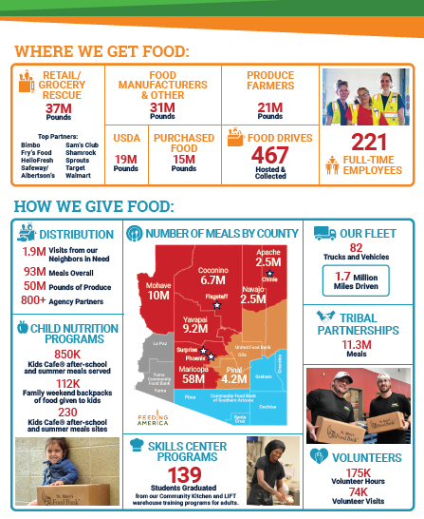
About St Mary’s Food Bank

Slide 4
Inbound Product Mix

Slide 5
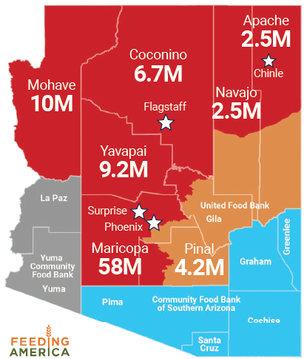
Meals Distributed
FY2023
By County

Slide 6
Tribal Support – FY2023
Support to Indigenous neighbors increased 15%. Mobile Distributions & Tribal Boxes have expanded our reach into Tribal communities
Agency partnerships are key to our growth and reach. Agency partners distributed 90% of food assistance to our Indigenous neighbors.

Slide 7
2024 PRIORITIES
CEO Priorities
Program Priorities

Slide 8
CEO Priorities
Continue to invest in Operations and facilities to be prepared for potential surge in demand from our community
Develop and Align around Strategic Plan – June 2024
Build a SMFB culture of respect, recognition and connection that is consistent with our mission
Be neighbor-focused in all that we do – seek out feedback from our neighbors, partner agencies, volunteers, team
Be a leader in our community – leverage our strong brand and actively engage, convene and collaborate to problem-solve with our partners
Measure and quantify our impact and results – internally and externally

Slide 9
Program Priorities – Agency Partners
Needs assessment – continue to identify areas of unmet need, match communities with food programs, and engage potential partners – focus on rural, remote, and Tribal communities.
Enhanced resources – redesign the client facing pantry finder and improve partner platform. Support partners with enhanced onboarding and ongoing training.
Partner agency engagement – deepen partnerships with more frequent visits and communication.

