Slide 1

Using Rescued Produce
Making the best use of rescued produce!
Timothy Olorunfemi
Program Manager- Gleaning and Food Sourcing
August 26, 2025
Notes:
Hi everyone! I’m Timothy Olorunfemi, Program Manager at St. Mary’s Food Bank. I am responsible for bringing in produce to St Mary’s Food Bank. I’m happy to be here with our partner agencies to talk I’m going to talk to you about various ways and the amount of produce are wasted, different sources of produce, and how to use rescued produce.

Slide 2
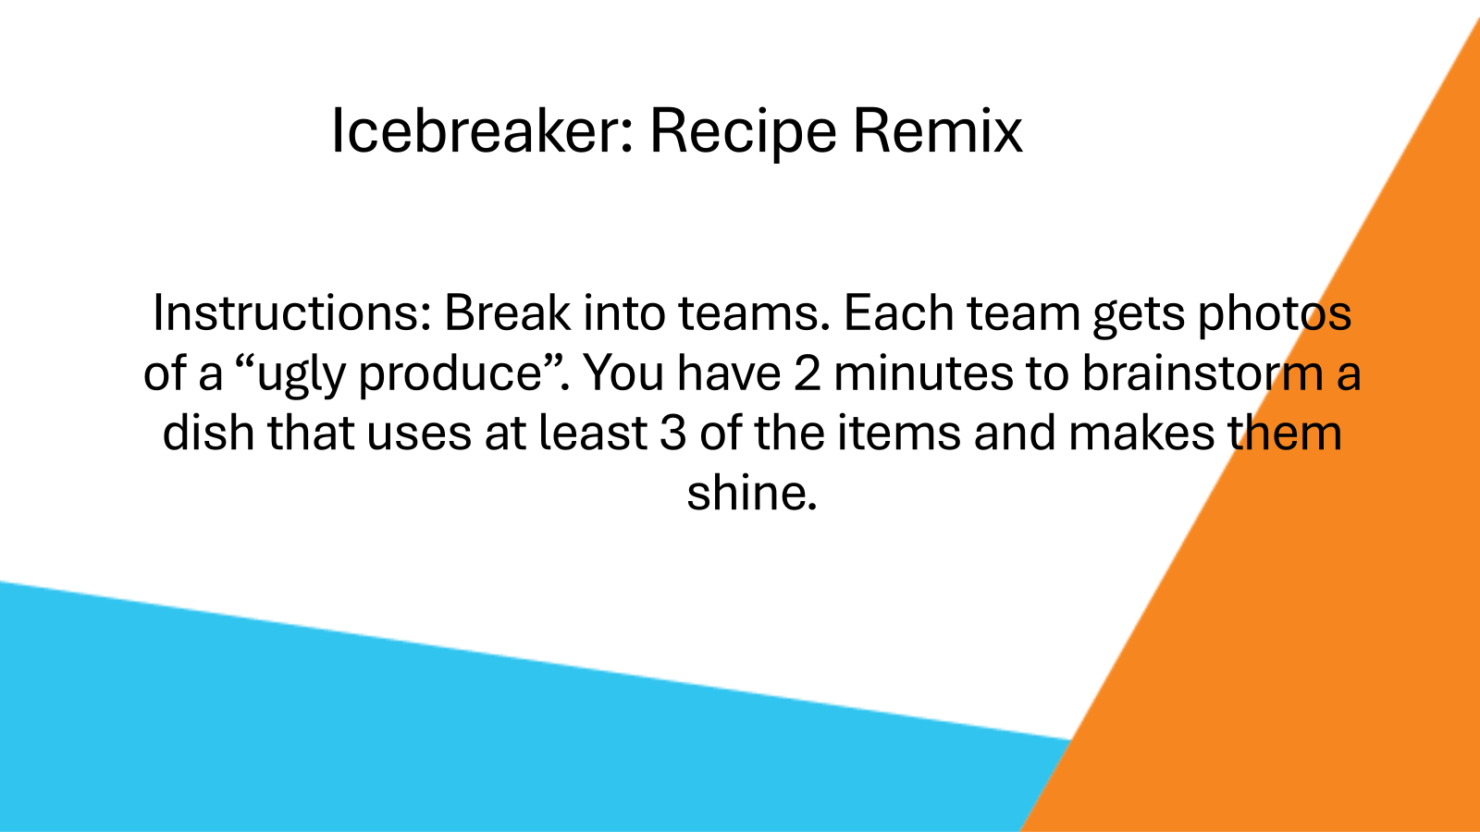

Slide 3
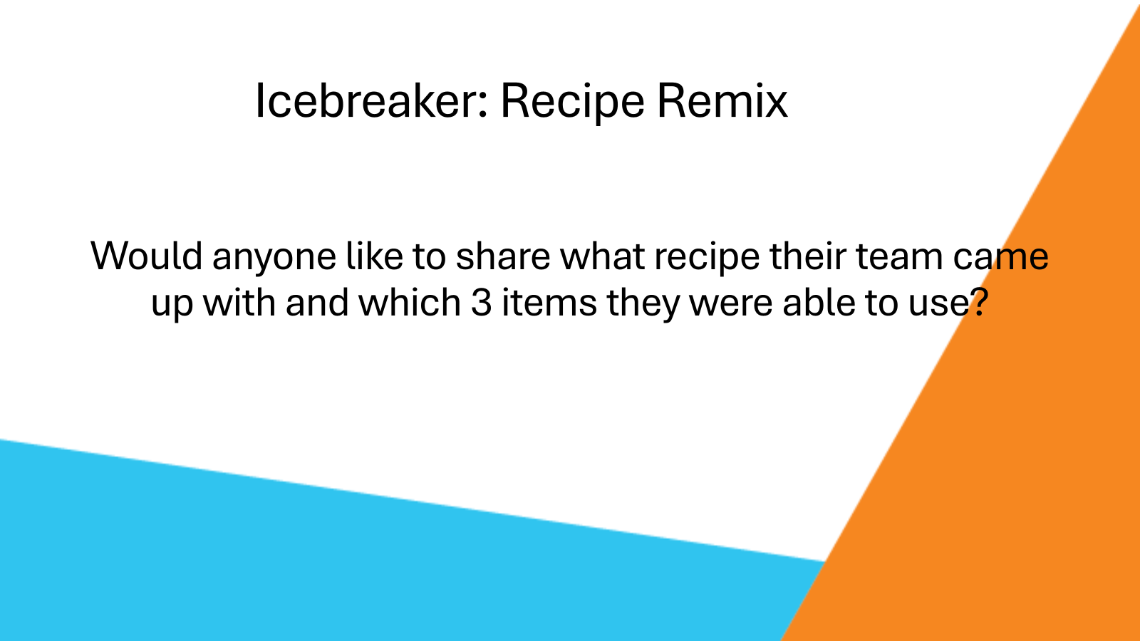

Slide 4
Using Rescued Produce
Making the best use of rescued produce!
Timothy Olorunfemi
Program Manager- Gleaning and Food Sourcing
August 26, 2025
Notes:
Hi everyone! I’m Timothy Olorunfemi, Program Manager at St. Mary’s Food Bank. I am responsible for bringing in produce to St Mary’s Food Bank. I’m happy to be here with our partner agencies to talk I’m going to talk to you about various ways and the amount of produce are wasted, different sources of produce, and how to use rescued produce.

Slide 5
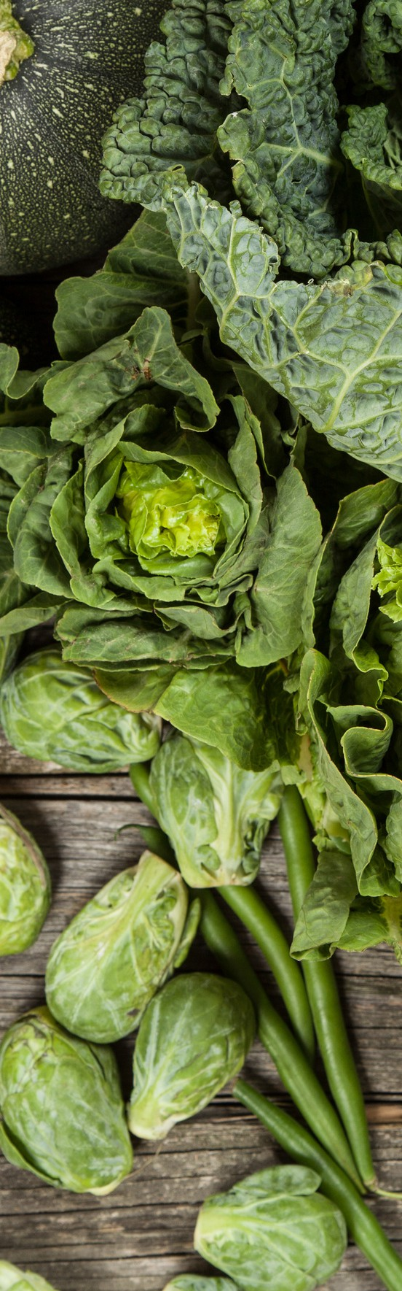
Points of Discussion
The tragedy of food waste in the US
Sources of Produce: Produce houses, farms, & gleaning
How to use rescued food
The beauty beneath the rough layers

Slide 6
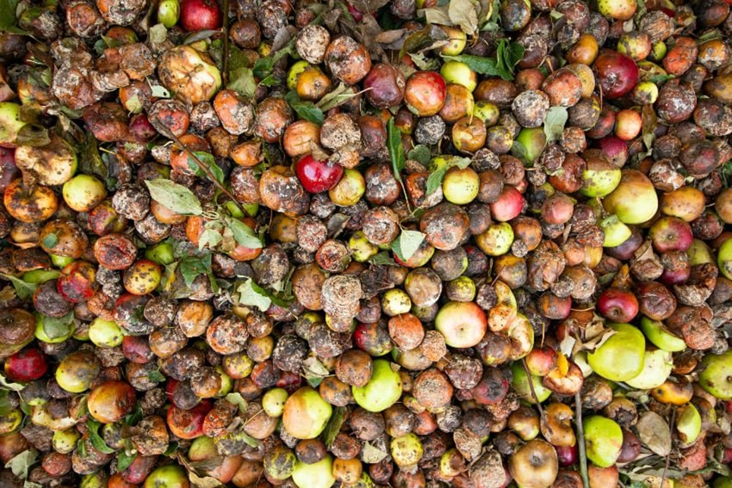
The Tragedy of Food Waste
92 billion pounds of food goes to waste
$473 billions worth of food
38% are unsold or uneaten
Notes:
According to Feeding America. 92 Billion pound of food goes to waste. $473 billions worth of food. 38% unsold or uneaten.

Slide 7
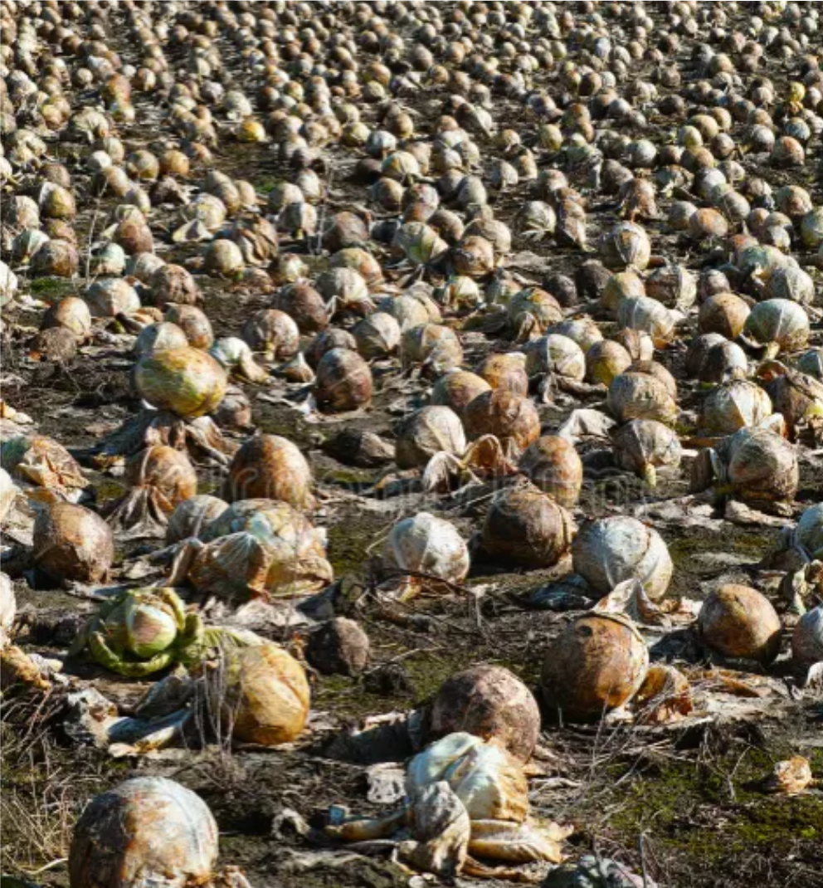
The Tragedy of Food Waste
145 billion meals go to landfills.
51.7% of total waste comes from the food industry
Notes:
145 Billions of meals goes to landfills. 51.7% of waste comes from food industry.

Slide 8
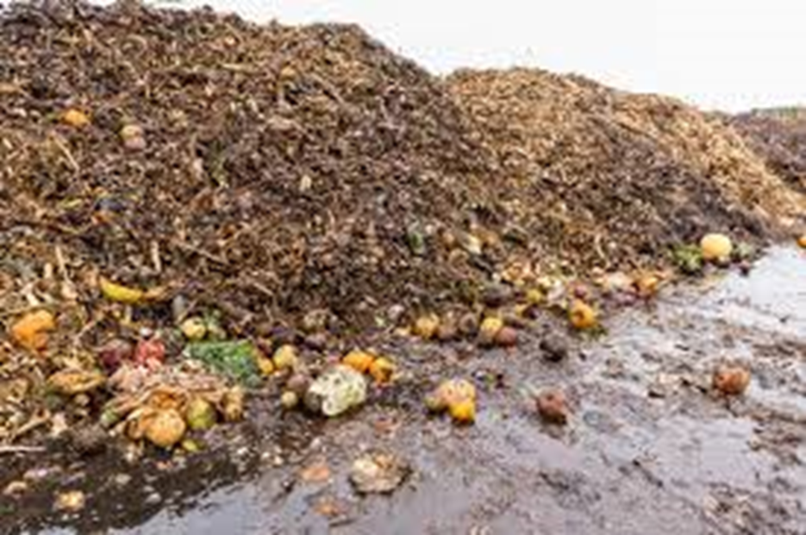
The Tragedy of Food Waste
Food Waste contributes to environmental issues
Notes:
Food waste is not only depriving people of access to nutritious food but cause hazards to the environment.

Slide 9
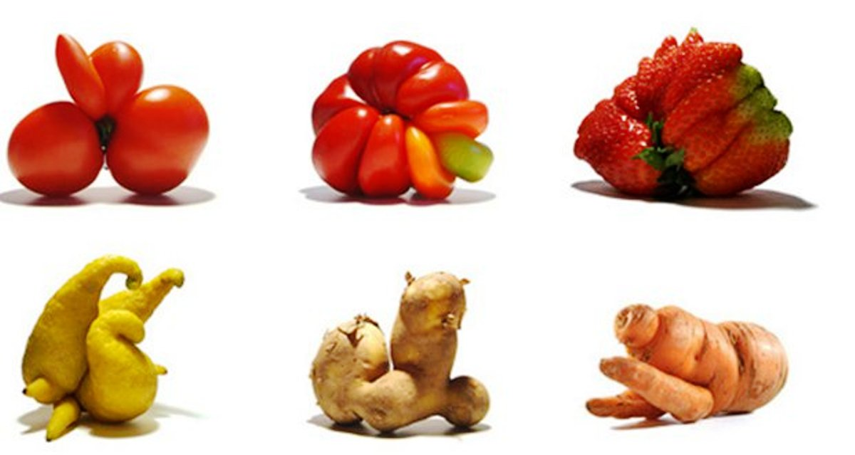
Why Food Is Wasted
Aesthetic - Not the same size, ugly or oddly shaped fruits and veggies.
Sell-by or expiration dates
Notes:
According to Feeding America. Millions of pounds of food go to landfill daily annually for many reason, including aesthetic reason.

Slide 10
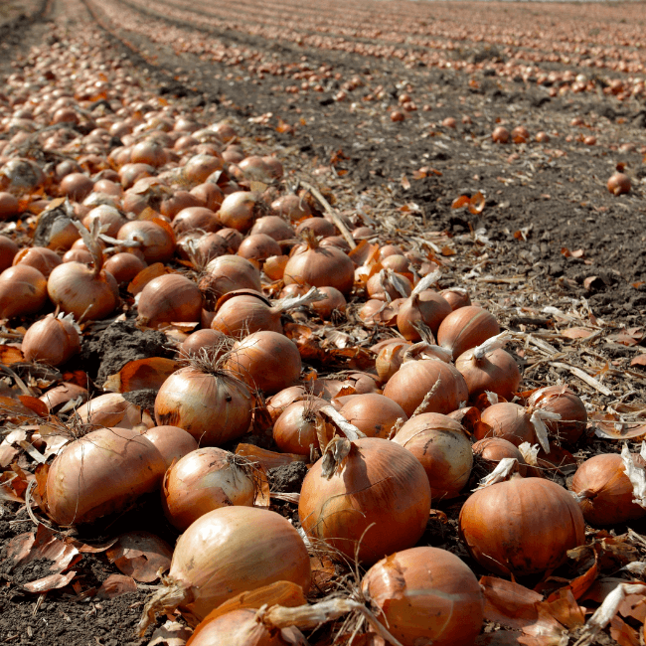
Why Food Is Wasted
Overproduction at farms
Food getting damaged during transport
Notes:
Like in many more years in the past, in 2025 thousands of acres of onion farms were not harvested. Billions of pounds of onions and other produce were disked into the soil.

Slide 11
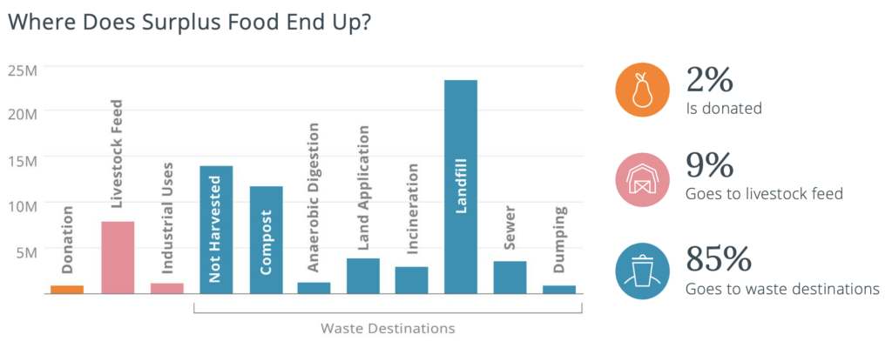
Where Surplus Foods Go
Notes:
Only 2% of the excess food are donated.

Slide 12
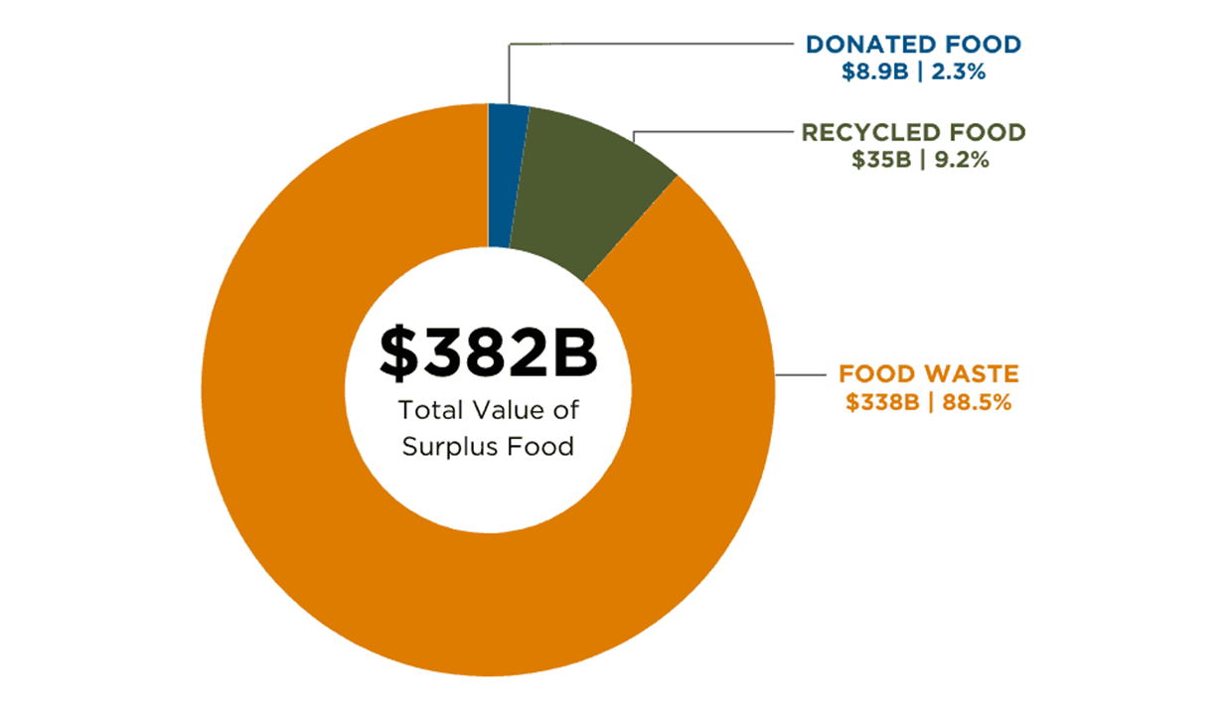
Cost of Surplus Food
Most of surplus food goes to waste
Notes:
$382B worth of food becomes surplus and $338B are wasted.

Slide 13
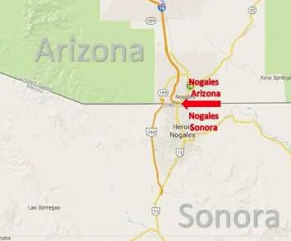
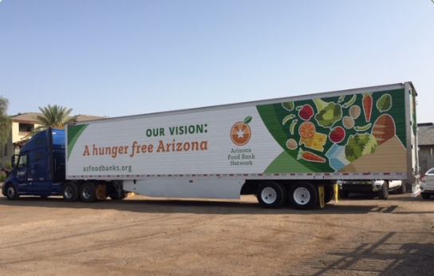
Sources of Produce

Slide 14
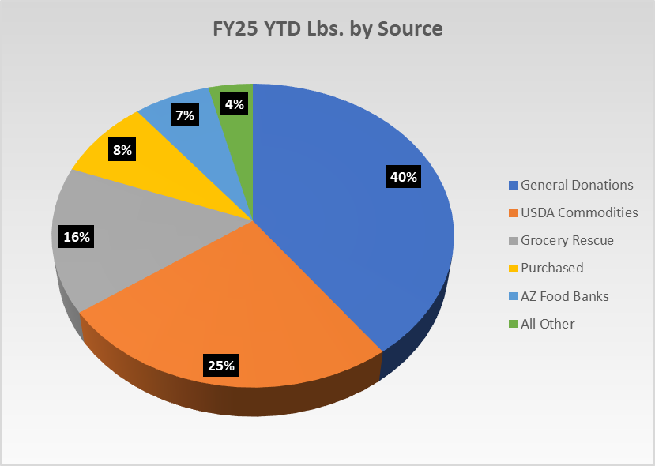
Sources of Food in SMFB
Sources of Food | Pounds CY 2025
General Donations | 41.2M
Gov't Comm. | 30.3M
Grocery Rescue | 22.2M
Purchased Foods | 15.2M
AZ Food Banks | 15.2M
Others | 6.6M

Slide 15
Sources of Produce SMFB

Slide 16
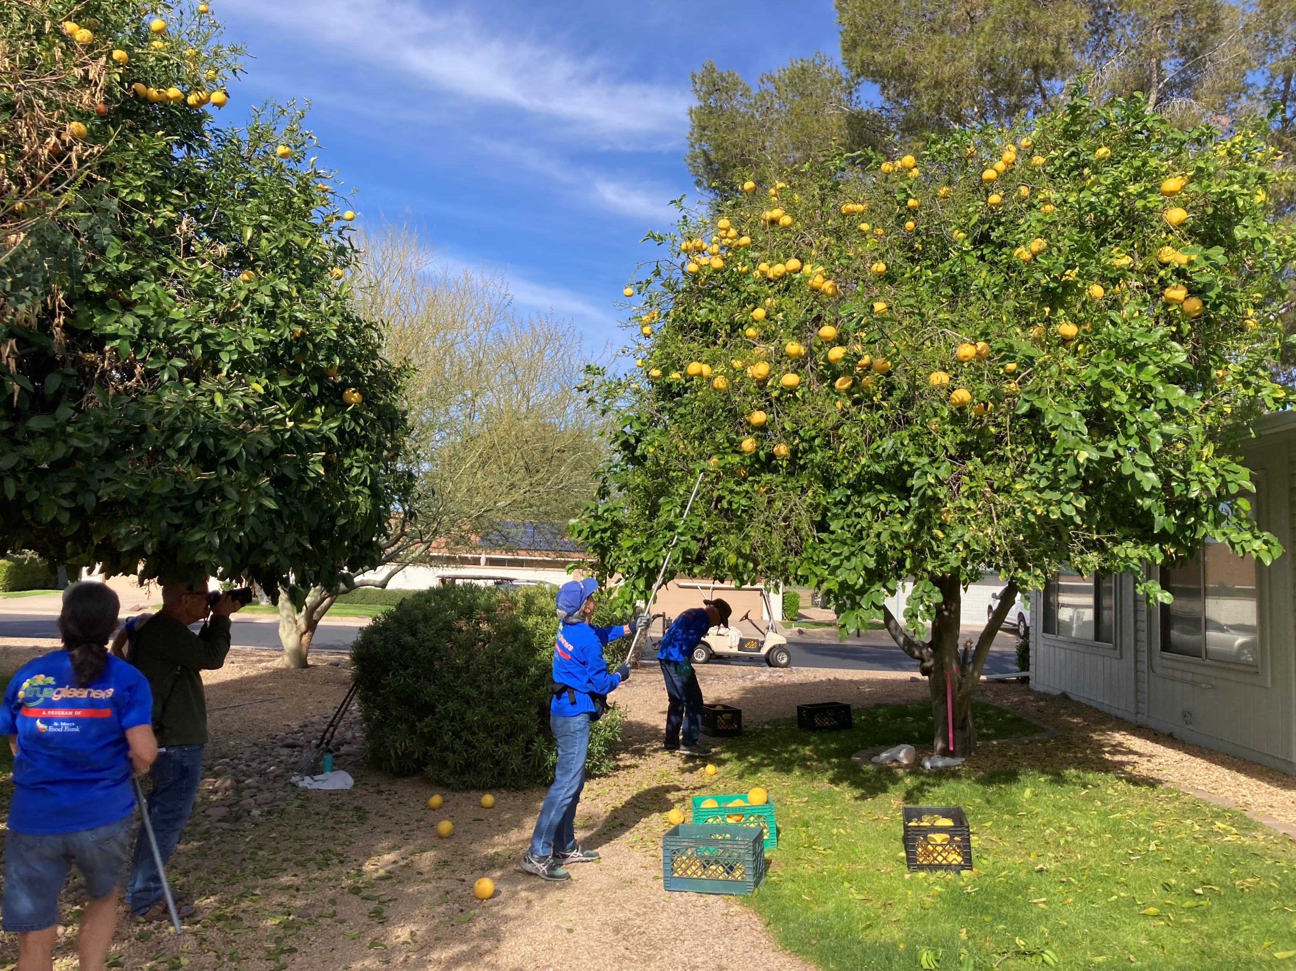
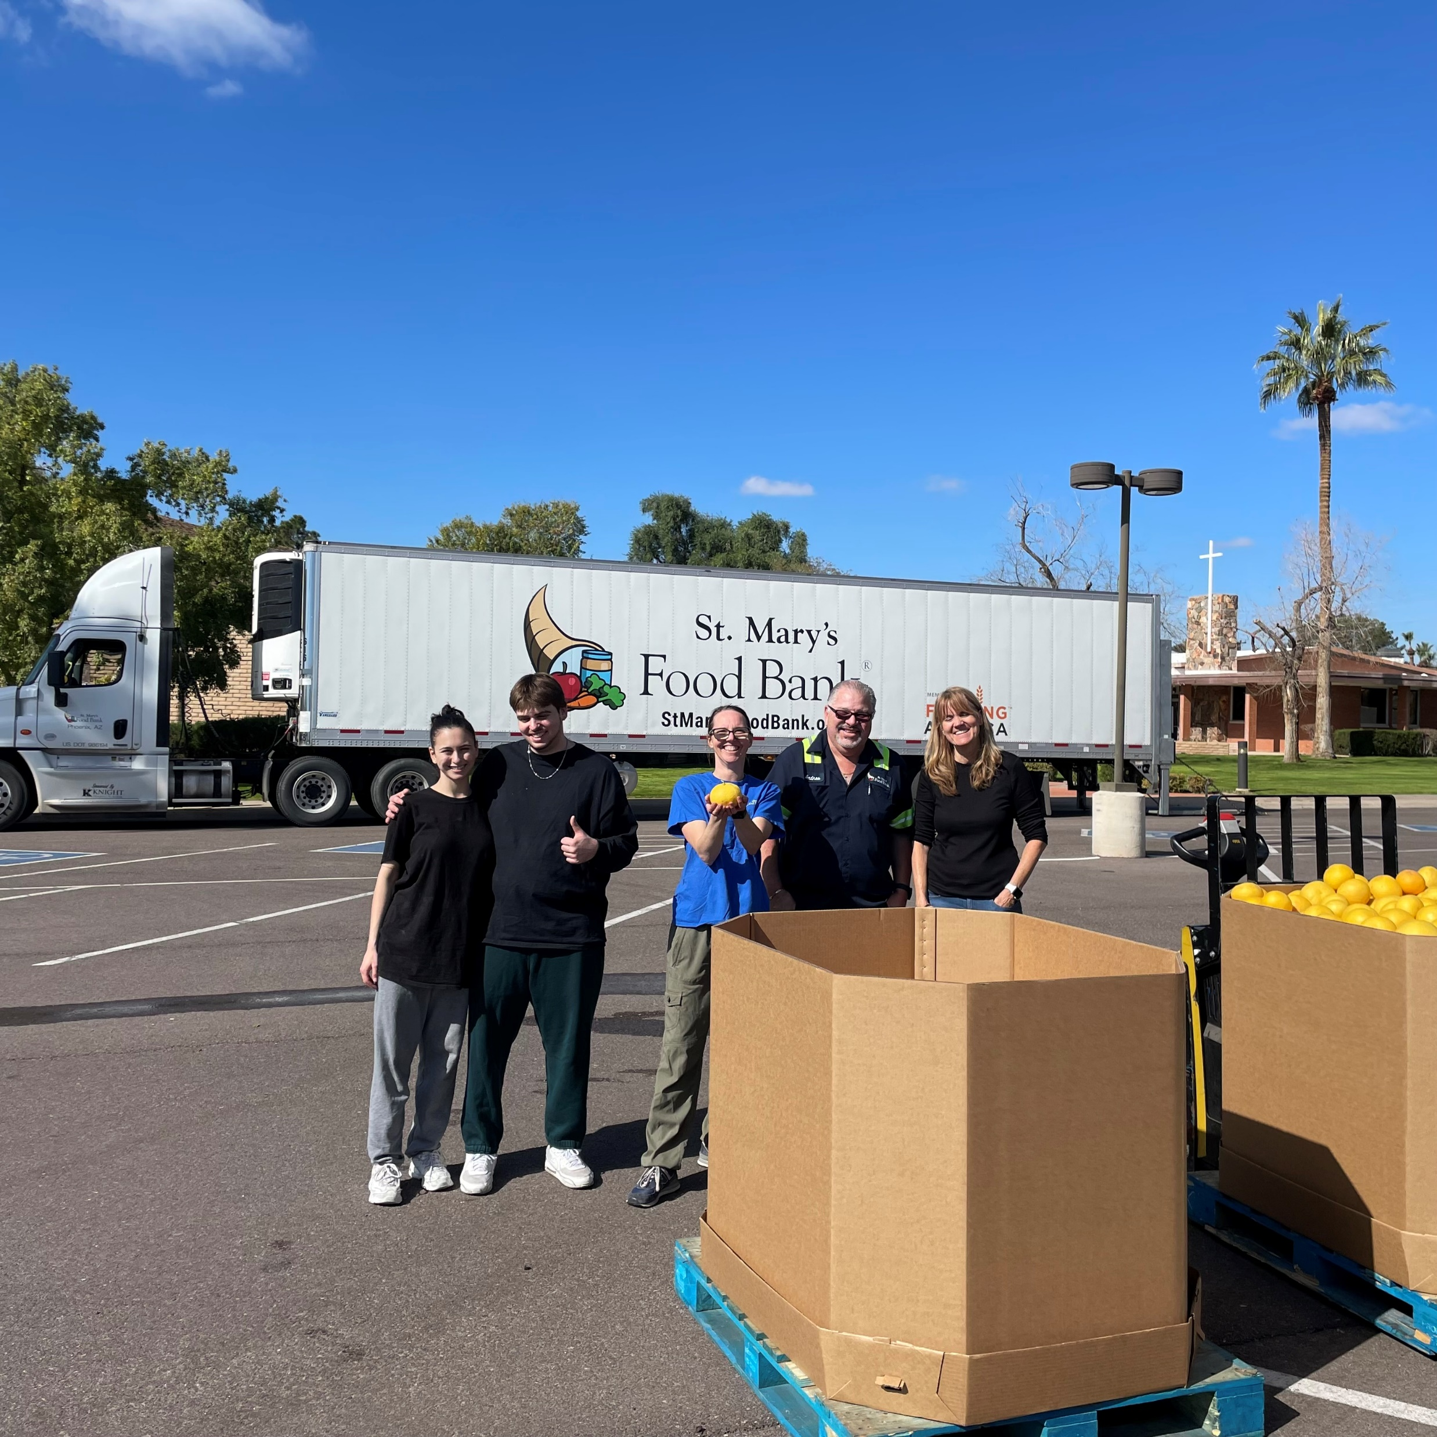
Citrus Gleaning

Slide 17
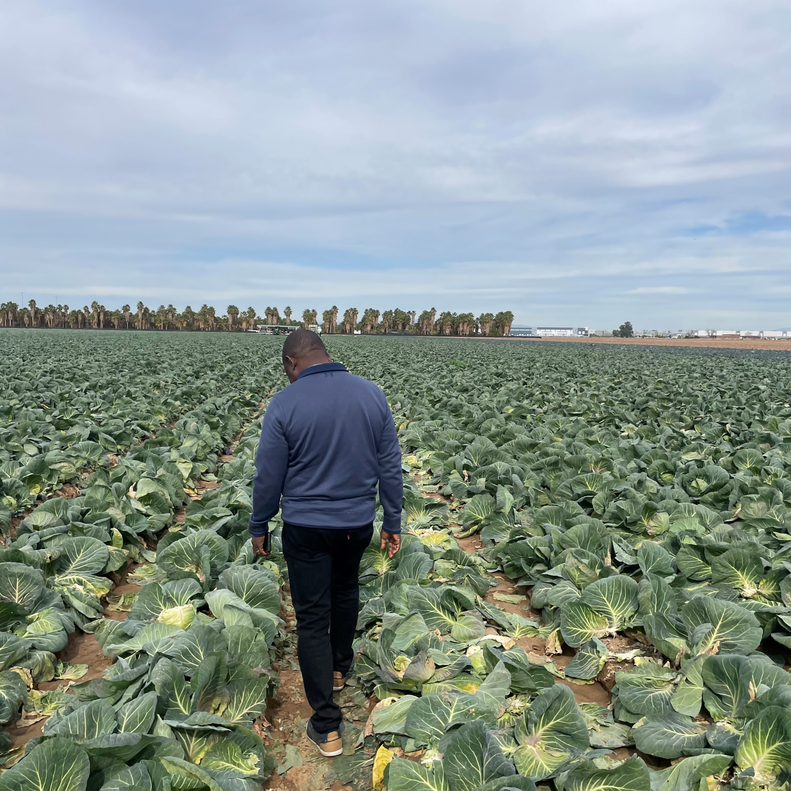
Cabbage Gleaning
Gleaning – second pass
Diminishing land to grown on = diminishing pounds to donate

Slide 18
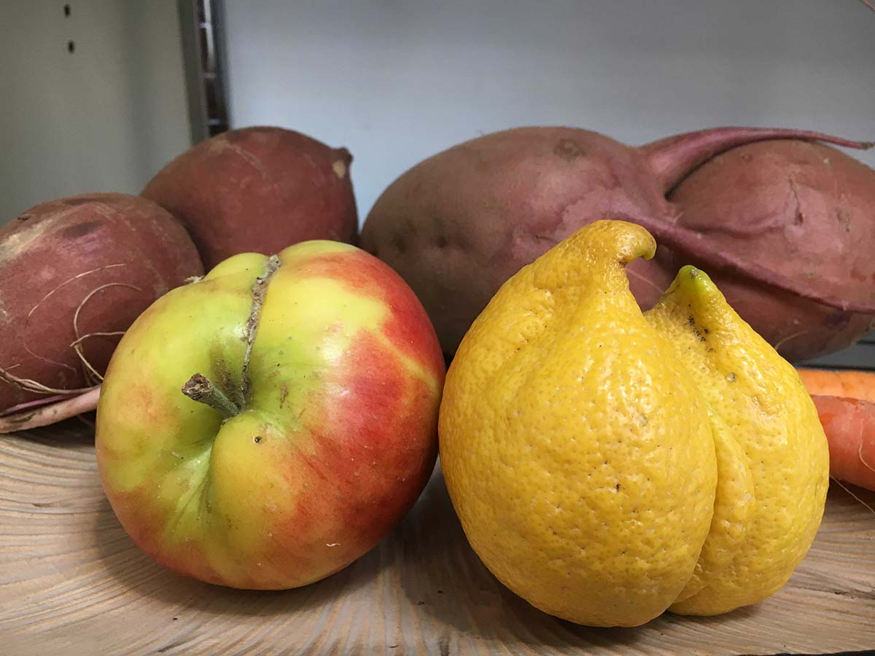
Reasons for Donations
Short Coded
Rejection
Surplus
Cosmetic defects
Quality Control

Slide 19
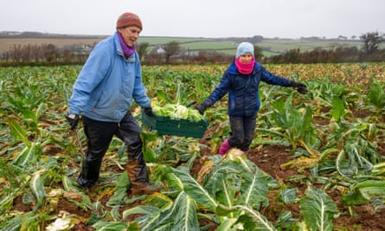
Use of Rescued Produce
We accept 80:20 of rescued/donated produce
We distribute 98.5%
1.5% ends up wasted

Slide 20
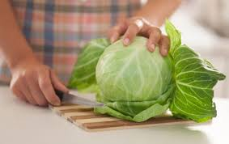
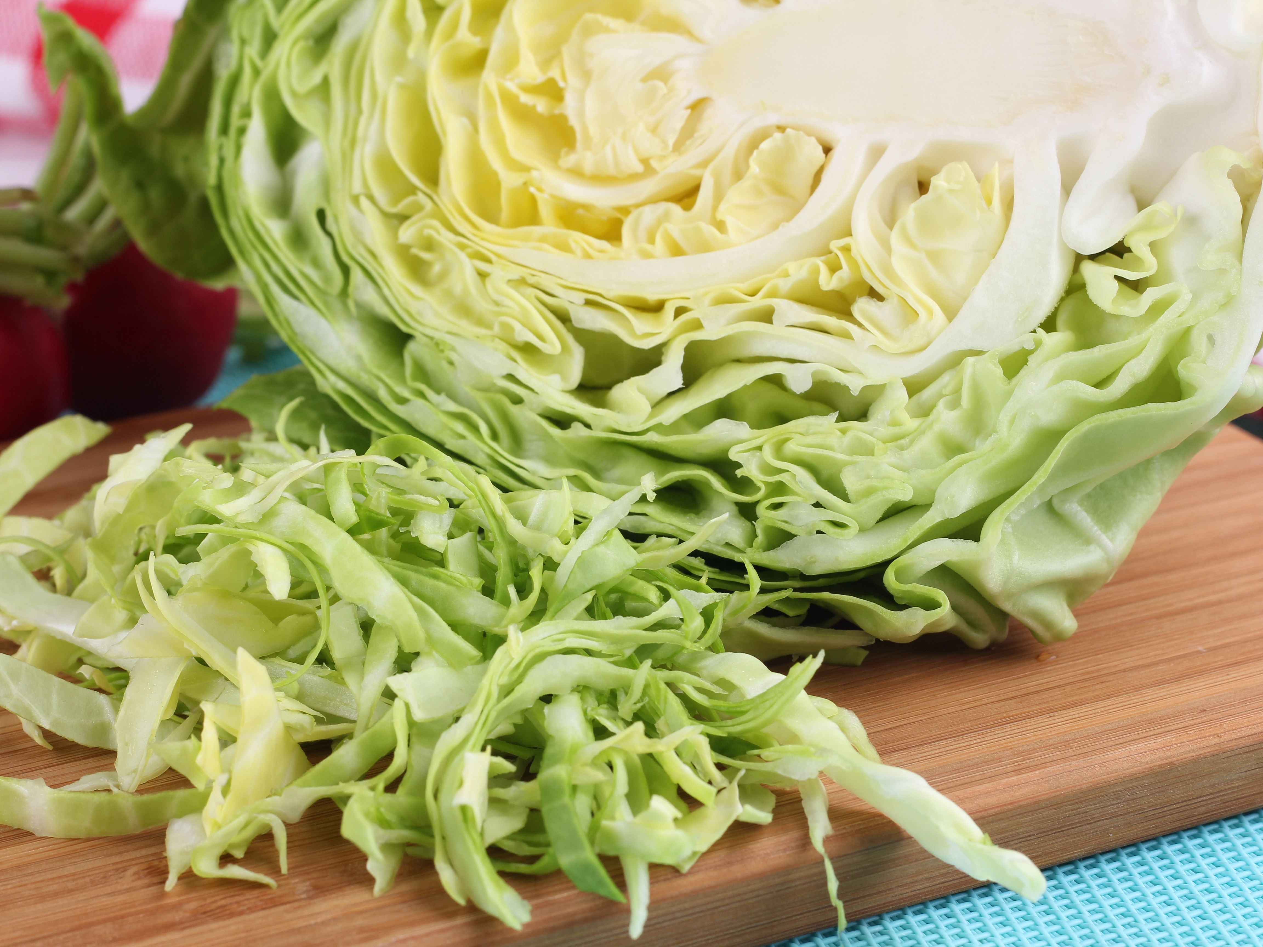
Use of Rescued Produce
Educate your consumers
Final consumers to take off the outer layers
Get information on how to prepare produce

Slide 21
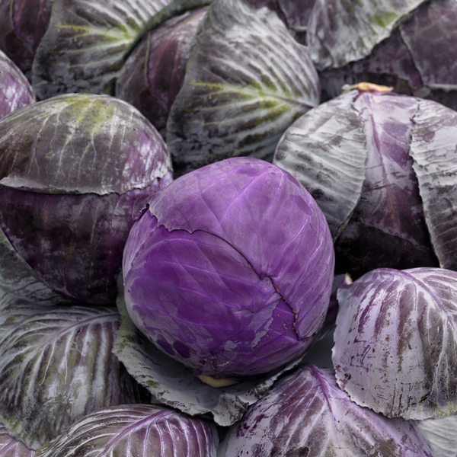
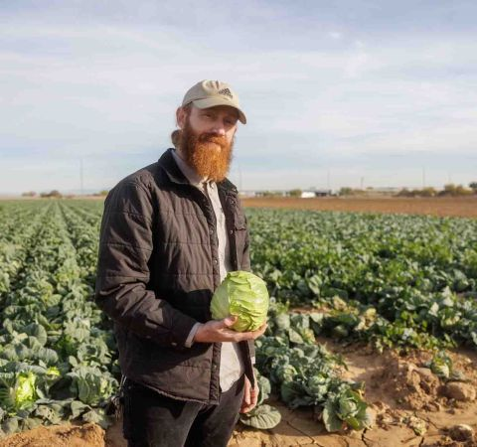
Beautiful Underlay
The quality is the same
Peel off the ugly layers
See the beauty beneath

Slide 22
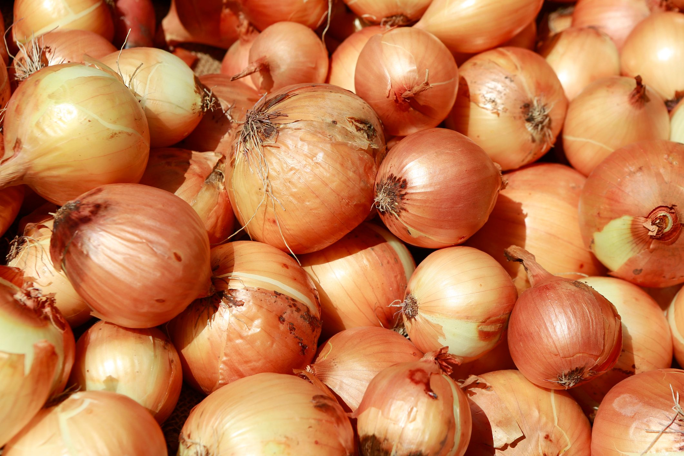
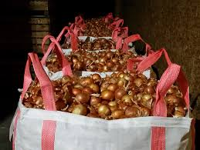
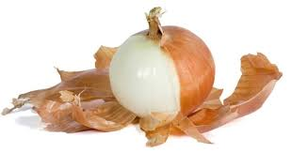
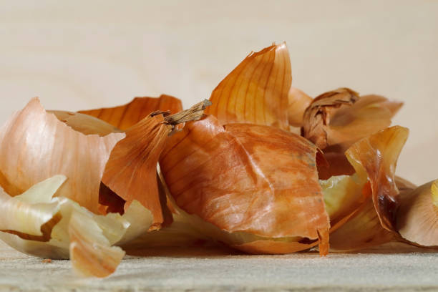
Beautiful Underlay
Peel off the outer layers

Slide 23
Thank you
Questions?
Timothy Olorunfemi
Program Manager- Gleaning and Food Sourcing
tolorunfemi@stmarysfoodbank.org
602 694 0640

Slide 24


