Slide 1
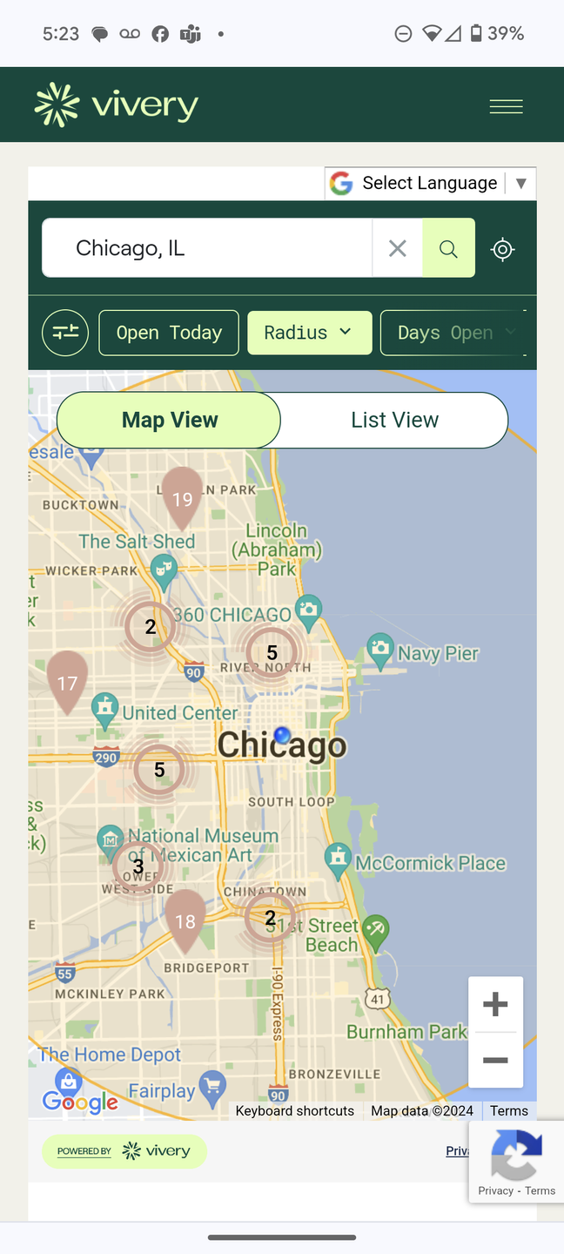

We take care of the tech. You can focus on your mission.
Making Finding Food Easier with Vivery
Notes:
Good [morning/afternoon] everyone! Thank you for joining this session, From Map to Table: Helping Neighbors Find You.
My name is Chris Borresen, and I manage implementation and support for our partner food banks and agencies.
Today, we’ll explore how you can boost your visibility on St. Mary’s AZFoodHelp.org map, connect with more neighbors, and get ready for the statewide rollout requirements coming soon.

Slide 2
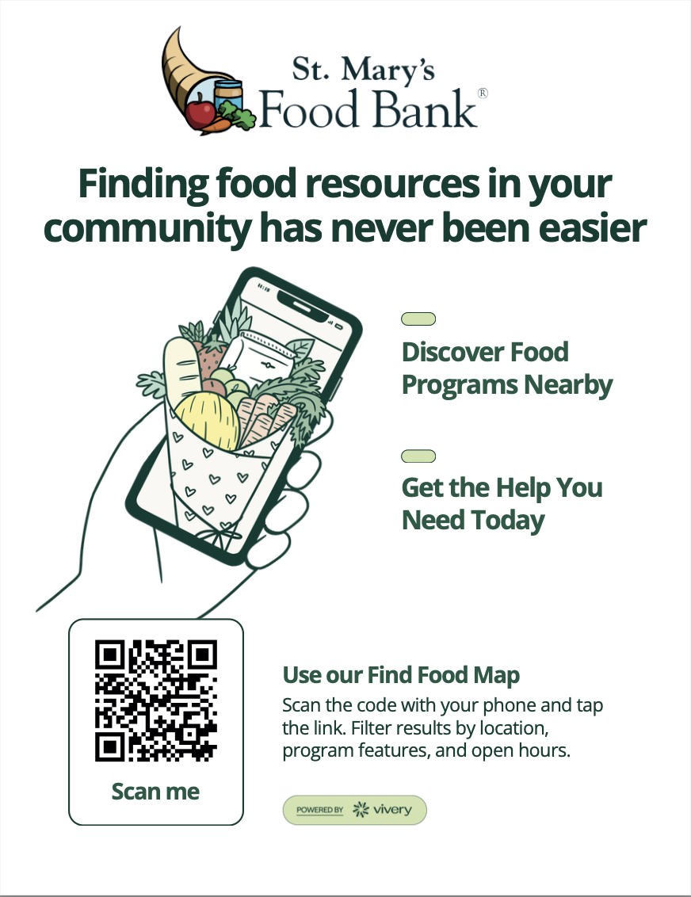
AZ Food Help
Check Out The Map
Find your location and others in your community
Get Your Find Food Map Flyer
  Stop by the Vivery table to pick a Map Flyer
  Great resource to spread awareness of the map with neighbors
Notes:
“Every day, neighbors across Arizona are using the AZ Food Help Map to find food near them. That means families are searching online first — before picking up the phone.
The question is: when they search, can they find you? And if they do, are they seeing the right information?”
Spreading awareness of the Find Food Map within your community can help more neighbors find the resources they need. We’ve created a flyer with a QR code that takes you directly to the Azfoodhelp.org map. Stop by our table today to get one to put up in your location.

Slide 3
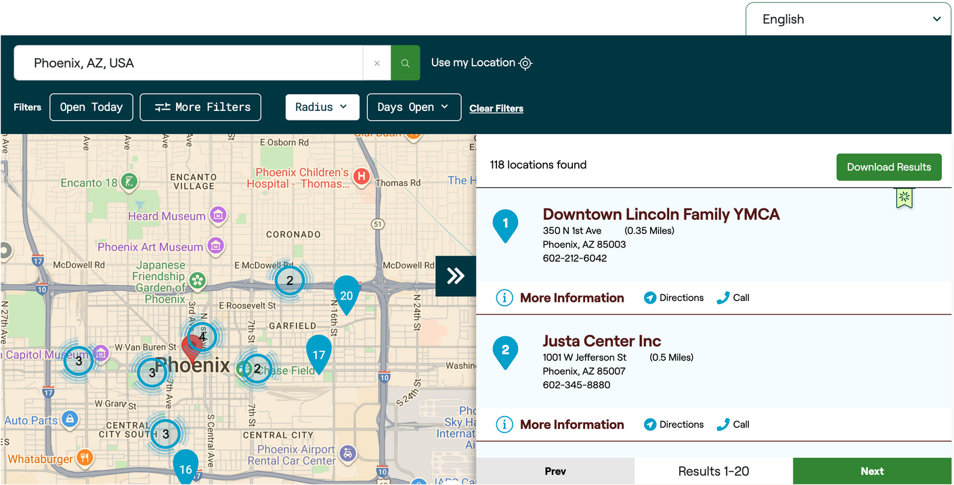
Neighbors Use the Map More Than You Think
Search Frequency
On average the map has 15,000 searches monthly
Most Common Filters Used
  Day Open
  Items Offered
  Food Program
  Food Program Features
Profiles Claimed
  Goal is 100% Claimed
  Current 96%
    11 profile remain unclaimed
    Stop by our table and claim today!
Notes:
Currently, the map sees an average of 15,000 searches a month. The most commonly used filters in these searches are the Days Open, Items Offered, Food Program, and Food Program Features.
The team at St. Mary’s is committed to their goal of 100% claimed profiles across their network and I am excited to share that there are only 11 profiles that remain unclaimed. I’d be happy to help get those claims done today!

Slide 4
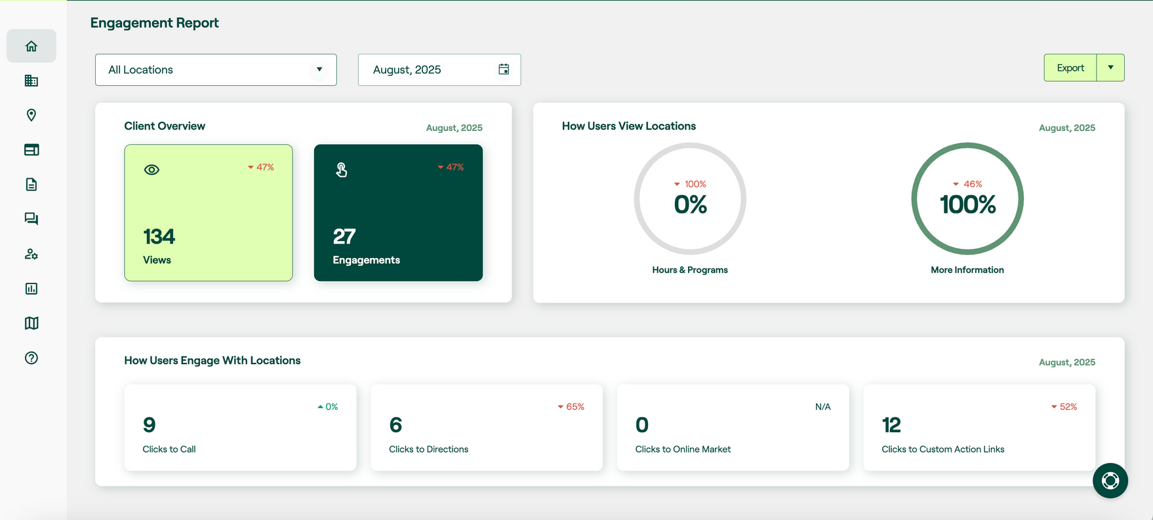
How Many Neighbors Are Viewing Your Profile?
Get statistics right on your Vivery platform home page.
Notes:
To see how many neighbors are viewing or engaging with your agency profile, you can check out your engagement report. The Engagement Report is located on the home screen when you log into Vivery, but you’ll have to scroll down to see it. This report gives insights into how many views your profile has had and how many clicks for directions, calls, etc.

Slide 5

Profile Completeness
Ensure neighbors find the right locations for their needs
Notes:
Frequently at conferences or other agency events, we’ll talk about getting into the Vivery platform for the first time. But, since your network is already 96% claimed, we can jump to the next level: Completing your profile to ensure neighbors find the right locations for their needs.

Slide 6
Key Profile Sections to Complete
Location
Programs
Location Hours
Location Features
Images
Food Program Features
Items Offered
Program Hours
Completing these sections only takes a few minutes and gives neighbors the key details they need to participate—helping them find the right locations and programs for their needs without having to make a phone call.
Notes:
This is where you come in— whether that means updating your hours, distribution type, or special programs.
It only takes a few minutes, and it saves your neighbors the frustration of calling or showing up without the right details.
Location features = close to public transit, parking
Food Program Features = online ordering, client choice
Items offered = eggs, meat, or non-food items like toiletries

Slide 7
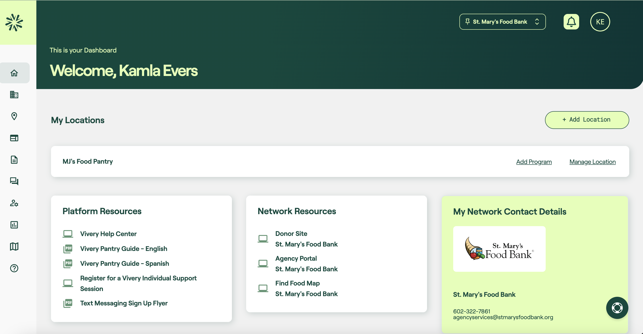
Getting to Your Profile
Click
“Manage Location”
Notes:
Completing your profile is not a long or complicated process. We have group and individual trainings available if anyone wants to get more detailed on updating profiles, but for today, I’ll do a quick overview. By the way - you can log in and do this just as easily from a computer or a phone!
For the agencies that have not claimed yet, the actual first step is to create your account and claim your profile. Again, I’m happy to help you through that process (also easy), or you can contact the folks at St. Mary’s to get started. Once claimed, log into Vivery (smfb.Vivery.org or manager.Vivery.org) - when you arrive at your dashboard click "Manage Location" to go to your profile.

Slide 8
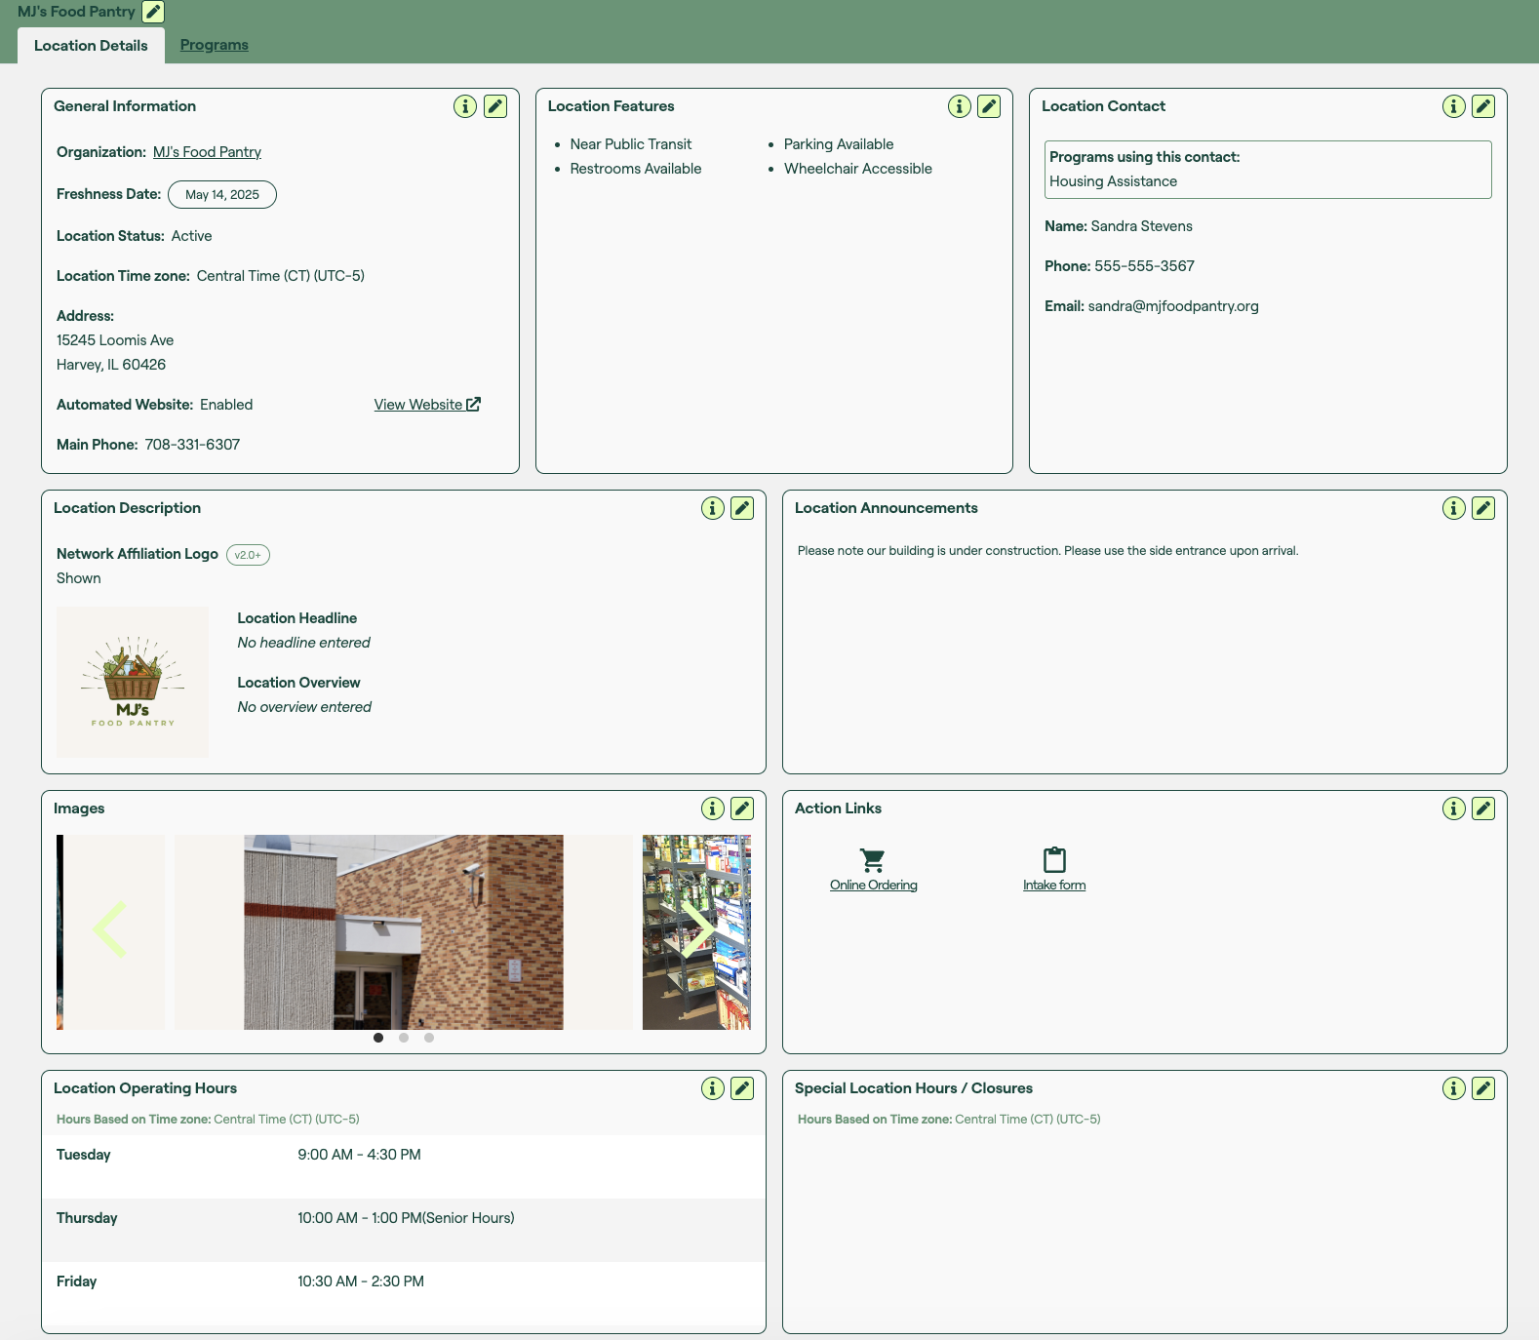
Location Details
Key Sections to Complete
  Location Features
  Location Hours
  Add Images
    Building
    Front Door
    Distribution
Notes:
Any of these areas are editable by clicking the pencil icon. Obviously, anything that has changed or may be incorrect should be updated, but the key areas to focus on are the Location Features, Images, and Hours.

Slide 9
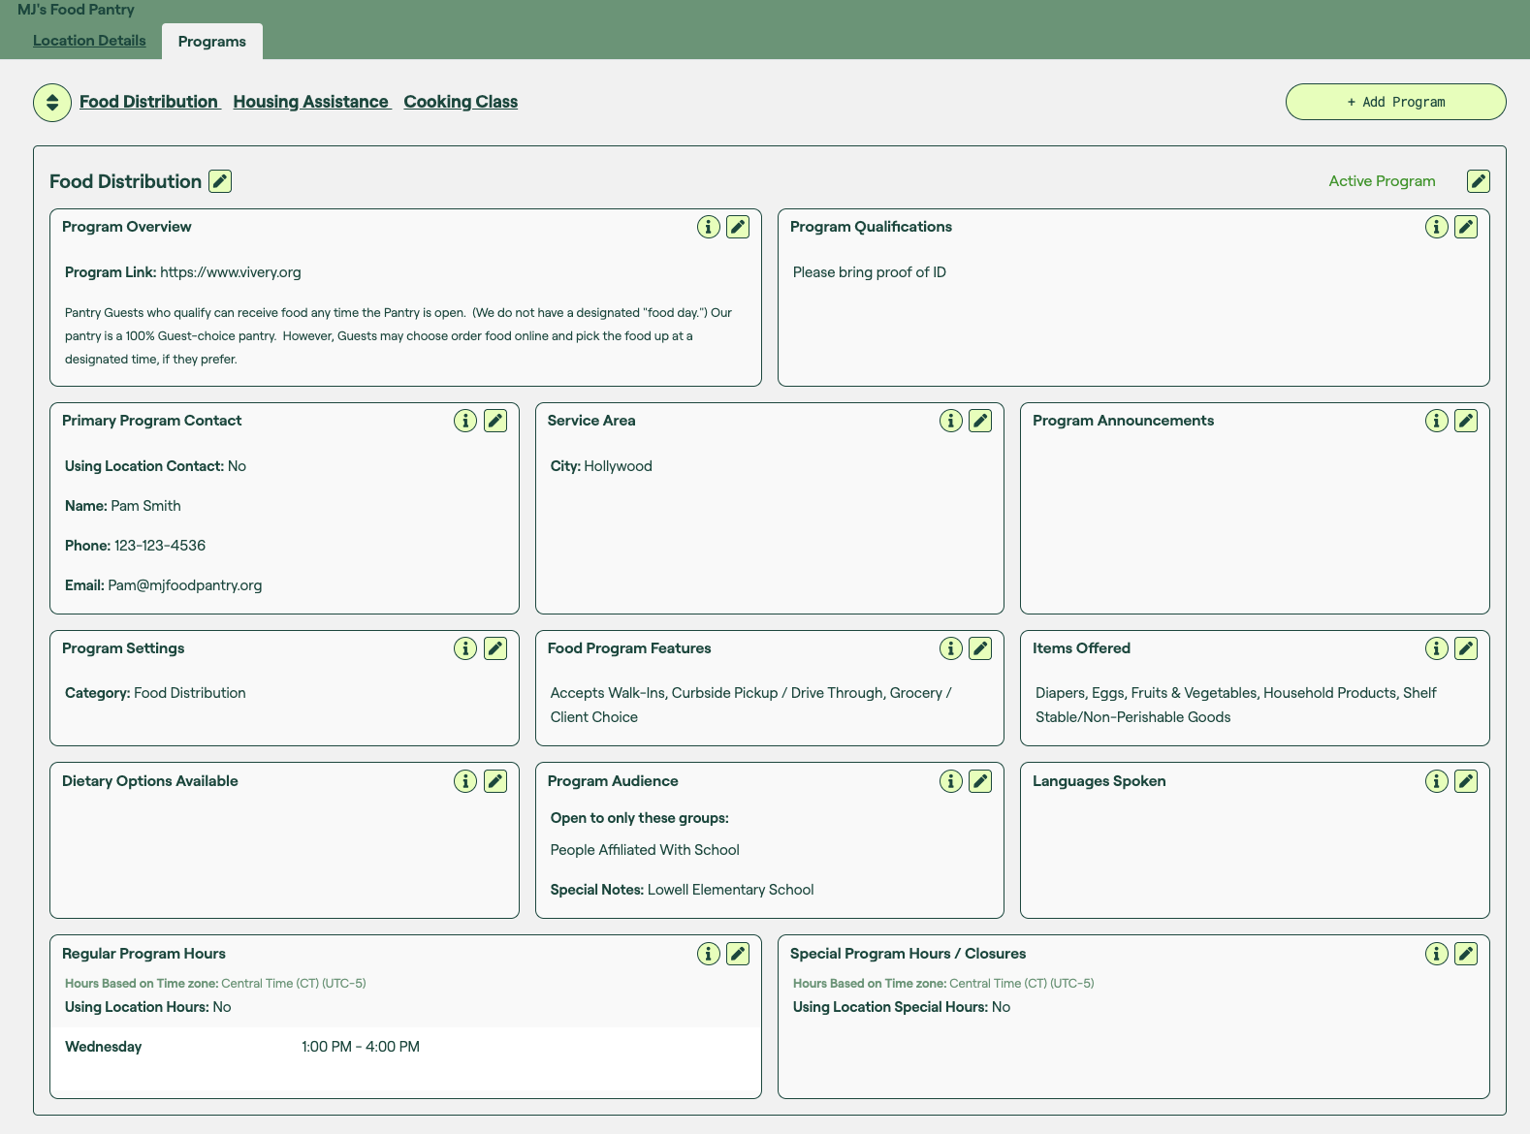
Program Details
Key Sections to Complete
  Food Program Features
  Program Hours
  Items Offered

Slide 10
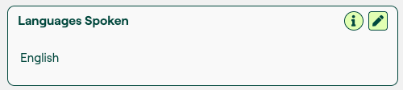
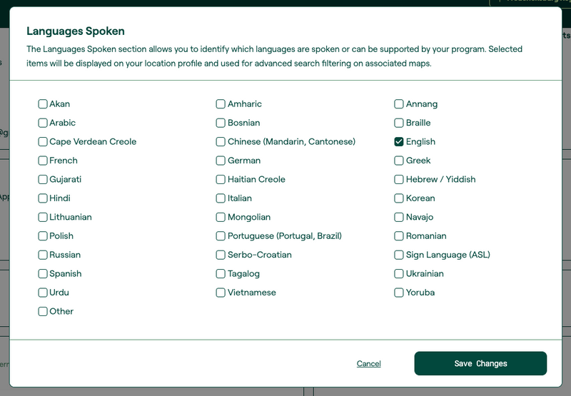
Update Languages Spoken at Your Location
Location Profile > Program Details > Languages Spoken
Share languages spoken at your location
Easily let neighbors know what languages are spoken at your location to make your services more accessible.
Notes:
Just a quick example of how some of these fields work – if you click the pencil in the program’s languages spoken area, you get a list of possible languages (and an “other” option). Check all that apply for your agency, then click Save Changes. Now, when a neighbor finds your agency, they’ll know they can speak in their preferred language.

Slide 11

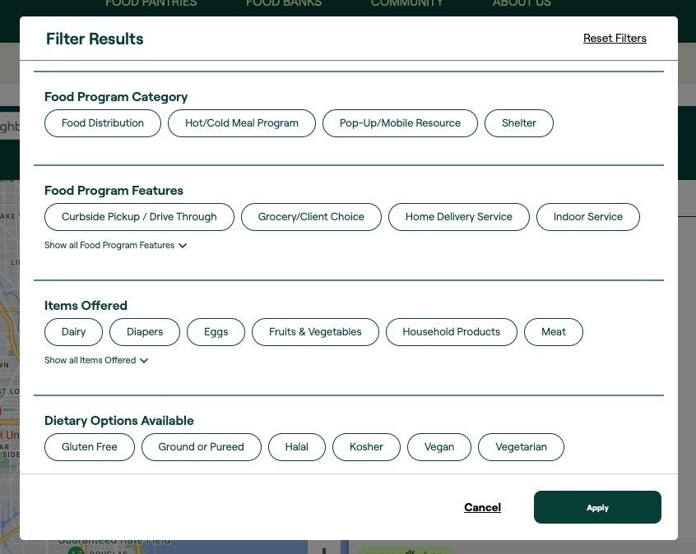
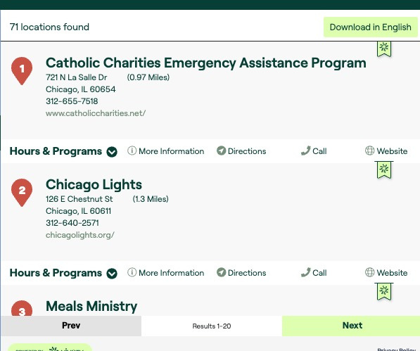
Information Neighbors Can Trust
Freshness Badge
Confidence in accurate information
Expiration: 120 days
How it works:
Stay fresh with updates:
  Any time you update your profile the 120 day clock restarts.
Staying fresh without updates:
  After 120 days Vivery will send you an email that lets you review and verify your details.
Lost your badge?
  Just log in and open any section of your profile and click “save”.
Notes:
Accuracy matters. That’s why every profile has a 120-day freshness badge.
Here’s how it works:
Every time you update your profile, the 120-day clock restarts.
If you don’t update, Vivery will remind you at the 120-day mark to review and verify your details.
Lost your freshness badge? Just open your profile, make any edit, and click ‘save.’ Or, just reply to the 120-day email we’ll send to remind you.
The freshness badge builds trust with neighbors — it shows them they can rely on your information.

Slide 12
Current Freshness Across the Network
XX profiles have expired badges
Go to Azfoodhelp.org/find-food-now/ and search your address to see if your profile has an active badge.
Check your last update date in Vivery
Login>Manage Profile>General Information>Freshness date
  Your Freshness Badge is good for 120 days from that date.
Notes:
Go to AZFoodHelp.org and search your agency’s address to see if you have an active freshness badge.
Whether you do or don’t have a freshness badge displayed, I suggest logging in to the Vivery platform and verifying when you last made an update. You can check that at [login/manageprofile/general information/freshness date]

Slide 13
Vivery Across Arizona

Slide 14



Vivery in Arizona
Statewide Coverage
Vivery is being implemented at every Food Bank in Arizona
    Mandated by the Arizona Department of Economic Security.
Neighbors across the state will rely on Vivery-powered maps to find food
resources in their communities.
Case Managers and Navigators will also use these maps to connect people
with the help they need.
Why it Matters: With so many people depending on Vivery to find food for themselves or others, it’s crucial that your profile is complete and kept up to date.
Notes:
Vivery is being implemented across all Arizona food banks, as required by the Arizona Department of Economic Security, creating one consistent statewide network.
That means your visibility doesn’t stop at the counties you serve. Neighbors searching anywhere in Arizona, and on any Arizona food bank’s map, will benefit from accurate, up-to-date information.
Neighbors across the state will rely on Vivery-powered maps to find food resources in their communities.
Case Managers and Navigators can also use these maps to connect people with the help they need.
With so many using Vivery powered maps to find food for themselves or others it is even more important to ensure that your profile is completed and up to date.

Slide 15
Stay Connected

Slide 16
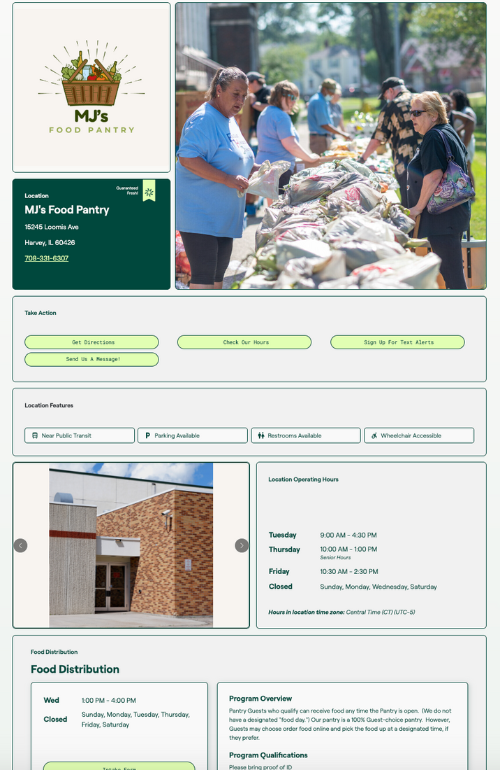
Benefits of a Free Automated Website
Help neighbors find your services
An automated website ensures neighbors can find your services when searching on the internet for food resources in your community.
Enhance an existing website
  Program is a part of a church or larger nonprofit
  Can be linked on a page to provide up-to-date info
    Automatically synced anytime the profile is updated.
Notes:
One of the biggest benefits of claiming your Vivery profile is the free automated website. This is not a requirement, but an added benefit if you don’t currently have a website, or if you’re not happy with your website.
It gives you a professional online presence instantly, without extra work — and it’s automatically updated when you update your profile.

Slide 17

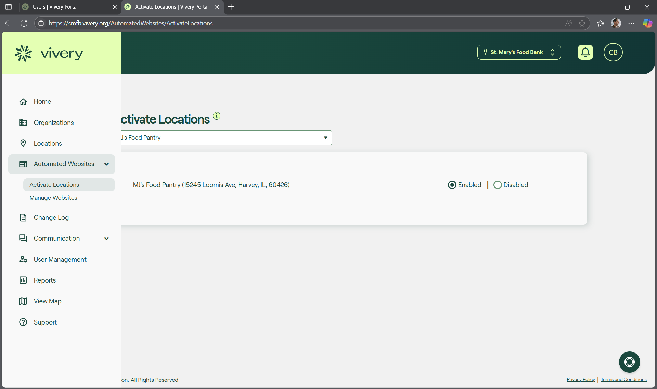
How to Activate
Get Started in 3 Simple Steps:
  Click Automated Websites in the navigation menu
  Click Activate Locations
  Click Enabled
Notes:
Getting started is simple:
Go to Automated Websites in the left navigation menu,
Select Activate Locations,
Click Enabled
To view your new site, go back to the left navigation menu and click Manage Websites.

Slide 18

Real Time Connections with Free Text Message Alerts
Fast, Simple Communication
Vivery’s free text alerts let you easily send important updates to neighbors and volunteers.
Use it for:
  Emergency closures
  Weather-related changes
  Special item availability
  Volunteer communication
42 Locations currently have Text Message Alerts Activated
Pro Tip: Start building your contact list now—so when you need to send an alert, you're ready.
Notes:
Another powerful tool is free text messaging.
With text alerts, you can:
Notify neighbors about emergency closures or weather-related changes,
Announce special item availability
Or communicate with volunteers.
Pro tip: start building your contact list now, so you’re ready when you need it.

Slide 19

Why Agencies Love Vivery’s Text Alerts
“Vivery text messaging couldn’t have worked better! Our neighbors were delighted to get the emergency distribution notification so they didn’t miss out, and we didn’t have to throw away one piece of meat. Vivery is one of the best steps we have taken to have better contact with our community and lighten our workload.”
Callie Fields, Food Pantry Director,
Living Water Life Center
A Powerful tool in the palm of your hand
  Real-time outreach
  Boosts turnout at distributions
  Helps manage volunteers
  Builds trust and transparency
Notes:
Here’s what one food pantry director told us who had a freezer fail and no timely repair available: “ read quote “
That’s impact in real time.”

Slide 20
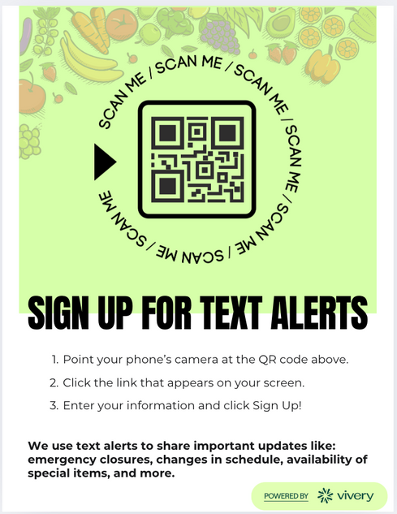
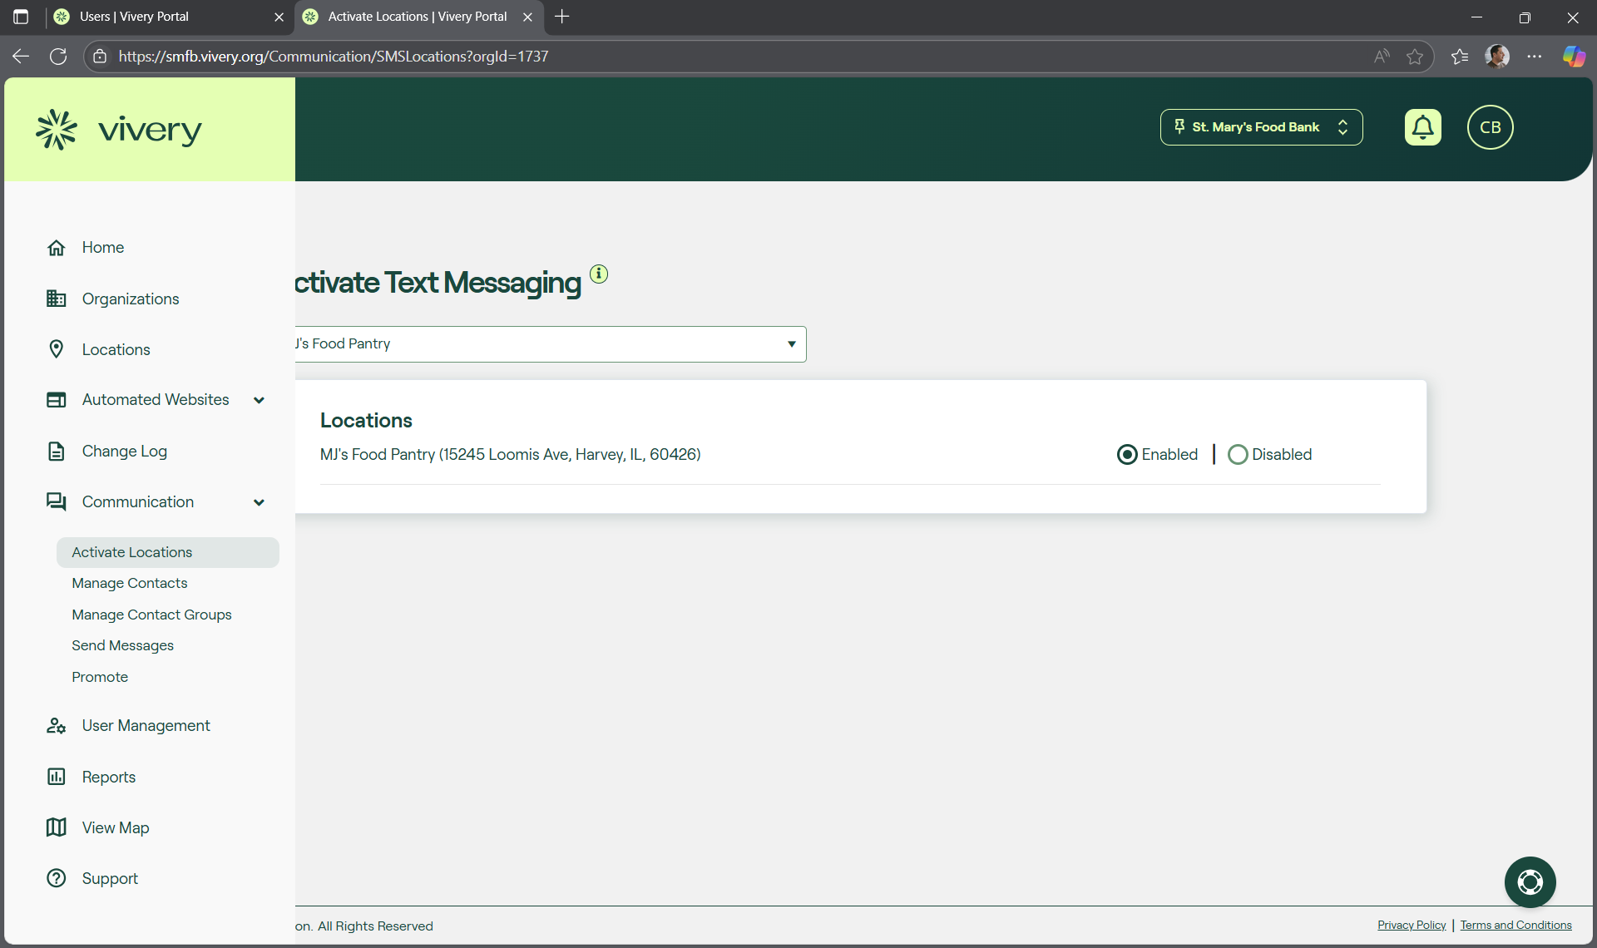
How to Activate
Get Started in 3 Simple Steps:
  Click Communication in the left navigation menu
  Click Activate Locations
  Click Enabled
Pro Tip: Use a QR Code to promote joining your contact list and start collecting phone numbers today.
Notes:
“Getting started is simple:
Go to Communication in your Vivery menu,
Select Activate Locations,
Click Enabled.
And here’s another pro tip: Use a QR code at your site to start collecting phone numbers today.

Slide 21

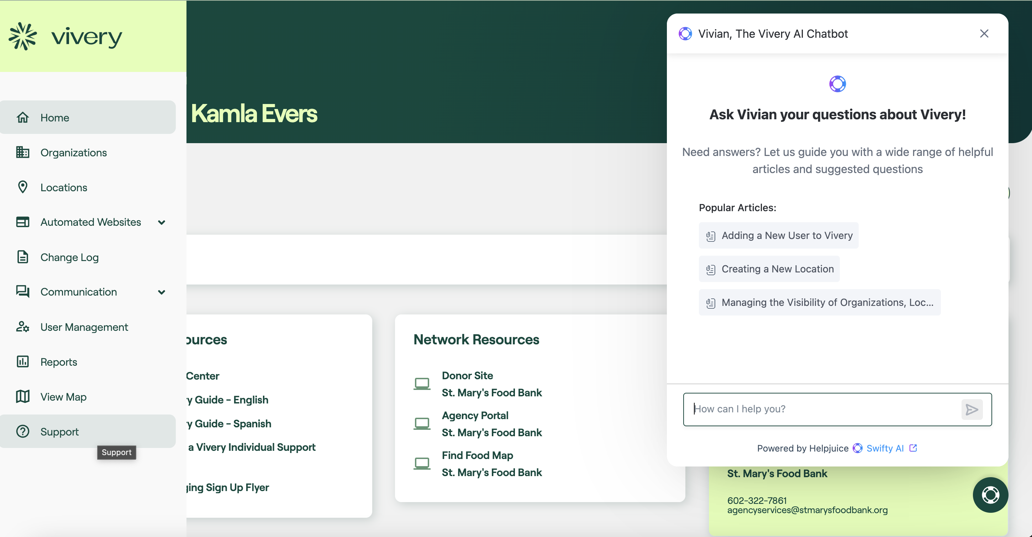
Have a question?
Get quick on-demand answers to your questions with our new and improved knowledge base
On-demand resources
Click
“Support”
Ask Vivian
Click
“Lifesaver icon”
Notes:
If you ever have any questions while using Vivery, there are two quick ways to get answers. The first is by clicking the support link in the left navigation menu. That will take you to our newly revamped knowledge base. If you’re not sure what to look for but have a question, we now have a chat bot that we’ve named Vivian. You can type a question in plain English and Vivian will pull up the most relevant articles or videos to help you. If these options are not getting the answers you need, we have lots of other options.

Slide 22
How to get additional support
Have other questions or need help getting started? Check out these options:
Live Group Training Sessions:
Join us for a 1-hour live training session to learn how to use Vivery, best practices, and what to expect during your set up process and beyond. Training sessions occur every other week.
To register: https://go.vivery.org/quickstartwebinars
One-on-One Support Appointments:
Need help completing your profile or have specific questions? Sign up for a 30-minute individual support session and we can walk you through everything you need to know about using Vivery.
To register: https://calendly.com/engagement_support/pantry-live-training
Vivery Help Center/Knowledgebase:
Browse our database of helpful articles and videos to assist you as you begin using Vivery. To access the Help Center: https://support.vivery.org/en_US
Contact Support:
Send us an email with questions and we’ll get back to you as soon as possible! If you prefer to talk to someone you can call us at our support phone number.
Email: Support@vivery.org - Phone: 312-373-9322
Notes:
So to wrap up:
Neighbors are using the AZFoodHelp.org map every day.
A complete, fresh profile makes sure they find you and get the right information.
Free tools like automated websites and text alerts help you stay connected and build trust.
And claiming your profile is the first step.
Together, we can make sure no neighbor has to wonder where their next meal will come from — because they’ll know exactly where to go.”
“Thank you! Now let’s open it up for questions.”

Slide 23
Questions?

Slide 24
Thank You!
Notes:
Once again, thank you to St. Mary’s Food Bank for inviting Vivery to be here, and thank you to everyone here for doing what you do. We don’t take any of it for granted and we are here to help.

Slide 25

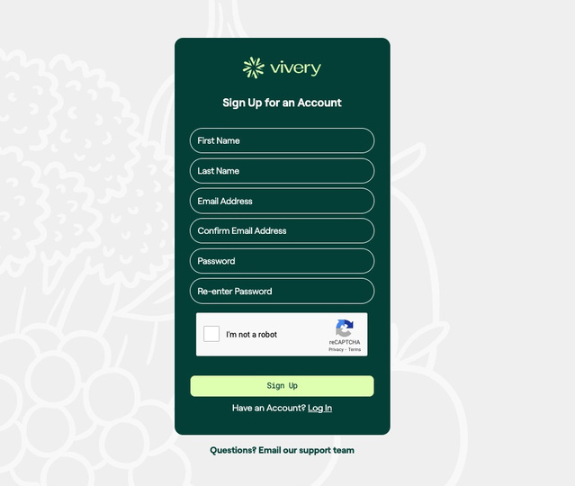
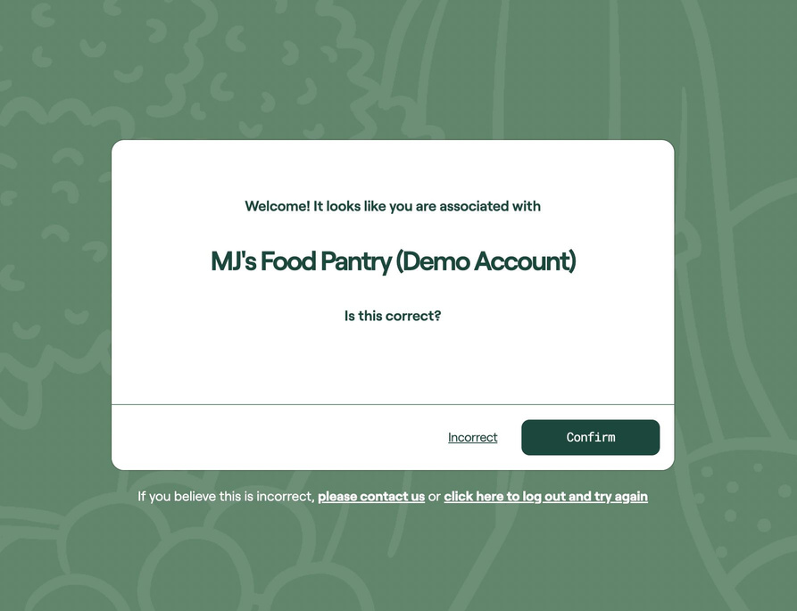

How to Claim Your Organization
Claiming & updating your Vivery profile can easily be done on a computer or mobile phone
Check your email for your unique claim link.
Please note that this is a link for your organization only. You may share it with others within your organization, but it will not work for others outside of your organization.
Click the link or copy/paste it into your browser to get started.
Sign up for your Vivery account
Confirm that you are being connected to the right organization
If the organization shown on your claim screen is incorrect, please contact support@vivery.org
Once you’ve claimed your account, you can log into Vivery
at https://smfb.vivery.org/

Slide 26
