Slide 1

Neighbor and Agency Programs

Slide 2
CSFP & TEFAP

Slide 3

Laura Walsh
CSFP & TEFAP Program Specialist
Arizona Department of Economic Security
Division of Community Assistance and Development
lwalsh@azdes.gov

Slide 4
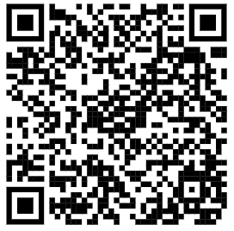
CSFP & TEFAP
The Commodity Senior Food Program (CSFP)
Eligible seniors 60+
At or below 130% Federal Poverty Level
Available statewide
The Emergency Food Assistance Program (TEFAP)
Eligible households
At or below 185% Federal Poverty Level
Available statewide

Slide 5

2023 CSFP Statewide Distribution
State Caseload
25,776
CSFP Packages Distributed
291,906
14% of those served were NEW to the
program in 2023!
Notes:
The entire caseload allocation for the state is

Slide 6

2023 TEFAP Statewide Distribution
TEFAP Packages Distributed 1,717,658
Individuals Served (Unique) 689,234
31% of those served were
NEW to the program in 2023!
Notes:
Unique Households 277,460
Unique Individuals 658,584
TEFAP Packages 1,596,801
Meals Served w/TEFAP 5,856,745 *At congregate feeding sites (soup kitchens)

Slide 7
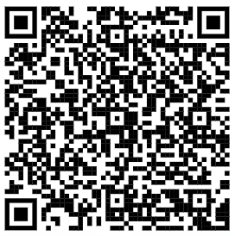
2023 CSFP & TEFAP Year in Review
Link to Report: 2023 CSFP and TEFAP Year in Review

Slide 8
Farmers Market Nutrition Programs

Slide 9

Persephonie Devereaux
Outreach Specialist
Pinnacle Prevention
persephoniedevereaux@pinnacleprevention.org
Pinnacleprevention.org

Slide 10
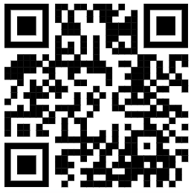
WIC Farmers Market Nutrition Program (FMNP)
Arizona WIC clients are eligible for coupons to spend on Arizona-grown fresh fruits and vegetables at participating farmers markets and farm stands.
2024 Annual benefit per client: $80 (16 x $5 coupons)
$30 benefit + $50 match
Coupons can be used February 1 - November 15
www.azfmnp.org 833-836-8253 x4
Notes:
The FMNP Program season is February 1st – September 30th (annually)
Deadline to obtain coupons: September 30th
Deadline to spend coupons: November 15th
With the FMNP Match Program Everyone participating in the WIC & Senior FMNP Programs will be eligible and receive an additional $50 in coupons at the time of registration
Limit one $30 FMNP booklet and one $50 match booklet per eligible individual per year
For a total of $80 per eligible WIC member in the household per year
If in need of a proxy please contact: our office at 833-836-8253 ext 4 or info@azfmnp.org
vouchers can be redeemed throughout the state at a participating SFMNP location
Direct audience to: QR code to find their nearest location.

Slide 11
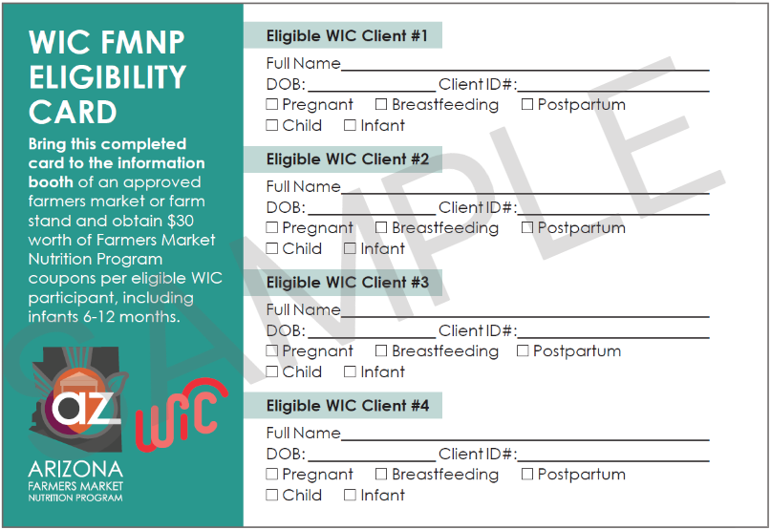
How it Works
The Client
Obtains a WIC FMNP Eligibility Card at a WIC office
Brings the card to a participating market’s information booth
Receives coupons
www.azfmnp.org 833-836-8253 x4

Slide 12
Senior Farmers Market Nutrition Program (SFMNP)
Arizona seniors 60+ who participate in the Commodity Senior Food Program (CSFP), or have a household income at or below 185% federal poverty level, can get coupons to spend on Arizona-grown fresh fruits and vegetables at participating farmers markets and farm stands.
2024 Annual benefit per eligible senior: $100 (20 x $5 coupon)
$50 benefit + $50 match
Coupons can be used February 1 - November 15
www.azfmnp.org 833-836-8253 x4
Notes:
The SFMNP Program season is February 1st – September 30th (annually)
Deadline to obtain coupons: September 30th
Deadline to spend coupons: November 15th
The Seniors Farmers' Market Nutrition Program (SFMNP) provides low-income seniors with access to locally grown fruits, vegetables, honey and herbs.
Increase the domestic consumption of agricultural commodities through farmers' markets, roadside stands, and community supported agriculture programs.
With the SFMNP Match Program Everyone participating in the Senior FMNP Program will be eligible and receive an additional $50 in coupons at the time of registration
that is a total of $100 per eligible SFMNP member in the household per year
Limit one $50 FMNP booklet and one $50 match booklet per eligible individual per year
If in need of a proxy please contact: our office at 833-836-8253 ext 4 or info@azfmnp.org
vouchers can be redeemed throughout the state at a participating SFMNP location
Direct audience to: QR code to find their nearest location.

Slide 13
How it Works
Seniors with yellow CSFP Cards
Visit a participating market
Go to the information booth
Show the yellow CSFP card
Receive coupons
Seniors who are income eligible
Visit a participating market
Go to the information booth and ask for a self-declaration form
Complete and sign
Receive coupons
www.azfmnp.org 833-836-8253 x4
Notes:
If your clients are already participants, they can go to azfmnp.org search for their nearest participating farmers market, visit the information booth, show their CSFP Yellow Cards to the market staff, then they will receive their $50 worth of coupons.
If the senior clients do not participate in CSFP they have the option to fill out a Self-Declaration Form to participate in the program.

Slide 14
Double-Up Food Bucks

Slide 15

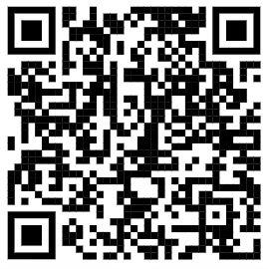
Double Up Food Bucks
Participants get $1 FREE fresh fruits and vegetables with every $1 SNAP spent!
Dollar-for-dollar match is activated when SNAP/EBT is spent at participating sites
No additional application required
www.doubleupaz.org

Slide 16
-Potential Partners and Community Feedback-
Marina Quiroz
Hunger Relief Program Coordinator
Arizona Department of Economic Security
Division of Community Assistance and Development
MMQuiroz@azdes.gov
Notes:
We are open to accepting new partners, and we take a community informed approach to where to go next, so we encourage feedback from your communities!

Slide 17
SNAP Career Advancement Network (SNAP CAN)

Slide 18
Abel Young
SNAP CAN Manager
ayoung@azdes.gov
Francesca Currie
SNAP CAN Program Specialist
fcurrie@azdes.gov
Arizona Department of Economic Security
Division of Employment and Rehabilitation Services

Slide 19
SNAP Career Advancement Network (SNAP CAN)
SNAP CAN is Arizona’s community-based employment and training program that provides employment readiness services to eligible SNAP recipients.
Services are provided through SNAP CAN Providers who are dedicated to connecting program participants to the tools and resources they need to overcome barriers, and obtain employment.
Eligible Recipients
16+ Years Old
Not on TANF Cash Assistance
Receiving SNAP
Providers
Offer approved employment and training (E&T) services using non-federal funds
SNAP CAN
E&T Success
www.AZSNAPCAN.gov SNAPCAN@azdes.gov

Slide 20
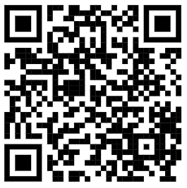
What’s Involved
SNAP CAN leverages existing employment and training expertise with local community-based organizations.
SNAP CAN Providers help participants in education, job readiness, job retention, job search, and vocational training.
Free support services for participants, including help covering expenses like:
Childcare
Job Interview Clothing
Work Uniforms
Job Equipment
Cell Phone or internet bills
Laptops
Wifi Hotspot
www.AZSNAPCAN.gov SNAPCAN@azdes.gov

Slide 21
Employment and Training Services
Supervised Job Search
Identifying employment opportunities
Applying for employment
Attending job fairs
Job Readiness
Career exploration and planning
Resume preparation
Vocational Training
Culinary
Construction
Education
Adult Basic Education (ABE)
Basic Literacy
English as a Second Language (ESL)
High school equivalency (GED)
Post-secondary Education
Job Retention
Offered up to 90 days to E&T participants who gain employment after participating in an E&T component, even if no longer participating in SNAP.
www.AZSNAPCAN.gov SNAPCAN@azdes.gov

Slide 22
SNAP Outreach

Slide 23

Mayra Ramirez
SNAP Outreach Program Director
Wildfire
mramirez@wildfireaz.org
wildfireaz.org

Slide 24
SNAP-Outreach
SNAP Outreach addresses hunger through a network of non-profit organizations working on SNAP outreach and/or application assistance.
www.wildfireaz.org

Slide 25
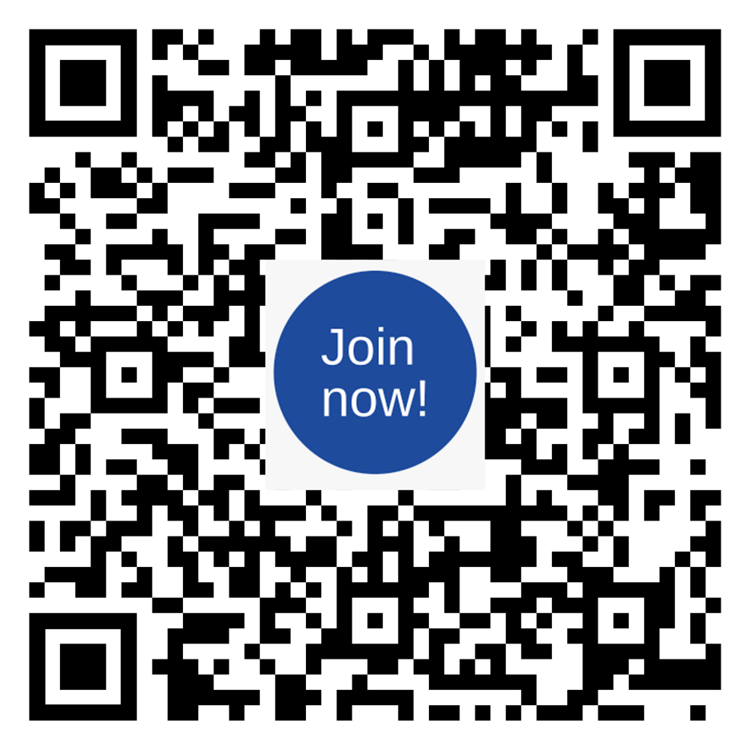
SNAP Partnership
Potential Partners
Non-profit organizations (faith-based, food banks, health centers, etc.) or government agencies, and some for-profit organizations working in the community on SNAP outreach and/or application assistance.
Partnership Types
Reimbursement and Non-Reimbursement
www.wildfireaz.org

Slide 26
Activities
SNAP Prescreening
SNAP Application assistance
Assistance obtaining verification documents
Client education and information distribution
Outreach booths and exhibits
Development of client education material
Maintaining an informational website
Maintaining a toll-free information line
Workshops conducted alone or with others
www.wildfireaz.org

Slide 27
Partner Service Levels
Outreach & Education
Self Assistance
Full Assistance
Provides materials and can help individuals make informed decisions.
Participate in outreach events/meetings
Provide outreach materials in office or onsite at events
Create and distribute application packets
Provides access to the tools needed in order to research and apply for benefits.
A computer for clients to prescreen or apply for benefits
Equipment for clients to copy/scan/fax documents
Telephone to call DES
Provides access to the tools needed in order to research and apply for benefits, and helps the client complete the work.
May track cases and contact DES on the client’s behalf.
www.wildfireaz.org
Notes:
Outreach & Education:
The partner will provide materials at their office or at various outreach events. The partner can help individuals make informed decisions about applying for SNAP benefits. Some examples are:
Provide outreach materials at events for clients
Education based on clients needs
Create an application packet ·
Self-Service
The partner will provide access to the tools individuals need in order to be considered for the benefits. Some examples are:
A computer to prescreen through https://www.arizonaselfhelp.org/ or another prescreening tool
A computer to apply online through www.healthearizonaplus.gov
Full Service Assistance
The partner will provide direct assistance and access to the tools clients need in order to be
considered for benefits. Some examples are:
Prescreening through https://www.arizonaselfhelp.org/ or another prescreening tool
Applying online through www.healthearizonaplus.gov
Copying, scanning, printing and/or faxing documents
Completing paper applications as requested
Tracking client’s case via MyFamilyBenefits website

Slide 28
Reimbursement
Reimbursable partners may receive up to 40%
reimbursement on allowable SNAP activities
Salaries and benefits of Outreach staff
Supplies, postage and copying/printing costs
Development and production of outreach materials
Internet/Telephone costs
Travel in-state and out-of-state
Vendors and contractors
Indirect (not able to be allocated to a direct cost category) costs
www.wildfireaz.org
Notes:
Participating SNAP partner agencies receive up to 40% reimbursement on allowable SNAP activities
Salaries and benefits of Outreach staff
Supplies, postage and copying/printing costs
Development and production of outreach materials
Internet/Telephone costs
Travel in-state and out-of-state
Vendors and contractors

Slide 29
Partner Application
wildfireaz.org/snap-partnership-opportunity
Apply by April 1, 2024 to be considered for partnership in
Federal Fiscal Year 2025 (10/01/24 - 09/30/25)
www.wildfireaz.org
Notes:
DES CHRP - point of contact is Marina Quiroz, Hunger Relief Program Coordinator

Slide 30
Thank You
Questions?

