Slide 1
PARTNERSHIPS MATTER
CONVENTIONAL AND
UNCONVENTIONAL COLLABORATIONS
Presented by:
Leigh Zydonik,
Executive Director
Foothills Food Bank & Resource Center

Slide 2
NONPROFITS:
WHAT DOES THERE NEVER SEEM TO BE ENOUGH OF?
RESOURCES
MANPOWER
TIME

Slide 3
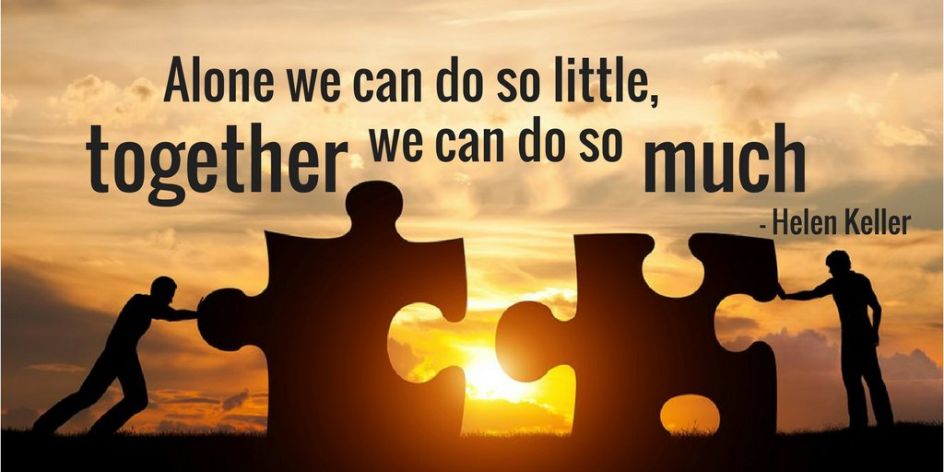

Slide 4
Benefits of partnering...
Increased Resources and Expertise
Enhanced Reach and Impact
Cost Savings and Efficency
Innovation and Synergy
Strengthen Advocacy and Influence

Slide 5
Where do you
find organizations
to partner with?

Slide 6
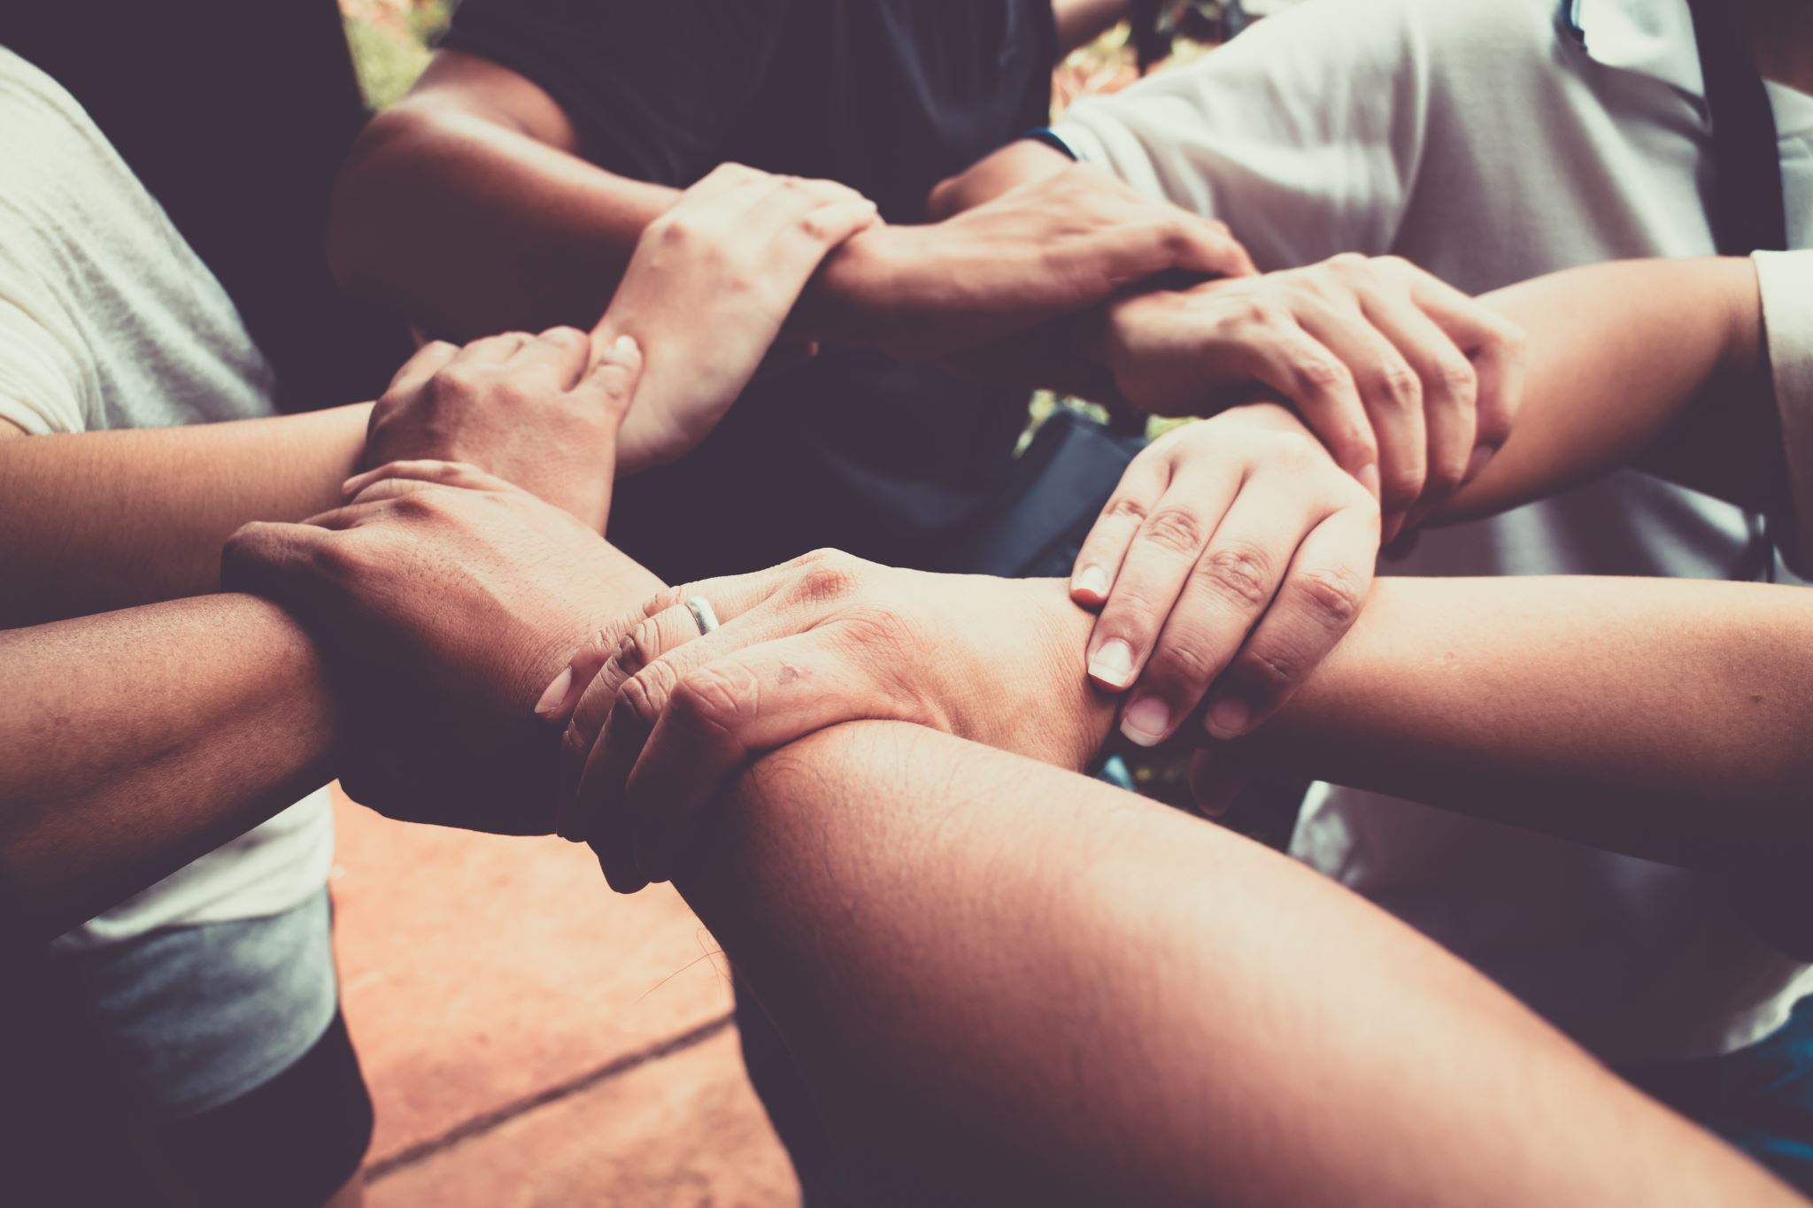
Community Alliances - local nonprofit leaders, NIN, NAAAP
Chamber of Commerce - local business community
Coalitions and Networks - AZFBN, AFSN, BNI
Civic/Social Organizations - Rotary, Kiwanis, Lions, etc...
Other- Leadership Academy
Where have you found partners?

Slide 7
Food/$ Collection Partners
Grocery stores, farmers markets, community events surplus food
Distribution centers will donate damaged pallets
Food Drive competition between schools, businesses, churches
Businesses provide discount when customers donate canned goods
Realtors: Encourage clients to donate pantry items when moving
Restaurants & businesses round up bill for donations

Slide 8
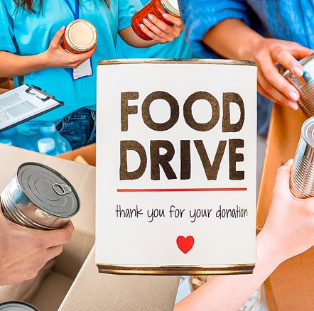
Who are your best collection partners?

Slide 9
Food Distribution Partners
Mobile and Micro-pantries at schools, churches, libraries, community centers, YMCA, Boys & Girls Club, senior centers, health clinics and community colleges

Slide 10
Who are
your best
distribution partners?

Slide 11
Before the Dump...
Animal Rescue
Farms
Compost

Slide 12
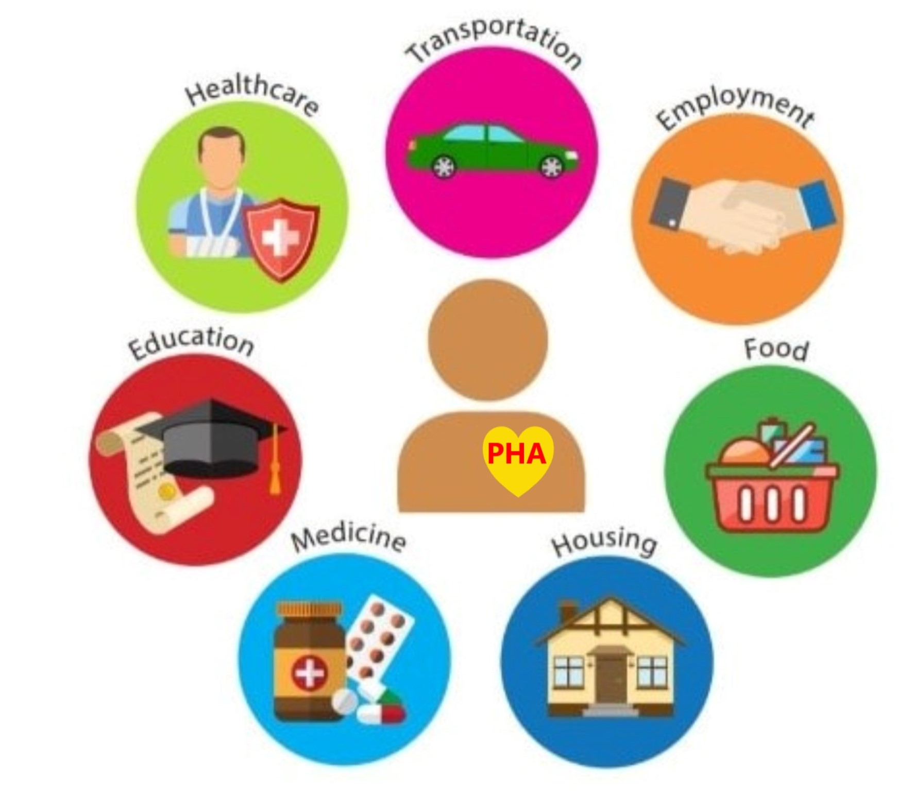
Resource Partners
Department of Economic Security
Agency on Aging
Public Health
APS/SRP
Churches
Thrift Stores
Health Clinics
Mental Health Counselors
Auto Repair
Gas stations
Pharmacy
YMCA or Campground
LYFT/UBER

Slide 13
DON’T TRY TO DO IT ALL!
Want to offer a workshop or training? Find an
organization who does it well and partner with them.
Universities/Community Colleges
Cooperative Extension Office
Banks/Credit Unions
Public Health Department
Department of Economic Security
Libraries
Community Centers
Other nonprofit service organizations
Workforce Readiness
Financial Literacy Programs
Nutrition/Cooking Classes
Health & Wellness Programs
Addiction Resources

Slide 14
Unusual Partners

Slide 15
Discussion Questions:
What unusual partnerships have you had?
What were your best and worst partner experiences?

Slide 16
Questions?

Slide 17
Thank you!
Leigh Zydonik
leigh@foothillsfoodbank.com

