Slide 1


CSFP
Caseload Review and
Waitlist Management
September Lopez
Agency Services Manager

Slide 2
Agenda
Our CSFP Business Model
Our CSFP Caseload Allocation
3. 3-Month Reallocation Strategy
4. End of the Month Waitlist Strategy
5. Waitlist Management

Slide 3
Our CSFP Business Model
Two Distribution Models
Direct Distribution – St. Mary’s Operated | Agency Network
2 Centralized Distribution Centers Homebound Deliveries Mobile Distributions Approx. 52% | 10 of 15 Arizona counties Contract with two other regional Food banks to serve counties in their service area

Slide 4
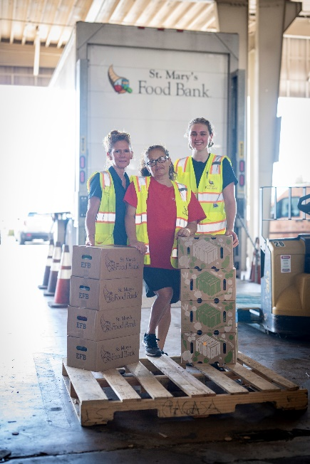
Our CSFP Business Model – Direct Distributions
Centralized Distribution Centers
2 Direct Client Service Centers
  Run by St. Mary’s Staff and Volunteers
Caseload for both 5200
Homebound Deliveries
Limited for individuals with disabilities or zero means of transportation to pick up
Utilized our own homebound routes and Door Dash deliveries
Caseload 2878

Slide 5
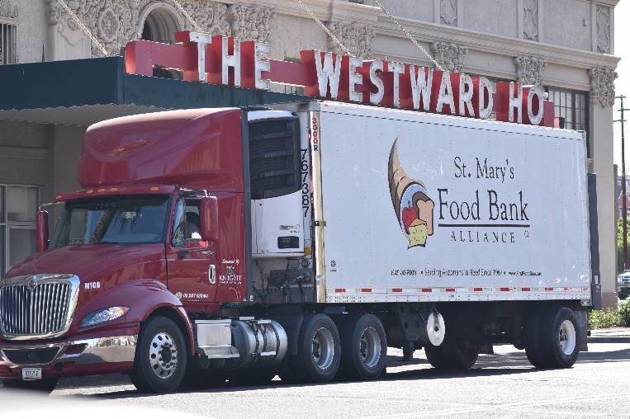

Our CSFP Business Model – Direct Distributions
Mobile Distributions
Serve areas where agency capacity is limited or non-existent
  Rural areas, agencies that have to stop serving CSFP, etc
9 Off-Site locations hosted by community partners (churches, senior centers, parks)
Caseload 1235

Slide 6
Our CSFP Business Model – Agency Network
Agency Network
73 partner agencies that run their own CSFP programs
Serve 10 of the 15 Arizona Counties
Sub-Contracts with two other RFB that serve within their service areas
Caseload: 8687

Slide 7
Our CSFP Caseload Allocation
February through March focus was finding homes for our new caseload
April through August utilized 3 month reallocation and redeliveries to increase %
2023 caseload increase 2895
January increase dropped our serving percentage from 100% to 85%

Slide 8
3 Month Reallocation Strategy
Provides 4 opportunities throughout a 3 month period to readjust caseload
Use a 3 month average for each agency to identify unused caseload
Use Link 2 Feed to identify partner agencies with a waitlist
Allows clients to naturally become inactive based on 2 month non-show rule

Slide 9
3 Month Reallocation Strategy

Slide 10
Utilizing Case Load with Waitlist
End of the Month Waitlist
  Beneficial for Agencies with multiple distribution dates in a month
  Pick a date at the end of the month to send out a last call to current clients
  After Cut Off Date, pull Waitlist Clients call clients to pick up box
  Okay to have a small percentage of active clients over caseload
  Increase percentage of caseload served to prevent losing caseload during the reallocation process

Slide 11
Waitlist Clean Up
  Statewide waitlist will be used to determine caseload increase requests moving forward (Accurate Numbers are Important)
  Step 1: Identify any clients that has been on waitlist prior to 1/1/2022
    Okay to Auto Change these clients to Inactive if Waitlist Number is Overwhelming
  Step 2: Reach out to clients that have been on waitlist for more than a year and ask them if they are still interested in the CSFP Program
    Note any No Answer, Incorrect Phone Number Clients
    Okay to Auto Change these clients to Inactive after 3 noted communication attempts
  Step 3: Once you have a handle on waitlist repeat this process every 6 months

Slide 12
Other Reminders
  Report Submissions should Include: MIR Sheet, Link 2 Feed Stat Report, AOR for the month
  Reports are due 48 hours after last distribution of the month or the 1st day of the following month for agencies that run month long distributions
  Reports should be sent to csfp@stmarysfoodbank.org and not directly to specialist/coordinator (Feel free to CC Specialist/Coordinator on submission)

