Slide 1
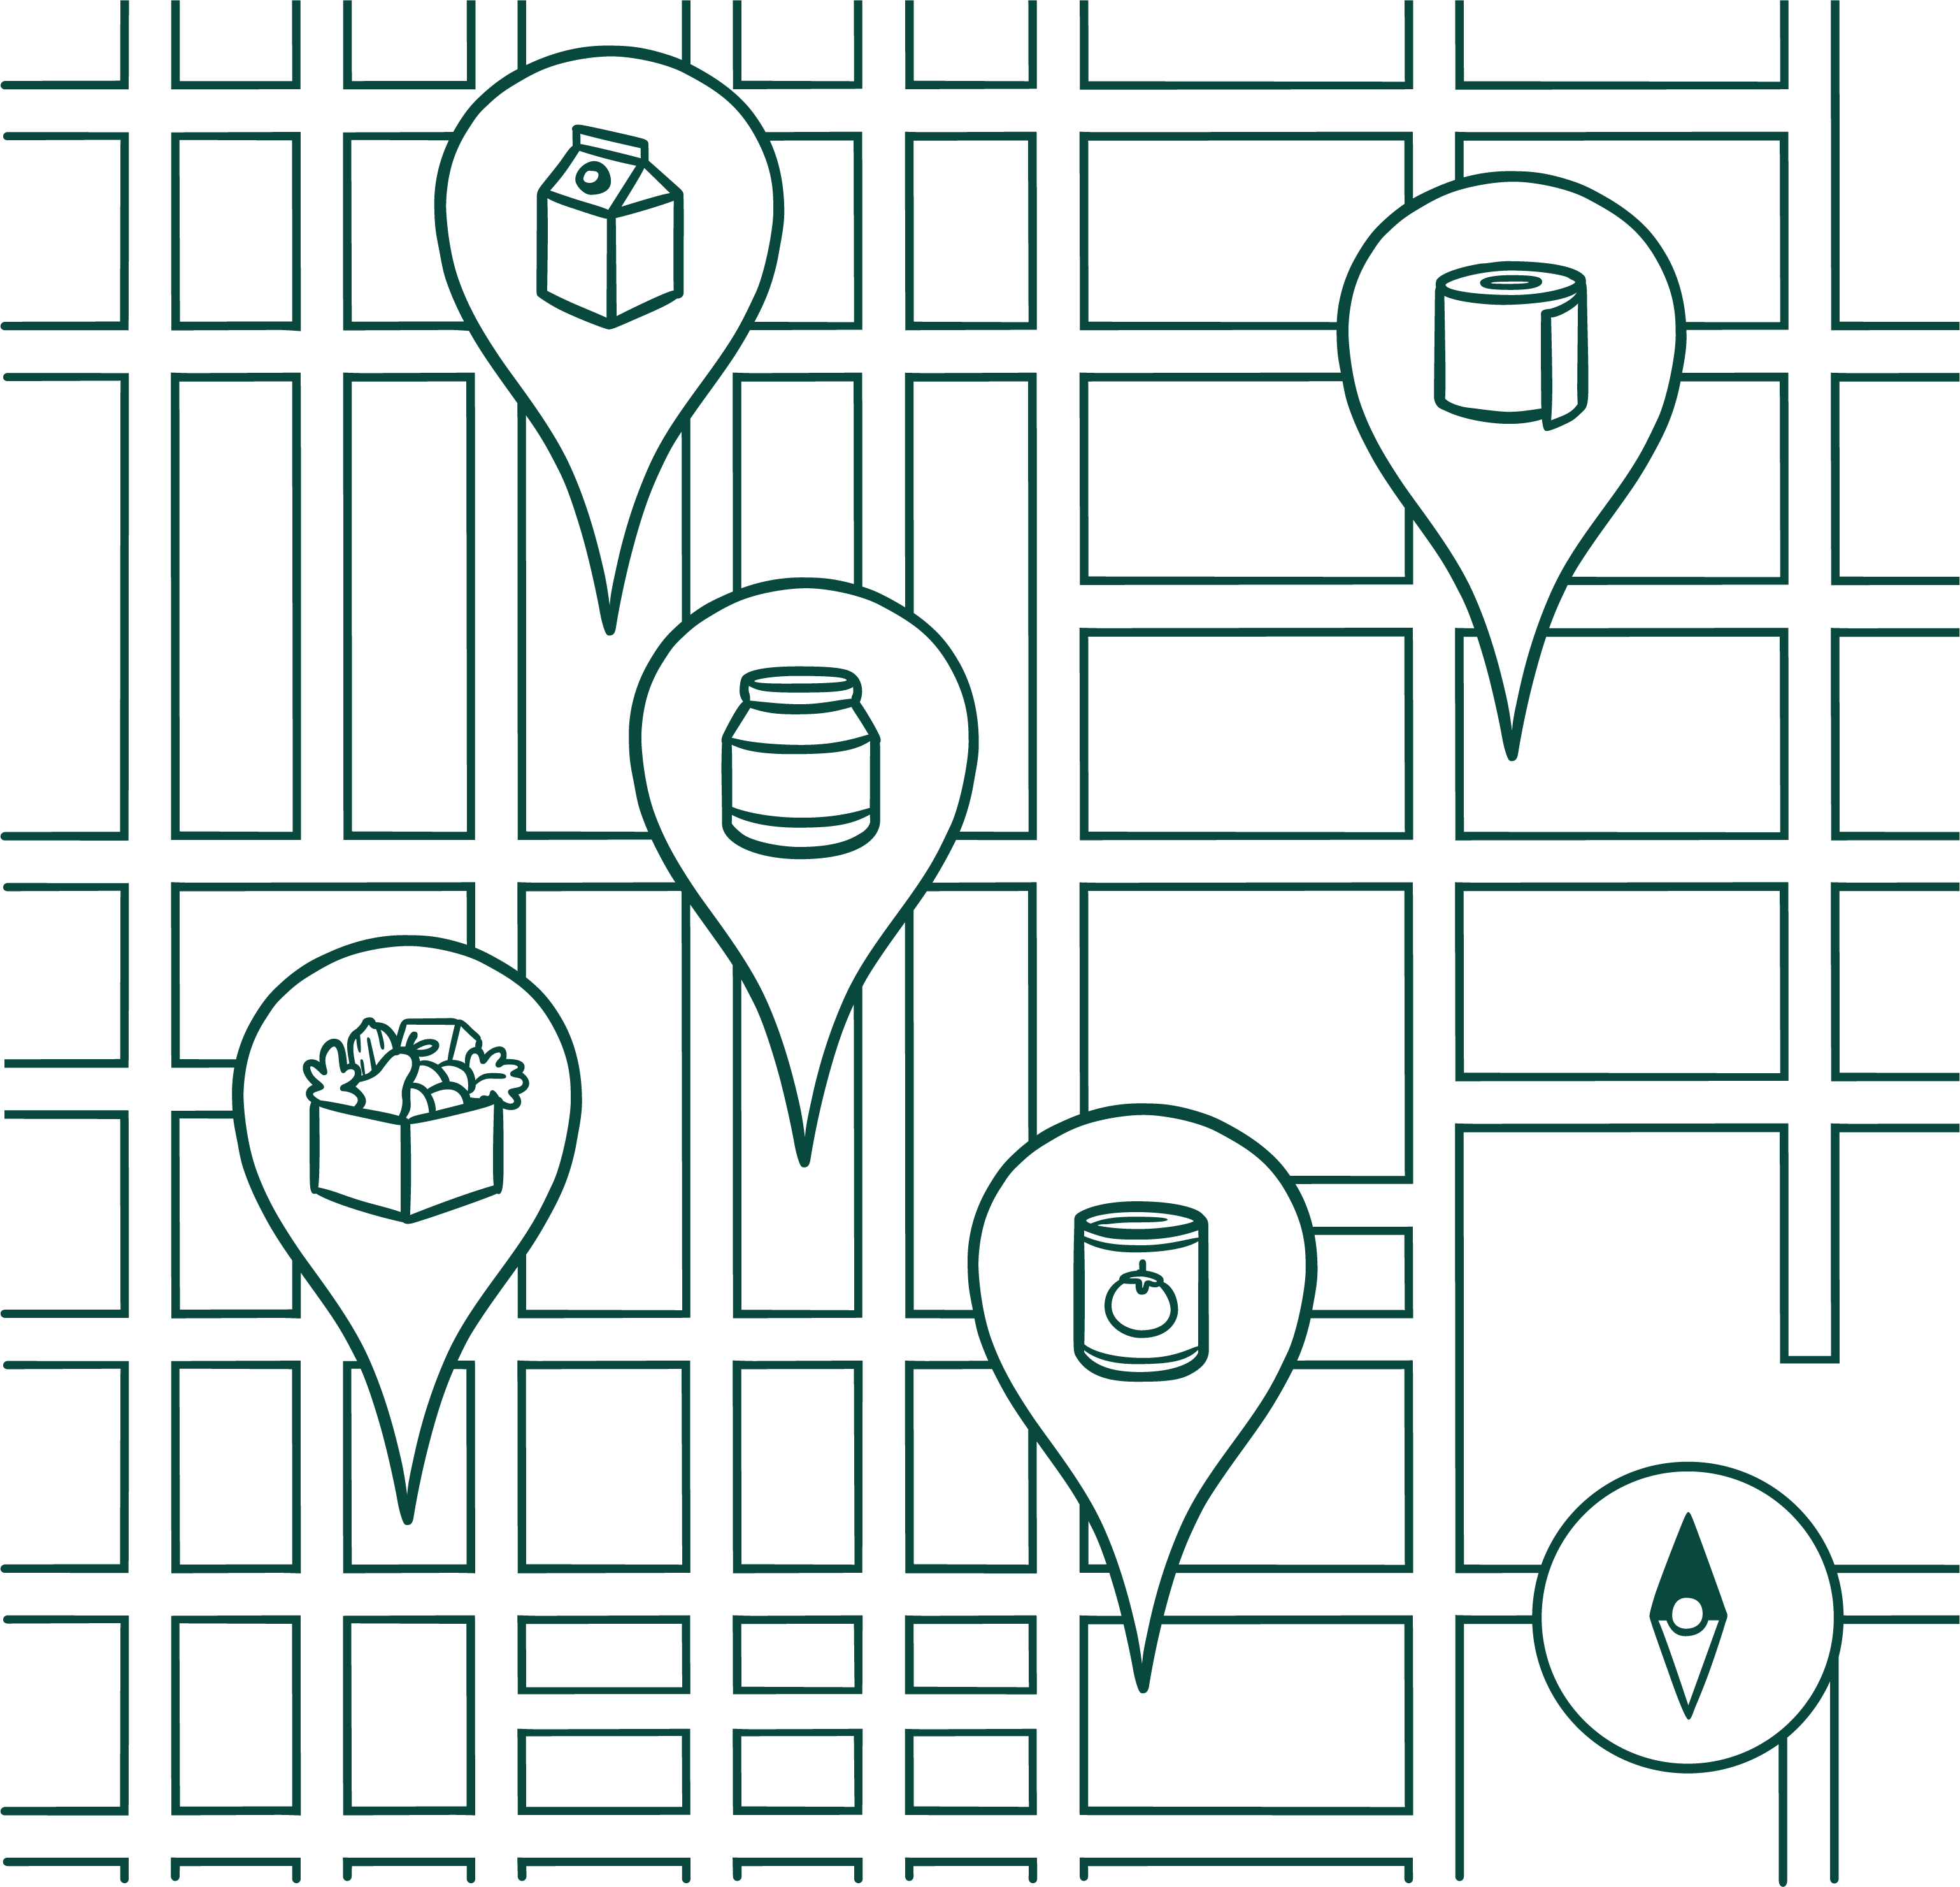
We take care of the tech.
You can focus on your mission.

Slide 2
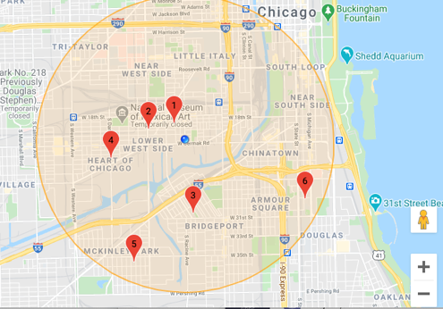
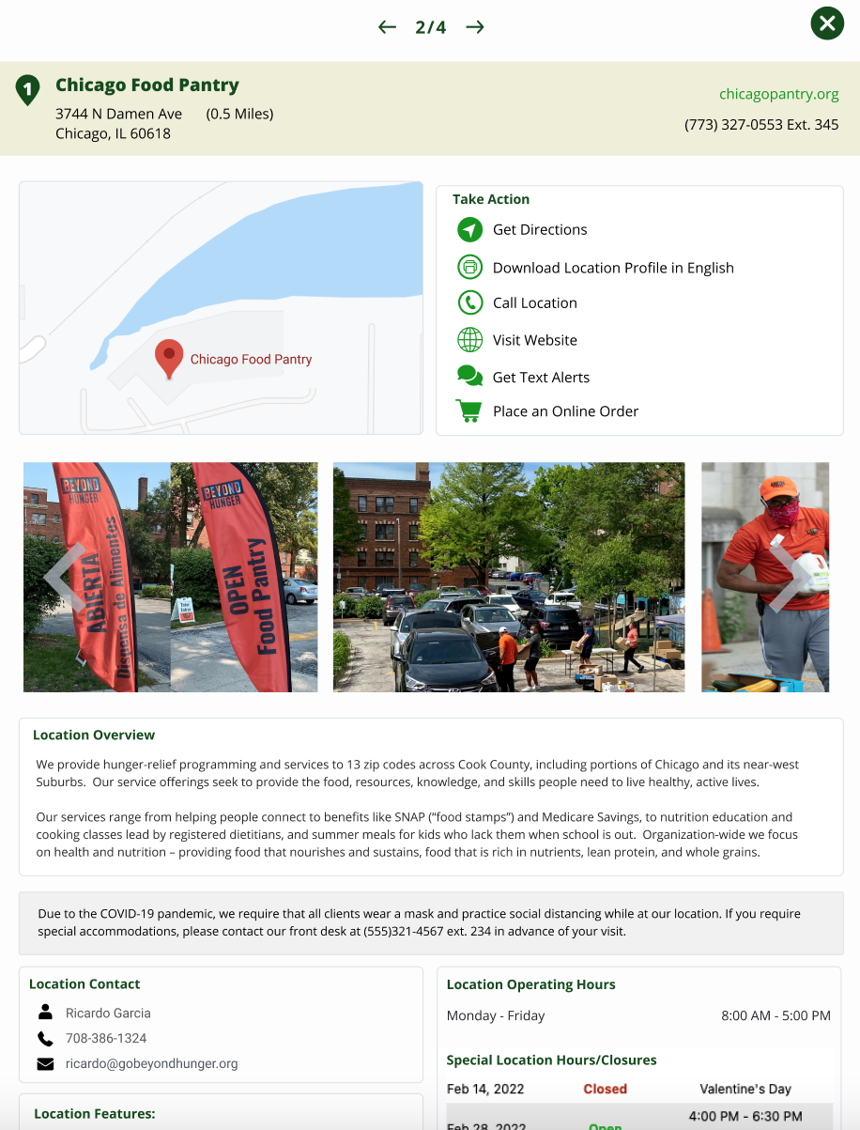
What is Vivery?
Vivery is a series of technology solutions developed by the Thierer Family Foundation in partnership with food bank and pantries.
Our mission is to ensure that​ every person is able to easily find and access food assistance near them, that meets their needs.

Slide 3
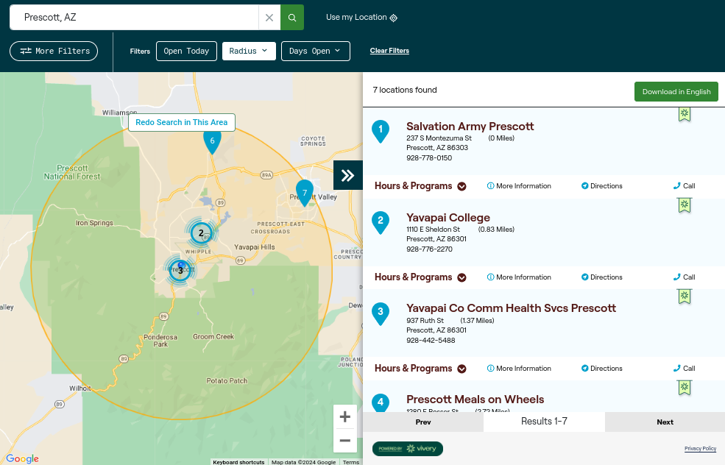
Introducing the Find Food Map
St. Mary's Food Bank has launched a new Find Food Map powered by Vivery to help neighbors find and access the free food provided by their partners.
Find Food Map URL:
https://azfoodhelp.org/find-food-partners

Slide 4
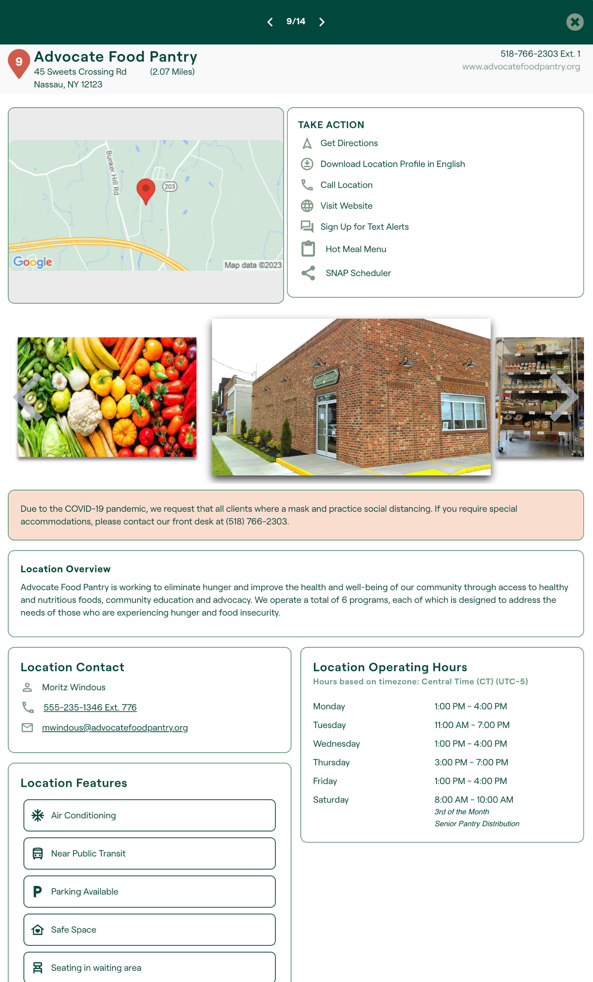
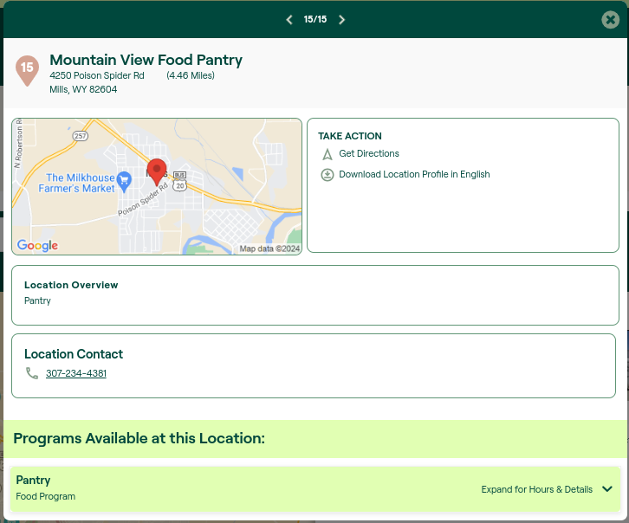
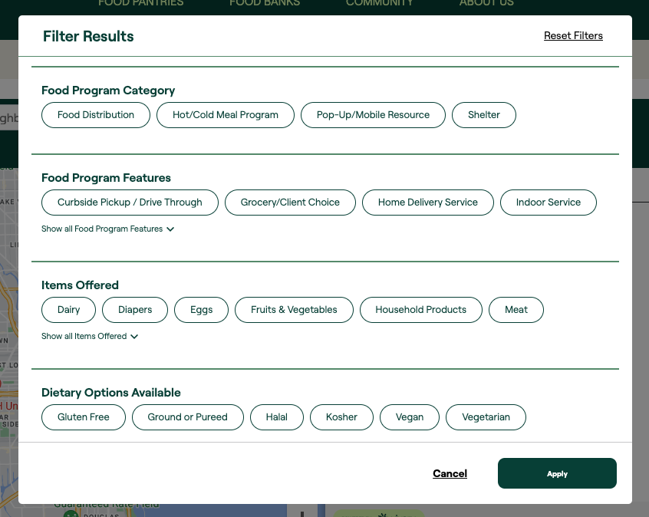
The information in your location profile is what powers the robust filters on the Find Food Map. Filters help neighbors use the map to find the specific resources and programs that meet their needs.
Verify Your Information
Location profiles start out with basic information.
Enhancing Your Profile
By adding additional information about your location and programs you increase the value of the map to our neighbors
Enable Map Filters Robust filter options on Vivery Maps help narrow results to locations and programs that meet a neighbor's specific needs.

Slide 5
What you get:
Food Resource Offering

Slide 6
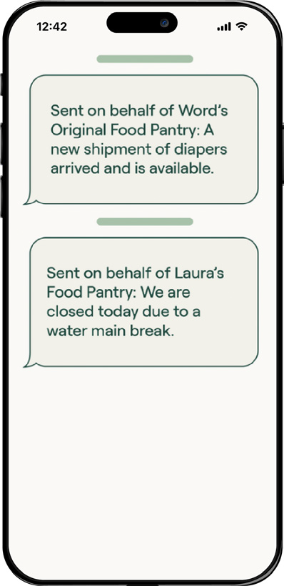
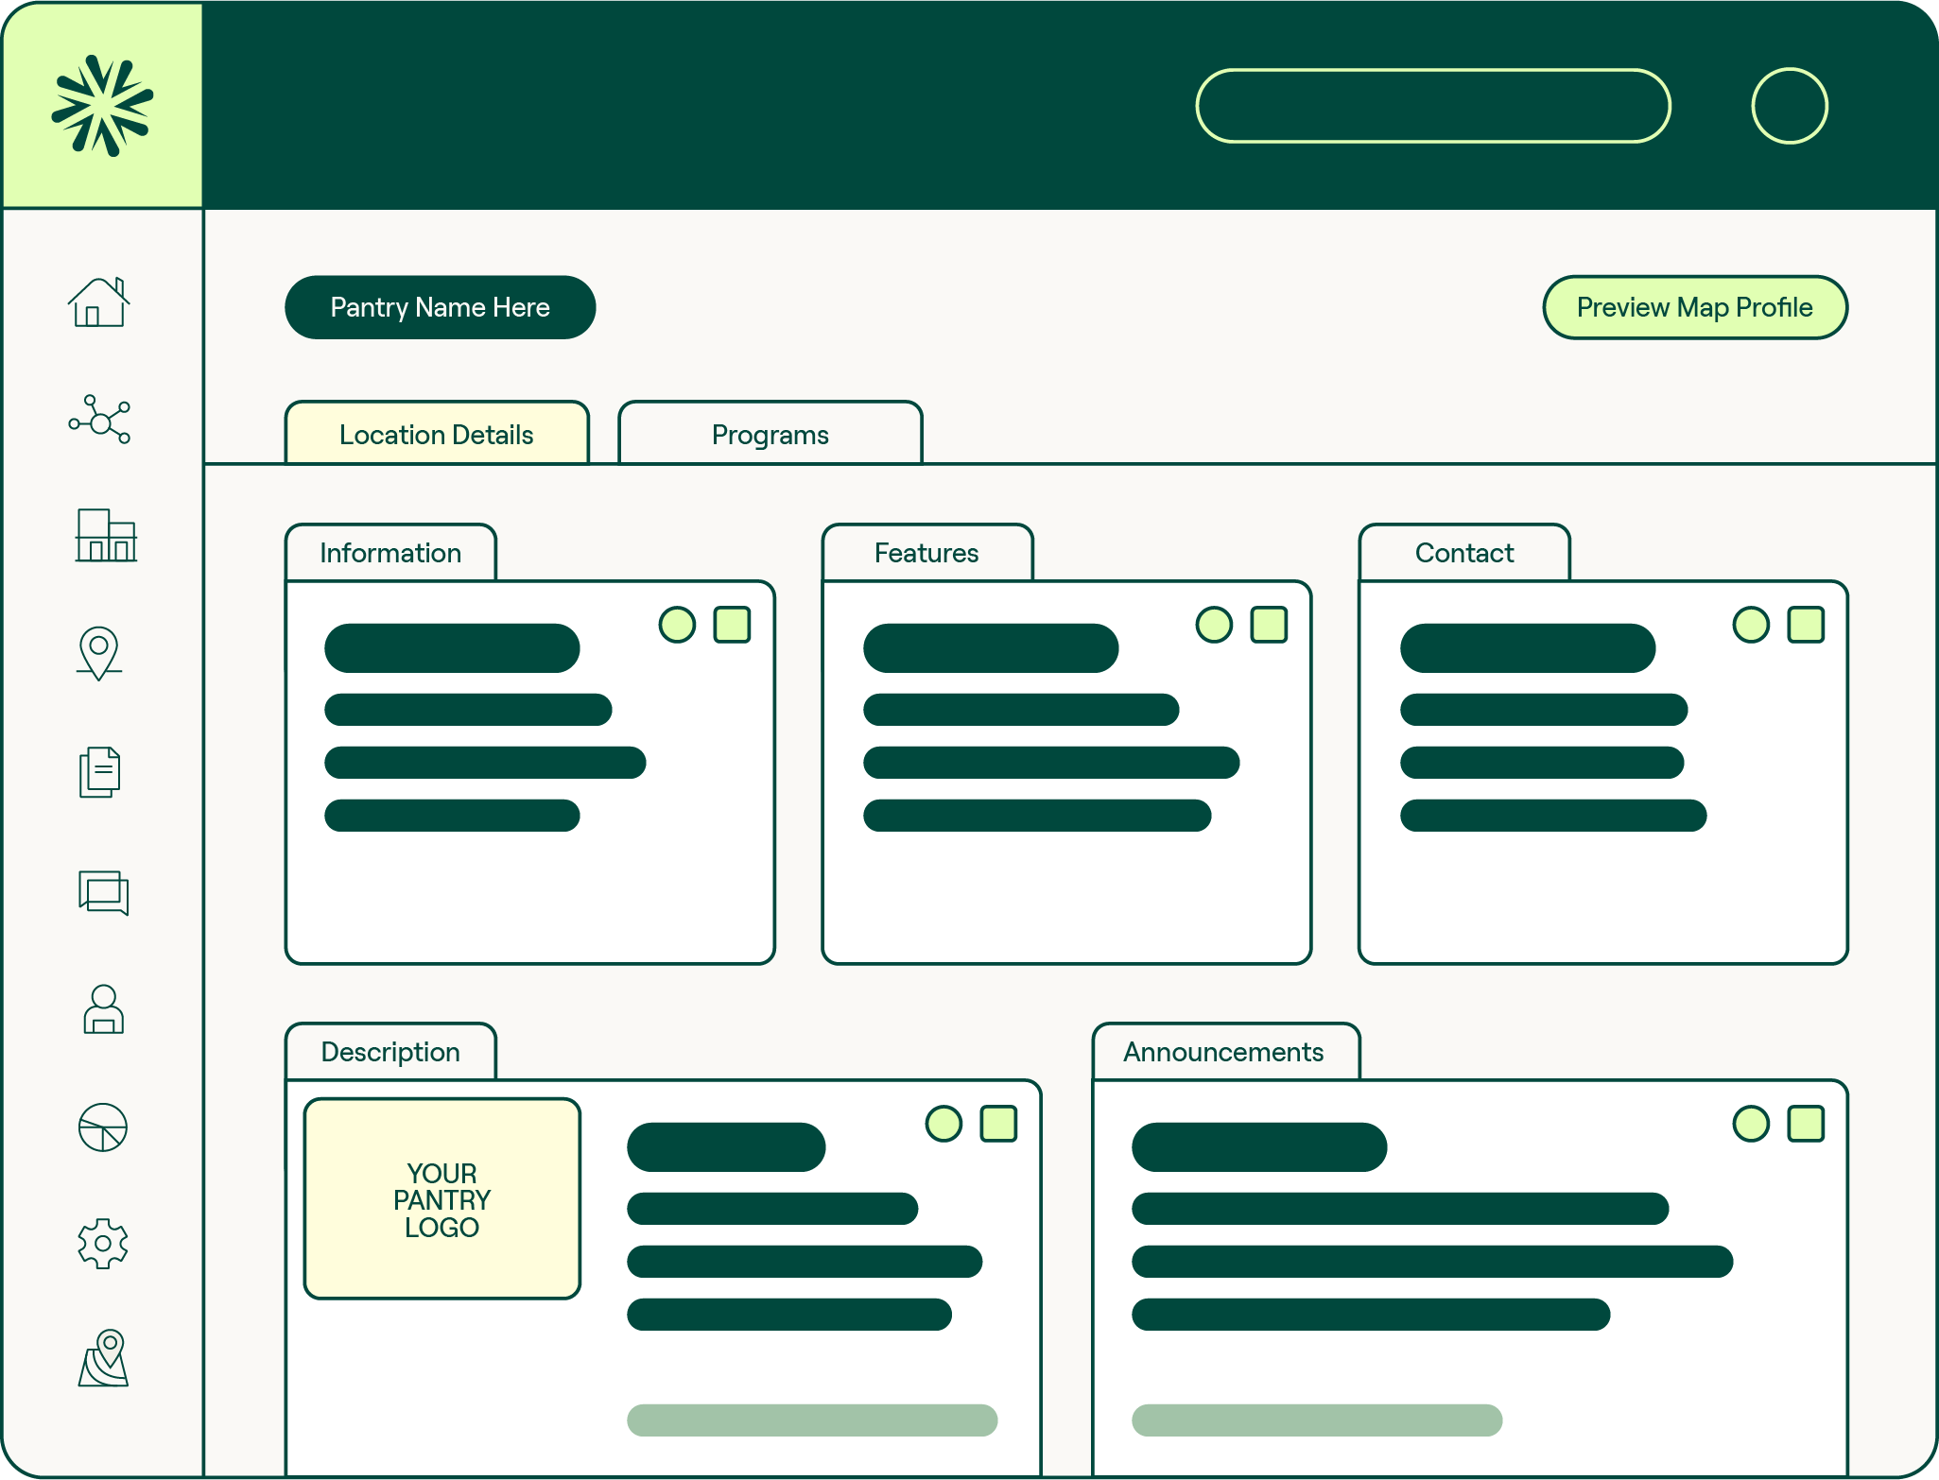
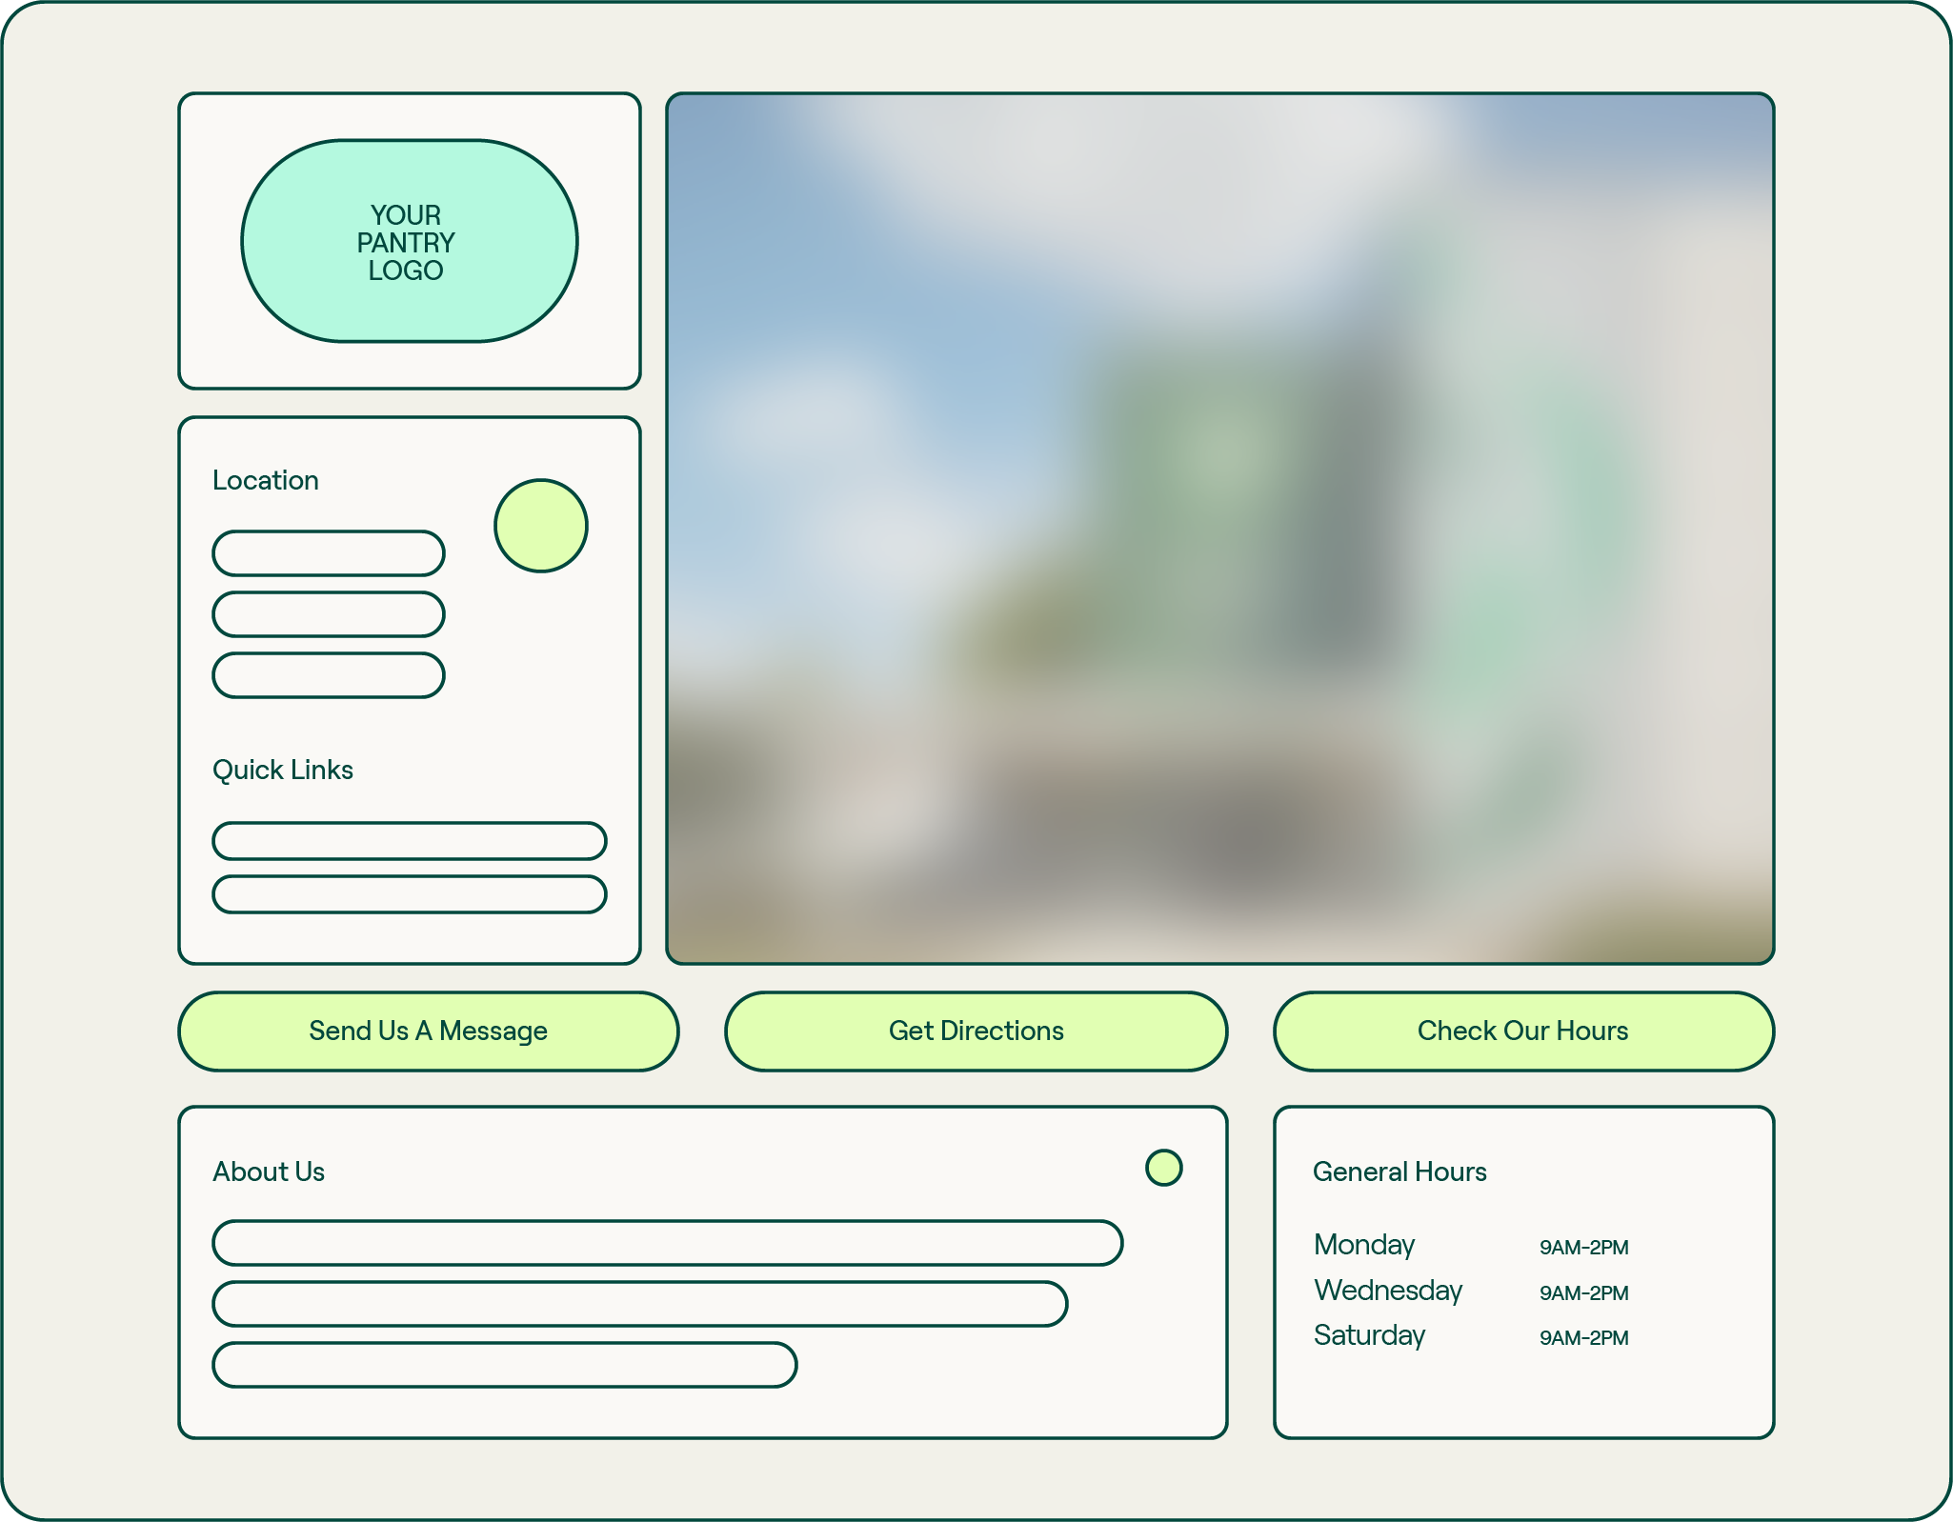
As a partner of St. Mary’s Food Bank, you are invited to claim an account on Vivery and easily manage information about your food pantry on the Find Food Map, send FREE text messages to your clients, and even launch a website in a few clicks!
Location Profile
Control your information across all Vivery-powered Maps from a single profile and add in additional programs and rich details.
Automated Websites
Quickly create a website for your pantry in just a few clicks using the information already entered in Vivery.
Text Messages
Alert clients of emergency closures, changes in service model, availability of special items, and more with free text alerts.

Slide 7
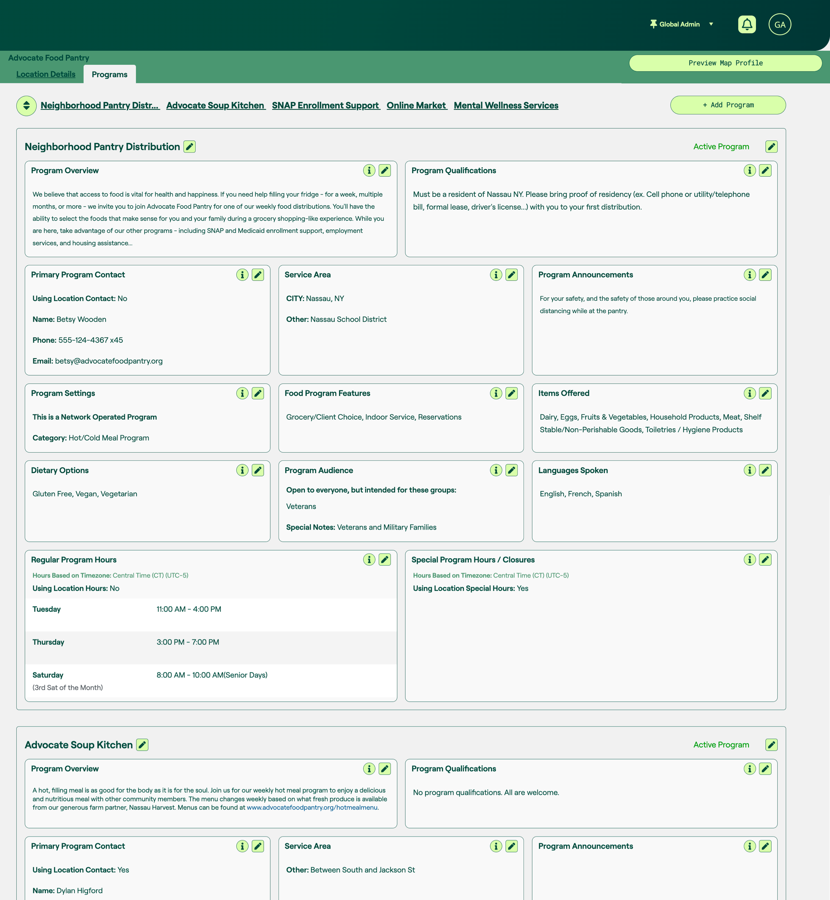
Location Profile
Control your information…
across all Vivery-powered Food Resource Maps from a single profile
Showcase all the programs you offer…
including food programs, social service programs, public benefits assistance, etc.
Add in additional details…
like service area, items offered, languages spoken and much more

Slide 8
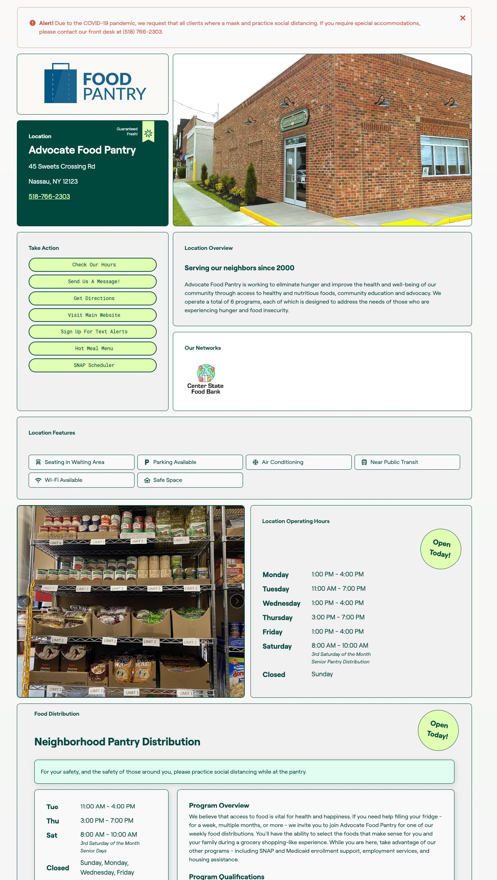
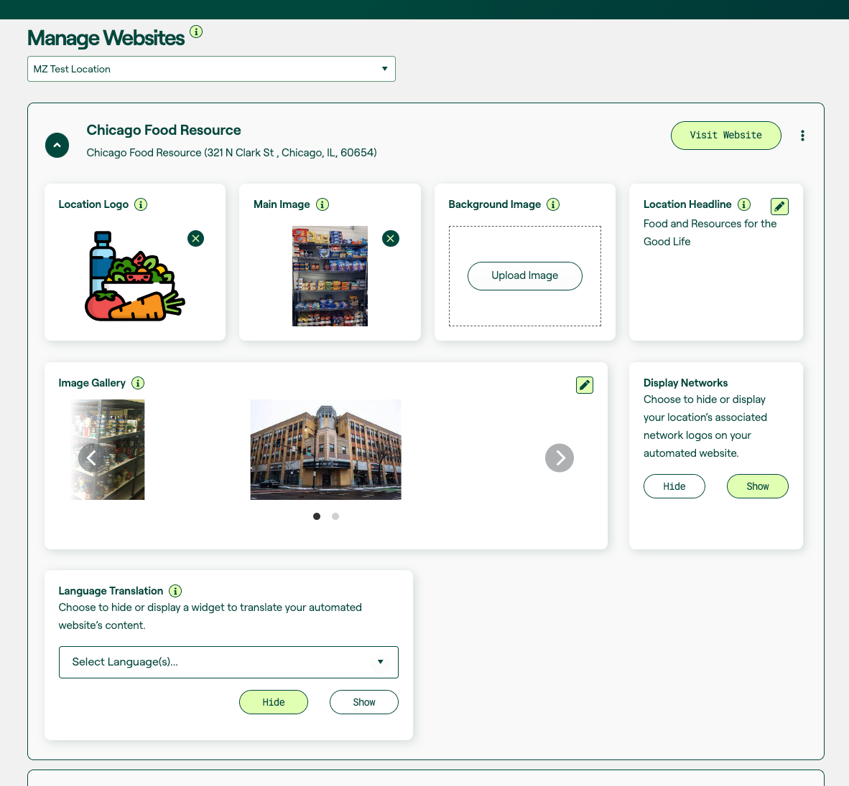
Automated Websites
Quickly generate a website…
using the information already entered in your Vivery profile
Customize the website…
with your logo, images, tagline and more
Get found online…
on Google and other search engines

Slide 9
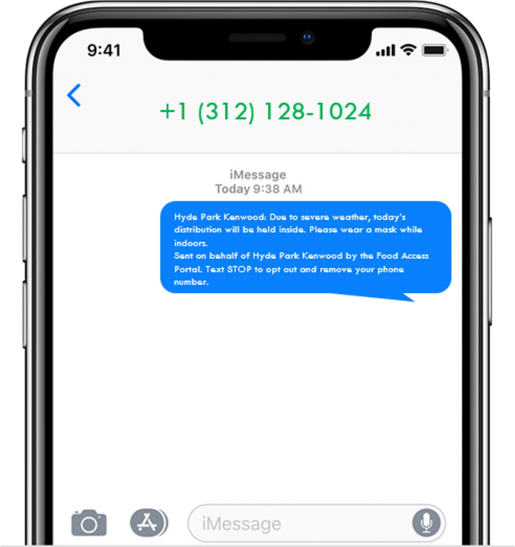
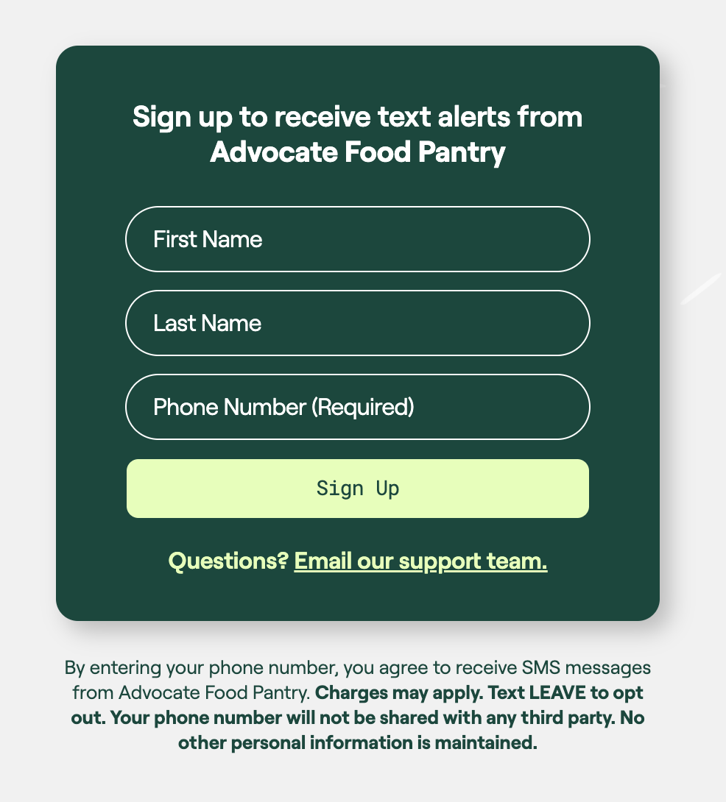
Text Messaging
Alert clients instantly…
of emergency closures, changes in service model, availability of special items, etc.
Send text alerts…
to groups or individuals for FREE
Enable text sign-up…
on Vivery-powered maps and on your own marketing materials via link and/or customized QR code

Slide 10
How to get started:
Claiming is simple: go to your claim link, set your login information and confirm that you are being connected to the right organization.
Claim
your Location
Some basic information about your locations and programs has already been entered into Vivery by your food bank. Please check this information for accuracy and update any information that may be out of date.
Verify
your Information
Add additional information about your location and programs including photos, location features, program audience, program restrictions/qualifications & more.
Enhance
your Profile
Turn on free digital tools like an Automated Website that allows you to create a website in seconds using the information already entered in your profile or Text Messaging that allows you to send free text messages to clients.
Activate
Digital Tools

Slide 11
Join the Vivery Quick Start Webinar
Date: March 19th
Time: 11am Local Time
Duration: 45 minutes
Check your email for more information on how to register!

Slide 12
How to get additional support
Have other questions or need help getting started? Check out these options:
Live Group Training Sessions:
Join us for a 1-hour live training session to learn how to use Vivery, best practices, and what to expect during your set up process and beyond. Training sessions occur every other week. The next available dates are:
To register: https://calendly.com/engagement_support/vivery-live-training
One-on-One Support Appointments:
Need help completing your profile or have specific questions? Sign up for a 30-minute individual support session and we can walk you through everything you need to know about using Vivery.
To register: https://calendly.com/engagement_support/pantry-live-training
Vivery Help Center/Knowledgebase:
Browse our database of helpful articles and videos to assist you as you begin using Vivery.
To access the Help Center: https://vivery.zohodesk.com/portal/en/home
Support@vivery.org:
Send us an email with questions and we’ll get back to you as soon as possible!

