Slide 1
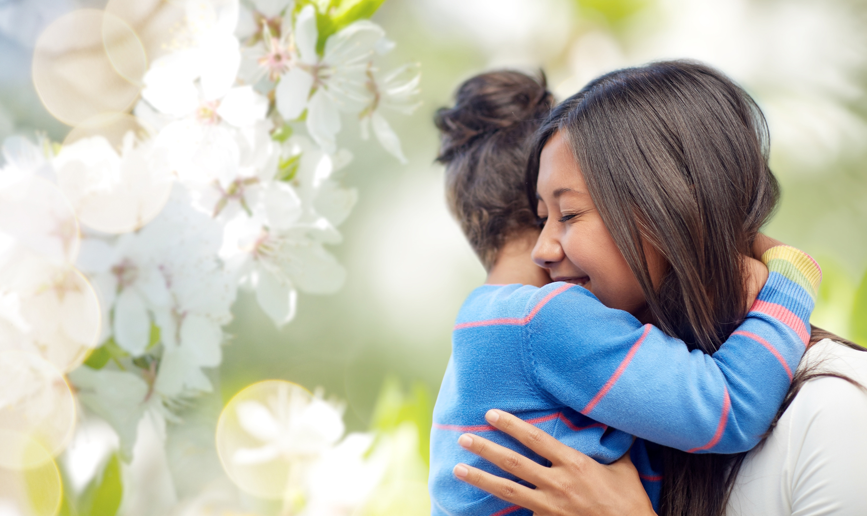

THE POWER OF RELATIONSHIPS
TO SUPPORT, COLLABORATE, AND THRIVE
Adrienne Z. Udarbe, MS, RDN
Executive Director,
Pinnacle Prevention

Slide 2
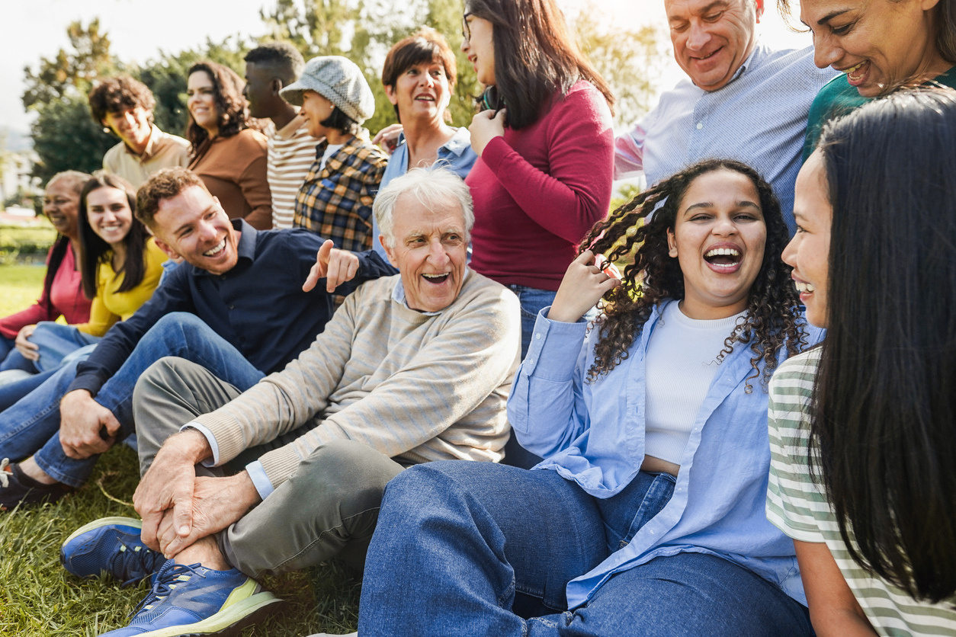

Our Time Together
  Reflect on difference
  Explore connection
  Deepen into the power of relationships

Slide 3


Which is “right”?

Slide 4
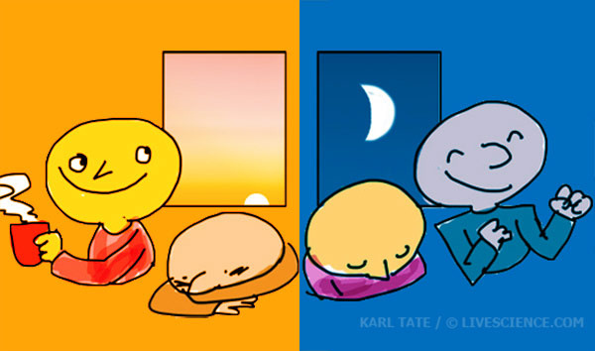
EARLY BIRD OR NIGHT OWL?

Slide 5
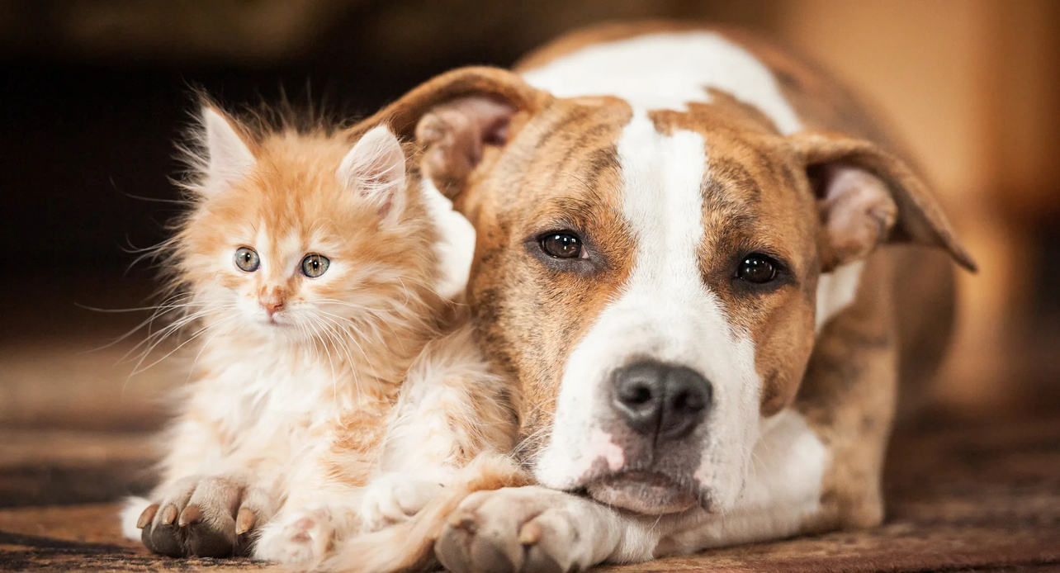
CAT OR DOG?

Slide 6
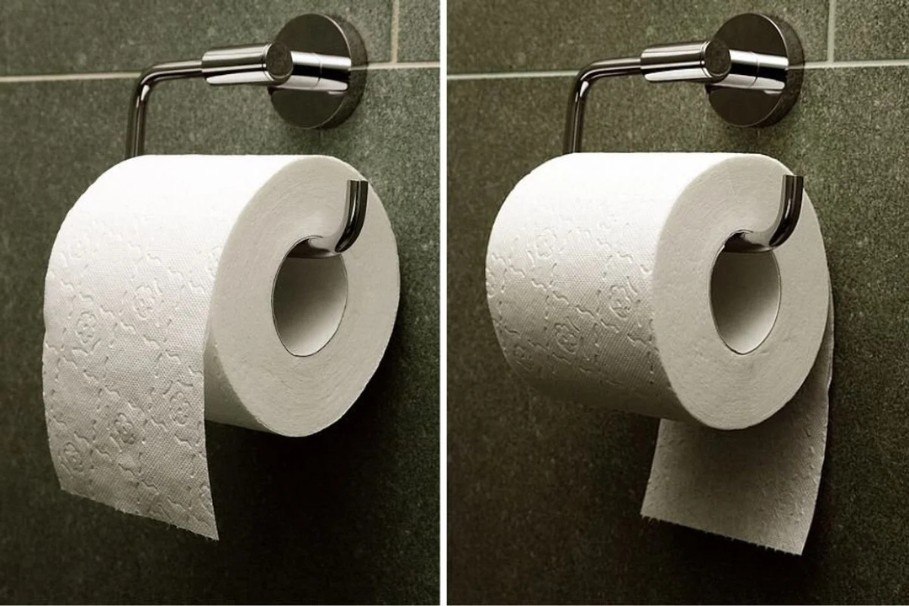
OVER OR UNDER?

Slide 7
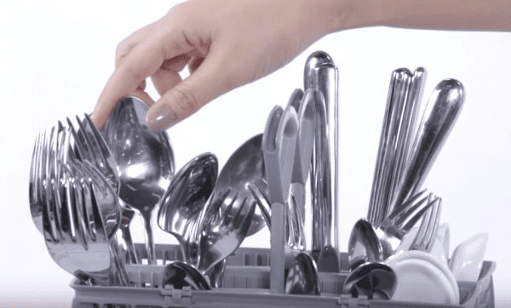
SILVERWARE UP OR DOWN?

Slide 8
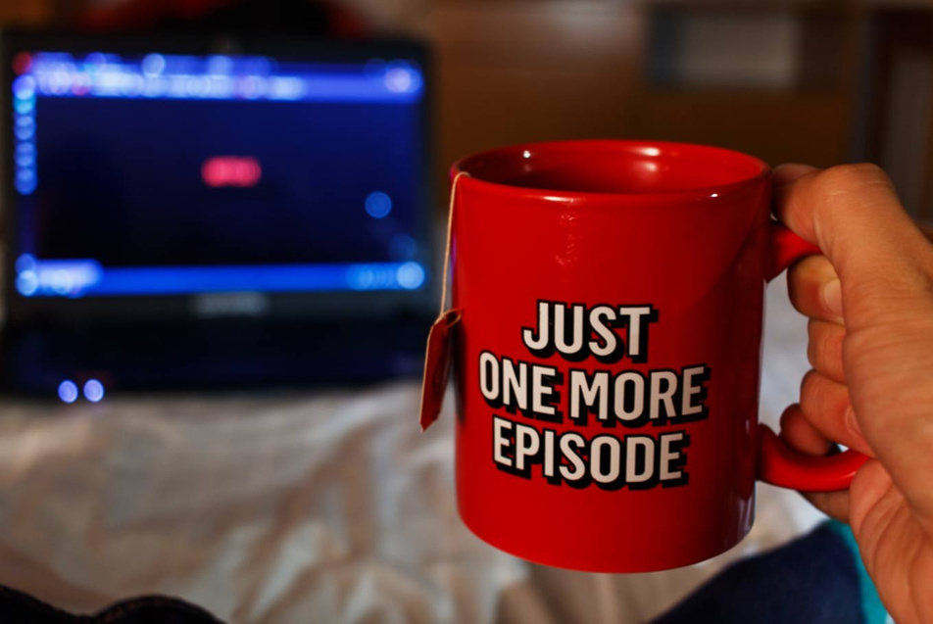
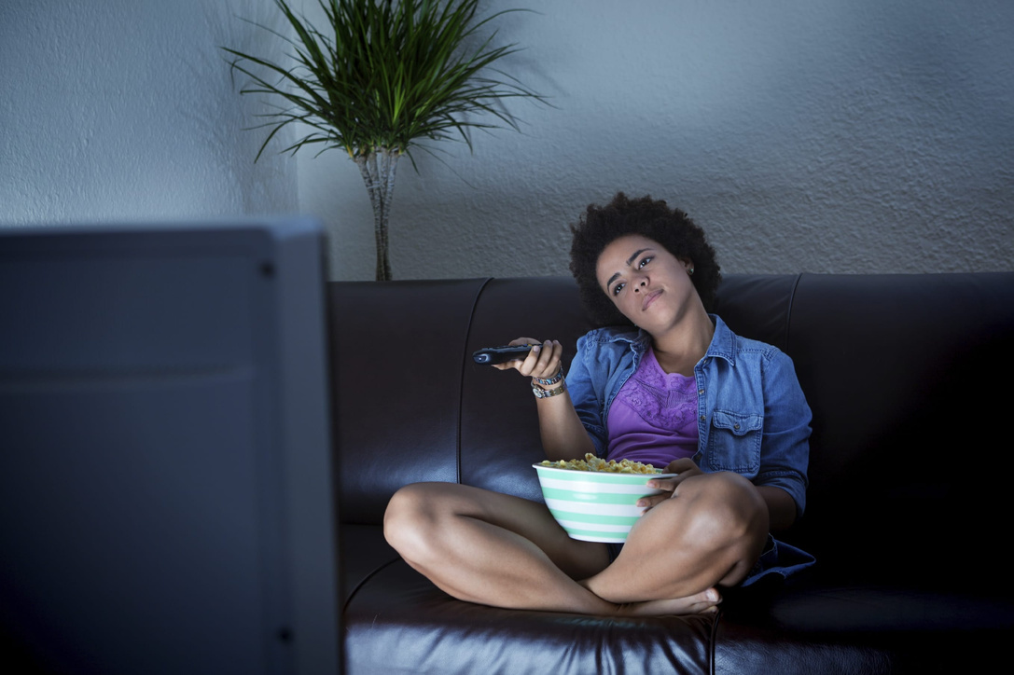
BINGE WATCH OR WAIT A WEEK?

Slide 9
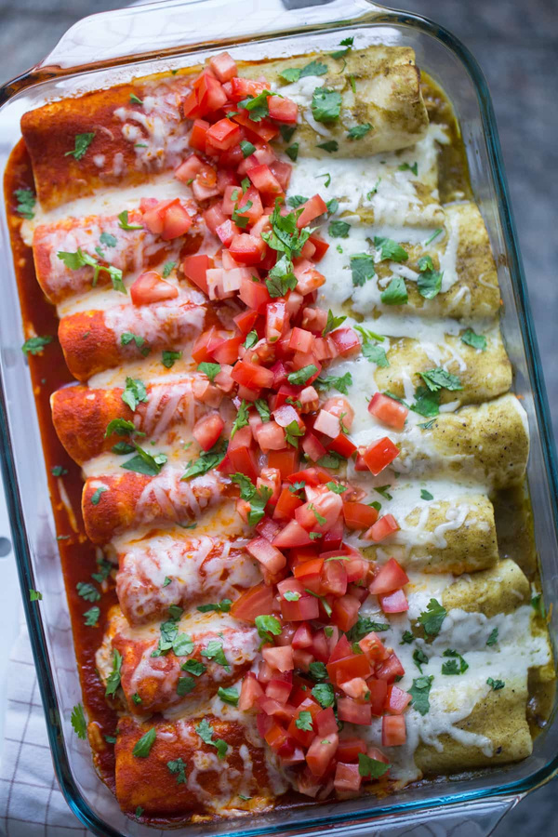
RED OR GREEN?

Slide 10
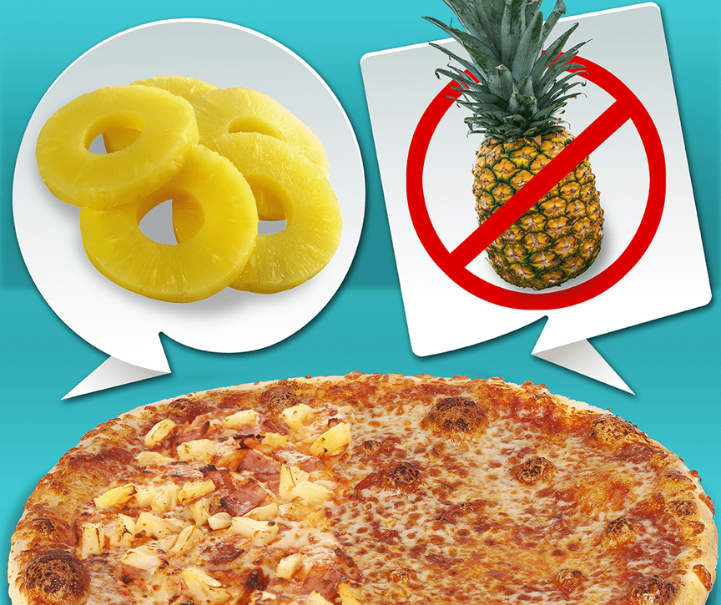
PINEAPPLE ON PIZZA?

Slide 11
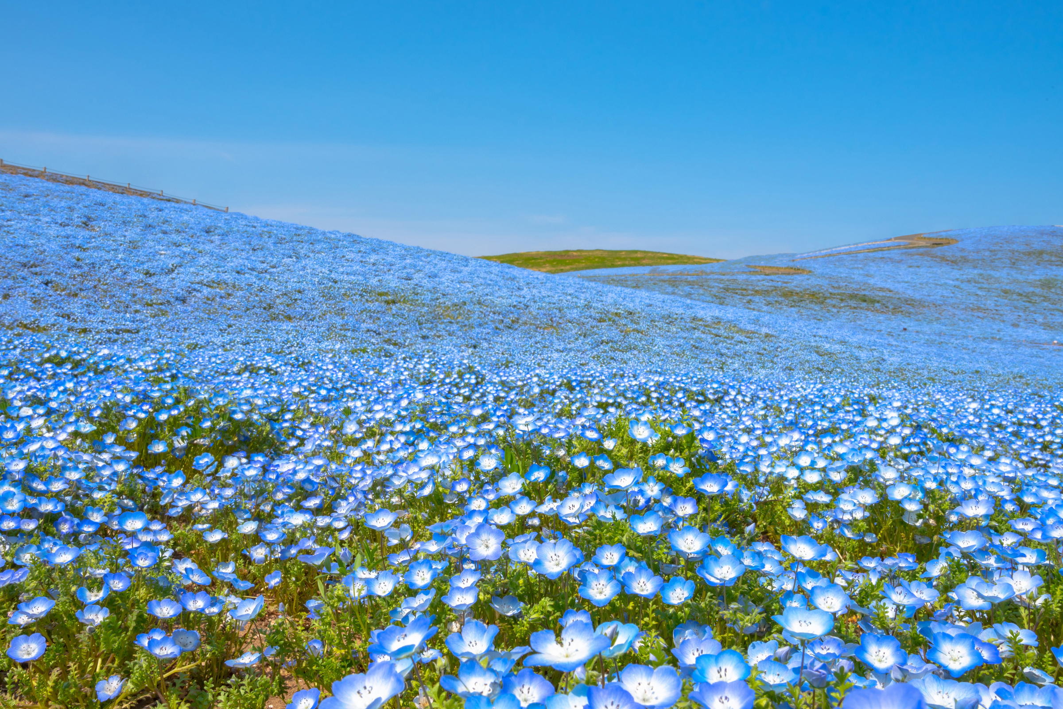
DELIGHTING IN DIFFERENCE

Slide 12
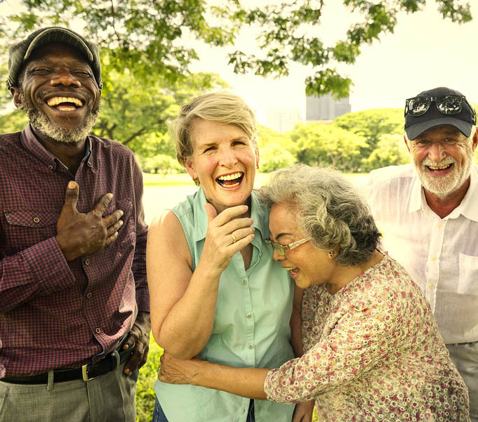


Recall a moment when you felt deeply connected to someone? What was happening that contributed to that feeling of ‘connection’?

Slide 13
WHY WE NEED EACH OTHER
Especially amid difference and uncertainty

Slide 14
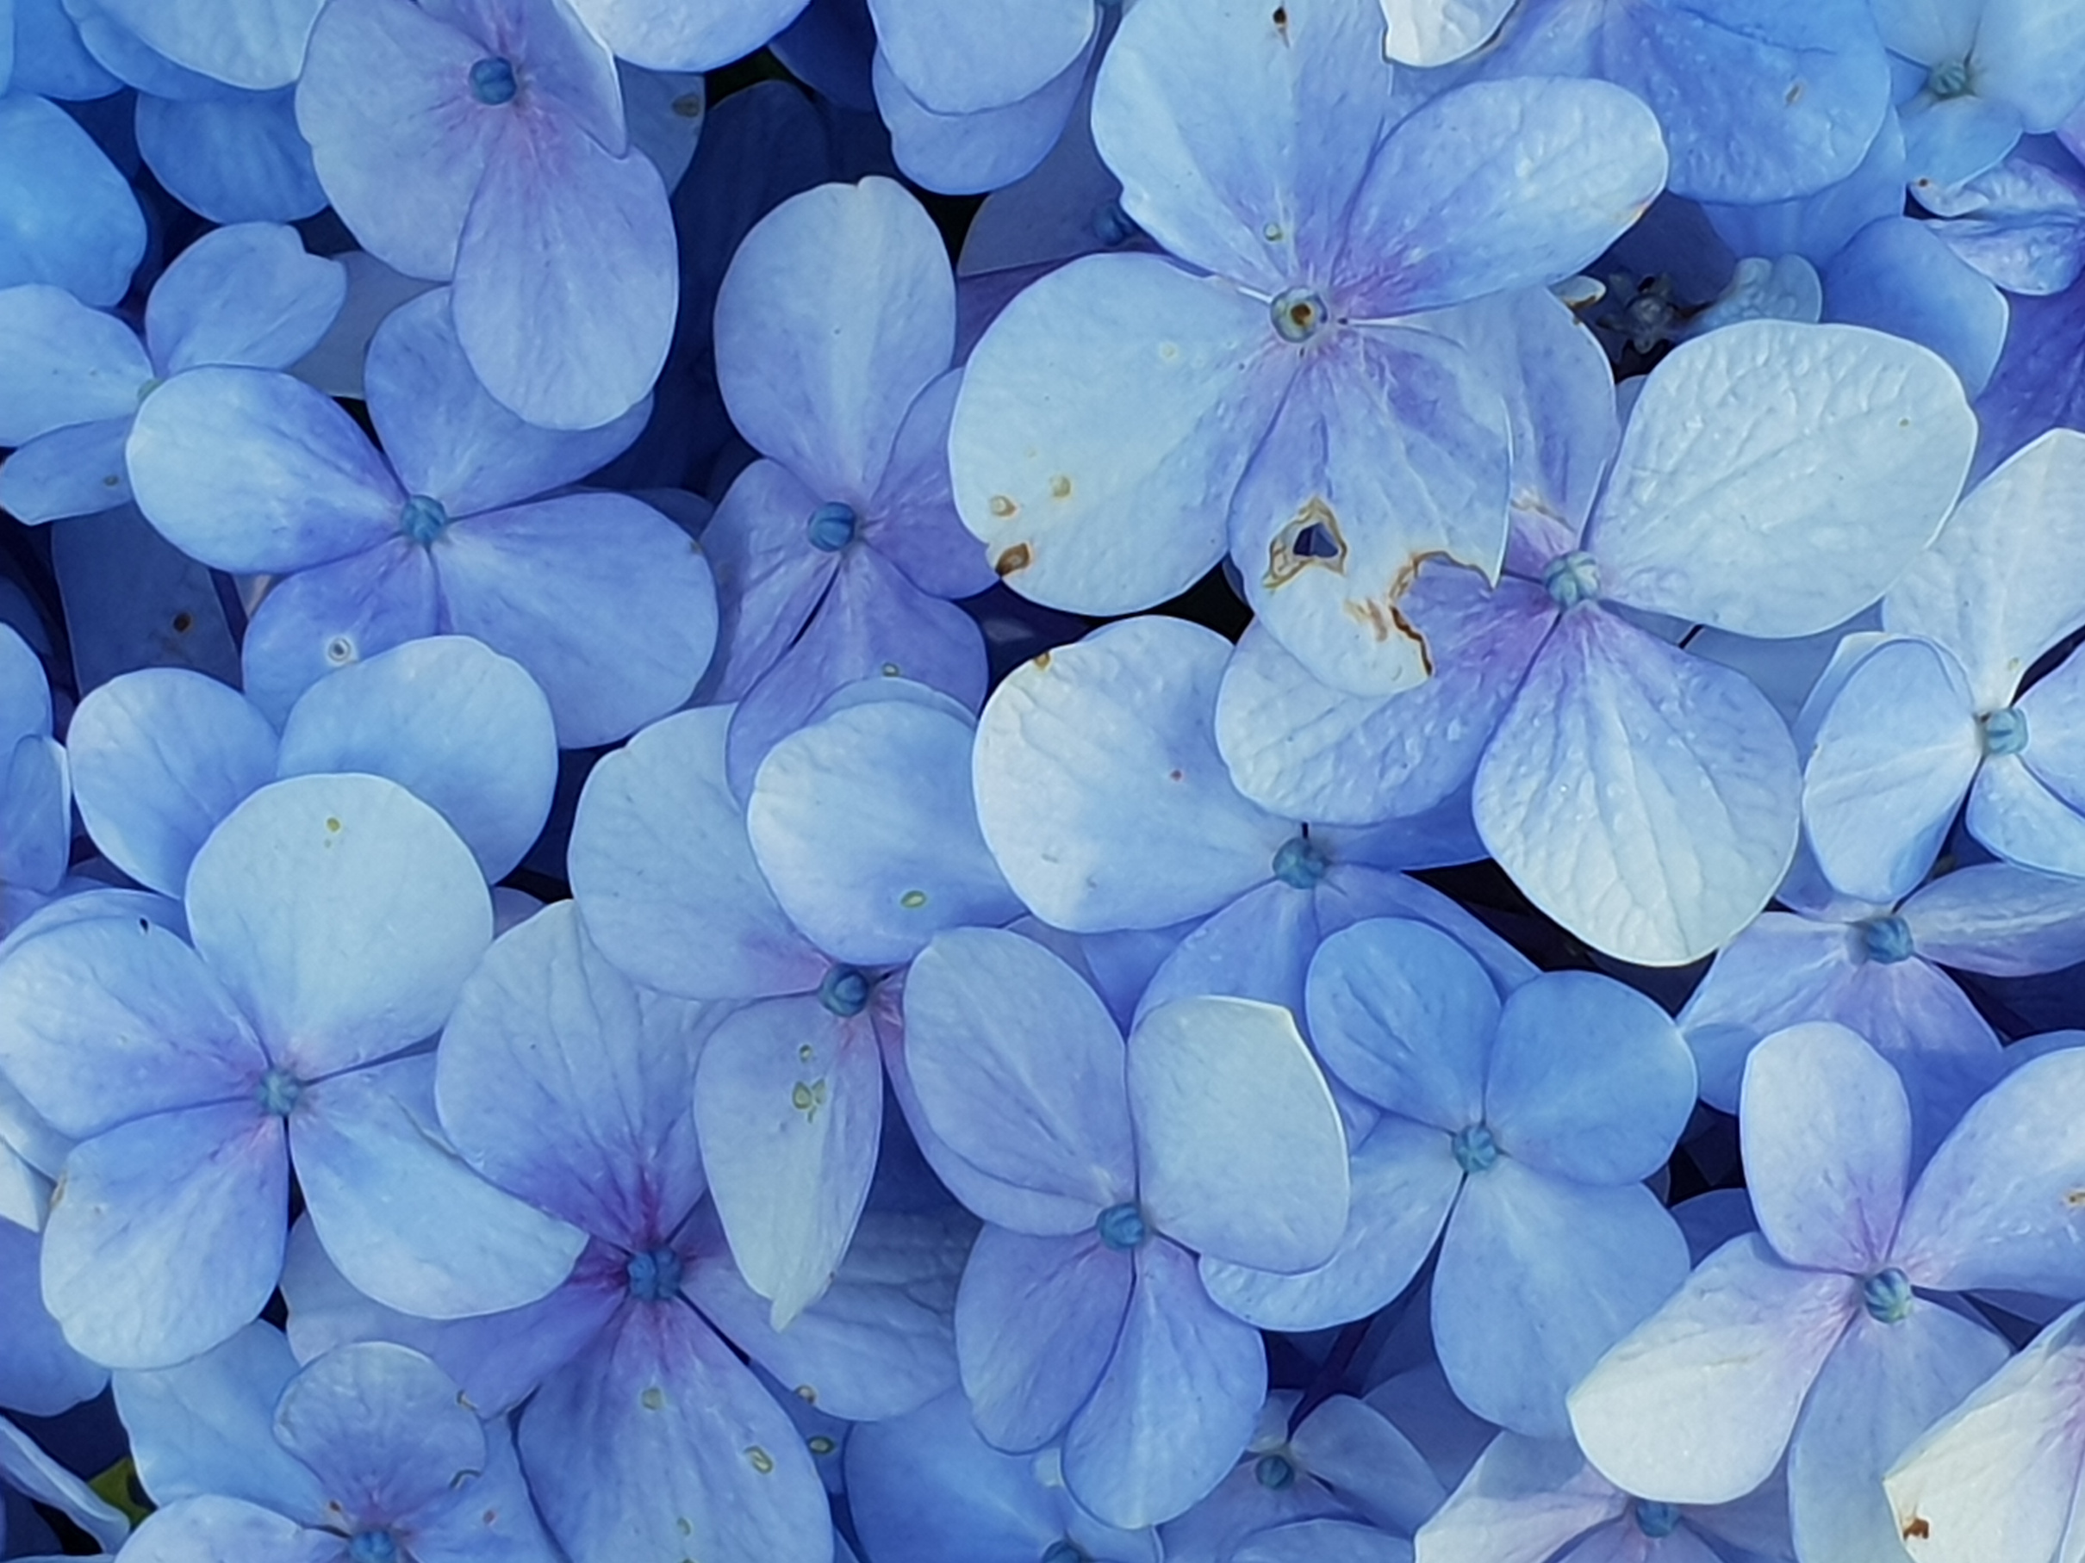
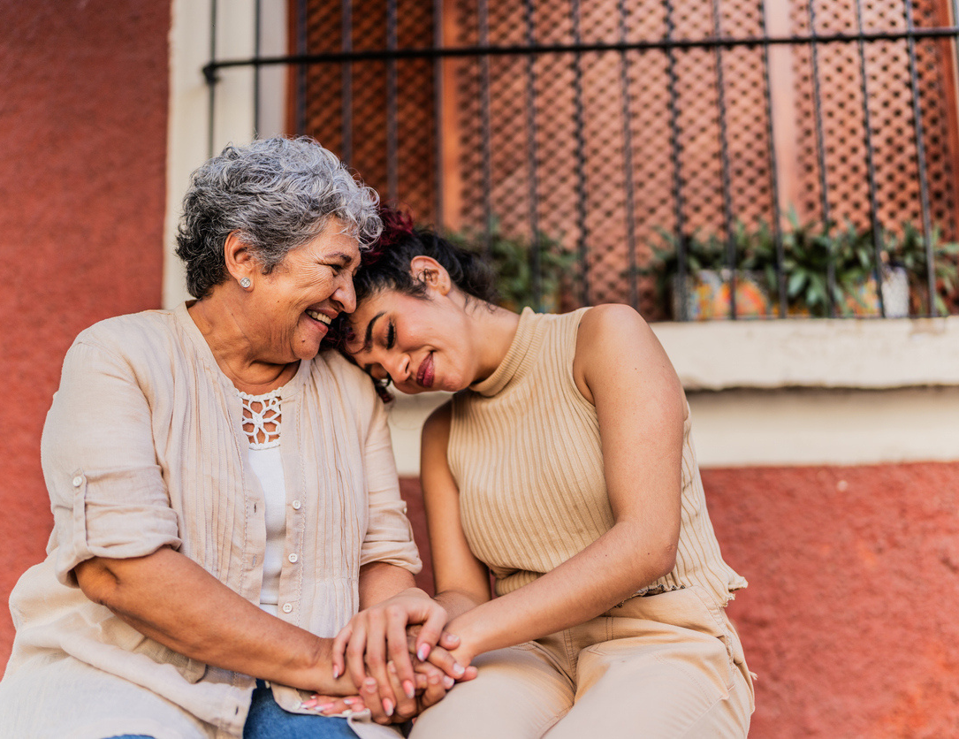
THE SCIENCE OF CONNECTION
  Connection is being seen, heard, known, and valued.
  A mindset versus a relationship status.
  Our brains are wired for social interaction.
  Connection is often an overlooked social determinant of health.
“Human connection is being fully known and fully loved.”
- Dr. John Deloney.

Slide 15


The Epidemic of Loneliness and Isolation
  3 in 5 Americans described themselves as lonely pre-pandemic.
  Increasing among young people and new mothers.
  As of 2024, 1 in 3 Americans report feeling lonely at least every week.
  Feelings and experiences with toxic polarization have increased 87% in just 2025 alone - and the year isn’t even over yet.

Slide 16
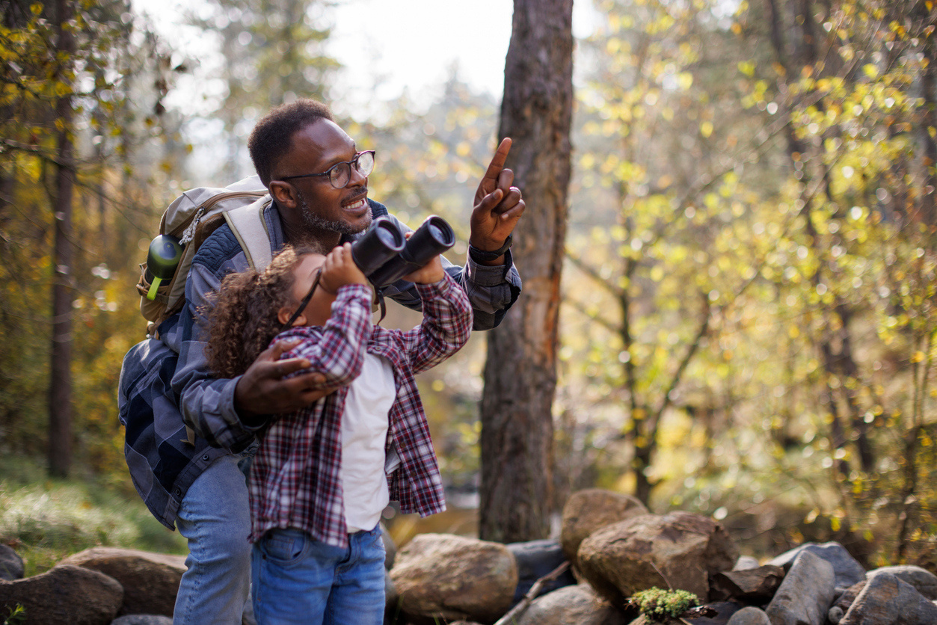
What’s Getting
in the Way?
  A need to hold more curiosity.
  A need to delight in difference versus othering.
  Our need to belong.

Slide 17
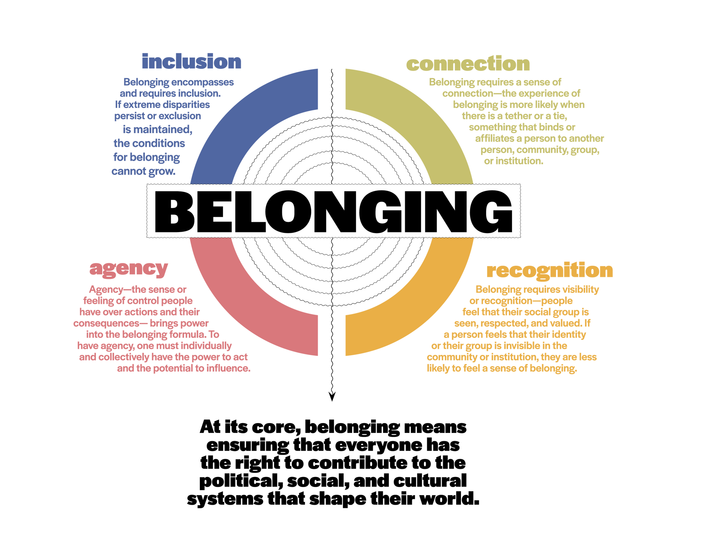

Slide 18
WHAT ARE WE HEARING FROM COMMUNITY IN THE ST. MARY’S SERVICE REGION

Slide 19

“Right now I just don’t believe people care or think that I am worth it. We need something, a group of people that can gather together in the park and talk to one another, maybe in a less structured way than a class or something like that.”
– Chino Valley Resident

Slide 20

“People are so stressed out and traumatized as a society. We need to get back on track and treat each other with decency. People don’t have social grace in public in how they are treating each other. People have something going on internally and you see it coming out in anger. We are impatient, rude, not treating people with respect, “I’m right/You’re wrong” - that worries me. We have become so jaded and not caring. We can not agree and still be respectful. The division is killing us.”
– Cottonwood Resident

Slide 21

“Another concern for me is being heard and seen, especially as an older person. I feel less visible and valuable and pushed around more as an older person. I don’t feel heard often. I try to wave and say hi to people, but a lot of people don’t acknowledge me back.”
– Kingman Resident

Slide 22

“I know what I’m talking about when it comes to me and my body. I need to be listened to, not talked ‘at’. I was supposed to go to a mental health place, not jail. When I got out of jail there was no way to call for help once let out, no rides, no nothing, no food, no connection. What do you do, there’s no way to navigate this or stop the cycle?”
– Prescott Re-Entry Program Resident

Slide 23
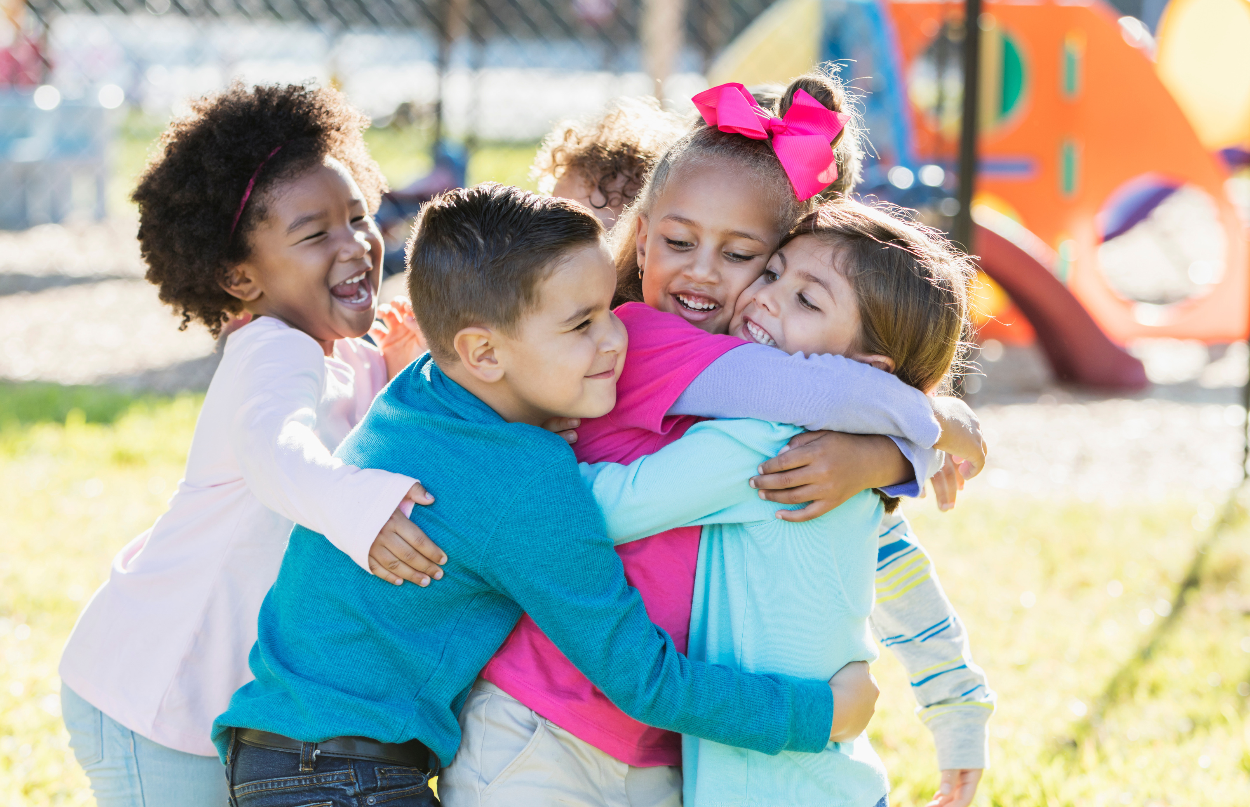
What do we have in this moment when everything else is uncertain?
We have each other.

Slide 24
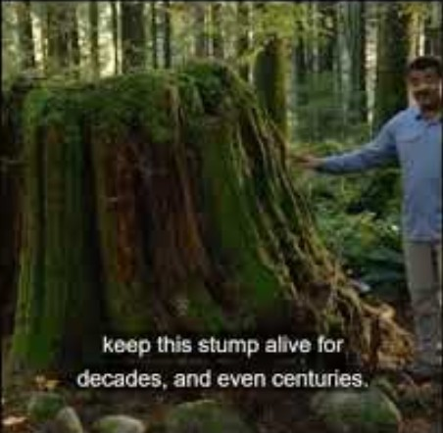
THE POWER OF RELATIONSHIPS

Slide 25
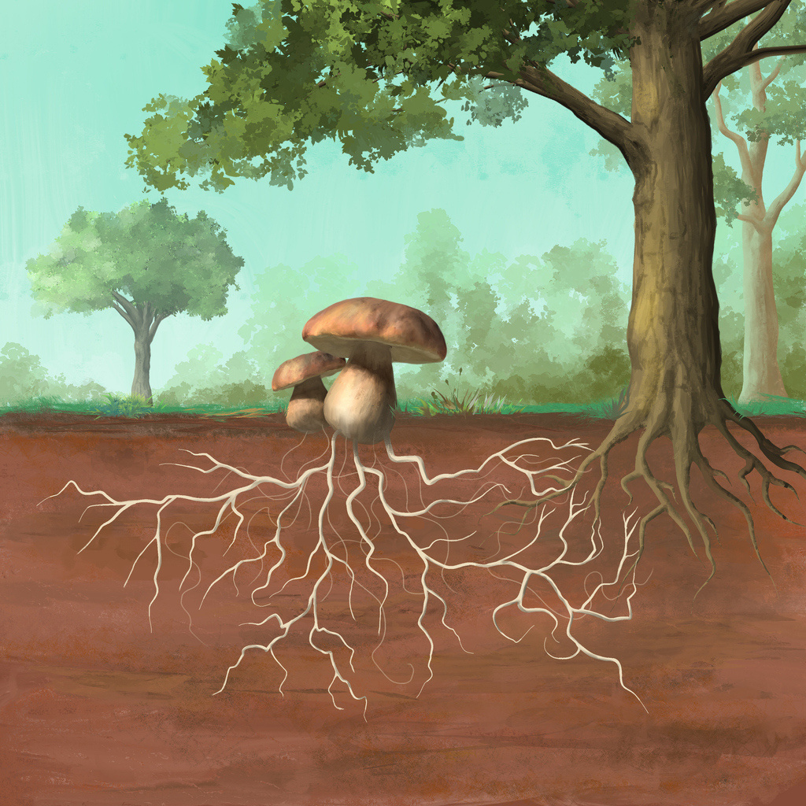
What does our mycelium network look like here in Arizona?

Slide 26
THE TINY BUT MIGHTY ACTIONS WE CAN ALL DO TODAY

Slide 27
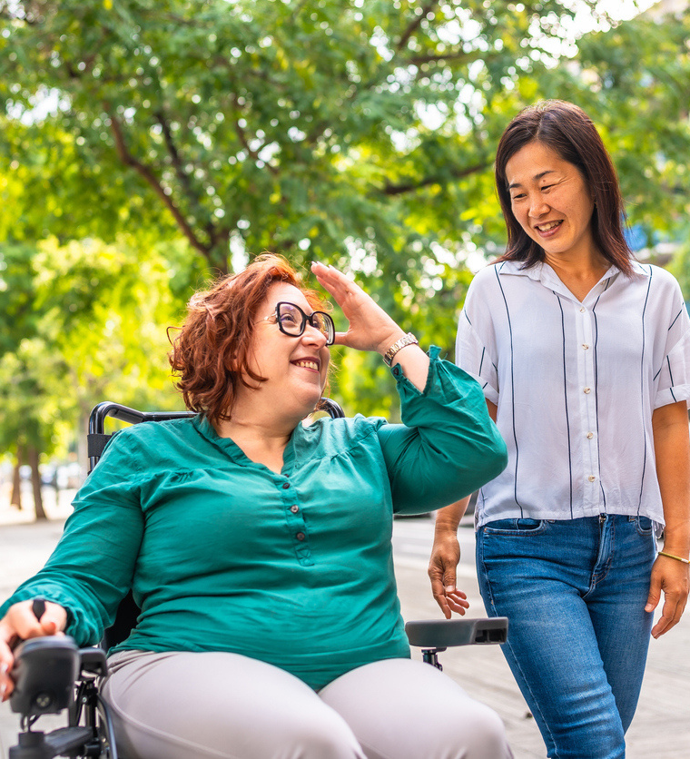

Be intentional with your time and time with others. Put screens down and look people in the eyes.

Slide 28

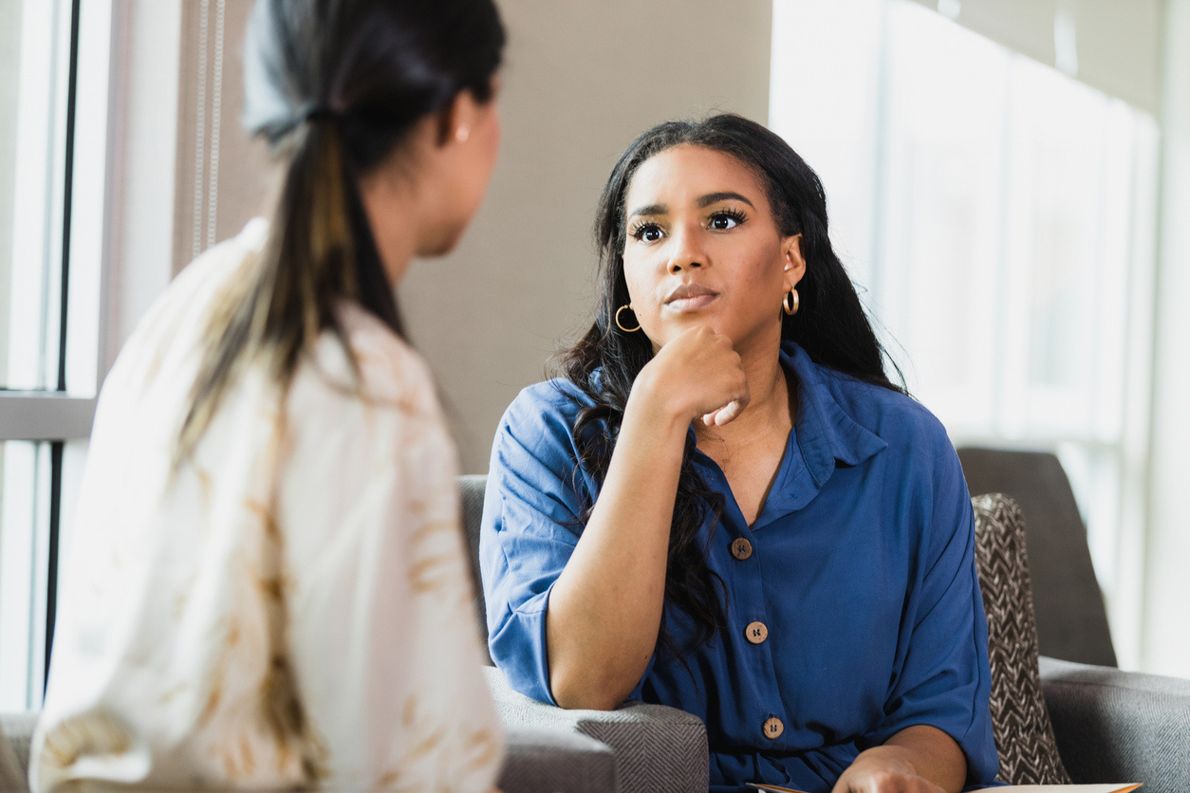
  Ask questions.
  Listen.
  Ask more questions.

Slide 29
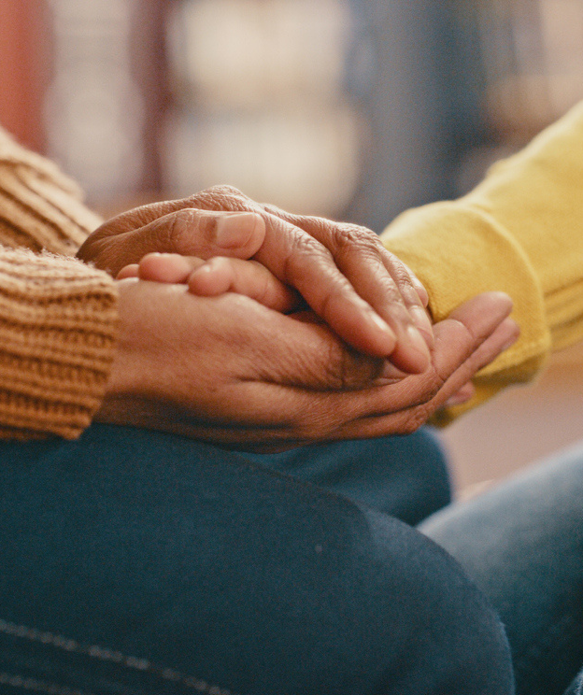

  Leave the judgement and perfection behind.
  Extend a lot of grace.

Slide 30
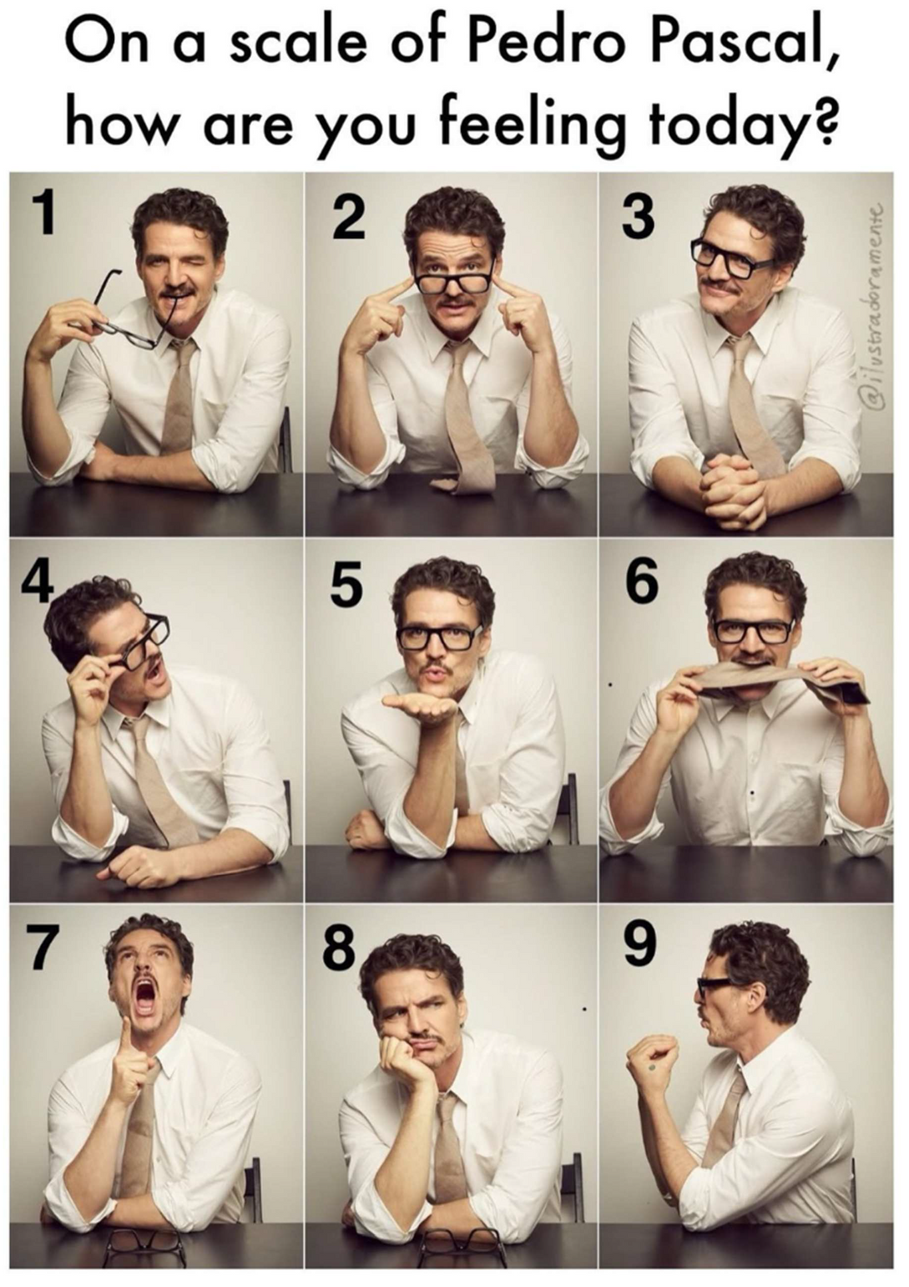

This network and our communities are resilient!
adrienneudarbe@
pinnacleprevention.org

