Slide 1

PARTNERING WITH
Disrupt the Real Estate Industry In the Best Way for Your Customers

Slide 2













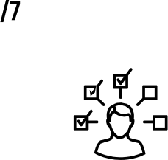
MARKETING & SPHERE
NEGOTIATING
Customer Expectations of
REAL ESTATE AGENTS
CUSTOMER SERVICE
24/7 AVAILABILITY
JACK OF ALL TRADES

Slide 3

What do Homebuyers and Sellers
EXPECT FROM YOU IN 2024?

Slide 4






What do Customers Expect from
MORTGAGE PROFESSIONAL?
GOOD COMMUNICATIONS
ACCURATE TERMS & TIMELINES
COMPETITIVE RATES
CUSTOMER SERVICE

Slide 5

What do you
EXPECT FROM YOUR LENDER PARTNER IN 2024?

Slide 6

What if we rethink the partnership between the lender and the real estate agent to truly serve the needs of the customer throughout their life?
What would that look like?

Slide 7



Together, we provide clarity and support to the
relationship with the customer for life.
Allowing the homebuyer to experience the joy of buying the home instead of the anxiety of "getting a loan".
Helping grow their generational wealth by accomplishing real estate & financial goals that likely would not happen without our teamwork.
Creating a more intentional process for the customer before they sell or buy a home.

Slide 8

Understand the customer's short and long-term goals.
DISCOVERY CALL:
Determine the advice that is best suited for them based on their current financial profile.
ANALYSIS:
Creating a more intentional process for the customer before they sell or buy a home.
Remove uncertainty and stress and create excitement & motivation.
CONSULTATION:
COMPETITIVE ADVANTAGE:
Increase the confidence when writing an offer on their ideal home.
CONTRACT MEETING:
Reinforce the decision, reduce anxiety, & provide certainty around the transaction.

Slide 9

How do we coach them to a confident and competitive place? We turn "I Can" into "I Must"!
HOUSING DATA
FINANCES
EDGE
COMMITMENT
HOUSING DATA
Deep understanding of the housing market
FINANCES
Showing them the difference between their personal economy & the national economy
EDGE
Giving them a competitive advantage through upfront underwriting
COMMITMENT
Proving that we are going to be a proactive lifetime guide to them
Deep understanding of the housing market
Showing them the difference between their personal economy & the national economy
Giving them a competitive advantage through upfront underwriting
Proving that we are going to be a proactive lifetime guide to them

Slide 10



Allowing homebuyers to experience the joy of buying the home instead of the anxiety of "getting a loan"

Slide 11












Empower Buyers By Managing Expectations
CD Review
Loan manager reviews final numbers
Smooth Closing Buyers close on their home!
Contract Meeting
All details for the transaction
Discovery Call
Goals and dreams
Documentation needed
Doc Signing Notary signs and wire info
Approval Review Loan manager reviews conditions for contingency
Financial Freedom Journey
Our teams help them reach their real estate and financial goals
Consultation Review pre-approval details and options

Slide 12








WHY WE CREATE AN EXPERIENCE THAT NO ONE EXPECTS
We send this book once we have our consultation with the homebuyers
When the offer is accepted, we send a moving supplies care package
Once the loan is closed, we send an engraved cutting board
When the loan is approved, we send cookies

Slide 13


Helping grow their generational wealth by accomplishing real estate & financial goals that likely would not happen without our teamwork.

Slide 14
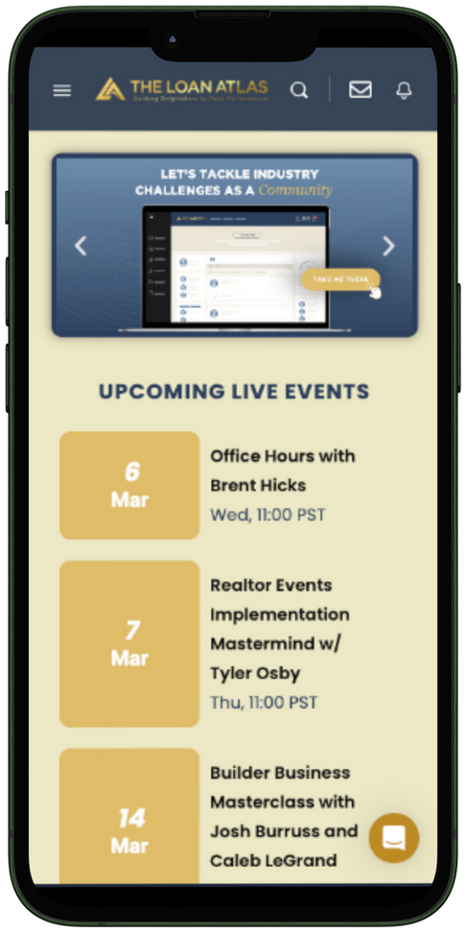
WEALTH CREATION AFTER CLOSING
When we promise value, it's because our commitment is something that the competition cannot or will not do wealth maximization through our ? experience. Most los and agents assign an email campaign and may try to reach out for further transactions. What is your strategy for adding significant value to their lives?

Slide 15

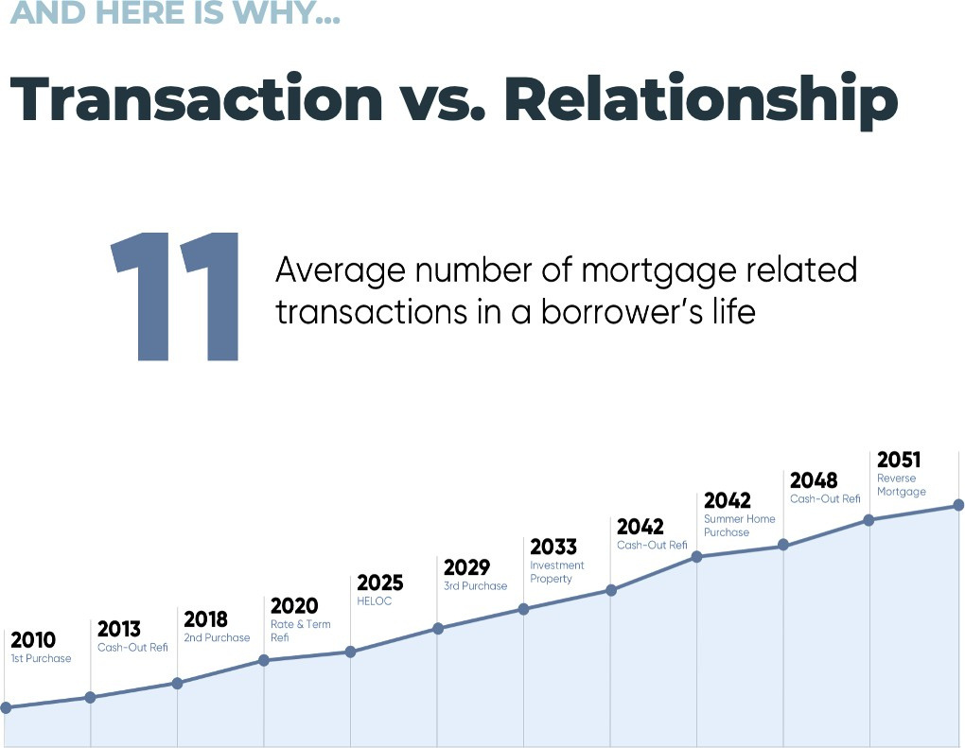

Slide 16
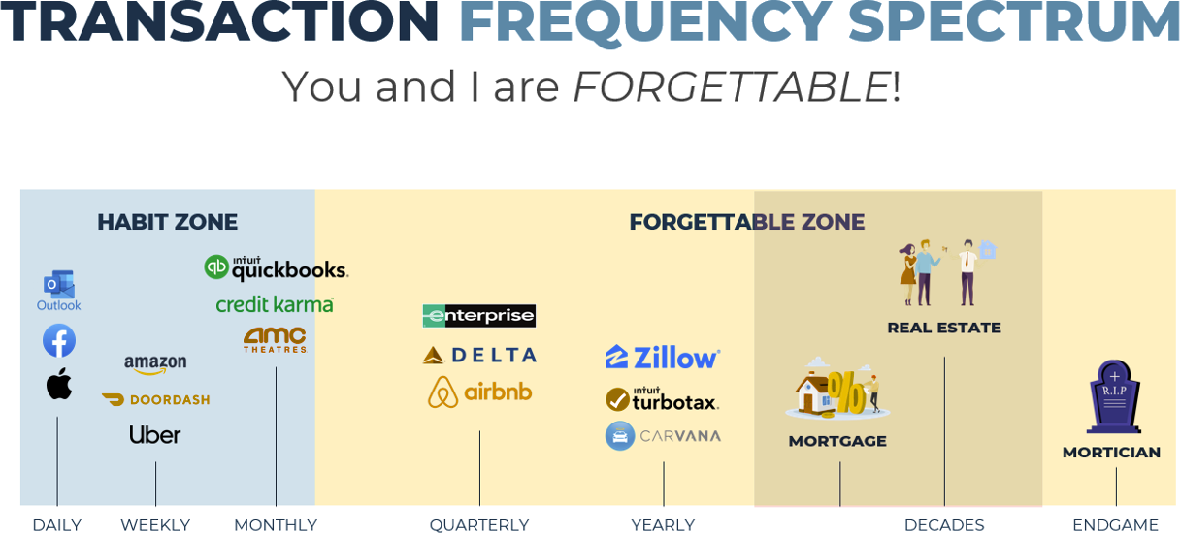

Slide 17

OUR TECHNOLOGY WORKS FOR & WITH YOU
Budget Management Credit Score Tracking Mortgage Readiness
Relocation Services Minimizes stress of Moving
1
2
Homeowner Wealth Digest Buyers Digest Home Value & Home Search
Provides borrowers with loan options based on financial situation, credit profile & life stages
4
3

Slide 18
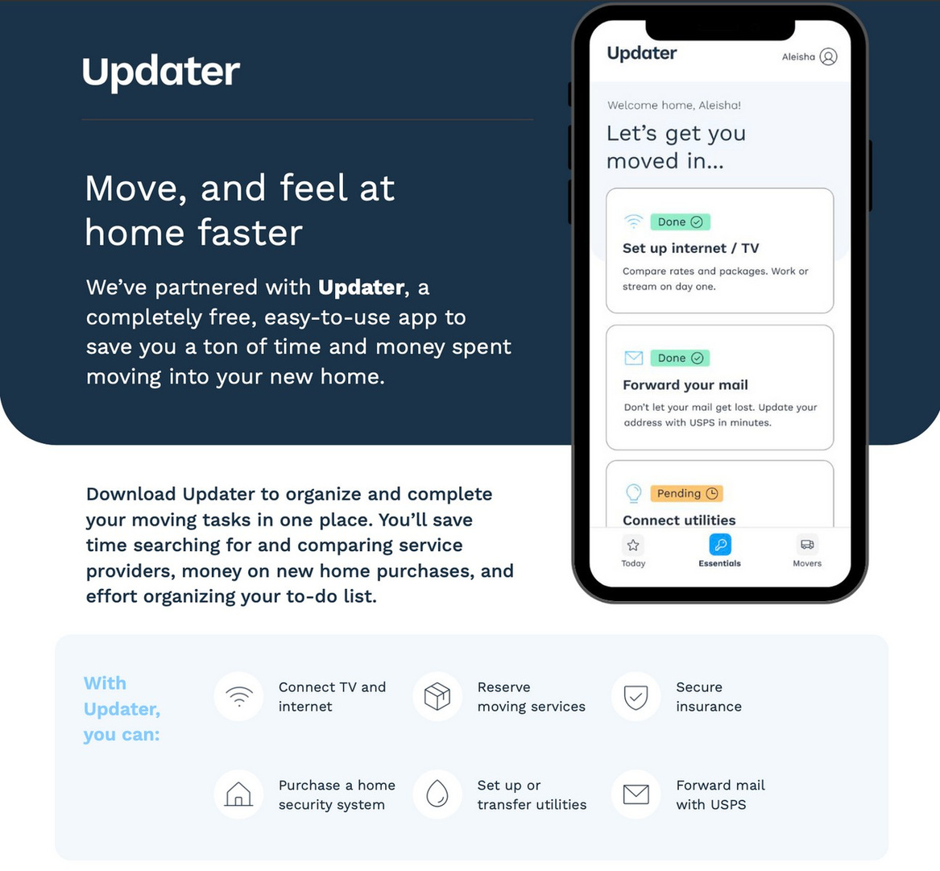
Relocation Technology

Slide 19
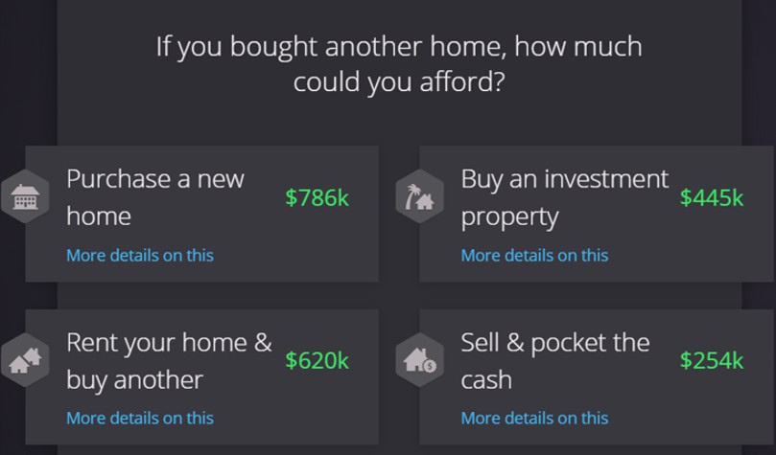
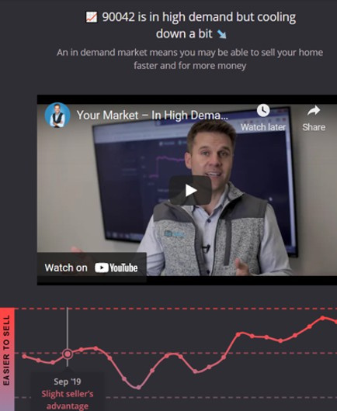
WE HELP OUR CLIENTS FULLY UNDERSTAND THEIR NET WORTH THROUGH REAL ESTATE & TEACH THEM WHAT THEY CAN AND SHOULD DO WITH IT.

Slide 20

RETENTION & REFERRAL GENERATION IS
OUR SPECIALTY
HELP WITH RETENTION, REPEAT AND REFERRAL BUSINESS BY TURNING YOUR DATABASE INTO A DATABANK

Slide 21
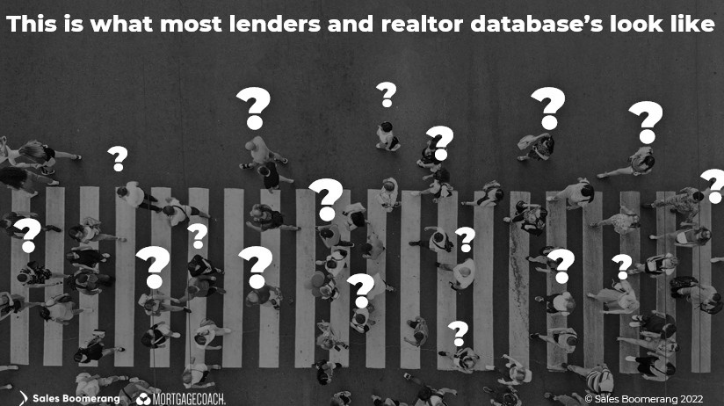
Most Lender and REALTOR databanks look like this:

Slide 22
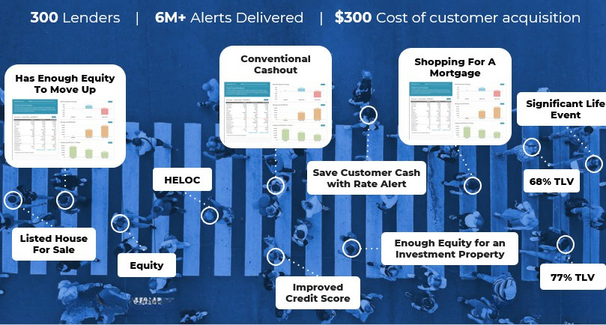
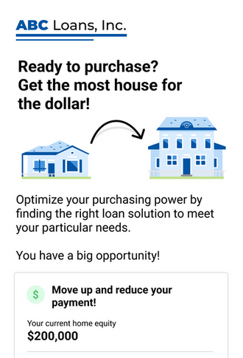
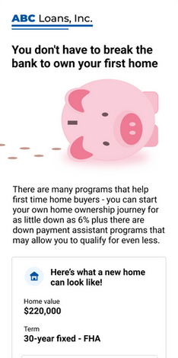
Our Collective databank will look like this...

Slide 23

PERFECT MORTGAGE PROMISE
Turn your database into a customized borrower search engine.
Artificial intelligence constantly scanning past clients for opportunities to increase the frequency of interaction & transaction.
Non-Credit Alerts
Cast a wide net with early insight into
potential loan needs
Core Credit Alerts
Retain your database with credit-qualified insight into loan needs
Prescriptive Scenarios
Act on credit-qualified scenarios with multiple loan-readiness signals
Listing: Know when your borrower lists their home for sale.
Mortgage Inquiry: Know when your borrower is shopping with a competitor.
Rate-And-Term: Know when your borrower is Credit Qualified AND can save real money on their mortgage. Cashout: Know when your borrower is Credit Qualified AND can benefit from the cash in their home.
FHA MI Removal: Know when your borrower is Credit Qualified AND can remove their mortgage insurance.
Rate Watch: Know when anyone in your database can benefit from current rates.
Early Payoff: Contact your borrower to avoid an early payoff penalty in the first 6 months.
Equity: Know when your customers have tappable equity in their homes.
Credit Improvement: Contact your borrower or prospect the moment their credit score improves.
Reverse Mortgage: Give borrowers 62+ a home- equity option tailored for their needs.
Data-rich High-Impact
Servicing Portfolio Monitoring
Retain your serviced loans
Alerts
Risk & Retention Know when a borrower is in danger of dropping out of your portfolio.
TIME-SENSITIVE: Act fast to maximize conversion or risk losing your customer forever.

Slide 24


DATA STRATEGY
TLA proactively gives the answers before we are asked.
Should they refinance to lower their payment?
Should they pay down their mortgage or shorten their term?
Should they convert an Adjustable to Fixed, or Fixed to Adjustable?
Should they use some of the equity and take cash out of the home for any reason and what is the best way to do that?
Should they move up to a larger home?
Should they move down to a smaller home?
Should they buy a second home or investment properties?
How should they navigate real estate and generational wealth planning?

Slide 25

Annual
FINANCIAL REVIEW
The Annual Financial Review shows the customer how invested we are in helping them set goals for homeownership, growing generational wealth and achieving financial freedom.
Our team gathers information about the customer's family, current financial situation and their short and long term goals with real estate and finance. We follow up post-closing and reach out at 3, 6, 12 months and beyond to strengthen relationships which builds client loyalty, retention and referrals.

Slide 26

How do we become the most valuable mortgage partner you have ever had?

Slide 27

MY COMMITMENT TO YOU
  Change the Real Estate Industry together.
  Differentiate your value proposition vs. your competitors.
  Unparalleled Client Experience that will reflect YOUR brand.
  Help with retention, repeat and referral business.
  Creating REAL client for life potential by having your clients do their personal and business banking with us.
  Shared tech access for monitoring opportunities & serving at the highest level Catch-all systems for leads & conversion machine.
  Help with lead gen.
  Generating more business from ancillary partners (CPA’s, Financial Planners, Attorney’s)
  Social media collaboration and content.
  Corp Affinity Partnerships with your clients

Slide 28


We can't work with everyone We need to find the right agent partners
READY
We want to partner with agents who want a relationship with their customers for life
OPEN
We want to advance data strategies and technology for our customers together
SMART
We agree that every human being deserves to have the same guidance toward generational wealth
SERVICE
DO OUR VISIONS ALIGN AS PARTNERS?
We want to partner with marketing, events, corporate affinity, lead generation and much more
VALUE

Slide 29

WHERE DO WE START?
Define our future together!
What is the REAL value?
What makes you different?
How do you create excitement with your database?
By working with both of us, PEOPLE will become better homeowners!
We are on your team and an extension of your brand.
When partnered, your commitment is our shared commitment.

Slide 30
Mortgage Company
CONTACT INFO

Slide 31




OUR NEXT STEPS
1
TEST DRIVE "THE TLA EXPERIENCE" EXPERIENCE" FOR YOURSELF
2
LET'S SCHEDULE A BUSINESS PARTNERSHIP PLANNING MEETING

Slide 32

THANK YOU!
Let's change our industries together.

