Slide 1






VYKON
SUCCESS SYSTEMS
The Consultation
vykon.us

Slide 2
Welcome to the VYKON Consultation Guide, a comprehensive roadmap tailored to empower your clients on their journey towards acquiring the ideal home loan. At VYKON, we understand that each client's needs are unique, and our primary goal is to align your loan strategy seamlessly with your overall financial plan. This guide is designed not only to assist your client in selecting the perfect loan but also to integrate it into a broader financial strategy, thereby maximizing their savings, cash flow, and net worth.
This guide is crafted to enhance your customers experience in navigating the complex landscape of mortgage lending. Our aim is to equip you with the knowledge and skills necessary to provide exceptional service to our clients, ensuring they find the best possible loan options that align with their financial goals. As a loan originator, your role is pivotal in guiding clients through their journey to homeownership or refinancing, and this guide will serve as your roadmap to delivering top-tier financial advice and mortgage solutions. Also helping you stand out in an ever-growing marketplace.

Slide 3

Financial Plan
Prepared for:
Happy Home Buyer
02/20/2023
VYKON
SUCCESS SYSTEMS

Slide 4
THE DIFFERENCE
• My Primary Role is to help you select the perfect loan strategy for you and your family and to help you integrate that strategy into your overall financial plan. That allows you to maximize your savings, cash flow and net worth.
• Simply stated, I am here to help you save money and to make this process both easy and enjoyable. I will take care of your loan so you can get back to your life.
VYKON
SUCCESS SYSTEMS

Slide 5
My Questions for You:
What is most important about this home loan to you?
What are your concerns?
Please describe what EXCELLENT customer service means to you?
What is crucial to the future of your financial success?
VYKON
SUCCESS SYSTEMS

Slide 6
My Commitments to You:
•Your closing costs will ALWAYS be equal to or LESS than our Loan Disclosure.
•We will ALWAYS honor our approval letters/commitments and close your loan.
•We will NEVER cause your closing to be delayed.
•We will ALWAYS ask the necessary questions to learn and understand YOUR financial goals and will explain EVERY piece of the loan process.
•We will study and review ALL of the possible scenarios to ensure you get the best options for your needs.
•We will communicate with your agent, CPA, Advisors, and/or attorneys to ensure your overall financial plans are integrated.
•Just like a professional financial advisor will manage assets, we will manage your mortgage after closing, so you are ALWAYS in the best loan.
•We will ALWAYS communicate pro-actively by giving you, your agent, and the seller’s agent a written update via email.
•We will ALWAYS ask you to explain your vision of excellent customer service so we can serve you better.
•We will ALWAYS do everything that we can to deliver your vision PLUS.
VYKON
SUCCESS SYSTEMS

Slide 7



How can you get me the lowers rate?
2009-Present
1938-2009
Conforming
Rates were the same for
Everyone who qualified
Sub-Prime
“Non-conforming”
Rates varied greatly, based
on anything & everything
Conventional
Based on Loan Level Pricing
Adjustments (LLPA)
VYKON
SUCCESS SYSTEMS

Slide 8
30 Things That Can Affect Rates
Loan Amount (<$180K, >$417K)
Loan Term (30, 15, 7/1)
Purpose (Purchase, Refinance)
LTV
Property/State
Occupancy (Owner/Investment)
Credit History
Asset Verification
Relocation
Concessions
Employment Status
Co-Borrower (Occ/Un-Occ)
Lock Period (15, 30, 45, 60)
UW System (DU, LP, AUS)
Property Type (SFR, Condo)
Loan Type (CONV, FHA, VA, USDA)
Amortization (Fixed, ARM)
Cash Out/Amount
Debt Tolerance Ratio
CLTV
Property County
# of Units (1-4)
Credit Score
Reserves
Gift Funds
Income Verification
Employment Documentation
Citizenship
Mortgage Insurance (MO, LPMI)
Escrow (Included, Yes or No)
VYKON
SUCCESS SYSTEMS

Slide 9

Why and When do rates change?
A mortgage backed security (MBS) is a type of asset-backed security that is
secured by a mortgage. The mortgages are usually sold to a government agency (Fannie Mae or Freddie Mac), who “securitizes” or “packages” the loans into a security that can be sold to investors.
THE PRICE OF MORTGAGE BACKED SECURITIES IS THE ONLY THING THAT MOVES MORTGAGE RATES!
Has anyone ever explained this to you?
VYKON
SUCCESS SYSTEMS

Slide 10
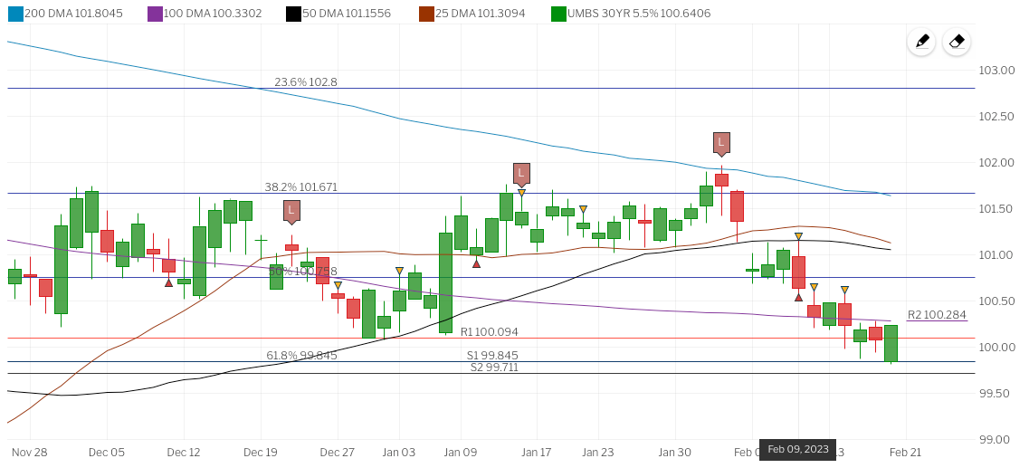
Why and When do rates change?
Do you want the lowest rate today or when you close?
How long do you think it will be before you close?
Would I recommend locking in the rate?
VYKON
SUCCESS SYSTEMS

Slide 11
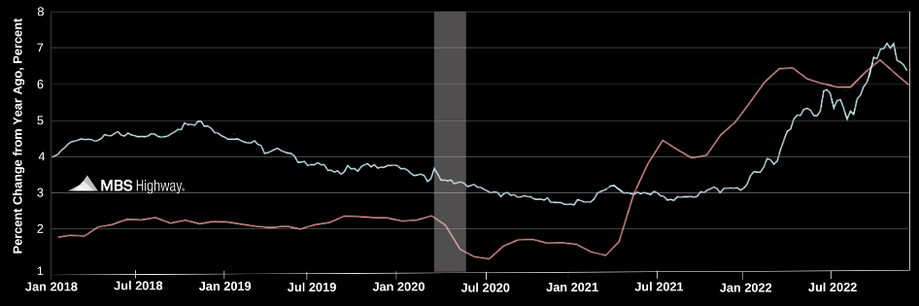
How can I save you money?
Inflation Drives Mortgage Rates.
Real-time market data with
lock recommendations
Daily Rate Advice:
Higher Stock prices coupled with an uptick in core consumer inflation are pushing Mortgage Bonds lower this morning, following yesterday's steep losses.
The two-day Fed meeting kicks off on Capitol Hill this morning. There will be no headlines out of today’s meeting. The monetary policy statement will be released at 2:00 p.m. ET tomorrow with a press conference by Fed Chair Yellen at 2:30.
With the recent big drop in Mortgage Bond prices and technical damage done, carefully floating is recommended. If anything changes, I will get back to you.
30-year fixed mortgage rate
Core Consumer Price Index (CPI)
VYKON
SUCCESS SYSTEMS

Slide 12
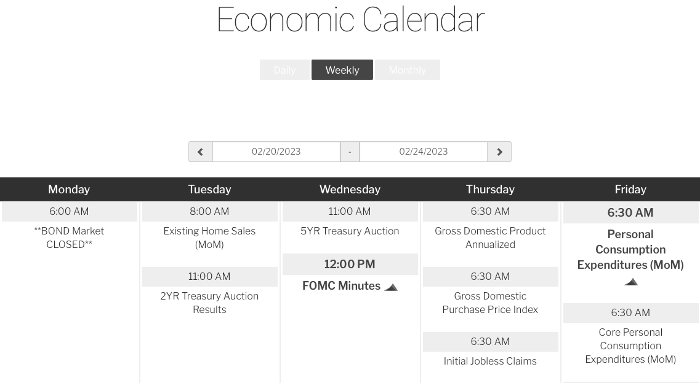
How can I save you money?
Weekly forecast and economic calendar monitoring
VYKON
SUCCESS SYSTEMS

Slide 13


How familiar are you with the term points?
Rate
Points
If you lowered your rate by 0.25%, how much do you think it would lower you monthly payment?
$ / month.
6.0%
Rebate
5.75%
No Points
1 Point
5.49%
5.0%
2 Points
Projected Loan Amount
1% =
Payment @ 5.75%
$2,137.25
$315,000.00
$3,150.00
Payment @ 5.75%
$2,085.56
VYKON
SUCCESS SYSTEMS

Slide 14
How familiar are you with the term points?
  Would you pay $3,150 today to save $51.69 a month?
  How long do you plan on living in this home?
  How many homes have you owned?
  How long did you live in your last home?
  Have you ever refinanced? If so, how many times?
  When did you buy your first home?
The average loan is only in place 5 years.
It would take almost
6 years (69 months)
to make your
money back
VYKON
SUCCESS SYSTEMS

Slide 15
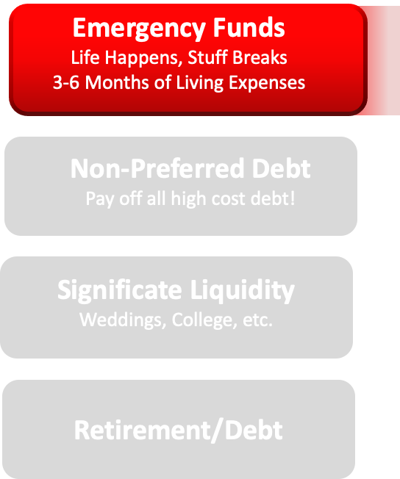

Down Payment Analysis and Document Review
Checking
Savings
Money Market
VYKON
SUCCESS SYSTEMS

Slide 16
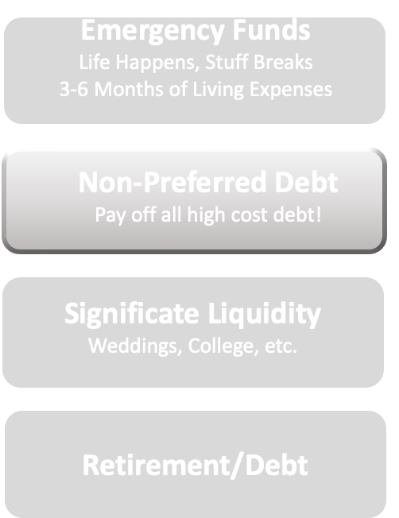
Down Payment Analysis and Document Review
Credit Card
Consumer
Other
VYKON
SUCCESS SYSTEMS

Slide 17
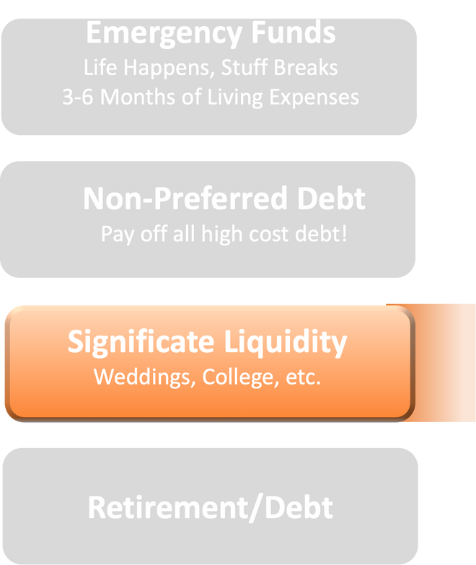
Down Payment Analysis and Document Review
401K, IRA
Stocks
Life Insurance (CV)
VYKON
SUCCESS SYSTEMS

Slide 18
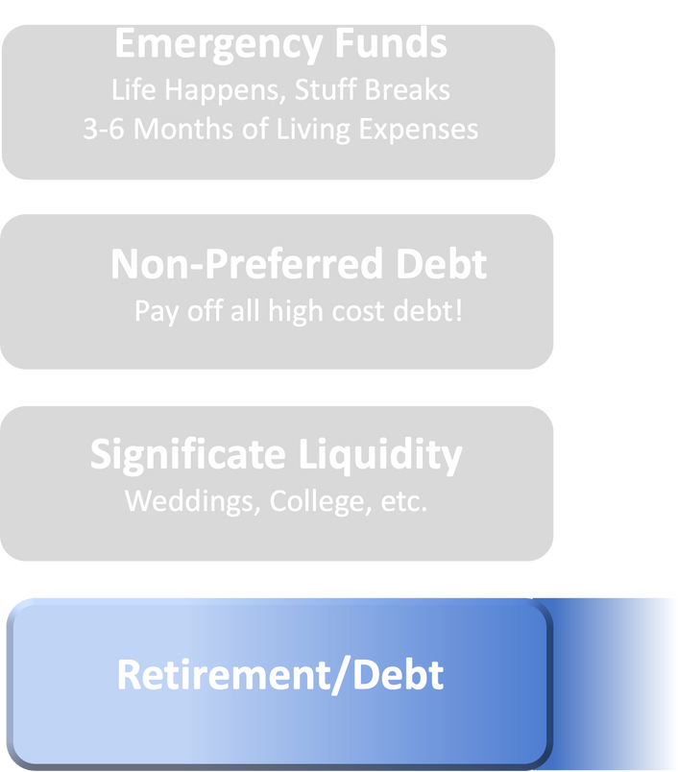
Down Payment Analysis and Document Review
Retirement Age
Location
Life Style
VYKON
SUCCESS SYSTEMS

Slide 19
Strategic Mortgage Plan
Market Analysis Weekly Updates Short Term: Lock or Float? Long Term: Annual Reviews | Expected Closing Date: Approximately 180 Days With interest rates expected to climb, the current bias is always toward locking, but….
Down Payment Analysis I recommend __% down payment because | We believe the biggest mistake buyers make is putting too much down on their home. Whether it be paying down a higher cost debt or increasing liquidity, most money is better utilized in other ways.
Product Selection Years in house?___ Years with loan?___ | With rates at all time lows, fixed rate mortgages became more popular than ever. With rates increasing it became more important to work with a professional who can explain the details of all of your options.
Debt Retirement Plan | The first priority for a stable financial future is to secure your emergency funds and to pay off all high cost debt. From there, it is to invest and balance wisely.
Financial Plan | Once you have a solid emergency fund and have paid off all high cost debt, your focus turns to investing and paying off lower cost auto loans and have mortgages. If you are going to error, then do so on the side that gives you control…
VYKON
SUCCESS SYSTEMS

Slide 20
Your Mortgage Total Cost
Fixed Costs
Variable Costs
VYKON
SUCCESS SYSTEMS

Slide 21
Things that can affect your approval (please contact me prior to any of these things taking place.):
  Any new debt or inquiries on your credit.
  Any use of part or all assets.
  A collection notification.
  A 30 day late payment.
  Job change of any kind.
  Do not co-sign for anyone.
  Call me before any large deposits are made to any account.
Also please make sure that all of your funds to close are seasoned for 2 months. If you would like to discuss other options please call.
VYKON
SUCCESS SYSTEMS

Slide 22
How Do You Feel?
  Have we answered all of your initial questions and concerns professionally?
  Have we met your expectations thus far?
  If not, what do we need to do?
  Do you feel less stressed than before?
  Did we show you how we can save you money?
  Do you feel like we delivered on our commitments thus far?
VYKON
SUCCESS SYSTEMS

Slide 23
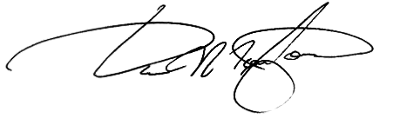
OUR GOAL IS TO HELP YOU ACCRUE GENERATIONAL WEALTH THROUGH THE ACQUISITION OF REAL ESTATE AND OUR MANAGEMENT OF THAT DEBT.
VYKON
SUCCESS SYSTEMS

Slide 24

As you reach the end of the VYKON Consultation Guide, our goal is that you feel empowered and well-prepared to assist clients in their home financing journey. Your role in helping clients understand their options, manage their mortgages, and make informed decisions is invaluable. Remember, at VYKON, we don't just empower loans professionals, we build lasting relationships and contribute to the financial well-being of our clients.
We trust this guide will be an asset in your toolkit, enabling you to offer tailored advice and solutions. Thank you for your dedication to excellence and for being a vital part of the VYKON team."
For over two decades, we've been mentoring individuals on enhancing their lives through effective Planning. Visit our website for additional insights and tools to assist you on your path.
vykon.us

