Slide 1
Liturgy and the mass
RCIA: February 7, 2021
Chapter 14

Slide 2
Opening prayer – Collect for today
Keep your family safe, O Lord, with unfailing care,
that, relying solely on the hope of heavenly grace,
they may be defended always by your protection.
Through our Lord Jesus Christ, your Son,
who lives and reigns with you in the unity of the Holy Spirit,
God for ever and ever.

Slide 3
liturgy
From Greek
  leitos – public
  -ergos – working
  Leitourgia – public service, worship of the gods
“public work or work done on behalf of the people”
Prayer offered to the Father, through the Son, and empowered by the Holy Spirit
Not a private act, but a public act of worship performed by the faithful gathered together
Call and response

Slide 4
Mystery
A reality that is both visible and hidden
Abundance of signs, symbols, and rituals (see first paragraph of “How Do We Celebrate?” on page 171)

Slide 5
When?
The Lord’s Day – Sunday – Day of the Resurrection
  “a day for rest and relaxation. It is also a day when the faithful can devote themselves to works of mercy and to the apostolate.”
Liturgy of the Hours
  Sacramentalizing each part of the day
  Structured on the Psalms
  The “Prayer of the Church”

Slide 6
The Mass
The Eucharist is the source and summit of our lives
The Mass is the center of our life

Slide 7
The Mass
Sacrosanctum Concilium – the Constitution on the Sacred Liturgy from Vatican II: “At the Last Supper, on the night He was betrayed, our Savior instituted the eucharistic sacrifice of His Body and Blood. This He did in order to perpetuate the sacrifice of the Cross through the ages until He should come again, and so to entrust to His beloved Spouse, the Church, a memorial of His death and resurrection: a sacrament of love, a sign of unity, a bond of charity, a paschal banquet in which Christ is consumed, the mind is filled with grace, and a pledge of future glory is given to us” (#47)

Slide 8
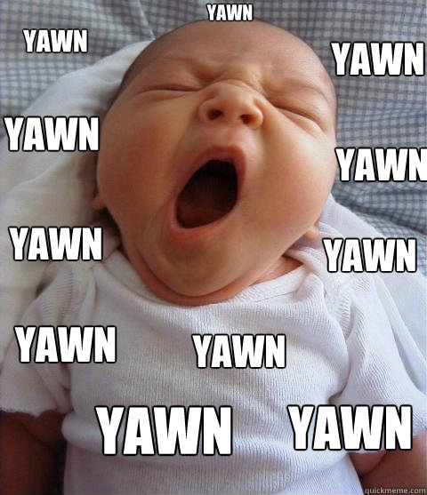
But…
Mass is boring!!

Slide 9
Mass
ἐκκλησία (“Ekklesia”) – a call from outside
From ἔκκλητος (“ékklētos” - summoned)
Summoned = a call that we respond to
  Spanish = iglesia
  French = eglise
  English = “ecclesiastical”

Slide 10
Mass
Entrance Procession
Introductory Rites
Liturgy of the Word
Liturgy of the Eucharist
Concluding Rites

Slide 11
Entrance procession

Slide 12
Entrance Procession
Being called out of the world
The world = chaos
Mass = order
Called out of chaos and into order
  That’s why the procession has order

Slide 13
Entrance Procession
The procession comes from the body of the congregation, from among the people
The procession comes to the front and genuflects before the tabernacle
This shifts the focus from the tabernacle to the altar

Slide 14
Entrance Procession
Priest(s) and Deacon(s) kiss (“reverence”) the altar
  Altar is the table for the sacrifice
  Honor the relic in the altar
    St. Casimir: St. Stephen of Hungary
    St. Adalbert: We aren’t sure

Slide 15
Introductory Rites

Slide 16
Introductory rites
Sign of the Cross
Greeting
Penitential Act
(Gloria)
Collect (Opening Prayer)
  The Latin word collēcta meant the gathering of the people together

Slide 17
Sign of the cross
How we start every prayer
Especially appropriate for Mass – our re-enactment and participation in the mystery of the Cross

Slide 18
Greeting
Priest: The Lord be with you
Congregation: And with your spirit
Mutual invitation to the Lord’s Feast (first call-and-response)
“Your spirit”: the priest acts in persona Christi
  Perhaps a reminder and assurance to the priest of the gift of the spirit he received at ordination, and a calling upon that spirit for the celebration of the sacred mysteries

Slide 19
Penitential act
Pope Pius XII: the tragedy of our times is the loss of a sense of sin
Remember our sins with sincere repentance
“I confess to Almighty God…”
“Lord have mercy / Christ have mercy / Lord have mercy” from processions

Slide 20
Penitential act
“May almighty God have mercy on us, forgive us our sins, and bring us to everlasting life.”
“Then the priest invites those present to take part in the Act of Penitence, which, after a brief pause for silence, the entire community carries out through a formula of general confession. The rite concludes with the priest's absolution, which, however, lacks the efficacy of the Sacrament of Penance.” (GIRM 51)

Slide 21
gloria
“Glory to God in the highest, and on earth peace to people of good will”
Connection between giving God glory and having peace on earth

Slide 22
Collect
Collects our selves and our prayers and lifts them up to heaven

Slide 23
Liturgy of the Word

Slide 24
Liturgy of the Word
First Reading
Responsorial Psalm
(Second Reading)
Versicle before the Gospel
Gospel
Homily
Creed
Prayers of the Faithful / General Intercessions

Slide 25
First Reading
Old Testament
  Except during the Easter season, when it is taken from the Acts of the Apostles

Slide 26
First reading
Sunday Mass: it’s connected with the Gospel
Daily Mass: continual reading from a book (not necessarily linked to Gospel)

Slide 27
Responsorial Psalm
First Reading: call
Psalm: Response

Slide 28
Second reading
Only on Sundays and solemnities
Continual reading from a letter of St. Paul
  Not linked to the Gospel

Slide 29
Versicle before the gospel
Most of the Year: “Alleluia”
Lent: “Glory and praise to you, Lord Jesus Christ”
Giving glory to the Gospel because it is the most important reading

Slide 30
gospel
The highest point of the Liturgy of the Word
We listen to the voice of the Lord
We (sometimes) use candles and incense

Slide 31
homily
Explanation of the readings
  To help better understand the readings
  To put them into practice in today’s world and in our daily lives
It is not for entertainment – continuation of Jesus’ speaking to us

Slide 32
creed
Only Sundays and solemnities
We proclaim the central beliefs of our faith

Slide 33
Prayers of the faithful
Exercising our baptismal priesthood
In baptism, we are made prophets, kings, priests
  Prophets: proclaim God
  King: advance the Kingdom of God
  Priest: offer sacrifice

Slide 34
Prayers of the faithful
As priests, we offer our needs to the Lord
This is the link between the Liturgy of the Word and the Liturgy of the Eucharist

Slide 35
Liturgy of the eucharist

Slide 36
Liturgy of the eucharist
Preparation of the Altar and Offering
Invitation to Prayer
Preface
Eucharistic Prayer
Rite of Communion

Slide 37
Preparation of the altar and offering
We place our offering in the basket as it is passed around
  Exercising our baptismal priesthood – making our offering to the Lord
Procession with the gifts
  Indicate that the bread and wine are offerings/gifts from the whole community
  Mass offerings
  All of what we offer to God gets placed on the altar

Slide 38
Preparation of the altar and offering
Raise up the bread and wine
  All of what we place on the altar are elements for our sacrifice to present to God and to be joined to Christ’s sacrifice

Slide 39
Invitation to prayer
Priest: Pray, brothers and sisters, that my sacrifice and yours may be aceptable to God our almighty father.
Congregation: May the Lord accept the sacrifice at your hands, for the praise and glory of His name, for our good and the good of all His holy Church.

Slide 40
preface
Preface = “before the fact”
A prayer of praise to God to prepare ourselves to enter the high point of the Mass
Heaven and earth join together

Slide 41
Eucharistic prayer
The high point of the Mass and of our lives

Slide 42
Eucharistic prayer
The consecration
Institution Narrative
Anamnesis
Intercessions
Doxology

Slide 43
The consecration
EP II: “Make holy, therefore, these gifts, we pray, by sending down your Spirit upon them like the dewfall, so that they may become for us the Body and Blood of our Lord Jesus Christ.”
EP III: “Therefore, O Lord, we humbly implore you: by the same Spirit gracioiusly make holy these gifts we have brought to you for consecration, that they may become the Body and Blood of your Son our Lord Jesus Christ, at whose command we celebrate these mysteries.”

Slide 44
The consecration
EP II: “Make holy, therefore, these gifts, we pray, by sending down your Spirit upon them like the dewfall, so that they may become for us the Body and Blood of our Lord Jesus Christ.”
EP III: “Therefore, O Lord, we humbly implore you: by the same Spirit gracioiusly make holy these gifts we have brought to you for consecration, that they may become the Body and Blood of your Son our Lord Jesus Christ, at whose command we celebrate these mysteries.”

Slide 45
The consecration
A miracle before our eyes
  Ordinary elements are made holy
  Our sacrifice is made holy
Father Don (from the novitiate): “The usual miracle”

Slide 46
A big debate
When is the exact moment of consecration?!?
  There’s no exact moment, but a process that began at the back of Church with bread and wine and culminates with our reception of Christ

Slide 47
The institution narrative
The telling of what happened at the Last Supper
Not just a memory, but a being drawn into and living what actually happened

Slide 48
The institution narrative
We see everything as a timeline, as unfolding history:
2021
The Last Supper

Slide 49
The Institution narrative
God sees everything more like this:
The Last Supper
2021

Slide 50
The institution narrative
Therefore, when we hear the institution narrative, we are the apostles sitting at the Last Supper

Slide 51
Institution narrative
Jesus, the Word of God
  “Do not fear”
  “Get up and walk”
  “Wash yourself and you will see”
  “Your sins are forgiven”

Slide 52
Institution narrative
Jesus, the Word of God
  “This is my Body”
  “This is the chalice of my Blood”

Slide 53
Institution narrative
“The mystery of faith”
  We proclaim your Death, O Lord, and profess your Resurrection until you come again.
  When we eat this Bread and drink this Cup, we proclaim your Death, O Lord, until you come again.
  Save us, Savior of the world, for by your Cross and Resurrection you have set us free.

Slide 54
Anamnesis
Anamnesis = “to remember”
But “to remember” according to God is not just an activity of our minds, but it makes present something remembered
  Especially the Paschal Mystery of Christ – the Passion, Death, and Resurrection
Interesting sidenote: anamnesis is also a word for a patient’s account of his/her medical history

Slide 55
intercessions
We pray for the Church (Pope, Bishops, priests, deacons, religious y lay)
We pray especially for the dead

Slide 56
Doxology
Doxology – a short hymn of praise to God often added to the end of other prayers, canticles, hymns, etc.

Slide 57
Doxology
“Through him, and with him, and in him, O God, almighty Father, in the unity of the Holy Spirit, all glory and honor is yours, for ever and ever.”

Slide 58
Doxology
“Through him, and with him, and in him, O God, almighty Father, in the unity of the Holy Spirit, all glory and honor is yours, for ever and ever.”

Slide 59
Doxology
“Through him, and with him, and in him, O God, almighty Father, in the unity of the Holy Spirit, all glory and honor is yours, for ever and ever.”

Slide 60
Communion rite
We consume the Body and Blood of Christ
The full presence* of Jesus is in both/either species (Body or Blood)
  * Full presence = Body, Blood, Soul, and Divinity

Slide 61
Communion rite
Our Father
Sign of Peace
Reception of Holy Communion

Slide 62
Our Father
After we re-enact and make present the perfect act of Jesus’ sacrifice, it is fitting to pray the perfect prayer that he taught us

Slide 63
sign of peace
“Lord Jesus Christ, who said to your Apostles, Peace I leave you, my peace I give you…”
  Comes from John 20:19
  Refers back to the Gloria: “Glory to God in the highest, and peace to people of good will.”

Slide 64
Sign of peace
In a world that lacks peace, if we eat the bread of heaven – Jesus – we will find peace
And share that peace with others

Slide 65
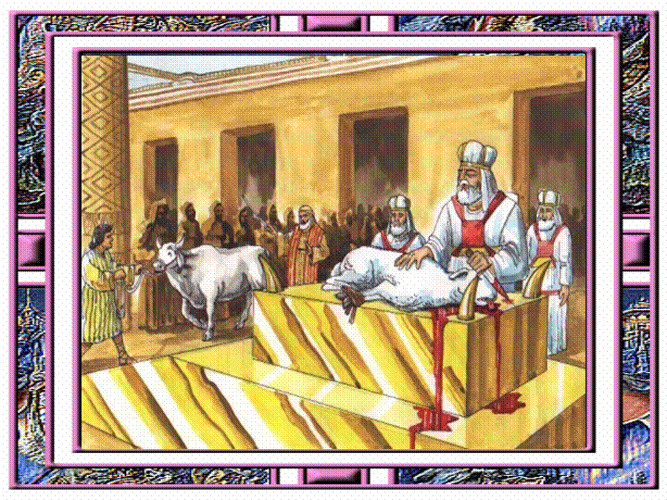
Reception of communion
Lamb of God, who takes away the sins of the world, have mercy on us
The lamb was a common animal sacrificed in Jewish rituals

Slide 66
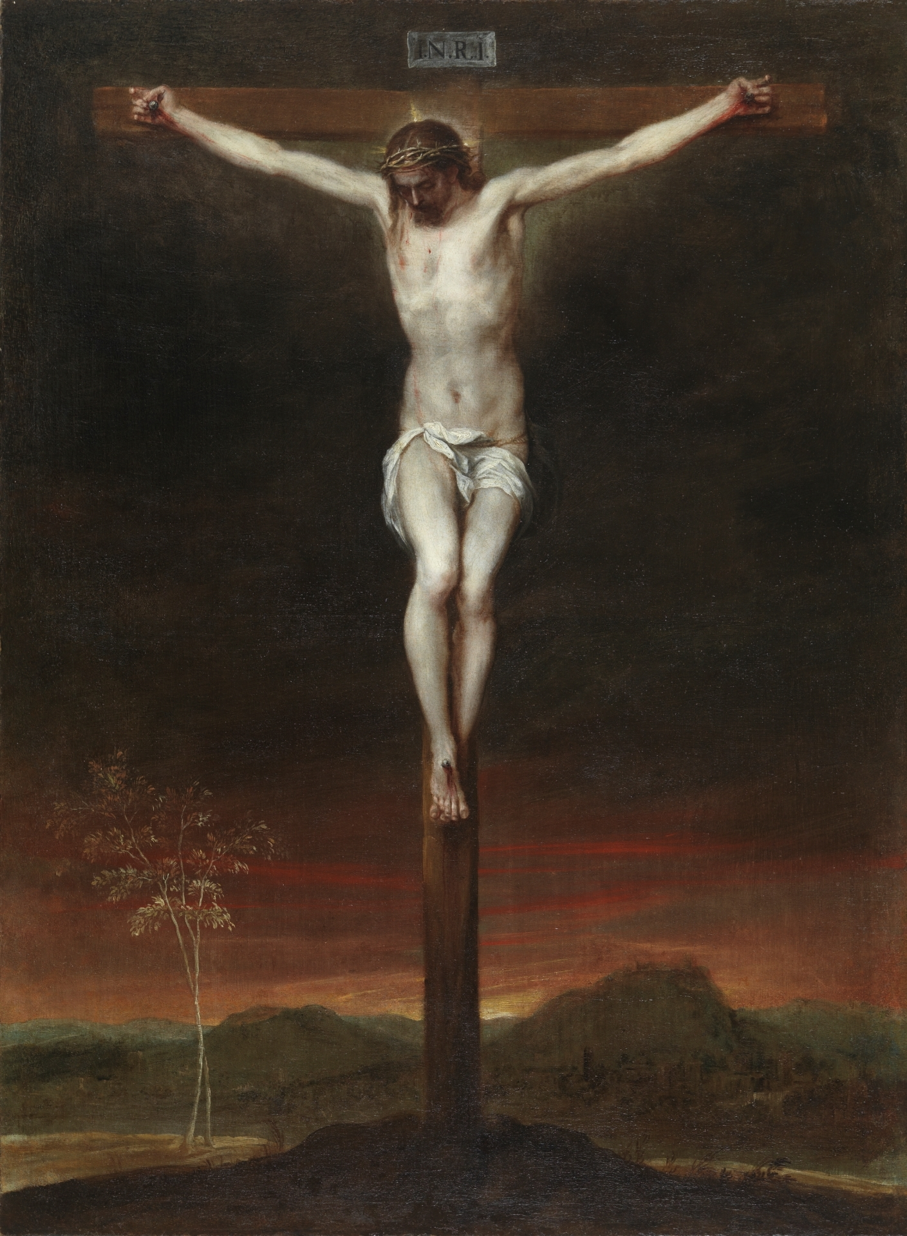
Reception of Communion
Jesus is our Lamb, whose sacrifice washes away all our sins
Hebrews 7:27: Unlike the other high priests, [Jesus] has no need to offer sacrifice day after day, first for His own sins and then for those of the people; He did that once for all when He offered Himself.

Slide 67
Reception of communion
Lamb of God, you take away the sins of the world, have mercy on us.
  Words of John the Baptist: John 1:36

Slide 68
Reception of COmmunion
Behold the Lamb of God, behold him who takes away the sins of the world. Blessed are those called to the supper of the Lamb.
  Again: the words of John the Baptist, in reference to Jesus

Slide 69
Reception of Communion
Lord, I am not worthy that you should enter under my roof, but only say the word and my soul shall be healed.
  Roman centurion in Luke 7:6-7: “Lord, do not trouble yourself, for I am not worthy to have you come under my roof; But only speak the word, and let my servant be healed.”

Slide 70
Reception of Communion
We receive by faith
We are not worthy to do so, but at the word of invitation from the Lord, we cannot refuse
His invitation is our forgiveness and purification to receive the Eucharist

Slide 71
Reception of communion
Another call and response
The Lord calls us to receive him in his Word and we respond by receiving him in the Eucharist

Slide 72
Concluding rites

Slide 73
Concluding rites
Prayer after Communion
The final blessing
The sending or dismissal

Slide 74
Dismissal
“Mass” means “sent”
  In Latin: “Ite, missa est” = “Go, she is sent” (she = the Church)

Slide 75
Dismissal
The Church is sent into the chaos of the world to bring the Order she has received and celebrated in Mass
To make Jesus present in the world
To orient the world to Jesus

Slide 76
Dismissal
As on the day of Pentecost, when those gathered in the Upper Room were sent to proclaim the Good News to all the world

Slide 77
The Dismissal
Another call and response:
Call: the Church calls us to go out
Response: we go out to orient the chaos of the world and of our lives to Christ
The recessional demonstrates this call, and this order leaving the doors of the Church into the world

Slide 78
The importance of mass
We are all obligated to go to Sunday Mass each week
If we love the Mass, this helps motivate us to go
Easier to love the Mass when we know what is going on

Slide 79
Importance of Mass
Going to Mass as a family is the most important thing a family can do together
  Forms unity and harmony (order in chaos!)
  To receive communion together conforms each person to Jesus – unity

Slide 80
Questions, Comments?

Slide 81
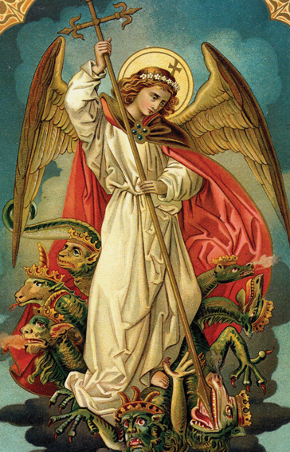
Closing Prayer
St. Michael the Archangel, defend us in battle.
Be our protection against the wickedness and snares of the Devil.
May God rebuke him, we humble pray,
and do thou, o prince of the heavenly host, by the power of God,
cast into hell Satan and all the evil spirits
who prowl about the world seeking the ruin of souls.
Amen.

