Slide 1
Holy Spirit and Confirmation
January 17, 2021

Slide 2
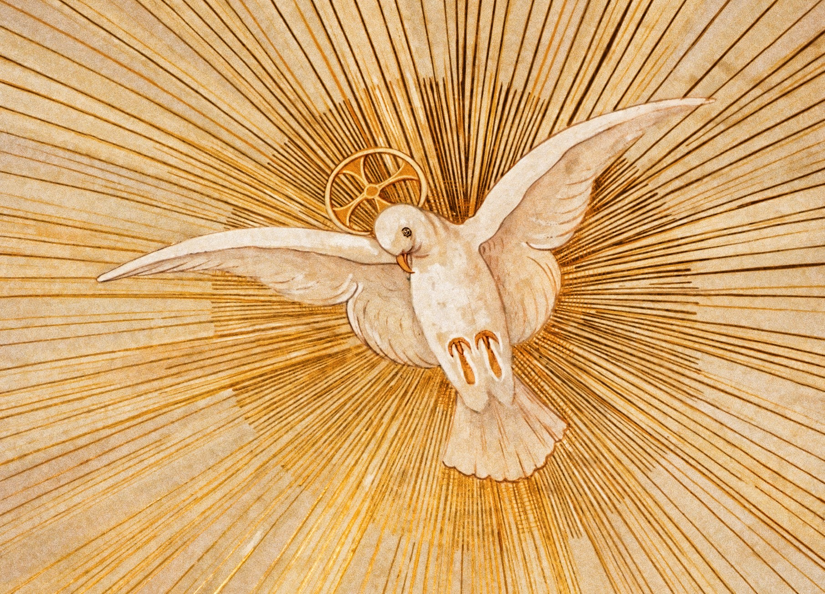
Prayer
Come Holy Spirit, fill the hearts of your faithful and kindle in them the fire of your love. Send forth your Spirit and they shall be created. And You shall renew the face of the earth.

Slide 3
Outline
Who is the Holy Spirit?
Scripture
Creed
Receiving the Holy Spirit
Rite of Confirmation
Symbols
Living in the Spirit
Bishop Rhoades
Mary
Questions and Discussion

Slide 4
Outline
Who is the Holy Spirit?
Scripture
Creed
Receiving the Holy Spirit
Rite of Confirmation
Symbols
Living in the Spirit
Bishop Rhoades
Mary
Questions and Discussion

Slide 5
Who Is the Holy Spirit?
Jesus’ own description
Pentecost
Creed
Living by the Spirit

Slide 6
The Advocate Sent by Jesus
⁷ Nevertheless I tell you the truth: it is to your advantage that I go away, for if I do not go away, the Advocate will not come to you; but if I go, I will send him to you. ⁸ And when he comes, he will prove the world wrong about sin and righteousness and judgment: ⁹ about sin, because they do not believe in me; ¹⁰ about righteousness, because I am going to the Father and you will see me no longer; ¹¹ about judgment, because the ruler of this world has been condemned.
¹² “I still have many things to say to you, but you cannot bear them now. ¹³ When the Spirit of truth comes, he will guide you into all the truth; for he will not speak on his own, but will speak whatever he hears, and he will declare to you the things that are to come. ¹⁴ He will glorify me, because he will take what is mine and declare it to you. ¹⁵ All that the Father has is mine. For this reason I said that he will take what is mine and declare it to you.
- John 16:7-15

Slide 7
The Advocate Sent by Jesus
⁷ Nevertheless I tell you the truth: it is to your advantage that I go away, for if I do not go away, the Advocate will not come to you; but if I go, I will send him to you. ⁸ And when he comes, he will prove the world wrong about sin and righteousness and judgment: ⁹ about sin, because they do not believe in me; ¹⁰ about righteousness, because I am going to the Father and you will see me no longer; ¹¹ about judgment, because the ruler of this world has been condemned.
¹² “I still have many things to say to you, but you cannot bear them now. ¹³ When the Spirit of truth comes, he will guide you into all the truth; for he will not speak on his own, but will speak whatever he hears, and he will declare to you the things that are to come. ¹⁴ He will glorify me, because he will take what is mine and declare it to you. ¹⁵ All that the Father has is mine. For this reason I said that he will take what is mine and declare it to you.
- John 16:7-15

Slide 8
The Advocate Sent by Jesus
⁷ Nevertheless I tell you the truth: it is to your advantage that I go away, for if I do not go away, the Advocate will not come to you; but if I go, I will send him to you. ⁸ And when he comes, he will prove the world wrong about sin and righteousness and judgment: ⁹ about sin, because they do not believe in me; ¹⁰ about righteousness, because I am going to the Father and you will see me no longer; ¹¹ about judgment, because the ruler of this world has been condemned.
¹² “I still have many things to say to you, but you cannot bear them now. ¹³ When the Spirit of truth comes, he will guide you into all the truth; for he will not speak on his own, but will speak whatever he hears, and he will declare to you the things that are to come. ¹⁴ He will glorify me, because he will take what is mine and declare it to you. ¹⁵ All that the Father has is mine. For this reason I said that he will take what is mine and declare it to you.
- John 16:7-15

Slide 9
Pentecost
¹ When the day of Pentecost had come, they were all together in one place. ² And suddenly from heaven there came a sound like the rush of a violent wind, and it filled the entire house where they were sitting. ³ Divided tongues, as of fire, appeared among them, and a tongue rested on each of them. ⁴ All of them were filled with the Holy Spirit and began to speak in other languages, as the Spirit gave them ability.
- Acts 2:1-4

Slide 10
Pentecost
¹ When the day of Pentecost had come, they were all together in one place. ² And suddenly from heaven there came a sound like the rush of a violent wind, and it filled the entire house where they were sitting. ³ Divided tongues, as of fire, appeared among them, and a tongue rested on each of them. ⁴ All of them were filled with the Holy Spirit and began to speak in other languages, as the Spirit gave them ability.
- Acts 2:1-4

Slide 11
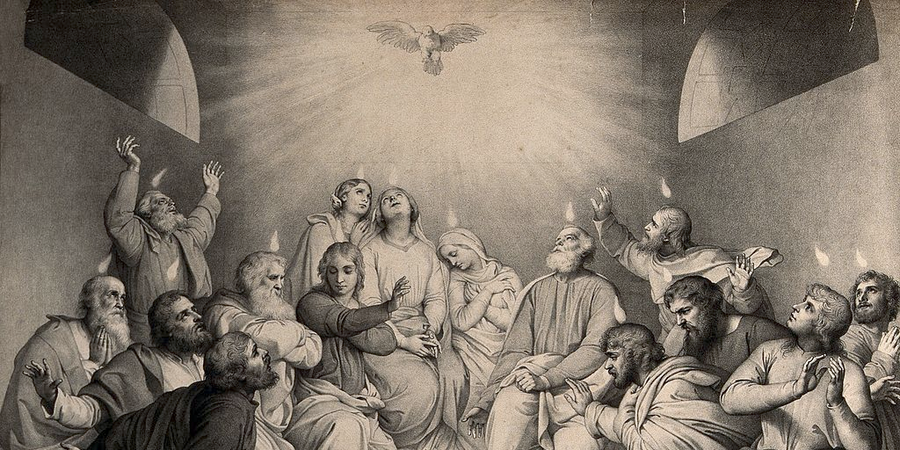
The Holy Spirit in the Creed
I believe in the Holy Spirit, the Lord, the giver of life, who proceeds from the Father and the Son, who with the Father and the Son is adored and glorified, who has spoken through the prophets.

Slide 12
The Holy Spirit in the Creed
I believe in the Holy Spirit, the Lord, the giver of life, who proceeds from the Father and the Son, who with the Father and the Son is adored and glorified, who has spoken through the prophets.

Slide 13
the giver of life
¹ In the beginning when God created the heavens and the earth, ² the earth was a formless void and darkness covered the face of the deep, while a wind from God swept over the face of the waters. ³ Then God said, “Let there be light”; and there was light. ⁴ And God saw that the light was good; and God separated the light from the darkness. ⁵ God called the light Day, and the darkness he called Night. And there was evening and there was morning, the first day.
- Genesis 1:1-5

Slide 14
the giver of life
¹ In the beginning when God created the heavens and the earth, ² the earth was a formless void and darkness covered the face of the deep, while a wind from God swept over the face of the waters. ³ Then God said, “Let there be light”; and there was light. ⁴ And God saw that the light was good; and God separated the light from the darkness. ⁵ God called the light Day, and the darkness he called Night. And there was evening and there was morning, the first day.
- Genesis 1:1-5

Slide 15
the giver of life
⁷ then the Lord God formed man from the dust of the ground, and breathed into his nostrils the breath of life; and the man became a living being.
- Genesis 2:7

Slide 16
the giver of life
⁷ then the Lord God formed man from the dust of the ground, and breathed into his nostrils the breath of life; and the man became a living being.
- Genesis 2:7

Slide 17
The Holy Spirit in the Creed
I believe in the Holy Spirit, the Lord, the giver of life, who proceeds from the Father and the Son, who with the Father and the Son is adored and glorified, who has spoken through the prophets.

Slide 18
who has spoken through the prophets
¹¹ “When they bring you before the synagogues, the rulers, and the authorities, do not worry about how you are to defend yourselves or what you are to say; ¹² for the Holy Spirit will teach you at that very hour what you ought to say.”
- Luke 12:11-12

Slide 19
Outline
Who is the Holy Spirit?
Scripture
Creed
Receiving the Holy Spirit
Rite of Confirmation
Symbols
Living in the Spirit
Bishop Rhoades
Mary
Questions and Discussion

Slide 20
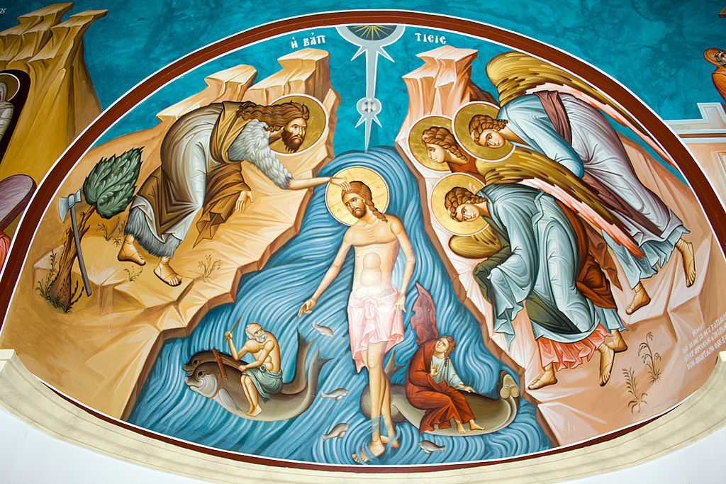
Receiving the Holy Spirit
Sacraments of Initiation
Baptism
Confirmation
Eucharist

Slide 21
Rite of Confirmation
At the Easter Vigil
Easter Candle
Liturgy of the Word
Baptismal Liturgy
Liturgy of the Eucharist
Baptismal Liturgy
Litany of Saints
Blessing of Water
Questions of Faith
Baptism
Confirmation

Slide 22
Rite of Confirmation
Confirmation Mass
Introductory Rites
Liturgy of the Word
Presentation of Candidates
Homily
Renewal of Baptismal Promises
Laying on of Hands
Anointing with Chrism
Liturgy of the Eucharist

Slide 23
Laying on of Hands
Now during those days, when the disciples were increasing in number, the Hellenists complained against the Hebrews because their widows were being neglected in the daily distribution of food. ² And the twelve called together the whole community of the disciples and said, “It is not right that we should neglect the word of God in order to wait on tables. ³ Therefore, friends, select from among yourselves seven men of good standing, full of the Spirit and of wisdom, whom we may appoint to this task, ⁴ while we, for our part, will devote ourselves to prayer and to serving the word.” ⁵ What they said pleased the whole community, and they chose Stephen, a man full of faith and the Holy Spirit, together with Philip, Prochorus, Nicanor, Timon, Parmenas, and Nicolaus, a proselyte of Antioch. ⁶ They had these men stand before the apostles, who prayed and laid their hands on them.
- Acts 6:1-6

Slide 24
Laying on of Hands
Now during those days, when the disciples were increasing in number, the Hellenists complained against the Hebrews because their widows were being neglected in the daily distribution of food. ² And the twelve called together the whole community of the disciples and said, “It is not right that we should neglect the word of God in order to wait on tables. ³ Therefore, friends, select from among yourselves seven men of good standing, full of the Spirit and of wisdom, whom we may appoint to this task, ⁴ while we, for our part, will devote ourselves to prayer and to serving the word.” ⁵ What they said pleased the whole community, and they chose Stephen, a man full of faith and the Holy Spirit, together with Philip, Prochorus, Nicanor, Timon, Parmenas, and Nicolaus, a proselyte of Antioch. ⁶ They had these men stand before the apostles, who prayed and laid their hands on them.
- Acts 6:1-6

Slide 25
prayed and laid their hands on them
Almighty God, Father of our Lord
Jesus Christ,
who brought these your servants to
new birth
by water and the Holy Spirit,
freeing them from sin:
send upon them, O Lord, the
Holy Spirit, the Paraclete;
give them the spirit of wisdom and
understanding,
the spirit of counsel and fortitude,
the spirit of knowledge and piety;
fill them with the spirit of the fear of
the Lord.
-Bishop’s Prayer
During Imposition of Hands

Slide 26
prayed and laid their hands on them
Almighty God, Father of our Lord
Jesus Christ,
who brought these your servants to
new birth
by water and the Holy Spirit,
freeing them from sin:
send upon them, O Lord, the
Holy Spirit, the Paraclete;
give them the spirit of wisdom and
understanding,
the spirit of counsel and fortitude,
the spirit of knowledge and piety;
fill them with the spirit of the fear of
the Lord.
-Bishop’s Prayer
During Imposition of Hands

Slide 27
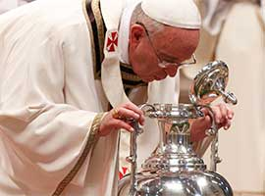
Anointing with Chrism
Sign of communion with Church
Chrism is blessed earlier in Holy Week
Chrism anointed
Oil mixed with balsam
Bishop breathes into it
When is Chrism used?
To confer an indelible mark on one’s soul, to change one’s life

Slide 28
Outline
Who is the Holy Spirit?
Scripture
Creed
Receiving the Holy Spirit
Rite of Confirmation
Symbols
Living in the Spirit
Bishop Rhoades
Mary
Questions and Discussion

Slide 29
Living by the Spirit
²² By contrast, the fruit of the Spirit is love, joy, peace, patience, kindness, generosity, faithfulness, ²³ gentleness, and self-control. There is no law against such things. ²⁴ And those who belong to Christ Jesus have crucified the flesh with its passions and desires. ²⁵ If we live by the Spirit, let us also be guided by the Spirit. ²⁶ Let us not become conceited, competing against one another, envying one another.
- Galatians 5:22-26

Slide 30
Living by the Spirit
²² By contrast, the fruit of the Spirit is love, joy, peace, patience, kindness, generosity, faithfulness, ²³ gentleness, and self-control. There is no law against such things. ²⁴ And those who belong to Christ Jesus have crucified the flesh with its passions and desires. ²⁵ If we live by the Spirit, let us also be guided by the Spirit. ²⁶ Let us not become conceited, competing against one another, envying one another.
- Galatians 5:22-26

Slide 31
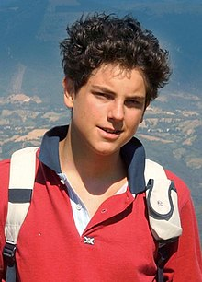
Blessed Carlo Acutis (1991-2006)
To be always united with Jesus, this is my plan of life.
The Eucharist is the highway to heaven.
The Virgin Mary is the only woman in my life.

Slide 32
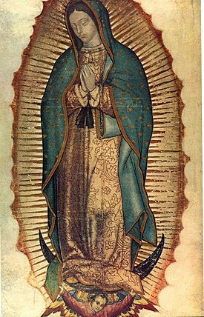
Mary
Mary said to the angel, “How can this be, since I am a virgin?” The angel said to her, “The Holy Spirit will come upon you, and the power of the Most High will overshadow you; therefore the child to be born will be holy; he will be called Son of God.”
-Luke 1:34-35
Now the birth of Jesus the Messiah took place in this way. When his mother Mary had been engaged to Joseph, but before they lived together, she was found to be with child from the Holy Spirit.
- Matthew 1:18

Slide 33
Outline
Who is the Holy Spirit?
Scripture
Creed
Receiving the Holy Spirit
Rite of Confirmation
Symbols
Living in the Spirit
Bishop Rhoades
Mary
Questions and Discussion

Slide 34
Questions?

Slide 35
Discussion
Do you pray to the Holy Spirit?
Which gift(s) of the Holy Spirit would you like to grow in?
When have you felt God’s presence very close to you in your life?
What excites you the most about being fully initiated into the Church?

Slide 36
Closing Prayer
St. Bonaventure’s Prayer for the Gifts of the Holy Spirit

