Slide 1

Federally Employed Women (FEW)
National Training Program (NTP)
Using Process Maps in Lean Six Sigma
Pamela H. Richards
FEW National President

Slide 2
Using Process Maps in Lean Six Sigma
Sheryl L Vogt

Slide 3
Welcome!
Learning Objectives:
Gain an overview of the uses of process maps
Learn tips and tools to build a process map to understand current situations and issues
Practice creating a process map

Slide 4

Sheryl L Vogt
Over 30 years of experience working in the areas of quality, process improvement and project management
BSME and MSIE from Purdue University
Worked as an engineer in both private sector manufacturing and for the Federal government
Trained as one of the first Black Belts at the General Electric Company.
Since starting Vogt Consulting Inc in 2002 she has developed and delivered Performance Improvement programs and training for manufacturing, distribution, service, healthcare, and government organizations.
Senior Fellow for the Center for Excellence in Public Leadership at George Washington University.

Slide 5
Our Approach Today
First, we will be walking through the Purpose of Process Maps and some high-level step by step instructions
Next, we are going to practice a couple parts together as a whole group
Then, I will break you into some small breakouts to continue the work on the tools in a small group

Slide 6
What is Lean Six Sigma?
LEAN - Maintains flow
Continuous improvements to produce necessary items in the necessary quantities at the necessary time without waste
Quality at the source
Fast response of production to demand changes in the marketplace
Respect for humanity
SIX SIGMA - Reduces variation
Focused projects to significantly improve key metrics
Create predictable processes that consistently meet customer requirements (defect elimination) without waste
Respect for both knowledge of process experts, and knowledge gained from objective study

Slide 7

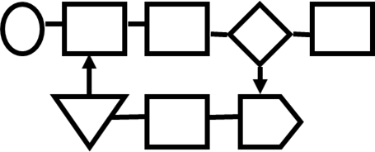
Why Process Maps?
We use different techniques for different purposes, but you always get at least these outcomes:
  Agree on where process boundaries – where process starts and stops
  Create a graphical picture of the process, including value adding and non-value adding steps
  Gain a common understanding of process

Slide 8
Process Mapping Types & Uses
Type | Key Outputs | View of Process (High, Medium, Working)
SIPOC | Determine Process Start/Stop points, Suppliers, Customers | High level
Value Stream Map (VSM) | See Flow and Waste | High, Medium
Flow Chart | See relationship of steps, decisions, rework | High, Medium ,or Working
Variables Flow Chart | See inputs and outputs, supplier and customer relationships between steps | Medium or Working
Swim Lane (or Deployment ) Maps | See Function / Dept. relationships and handoffs; See Decisions; Rework | High, Medium ,or Working
Alternative path | See largest volumes of transactions or product ( i.e, a Flow Chart with data attached) | Medium or Working
Simple Time Study | Understand how much time is used per process step | Working

Slide 9
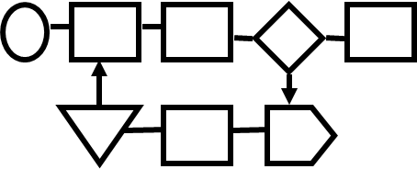
5 Steps to Making a Flow Chart
1) Identify the boundaries
2) Create the map
3) Uncover complexities
4) Add additional information
5) Evaluate map
Who Should be included?
People who are closest to the process
Customers and suppliers of the process
Each step of the process must be represented on the mapping team

Slide 10

Step 1 - Identify the Boundaries
Start
Boundary
Stop
Boundary
Input
Output
Process
This Helps Define our Scope!

Slide 11
Step 2 Create the Map
Inputs
Output
A process is a series of actions to take the things we start with - inputs - and turns it into something else. We call the results or outcomes of the process the output

Slide 12

Tips to help Create the Map
Gather the team and Gemba – go and see the process in real life
Walk the process with the team – have people show you what they are doing.
For transaction processes …follow the paper trail.
Pick a “unit” to follow through the process

Slide 13
Tips to help Create the Map
Gather
Gather materials: ‘butcher’ paper & post-it notes or in the Virtual environment tools like Miro or other sharing platforms
Start
With your team, start with what “triggers” the process
Write
Write the process step on the post-it and place in the right order for the process
Continue by
Continue by asking “what happens next”
Connect
Connect steps with arrows
Continue
Continue until the end boundary ( or high level process output) is reached

Slide 14
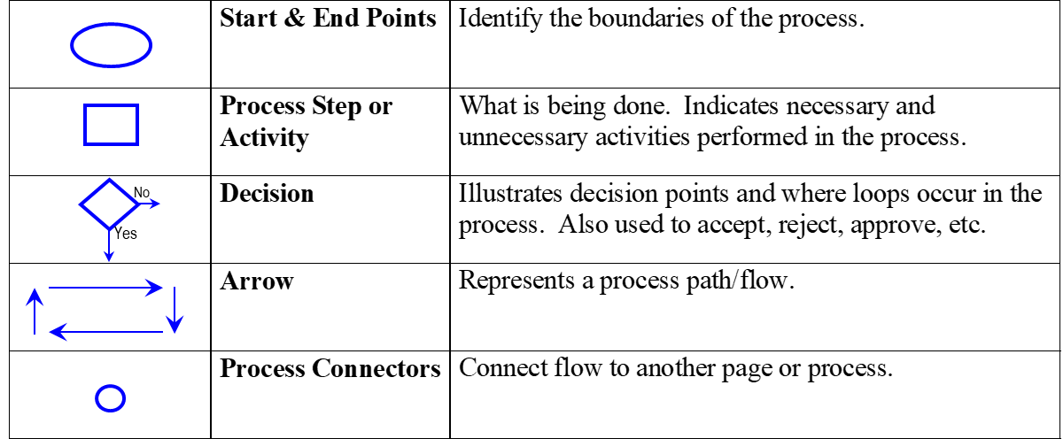
Basic Process Mapping Symbols

Slide 15
Step 3 Uncover Complexities
  Ask questions about the process:
  What happens if something goes wrong at this step?
  Does this step add value to the customer?
  What happens if there is a problem with materials, machines, measurements, information, manpower, or methods?

Slide 16
There Are 3 Versions of a Process Map
What you
think it is
What it
actually is
What you would
like it to be
Don’t Forget!
Validate the map you have created

Slide 17
Step 4 Add Additional Information
VA
VA
Y
N
VA

Slide 18
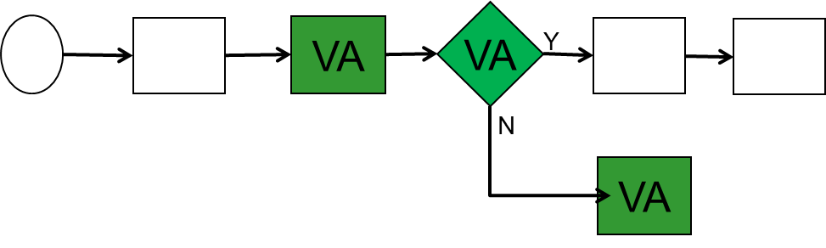
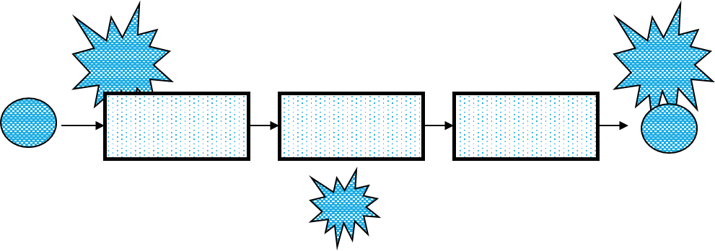
Step 4 Add Additional Information
For example:
Identify steps in your process that are Value Added (VA) and Non-Value Added (NVA)
Identify steps or inputs in your process that could impact identified customer needs

Slide 19
Step 5 Evaluate the Map
Look at each step in the process and add necessary data to help better understand what is happening:
  Value-added time vs. non-value-added time
  Decisions & Rework loops
  Process parameters and controls
  Look for bottlenecks, hand-offs, delays – all waste in the process

Slide 20
Quick Exercise
Why would you use a flow chart? What does this type of map help you see?
Are there any applications for a flow chart in your day-to-day work? Will you use this?

Slide 21
Let’s Try One Together

Slide 22
Let’s Create a Flowchart
We are going to use “Driving to Work” as our process
For this exercise, we will keep our flowchart small, so no more than 5 activity blocks total!
Remember the 5 steps:
    Identify the Boundaries
    Draw the map
    Uncover complexities
    Add additional information
    Evaluate

Slide 23
Flow Chart Template
Distraction
loses place
I need
coffee
Verify and
gather
ingredients
All?
Yes
Turn on
machine
Insert Filter
Decaf?
No
Insert coffee
grounds
Fill water
No
A
Yes
Starbuck
Find decaf
Put carafe
In machine
Press Brew
Fill coffee
cup
Additives?
No
Drink Coffee
A
Wrong size
Yes
Too Weak
Add cream
sugar etc.
Symbols
No
Yes

Slide 24
Group Exercise
  For this entire exercise in your small groups, consider the process of brushing your teeth
  Use the Flow Chart Template to create a 3-5 activity block process for brushing your teeth.
  Use the 5 steps
    Identify the Boundaries
    Draw the map
    Uncover complexities
    Add additional information
    Evaluate

Slide 25
Any Questions?

Slide 26
Thank you!
sheryl.vogt@vogtconsultinginc.com
Explore Lean Six Sigma courses at GWU’s Center for Excellence in Public Leadership:
https://cepl.cps.gwu.edu/lean-six-sigma-certification

Slide 27
Appendix

Slide 28
Cust
Serv
Stow Cust Service
Cust Serv
enters order
Finished stock
Yes
looks for
another whs to
Example Swim Lane
provide
No
Order entry generates
Glenn assigns
S.O. copy to mfg to
Reply to C.S.
a S.O. and schedules
slitting load for
run & to shipping
Pick pack syst
w/ b/o on rest
in first available slitter
the day based
dock to pre-notify
slot
on:
carriers
Scheduling
Selects machine based
ship dates
on material
Material availability
full order
No
Provide what is
'Not before' will make it
Like jobs together
available
available
Order Entry through Ship
scheduled for later
Max on-time & up-time
Mfg /
Packing
Yes
Slitter runs
Label, Bag,
order
stack, wrap
and strap it
O.E.
Yes
Overnight
Glen gets
automatica
Express
Yes
Over 150lbs
S.O. and
lly gets the
waiting
coordinates
Not O.E. if:
load
shipping
Cust directed
Lowest
No
No
Potential
Failure
Points
Shipping
Expedite
Cost?
Unusual destination
Ship UPS
Assign carrier
Eastbound
- Roadway, Yellow,
Is 150lbs the
Overnight Trans
perfect cut-off?
West Coast
- Motor Cargo
B
A
Express
- Matheson Fast Freight

Slide 29
Pricing Deployment Map
RFQ in
Sales-Initiated
Price Change
(Reduction)
Other Price Changes
Example “Deployment” Map
Generate
formal
Quote
Send to
Customer
Receive
RFQ
Order in
3rd floor-Sales
PRICE CHANGE: Update Order System Price on Open Orders
Order
System
Entry
Order
Price
match
CQF?
Ship Product,
Invoice at
Order System
Price
Issue Credit
Y
Prdn Sched and Manufacture:
Price is Order System Price
Lost Revenue
N
Resolve
w/ Cust,
Sales
2nd floor-Customer Service
Work up
Costing
Enter in
Customer
Quote
File (CQF)
On P-hold
Verify
price
Master
Quote
Book
1st floor-Cost Estimating
Price Change
for Cost:
Materials,
Labor, etc.
Costing Price Changes

Slide 30
Alternative Path maps
This technique comes from process reengineering. Diverging or alternative “paths” are noted by split arrows
Leave
Voicemail
Message
Hang
Up
75
Decide Who To Call
30
5
Say
“Hello”
Hang
Up
Dial
Conversation
20
70
Look
Up
#
Hang
Up
Teams study the relative % of time or transactions which follow each path
This tool can also be used to scope a project
Key:
60
Tools
40
Percentages
Task
Direction

Slide 31
Section of a Variables map
Input Xs
Output Ys
Clean Vessel, Lines,
Equipment
Ready to go
Trained Man power
Prepare
With:
Raw material Quality
Msmt sys for RMS Charge
Correct Procedure
Equipment for Charge
Appropriate Vessel for
Filtered Raw Materials
batch size
Procedure
Manpower Availability
Qualified Operator
Equipment function check
Right Raw materials
Measurement System for
Right amount of raw
RMS. Charge
materials
Lineup for raw material charge
Charge Batch
Right vessel
Raw material storage
Right charging
conditions (N2 sparge, mixing
etc.)
Properly filtered raw
materials
Accurate, complete, honest
batch records
Equipment for Charge ready

Slide 32
How do we know what our current cycle times are?
Supplier
Tues + Thurs
Supplier
Daily
I
I
I
Input info
Review file
Approval
Compile
I
75 invoices
75 invoices
130 invoices
Loan Applications
1 day
C/T = 160 sec
Uptime = 90%
cost = $0.035
50% avail
C/T = 60 sec
Uptime = 94%
cost = $0.27
10% avail
C/T = 180 sec
cost = $4.70
40% avail
C/T = 30 sec
Uptime = 89%
cost = $2.85
40% avail
1 day
2 days
.5 days
3.5 days
6 days
160 sec
60 sec
180 sec
30 sec
430 sec
Value Stream Map

Slide 33
Spaghetti Diagram
Fiscal
Manager
Controller
19
7
10
23
42
27
13
6
5
8
Purchasing
Maintenance
Foreman
8
1
11
2
4
14
17
1
20
33
28
12
19
27
30
24
45
40
38
31
23
Storeroom
26
36
9
15
16
21
19
3
3
Receiving
37
36
18
34
39
35
29
27
41
30
25
43
19
32
23
44
22
Accounts Payable
XYZ Agency Purchasing Process

