Slide 1

Federally Employed Women (FEW)
National Training Program (NTP)
Using Voice of the Customer to Define Problem Statements
Pamela H. Richards
FEW National President

Slide 2
Using Voice of the Customer to Define Problem Statements
Sheryl L Vogt

Slide 3
Welcome!
Learning Objectives:
Gain an overview on collecting and using Voice of the Customer
Learn tips and tools to collect and use Voice of the Customer to craft a problem statement
Practice creating a plan for collecting and translating Voice of the Customer

Slide 4
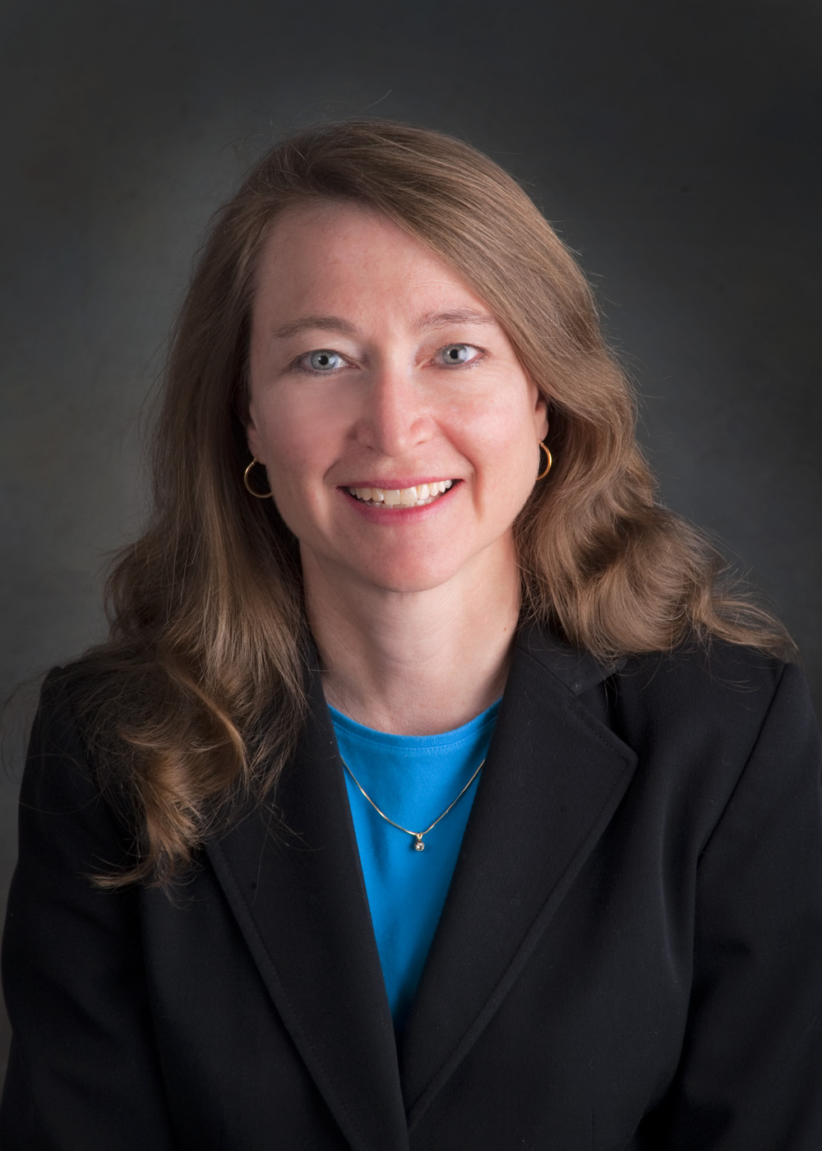
Sheryl L Vogt
Over 30 years of experience working in the areas of quality, process improvement and project management
BSME and MSIE from Purdue University
Worked as an engineer in both private sector manufacturing and for the Federal government
Trained as one of the first Black Belts at the General Electric Company.
Since starting Vogt Consulting Inc in 2002 she has developed and delivered Performance Improvement programs and training for manufacturing, distribution, service, healthcare, and government organizations.
Senior Fellow for the Center for Excellence in Public Leadership at George Washington University.

Slide 5
Our Approach Today
First, we will be walking through Voice of the Customer concepts and some high-level step by step instructions
Next, we are going to practice using some templates together as a whole group
Then, I will break you into some small breakouts to continue the work on the tools in a small group

Slide 6
What is Lean Six Sigma?
LEAN - Maintains flow
Continuous improvements to produce necessary items in the necessary quantities at the necessary time without waste
Quality at the source
Fast response of production to demand changes in the marketplace
Respect for humanity
SIX SIGMA - Reduces variation
Focused projects to significantly improve key metrics
Create predictable processes that consistently meet customer requirements (defect elimination) without waste
Respect for both knowledge of process experts, and knowledge gained from objective study

Slide 7
Why the Customer?
Waste is “anything other than the minimum amount of equipment, materials, parts, space, and worker’s time, which are absolutely essential to add *value to the product. *Value is defined by the customer
Create predictable processes that consistently meet customer requirements (defect elimination) without waste

Slide 8
Getting the Voice of the Customer (VOC)

Slide 9
Who is the Customer?
Who is going to use this service or product?
Is this only existing customers or do you expect to expand the customer base with this product/service?
Are there different types of customers who might use this?
Quick Exercise:
We are going to use the process of setting up a virtual meeting. Think of at least 5 customers

Slide 10
Customer Segmentation
Do different Customer types have different needs?
Individuals
End Customers/
Constituents
Groups/ Organizations
All Customers
Executive
Leadership
Operational/ Supervisory
Internal
Regulatory
External
Quick Exercise:
  Let’s think about different segments for our Customers.

Slide 11
Pay Attention to All Customers?
Some will see impact from this work, some won’t
Some will reward us more than others
Some may not be willing to work with us
Some measure our performance, some don’t
Some are more concerned with issues outside this work
Some are more important to our future than others
Quick Exercise:
  From your list of customer groups, which voices will carry more weight? Why?

Slide 12
Template for Customer ID
Customer | Segment | Importance(L.M.H)

Slide 13
Voice of the Customer isn’t easy to understand
Customers often provide only qualitative information
Customers sometimes have difficulty expressing actionable requirements
An openness to learning on our part is essential
Different voices within the same customer can often be heard
Notes:
Again an open attitude – one that listens carefully to what customers are saying – and
a disciplined approach to acting on those “voices” will prevent project delays and restarts as well as improve the odds that you are working on the service improvements that counts the most to the customer and the
bottom line.

Slide 14
Getting VOC Data
Look for existing information
Conduct Surveys
Conduct Team Meetings or Focus Groups
Conduct individual interviews

Slide 15
Why Set Objectives?
Setting VOC objectives
Define
Define scope
Imply
Imply a measure of success
Follow
Direct follow-up action
Stay
Stay focused
Link
Link to the original need

Slide 16
Example Objectives Include:
Learn
Learn . . . Most important requirements
Describe
Describe . . . Current situation
Predict
Predict . . . What implications changes would have
Compare
Compare . . . Groups, locations, times
Explain
Explain . . . relationship between two characteristics
Objectives can point out need for both qualitative data (e.g. open-ended questions) and quantitative data (e.g. answers recorded on a scale)

Slide 17
Questions to Consider
Why you are collecting data
From whom you are collecting
What data are you collecting
Where will you collect it
When will you collect it
How will you collect it
How will you handle the data
Political context
Notes:
14

Slide 18
VOC collection tool - What approach will work best for my objective?
RESEARCH OBJECTIVE
Identify most common types of service failures (SURVEYS)
Forum for suggested service improvement ideas (FOCUS GROUP)
Identify customer priorities, predict the effect on customer loyalty(FOCUS GROUP & SURVEY)
WHAT I WANT TO KNOW
  “Is my customer getting callbacks they expect?”
  “What would my customers like me to do differently?”
  “If we put money into this stuff, will it pay off?”

Slide 19
Surveys, Focus Groups, and Interviews
Surveys (Best for precise questions that need data)
Pro: Can get large samples with few resources & can be quantifiable
Con: Results can be questionable (bias)
Focus Groups (Best for exploring with interaction of groups)
Pro: Can explore topics and get opposing views
Con: Not usually quantifiable and not always translatable to all customers
Interviews (Best for tackling very complex problems)
Pro: Allows deepest understanding and ability to dig into problem
Con: Requires skilled interviewer and time and represents only people that are interviewed

Slide 20
Template for VOC Collection
Customers | Information I Need | Collection Approach
Quick Exercise:
Let’s add our Customers from earlier and decide on our VOC Collection Approach

Slide 21
Last Step - Voice of the Customer (VOC)
A complete set of customer wants and needs
Expressed in their own language
Organized into a hierarchy
Prioritized by importance and current performance or satisfaction

Slide 22
Defining Customer Value
Value is defined by the customer
Your project should clearly link Voice of the Customer (VOC) and Voice of the Process (VOP)

Slide 23
Linking What We Do and Measure to What Customer Wants and Judges
Delivery
Us
Cycle Time
Customer
Price
Want
Do
Cost
Quality
Defects
We Have to “Translate” VOC into process terms

Slide 24
Group Exercise
  For this entire exercise in your small groups, consider the process of scheduling a family vacation
  Use the Customer Identification Template to identify and segment your customers
  Use the VOC data collection tool to plan your strategy for gathering data

Slide 25
Any Questions?

Slide 26
Thank you!
sheryl.vogt@vogtconsultinginc.com
Explore Lean Six Sigma courses at GWU’s Center for Excellence in Public Leadership:
https://cepl.cps.gwu.edu/lean-six-sigma-certification

