Slide 1
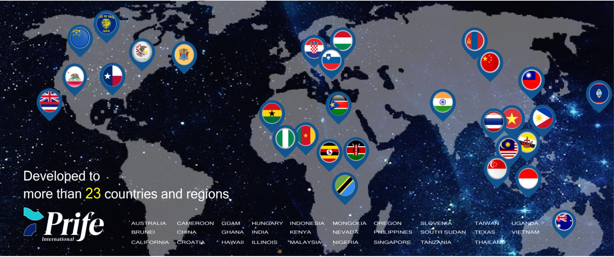
Business Plan

Slide 2
HOW TO JOIN
3 ENTRY PACKAGES - DISTRIBUTORS PRICE
Package | iTeraCare | Price
Silver | 1 unit Classic | $350
Gold | 3 units Classic | $1,050
Diamond | 10 units CLASSIC OR 1 PRO | $3,500

Slide 3
INCOME DISTRIBUTION
INCOME FROM UNILEVEL = 100% CASH
INCOME FROM SPONSORSHIP, LEVEL PAIRING, PAIRING BONUS, AND MATCHING BONUS IS SUBJECT TO:
80% - CASH
20% - PRODUCT POINTS

Slide 4
6 WAYS TO GENERATE INCOME
DIRECT SPONSORSHIP BONUS
PRODUCT POINTS VOUCHER
EVERY LEVEL PAIRING BONUS
GROUP PAIRING BONUS
MATCHING BONUS
UNILEVEL BONUS

Slide 5
1. DIRECT SPONSORSHIP BONUS
ENTRY PACKAGE | POINT VALUE | PERCENTAGE | BONUS
Silver | 200 | 10% | $20
Gold | 600 | 10% | $60
Diamond | 2,000 | 10% | $200

Slide 6
2. PRODUCT POINT VOUCHER
DIRECT SPONSOR PACKAGE | PRODUCT POINTS
Silver | $65
Gold | $225
Diamond | $890

Slide 7
PACKAGES
PACKAGE | PRODUCT ( USD ) | PV (POINT VALUE) | DIRECT SPONSOR | LEVEL PAIRING 40% | PAIRING BONUS | MAX DAILY PAIRING | MATCHING BONUS | PRODUCT POINT (SPONSOR)
SILVER | $350 | 200 | 10% | $80 | 8% | $300 | 4 LEVELS 10% 5% 5% 5% | $65
200 x 10% = $20 + $65 [Product point] = $85
GOLD | $1,050 | 600 | 10% | $240 | 10% | $900 | 5 LEVELS 10% 5% 5% 5% 5% | $225
2000 x 10% = $200 + $890 [Product point] = $1090
DIAMOND | $3,500 | 2,000 | 10% | $800 | 12% | $3,750 | 6 LEVELS 10% 5% 5% 5% 5% 5% | $890

Slide 8
6 WAYS TO GENERATE INCOME
DIRECT SPONSORSHIP BONUS
PRODUCT POINTS VOUCHER
EVERY LEVEL PAIRING BONUS
GROUP PAIRING BONUS
MATCHING BONUS
UNILEVEL BONUS

Slide 9
3. LEVEL FIRST PAIR BONUS – Direct / Indirect
40% OF EVERY 1ST Pair in All Levels * From Family and Placement Hierarchy
DS: Direct Sponsor
PP: Product Point
LP: Level Pairing
PB: Pairing Bonus
Silver Sponsor Silver Bonus
200 PV
SILVER
1st
DS $20
U
2nd
PP $65
DS $20
TOTAL: US$250
($20+65=$85) x 2 (=$170)+$80 = $250
PP $65
3rd
A
Silver
LP $80
Silver
B
Level Pairing 40%
1st pair of each level
L1
200 PV x 40% = $80
A1
LP $80
Silver
B1
Diamond
L2
200 PV x 40% = $80
A2
Silver
B2
200 PV x 40% = $80
LP $80
Diamond
L3
1
Diamond
LP $800
3
Diamond
L4
2000 PV x 40% = $800
5
9
L5
Infinity

Slide 10
LEVEL PAIRING @40%
SILVER = 200 PV
DIAMOND = 2000PV
YOU
LEFT/LEFT
RIGHT/LEFT
A
B
SILVER
LEVEL 1
$80
SILVER
A1
B1
LEVEL 2
DIAMOND
$80
SILVER
A2
B2
SILVER
$80
DIAMOND
LEVEL 3
A3
B3
LEVEL 4
DIAMOND
$800
DIAMOND
A4
B4
INFINITY
LEVEL 5

Slide 11
6 WAYS TO GENERATE INCOME
DIRECT SPONSORSHIP BONUS
PRODUCT POINTS VOUCHER
EVERY LEVEL PAIRING BONUS
GROUP PAIRING BONUS
MATCHING BONUS
UNILEVEL BONUS

Slide 12
4a. GROUP PAIRING BONUS
From 2nd Pair (BLUE) onwards of every level beginning from the 4th level (1st PAIR = RED)
Silver – 200PV
Diamond – 2,000PV
Silver Sponsor Silver Bonus
U
SILVER
1st
DS $20
200 PV
DS $20
2nd
PP $65
PP $65
3rd
A
LP $80
B
TOTAL: US$250
Level Pairing (40%)
1st pair of each level
L1
4th
A1
LP $80
B1
Group Pairing Bonus
8%
L2
5th
A2
B2
Matching Bonus
L1 X 10%
L2 X 5%
L3 X 5%
L4 X 5%
LP $80
L3
1
2
3
4
PB $16 per pair
(200 x 8% =$16)
LP $80
L4
5
6
7
8
9
10
11
12
PB $16 x 3 = $48
(600 x 8% =$48)
Infinity
MAX “Daily” Pairing $300 * Max per “Month” $9,000

Slide 13
4b. GROUP PAIRING BONUS
From 2nd Pair (BLUE) onwards of every level beginning from the 4th level (1st PAIR = RED)
Silver – 200PV
Diamond – 2,000PV
Diamond Sponsor Diamond Bonus
U
DIAMOND
1st
DS $200
DS $200
2000 PV
2nd
PP $890
PP $890
3rd
A
LP $800
B
TOTAL: US$2980
Level Pairing (40%)
1st pair of each level
L1
4th
($200+890=$1019) x 2 =$2180
+$800 = $2980
A1
LP $800
B1
Group Pairing Bonus
12%
L2
5th
Matching Bonus
L1 X 10%
L2 X 5%
L3 X 5%
L4 X 5%
L5 X 5%
L6 X 5%
A2
B2
LP $800
L3
1
2
3
4
PB $240 per pair
(2000 x 12% =$240)
LP $800
L4
5
6
7
8
9
10
11
12
PB $240 x 3 = $720
2000 X 3 =6000
6000 X 12% = $720)
Infinity
MAX “Daily” Pairing $3,750 * Max per “Month” $112,500

Slide 14
US400

Slide 15
5. MATCHING BONUS Taken from GROUP PAIRING Income
ENTRY PACKAGE | FAMILY HIERARCHY | PERCENTAGE
Silver 4 Levels | LEVEL 1 – ALL DIRECT LEVEL 2 – ALL DIRECT OF YOUR DIRECT LEVEL 3 – ALL DIRECTS OF YOUR 2ND GENERATION LEVEL 4 – ALL DIRECTS OF YOUR 3RD GENERATION | LEVEL 1 – 10% LEVEL 2 – 5% LEVEL 3 – 5% LEVEL 4 – 5%
Gold 5 LEVELS | 5 LEVELS | LEVEL 1 – 10% LEVEL 2 – 5% LEVEL 3 – 5% LEVEL 4 – 5% LEVEL 5 – 5%
Diamond 6 LEVELS | UP TO THE 6TH LEVEL ALL DIRECTS OF YOUR 5TH GENERATION DOWNLINES | LEVEL 1 – 10% LEVEL 2 – 5% LEVEL 3 – 5% LEVEL 4 – 5% LEVEL 5 – 5% LEVEL 6 – 5%

Slide 16
6. UNILEVEL BONUS
FAMILY AND PLACEMENT HIERARCHY
UNILEVEL BONUS 60%
MONTHLY ACTIVATION BUDGET =
** Monthly Personal Maintenance $30 (21PV)

Slide 17
10th level 1024 x 21 x 2% = $ 430.08

Slide 18
$442,365 x 10% = $44,236
$442,365 x 1% = $4,423

Slide 19
