Slide 1
Jackson Pride Week 2019 Sponsorship packet

Slide 2
Jackson PRIDE Week – August 18-24, 2019

Slide 3
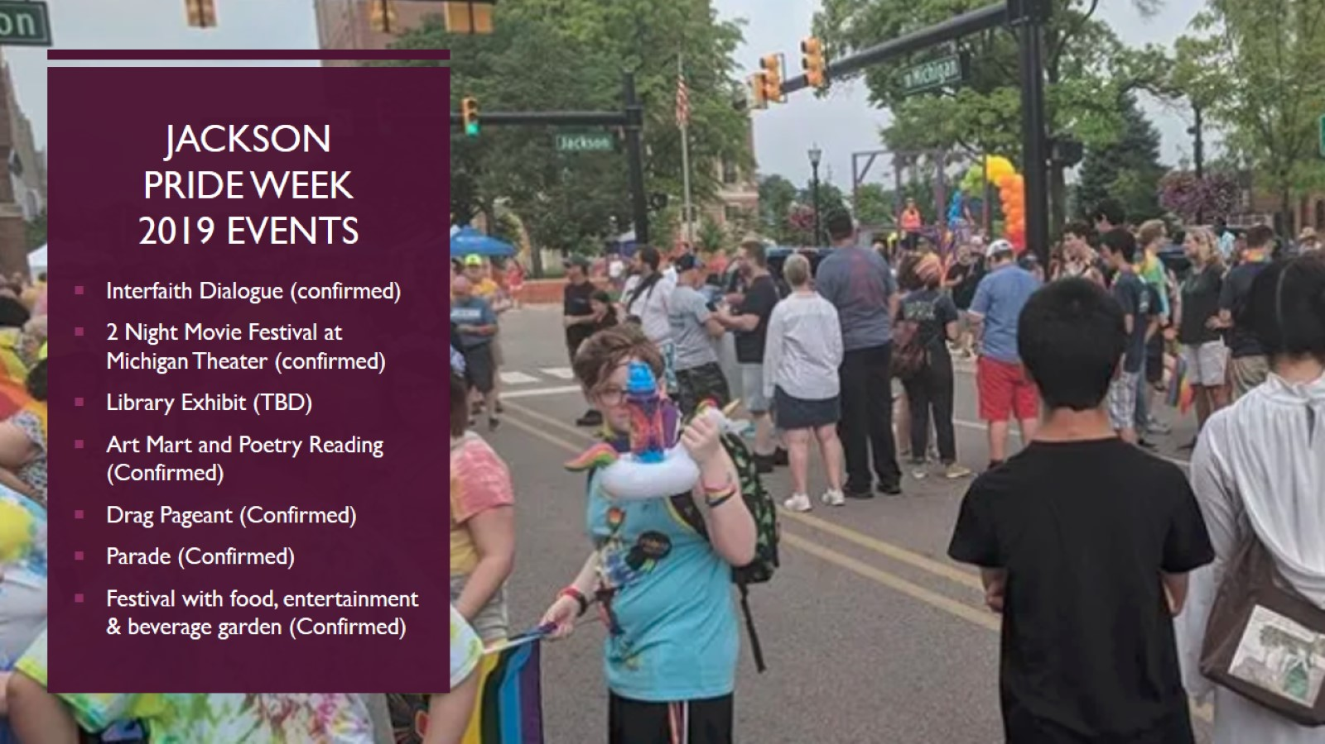
Jackson Pride week 2019 events

Slide 4
Jackson pride center who are we?

Slide 5
SPONSORSHIP OPPORTUNITIES

Slide 6
Jackson pride week 2019 executive Sponsorship opportunities

Slide 7
Jackson pride week 2019 executive Sponsorship opportunities

Slide 8
Jackson pride week 2019 executive Sponsorship opportunities

Slide 9
Jackson pride week 2019 community Sponsorship opportunities

Slide 10
Jackson pride week 2019 community Sponsorship opportunities

Slide 11
Jackson pride week 2019 Miscellaneous community Support opportunities

Slide 12
Questions?

