Slide 1
Introduction to Business

Slide 2
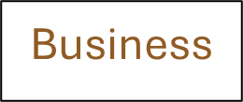
A Guide to the Slides
These slides are designed to facilitate self-study.
They include a variety of audio clips that can be accessed by clicking on the outlined terms. For example, hover your mouse or click on the “Business” icon above. If you click on the play button, you’ll hear a definition of the word. You will find icons like these throughout the slides.
Use these slides as a review of the material in each chapter of the textbook and to provide context to many of the key terms.

Slide 3
Learning Outcomes for this Chapter
How do businesses and not-for-profit organizations help create our standard of living?
What are the sectors of the business environment, and how do changes in them influence business decisions?
What are the primary features of the world’s economic systems, and how are the three sectors of the U.S. economy linked?
How do economic growth, full employment, price stability, and inflation indicate a nation’s economic health?
How does the government use monetary policy and fiscal policy to achieve its macroeconomic goals?
What are the basic microeconomic concepts of demand and supply, and how do they establish prices?
What are the four types of market structure?
Which trends are reshaping the business, microeconomic, and macroeconomic environments and competitive arena?

Slide 4
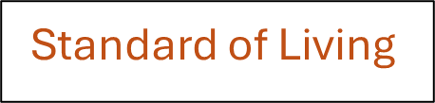

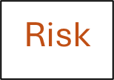

Beginning Concepts
Business – organization that strives for a profit by providing goods and services
Goods – tangible items manufactured by businesses
Services – intangible offerings of businesses that can’t be held, touched, or stored
Standard of Living – measured by the output of goods and services people can buy with the money they have.
Quality of Life – general level of human happiness based on such things as life expectancy, educational standards, health, sanitation, and leisure time
Risk – the potential to lose time and money
Revenue – the money a company receives by providing services or selling goods to customers
Costs - expenses for rent, salaries, supplies, transportation, and many other items
Profit - money left over after a company pays all costs. If costs are higher than revenue, the company has a loss

Slide 5
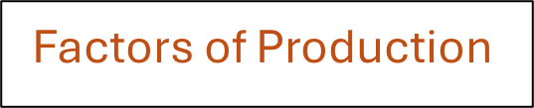
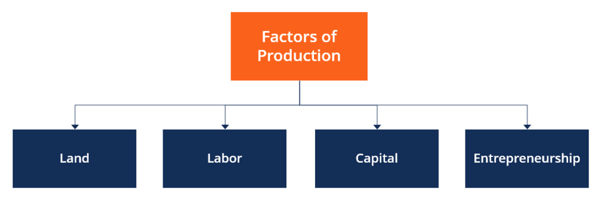
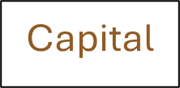
Four factors of production image
Natural
Resources
https://corporatefinanceinstitute.com/resources/economics/factors-of-production/

Slide 6
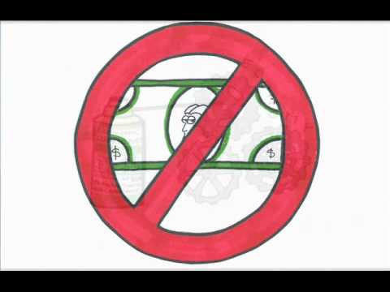
Knowledge
The four factors of production are typically thought to be combined to create entrepreneurial success, but should Knowledge fit into the recipe as a fifth element? Watch this video now posted about various subjects related to Economics, and after viewing it, research one or more of the entrepreneurs mentioned in this section, such as Microsoft cofounder Bill Gates, or Google founders Sergey Brin and Larry Page.

Slide 7
Knowledge
Now that you have watched this video and performed your research, think about the fifth factor of production mentioned in the section: Knowledge.
Based upon your investigation, would you agree or not that this fifth factor needs to be formally added to the list of factors of production for every business in most every industry, or do you think the this fifth factor only relates to industries such as technology, computers or the Internet?

Slide 8
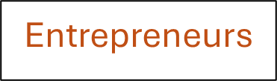
Entrepreneurs/Entrepreneurship
Entrepreneurs are the people who combine the inputs of natural resources, labor, and capital to produce goods or services with the intention of making a profit or accomplishing a not-for-profit goal.
  Take risks
  Manage/direct
  Invest their own resources
Risk – the level of uncertainty of the outcome. Means that you can lose money or time invested

Slide 9
These are good questions/exercises to practice your understanding of the concepts
CONCEPT CHECK
Explain the concepts of revenue, costs, and profit.
What are the five factors of production?
What is the role of an entrepreneur in society.

Slide 10
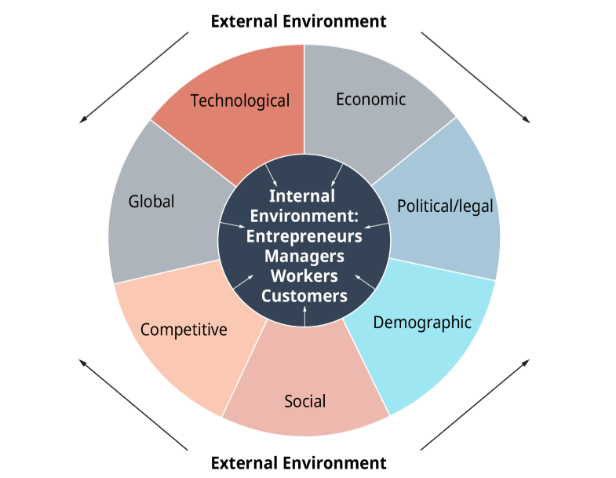
Exhibit 1.4 The Dynamic Business Environment

Slide 11
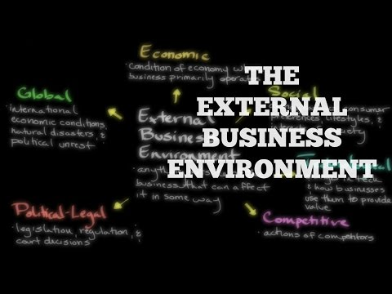
The External Business Environment
Understanding the seven parts of the external environment are key to business success, particularly because these are outside the control of businesspeople. Watch this video from Khan Academy: The External Business Environment, and after viewing, think about how a regional disaster such an earthquake or global pandemic such as COVID-19 might affect each of the seven components of the business environment that Exhibit 1.4 illustrates.

Slide 12

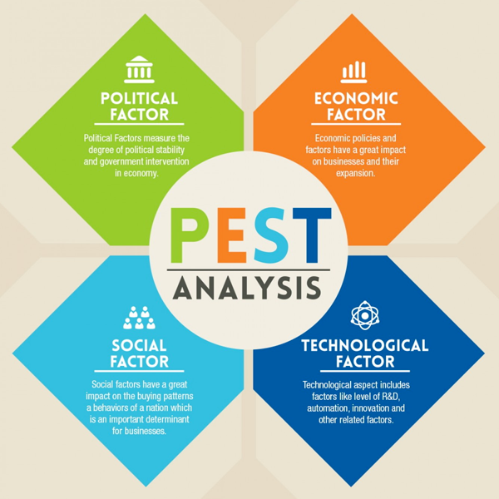
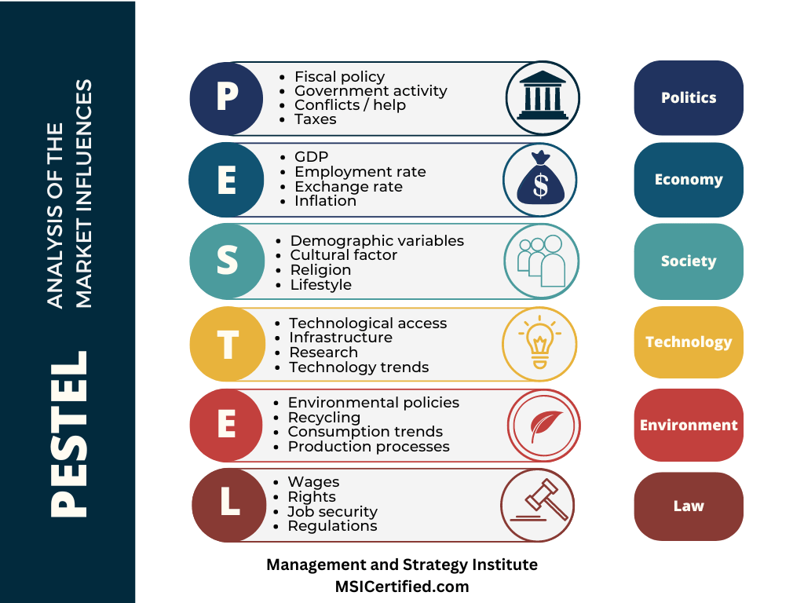

Other environment models
There are many different ways to model the components of the business environment. Here are some additional examples.
https://www.msicertified.com/blog/pestle-analysis/
Competitive
Eoconomic
Legal
Technological
Social/cultural
https://venturefounders.com/pest-analysis/

Slide 13
The External Business Environment
Think about the different components of the business environment and how they might impact different business in different ways and to a greater or lesser extent.
For example, a small restaurant would be affected differently than a company that imports and resells auto parts.
Think about a business you might be interested in owning, or simply working in, and which elements of the environment would be most important to that business.

Slide 14
These are good questions/exercises to practice your understanding of the concepts
CONCEPT CHECK
Define the components of the internal and the external business environments.
What factors within the economic environment affect businesses?
Why do demographic shifts and technological developments create both challenges and new opportunities for business?

Slide 15
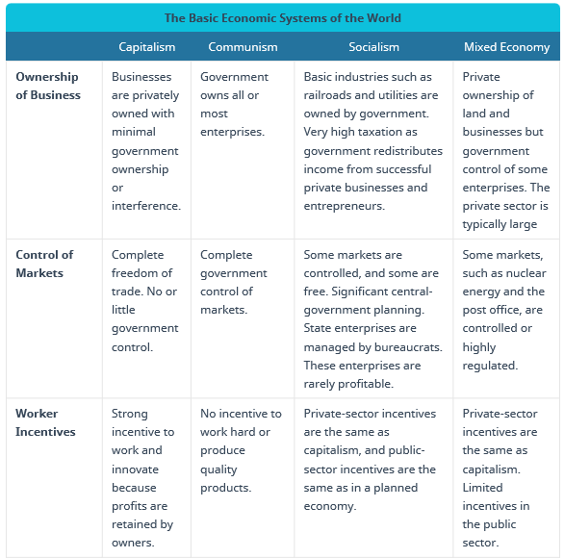
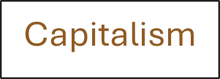
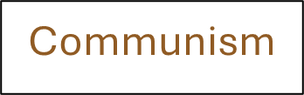
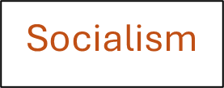
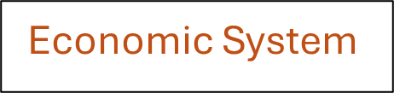
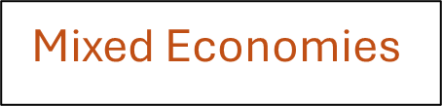
Table 1.1 The Basic Economic Systems of the World

Slide 16

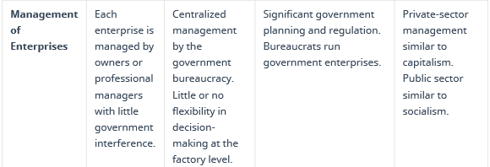
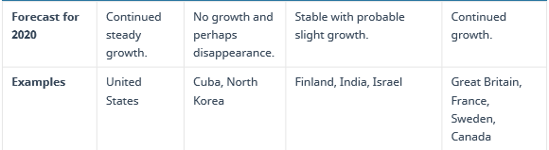
Table 1.1, The Basic Economic Systems of the World - Continued

Slide 17
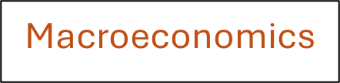

Macro versus micro
We typically talk about economies and learn economics at two different levels.
Macroeconomics refers to the overall economy
Microeconomics refers to individual actors, people or companies

Slide 18
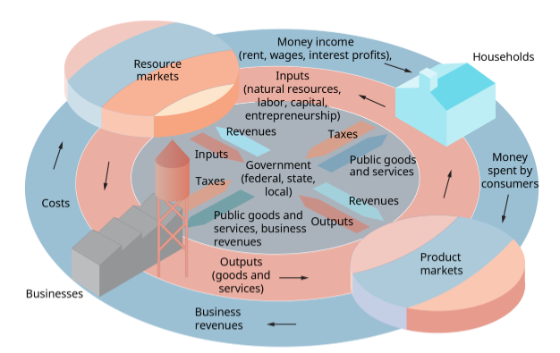
Exhibit 1.6 Economics as a Circular Flow

Slide 19
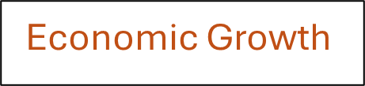
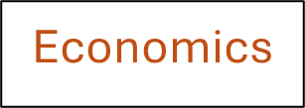
Economic Systems and Terms
Types of Economic Systems

Slide 20
Table 1.1 The Basic Economic Systems of the World

Slide 21
Table 1.1, The Basic Economic Systems of the World - Continued

Slide 22
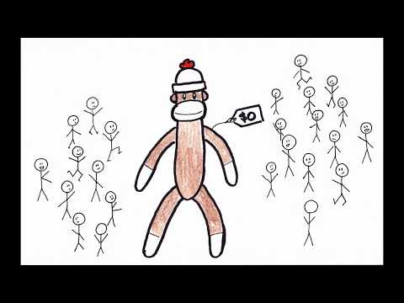
Economic Systems: Free, Mixed, and Planned Economies
The extremes of both free market and centrally planned economic systems have moved to the center as most global economies have embraced a more mixed approach. As described in Section 1.2, a nation’s economic system is the combination of policies, laws, and choices made by its government to establish the systems that determine what goods and services are produced and how they are allocated. After reviewing the video from mjmfoodie titled Economic Systems: Free, Mixed, and Planned Economies, andwer the questions on the next slide.

Slide 23
Economic Systems: Free, Mixed, and Planned Economies
Here is a thought exercise for you:
Draw a continuum similar to the one shown in the video, and below, and place your home country and at least one other nation on the continuum in the place where you think it falls between Central Planning and Free Market.
Central Planning Free Market

Slide 24
These are good questions/exercises to practice your understanding of the concepts
CONCEPT CHECK
What is economics, and how can you benefit from understanding basic economic concepts?
Compare and contrast the world’s major economic systems. Why is capitalism growing, communism declining, and socialism still popular?
What is the difference between macroeconomics and microeconomics?
This is a good opportunity to explore online resources to help you learn.
Ask Google.com these questions and see how it answers.
Now, select an Artificial Intelligence site, such as ChatGPT or Google’s Gemini and ask these questions.

Slide 25

Macroeconomics: The Big Picture
The method used to calculate unemployment based upon the categories used to identify workers from non-workers is learned and applied. As students learned in Section 1.4, full employment doesn’t mean 100% of every adult person in an economy is working. It is calculated based upon two main concepts, employed and unemployed, that is true, but the key is to understand what is categorized in each group before the unemployment rate is calculated. Although figuring out who is employed may seem easier, it’s the concept of the unemployed which requires a bit more thought. If a person is regarded as in the labor force, then they must meet the criteria explained in this video.

Slide 26
Macroeconomics: The Big Picture
Now that you know how the unemployment number in the United States is computed, think about how you would explain the concept to another student in this class, a friend or family member the next time the official unemployment rate is announced.

Slide 27
These are good questions/exercises to practice your understanding of the concepts
CONCEPT CHECK
What is a business cycle? How do businesses adapt to periods of contraction and expansion?
Why is full employment usually defined as a target percentage below 100 percent?
What is the difference between demand-pull and cost-push inflation?

Slide 28
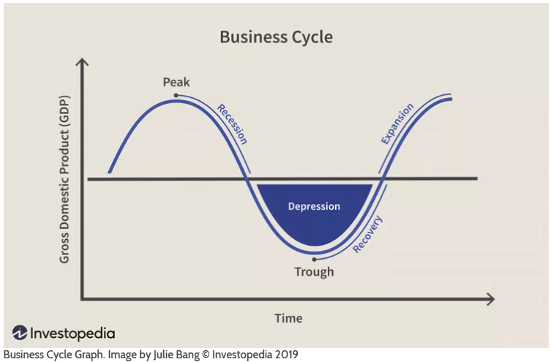
Business Cycles
Economies go through periods of growth and decline, expansion and contraction, prosperity and hardship.
We model these as business cycles. You can learn more here:
https://www.investopedia.com/terms/b/businesscycle.asp
Or Google “business cycles”

Slide 29
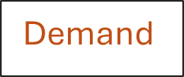
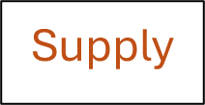
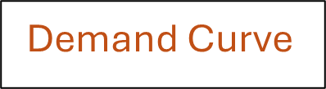
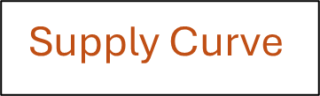
Understanding economic behaviors
It’s important to understand the relationship between prices and both demand for products and the supply that will be available. We typically display these relationships with graphs that show either quantity demanded or quantity supplied at different prices. We call these supply and demand curves.

Slide 30
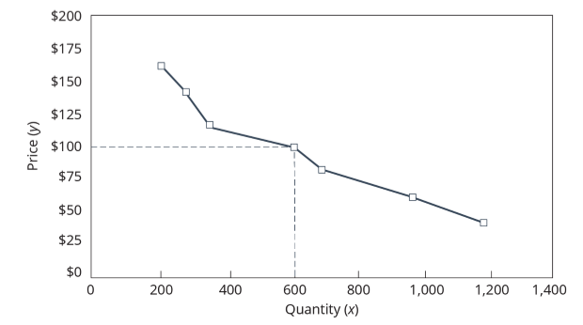
Exhibit 1.11 Demand Curve for Jackets for Snowboarders

Slide 31
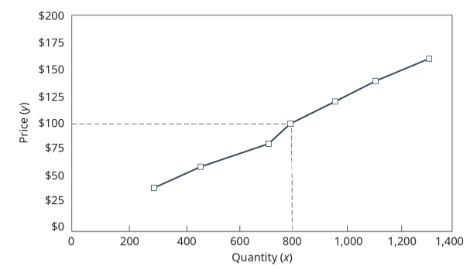
Exhibit 1.12 Supply Curve for Jackets for Snowboarders

Slide 32
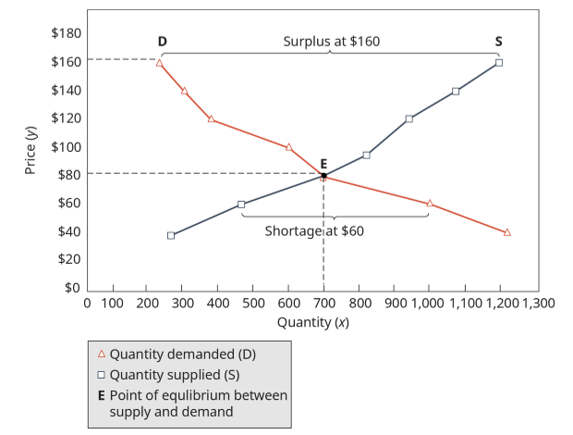
Exhibit 1.13 Equilibrium Price and Quantity for Jackets for Snowboarders

Slide 33
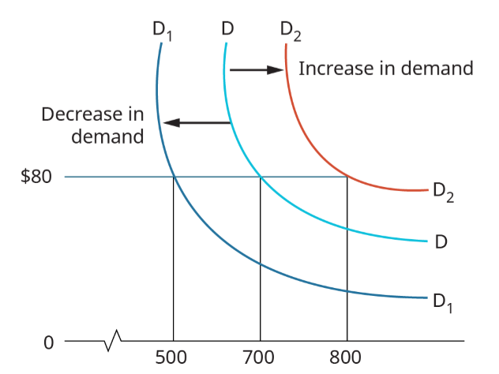
Exhibit 1.14 Shifts in Demand for Jackets for Snowboarders

Slide 34
These are good questions/exercises to practice your understanding of the concepts
CONCEPT CHECK
What is the relationship between prices and demand for a product?
How is market equilibrium achieved? Describe the circumstances under which the price for gasoline would have returned to equilibrium in the United States after Hurricane Katrina.
Draw a graph that shows an equilibrium point for supply and demand.

Slide 35
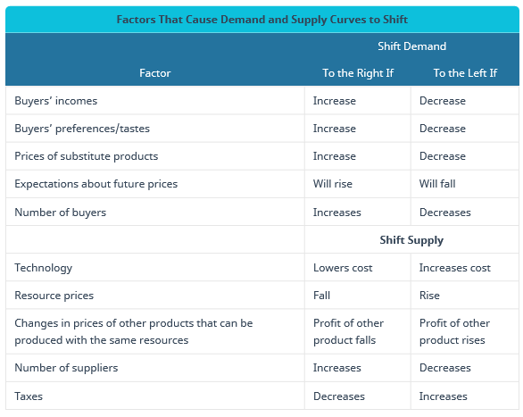
Table 1.2 Factors That Cause Demand and Supply Curves to Shift

Slide 36
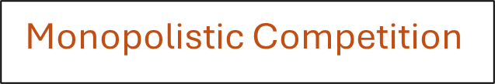
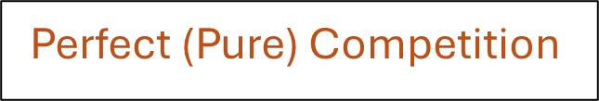
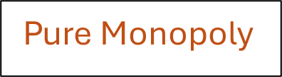
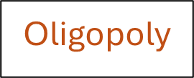
Market Structures
Markets are structured in different ways, based on the number of competitors and the extent to which these competitors offer different products. This influences the level of competition in the market.

Slide 37
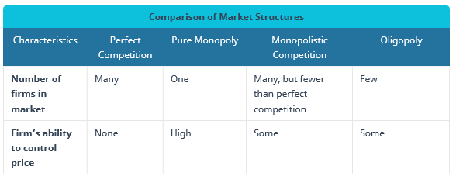
Table 1.3 Comparison of Market Structures

Slide 38
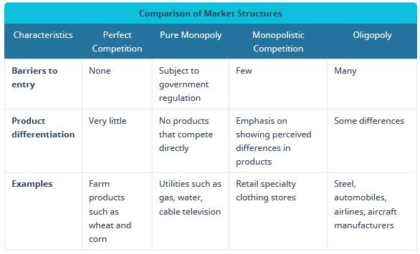
Table 1-3, Comparison of Market Structures - continued

Slide 39
These are good questions/exercises to practice your understanding of the concepts
CONCEPT CHECK
What is meant by market structure?
Compare and contrast perfect competition and pure monopoly. Why is it rare to find perfect competition?
How does an oligopoly differ from monopolistic competition?

Slide 40
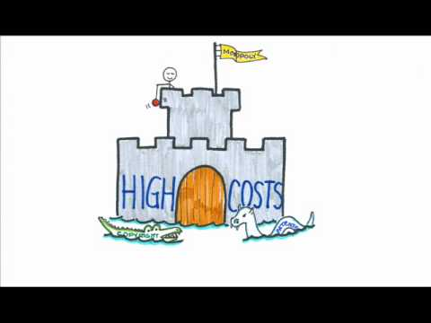
Competing in a Free Market
The way economists differentiate between the four main Market Structures is highlighted, in this video. As explained in Section 1.7, economists identify four types of market structures: (1) perfect competition, (2) pure monopoly, (3) monopolistic competition, and (4) oligopoly. Table 1.3 summarizes the characteristics of each of these market structures. Watch this video and then using the information from this video and Section 1.7, try to complete this table with at least one example by name of a real organization or company that fits into that structure.

Slide 41
Competing in a Free Market
Complete this table with at least one example by name of a real organization or company that fits into that structure. For example, into which structure would organizations like Apple, Microsoft, and Facebook go? What about the farmer who grew the carrots, broccoli or potatoes for sale at your local grocery store? Where would you place a small, local business like a dry cleaner, nail shop or auto repair. What about the power, cable TV or utility company in your geographic area? Any others you can think of?

