Slide 1
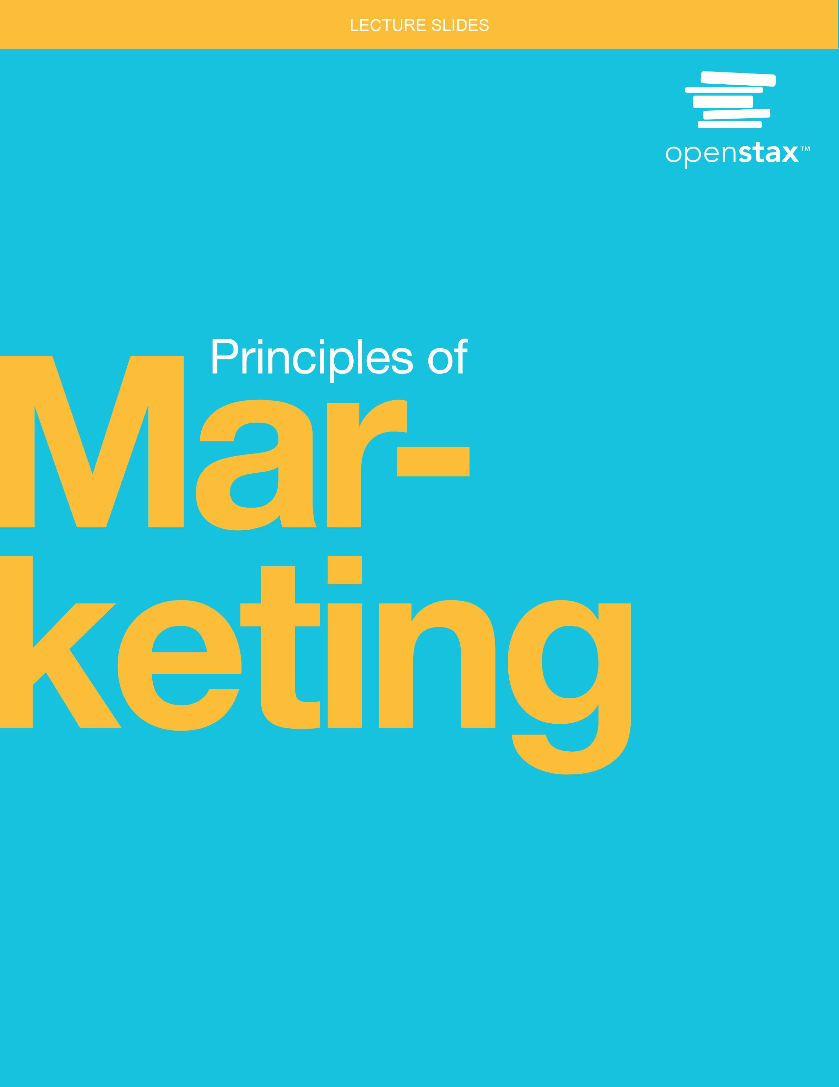
Principles of Marketing
Chapter 2: Strategic Planning in Marketing

Slide 2
Chapter Outline
2.1 Developing a Strategic Plan
2.2 The Role of Marketing in the Strategic Planning Process
2.3 Purpose and Structure of the Marketing Plan
2.4 Marketing Plan Progress Using Metrics
2.5 Ethical Issues in Developing a Marketing Strategy

Slide 3
2.1 Developing a Strategic Plan
Learning Outcomes
LO1 Define strategic planning and list the steps in the strategic planning process.
LO2 Write an effective vision statement and mission statement.
LO3 Describe the role of company values.
LO4 Perform a gap analysis.
LO5 Write SMART objectives and goals.
LO6 Summarize ways to monitor progress of the strategic plan.

Slide 4
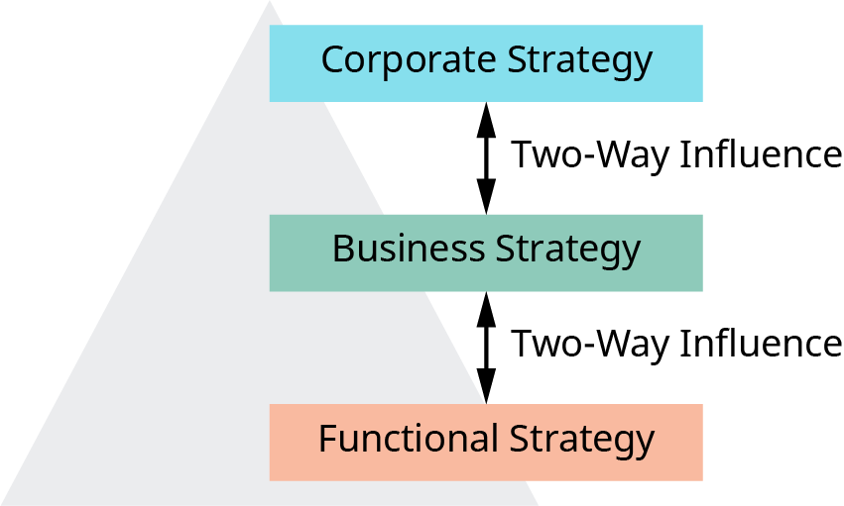


Strategic Planning
Strategy: the plans, actions, objectives, and goals that outline how the business is going to compete in its chosen markets given its portfolio of products or services
Corporate-level strategy: covers the entire business in a complex organization where there are multiple businesses, divisions, or operating units (sometimes called strategic business units, or SBUs)
Business-level strategy: the plan created for a single business or operating unit
Functional strategy: the plan to achieve the corporate- and business-level objectives in functional areas (e.g., human resources, marketing, and production)
Figure 2.2 Different Levels of Strategy Required in Complex Organizations (attribution: Copyright Rice University, OpenStax, under CC BY 4.0 license)

Slide 5




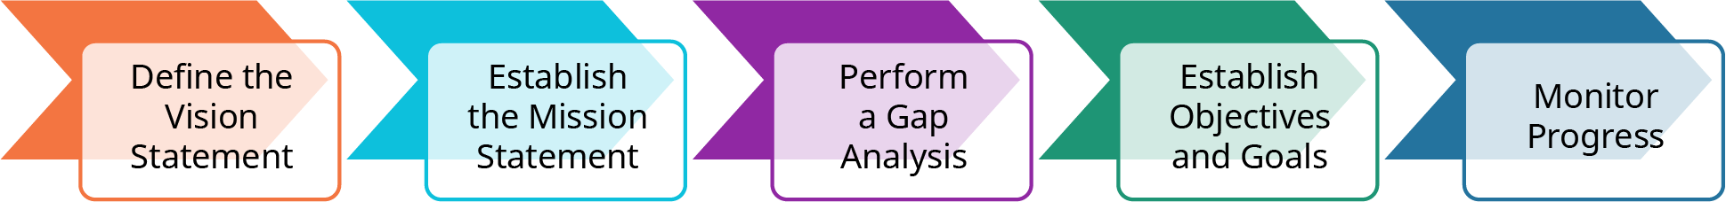
Strategic Planning Process
Step One: The Vision Statement: Where Do We See the Business Going? What the company is trying to create
Step Two: The Mission Statement: Why Does the Business Exist? What it does, who it serves, what sets it apart from the competition
Step Three: Perform a Gap Analysis. Internal audit answering the following questions: Where are we now? Where would we like to be? What’s stopping us from getting there?
Step Four: Establish Objectives and Goals. The key actions that will allow the company to implement the strategy
Step Five: Monitor Progress. A continuous monitoring and revising when necessary to keep on track to meet the goals and objectives
Figure 2.3 Steps in the Strategic Planning Process (attribution: Copyright Rice University, OpenStax, under CC BY 4.0 license)

Slide 6
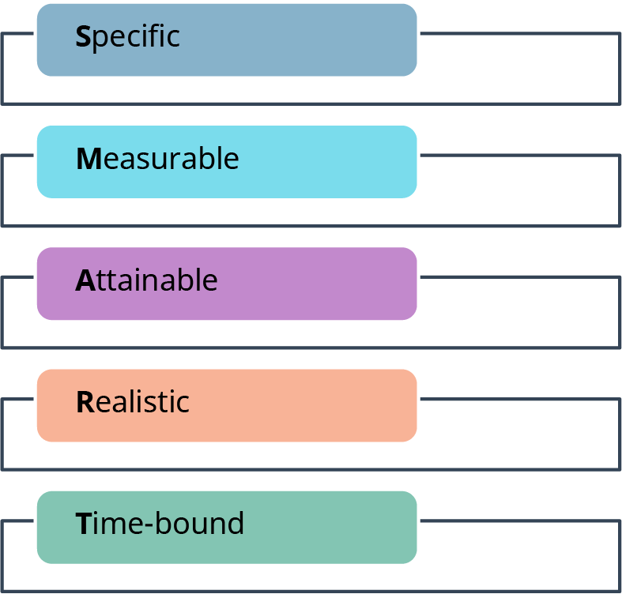

SMART Goals
Specific: clear and easy to understand
Measurable: quantifiable and easy to track
Attainable: should be reachable with some stretch
Realistic: substantial yet obtainable
Time-bound: a target or end date, creating some urgency
Figure 2.4 SMART Goals (attribution: Copyright Rice University, OpenStax, under CC BY 4.0 license)

Slide 7
Discussion Question
Create two SMART Goals. List them out specifically. Use your personal situation, work, home, or school.
  What can you plan now to meet the goal?

Slide 8
2.2 The Role of Marketing in the Strategic Planning Process
Learning Outcomes
LO1 Explain the role of marketing in the strategic planning process.
LO2 Discuss the business portfolio and identify planning tools.
LO3 Describe a SWOT analysis.
LO4 List and describe marketing strategies based on analytics.

Slide 9
Role of Marketing and Critical Functions
First, the marketing philosophy is important to represent throughout the strategic planning process. It is the marketing team that helps the strategic planning team to maintain this philosophy.
Second, to examine the current situation, marketers gather and analyze information along with the strategic planning team (the first step in a gap analysis).
Third, marketers are responsible for identifying and assessing the trends and impact of those trends in the marketing environment.

Slide 10
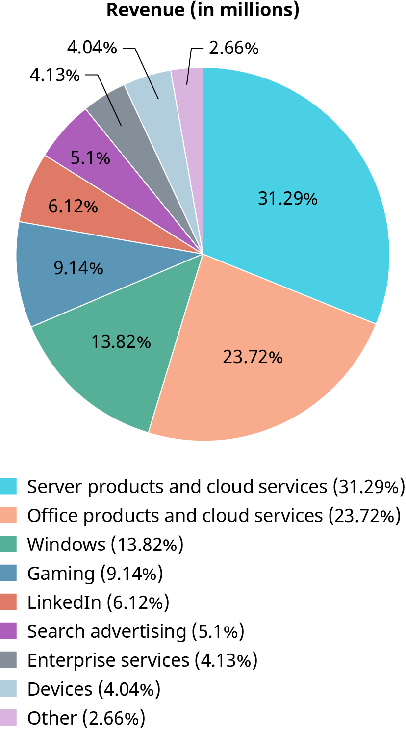

Business Portfolio
Total group of product lines, services, and business units that the company possesses. Some business have only one, some a few, and as we see here, companies like Microsoft’s revenue comes from many business units.
Analyzing and designing the business portfolio is important to gauge what strategic movement needs to take place.
Tools such as the BCG (Boston Consulting Group) matrix and a SWOT analysis aid in this analysis.
Figure 2.5 Composition of Microsoft Revenues (data source: Microsoft Annual Report 2021; attribution: Copyright Rice University, OpenStax, under CC BY 4.0 license)

Slide 11
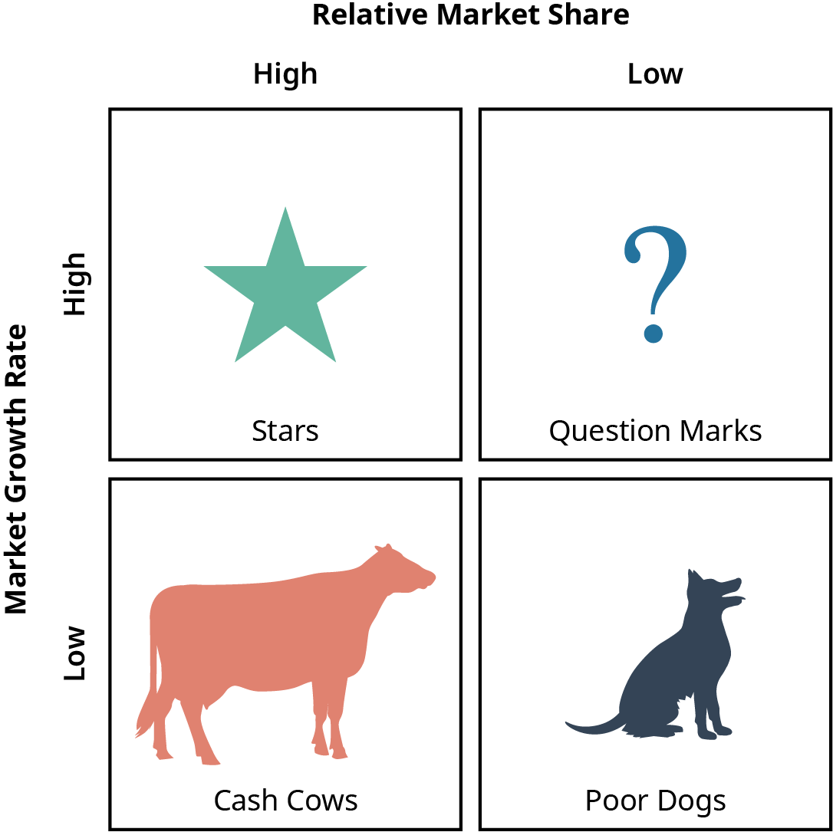

Boston Consulting Group (BCG) Matrix
How to read the BCG
Stars: high market share and high market growth rate
Question marks: low market share, yet high market growth rate
Cash cows: high market share and low market growth rate
Poor dogs: low market share and market growth rate
Figure 2.6 Boston Consulting Group (BCG) Matrix (attribution: Copyright Rice University, OpenStax, under CC BY 4.0 license)

Slide 12
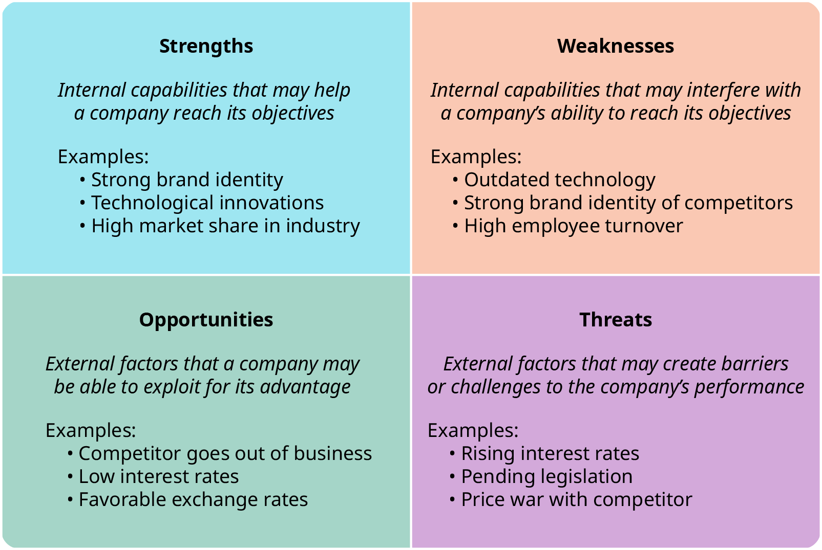

SWOT Analysis
Keys to successful use of SWOT:
Unbiased input
Prioritize listings
Develop an action plan
Follow up, review, and modify where necessary
Figure 2.8 Common SWOT Analysis Template (attribution: Copyright Rice University, OpenStax, under CC BY 4.0 license)

Slide 13
Market Share Growth Strategies
Market penetration: increased expenditures in marketing efforts such as advertising and promotions to increase revenue and grow market share in existing markets
Product development: new or improved products introduced to existing market to drive revenue, increase profits, and increase market share
Market development: looking to expand the market by reaching new customers

Slide 14
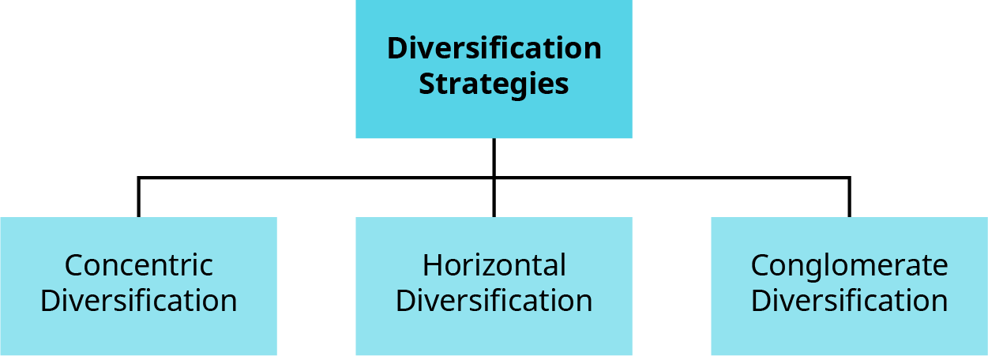
Product Diversification Strategies
Concentric diversification applies to a company’s existing business by adding similar products or services.
Horizontal diversification is used to develop a larger customer base by offering new and/or unrelated products or services.
Conglomerate diversification is when a company develops new products or services that are significantly unrelated to its current products.
Figure 2.9 Types of Diversification Strategies (attribution: Copyright Rice University, OpenStax, under CC BY 4.0 license)

Slide 15
Discussion Question
Discuss the pros and cons of each of the market development strategies.

Slide 16
2.3 Purpose and Structure of a Marketing Plan
Learning Outcomes
LO1 Explain the purpose of a marketing plan.
LO2 List and discuss elements that should be included in a marketing plan.

Slide 17

Marketing Plan Purpose
Marketing plans create structure:
  to carryout strategic plans
  to support the request for outside funding
  to create action plans
  to incorporate all the necessary components
  to create a method for monitoring goals and objectives
  to keep the team on a consistent path
  to include budgeting along with the action plan

Slide 18
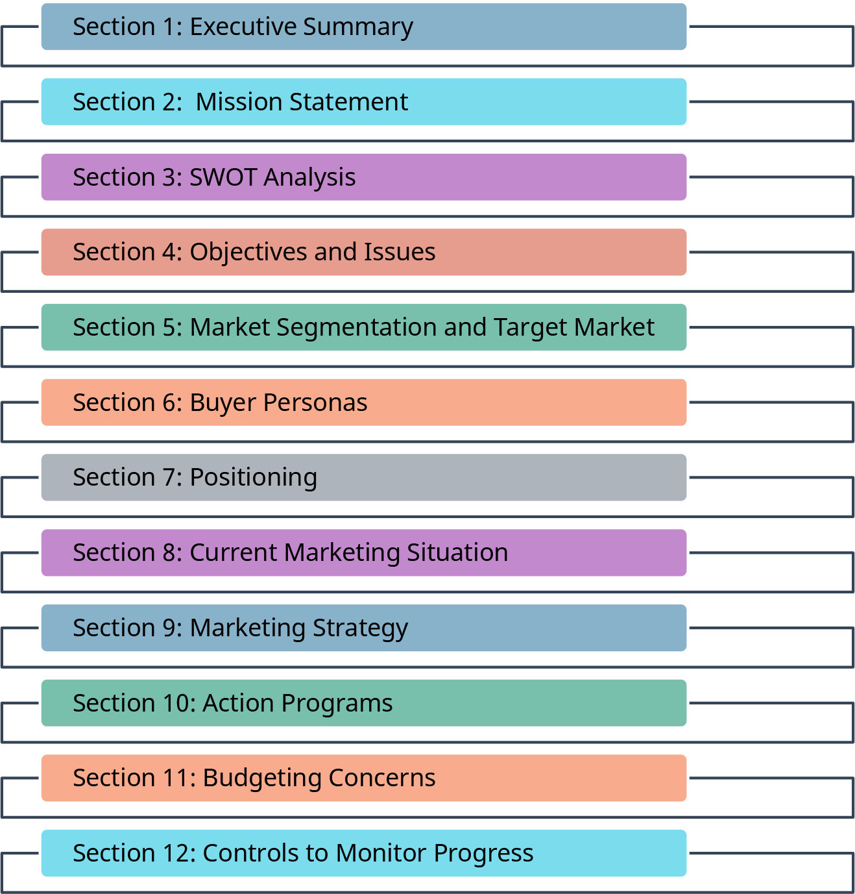
Marketing Plan Structure
Figure 2.11 Elements of a Marketing Plan (attribution: Copyright Rice University, OpenStax, under CC BY 4.0 license)

Slide 19
Marketing Plan Structure Details
Executive summary: a brief overview with a focus on clarity that informs even an outsider who needs the broad details. It includes the following sections:
  Introduction
  Description of company and team
  Description of market factors and trends
  Description of product and services being marketed
  Description of customer base and related marketing activities
  Financial overview
  Summary of overall objectives and strategies
Mission statement: the company’s action statement that clearly and concisely declares the purpose of the organization and how it serves its customers

Slide 20

Marketing Plan Structure Details (continued)
SWOT Analysis: identifies key internal and external influences in a company’s current position
Objectives and issues: uses the SMART goal/objective method and can be revenue based, market share, foot traffic, awareness, and anything else that needs to be addressed and can be quantified
Market segmentation and target market: covers the “who” (will be your customer) and “how” (you are going to reach them)
Buyer persona: Who is your ideal customer? What do they “look” like?
Positioning: after dividing the market into segments, how you are planning to reach each segment that you are targeting

Slide 21
Marketing Plan Structure Details (continued)
Current marketing situation: clear description of the total market; includes market description, product review, and competitor analysis
Marketing strategy: includes the following sections:
  Product strategy: how the product or service will benefit the consumer, fill a void in the market, or solve a problem
  Pricing strategy: key to positioning the product and generating revenue
  Promotion strategy: what needs to be done to generate awareness and drive demand for the product or service
  Distribution strategy: how you will provide access to the consumer for the product or service

Slide 22
Marketing Plan Structure Details (continued)
Action programs: specific actions, costs, and timing for the plan to be implemented
Budget concerns: a projected P&L (profit and loss) statement that should include:
  forecasted number of units to be sold during the period outlined in the marketing plan
  the average net price for revenues
  the cost of production
  physical distribution
  marketing expenditures
Controls to monitor progress: metrics necessary to track the pace of sale, revenue, and expenses

Slide 23
Discussion Question
Of the marketing plan components, some say the most important are the controls to monitor progress.
Why do you think that is?
What can they tell the marketing department?
What action can they take if the numbers indicate that they are not making their goals?
What action can they take if they indicate that they are exceeding their goals?

Slide 24
2.4 Marketing Plan Progress Using Metrics
Learning Outcomes
LO1 Define marketing metrics.
LO2 Explain key performance indicators (KPIs).
LO3 Provide examples of business objective KPIs.
LO4 Characterize sales/revenue generation KPIs.
LO5 Provide examples of market share KPIs.
LO6 Classify and discuss customer support KPIs.

Slide 25

Key Performance Indicators (KPIs)
Key performance indicators allow marketers to identify and maintain a focus on the data that counts.
Metrics measures what is happening at any point in time, without telling us why.
KPIs are directly tied to business objectives and have targets and specific time frames that are measured, basically creating a “scorecard” to gauge company standing against the goals.

Slide 26
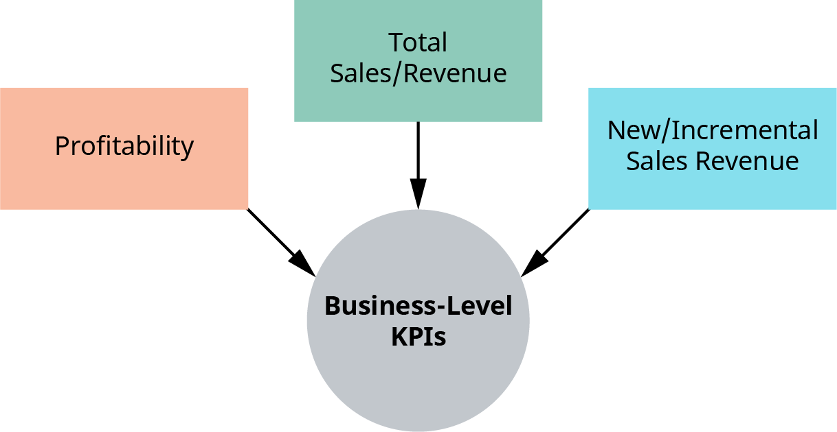
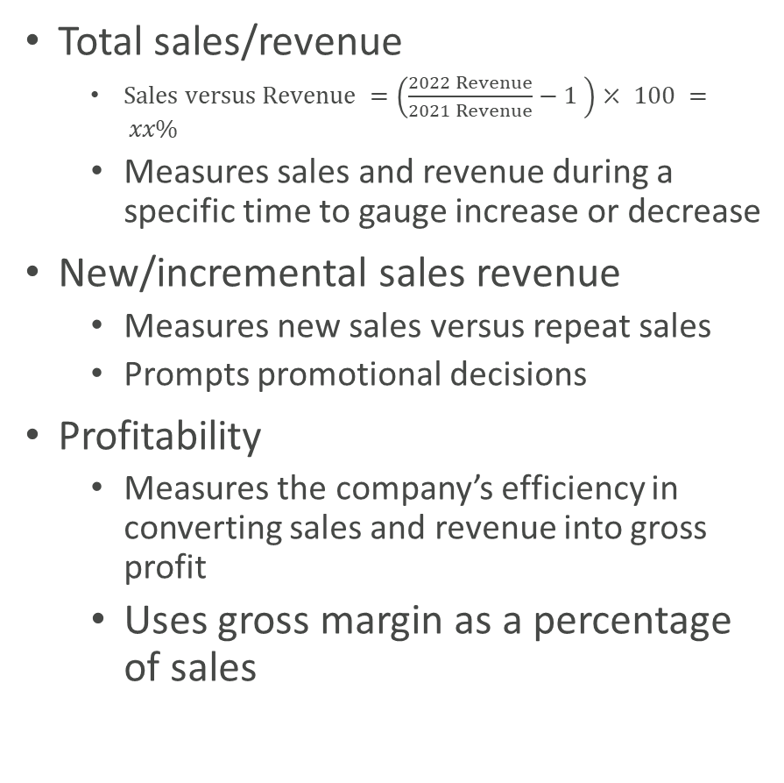
Business-Level KPIs
Total sales/revenue
  $Sales versus Revenue =\left(\frac{2022 Revenue}{2021 Revenue}−1 \right)⤫ 100 = xx\%$
  Measures sales and revenue during a specific time to gauge increase or decrease
New/incremental sales revenue
  Measures new sales versus repeat sales
  Prompts promotional decisions
Profitability
  Measures the company’s efficiency in converting sales and revenue into gross profit
  Uses gross margin as a percentage of sales
Figure 2.12 Business-Level KPIs (attribution: Copyright Rice University, OpenStax, under CC BY 4.0 license)

Slide 27
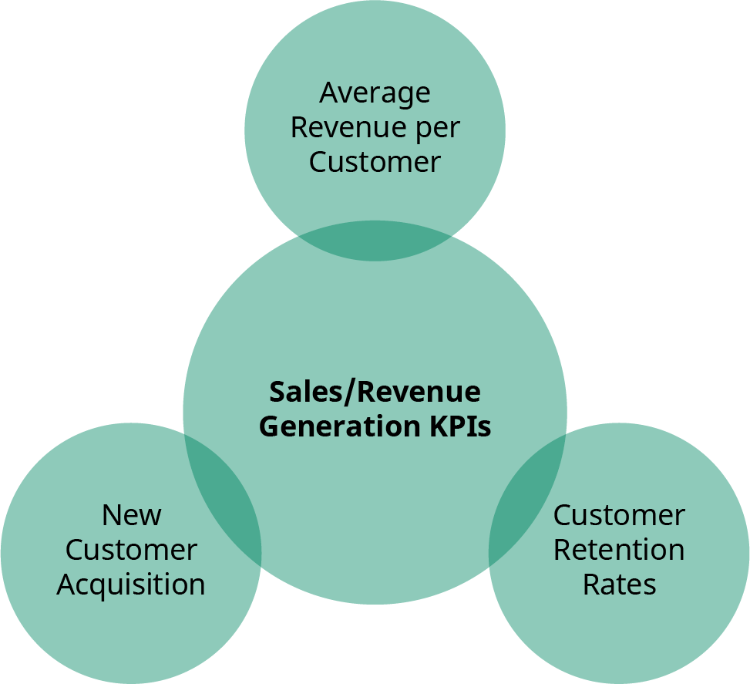
Sales/Revenue Generation KPIs
Average revenue per customer
  Total revenue divided by number of customers
New customer acquisition
  Total cost of sales and marketing efforts divided by number of new customers, measured during a specific period
Customer retention rates
  Measures the percentage of customers who have purchased in the past
Figure 2.13 Sales/Revenue Generation KPIs (attribution: Copyright Rice University, OpenStax, under CC BY 4.0 license)

Slide 28
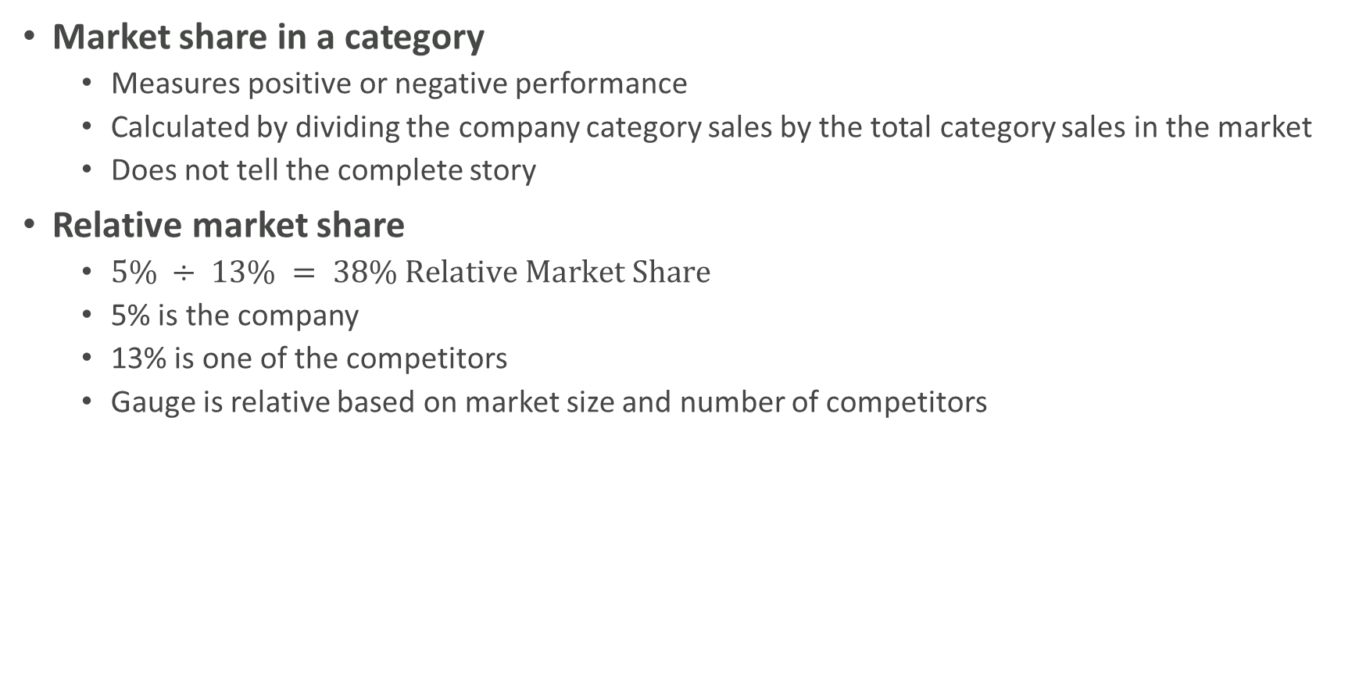
Examples of Market Share KPIs
Market share in a category
  Measures positive or negative performance
  Calculated by dividing the company category sales by the total category sales in the market
  Does not tell the complete story
Relative market share
  $5\% ÷ 13\% = 38\% Relative Market Share$
  5% is the company
  13% is one of the competitors
  Gauge is relative based on market size and number of competitors

Slide 29
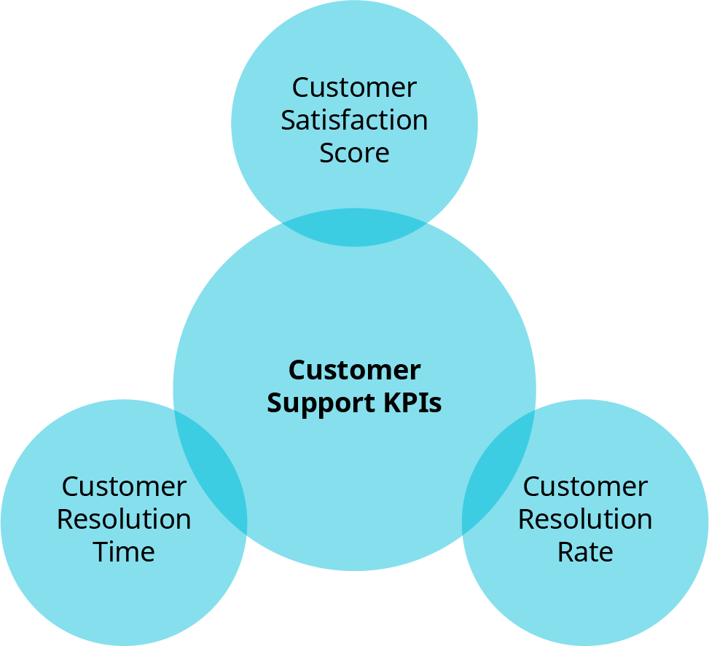
Customer Support KPIs
Customer satisfaction score
  High scores key to success
  Measured from surveys
Customer resolution rate
  What percentage of customer issues is resolved, aiding in customer satisfaction
Customer resolution time
  Ties to the rate of resolution; measures how long it takes to resolve issues
Figure 2.14 Customer Support KPIs (attribution: Copyright Rice University, OpenStax, under CC BY 4.0 license)

Slide 30
Discussion Question
Which KPI do you believe is the most useful?
  Why?
  How would you use this calculation?
  What would the company response possibilities be?

Slide 31


2.5 Ethical Issues in Developing a Marketing Strategy
Learning Outcomes
LO1 Explain the importance of ethical marketing.
LO2 Describe key ethical considerations in strategic planning.
LO3 Discuss examples of ethical companies.

Slide 32
Marketing Ethics
Marketing ethics impact on business:
  Customer loyalty
  Improved credibility
  Brand enhancement
Corporate social responsibility
  Is growing to meet the demands of the younger generations and growing in other generations
  Transparency considered extremely important
  A commitment to employee rights, inclusion, the environment, sustainability, and other social causes

Slide 33
Key Ethical Considerations
Choices such as:
  doing what sells or what is known to be best?
  public safety or profits?
  continue standard operating procedures or do what is right for the environment, employees, and consumers?
Questions to consider when strategically planning:
  Are all stakeholders of the company being incorporated into the planning?
  Does the business plan support the triple bottom line?
  Do the organizational and individual values align?
  Do adjustments need to be made to the mission and vision statements to convey the current direction of the company?

Slide 34
Discussion Question
Does your support for companies, products, or services depend on the company’s practices?
  If it does, where do you draw the line? Need, want, situations?
  What percentage of your purchases do you align with your personal beliefs?
  If you were to invest in a company, would you align with their profits or their CSR efforts?

Slide 35
This OpenStax ancillary resource is © 2023 Rice University under a CC-BY 4.0 International license; it may be reproduced or modified but must be attributed to OpenStax, Rice University and any changes must be noted.

