Slide 1
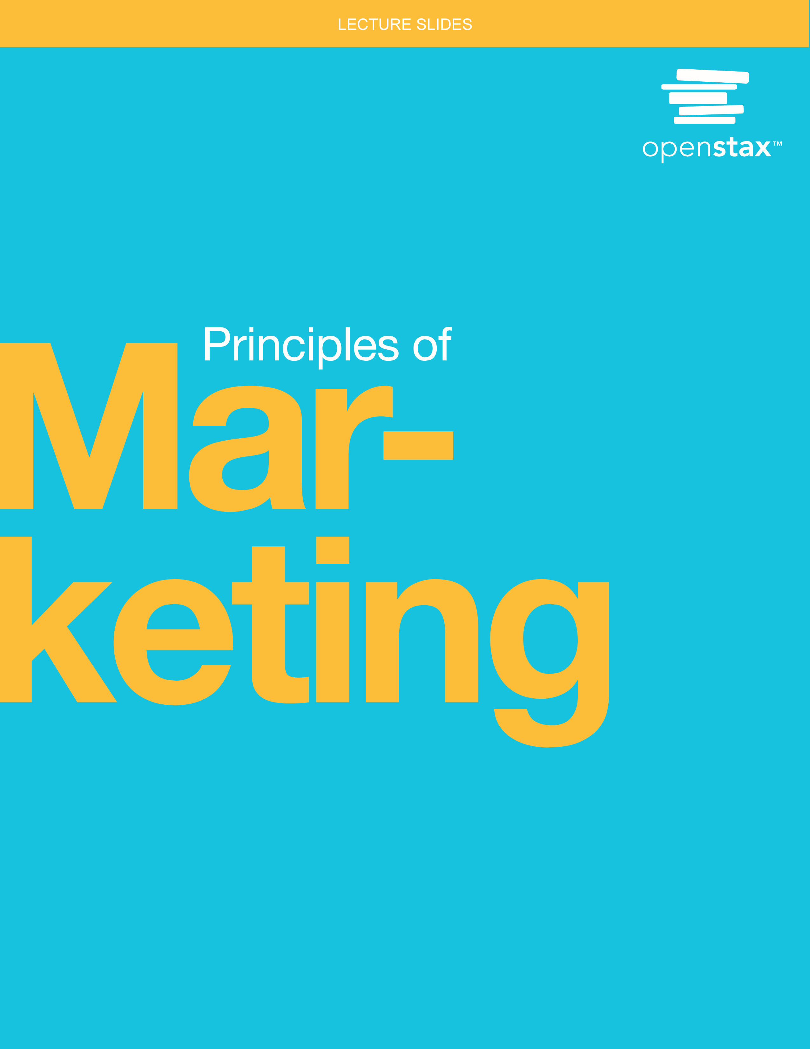
Principles of Marketing
Chapter 1: Marketing and Customer Value

Slide 2
Chapter Outline
1.1 Marketing and the Marketing Process
1.2 The Marketing Mix and the 4Ps of Marketing
1.3 Factors Comprising and Affecting the Marketing Environment
1.4 Evolution of the Marketing Concept
1.5 Determining Consumer Needs and Wants
1.6 Customer Relationship Management (CRM)
1.7 Ethical Marketing

Slide 3
1.1 Marketing and the Marketing Process
Learning Outcomes
LO1 Define and describe marketing.
LO2 Describe the benefits of marketing to the organization, its interested parties, and society.
LO3 Explain the marketing process.

Slide 4


Chapter 1 Summary
Place your cursor on the speaker icon and click on the arrow that appears to listen to a brief summary of the chapter
From your professor,
In my opinion, marketing is really all about two things:
Creating value
Measuring things well
We create value by offering exchange opportunities in which the customer is better off after the exchange than they were before. If we have done our jobs well, the firm is also better off than before.
If marketers do their jobs really well, they can make the world a better place, one exchange at a time.

Slide 5
Marketing Defined
Identifying customer needs. Companies use marketing research to gather data regarding who the customer is and what their wants and needs are.
Anticipating customer needs. Using the data collected, marketers can modify products by making changes, adaption, or updates.
Satisfying customer needs. If customer’s needs are met, it increases the chances that they will become repeat customers.
Profitably. This requires adding value to a product so the customer pays a price that is greater than the cost of making the product.
The American Marketing Association (AMA) defines marketing as “the activity, set of institutions, and processes for creating, communicating, delivering, and exchanging offerings that have value for customers, clients, partners, and society at large.”⁶

Slide 6
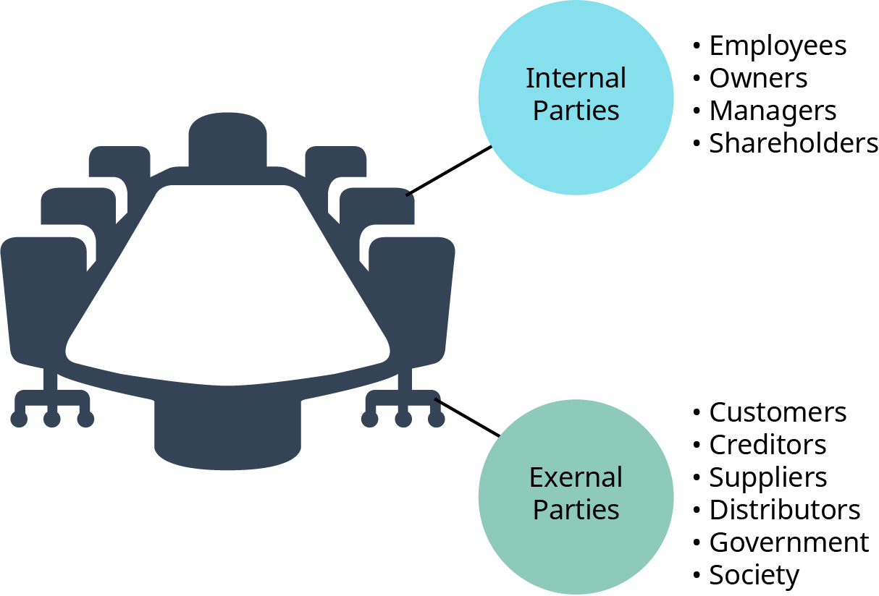
Types of Stakeholders
Internal parties
Internal marketing
  Promoting the company offerings to the employees
External parties: vital to the success of the company
Utility: usefulness to customers
  Form: increase value by altering physical form
  Time: most convenient for purchase
  Place: physically available and accessible
  Possession: easy to acquire
Figure 1.2 (attribution: Copyright Rice University, OpenStax, under CC BY 4.0 license)

Slide 7

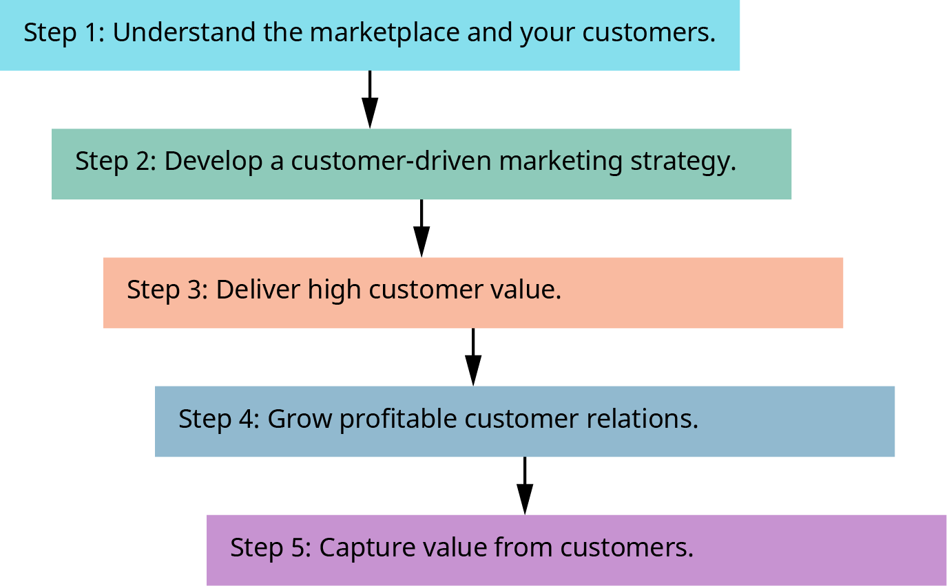
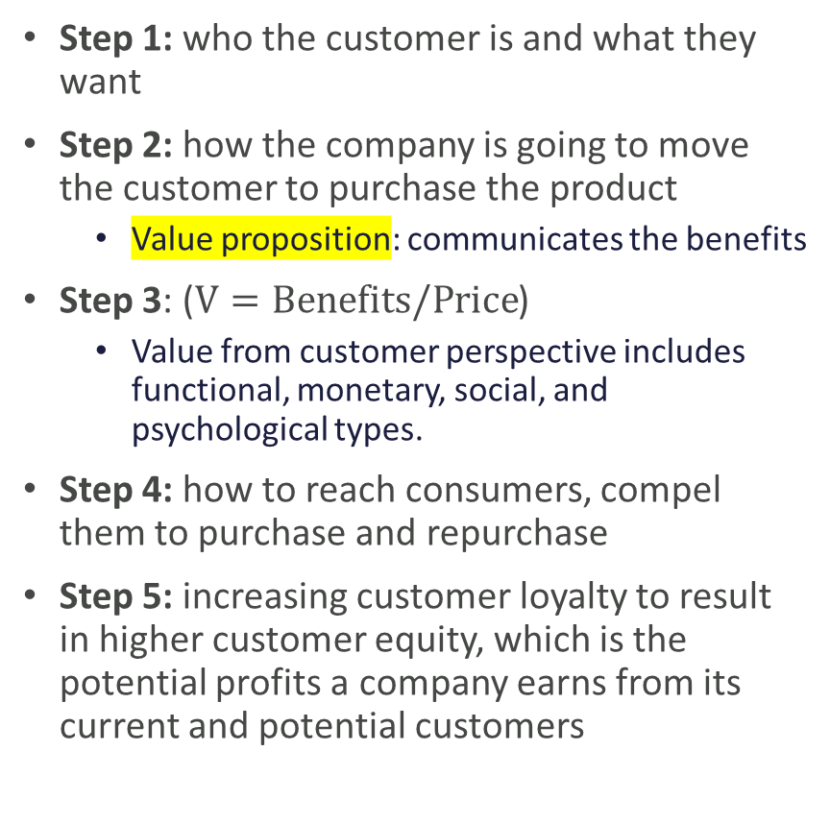
Steps in the Marketing Process
Step 1: who the customer is and what they want
Step 2: how the company is going to move the customer to purchase the product
  Value proposition: communicates the benefits
Step 3: ($V=Benefits/Price$)
  Value from customer perspective includes functional, monetary, social, and psychological types.
Step 4: how to reach consumers, compel them to purchase and repurchase
Step 5: increasing customer loyalty to result in higher customer equity, which is the potential profits a company earns from its current and potential customers
Figure 1.3 Steps in the Marketing Process (attribution: Copyright Rice University, OpenStax, under CC BY 4.0 license)

Slide 8




Discussion Question
Discuss delivering the utility of the following products:
  Fresh vegetables
  Yoga instruction
  New car
What are the differences and the similarities?

Slide 9
1.2 The Marketing Mix and the 4Ps of Marketing
Learning Outcomes
LO1 Define and describe the marketing mix.
LO2 List and explain the 4Ps of marketing.

Slide 10
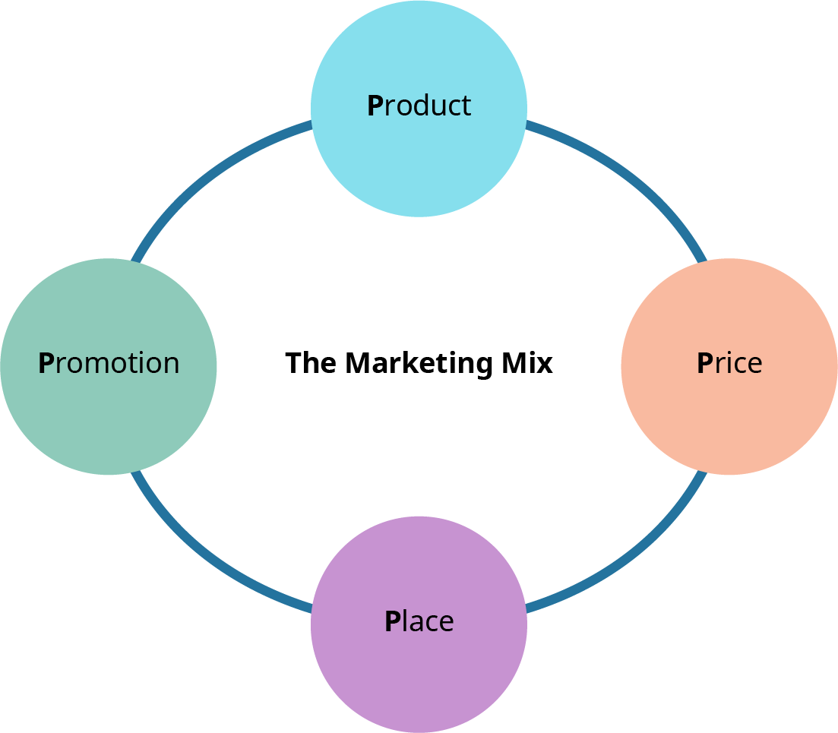

4Ps The Marketing Mix
Product: product or service
Price: the charge to the customer for the product or service
Place: where the customer is being offered the product or service
Promotion: the means of communication that is used to create awareness and interest to purchase
Figure 1.4 The Marketing Mix and the 4Ps of Marketing (attribution: Copyright Rice University, OpenStax, under CC BY 4.0 license)

Slide 11
Discussion Question
How has place changed in the last decade? Consider Amazon, direct to consumer (D2C), music, and even groceries.

Slide 12
1.3 Factors Comprising and Affecting the Marketing Environment
Learning Outcomes
LO1 Define and describe the marketing environment.
LO2 Explain the components of the marketing environment.
LO3 Identify and describe the internal factors of the marketing environment.
LO4 List and describe the components of the micro- and macroenvironments.

Slide 13
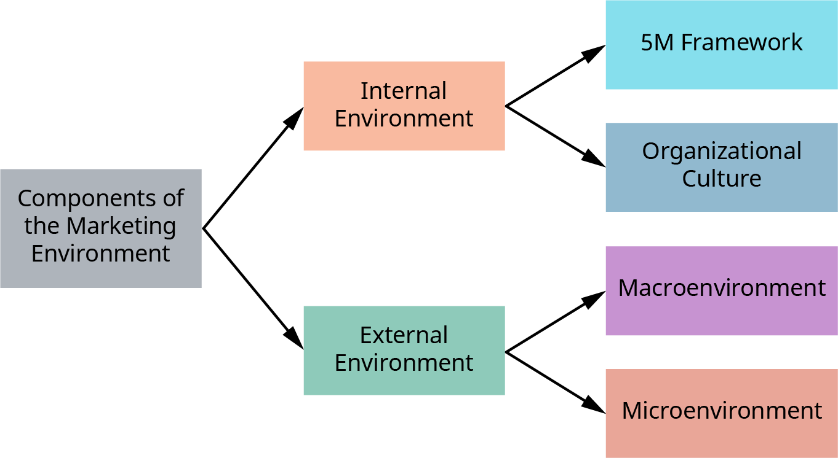
The Marketing Environment
Figure 1.6 The Components of the Marketing Environment (attribution: Copyright Rice University, OpenStax, under CC BY 4.0 license)

Slide 14

Internal and External Environment
Internal environment = controllable
  5M framework
    Minds (staffing)
    Minutes (time)
    Machinery (equipment)
    Materials
    Money (finances)
  Organizational culture
    A strong culture retains employees.
    It gives the customer an idea of the values of the company, which can drive them to support the company.
External environment = uncontrollable
  Macroenvironment
    Consumers
    Competition
  Microenvironment
    Political
    Legal
    Environmental
    Social
    Economic
    Technological

Slide 15
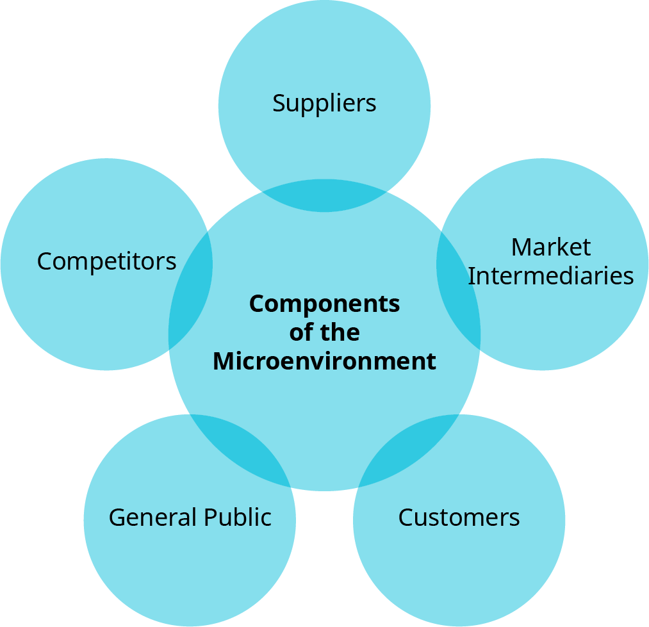
Microenvironment
Figure 1.7 Components of the Microenvironment (attribution: Copyright Rice University, OpenStax, under CC BY 4.0 license)

Slide 16
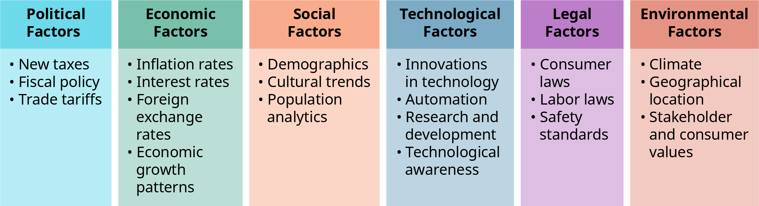

Macroenvironment
Figure 1.8 PESTLE Factors (attribution: Copyright Rice University, OpenStax, under CC BY 4.0 license)
An alternative model of the external environment

Slide 17
Discussion Question
How can each category of the PESTLE factors impact marketing to the final consumer?

Slide 18
1.4 Evolution of the Marketing Concept
Learning Outcomes
LO1 Describe the production concept.
LO2 Define the product concept.
LO3 Discuss the selling concept.
LO4 Explain the marketing concept.
LO5 Summarize the societal marketing concept and its features.

Slide 19
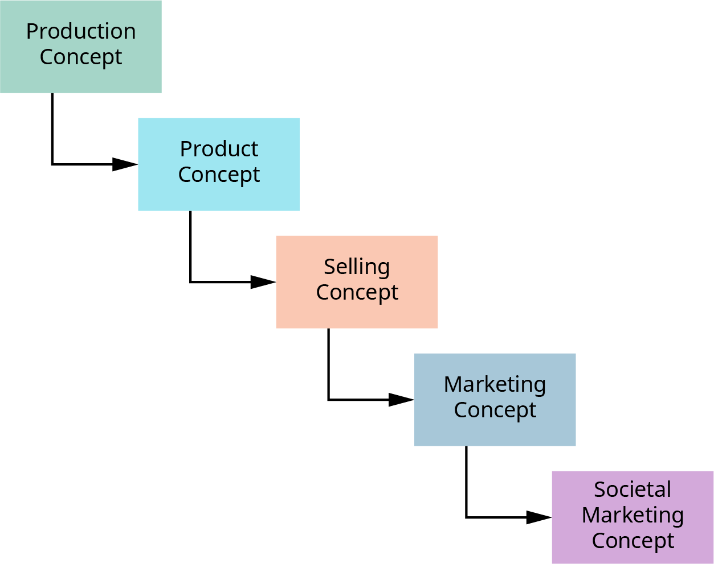
The Evolution of Marketing
Figure 1.9 Evolution of Marketing (attribution: Copyright Rice University, OpenStax, under CC BY 4.0 license)

Slide 20
The Concepts
The production concept
  Companies focus on high production, low cost, and high distribution.
  Customers focus on product availability and low price.
The product concept
  Companies focus on superior products with improvements over time.
  Consumers focus on products that offer quality, innovative features, and performance.

Slide 21
The Concepts (continued)
The sales concept
  Companies focus on selling what they have.
  Consumers are coaxed into buying.
The marketing concept
  Companies focus on customer needs before developing products and building relationships with consumers.
  Consumers focus on having their needs met.

Slide 22
The Concepts (continued)
The societal marketing concept
  Companies focus on meeting the needs of the consumer, the needs of the company, and the growing concern over the needs of society. This includes future concerns and the environment.
  Consumers focus on buying products based on societal impact.

Slide 23
Discussion Question
Discuss your thoughts on what the next evolution of marketing will look like.

Slide 24
1.5 Determining Consumer Needs and Wants
Learning Outcomes
LO1 Explain how an organization identifies consumer needs and wants.
LO2 Describe the process through which an organization satisfies consumer needs and wants.

Slide 25
Identifying Consumer Needs and Wants
Needs fall into categories that help the marketer/salesperson to narrow down the parameters needed to successfully fulfill those needs.
Stated needs are clearly specified by the customer.
Real needs are one level above stated needs in terms of specific details.
Unstated needs are those that the customer also expects but doesn’t ask for.
Delight needs can make some products more desirable than others if they meet the “wow” factor or are above and beyond needs.
Secret needs are those that a customer may not state or realize and can be important reasons for choosing a particular product.

Slide 26
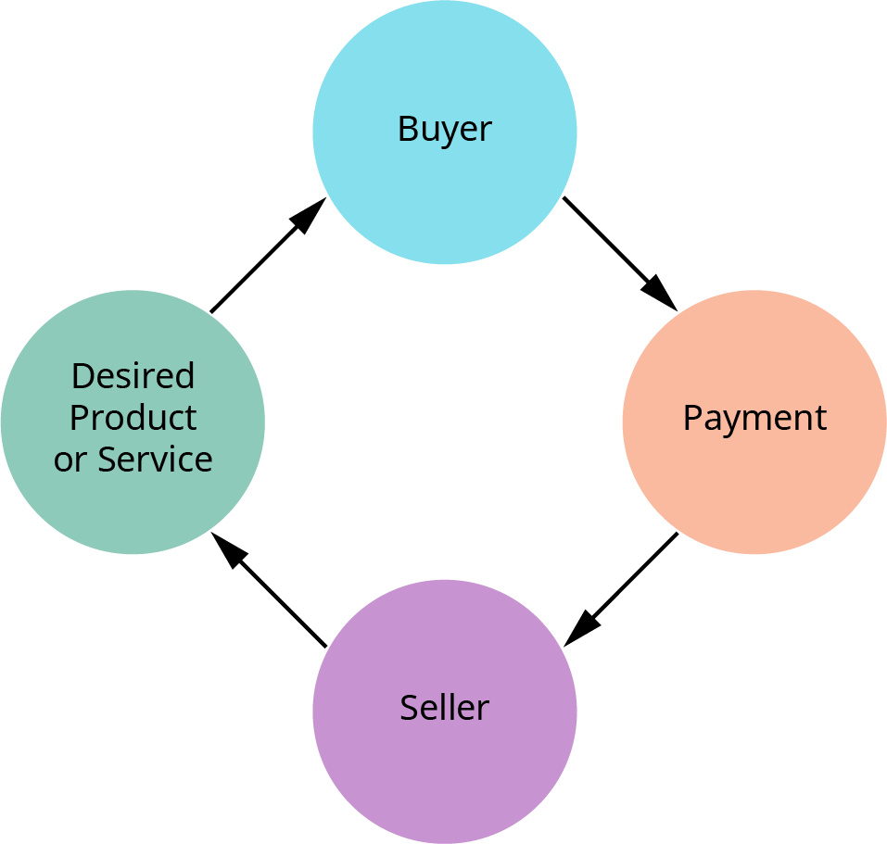
The Exchange Process
Figure 1.10 The Exchange Process (attribution: Copyright Rice University, OpenStax, under CC BY 4.0 license)

Slide 27
Discussion Question
Consider the exchange process. How has each component changed in the last decade? What comes next?

Slide 28
1.6 Customer Relationship Management (CRM)
Learning Outcomes
LO1 Define customer relationship management (CRM).
LO2 Describe the impact of CRM on customer loyalty and retention.
LO3 Explain how CRM builds customer equity.

Slide 29
CRM
A system with which a company can manage information regarding leads, prospect, and customers
Types of CRM systems:
  Operational. Deals with three types of operations: marketing, sales, and service automation. The purpose is to automate processes for a business, aiding in the conversion of prospects into customers.
  Analytical. Software that aids in the collection, organization, and analysis of data, providing management with insights needed to make data-driven strategic decisions.
  Collaborative. Provides the ability for companies to share customer information and data to mutually benefit them both.

Slide 30
Impact of CRM on Customer Loyalty and Retention
Customer loyalty is a continuous positive relationship between business and consumer.
Customer retention is the ability of the business to move a customer to a returning customer.
CRM has the following positive impacts on both:
  Leveraging customer data
  Enhancing customer communications
  Ascertaining customer needs
  Gathering feedback
  Managing customer loyalty programs

Slide 31
Discussion Question
As a business owner, how would you leverage the information that you gather from the CRM system to enhance your customer relations?

Slide 32
1.7 Ethical Marketing
Learning Outcomes
LO1 Define ethical marketing.
LO2 Describe the importance of ethical marketing.
LO3 Explain the dos and don’ts of ethical marketing.

Slide 33
Ethical Marketing
Principles of ethical marketing
  All marketing should be true.
  The privacy of the end user is most important.
  Marketing campaigns must adhere to the norms, standards, rules, and regulations set forth by the government and other lawmaking authorities.
  Marketing professionals must be transparent about what they are trying to convey and whom they are approaching to convey it.
Importance
  Consider company reputation
  56% of customers will not buy from companies they think are unethical

Slide 34
Ethical Marketing (continued)
Dos of ethical marketing
  Ensure transparency
  Protect data security
  Prioritize the concerns of the consumer
Don’ts of ethical marketing
  Don’t overemphasize or exaggerate
  Don’t make false claims
  Don’t make false comparisons

Slide 35
Discussion Question
Discuss the instances that you can think of where a company consistently crosses into the don’ts of marketing.
  Do you buy from them?
  Would you report them if you could?
  Would you tell others that the claims were unethical?

Slide 36


This OpenStax ancillary resource is © 2023 Rice University under a CC-BY 4.0 International license; it may be reproduced or modified but must be attributed to OpenStax, Rice University and any changes must be noted.
Additional Sound Bytes Related to this Chapter

