Slide 1
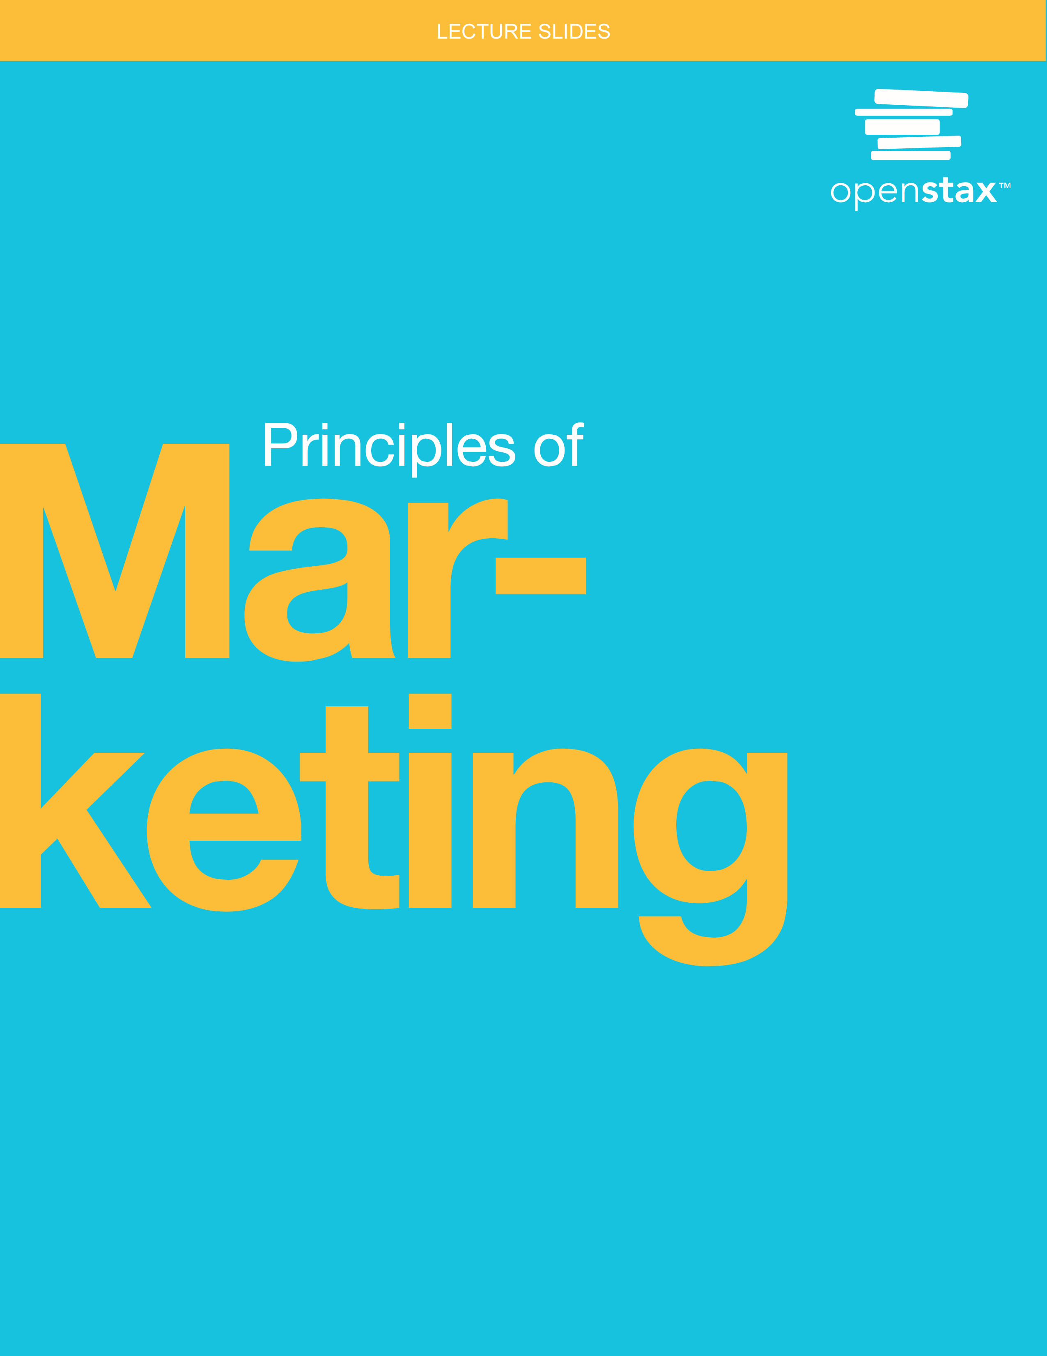
Principles of Marketing
Chapter 3: Consumer Markets and Purchasing Behavior

Slide 2
Chapter Outline
3.1 Understanding Consumer Markets and Buying Behavior
3.2 Factors That Influence Consumer Buying Behavior
3.3 The Consumer Purchasing Decision Process
3.4 Ethical Issues in Consumer Buying Behavior

Slide 3
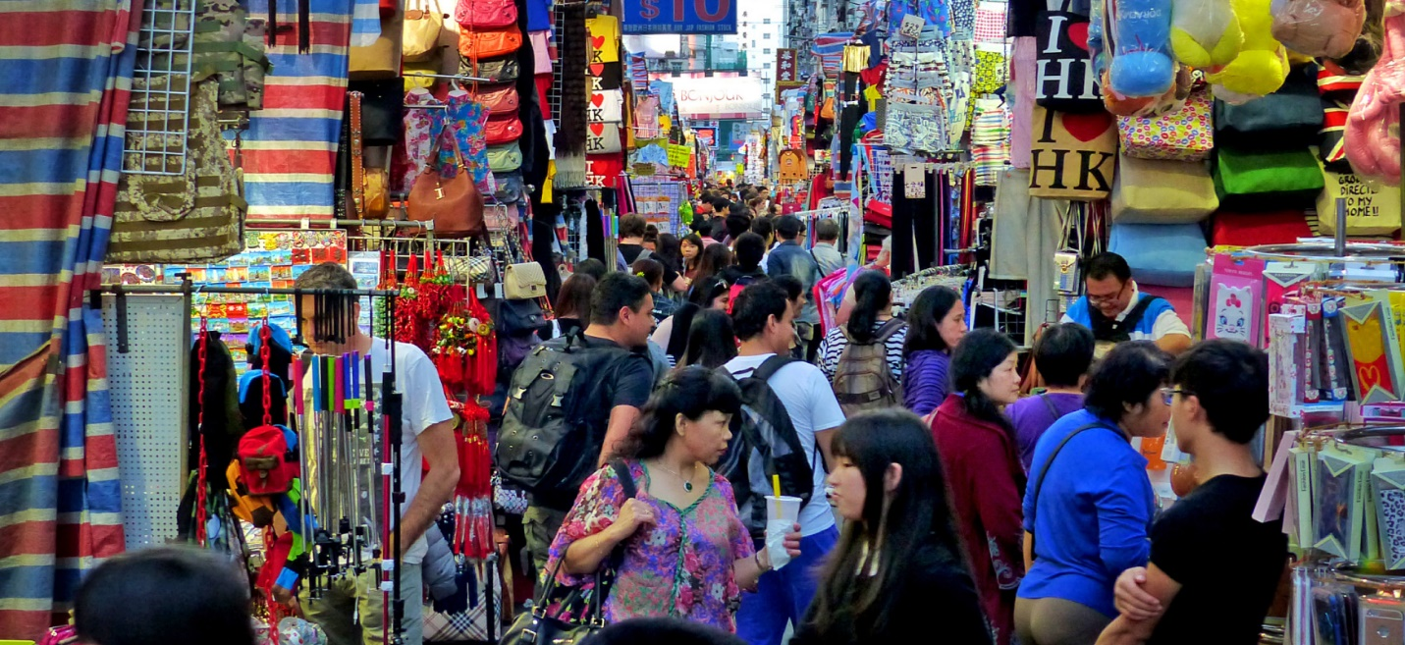
Marketplace
Consumer Markets and Purchasing Behavior
Figure 3.1 Understanding consumer purchasing decisions is important because it allows companies to better influence those behaviors. (credit: modification of work "Hong Kong street market" by Bernard Spragg. NZ/flickr, Public Domain)

Slide 4

3.1 Understanding Consumer Markets and Buying Behavior
Learning Outcomes
LO1 Define consumer buying behavior.
LO2 Explain the nature of the buyer’s black box.
LO3 Describe how consumer behavior is characterized into types.
Consumer Buying Behavior
Refers to the decisions and acts people undertake to buy products or services for personal use

Slide 5

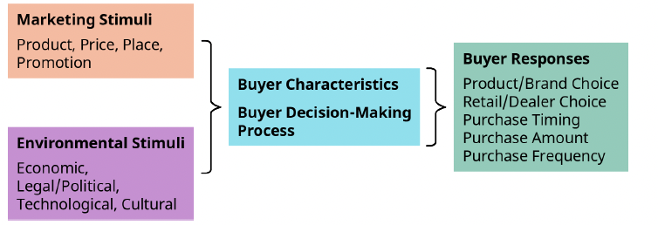
Buyer’s Black Box
Figure 3.2 Stimulus-Response Model/Buyer’s Black Box (attribution: Copyright Rice University, OpenStax, under CC BY 4.0 license)

Slide 6
Buyer’s Black Box
Stimuli
  4Ps (product, price, promotion, and place)
  Environmental: economic factors, legal/political factors, technological and cultural factors
  Stimuli go into two parts of “black box”
    Buyer characteristics
      Beliefs and attitudes, motives, perceptions, and values
    Buyer decision-making process
The outcome of the thinking that takes place in that black box is the consumer response.

Slide 7
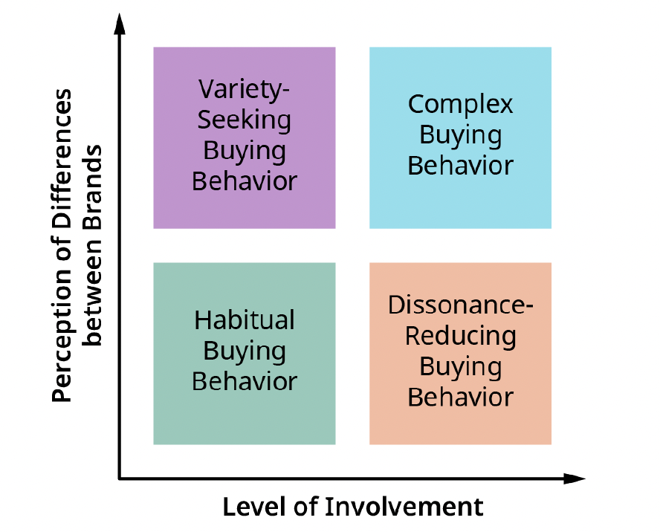

Types of Consumer Buying Behavior

Slide 8
Consumer Buying Behavior
Complex buying behavior
  Significant or expensive purchase
  High level of involvement
Dissonance-reducing buying behavior
  High level of involvement
  May experience post-purchase dissonance
Habitual buying behavior
  Low involvement
  Repeat buy
Variety-seeking buying behavior
  Lowest customer involvement
  Switching for the sake of variety

Slide 9
3.2 Factors That Influence Consumer Buying Behavior
Learning Outcomes
LO1 List and describe the cultural factors that influence consumer buying behavior.
LO2 Explain the social factors that impact consumer buying behavior.
LO3 Discuss the personal factors that influence consumer buying behavior.
LO4 Describe the psychological factors that influence consumer buying behavior.
LO5 Explain situational factors that impact consumer buying behavior.

Slide 10
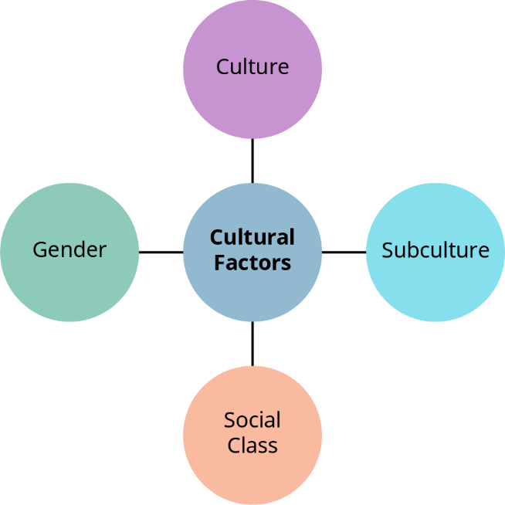
Cultural Factors Influencing Consumer Purchasing Behavior
Figure 3.4 Cultural Factors Influencing Consumer Purchasing Behavior (attribution: Copyright Rice University, OpenStax, under CC BY 4.0 license)

Slide 11


Cultural Factors
Culture: the values, ideas, and attitudes that are learned and shared among members of a group
Subculture: a group of people who share a set of secondary values
Social class: defined in several ways: income, occupation, education, etc.
Gender: may affect motives, perspectives, considerations, and the desire for different products

Slide 12
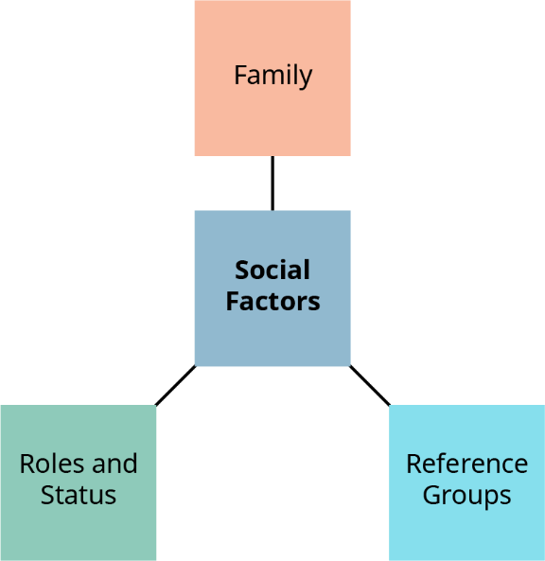
Social Factors Influencing Consumer Purchasing Behavior
Figure 3.5 Social Factors Influencing Consumer Purchasing Behavior (attribution: Copyright Rice University, OpenStax, under CC BY 4.0 license)

Slide 13

Social Factors
Family: People belong to two families—a family of orientation (with which they grew up) and family of procreation (the family formed through marriage or cohabitation).
Reference groups: These include formal groups (such as being a member of church, professional group, or social club) and informal groups (friends or acquaintances).
Roles and status: People assume different roles and statuses within the groups, clubs, family, or organizations to which they belong.

Slide 14
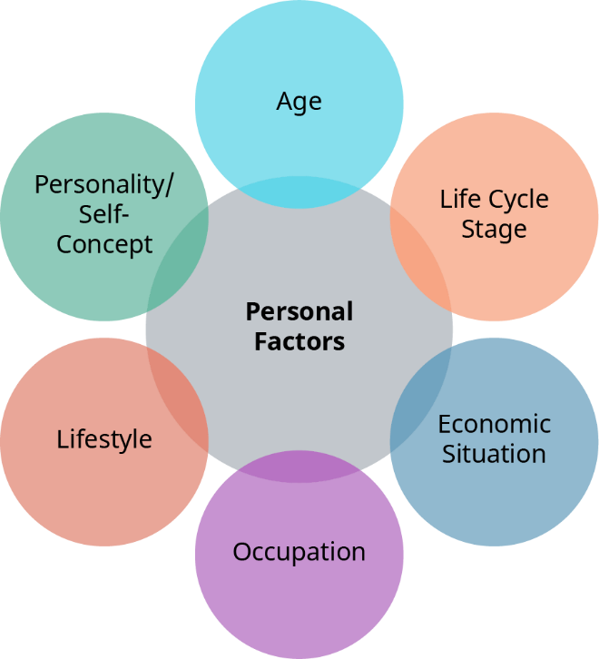
Personal Factors Influencing Consumer Purchasing Behavior
Figure 3.6 Personal Factors Influencing Consumer Purchasing Behavior
(attribution: Copyright Rice University, OpenStax, under CC BY 4.0 license)

Slide 15
Personal Factors
Age: Buying habits are vastly different among consumers of different ages.
  Baby boomers (born between 1946 and 1964), currently 60s and 70s
    Key categories: pharmacy, health care, household items, wine, books, cosmetics, and skin care
  Generation Xers (born between 1965 and 1979/80), currently 40s and 50s
    Key categories: higher-end brands, convenience-related goods
  Generation Y, or millennials (born between 1981 and 1994/96), currently 20s and 30s
    Key categories: natural ingredients, ethical production, and sustainable goods
  Generation Z, or Zoomers (born between 1997 and 2012), currently teens to early 20s
    Key categories: limited discretionary spending

Slide 16
Personal Factors, continued
Life cycle stage: This factor is a major influencer on buying decisions.
Economic situation: A higher income typically means higher disposable income and spending on high-end products. A lower income means spending on basic needs.
Occupation: This factor influences purchases of clothing, tools, and accessories.
Lifestyle: This reflects a person’s attitude and values.
Personality: This means a person’s characteristic patterns of thoughts, feelings, and behaviors.

Slide 17
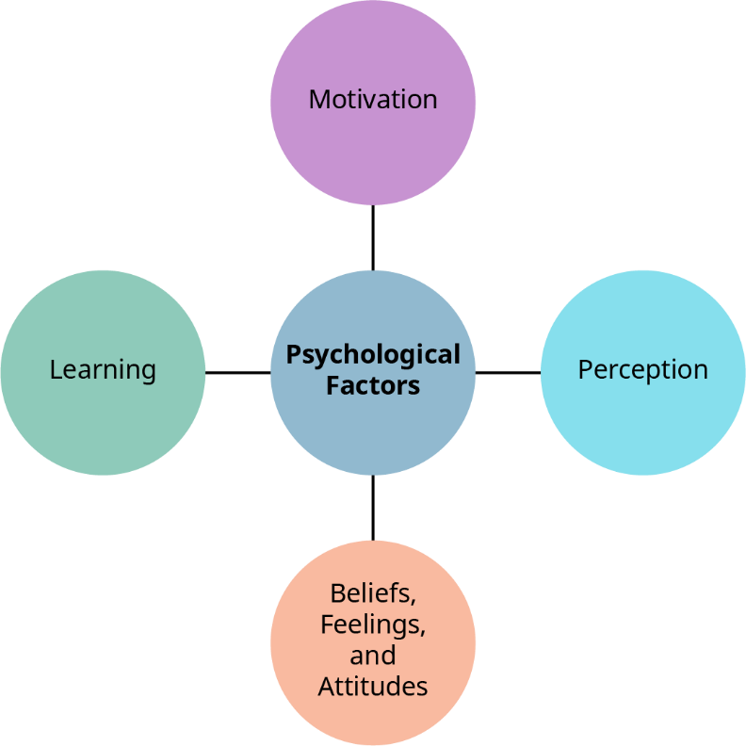
Psychological Factors Influencing Consumer Buying Behavior
Figure 3.7 Psychological Factors Influencing Consumer Buying Behavior
(attribution: Copyright Rice University, OpenStax, under CC BY 4.0 license)

Slide 18

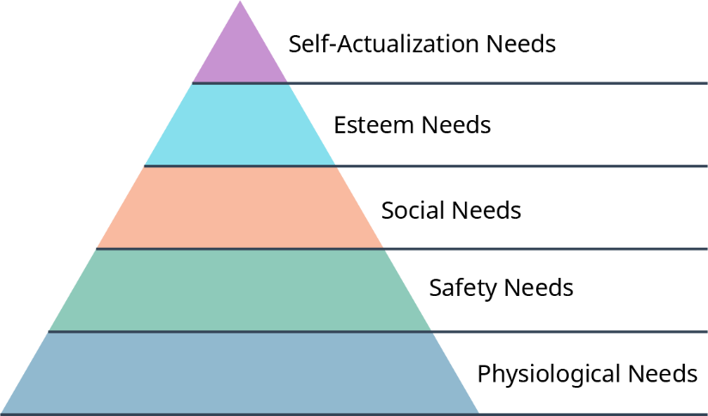
Psychological Factors
Motivation: the process that initiates, guides, and maintains goal-oriented behaviors
  Maslow’s hierarchy of needs
Figure 3.8 Maslow’s Hierarchy of Needs (attribution: Copyright Rice University, OpenStax, under CC BY 4.0 license)

Slide 19
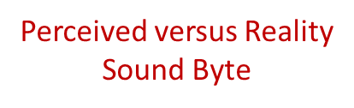




Psychological Factors (continued)
Perception: the way in which people identify, organize, and interpret sensory information
Selective distortion: the tendency of people to interpret information in a way that fits their preconceived notions
Selective retention: a bias in which people are more likely to remember messages that are closely related to their interests, values, and beliefs
Beliefs: consumer perceptions toward a product or service
Learning: a factor in buying behavior because behavior is learned

Slide 20

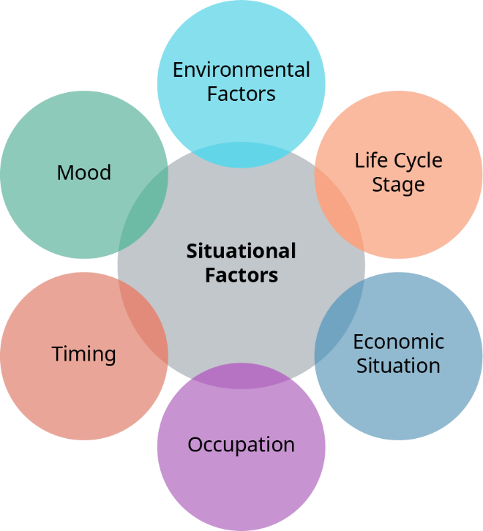
Situational Factors Influencing Consumer Buying Behavior
Figure 3.10 Situational Factors Influencing Consumer Buying Behavior
(attribution: Copyright Rice University, OpenStax, under CC BY 4.0 license)

Slide 21
Situational Factors
Environmental: music, lightening, ambient noise, smells
Life cycle stage: a major influencer
Economic situation: dictates discretionary income
Occupation: dictates clothing needs
Timing: the amount of time spent
Mood: sad vs. happy, stressed vs. relaxed, hungry vs. satisfied, fatigued vs. energetic

Slide 22
Discussion Question
What are two ways your purchasing behavior is affected by your mood, age, and occupation?

Slide 23
3.3 The Consumer Purchasing Decision Process
Learning Outcomes
LO1 Explain the first stage in the consumer purchasing decision process.
LO2 Summarize the second stage in the consumer purchasing decision process.
LO3 Describe the third stage in the consumer purchasing decision process.
LO4 Discuss the fourth stage in the consumer purchasing decision process.
LO5 Explain the fifth and final stage in the consumer purchasing decision process.

Slide 24

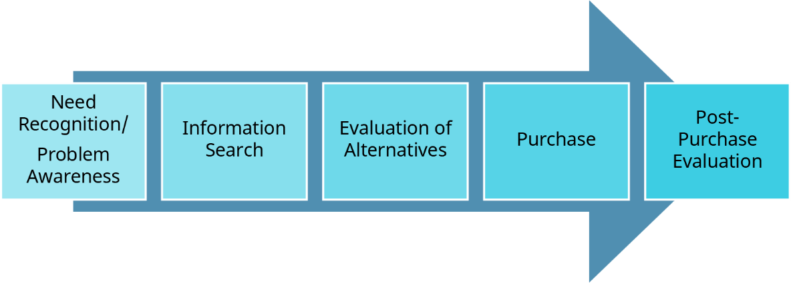
The Consumer Decision Process
Figure 3.12 The Consumer Decision Process (attribution: Copyright Rice University, OpenStax, under CC BY 4.0 license)

Slide 25
Five Stages of the Consumer Decision Process
Need Recognition
Information Search
Evaluation of Alternatives
Purchase Decision
Post-Purchase Evaluation
Problem or need recognition
Two search states: heightened attention and active information search
Evaluate several attributes
Reach a decision
Satisfied or dissatisfied

Slide 26

3.4 Ethical Issues in Consumer Buying Behavior
Learning Outcomes
LO1 Describe ethical issues related to consumer buying behavior.
LO2 Identify the characteristics of an ethical consumer.

Slide 27
Ethical Issues in Consumer Buying Behavior
Consumer concerns
  Turn into purchasing decisions
  Support the products, brands, and companies that support the consumer’s beliefs and values
  Example of ethical issues
    Abuse of human rights
    Animal rights/animal testing
    Sustainability
    Women’s rights
    Fair trade

Slide 28
Ethical Consumerism
Characteristics—company support
Ethical labeling for clear messaging
Non-GMO
Making ethical decisions that positively impact the brand
Corporate socially responsible reporting
These, among other strategies, highlight and differentiate one brand from another.

Slide 29
Ethical Consumers
Choose goods that are ethically sourced, made, and distributed
Join boycotts of a brand if the company engaged in irresponsible business practices
Choose not to do business with unethical businesses
Purchase goods and services from companies with similar beliefs and values
Vote with their pocketbook

Slide 30
Discussion Question
Delve into McDonald’s, a company mentioned at the beginning of this chapter. Does McDonald’s have an environmental sustainability statement? If so, list evidence showing how McDonald’s carries out this policy.

Slide 31
Applied Marketing Knowledge
You belong to many membership groups. You might be a member of the college soccer team or sing in a choir. Right now, you likely aspire to join the group of college graduates. Why is it so important for marketers to know which groups consumers have joined or refer to when making purchases?
[Section 3.2, LO1–LO4]

Slide 32
This OpenStax ancillary resource is © 2023 Rice University under a CC-BY 4.0 International license; it may be reproduced or modified but must be attributed to OpenStax, Rice University and any changes must be noted.

