Slide 1
Introduction to Business
Chapter 2 MAKING ETHICAL DECISIONS AND MANAGING A SOCIALLY RESPONSIBLE BUSINESS

Slide 2

A Guide to the Slides
These slides are designed to facilitate self-study.
They include a variety of audio clips that can be accessed by clicking on the outlined terms. For example, hover your mouse or click on the “Business” icon above. If you click on the play button, you’ll hear a definition of the word. You will find icons like these throughout the slides.
Use these slides as a review of the material in each chapter of the textbook and to provide context to many of the key terms.

Slide 3
Learning Outcomes
What philosophies and concepts shape personal ethical standards?
How can organizations encourage ethical business behavior?
What is corporate social responsibility?
How do businesses meet their social responsibilities to various stakeholders?

Slide 4
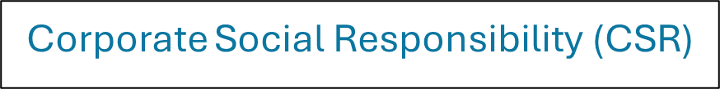
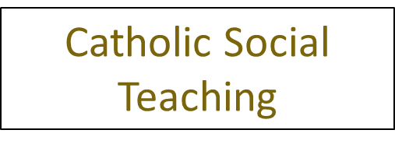

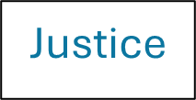
Some Key Terms to start with
(Click on a term to access an audio clip)

Slide 5
Ethics and Business
Ethics are basically the framework for deciding what is right or wrong.
They include how we treat other people, our level of honesty, and our responsibilities as individuals and businesses.
  For instance:
    is a business responsible for ensuring that everything it sells is safe for users, or should consumer’s have that responsibility?
    is a business responsible for charging fair prices, or is it OK to charge whatever people are willing to pay?
We all have our own ethical frameworks.
The ethics of the business are a critical component of the brand.

Slide 6
Catholic Social Teaching
There are slides in your learning module on Catholic Social Teaching that augment the textbook.
Catholic social teaching is the label given to the teachings of the Church that have created a body of wisdom on how to create a just, functional, and holy society.
These themes not only provide a framework for how to live according to God’s direction, but also provide a great framework for developing businesses that create a just society.
You can find a discussion here.

Slide 7

These are good questions/exercises to practice your understanding of the concepts
CONCEPT CHECK
How are individual business ethics formed?
What is utilitarianism?
How can you recognize unethical activities?

Slide 8

These are good questions/exercises to practice your understanding of the concepts
CONCEPT CHECK
What is the role of top management in organizational ethics?
What is a code of ethics?

Slide 9
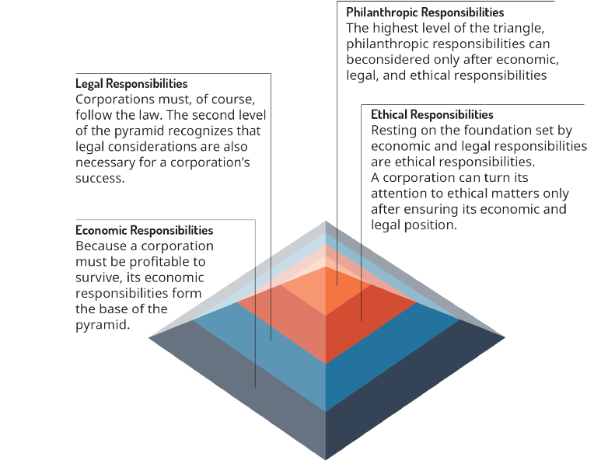
Exhibit 2.4 The Pyramid of Corporate Social Responsibility

Slide 10
Thought Exercise
Code of Ethics
The text indicates that some people believe that formal codes do help influence better behavior, but that others think that they are little more than public relations gimmicks. If senior management abides by the code of ethics and regularly emphasizes the code to employees, do you think this will likely have a positive influence on behavior?

Slide 11
These are good questions/exercises to practice your understanding of the concepts?
CONCEPT CHECK
What is Corporate Social Responsibility?
What are the four components of social responsibility?
Give an example of legal but irresponsible behavior.

Slide 12
These are good questions/exercises to practice your understanding of the concepts
CONCEPT CHECK
How do businesses carry out their social responsibilities to consumers?
What is corporate philanthropy?
Is a company’s only responsibility to its investors to make a profit? Why or why not?

Slide 13





Additional Terms

Slide 14
These are good questions/exercises to practice your understanding of the concepts
CONCEPT CHECK
Describe strategic giving.
What role do employees have in improving their job security?
How do multinational corporations demonstrate social responsibility in a foreign country?
This OpenStax ancillary resource is © Rice University under a CC-BY 4.0 International license; it may be reproduced or modified but must be attributed to OpenStax, Rice University and any changes must be noted. Any images credited to other sources are similarly available for reproduction, but must be attributed to their sources.

